Slide 1
Chapter 4 – Decisions
4.1 Relational and Logical Operators
4.2 If Blocks
4.3 Select Case Blocks
Chapter 4 - VB 2008 by Schneider

Slide 2
4.1 Relational and Logical Operators
ANSI Values
Relational Operators
Logical Operators
Boolean Data Type
Chapter 4 - VB 2008 by Schneider

Slide 3
Condition
A condition is an expression involving relational and/or logical operators
Result of the condition is Boolean – that is, True or False
Chapter 4 - VB 2008 by Schneider

Slide 4
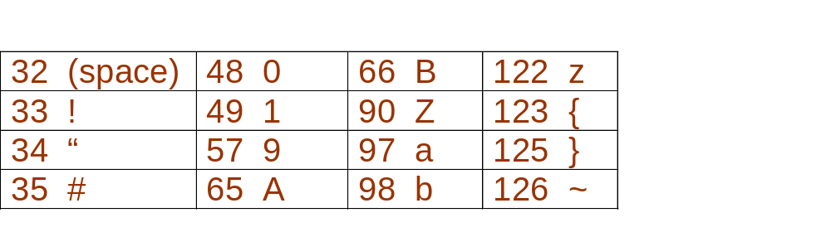
ANSI Character Set
A numeric representation for every key on the keyboard and for other assorted characters.
Chapter 4 - VB 2008 by Schneider

Slide 5
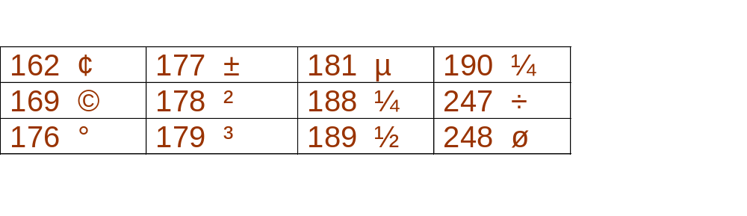
ANSI Character Set: continued
A numeric representation for every key on the keyboard and for other assorted characters.
Chapter 4 - VB 2008 by Schneider

Slide 6
Chr Function
For n between 0 and 255,
Chr(n)
is the string consisting of the character with
ANSI value n.
EXAMPLES: Chr(65) is "A"
Chr(162) is "¢"
Chapter 4 - VB 2008 by Schneider

Slide 7
Asc Function
For a string str,
Asc(str)
is ANSI value of the first character of str.
EXAMPLES: Asc("A") is 65
Asc("¢25") is 162
Chapter 4 - VB 2008 by Schneider

Slide 8
Relational Operators
< less than
<= less than or equal to
> greater than
>= greater than or equal to
= equal to
<> not equal to
ANSI values are used to decide order for strings.
Chapter 4 - VB 2008 by Schneider

Slide 9
Condition
A condition is an expression involving relational and/or logical operators.
Result of the condition is True or False.
Chapter 4 - VB 2008 by Schneider

Slide 10
Example
When a = 3, b = 4
(a + b) < 2 * a
3 + 4 = 7
2 * 3 = 6
7 is NOT less than 6 and the value of the expression is False
Chapter 4 - VB 2008 by Schneider

Slide 11
Another Example
a = 4 b = 3 c = "hello" d = "bye"
( c.Length – b ) = ( a / 2 )
5 – 3 = 2
4 / 2 = 2
True because 2 equals 2
Chapter 4 - VB 2008 by Schneider

Slide 12
Relational Operator Notes
Relational operators are binary – they require an operand on both sides of the operator
Value of a relational expression will always be True or False
Expressions are evaluated from left to right with no order of operations
Chapter 4 - VB 2008 by Schneider

Slide 13
Logical Operators
Used with Boolean expressions
Not – makes a False expression True and vice versa
And – will yield a True if and only if both expressions are True
Or – will yield a True if at least one of both expressions are True
Chapter 4 - VB 2008 by Schneider

Slide 14
Example 4.3
n = 4, answ = “Y” Are the following expressions true or false?
Not (n < 6)
(answ = "Y") Or (answ = "y")
(answ = "Y") And (answ = "y")
Not(answ = "y")
Chapter 4 - VB 2008 by Schneider
Notes:
Not (n < 6) = False
(answ = "Y") Or (answ = "y") = True
(answ = "Y") And (answ = "y") = False
Not(answ = "y") = True

Slide 15
Boolean Expression
An expression that evaluates to either True or False is said to have Boolean data type.
Example:
The statement
txtBox.Text = CStr((2+3)<6)
displays True in the text box.
Chapter 4 - VB 2008 by Schneider

Slide 16
Boolean Variable
A variable declared with a statement of the form
Dim var As Boolean
is said to have Boolean data type. It can assume
just the two values True and False.
Example:
Dim boolVar As Boolean
boolVar = 2 < 6
txtBox.Text = CStr(boolVar)
displays True in the text box.
Chapter 4 - VB 2008 by Schneider

Slide 17
Syntax Error
The following is NOT a valid way to test if n falls between 2 and 5:
(2 < n < 5 )
Chapter 4 - VB 2008 by Schneider

Slide 18
Correction to Syntax Error
To test if n falls between 2 and 5 use:
(2 < n ) And ( n < 5 )
A complete relational expression must be
on either side of the logical operators And
and Or.
Chapter 4 - VB 2008 by Schneider
Notes:
And and Or are binary operators requiring two operands
Not is a unary operator requiring only one operand

Slide 19
Common Error in Boolean Expressions
A common error is to replace the condition Not ( 2 < 3 ) with the condition ( 2 > 3 )
The correct replacement is ( 2 >= 3 )
because >= is the opposite of <, just as <= is the opposite of >
Chapter 4 - VB 2008 by Schneider

Slide 20
4.2 If Blocks
If Block
ElseIf Clauses
Chapter 4 - VB 2008 by Schneider

Slide 21
If Block
The program will take a course of action
based on whether a condition is true.
If condition Then
action1
Else
action2
End If
Will be executed if
condition is true
Will be executed if
condition is false
Chapter 4 - VB 2008 by Schneider

Slide 22
Another example If block
If condition Then
action1
End If
Statement2
Statement3
Regardless of whether
the condition in the
If statement is true or
alse, these statements
will be executed
Chapter 4 - VB 2008 by Schneider

Slide 23
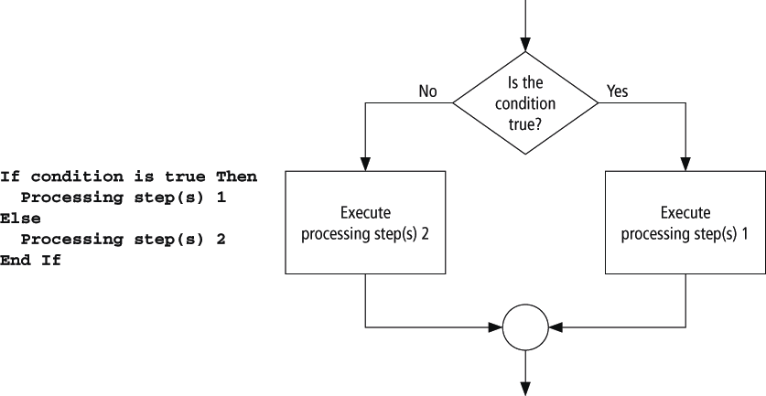
Pseudocode and Flowchart for an If Block
Chapter 4 - VB 2008 by Schneider

Slide 24
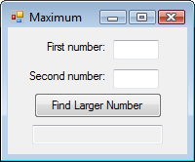
Example 1: Form
txtFirstNum
txtSecondNum
txtResult
Chapter 4 - VB 2008 by Schneider

Slide 25
Example 1: Code
Private Sub btnFindLarger_Click(...) _
Handles btnFindLarger.Click
Dim num1, num2, largerNum As Double
num1 = CDbl(txtFirstNum.Text)
num2 = CDbl(txtSecondNum.Text)
If num1 > num2 Then
largerNum = num1
Else
largerNum = num2
End If
txtResult.Text = "The larger number is " & largerNum
End Sub
Chapter 4 - VB 2008 by Schneider

Slide 26
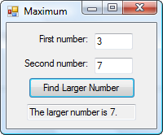
Example 1: Output
Chapter 4 - VB 2008 by Schneider

Slide 27
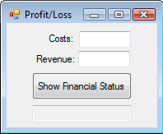
Example 2: Form
Chapter 4 - VB 2008 by Schneider

Slide 28
Example 2: Partial Code
If costs = revenue Then
txtResult.Text = "Break even"
Else
If costs < revenue Then
profit = revenue - costs
txtResult.Text = "Profit is " & _
FormatCurrency(profit) & "."
Else
loss = costs - revenue
txtResult.Text = "Loss is " & _
FormatCurrency(loss) & "."
End If
End If
Chapter 4 - VB 2008 by Schneider
Notes:
Note the nested if statement – the If inside an If. This can be rewritten using the ElseIf construct.

Slide 29
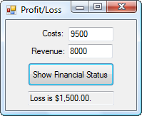
Example 2: Output
Chapter 4 - VB 2008 by Schneider

Slide 30
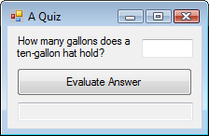
Example 3: Form
txtAnswer
txtSolution
Chapter 4 - VB 2008 by Schneider

Slide 31
Example 3: Code
Private Sub btnEvaluate_Click(...) _
Handles btnEvaluate.Click
Dim answer As Double
answer = CDbl(txtAnswer.Text)
If (answer >= 0.5) And (answer <= 1) Then
txtSolution.Text = "Good, "
Else
txtSolution.Text = "No, "
End If
txtSolution.Text &= "it holds about 3/4 of" _
& " a gallon."
End Sub
Chapter 4 - VB 2008 by Schneider

Slide 32
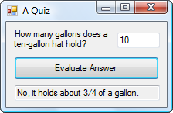
Example 3: Output
Chapter 4 - VB 2008 by Schneider

Slide 33
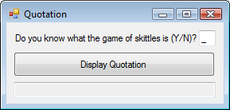
Example 4: Form
mtxtAnswer
txtQuote
Chapter 4 - VB 2008 by Schneider

Slide 34
Example 4
Private Sub btnDisplay_Click(...) _
Handles btnDisplay.Click
Dim message As String
message = "Skittles is an old form of bowling in " _
& "which a wooden disk is used to knock down nine" _
& " pins arranged in a square."
If txtAnswer.Text.ToUpper = "N" Then
MessageBox.Show(message, "")
End If
txtQuote.Text = "Life ain't all beer and skittles.“
txtQuote.Text &= " – Du Maurier (1894)."
End Sub
Chapter 4 - VB 2008 by Schneider
Notes:
No matter what the user enters in the text box, the quote will appear.

Slide 35
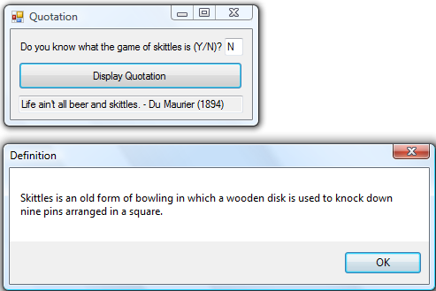
Example 4: Output
Chapter 4 - VB 2008 by Schneider

Slide 36
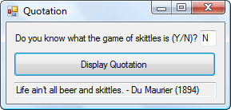
Example 4: Output continued
Chapter 4 - VB 2008 by Schneider

Slide 37
ElseIf clause
If condition1 Then
action1
ElseIf condition2 Then
action2
ElseIf condition3 Then
action3
Else
action4
End If
Chapter 4 - VB 2008 by Schneider
Notes:
An extension of the If block allows for more than two possible alternatives with the
inclusion of ElseIf clauses.
Note: there is no space between the word "Else" and "If"
Only one "End If" is required.

Slide 38
Example 5: Form
txtFirstNum
txtSecondNum
txtResult
Chapter 4 - VB 2008 by Schneider

Slide 39
Example 5: Code
Private Sub btnFindLarger_Click(...) _
Handles btnFindLarger.Click
Dim num1, num2 As Double
num1 = CDbl(txtFirstNum.Text)
num2 = CDbl(txtSecondNum.Text)
If (num1 > num2) Then
txtResult.Text = "Larger number is " & num1
ElseIf (num2 > num1) Then
txtResult.Text = "Larger number is " & num2
Else
txtResult.Text = "The two are equal."
End If
End Sub
Chapter 4 - VB 2008 by Schneider
Notes:
Note: there is no "if" required after the last Else to determine if the two numbers are equal. There have already been if statements to evaluate if num1 is larger than num2 and if num2 is larger than num1, so if the last Else is reached, there is no other alternative left but that they are both equal.

Slide 40
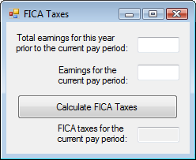
Example 6: Form
Chapter 4 - VB 2008 by Schneider

Slide 41
Example 6: Partial Code
Dim ytdEarnings, curEarnings As Double
Dim socSecBenTax, medicareTax, ficaTaxes As Double
ytdEarnings = CDbl(txtToDate.Text)
curEarnings = CDbl(txtCurrent.Text)
If (ytdEarnings + curEarnings) <= 102000 Then
socSecBenTax = 0.062 * curEarnings
ElseIf ytdEarnings < 102000 Then
socSecBenTax = 0.062 * (102000 - ytdEarnings)
End If
medicareTax = 0.0145 * curEarnings
ficaTaxes = socSecBenTax + medicareTax
txtText.Text = FormatCurrency(ficaTaxes)
End Function
Chapter 4 - VB 2008 by Schneider
Notes:
Note ElseIf construct replaces nested If statement. Only one "End If" is required with the ElseIf.

Slide 42
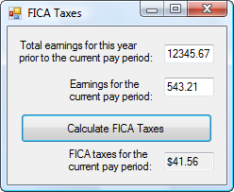
Example 6: Output
Chapter 4 - VB 2008 by Schneider

Slide 43
Comments
When one If block is contained inside another If block, the structure is referred to as nested If blocks.
Care should be taken to make If blocks easy to understand.
Chapter 4 - VB 2008 by Schneider

Slide 44
Simplified Nested If Statement
If cond1 Then If cond1 And cond2 Then
If cond2 Then action
action End If
End If
End If
Nested
If
Less
Confusing
Chapter 4 - VB 2008 by Schneider

Slide 45
More Comments
Some programs call for selecting among many possibilities. Although such tasks can be accomplished with complicated nested If blocks, the Select Case block (discussed in Section 4.3) is often a better alternative.
Chapter 4 - VB 2008 by Schneider

Slide 46
4.3 Select Case Blocks
Chapter 4 - VB 2008 by Schneider
Notes:
A Select Case block is an efficient decision-making structure that simplifies choosing
among several actions. It avoids complex nested If constructs. If blocks make decisions
based on the truth value of a condition; Select Case choices are determined by the value
of an expression called a selector. Each of the possible actions is preceded by a clause
of the form
Case valueList
where valueList itemizes the values of the selector for which the action should be taken.

Slide 47
Select Case Block
A decision-making structure that simplifies choosing among several actions.
Avoids complex nested If constructs.
If blocks make decisions based on the truth value of a condition. Select Case choices are determined by the value of an expression called a selector.
Chapter 4 - VB 2008 by Schneider
Notes:
A Select Case block is an efficient decision-making structure that simplifies choosing
among several actions. It avoids complex nested If constructs. If blocks make decisions
based on the truth value of a condition; Select Case choices are determined by the value
of an expression called a selector. Each of the possible actions is preceded by a clause
of the form
Case valueList
where valueList itemizes the values of the selector for which the action should be taken.

Slide 48
Select Case Terminology
Each of the possible actions is preceded
by a clause of the form
Case valueList
where valueList itemizes the values of the
selector for which the action should be
taken.
Chapter 4 - VB 2008 by Schneider

Slide 49
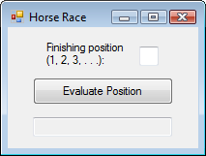
Example 1: Form
txtPosition
txtOutcome
Chapter 4 - VB 2008 by Schneider

Slide 50
Example 1: Code
Private Sub btnEvaluate_Click(...) _
Handles btnEvaluate.Click
Dim position As Integer = CInt(txtPosition.Text)
Select Case position
Case 1
txtOutcome.Text = "Win"
Case 2
txtOutcome.Text = "Place"
Case 3
txtOutcome.Text = "Show"
Case 4, 5
txtOutcome.Text = "You almost placed in the money."
Case Else
txtBox.Text = "Out of the money."
End Select
End Sub
Selector
Value Lists
Chapter 4 - VB 2008 by Schneider

Slide 51
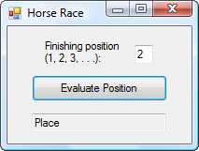
Example 1: Output
Chapter 4 - VB 2008 by Schneider

Slide 52
Example 2: Code
Private Sub btnEvaluate_Click(...) _
Handles btnEvaluate.Click
Dim position As Integer = CInt(txtPosition.Text)
Select Case position
Case 1 To 3
txtOutcome.Text = "In the money. Congratulations"
Case Is >= 4
txtOutcome.Text = "Not in the money."
End Select
End Sub
Chapter 4 - VB 2008 by Schneider
Notes:
The keyword "To" allows the programmer to specify a range of values in the value list.
The keyword "Is" allows the programmer to form a relational expression with the selector

Slide 53
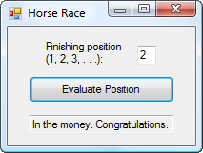
Example 2: Output
Chapter 4 - VB 2008 by Schneider

Slide 54
Select Case Syntax
The general form of the Select Case block is
Select Case selector
Case valueList1
action1
Case valueList2
action2
Case Else
action of last resort
End Select
Chapter 4 - VB 2008 by Schneider

Slide 55
Rules for Select Case
Case Else (and its action) is optional
Each value list contains one or more of the following types of items separated by commas:
a literal;
a variable;
an expression;
an inequality sign preceded by Is and followed by a literal, variable, or expression;
a range expressed in the form a To b, where a and b are literals, variables, or expressions.
Chapter 4 - VB 2008 by Schneider

Slide 56
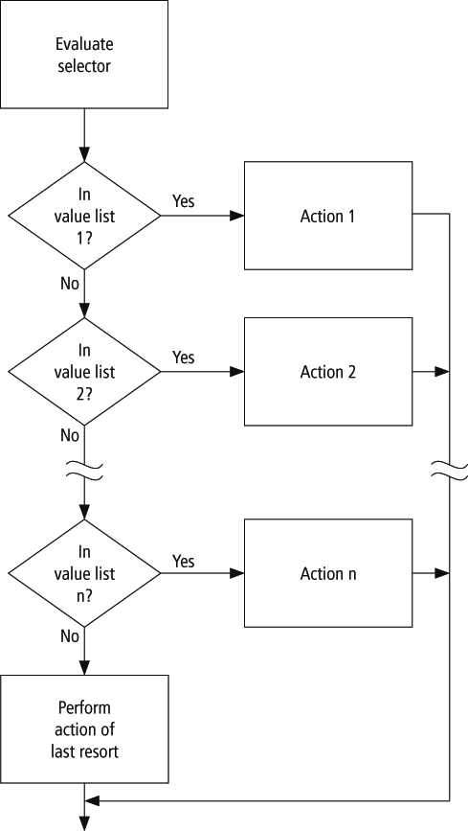
Flowchart for Select Case
Chapter 4 - VB 2008 by Schneider

Slide 57
Example 3: Partial Code
Dim x As Integer = 2, y As Integer = 3
Select Case num
Case y - x, x
txtPhrase.Text = "Buckle my shoe."
Case Is <= 4
txtPhrase.Text = "Shut the door."
Case x + y To x * y
txtPhrase.Text = "Pick up sticks."
Case 7, 8
txtPhrase.Text = "Lay them straight."
Case Else
txtPhrase.Text = "Start all over again."
End Select
Chapter 4 - VB 2008 by Schneider

Slide 58
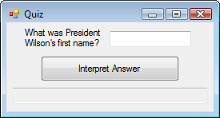
Example 4: Form
txtReply
Chapter 4 - VB 2008 by Schneider

Slide 59
Example 4: Partial Code
Select Case firstName
Case "THOMAS"
txtReply.Text = "Correct."
Case "WOODROW"
txtReply.Text = "Sorry, his name" _
& " was Thomas Woodrow Wilson."
Case "PRESIDENT"
txtReply.Text = "Are you for real?"
Case Else
txtReply.Text = "Nice try."
End Select
Chapter 4 - VB 2008 by Schneider

Slide 60
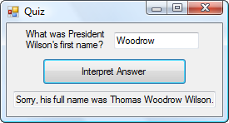
Example 4: Output
Chapter 4 - VB 2008 by Schneider

Slide 61
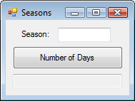
Example 7: Form
Chapter 4 - VB 2008 by Schneider

Slide 62
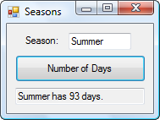
Example 7: Form & Output
Chapter 4 - VB 2008 by Schneider

Slide 63
Example 7: Partial Code
Dim season As String, numDays As Integer
Select Case season.ToUpper
Case "WINTER"
numDays = 87
Case "SPRING"
numDays = 92
Case "SUMMER", "AUTUMN", "FALL"
numDays = 93
End Select
Chapter 4 - VB 2008 by Schneider

Slide 64
Comments
In a Case clause of the form Case b To c, the value of b should be less than or equal
to the value of c.
The word Is should precede an inequality sign in a value list.
If the word Is is accidentally omitted where required, the editor will automatically insert it when checking the line.
Chapter 4 - VB 2008 by Schneider

Slide 65
Data Type Comment
The items in the value list must evaluate to a literal of the same data type as the selector.
For instance, if the selector evaluated to a string value, as in
Dim firstName As String = txtBox.Text
Select Case firstName
then the clause
Case firstName.Length
would be meaningless.
Chapter 4 - VB 2008 by Schneider

Slide 66
Block-level Scope
A variable declared inside an If … Then or Select Case block has block-level scope.
The variable cannot be referred to outside the block.
Chapter 4 - VB 2008 by Schneider

