Slide 1

Chapter 9
Object-Oriented Design and High-Level Programming Languages

Slide 2
Chapter Goals
Distinguish between functional design and object-oriented design
Describe the stages of the object-oriented design process
Apply the object-oriented design process
Name, describe, and give examples of the three essential ingredients of an object-oriented language

Slide 3
Chapter Goals
Describe the translation process and distinguish between assembly, compilation, interpretation, and execution
Name four distinct programming paradigms and name a language characteristic of each
Define the concepts of a data type and strong typing

Slide 4
Chapter Goals
Understand how the constructs of top-down and object-oriented design are implemented in programming languages

Slide 5
Object-Oriented Design
Object-oriented Design
A problem-solving methodology that produces a solution to a problem in terms of self-contained entities called objects
Object
A thing or entity that makes sense within the context of the problem
  For example, a student, a car, time, date

Slide 6
Object-Oriented Design
World View of OOD
Problems are solved by
  isolating the objects in a problem,
  determining their properties and actions (responsibilities), and
  letting the objects collaborate to solve a problem
What? Say again!

Slide 7
Object-Oriented Design
An analogy: You and your friend fix dinner
Objects: you, friend, dinner
Class: you and friend are people
People have name, eye color, …
People can shop, cook, …
Instance of a class: you and friend are instances of class People, you each have your own name and eye color, you each can shop and cook
You collaborate to fix dinner

Slide 8
Object-Oriented Design
Class (or object class)
A description of a group of similar objects
Object (instance of a class)
A concrete example of the class
Classes contain fields that represent the
  properties (name, eye color) and
  behaviors (responsibilities) (shop, cook) of the class
Method
A named algorithm that defines behavior (shop, cook)

Slide 9
Object-Oriented Design
Top-Down Design
decomposes problems into tasks
Object-Oriented Design
decomposes problems into
collaborating objects
Yes, but how?

Slide 10
Object-Oriented Design
Steps
  isolate the real-world objects in the problem
  abstract the objects with like properties into groups (classes)
  determine the responsibilities of the group in interacting with other groups

Slide 11
Object-Oriented Design
Think of design as a mapping from real world objects to classes of objects
birth
date
Date class
marriage
date
dog's
birth date
Objects Classes of objects

Slide 12
Object-Oriented Design
Program World simulates these groups
dogBirthdate
class Date
birthdate
marriageDate
Description Instances

Slide 13
Object-Oriented Design
Date's
Actions in
real world
?
We call an object's interactions
with other objects its
responsibilities
Create itself
Know the state of its fields
Compare itself to another date
Return a date a number of days hence

Slide 14
Object-Oriented Design
Responsibilities become methods in the Program World
dogBirthdate
class Date
getMonth
getDay
getYear
birthdate
marriageDate

Slide 15
Object-Oriented Design Methodology
Four stages to the decomposition process
  Brainstorming to locate possible classes
  Filtering the classes to find duplicates or remove unnecessary ones
  Scenarios are tried to be sure we understand collaborations
  Responsibility algorithms are designed for all actions that classes must exhibit

Slide 16
Brainstorming
A group problem-solving technique that involves the spontaneous contribution of ideas from all members of the group
  All ideas are potential good ideas
  Think fast and furiously first, and ponder later
  A little humor can be a powerful force
Brainstorming is designed to produce a list of candidate classes

Slide 17
Filtering
Determine which are the core classes in the problem solution
There may be two classes in the list that have many common attributes and behaviors
There may be classes that really don’t belong in the problem solution

Slide 18
Scenarios
Assign responsibilities to each class
There are two types of responsibilities
  What a class must know about itself (knowledge responsibilities)
  What a class must be able to do (behavior responsibilities)

Slide 19
Scenarios
Encapsulation
The bundling of data and actions in such a way that the logical properties of the data and actions are separated from the implementation details
Each class encapsulates its data but shares their values through knowledge responsibilities

Slide 20
Responsibility Algorithms
The algorithms must be written for the responsibilities
  Knowledge responsibilities usually just return the contents of one of an object’s variables
  Action responsibilities are a little more complicated, often involving calculations

Slide 21
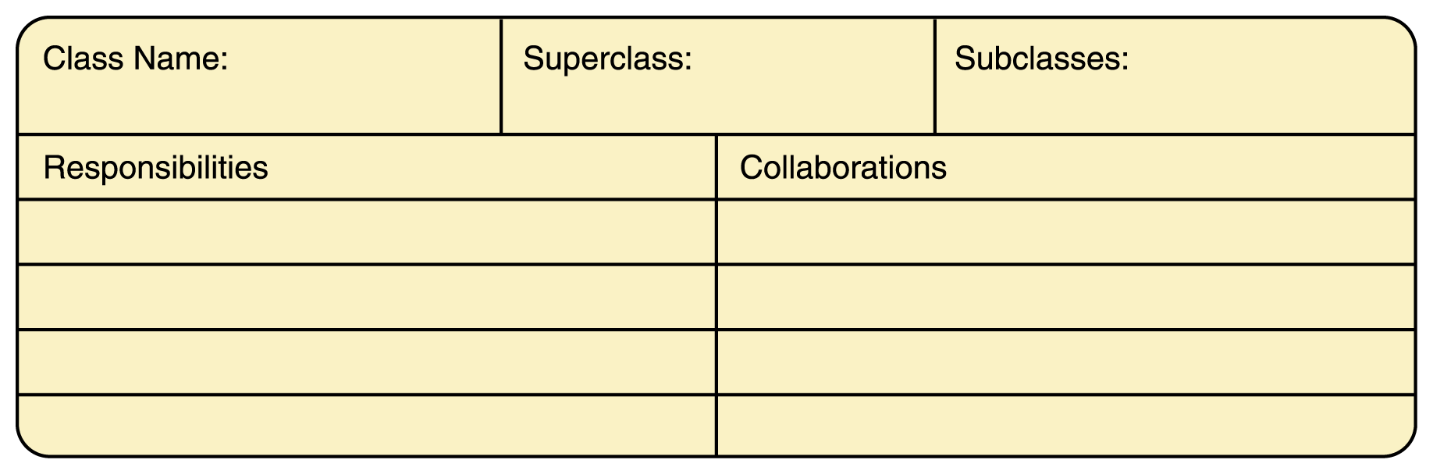
CRC Cards
CRC cards are a notational device to record information
about a class, what it must do and with whom it must
collaborate

Slide 22
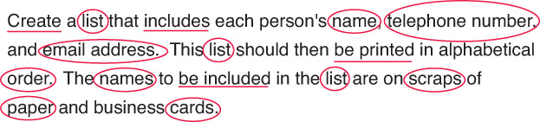
Computer Example
Let’s examine the problem-solving process for creating an address list
Brainstorming and filtering
  Circling the nouns and underlining the verbs is a good way to begin

Slide 23
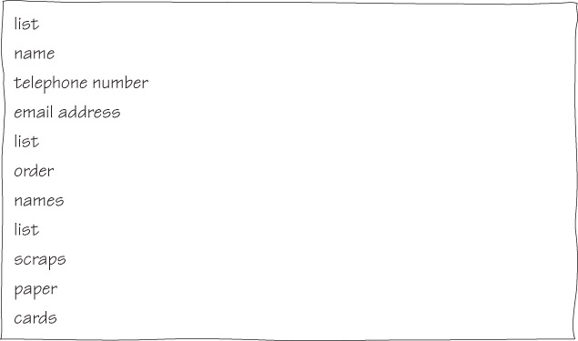
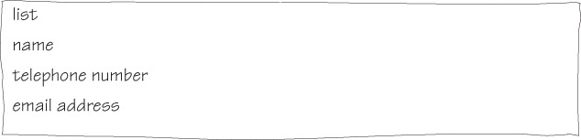
Computer Example

Slide 24
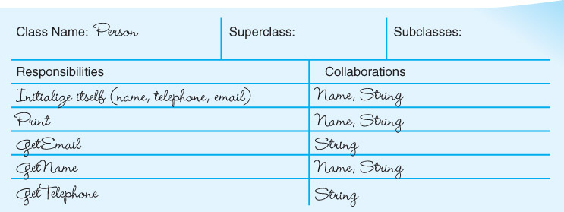
CRC Cards
Can you think of any other useful responsibilities?

Slide 25
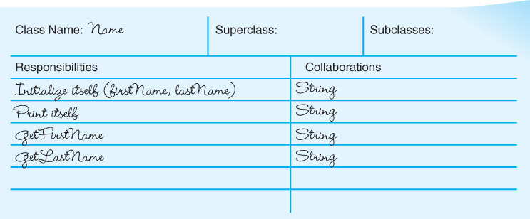
CRC Cards
Can you think of any other useful responsibilities?

Slide 26
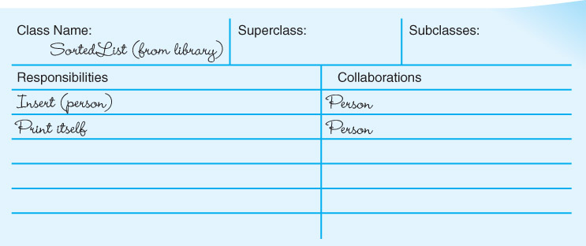
CRC Cards
How is this class different from Name and Person?

Slide 27
Responsibility Algorithms
Person Class
Initialize
name.initialize()
Write "Enter phone number; press return."
Get telephone number
Write "Enter email address; press return."
Get email address
Print
name.print()
Write "Telephone number: " + telephoneNumber
Write "Email address: " + emailAddress
Tells name to initialize itself
Tells name to print itself

Slide 28
Responsibility Algorithms
Name Class
Initialize
"Enter the first name; press return."
Read firstName
"Enter the last name; press return."
Read lastName
Print
Print "First name: " + firstName
Print "Last name: " + lastName

Slide 29
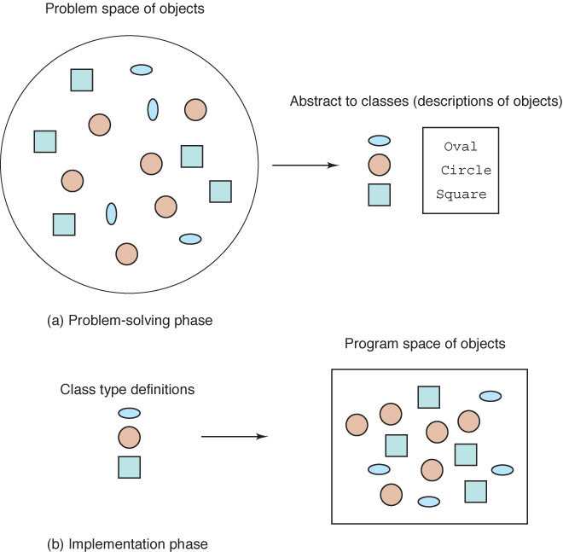
Object Oriented Problem Solving and Implementation Phases

Slide 30
Translation Process
A program written in a high-level language must be translated into machine code
The machine code is then executed
Compilers and Interpreters are software tools employed to help with the translation process

Slide 31
Compilers
High-level language
A language that provides a richer (more English-like) set of instructions
Compiler
A program that translates a high-level language program into machine code

Slide 32
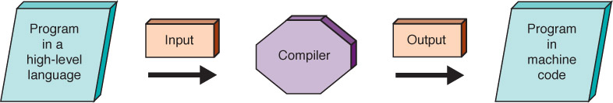
Compilers
How does this differ from
the assembly process?
Figure 9.2 Compilation process

Slide 33
Interpreters
Interpreter
A translating program that translates and executes the statements in sequence
  Assembler or compiler produce machine code as output, which is then executed in a separate step
  An interpreter translates a statement and then immediately executes the statement
  Interpreters can be viewed as simulators

Slide 34
Java
Introduced in 1996 and became instantly popular
Portability was of primary importance
Java is compiled into a standard machine language called Bytecode
A software interpreter called the JVM (Java Virtual Machine) takes the Bytecode program and executes it

Slide 35
Portability
Portability
The ability of a program to be run on different machines
Compiler portability
A program in a standardized language can be compiled
and run on any machine that has the appropriate compiler
Bytecode portability
A program translated into Bytecode can be run on
any machine that has a JVM
Do you understand the difference?

Slide 36
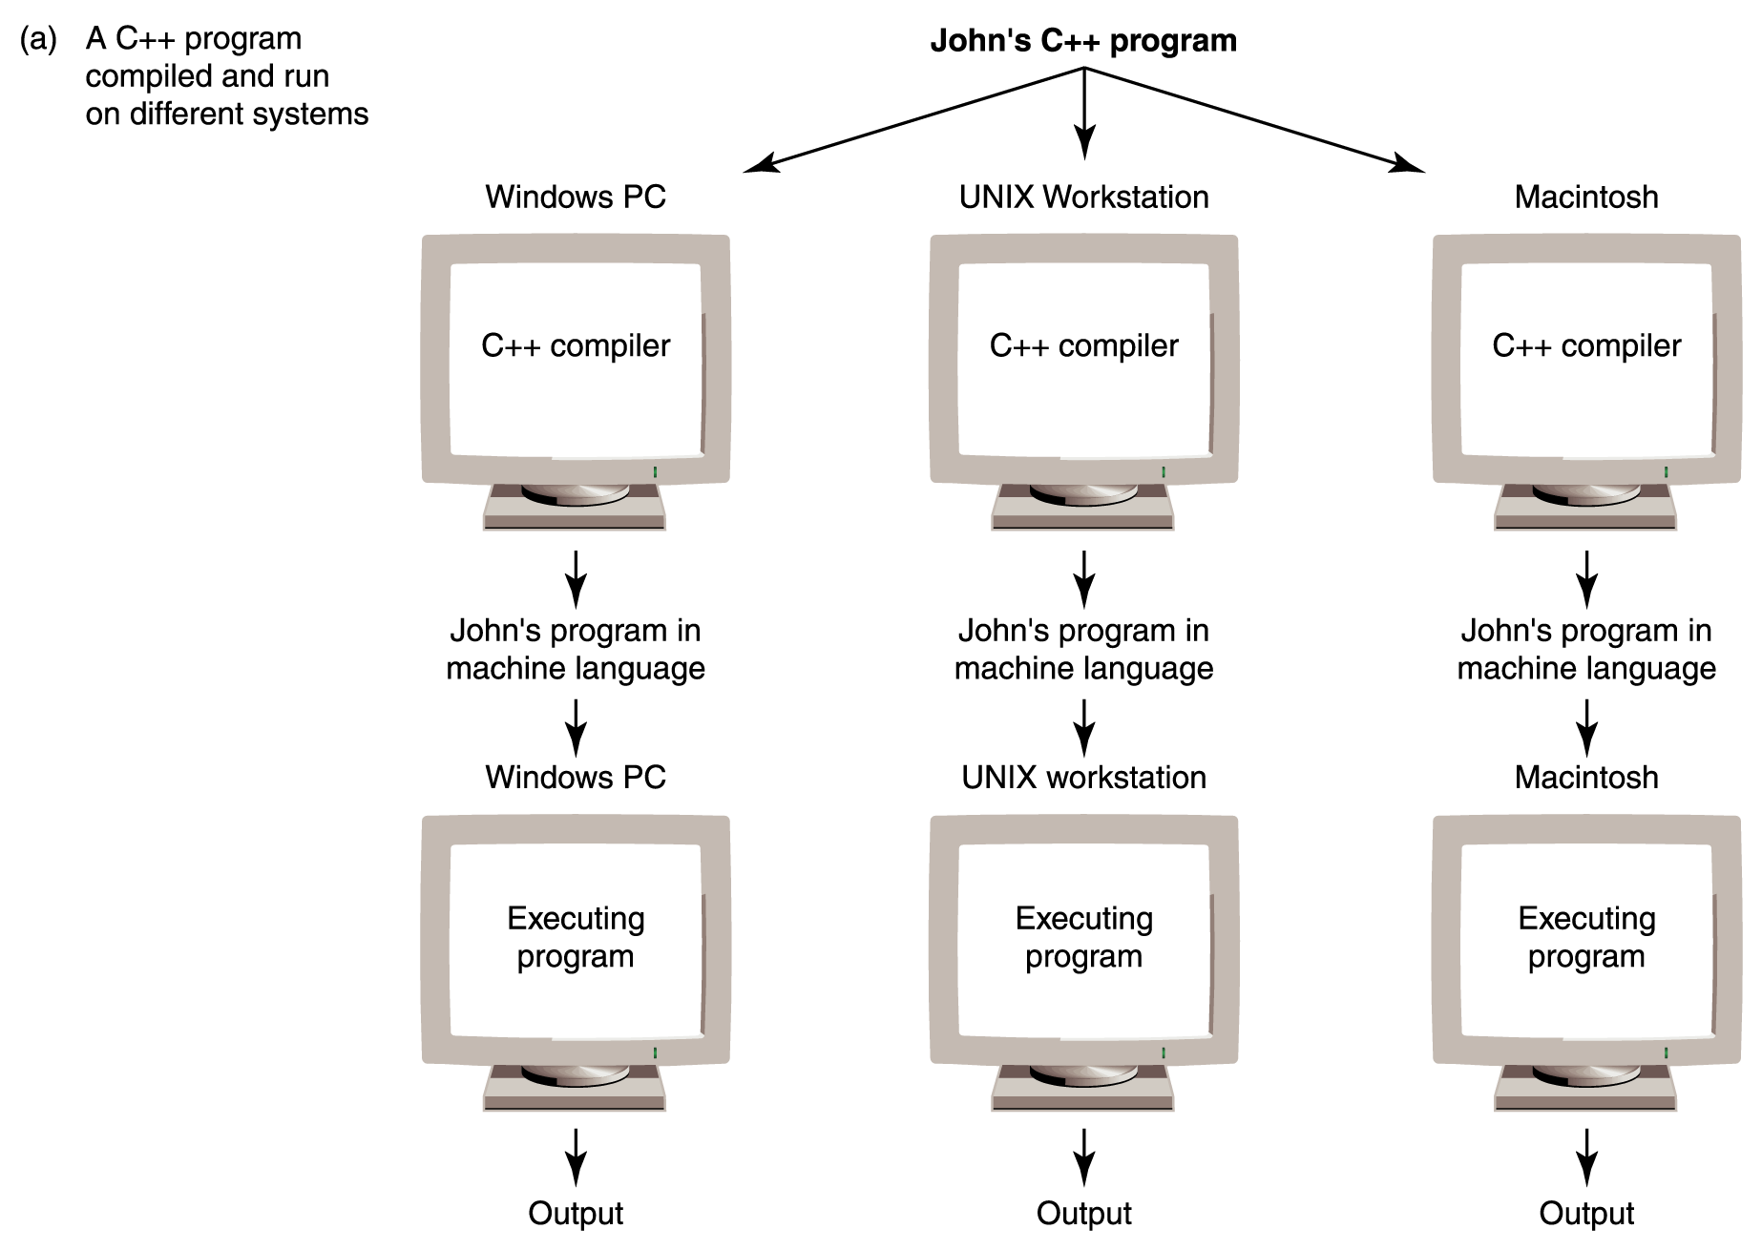
Portability
Figure 9.3
Portability provided by standardized languages versus interpretation by Bytecode

Slide 37
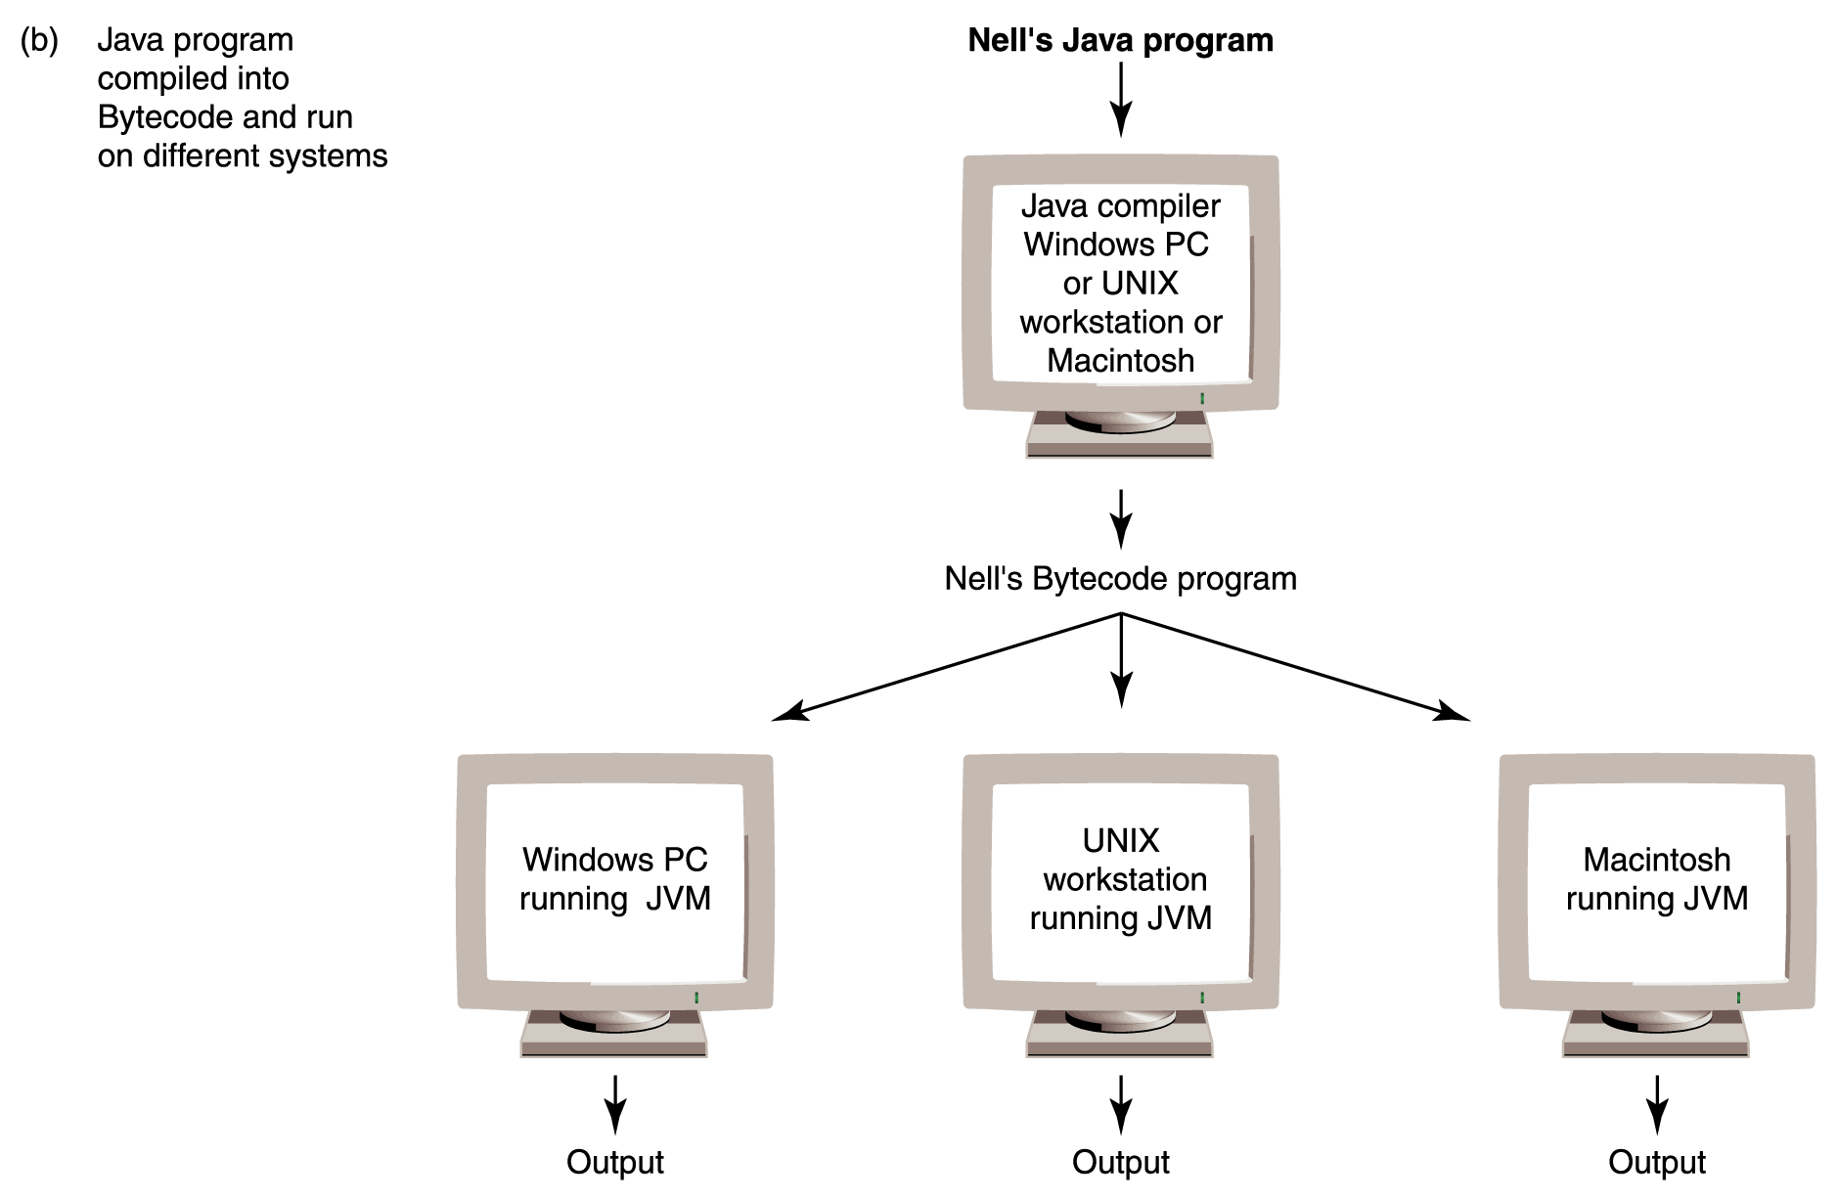
Portability
Figure 9.3
Portability provided by standardized languages versus interpretation by Bytecode

Slide 38
Programming Language Paradigms
Imperative Paradigm
Program describes the processing
Declarative Paradigm
Program describes the results
Each of these major paradigms have distinct subparadigms

Slide 39
Programming Language Paradigms
Imperative
  Procedural
    Characterized by sequential instructions
    A program in which statements are grouped into a hierarchy of subprograms
    Fortran, C, C++
  Object-oriented model
    Program consists of a set of objects and the interactions among the objects
    Python, Java, Smalltalk, Simula

Slide 40
Programming Language Paradigms
C++ is a procedural language with some object-oriented features
Java is an object-oriented language with some procedural features

Slide 41
Programming Language Paradigms
Declarative
  Functional
    Based on the mathematical concept of a function
    Lisp, Scheme, and ML
  Logic
    Based on principles of symbolic logic
    Types of statements
      declares facts about objects and relationships
      defines rules about objects
      asks questions about objects
    PROLOG

Slide 42
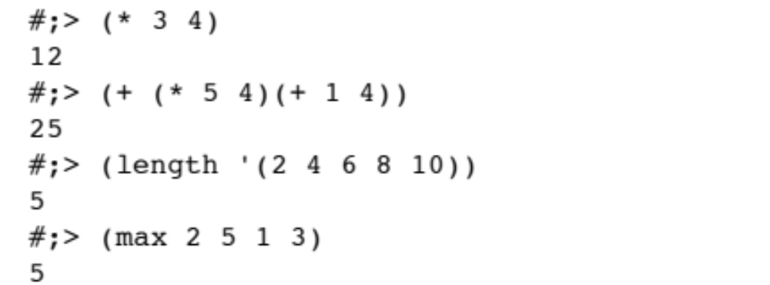
Scheme

Slide 43
Scheme
#;> (define factorial
#;> (lambda(n)
#;> (if
#;> (= n 0)
#;> 1
#;> (* n (factorial (- n 1))))))
#;> (factorial 7)
5040
Compare to pseudocode algorithm

Slide 44
PROLOG
Pets to owners
  owns(mary,bo).
  owns(ann,kitty).
  owns(bob,riley).
  owns(susy,charlie).
  ?-owns(mary,bo)
  yes
  ?-owns(bo,mary)
  no
  ?-owns(susy,bo)
  no
States
facts
Asks
questions

Slide 45
PROLOG
Upper case is
variable;
lower case
is constant
?-owns(ann, Cat).
Cat = kitty
?-owns(Name,charlie).
Name = susy

Slide 46
Functionality of High-Level Languages
We examine procedural and object-oriented languages in the rest of this chapter by looking at the functionality provided in these languages
We give examples in different languages to show how syntax used to provide the functionality

Slide 47
Functionality of Imperative Languages
Sequence
Executing statements in sequence until an instruction is encountered that changes this sequencing
Selection
Deciding which action to take
Iteration (looping)
Repeating an action
Do these concepts sound familiar?
Let's review them

Slide 48
Boolean Expressions
Boolean expression
A sequence of identifiers, separated by compatible operators, that evaluates to true or false
A Boolean expression can be
  A Boolean variable
  An arithmetic expression followed by a relational operator followed by an arithmetic expression
  A Boolean expression followed by a Boolean operator followed by a Boolean expression

Slide 49
Boolean Expressions
Remember the relational operators?
List them!

Slide 50
Strong Typing
Data type
A description of the set of values and the basic set of operations that can be applied to values of the type
Strong typing
The requirement that only a value of the proper type can be stored into a variable

Slide 51
Data Types
Integer numbers
Real numbers
Characters
Boolean values
Strings
Give examples
of
each

Slide 52
Integers
What determines the range of an integer value?
Is the range of an integer value the same in all languages?
What operations can be applied to integers?

Slide 53
Reals
How are real values like integer values?
How do real values differ from integer values?

Slide 54
Characters
Do you remember
ASCII?
Extended ASCII?
UNICODE?
How many characters in Extended ASCII?
How many characters in UNICODE mapping?
What does a relational operator between two characters mean?

Slide 55
Boolean and Strings
What values can a Boolean variable be?
For what are Boolean expressions used?
What is a string?
What operations can be applied to strings?

Slide 56
Declarations
Declaration
A statement that associates an identifier with a variable, an action, or some other entity within the language that can be given a name; the programmer can refer to that item by name
Reserved word
A word in a language that has special meaning
Case-sensitive
Uppercase and lowercase letters are considered the same

Slide 57
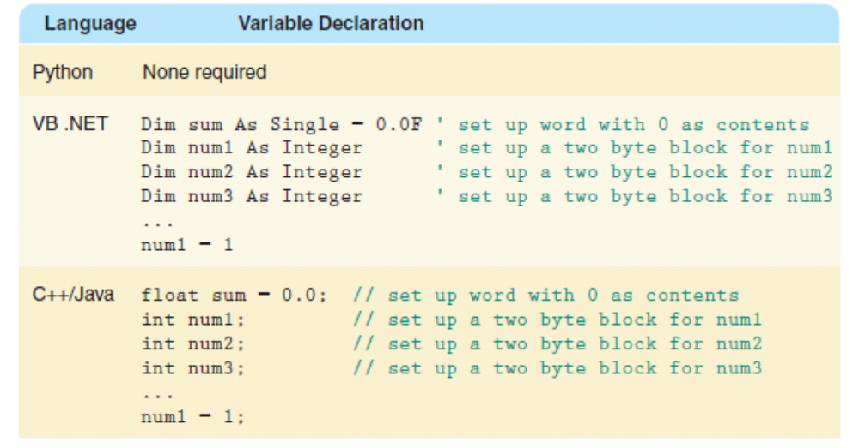
Declaration Example

Slide 58
Assignment statement
Assignment statement
An action statement (not a declaration) that says to evaluate the expression on the right-hand side of the symbol and store that value into the place named on the left-hand side
Named constant
A location in memory, referenced by an identifier, that contains a data value that cannot be changed
Remember?

Slide 59
Input/Output Structures
Pseudocode algorithms used the expressions Read or Get and Write or Print
High-level languages view input data as a stream of characters divided into lines
Key to the processing
The data type determines how characters are to be converted to a bit pattern (input) and how a bit pattern is to be converted to characters (output)

Slide 60
Input/Output Structures
Read name, age, hourlyWage
name is a string;
age is an integer;
hourlyWage is a real
The data must be a string, an integer, and a
real in that order.

Slide 61
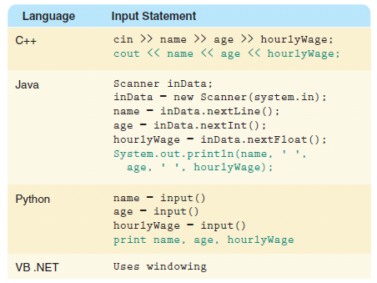
Input/Output Structures

Slide 62
Control Structures
Control structures
An instruction that determines the order in which other instructions in a program are executed
Can you name the ones we defined in the functionality of pseudocode?

Slide 63
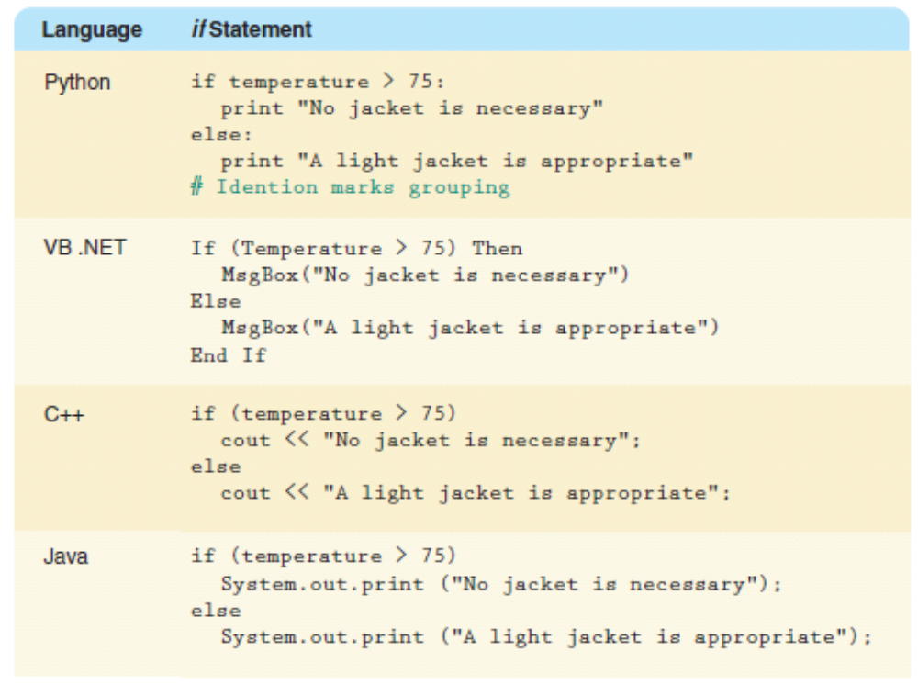
Selection Statements
The if statement allows the program to test the state of the program variables using a Boolean expression

Slide 64
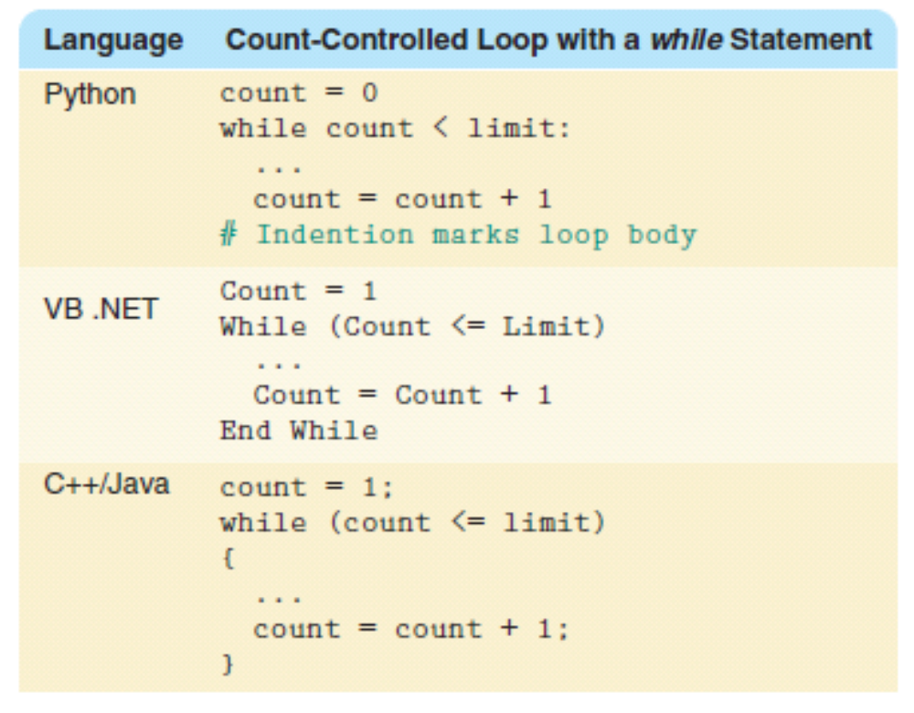
Looping Statements

Slide 65
Subprogram Statements
We can give a section of code a name and use that name as a statement in another part of the program
When the name is encountered, the processing in the other part of the program halts while the named code is executed
Remember?

Slide 66
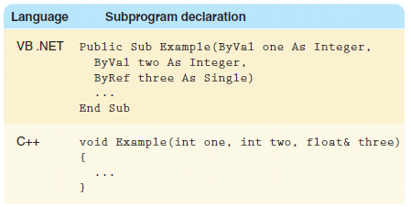
Subprogram Statements

Slide 67
Nested Logic
Set sum to 0 // Initialize sum
Set posCount to 0 // Initialize event
WHILE (posCount <= 10) // Test event
Read a value
IF (value > 0) // Update event?
Set posCount to posCount + 1
// Update event
Set sum to sum + value
// Statement(s) following loop
IF within a WHILE

Slide 68
Set weekCount to 1
WHILE (weekCount<= 52)
Set weekSum to 0
Set dayCount to 1
WHILE (dayCount <= 7)
Read rainfall
Set weekSum to weekSum + rainfall
Set dayCount to dayCount + 1
Write “Week “ + weekCount + “ total: “ + weekSum
Set weekCount to weekCount +
WHILE within a WHILE

Slide 69
Set weekCount to 1
WHILE (weekCount<= 52)
Set weekSum to CalculateWeekSum(weekCount)
Write “Week “ + weekCount + “ total: “ + weekSum
Set weekCount to weekCount +
CalculateWeekSum(weekCount)
…..
Which is easier to read?

Slide 70
Asynchronous Processing
Asynchronous processing
Not synchronized with the program's action
  Clicking has become a major form of input
  to the computer
  Mouse clicking is not within the sequence
  of the program
  A user can click a mouse at any time during
  the execution of a program

Slide 71
Functionality of OOPs
Encapsulation
A language feature that enforces information hiding
Classes
Different meanings in different places (See next slide)
Inheritance
A property that allows a class to inherit the data and actions of another class
Polymorphism
An ability to handle the ambiguity of duplicate names

Slide 72
Functionality of OOPs
Object class (problem-solving phase)
An entity or thing that is relevant in the context of a problem
Object class (class) (problem-solving phase)
A description of a group of objects with similar properties and behaviors
Class (implementation phase) A pattern for an object
Object ( implementation phase) An instance of a class

Slide 73
Class Definition
A class encapsulates both data and actions
public class Person // Name the class
// Declare Class variables
Name name
String telephone
String email

Slide 74
Class Definition
// Declare Class Methods
Initialize() // Code for Initialize
public Print() // Code for Print
public Name GetName()
RETURN Name
public String GetEmail()
RETURN email
public String GetTelephone()
RETURN telephone

Slide 75
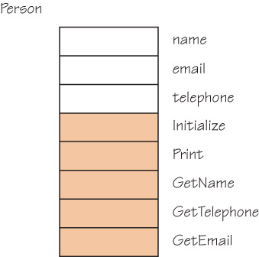
Class Definition
Figure 9.4 Class person

Slide 76
Class Definition
Name aName = new Name()
aName.Initialize("Frank", "Jones")
Person aPerson = new Person()
aPerson.Initialize(aName, telephone, email)
aPerson.Print()
Write "Name: ", aPerson.GetName().Print()
Write " Telephone: ", aPerson.GetTelephone()
Write " Email: ", a Person.GetEmail()

Slide 77
Class Definition
To get an object of a class, we must ask that one be created (instantiated). The new operator does this for us
Person myPerson = new Person()
Student myStudent = new Student()
myPerson.Initialize(…)
myStudent.Initialize(…)
myPerson.Print()
myStudent.Print()

Slide 78
Inheritance and Polymorphism
Inheritance
A construct that fosters reuse by allowing an application to take an already-tested class and derive a class from it that inherits the properties the application needs
Polymorphism
The ability of a language to have duplicate method names in an inheritance hierarchy and to apply the method that is appropriate for the object to which the method is applied

Slide 79
Inheritance and Polymorphism
Inheritance and polymorphism work together
How?
They combine to allow the programmer to build useful hierarchies of classes that can be put into a library to be reused in different applications

Slide 80
Top-Down vs OO Designs
Top-down Solution
Data structures needed in solution are determined
Subprograms are written to manipulate the the data structures
Main program declares data structure
Main program calls to the subprograms, passing data structures as parameters

Slide 81
Top-Down vs OO Designs
Object-oriented Solution
ADTs needed in solution are determined
ADTs are written only if not in library
Data structure is encapsulated within the class that implements the ADT
Main program is instructions to ADTs to perform the necessary tasks

Slide 82
Ethical Issues
Gambling on the Internet
Have you ever visited an Internet gambling site?
Should Internet gambling be outlawed?
Should Internet gambling be legalized and regulated?
Should Internet gambling be taxed?

Slide 83
Ethical Issues
Computer Hoaxes and Scams
What is the principal difference between a hoax and a scam?
What are the most common complaints of Internet users about computer scams and hoaxes?
What are the most serious crimes perpetrated on the Web?
Why is it so difficult to police these schemes?

Slide 84

Who am I?
I am best known
for structured
programming.
Can you define
it?
I am also known
for my wit. Can
you recall some
of my witty
sayings?
Courtesy of Dianne Driskell, UTCS,
The University of Texas at Austin.

Slide 85

Do you know?
How are computers used in tennis tournaments?
What predated the functionality of Bytecode?
What does the word "paradigm" mean? How
has its meaning changed over time?
How many definitions can you think of for
"bow"?

