Slide 1
Problem Solving and Algorithm Design
Describe the computer problem-solving process and relate it to Polya’s How to Solve It list
Following an algorithm and developing one
Describe the pseudocode constructs used in expressing an algorithm
top-down design methodology
Langara College, Computer Science & Information System

Slide 2
Problem Solving
Problem:
A question raised for inquiry, consideration, or solution.
In mathematics, a problem is usually a situation to resolve with well-defined mathematical principles.
Problem Solving:
The act of finding a solution to a question

Slide 3
Problem Solving
Computers cannot be used directly to solve problems such as a drifting girl/boy-friend.
Computers can do nothing without being told explicitly what to do.
Computer is not intelligent.
Computer cannot analyze a problem and come up with a solution.

Slide 4
Problem Solving
A problem should be specify by human (client), analyze by human (system analyst), and solve by human (programmer)
So what is its advantageous?
Once we have written a solution for a computer, the computer can repeat the solution very quickly and consistency, again and again.
Frees people from repetitive and boring tasks.
Can you provide example of some of these boring tasks? Managing your budget

Slide 5
Problem Solving
How to Solve It: A New Aspect of Mathematical Method by George Polya, 1945.
"How to solve it" written within the context of mathematical problems
But it is quite general
We can use it to solve computer
related problems!

Slide 6
Problem Solving
How do you solve problems?
  Understand the problem
  Devise a plan
  Carry out the plan
  Test the solution

Slide 7
Strategies
Ask questions!
  What do I know about the problem?
  What is the information that I have to process in order the find the solution?
  What does the solution look like?
  What sort of special cases exist?
  How will I recognize that I have found
  the solution?

Slide 8
Strategies
Ask questions! Never reinvent the wheel!
Similar problems come up again and again in different guises
A good programmer recognizes a task or subtask that has been solved before and plugs in the solution
Can you think of two similar problems?
  daily highest and lowest temperature
  highest and lowest grade of an exam

Slide 9
Strategies
Divide and Conquer!
Break up a large and overwhelming problem into smaller units and solve each smaller problem separately.
  Applies the concept of abstraction
  The divide-and-conquer approach can be applied over and over again until each subtask is manageable.
Can you give an example?
  Cleaning a house or an apartment.

Slide 10
Algorithms
Algorithm
A set of unambiguous instructions for solving a problem or subproblem in a finite amount of time using a finite amount of data
Why must instructions be unambiguous?
Why must time and data be finite?

Slide 11
Computer Problem-Solving
Analysis and Specification Phase
Analyze
Specification
Algorithm Development Phase
Develop algorithm
Test algorithm
Implementation Phase
Code algorithm
Test algorithm
Maintenance Phase
Use
Maintain

Slide 12
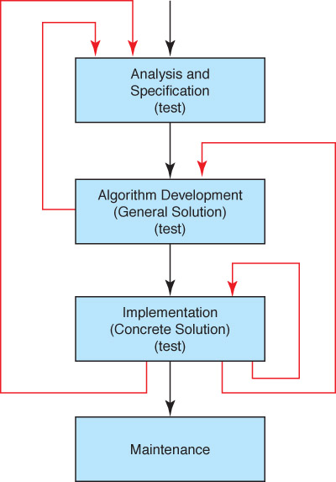
Phase Interactions

Slide 13
Pseudocode
Pseudocode
A mixture of English and formatting to make the steps in an algorithm explicit
Algorithm to Convert base-10 number to other bases
While ( the quotient is not zero )
Divide the decimal number by the new base
Make the remainder the next digit to the left in the answer
Replace the original decimal number with the quotient

Slide 14
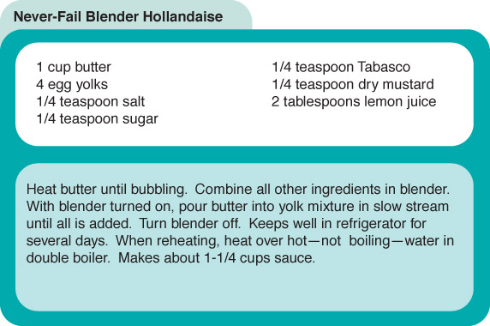
Following an Algorithm
A recipe for Hollandaise sauce

Slide 15
Following an Algorithm
Algorithm for preparing a Hollandaise sauce
If concerned about cholesterol
Put butter substitute in a pot
Else
Put butter in a pot
Turn on burner
Put pot on the burner
While (NOT bubbling)
Leave pot on the burner
Put other ingredients in the blender
Turn on blender
While (more in pot)
Pour contents into lender in slow steam
Turn off blender

Slide 16
Developing an Algorithm
Two methodologies used to develop computer solutions to a problem
  Top-down design focuses on the tasks to be done
  Object-oriented design focuses on the data involved in the solution
But first, let's look at a way to express algorithms: pseudocode

Slide 17
Pseudocode
Pseudocode
A way of expressing algorithms that uses a mixture of English phrases, Math and indention to make the steps in the solution explicit
There are no grammar rules in pseudocode
Pseudocode is not case sensitive

Slide 18
Following Pseudocode
While ( the quotient is not zero )
Divide the decimal number by the new base
Make the remainder the next digit to the left in the answer
Replace the original decimal number with
What is 93 in base 8?
93/8 gives 11 remainder 5
11/6 gives 1 remainder 3
1/ 8 gives 0 remainder 1
answer 1 3 5

Slide 19
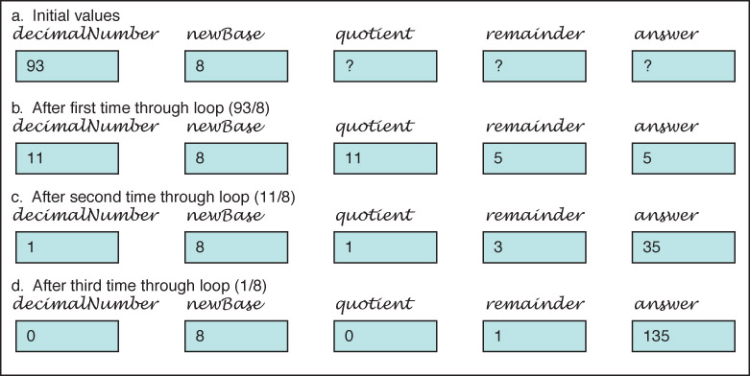
Following Pseudocode

Slide 20
Pseudocode for Complete Computer Solution
Write "Enter the new base"
Read newBase
Write "Enter the number to be converted"
Read decimalNumber
Set quotient to 1
While (quotient is not zero)
Set quotient to decimalNumber DIV newBase
Set remainder to decimalNumber REM newBase
Make the remainder the next digit to the left in the answer
Set quotient to decimalNumber
Write "The answer is "
Write answer

Slide 21
Pseudocode Functionality
Variables
Names of places to store values
quotient, decimalNumber, newBase
Assignment
Storing the value of an expression into a
variable
Set quotient to 64
quotient ← 64
quotient ← 6 * 10 + 4

Slide 22
Pseudocode Functionality
Output
Printing a value on an output device
Write, Print
Input
Getting values from the outside word and storing them into variables
Get, Read

Slide 23
Pseudocode Functionality
Repetition
Repeating a series of statements
Set count to 1
While ( count < 10)
Write "Enter an integer number"
Read aNumber
Write "You entered " + aNumber
Set count to count + 1
How many values were read?

Slide 24
Pseudocode Functionality
Selection
Making a choice to execute or skip a statement (or group of statements)
Read number
If (number < 0)
Write number + " is less than zero."
or
Write "Enter a positive number.“
Read number
If (number < 0)
Write number + " is less than zero."
Write "You didn't follow instructions."

Slide 25
Pseudocode Functionality
Selection
Choose to execute one statement (or group of statements) or another statement (or group of statements)
If ( age < 12 )
Write "Pay children's rate"
Write "You get a free box of popcorn"
else If ( age < 65 )
Write "Pay regular rate"
else
Write "Pay senior citizens rate"

Slide 26
Pseudocode Example
Write "How many pairs of values are to be entered?"
Read numberOfPairs
Set numberRead to 0
While (numberRead < numberOfPairs)
Write "Enter two values separated by a blank; press return"
Read number1
Read number2
If (number1 < number2)
Print number1 + " " + number2
Else
Print number2 + " " number1
Increment numberRead

Slide 27
Walk Through
Data Fill in values during each iteration
3 numberRead number1 number2
55 70
2 1
33 33
numberOfPairs
What is the output?

Slide 28
Top-Down Design
Top-Down Design
  Problem-solving technique in which the problem is divided into subproblems; the process is applied to each subproblem
Modules
  Self-contained collection of steps, that solve a problem or subproblem
Abstract Step
  An algorithmic step containing unspecified details
Concrete Step
  An algorithm step in which all details are specified

Slide 29
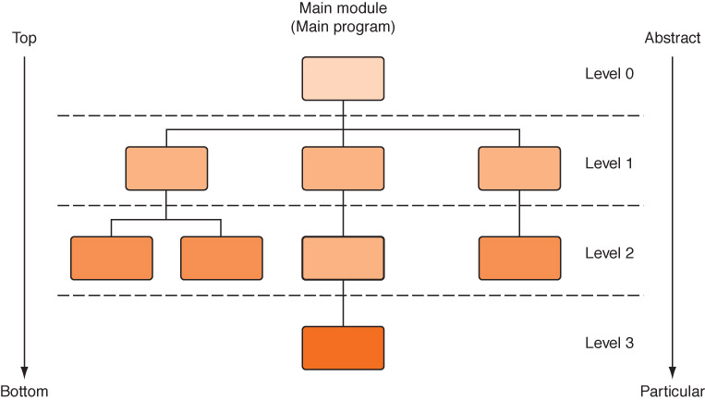
Top-Down Design
Process continues for as many levels as it takes to make every step concrete
Name of (sub)problem at one level becomes a module at next lower level

Slide 30
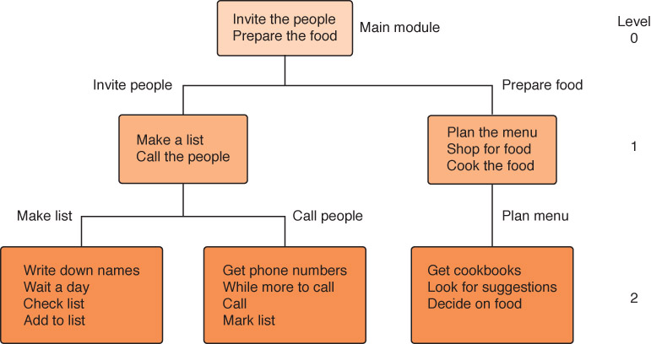
A General Example
Planning a large party
Subdividing the party planning

Slide 31
A Computer Example
Problem
Create a list that includes each person’s name, telephone number, and e-mail address
  This list should then be printed in alphabetical order
  The names to be included in the list are on scraps of paper and business cards

Slide 32
A Computer Example
Main Level 0
Enter names and numbers into list
Put list into alphabetical order
Print list
Enter names and numbers into list Level 1
While ( more names)
Enter name
Enter telephone number
Enter email address
Insert information into list

Slide 33
A Computer Example
Enter names and numbers into list (revised) Level 1
Set moreNames to true
While (moreNames)
Prompt for and enter name
Prompt for and enter telephone number
Prompt for and enter email address
Insert information into list
Write "Enter a 1 to continue or a 0 to stop."
Read response
If (response = 0)
Set moreNames to false

Slide 34
A Computer Example
Prompt for and enter name Level 2
Write "Enter last name; press return."
Read lastName
Write "Enter first name; press return."
Read firstName
Prompt for and enter telephone number Level 2
Write "Enter area code and 7-digit number; press return."
Read telephoneNumber
Prompt for and enter email address Level 2
Write "Enter email address; press return."
Read emailAddress

Slide 35
A Computer Example
Put list into alphabetical order
Print the list Level 1
Write "The list of names, telephone numbers, and email
addresses follows:"
Get first item from the list
While (more items)
Write item's firstName + " " + lastName
Write item's telephoneNumber
Write item's emailAddress
Write a blank line
Get next item from the list

Slide 36
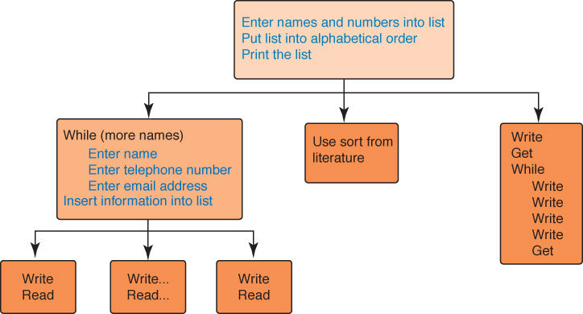
A Computer Example

Slide 37
Testing the Algorithm
Important distinction
Mathematics
We tests the answer
Programs
We test the process

Slide 38
Testing the Algorithm
Desk checking
Working through a design at a desk with a pencil and paper
Walk-through
Manual simulation of the design by team members, taking sample data values and simulating the design using the sample data
Inspection
One person (not the designer) reads the design (handed out in advance) line by line while the others point out errors

