Slide 1
Chapter 2 –Visual Basic, Controls, and Events
2.1 An Introduction to Visual Basic
2.2 Visual Basic Controls
2.3 Visual Basic Events
Chapter 2 - VB 2008 by Schneider

Slide 2
2.1 An Introduction to Visual Basic 2008
Why Windows and Why Visual Basic
How You Develop a Visual Basic Application
The Different Versions of Visual Basic
Chapter 2 - VB 2008 by Schneider

Slide 3
Visual Basic 2008
Language used to create Windows applications.
Provides a Graphical User Interface or GUI.
The sequence of instructions executed in the program is controlled by events.
Chapter 2 - VB 2008 by Schneider

Slide 4
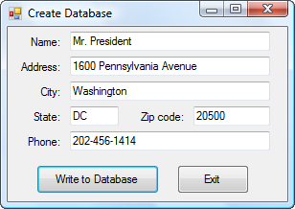
Sample Input Screen
Chapter 2 - VB 2008 by Schneider

Slide 5
How to Develop a Visual Basic Application
Design the Interface for the user.
Determine which events the controls on the window should recognize.
Write the event procedures for those events.
Chapter 2 - VB 2008 by Schneider

Slide 6
Different Versions of Visual Basic
Version 1.0 – 1991 Version 2.0 – 1992
Version 3.0 – 1993 Version 4.0 – 1995
Version 5.0 – 1997 Version 6.0 – 1998
Visual Basic.NET – 2002 (NOT BACKWARD COMPATIBLE WITH EARLIER VERSIONS)
Visual Basic 2005 – November 2005
Visual Basic 2008 – November 2007
Chapter 2 - VB 2008 by Schneider

Slide 7
2.2 Visual Basic Controls
Invoking Visual Basic
Text Box Control
Button Control
Label Control
List Box Control
Name Property
Help / Fonts / Auto Hide
Positioning and Aligning Controls
Chapter 2 - VB 2008 by Schneider

Slide 8
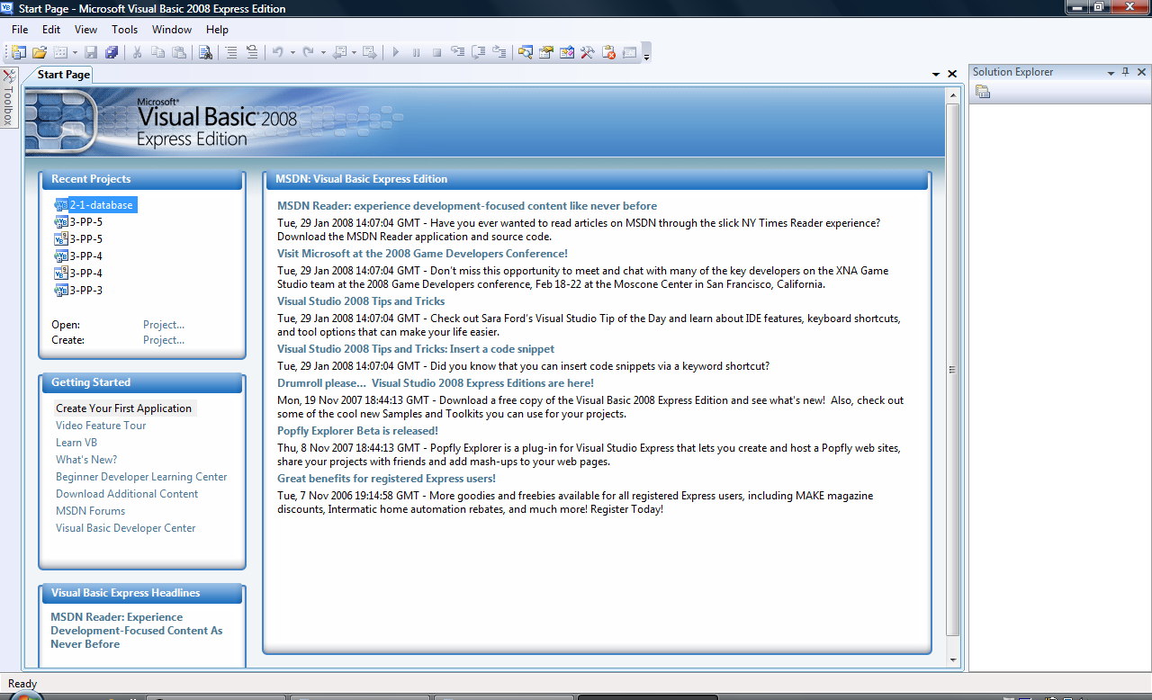
Visual Basic Start Page
Chapter 2 - VB 2008 by Schneider
Notes:
Point out menu bar; especially file item.

Slide 9
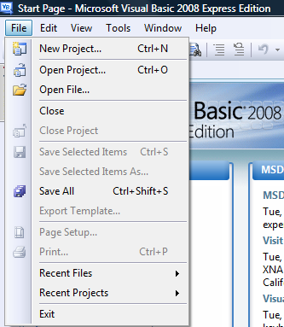
Start a New Project
Chapter 2 - VB 2008 by Schneider

Slide 10
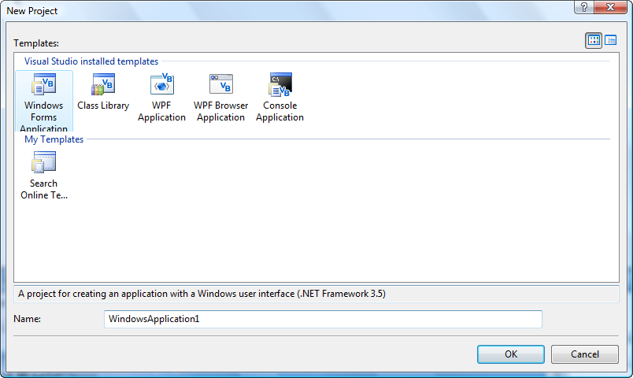
New Project Dialog Box
Chapter 2 - VB 2008 by Schneider

Slide 11
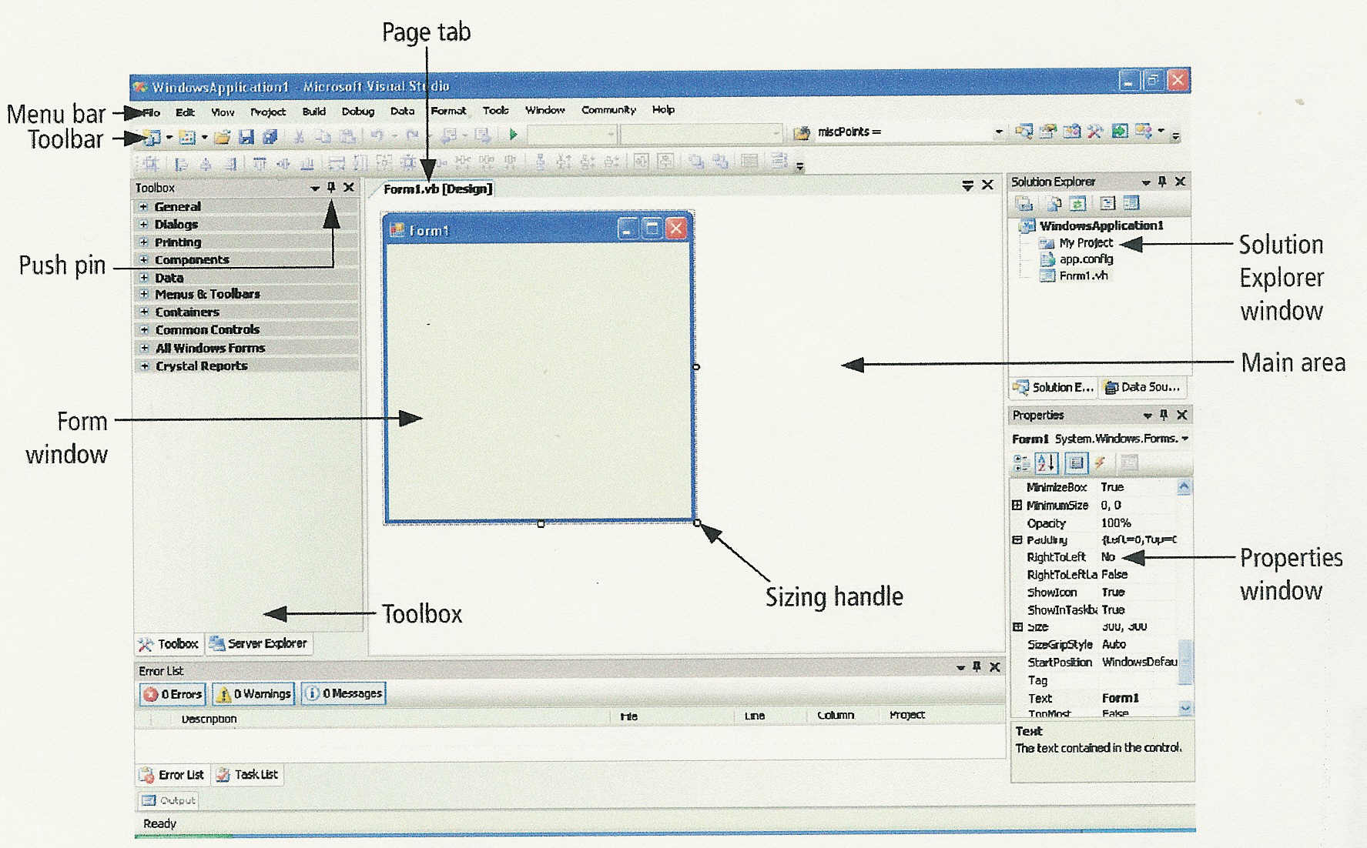
Initial Visual Basic Screen
Chapter 2 - VB 2008 by Schneider

Slide 12
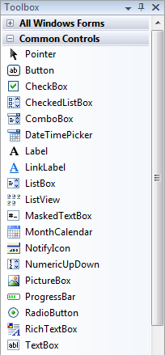
Toolbox
Chapter 2 - VB 2008 by Schneider

Slide 13
3 Ways to Place a Control from the Toolbox onto the Form Window
Double-click
Drag and Drop
Click, Point, and Drag
Chapter 2 - VB 2008 by Schneider

Slide 14
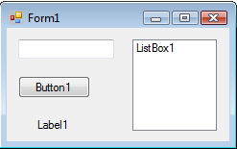
Four Controls at Design Time
Text box
To select a control, click on it. Sizing handles will appear when a control is selected.
Chapter 2 - VB 2008 by Schneider

Slide 15
Text Box Control
Used for input and output
When used for output, ReadOnly property is set to True
Tasks button
Sizing handles
Chapter 2 - VB 2008 by Schneider

Slide 16
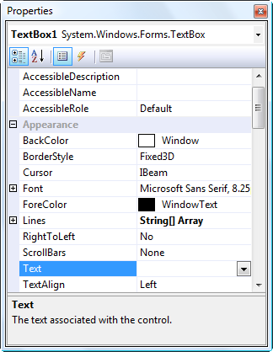
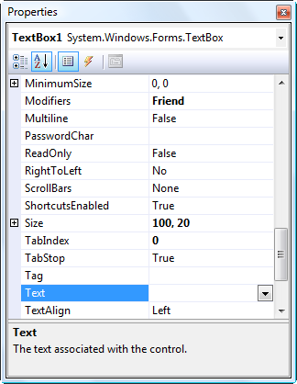
Properties Window
Press F4 to display the Properties window for the selected control.
Categorized view Alphabetical view
Chapter 2 - VB 2008 by Schneider

Slide 17
Properties Window
Selected control
Properties
Settings
Chapter 2 - VB 2008 by Schneider

Slide 18
Some Often Used Properties
Text
Autosize
Font.Name
Font.Size
ForeColor
BackColor
ReadOnly
Chapter 2 - VB 2008 by Schneider

Slide 19
Setting Properties
Click on property name in left column.
Enter its setting into right column by typing or selecting from options displayed via a button or ellipses.
Chapter 2 - VB 2008 by Schneider

Slide 20
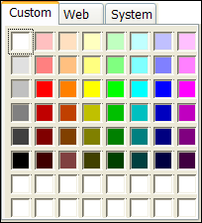
Setting the ForeColor Property
Click on ForeColor.
Click on button at right of settings box.
Click on Custom tab to obtain display shown.
Click on a color.
Chapter 2 - VB 2008 by Schneider
Notes:
The 16 white boxes at the bottom of the grid are used to create custom colors. (Explained in Appendix B.)

Slide 21
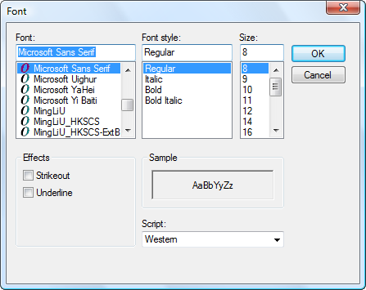
Font Property
Click on Font in left column.
Click on ellipsis at right of settings box to obtain display shown,
Make selections.
Chapter 2 - VB 2008 by Schneider

Slide 22
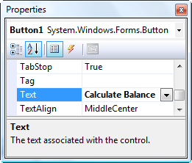

Button Control
The caption on the button should indicate the effect of clicking on the button.
Text property determines caption.
Chapter 2 - VB 2008 by Schneider
Notes:
To add the button, double-click on the button icon in the ToolBox, or single click and click and drag

Slide 23
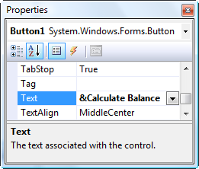

Add an "access key"
Chapter 2 - VB 2008 by Schneider

Slide 24
Label Control
Used to identify the contents of a text box.
Text property specifies caption.
By default, label automatically resizes to accommodate caption on one line.
When the AutoSize property is set to False, label can be resized manually. Used primarily to obtain a multi-rowed label.
Chapter 2 - VB 2008 by Schneider

Slide 25
List Box Control
Initially used to display several pieces of output.
In Chapter 9 used to select from a list.
Chapter 2 - VB 2008 by Schneider

Slide 26
The Name Property
Used by the programmer to refer to a control in code
Setting for Name property near top of Properties window.
Name must begin with a letter, be less than 215 characters long, and may include numbers and letters.
Use appropriate 3- or 4-character naming prefix
Chapter 2 - VB 2008 by Schneider

Slide 27
Control Name Prefixes
Control | Prefix | Example
button | btn | btnCompute
label | lbl | lblAddress
text box | txt | txtAddress
list box | lst | lstOutput
Chapter 2 - VB 2008 by Schneider

Slide 28
Renaming the Form
Initial name is Form1
The Solution Explorer window lists a file named Form1.vb.
To rename the form, change the name of this file to newName.vb
newName should begin with prefix frm.
Chapter 2 - VB 2008 by Schneider

Slide 29
Fonts
Proportional width fonts take up less space for "I" than for "W" – like Microsoft Sans Serif
Fixed-width fonts take up the same amount of space for each character – like Courier New
Fixed-width fonts are used for tables.
Chapter 2 - VB 2008 by Schneider

Slide 30
Auto Hide
Hides Toolbox when not in use
Vertical push pin icon indicates auto hide is disabled.
Click the push pin to make it horizontal and enable auto hide.
Push pin
Chapter 2 - VB 2008 by Schneider

Slide 31
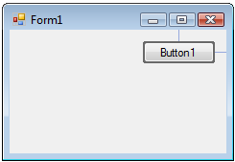
Positioning Controls
Proximity line
Chapter 2 - VB 2008 by Schneider

Slide 32
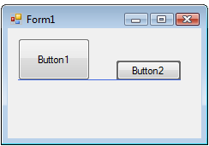
Aligning Controls
Snap line
Chapter 2 - VB 2008 by Schneider

Slide 33
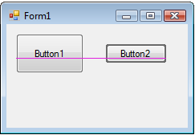
Aligning Controls
Snap line
Chapter 2 - VB 2008 by Schneider

Slide 34
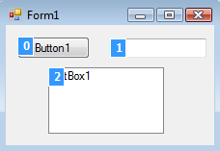
Tab Order
Tab index
The tab indices determine the order in which controls receive the focus during tabbing.
Chapter 2 - VB 2008 by Schneider
Notes:
Tab index determines the order in which the control receives the focus while tabbing.
Setting of tab order invoked from Edit window.

Slide 35
2.3 Visual Basic Events
An Event Procedure Walkthrough
Properties and Event Procedures of the Form
The Header of an Event Procedure
Chapter 2 - VB 2008 by Schneider

Slide 36
Event
An event is an action, such as the user clicking on a button
Usually, nothing happens in a Visual Basic program until the user does something and generates an event.
What happens is determined by statements.
Chapter 2 - VB 2008 by Schneider

Slide 37
Sample Statements
txtBox.ForeColor = Color.Red
txtBox.Visible = True
txtBox.Text = "Hello World"
General Form:
controlName.property = setting
Chapter 2 - VB 2008 by Schneider

Slide 38
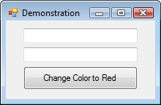
Sample Form
txtFirst
txtSecond
btnRed
Chapter 2 - VB 2008 by Schneider

Slide 39
Focus
When you click on a text box, a cursor appears in the text box, and you can type into the text box.
Such a text box is said to have the focus.
If you click on another text box, the first text box loses the focus and the second text box receives the focus.
Chapter 2 - VB 2008 by Schneider

Slide 40
Examples of Events
btnShow.Click
txtBox.TextChanged
txtBox.Leave
General Form:
controlName.event
Chapter 2 - VB 2008 by Schneider

Slide 41
The three steps in creating a Visual Basic program:
Create the interface; that is, generate, position, and size the objects.
Set properties; that is, configure the appearance of the objects.
Write the code that executes when events occur.
Chapter 2 - VB 2008 by Schneider

Slide 42
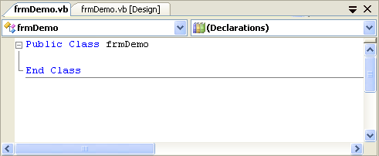
Code Editor
Code Editor tab
Form Designer tab
Class Name box
Method Name box
Chapter 2 - VB 2008 by Schneider

Slide 43
Structure of an Event Procedure
Private Sub objectName_event(...)
Handles objectName.event
statements
End Sub
(...) is filled automatically with (ByVal sender As System.Object, ByVal e As System.EventArgs)
Header
Chapter 2 - VB 2008 by Schneider

Slide 44
Create an Outline for an Event Procedure; i.e. header and End Sub
Double-click on a control
or
Use the Class Name and Method
Name boxes.
(We nearly always use the first
method.)
Chapter 2 - VB 2008 by Schneider

Slide 45
Sample Form
txtFirst
txtSecond
btnRed
Double Click on txtFirst
Chapter 2 - VB 2008 by Schneider

Slide 46
Code for Walkthrough
Public Class frmDemo
Private Sub txtFirst_TextChanged(...)
Handles txtFirst.TextChanged
End Sub
End Class
Chapter 2 - VB 2008 by Schneider

Slide 47
Code for Walkthrough
Public Class frmDemo
Private Sub txtFirst_TextChanged(...)
Handles txtFirst.TextChanged
txtFirst.ForeColor = Color.Blue
End Sub
End Class
Chapter 2 - VB 2008 by Schneider

Slide 48
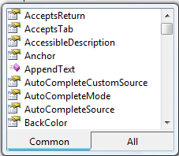
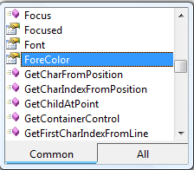
IntelliSense
Automatically pops up to give the programmer help.
txtFirst.
Chapter 2 - VB 2008 by Schneider

Slide 49
Code Editor
Click tab to return to Form Designer
Chapter 2 - VB 2008 by Schneider

Slide 50
Sample Form
txtFirst
txtSecond
btnRed
Double-click on btnRed
Chapter 2 - VB 2008 by Schneider

Slide 51
Code for Walkthrough
Public Class frmDemo
Private Sub txtFirst_TextChanged(...)
Handles txtFirst.TextChanged
txtFirst.ForeColor = Color.Blue
End Sub
Private Sub btnRed_Click(...)
Handles btnRed.Click
End Sub
End Class
Chapter 2 - VB 2008 by Schneider

Slide 52
Code for Walkthrough
Public Class frmDemo
Private Sub txtFirst_TextChanged(...)
Handles txtFirst.TextChanged
txtFirst.ForeColor = Color.Blue
End Sub
Private Sub btnRed_Click(...)
Handles btnRed.Click
txtFirst.ForeColor = Color.Red
End Sub
End Class
Chapter 2 - VB 2008 by Schneider

Slide 53
Event Procedure txtFirst.Leave
Select txtFirst from Class Name box drop-down list.
Select Leave from Method Name box drop-down list.
Chapter 2 - VB 2008 by Schneider

Slide 54
Code for Walkthrough
Private Sub txtFirst_Leave(...) Handles txtFirst.Leave
End Sub
Private Sub txtFirst_TextChanged(...)
Handles txtFirst.TextChanged
txtFirst.ForeColor = Color.Blue
End Sub
Private Sub btnRed_Click(...) Handles btnRed.Click
txtFirst.ForeColor = Color.Red
End Sub
Chapter 2 - VB 2008 by Schneider

Slide 55
Code for Walkthrough
Private Sub txtFirst_Leave(...) Handles txtFirst.Leave
txtFirst.ForeColor = Color.Black
End Sub
Private Sub txtFirst_TextChanged(...)
Handles txtFirst.TextChanged
txtFirst.ForeColor = Color.Blue
End Sub
Private Sub btnRed_Click(...) Handles btnRed.Click
txtFirst.ForeColor = Color.Red
End Sub
Chapter 2 - VB 2008 by Schneider

Slide 56
Header of Event Procedure
Private Sub btnRed_Click(…) Handles btnRed.Click
Identifies event
Name, can be changed.
Private Sub Button_Press(…) Handles btnRed.Click
Chapter 2 - VB 2008 by Schneider

Slide 57
Handling Multiple Events
Event procedure can be invoked by two events.
Private Sub Happening(...)
Handles btnRed.Click,txtSecond.Leave
txtFirst.ForeColor = Color.Red
End Sub
Chapter 2 - VB 2008 by Schneider

Slide 58
Altering Properties of the Form
The following won't work: frmDemo.Text = "Demonstration"
The form is referred to by the keyword Me.
Me.Text = "Demonstration"
Chapter 2 - VB 2008 by Schneider

Slide 59
Text File
Holds data to be processed by programs.
Can be created, viewed, and managed by the Visual Basic IDE.
Create: Use “Add New Item” input dialog box.
View: Click on filename in Solution Explorer.
Manage: Use Solution Explorer like Windows
Explorer.
Chapter 2 - VB 2008 by Schneider

Slide 60
Sample Text File
Mike Jones
9.35
35
John Smith
10.75
33
PAYROLL.TXT
Chapter 2 - VB 2008 by Schneider

Slide 61
Sample Text File
name
Mike Jones
9.35
35
John Smith
10.75
33
hourly wage
hours worked
PAYROLL.TXT
Chapter 2 - VB 2008 by Schneider

Slide 62
Our Text File Convention
PAYROLL.TXT uses one item of data per line. That will be our convention in this book.
Chapter 2 - VB 2008 by Schneider

Slide 63
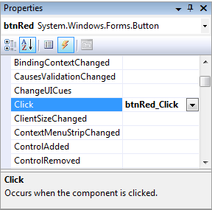
Use Property Window to View all Possible Events for a Control
Events
button
Chapter 2 - VB 2008 by Schneider

Slide 64
Open and Run an Existing Program
Click on Open Project in the File menu.
Navigate to the program’s folder.
Click on the program’s folder.
Double-click on the file with extension .sln.
In the Solution Explorer double-click on the file with extension .vb. (The Form Designer will appear.)
Press F5 to run the program.
Chapter 2 - VB 2008 by Schneider

