Slide 1

Chapter 7
Problem Solving
and Algorithms
Notes:
Change cover and background

Slide 2
Chapter Goals
Describe the computer problem-solving process and relate it to Polya’s How to Solve It list
Distinguish between a simple type and a composite type
Describe two composite data-structuring mechanisms
Recognize a recursive problem and write a recursive algorithm to solve it
Distinguish between an unsorted array and a sorted array
Distinguish between a selection sort and an insertion sort

Slide 3
Chapter Goals
Describe the Quicksort algorithm
Apply the selection sort, the bubble sort, insertion sort, and Quicksort to an array of items by hand
Apply the binary search algorithm
Demonstrate an understanding of the algorithms in this chapter by hand-simulating them with a sequence of items

Slide 4
Problem Solving
Problem solving
The act of finding a solution to a perplexing, distressing, vexing, or unsettled question
How do you define problem solving?

Slide 5
Problem Solving
How to Solve It: A New Aspect of Mathematical Method by George Polya
"How to solve it list" written within the context of mathematical problems
But list is quite general
We can use it to solve computer
related problems!

Slide 6
Problem Solving
How do you solve problems?
Understand the problem
Devise a plan
Carry out the plan
Look back

Slide 7
Strategies
Ask questions!
  What do I know about the problem?
  What is the information that I have to process in order the find the solution?
  What does the solution look like?
  What sort of special cases exist?
  How will I recognize that I have found
  the solution?

Slide 8
Strategies
Ask questions! Never reinvent the wheel!
Similar problems come up again and again in different guises
A good programmer recognizes a task or subtask that has been solved before and plugs in the solution
Can you think of two similar problems?

Slide 9
Strategies
Divide and Conquer!
Break up a large problem into smaller units and solve each smaller problem
  Applies the concept of abstraction
  The divide-and-conquer approach can be applied over and over again until each subtask is manageable

Slide 10
Computer Problem-Solving
Analysis and Specification Phase
Analyze
Specification
Algorithm Development Phase
Develop algorithm
Test algorithm
Implementation Phase
Code algorithm
Test algorithm
Maintenance Phase
Use
Maintain
Can you
name
a recurring
theme?

Slide 11
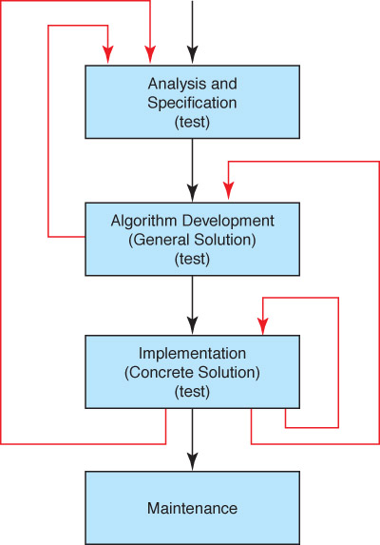
Phase Interactions
Should we
add another
arrow?
(What happens
if the problem
is revised?)

Slide 12
Algorithms
Algorithm
A set of unambiguous instructions for solving a problem or subproblem in a finite amount of time using a finite amount of data
Abstract Step
An algorithmic step containing unspecified details
Concrete Step
An algorithm step in which all details are specified

Slide 13
Developing an Algorithm
Two methodologies used to develop computer solutions to a problem
  Top-down design focuses on the tasks to be done
  Object-oriented design focuses on the data involved in the solution (We will discuss this design in Ch. 9)

Slide 14
Summary of Methodology
Analyze the Problem
  Understand the problem!!
  Develop a plan of attack
List the Main Tasks (becomes Main Module)
  Restate problem as a list of tasks (modules)
  Give each task a name
Write the Remaining Modules
  Restate each abstract module as a list of tasks
  Give each task a name
Re-sequence and Revise as Necessary
  Process ends when all steps (modules) are concrete

Slide 15
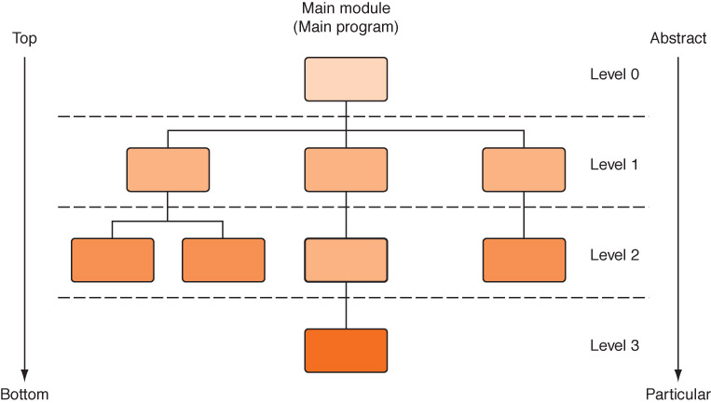
Top-Down Design
Process continues for as many levels as it takes to make every step concrete
Name of (sub)problem at one level becomes a module at next lower level

Slide 16
Control Structures
Control structure
An instruction that determines the order in which other instructions in a program are executed
Can you name the ones we defined in the functionality of pseudocode?

Slide 17
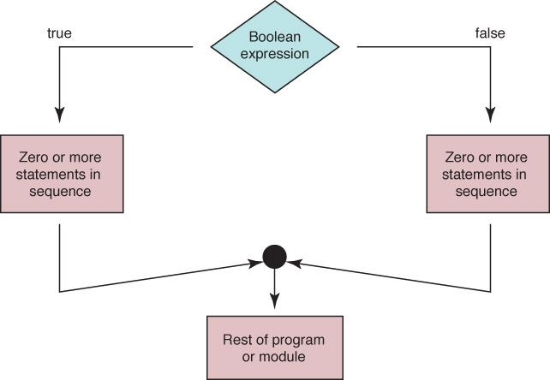
Selection Statements
Flow of control of if statement

Slide 18
Algorithm with Selection
Problem: Write the appropriate dress for a given temperature.
Write "Enter temperature"
Read temperature
Determine Dress
Which statements are concrete?
Which statements are abstract?

Slide 19
Algorithm with Selection
Determine Dress
IF (temperature > 90)
Write “Texas weather: wear shorts”
ELSE IF (temperature > 70)
Write “Ideal weather: short sleeves are fine”
ELSE IF (temperature > 50)
Write “A little chilly: wear a light jacket”
ELSE IF (temperature > 32)
Write “Philadelphia weather: wear a heavy coat”
ELSE
Write “Stay inside”

Slide 20
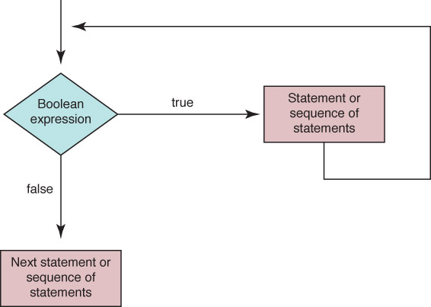
Looping Statements
Flow of control of while statement

Slide 21
Looping Statements
A count-controlled loop
Set sum to 0
Set count to 1
While (count <= limit)
Read number
Set sum to sum + number
Increment count
Write "Sum is " + sum
Why is it
called a
count-controlled
loop?

Slide 22
Looping Statements
An event-controlled loop
Set sum to 0
Set allPositive to true
WHILE (allPositive)
Read number
IF (number > 0)
Set sum to sum + number
ELSE
Set allPositive to false
Write "Sum is " + sum
Why is it
called an
event-controlled
loop?
What is the
event?

Slide 23
Looping Statements
Calculate Square Root
Read in square
Calculate the square root
Write out square and the square root
Are there any abstract steps?

Slide 24
Looping Statements
Calculate Square Root
Set epsilon to 1
WHILE (epsilon > 0.001)
Calculate new guess
Set epsilon to abs(square - guess * guess)
Are there any abstract steps?

Slide 25
Looping Statements
Calculate New Guess
Set newGuess to
(guess + (square/guess)) / 2.0
Are there any abstract steps?

Slide 26
Looping Statements
Read in square
Set guess to square/4
Set epsilon to 1
WHILE (epsilon > 0.001)
Calculate new guess
Set epsilon to abs(square - guess * guess)
Write out square and the guess

Slide 27
Composite Data Types
Records
A named heterogeneous collection of items in which individual items are accessed by name. For example, we could bundle name, age and hourly wage items into a record named Employee
Arrays
A named homogeneous collection of items in which an individual item is accessed by its position (index) within the collection

Slide 28
Composite Data Types
Employee
name
age
hourly/Wage
Following algorithm, stores values into the fields of record:
Employee employee // Declare and Employee variable
Set employee.name to “Frank Jones”
Set employee.age to 32
Set employee.hourlyWage to 27.50

Slide 29
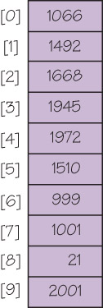
Composite Data Types
numbers[0]
numbers[4]

Slide 30
Arrays
As data is being read into an array, a counter is updated so that we always know how many data items were stored
If the array is called list, we are working with
list[0] to list[length-1] or
list[0]..list[length-1]

Slide 31
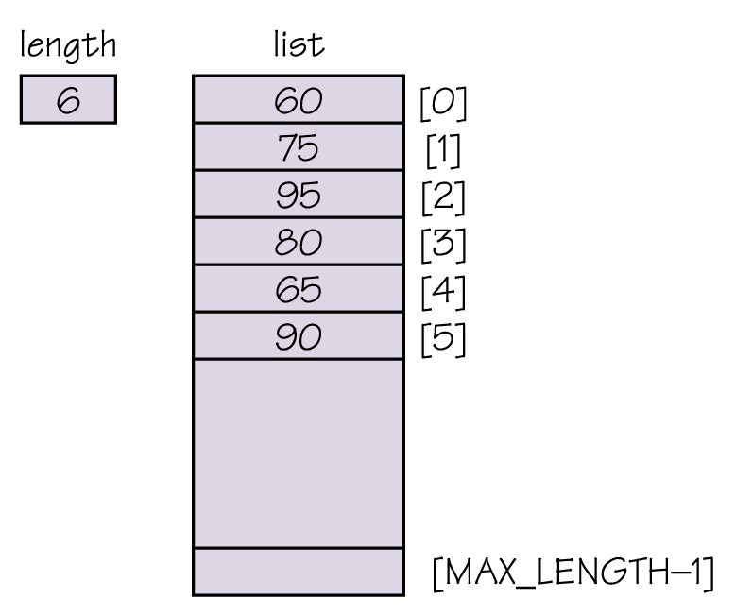
An Unsorted Array
data[0]...data[length-1]
is of interest

Slide 32
Composite Data Types
Fill array numbers with limit values
integer data[20]
Write “How many values?”
Read length
Set index to 0
WHILE (index < length)
Read data[index]
Set index to index + 1

Slide 33
Sequential Search of an Unsorted Array
A sequential search examines each item in turn and compares it to the one we are searching.
If it matches, we have found the item. If not, we look at the next item in the array.
We stop either when we have found the item or when we have looked at all the items and not found a match
Thus, a loop with two ending conditions

Slide 34
Sequential Search Algorithm
Set Position to 0
Set found to FALSE
WHILE (position < length AND NOT found )
IF (numbers [position] equals searchitem)
Set Found to TRUE
ELSE
Set position to position + 1

Slide 35
Booleans
Boolean Operators
A Boolean variable is a location in memory that can contain either true or false
Boolean operator AND returns TRUE if both operands are true and FALSE otherwise
Boolean operator OR returns TRUE if either operand is true and FALSE otherwise
Boolean operator NOT returns TRUE if its operand is false and FALSE if its operand is true

Slide 36
Sorted Arrays
The values stored in an array have unique keys of a type for which the relational operators are defined
Sorting rearranges the elements into either ascending or descending order within the array
A sorted array is one in which the elements are in order

Slide 37
Sequential Search in a Sorted Array
If items in an array are sorted, we can stop looking when we pass the place where the item would be it were present in the array
Is this better?

Slide 38
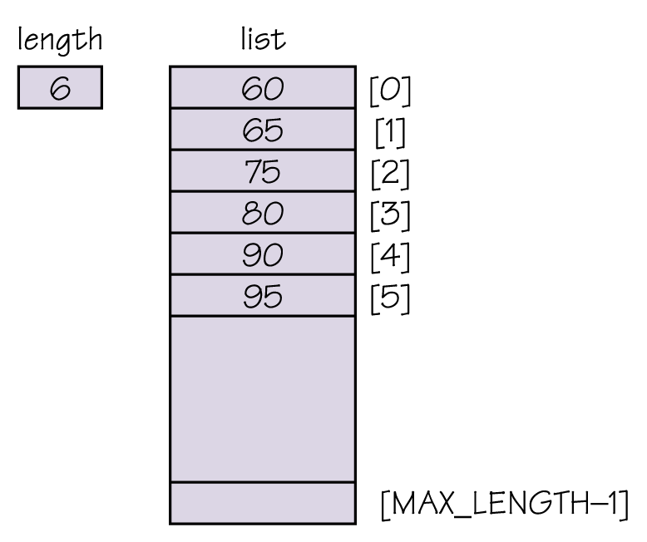
A Sorted Array
A sorted array of
integers

Slide 39
A Sorted Array
Read in array of values
Write “Enter value for which to search”
Read searchItem
Set found to TRUE if searchItem is there
IF (found)
Write “Item is found”
ELSE
Write “Item is not found”

Slide 40
A Sorted Array
Set found to TRUE if searchItem is there
Set index to 0
Set found to FALSE
WHILE (index < length AND NOT found)
IF (data[index] equals searchItem)
Set found to TRUE
ELSE IF (data[index] > searchItem)
Set index to length
ELSE
Set index to index + 1

Slide 41
Binary Search
Sequential search
Search begins at the beginning of the list and continues until the item is found or the entire list has been searched
Binary search (list must be sorted)
Search begins at the middle and finds the item or eliminates half of the unexamined items; process is repeated on the half where the item might be
Say that again…

Slide 42
Binary Search
Set first to 0
Set last to length-1
Set found to FALSE
WHILE (first <= last AND NOT found)
Set middle to (first + last)/ 2
IF (item equals data[middle]))
Set found to TRUE
ELSE
IF (item < data[middle])
Set last to middle – 1
ELSE
Set first to middle + 1
RETURN found

Slide 43
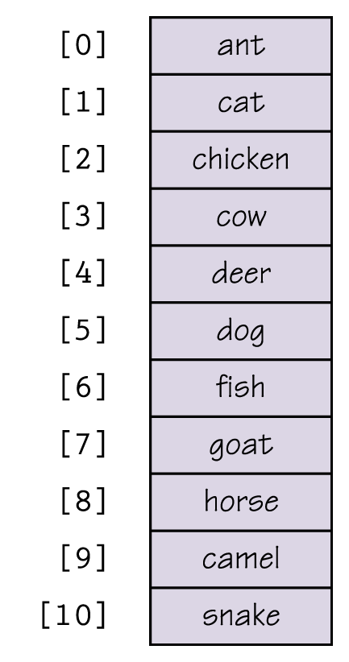
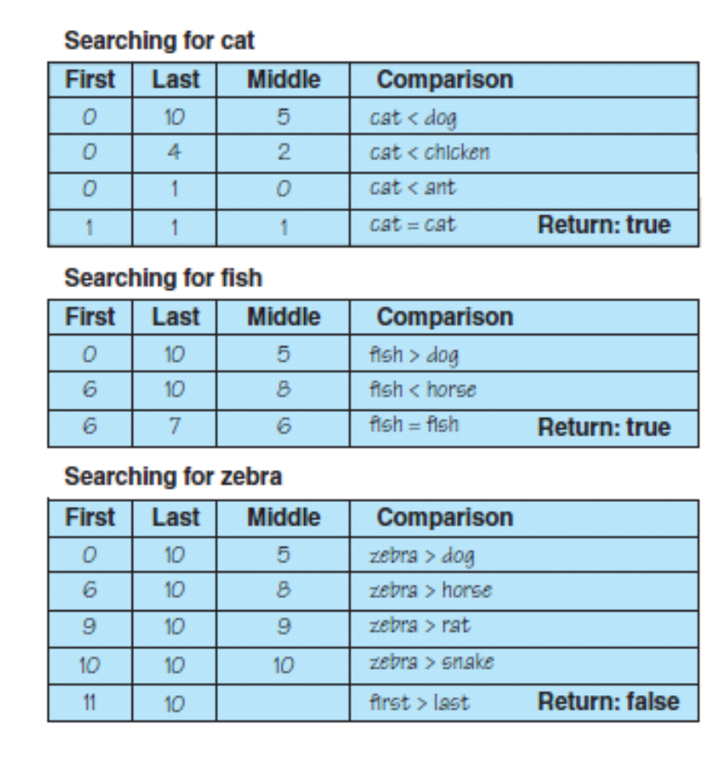
Binary Search
Figure 7.10 Trace of the binary search

Slide 44
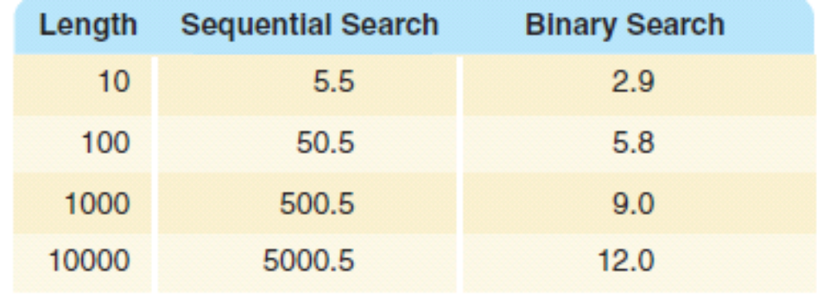
Binary Search
Table 7.1 Average Number of Comparisons
Is a binary search
always better?

Slide 45
Sorting
Sorting
Arranging items in a collection so that there is an ordering on one (or more) of the fields in the items
Sort Key
The field (or fields) on which the ordering is based
Sorting algorithms
Algorithms that order the items in the collection based on the sort key
Why is sorting important?

Slide 46
Selection Sort
Given a list of names, put them in alphabetical order
  Find the name that comes first in the alphabet,
  and write it on a second sheet of paper
  Cross out the name off the original list
  Continue this cycle until all the names on the original list have been crossed out and written onto the second list, at which point the second list contains the same items but in sorted order

Slide 47
Selection Sort
A slight adjustment to this manual approach does away with the need to duplicate space
  As you cross a name off the original list, a free space opens up
  Instead of writing the value found on a second list, exchange it with the value currently in the position where the crossed-off item should go

Slide 48
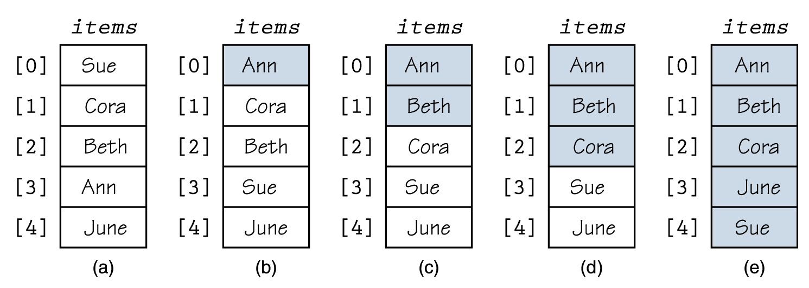
Selection Sort
Figure 7.11 Example of a selection sort (sorted elements are shaded)

Slide 49
Selection Sort
Selection Sort
Set firstUnsorted to 0
WHILE (not sorted yet)
Find smallest unsorted item
Swap firstUnsorted item with the smallest
Set firstUnsorted to firstUnsorted + 1
Not sorted yet
current < length – 1

Slide 50
Selection Sort
Find smallest unsorted item
Set indexOfSmallest to firstUnsorted
Set index to firstUnsorted + 1
WHILE (index <= length – 1)
IF (data[index] < data[indexOfSmallest])
Set indexOfSmallest to index
Set index to index + 1
Set index to indexOfSmallest

Slide 51
Selection Sort
Swap firstUnsorted with smallest
Set tempItem to data[firstUnsorted]
Set data[firstUnsorted] to data[indexOfSmallest]
Set data[indexOfSmallest] to tempItem

Slide 52
Bubble Sort
Bubble Sort uses the same strategy:
Find the next item
Put it into its proper place
But uses a different scheme for finding the next item
Starting with the last list element, compare successive pairs of elements, swapping whenever the bottom element of the pair is smaller than the one above it

Slide 53
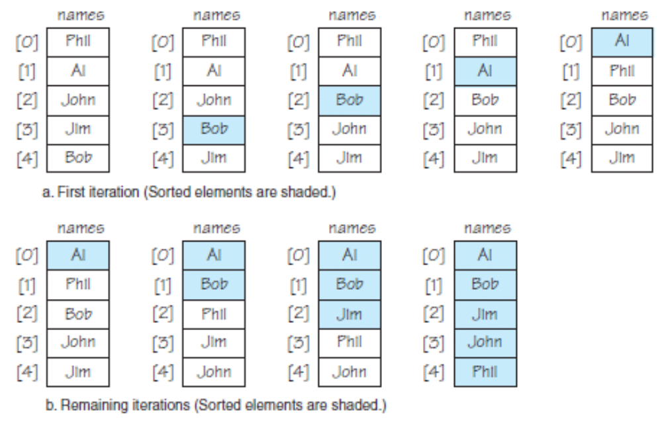
Bubble Sort

Slide 54
Bubble Sort
Bubble sort is very slow!
Can you see a way to make it faster?
Under what circumstances is bubble
sort fast?

Slide 55
Bubble Sort
Bubble Sort
Set firstUnsorted to 0
Set index to firstUnsorted + 1
Set swap to TRUE
WHILE (index < length AND swap)
Set swap to FALSE
“Bubble up” the smallest item in unsorted part
Set firstUnsorted to firstUnsorted + 1

Slide 56
Bubble Sort
Bubble up
Set index to length – 1
WHILE (index > firstUnsorted + 1)
IF (data[index] < data[index – 1])
Swap data[index] and data[index – 1]
Set swap to TRUE
Set index to index - 1

Slide 57
Insertion Sort
If you have only one item in the array, it is already sorted.
If you have two items, you can compare and swap them if necessary, sorting the first two with respect to themselves.
Take the third item and put it into its place relative to the first two
Now the first three items are sorted with respect to one another

Slide 58
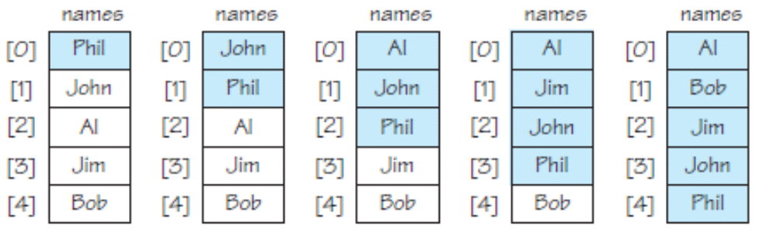
Insertion Sort
The item being added to the sorted portion can be bubbled up as in the bubble sort

Slide 59
Insertion Sort
InsertionSort
Set current to 1
WHILE (current < length)
Set index to current
Set placeFound to FALSE
WHILE (index > 0 AND NOT placeFound)
IF (data[index] < data[index – 1])
Swap data[index] and data[index – 1]
Set index to index – 1
ELSE
Set placeFound to TRUE
Set current to current + 1

Slide 60
Subprogram Statements
We can give a section of code a name and use that name as a statement in another part of the program
When the name is encountered, the processing in the other part of the program halts while the named code is executed
Remember?

Slide 61
Subprogram Statements
What if the subprogram needs data from the calling unit?
Parameters
Identifiers listed in parentheses beside the subprogram declaration; sometimes called formal parameters
Arguments
Identifiers listed in parentheses on the subprogram call; sometimes called actual parameters

Slide 62
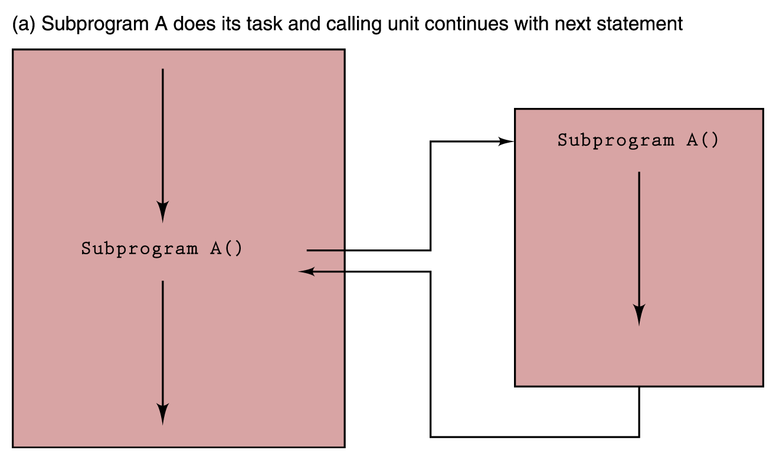
Subprogram Statements
Figure 7.14 Subprogram flow of control

Slide 63
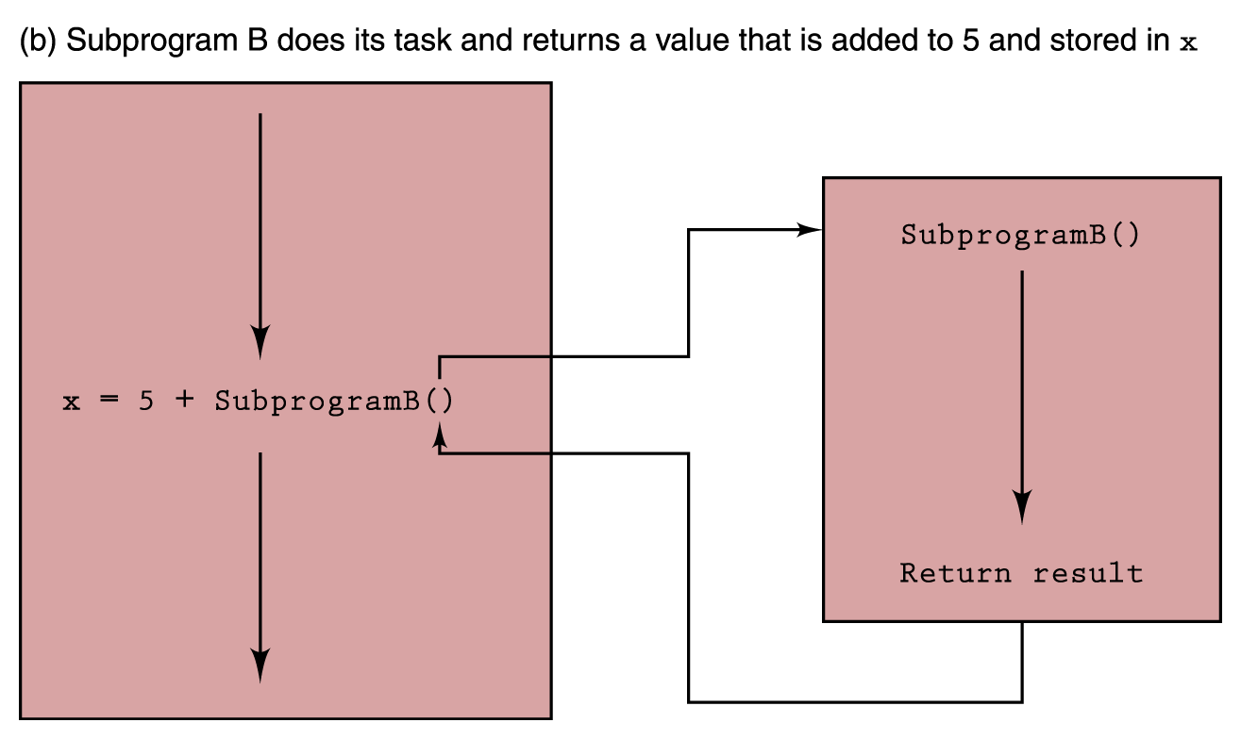
Subprogram Statements

Slide 64
Recursion
Recursion
The ability of a subprogram to call itself
Base case
The case to which we have an answer
General case
The case that expresses the solution in terms of a call to itself with a smaller version of the problem

Slide 65
Recursion
For example, the factorial of a number is defined as the number times the product of all the numbers between itself and 0:
N! = N * (N − 1)!
Base case
Factorial(0) = 1 (0! is 1)
General Case
Factorial(N) = N * Factorial(N-1)

Slide 66
Recursion
Write “Enter n”
Read n
Set result to Factorial(n)
Write result + “ is the factorial of “ + n
Factorial(n)
IF (n equals 0)
RETURN 1
ELSE
RETURN n * Factorial(n-1)

Slide 67
Recursion
BinarySearch (first, last)
IF (first > last)
RETURN FALSE
ELSE
Set middle to (first + last)/ 2
IF (item equals data[middle])
RETURN TRUE
ELSE
IF (item < data[middle])
BinarySearch (first, middle – 1)
ELSE
BinarySearch (middle + 1, last

Slide 68
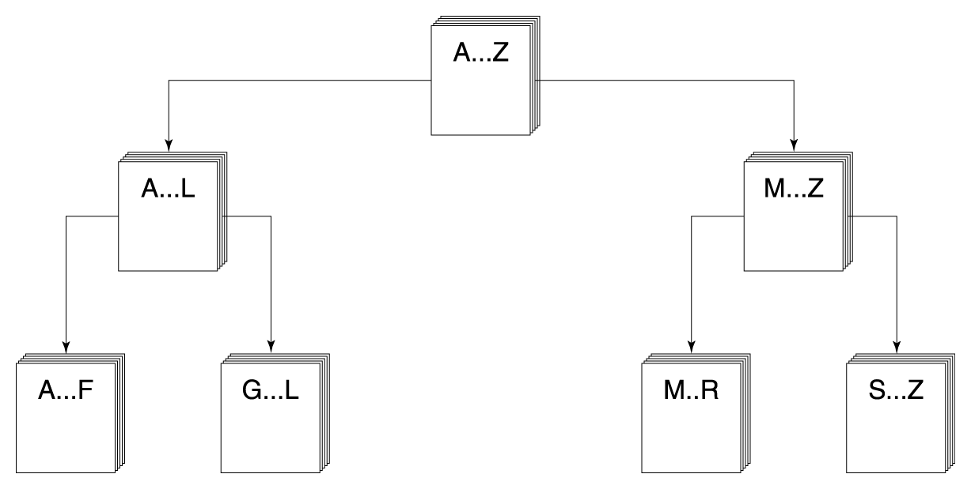
Quicksort
It is easier to sort a smaller
number of items: Sort A…F,
G…L, M…R, and S…Z and
A…Z is sorted
Ordering a list using the Quicksort algorithm

Slide 69
Quicksort algorithm
With each attempt to sort the stack of data elements, the stack is divided at a splitting value, splitVal, and the same approach is used to sort each of the smaller stacks (a smaller case)
Process continues until the small stacks do not need to be divided further (the base case)
The variables first and last in Quicksort algorithm reflect the part of the array data that is currently being processed

Slide 70
Quicksort
Quicksort(first, last)
IF (first < last) // There is more than one item
Select splitVal
Split (splitVal) // Array between first and
// splitPoint–1 <= splitVal
// data[splitPoint] = splitVal
// Array between splitPoint + 1
// and last > splitVal
Quicksort (first, splitPoint - 1)
Quicksort (splitPoint + 1, last)

Slide 71
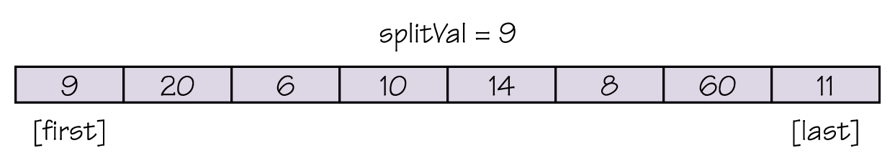
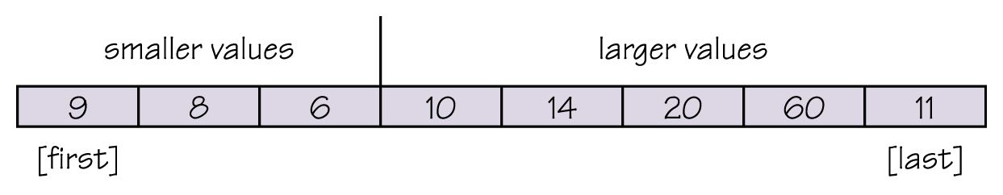
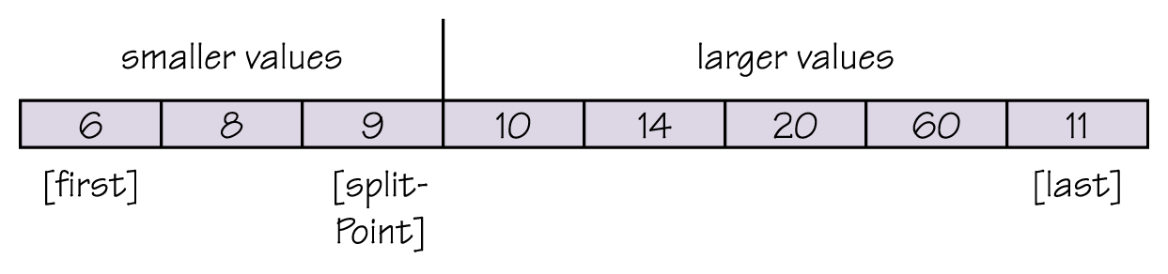
Quicksort

Slide 72
Quicksort
Split(splitVal)
Set left to first + 1
Set right to last
WHILE (left <= right)
Increment left until data[left] > splitVal OR left > right
Decrement right until data[right] < splitVal
OR left > right
IF(left < right)
Swap data[left] and data[right]
Set splitPoint to right
Swap data[first] and data[splitPoint]
Return splitPoint

Slide 73
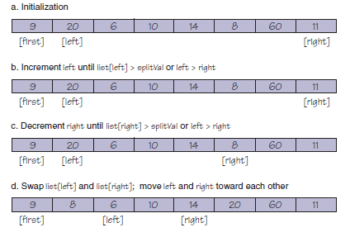
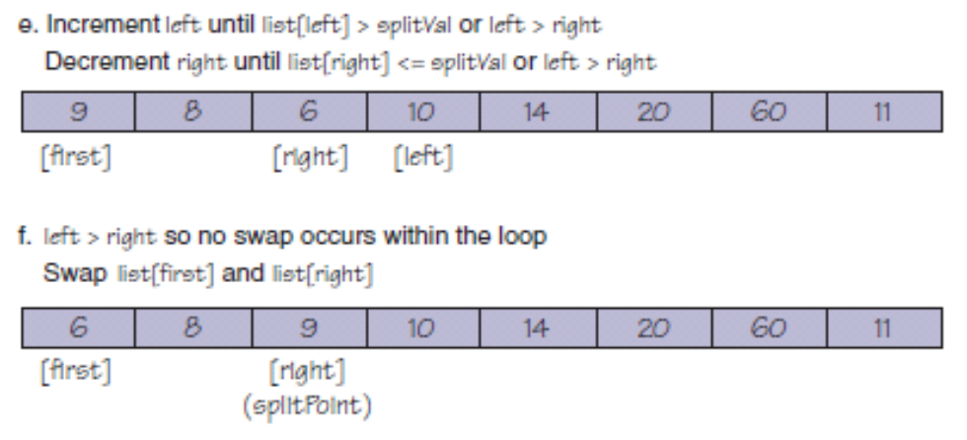
Quicksort

Slide 74
Important Threads
Information Hiding
The practice of hiding the details of a module with the goal of controlling access to it
Abstraction
A model of a complex system that includes only the details essential to the viewer
Information Hiding and Abstraction are two sides of the same coin

Slide 75
Important Threads
  Data abstraction
  Separation of the logical view of data from their implementation
  Procedural abstraction
  Separation of the logical view of actions from their implementation
  Control abstraction
  Separation of the logical view of a control structure from its implementation

Slide 76
Important Threads
Identifiers
Names given to data and actions, by which
  we access the data and
    Read firstName, Set count to count + 1
  execute the actions
    Split(splitVal)
Giving names to data and actions is a form of abstraction

Slide 77
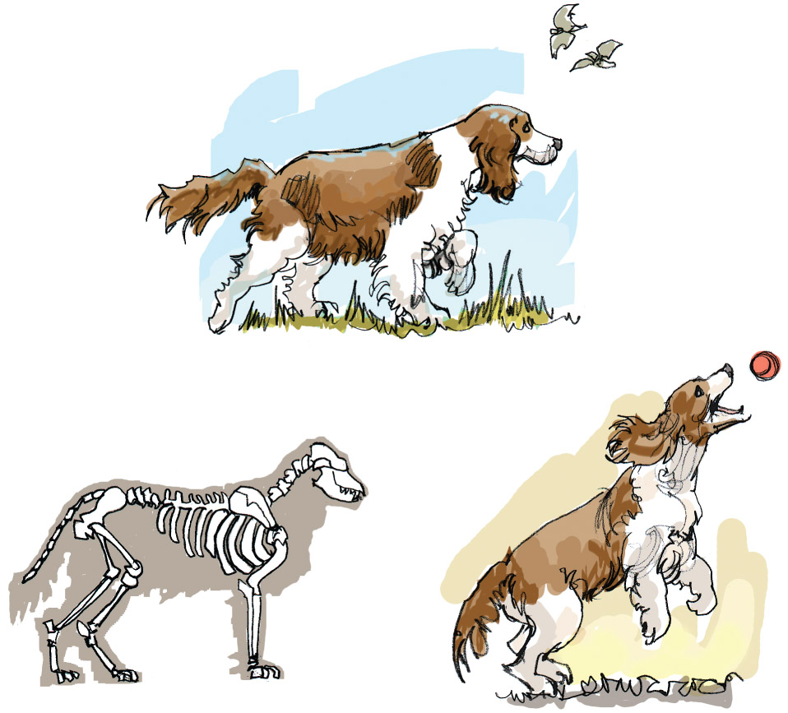
Important Threads
Abstraction is the most powerful tool people have for
managing complexity!

Slide 78
Ethical Issues
Open-Source Software Development
What are the advantages and disadvantages of open-source software?
What does the success of Linux suggest about the future of open-source software?
Should open-source software be licensed and subject to standard copyright laws?

Slide 79
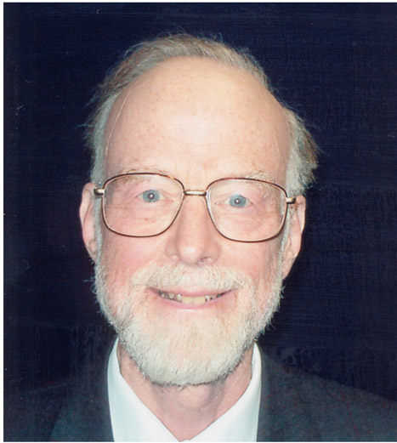
Who am I?
I was awarded
Knighthood in
1999.
What university
did I retire from
and where am
I working now?

Slide 80
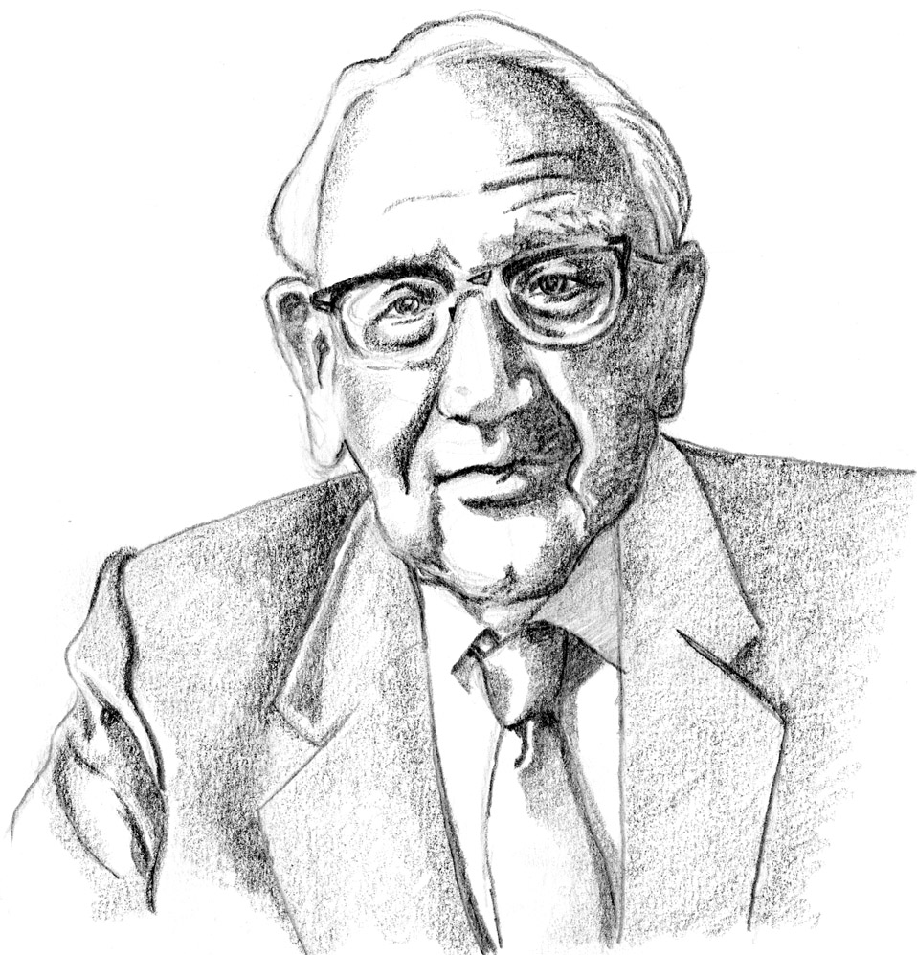
Who am I?
I am a
mathematician.
Why is my
picture in a
book about
computer
science?

Slide 81

Do you know?
What writing system did the Rosetta stone
serve as a key to translating?
Why should bloggers never post their
uncensored thoughts?
What is piggybacking? Is it ethical?

