Slide 1

Chapter 8
Abstract Data Types
and Subprograms
Notes:
Change cover and backgrounds

Slide 2
Chapter Goals
Distinguish between an array-based visualization and a linked visualization
Distinguish between an array and a list
Distinguish between and a unsorted list and a sorted list
Distinguish between the behavior of a stack and a queue
Distinguish between the binary tree and a binary search tree

Slide 3
Chapter Goals
Draw the binary search tree that is built from inserting a series of items
Understand the difference between a tree and a graph
Explain the concept of subprograms and parameters and distinguish between value and reference parameters

Slide 4
Abstract Data Types
Abstract data type
A data type whose properties (data and operations) are specified independently of any particular implementation
Remember what the most powerful tool is for managing complexity?

Slide 5
Three Views of Data
Application (user) level
View of the data within a particular problem
View sees data objects in terms of properties and behaviors

Slide 6
Three Views of Data
Logical (abstract) level
Abstract view of the data and the set of operations to manipulate them
View sees data objects as groups of objects with similar properties and behaviors

Slide 7
Three Views of Data
Implementation level
A specific representation of the structure that hold the data items and the coding of the operations in a programming language
View sees the properties represented as specific data fields and behaviors represented as methods implemented in code

Slide 8
Three Views of Data
Describe a word processor from the three views

Slide 9
Three Views of Data
Composite data type
A data type in which a name is given to a collection of data values
Data structures
The implementation of composite data fields in an abstract data type
Containers
Object’s whole role is to hold and manipulate other objects

Slide 10
Logical Implementations
Two logical implementations of containers:
Array-based implementation
Objects in the container are kept in an array
Linked-based implementation
Objects in the container are not kept physically together, but each item tells you where to go to get the next one in the structure
Did you ever play treasure hunt, a game in which each clue
told you where to go to get the next clue?

Slide 11
Stacks
Stack
An abstract data type in which accesses are made at only one end
  LIFO, which stands for Last In First Out
  The insert is called Push and the delete is called Pop
Name three everyday
structures that are stacks

Slide 12
Stacks
WHILE (more data)
Read value
Push(myStack, value)
WHILE (NOT IsEmpty(myStack))
Pop(myStack, value)
Write value
Can you hand simulate this algorithm?

Slide 13
Queues
Queue
An abstract data type in which items are entered at one end and removed from the other end
  FIFO, for First In First Out
  No standard queue terminology
    Enqueue, Enque, Enq, Enter, and Insert
    are used for the insertion operation
    Dequeue, Deque, Deq, Delete, and Remove
    are used for the deletion operation.
Name
three
everyday
structures
that are
queues

Slide 14
Queues
WHILE (more data)
Read value
Enque(myQueue, value)
WHILE (NOT IsEmpty(myQueue))
Deque(myQueue, value)
Write value
Can you hand simulate this algorithm?

Slide 15
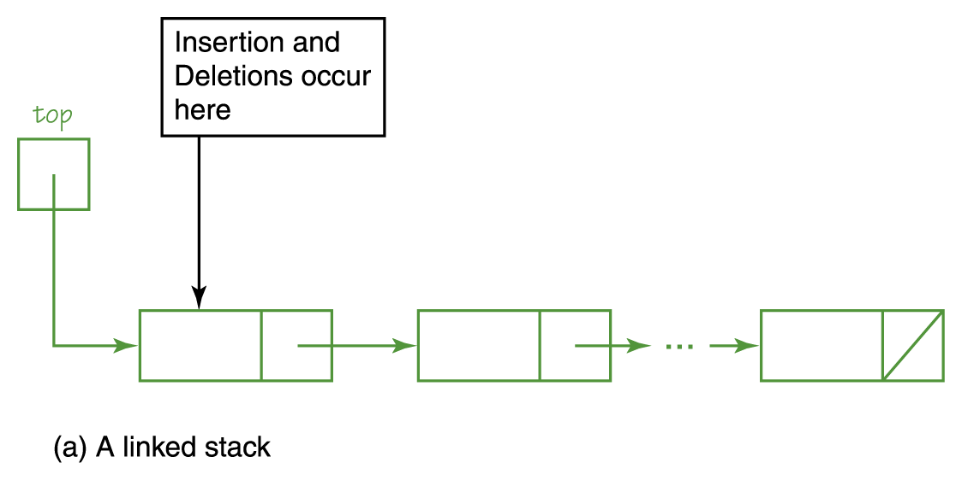
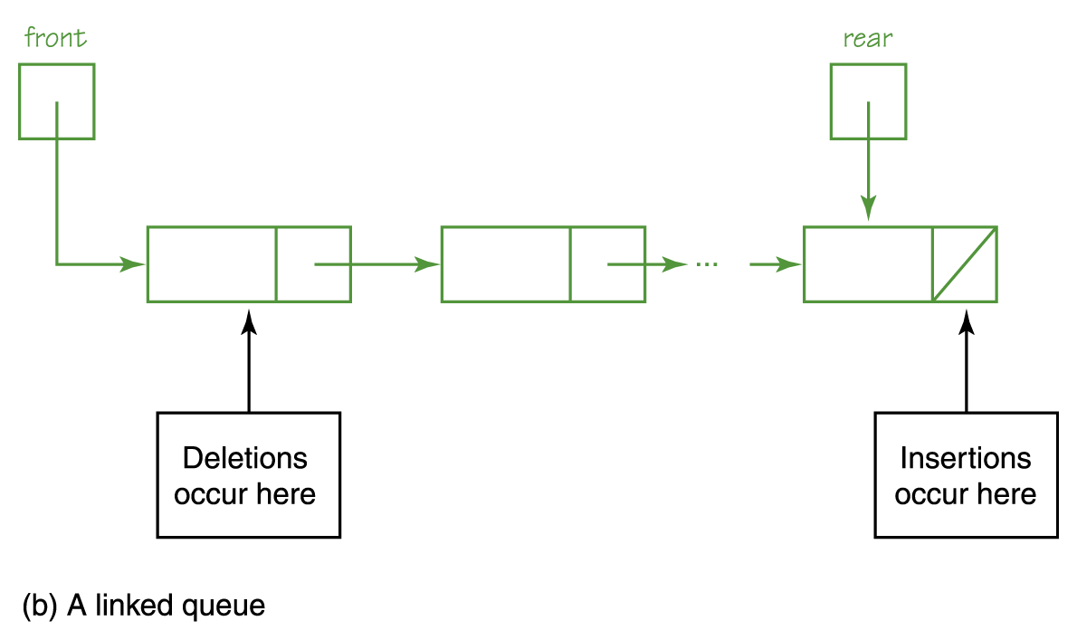
Stacks and Queues
Stack and queue visualized as linked structures

Slide 16
Lists
Think of a list as a container of items
Here are the logical operations that can be applied
to lists
  Add item Put an item into the list
  Remove item Remove an item from the list
  Get next item Get (look) at the next item
  more items Are there more items?

Slide 17
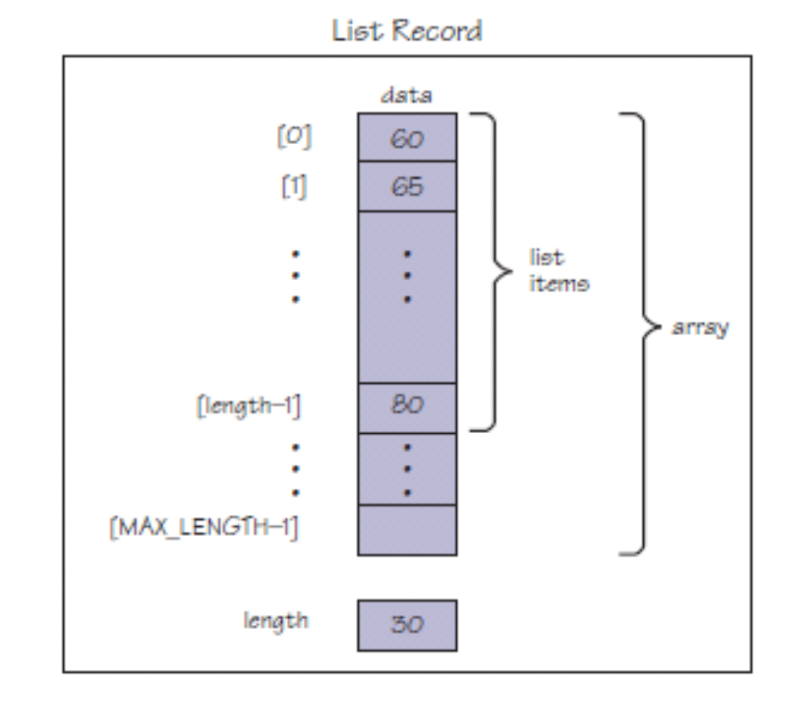
Array-Based Implementations

Slide 18
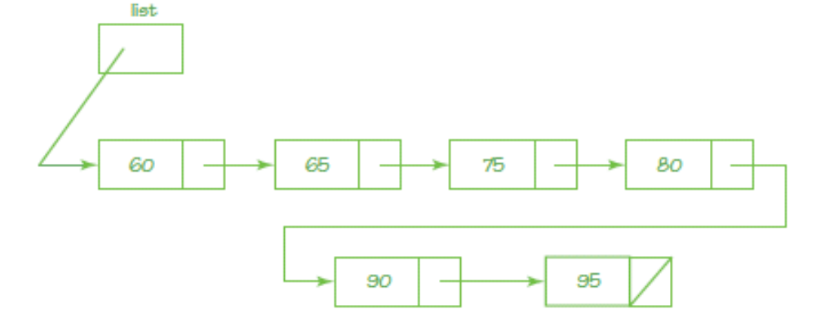
Linked Implementations

Slide 19
Algorithm for Creating and Print Items in a List
WHILE (more data)
Read value
Insert(myList, value)
Reset(myList)
Write "Items in the list are "
WHILE (moreItems(myList))
GetNext(myList, nextItem)
Write nextItem, ' '
Which implementation?

Slide 20
Logical Level
The algorithm that uses the list does not need to know how it is implemented
We have written algorithms using a stack, a queue, and a list without ever knowing the internal workings of the operations on these containers

Slide 21
Trees
Structure such as lists, stacks, and queues are linear in nature; only one relationship is being modeled
More complex relationships require more complex structures
Can you name three more complex
relationships?

Slide 22
Trees
Binary tree
A linked container with a unique starting node called the root, in which each node is capable of having two child nodes, and in which a unique path (series of nodes) exists from the root to every other node
A picture is worth a
thousands words…

Slide 23
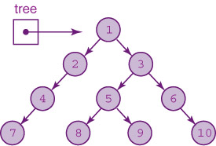
Trees
Root node
Node with two children
Node with right child
Leaf node
What is the unique path
to the node containing
5? 9? 7? …
Node with left child

Slide 24
Binary Search Trees
Binary search tree (BST)
A binary tree (shape property) that has the (semantic) property that characterizes the values in a node of a tree:
The value in any node is greater than the value in any node in its left subtree and less than the value in any node in its right subtree

Slide 25
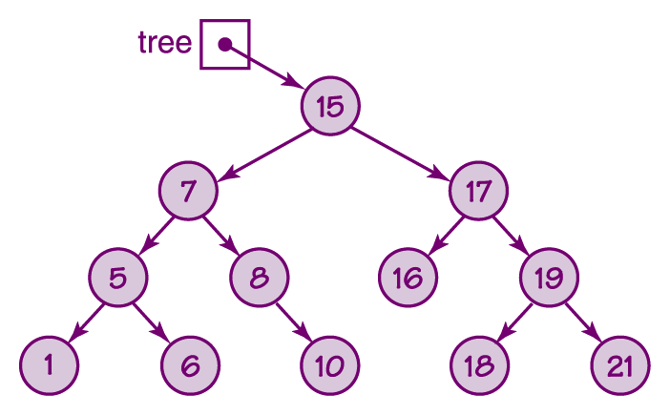
Binary Search Tree
Each node
is the root
of a subtree
made up of
its left and
right children
Prove that this
tree is a BST
Figure 8.7 A binary search tree

Slide 26
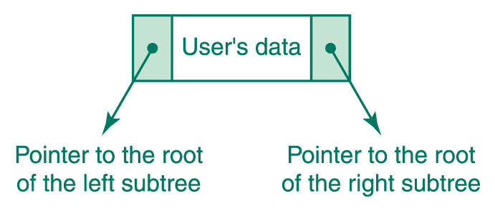
Binary Search Tree

Slide 27
Binary Search Tree
Boolean IsThere(current, item)
If (current is null)
return false
Else
Set result to item.compareTo(info(current))
If (result is equal to 0)
return true
Else
If (result < 0)
IsThere(item, left(current))
Else
IsThere(item, right(current))

Slide 28
Binary Search Tree
Trace the
nodes passed
as you search
for 18, 8, 5,
4, 9, and 15
What is special
about where
you are when
you find null?

Slide 29
Binary Search Tree
IsThere(tree, item)
IF (tree is null)
RETURN FALSE
ELSE
IF (item equals info(tree))
RETURN TRUE
ELSE
IF (item < info(tree))
IsThere(left(tree), item)
ELSE
IsThere(right(tree), item)

Slide 30
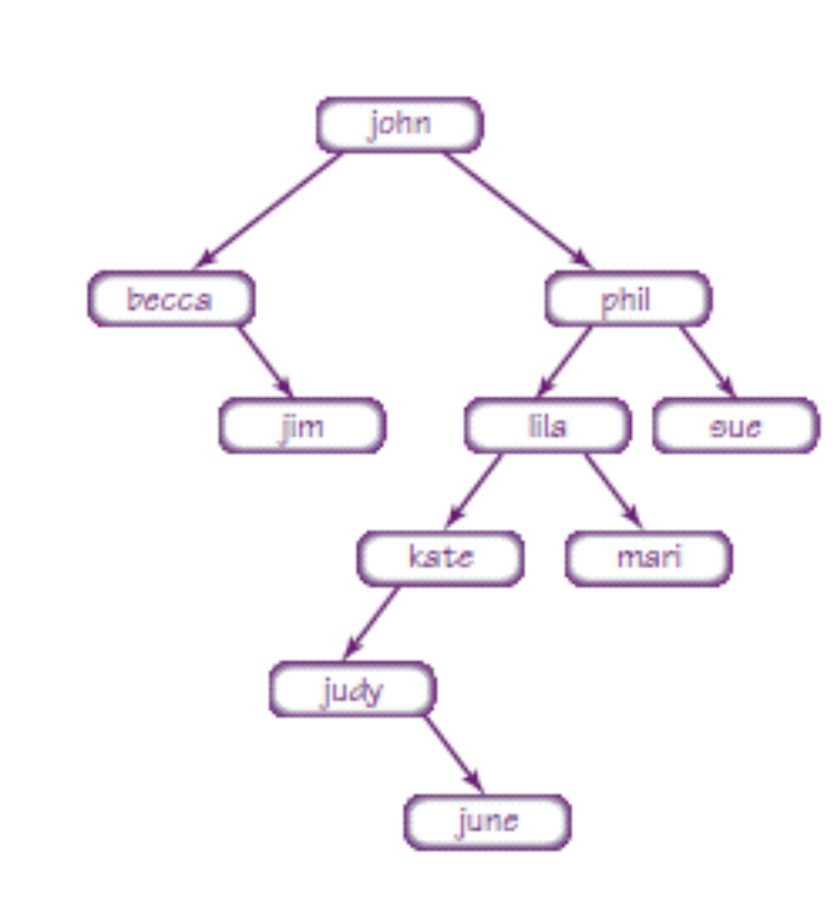
Building Binary Search Tree

Slide 31
Building Binary Search Tree
Insert(tree, item)
IF (tree is null)
Put item in tree
ELSE
IF (item < info(tree))
Insert (left(tree), item)
ELSE
Insert (right(tree), item)

Slide 32
Binary Search Tree
Print(tree)
If (tree is not null)
Print (left(tree))
Write info(tree)
Print (right(tree))
Is that all there is to it? Yes!
Remember we said that recursive
algorithms could be very powerful!

Slide 33
Graphs
Graph
A data structure that consists of a set of nodes (called vertices) and a set of edges that relate the nodes to each other
Undirected graph
A graph in which the edges have no direction
Directed graph (Digraph)
A graph in which each edge is directed from one vertex to another (or the same) vertex

Slide 34
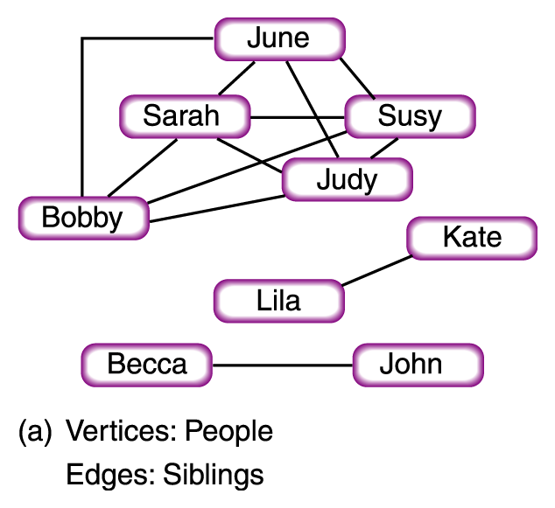
Graphs
Figure 8.10
Examples of graphs

Slide 35
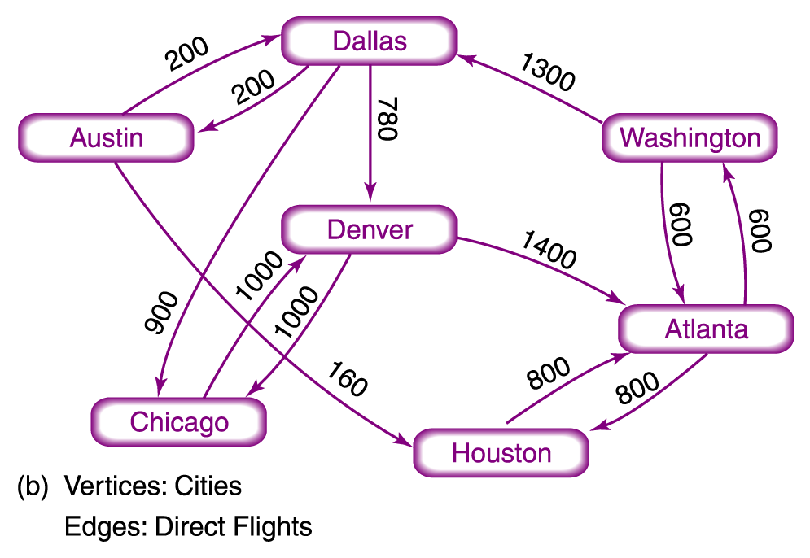
Graphs
Figure 8.10
Examples of graphs

Slide 36
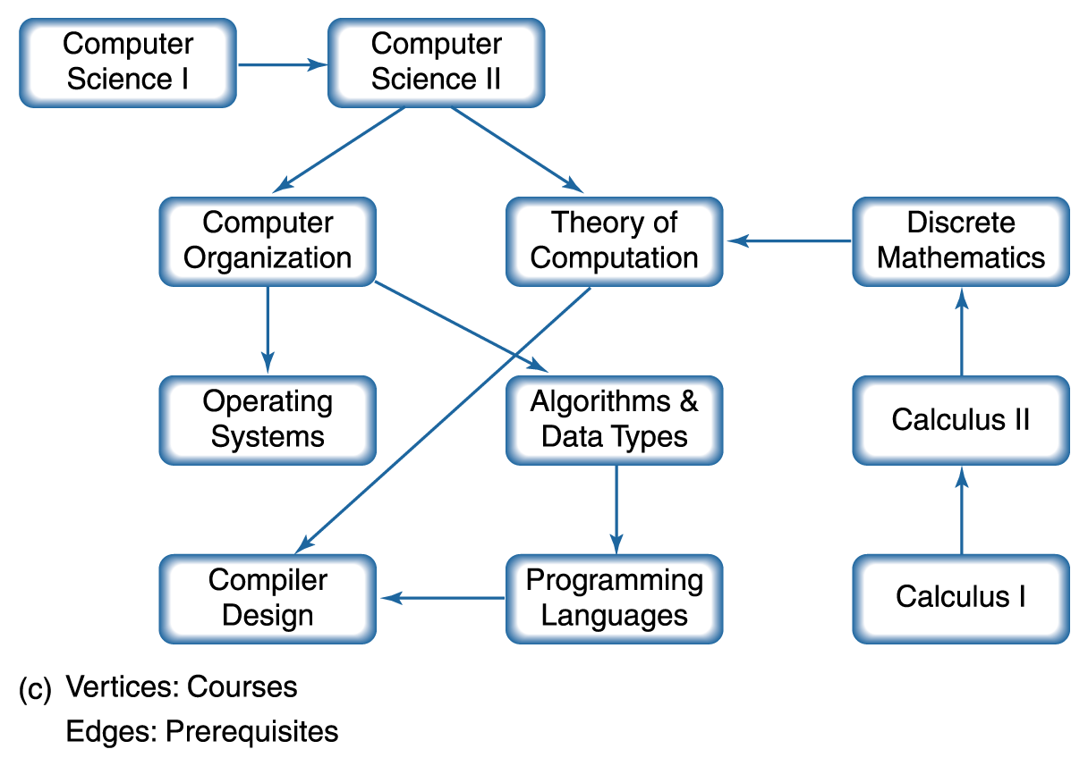
Graphs
Figure 8.10
Examples of graphs

Slide 37
Graph Algorithms
A Depth-First Searching Algorithm--Given a starting vertex and an ending vertex, we can develop an algorithm that finds a path from startVertex to endVertex
This is called a depth-first search because we start at a given vertex and go to the deepest branch and explore as far down one path before taking alternative choices at earlier branches

Slide 38
Depth First Search(startVertex, endVertex)
Set found to FALSE
Push(myStack, startVertex)
WHILE (NOT IsEmpty(myStack) AND NOT found)
Pop(myStack, tempVertex)
IF (tempVertex equals endVertex)
Write endVertex
Set found to TRUE
ELSE IF (tempVertex not visited)
Write tempVertex
Push all unvisited vertexes adjacent with tempVertex
Mark tempVertex as visited
IF (found)
Write "Path has been printed"
ELSE
Write "Path does not exist")

Slide 39
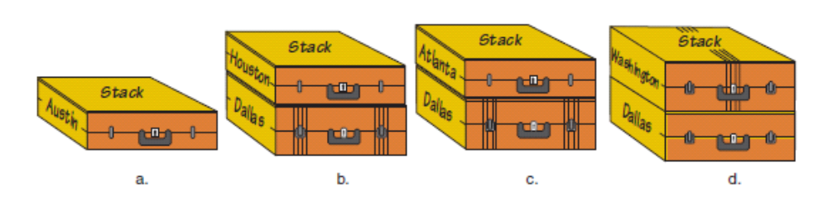
Can we get from Austin to Washington?
Figure 8.11 Using a stack to store the routes

Slide 40
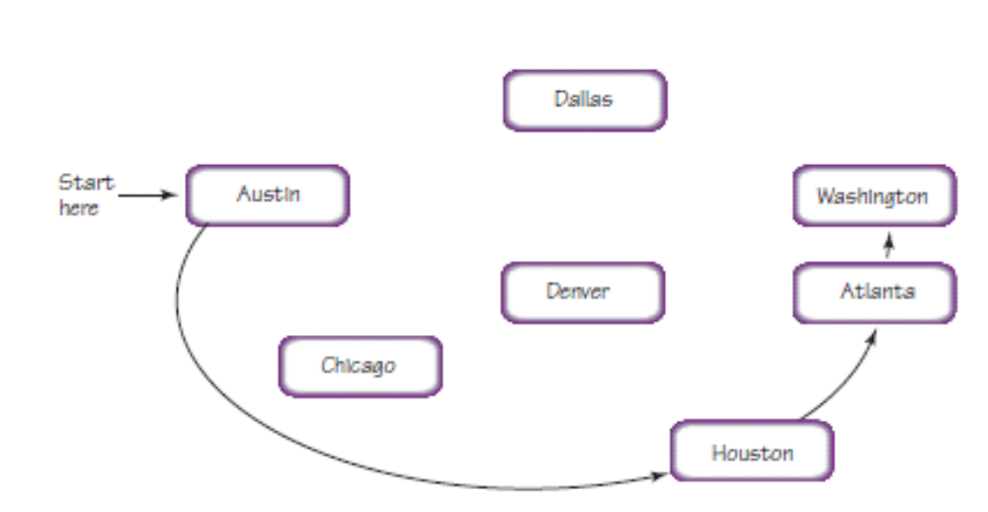
Can we get from Austin to Washington?
Figure 8.12, The depth-first search

Slide 41
Breadth-First Search
What if we want to answer the question of how to get from City X to City Y with the fewest number of airline stops?
A Breadth-First Search answers this question
A Breadth-First Search examines all of the vertices adjacent with startVertex before looking at those adjacent with those adjacent to these vertices
A Breadth-First Search uses a queue, not a stack, to answer this above question Why??

Slide 42
Breadth First Search(startVertex, endVertex)
Set found to FALSE
Enque(myQueue, startVertex)
WHILE (NOT IsEmpty(myQueue) AND NOT found)
Deque(myQueue, tempVertex)
IF (tempVertex equals endVertex)
Write endVertex
Set found to TRUE
ELSE IF (tempVertex not visited)
Write tempVertex
Enque all unvisited vertexes adjacent with tempVertex
Mark tempVertex as visited
IF (found)
Write "Path has been printed"
ELSE
Write "Path does not exist"

Slide 43
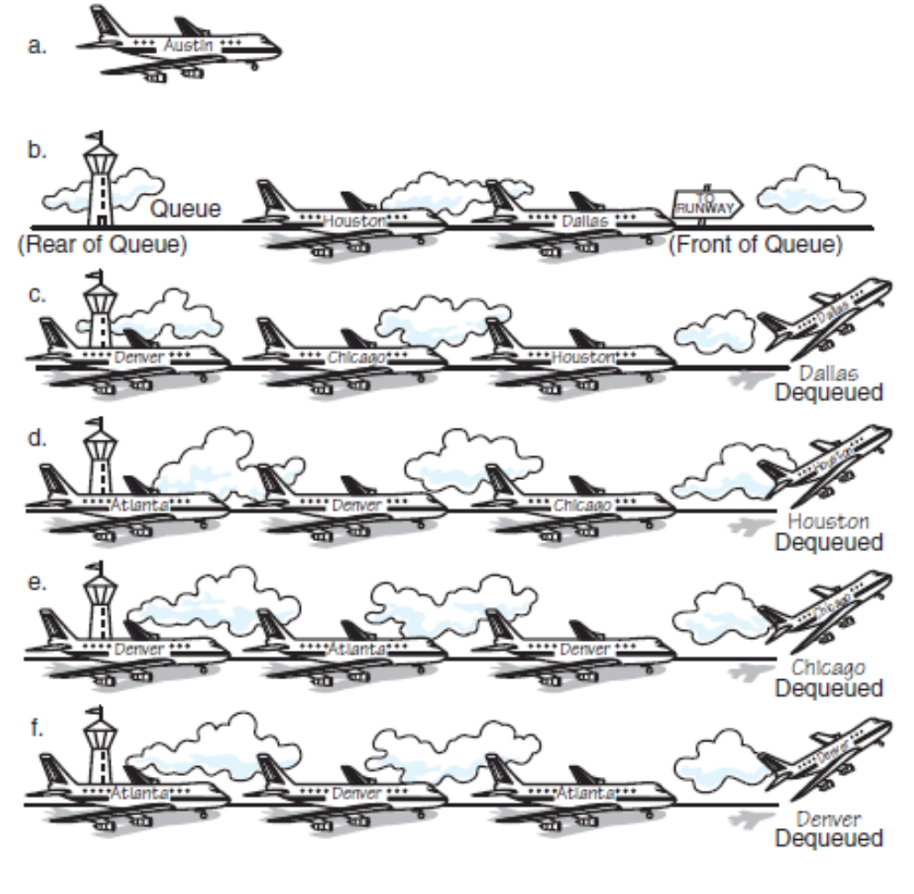
How can I get from Austin to Washington in the fewest number of stops?
Figure 8.13 Using a queue to store the routes

Slide 44
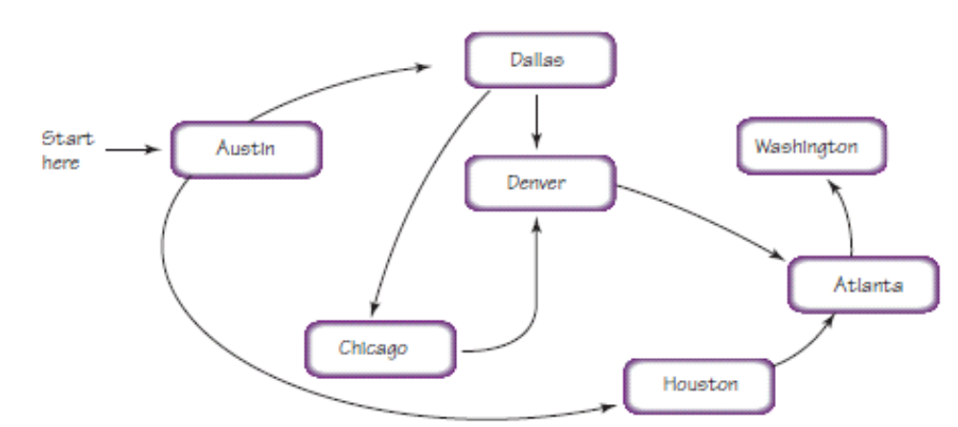
Breadth-First Search Traveling from Austin to Washington, DC
Figure 8.14, The Breadth-First Search

Slide 45
Subprogram Statements
We can give a section of code a name and use that name as a statement in another part of the program
When the name is encountered, the processing in the other part of the program halts while the named code is executed
Remember?

Slide 46
Subprogram Statements
What if the subprogram needs data from the calling unit?
Parameters
Identifiers listed in parentheses beside the subprogram declaration; sometimes called formal parameters
Arguments
Identifiers listed in parentheses on the subprogram call; sometimes called actual parameters

Slide 47
Subprogram Statements
Value parameter
A parameter that expects a copy of its argument to be passed by the calling unit
Reference parameter
A parameter that expects the address of its argument to be passed by the calling unit
Notes:
Insert a slide following this one with Figure 8.15

Slide 48
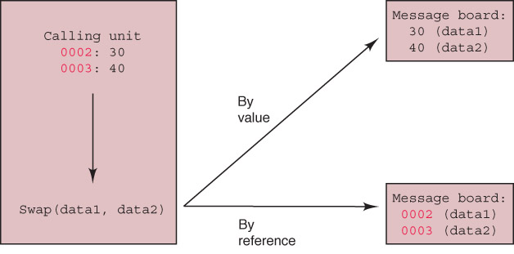
Subprogram Statements
Think of arguments as being placed on a message board

Slide 49
Subprogram Statements
Insert(list, item) // Subprogram definition
Set list.values[length-1] to item
Set list.length to list.length + 1
Insert(myList, value) // Calling statement
Which parameter must be by reference?

Slide 50
Ethical Issues
Workplace Monitoring
Do privacy rights extend to the workplace?
What is employee Internet monitoring?
Have you been monitored in the workplace?
How is email equivalent to DNA?

Slide 51
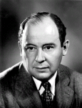
Who am I?
In the 1940s, the new
computer architecture
I developed
revolutionized the
design of computers.
Today’s computers are
referred to as [my last
name] machines
because the
architectural principles
I described have proven
very successful.
Courtesy of the U.S. Department of Energy.

Slide 52

Do you know?
What is peer-to-peer funding?
What is an EAN message?
How did the 2007 Economic Stimulus Package provide a feast day for scammer?
What is the difference between a hacker and a cracker?

