Slide 1

Chapter 13
Artificial Intelligence

Slide 2
Chapter Goals
Distinguish between the types of problems that humans do best and those that computers do best
Explain the Turing test
Define what is meant by knowledge representation and demonstrate how knowledge is represented in a semantic network

Slide 3
Chapter Goals
Develop a search tree for simple scenarios
Explain the processing of an expert system
Explain the processing of biological and artificial neural networks
List the various aspects of natural language processing
Explain the types of ambiguities in natural language comprehension

Slide 4
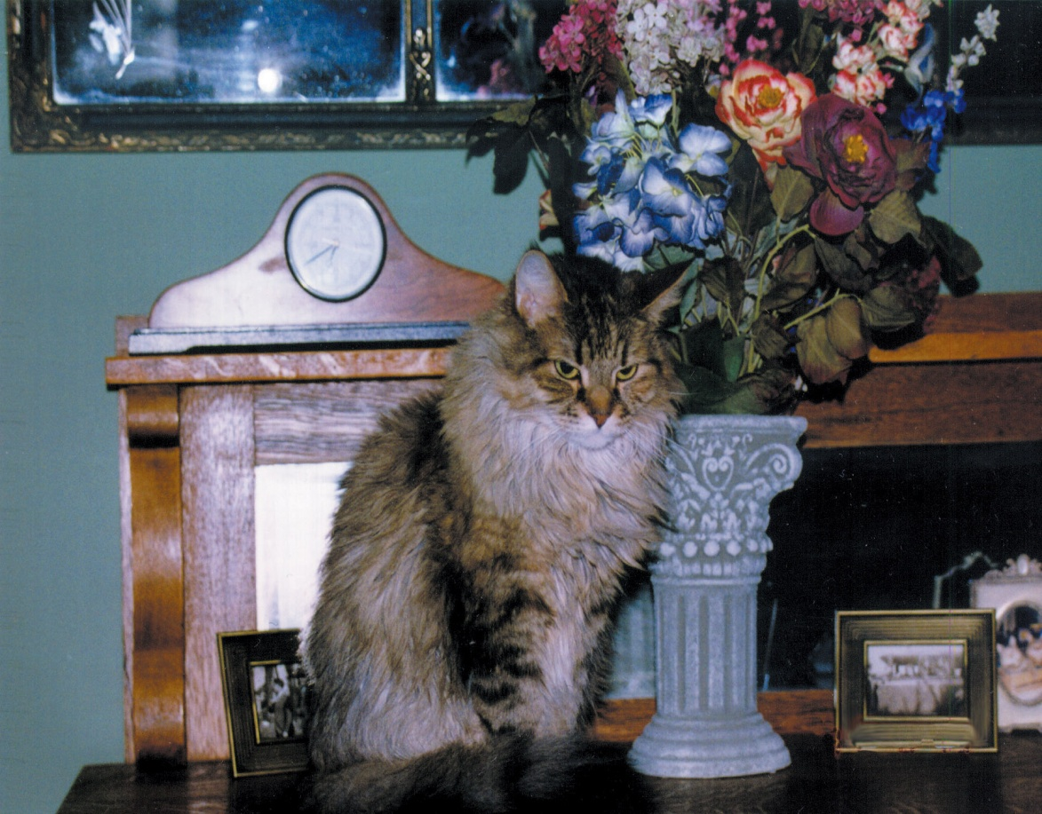
Thinking Machines
Can you
list the items
in this
picture?
Courtesy of Amy Rose.

Slide 5

Thinking Machines
Can you count
the distribution
of letters in a
book?
Add a thousand
4-digit numbers?
Match finger
prints?
Search a list of
a million values
for duplicates?
Cover Image: © Gurgen Bakhshetsyan/ShutterStock, Inc.

Slide 6
Thinking Machines
Computers do best
Humans do best
Can you count the
distribution of letters in
a book?
Add a thousand4-digit
numbers?
Match finger prints?
Search a list of a
million values
for duplicates?
Can you
list the items
in this
picture?

Slide 7
Thinking Machines
Artificial intelligence (AI)
The study of computer systems that attempt to model and apply the intelligence of the human mind
For example, writing a program to pick out objects in a picture

Slide 8
The Turing Test
Turing test
A test to empirically determine whether a computer has achieved intelligence
Alan Turing
An English mathematician who wrote a landmark paper in 1950 that asked the question: Can machines think?
He proposed a test to answer the question "How will we know when we’ve succeeded?"

Slide 9
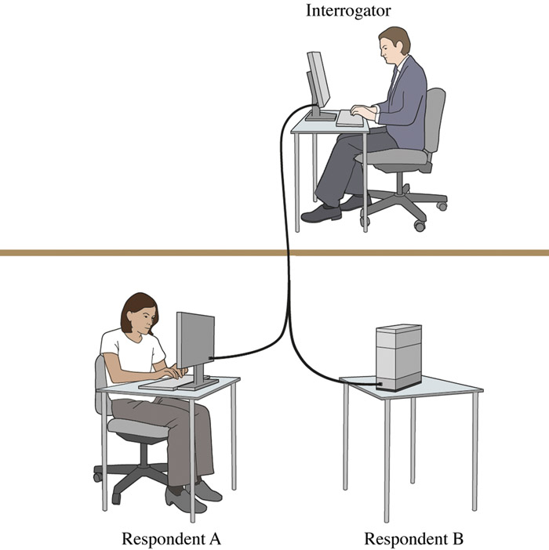
The Turing Test
Figure 13.2
In a Turing test, the interrogator must determine which respondent is the computer and which is the human

Slide 10
The Turing Test
Weak equivalence
Two systems (human and computer) are equivalent in results (output), but they do not arrive at those results in the same way
Strong equivalence
Two systems (human and computer) use the same internal processes to produce results

Slide 11
The Turing Test
Loebner prize
The first formal instantiation
of the Turing test, held
annually
Chatbots
A program designed to carry on a conversation with a human user
Has it been
won yet?

Slide 12
Knowledge Representation
How can we represent knowledge?
We need to create a logical view of the data, based on how we want to process it
Natural language is very descriptive, but does not lend itself to efficient processing
Semantic networks and search trees are promising techniques for representing knowledge

Slide 13
Semantic Networks
Semantic network
A knowledge representation technique that focuses on the relationships between objects
A directed graph is used to represent a semantic network or net
Remember directed
graphs?

Slide 14
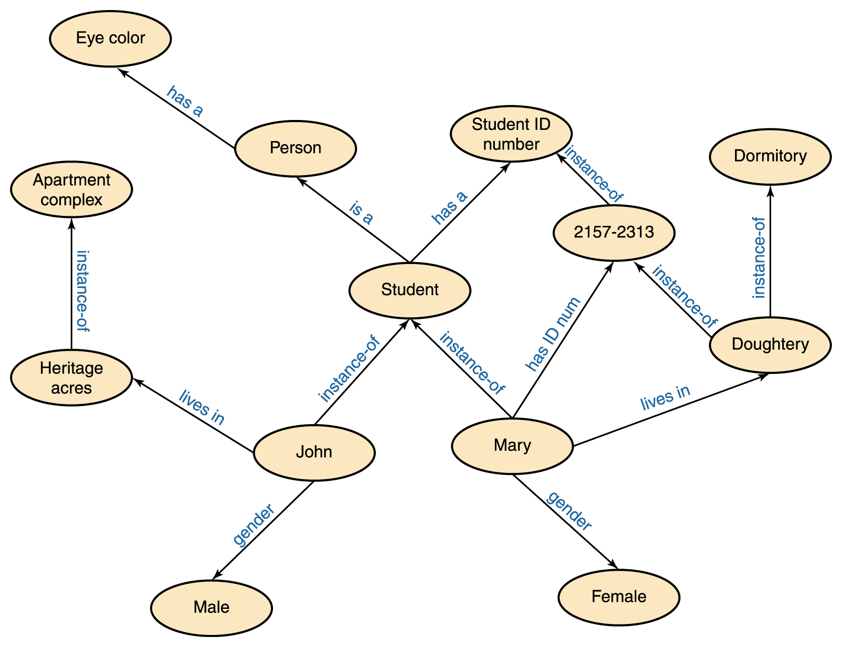
Semantic Networks

Slide 15
Semantic Networks
What questions can you ask about the data in Figure 13.3 (previous slide)?
What questions can you not ask?

Slide 16
Semantic Networks
Network Design
  The objects in the network represent the objects in the real world that we are representing
  The relationships that we represent are based on the real world questions that we would like to ask
  That is, the types of relationships represented determine which questions are easily answered, which are more difficult to answer, and which cannot be answered

Slide 17
Search Trees
Search tree
A structure that represents alternatives in adversarial situations such as game playing
The paths down a search tree represent a series of decisions made by the players
Remember trees?

Slide 18
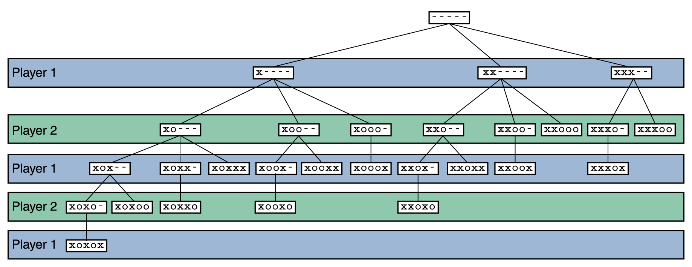
Search Trees
Figure 13.4 A search tree for a simplified version of Nim

Slide 19
Search Trees
Search tree analysis can be applied to other, more complicated games such as chess
However, full analysis of the chess search tree would take more than your lifetime to determine the first move
Because these trees are so large, only a fraction of the tree can be analyzed in a reasonable time limit, even with modern computing power
Therefore, we must find a way to prune the tree

Slide 20
Search Trees
Techniques for pruning search space
Depth-first
A technique that involves searching down the paths of a tree prior to searching across levels
Breadth-first
A technique that involves searching across levels of a tree prior to searching down specific paths
Breadth-first tends to yield the best results

Slide 21
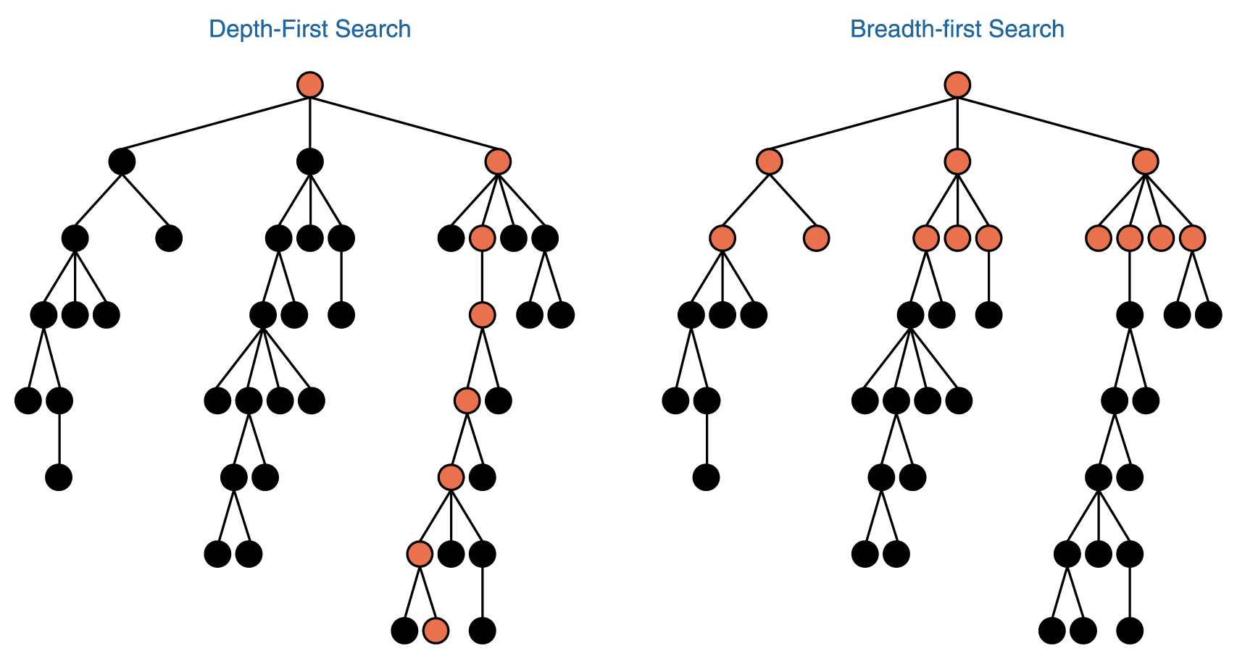
Search Trees
Figure 13.5 Depth-first and breadth-first searches

Slide 22
Expert Systems
Knowledge-based system
Software that uses a specific set of information, from which it extracts and processes particular pieces
Expert system
A software system based on the knowledge of human experts; it is a
  Rule-based system A software system based on a set of if-then rules
  Inference engine The software that processes rules to draw conclusions

Slide 23
Expert Systems
Named abbreviations that represent conclusions
  NONE—apply no treatment at this time
  TURF—apply a turf-building treatment
  WEED—apply a weed-killing treatment
  BUG—apply a bug-killing treatment
  FEED—apply a basic fertilizer treatment
  WEEDFEED—apply a weed-killing and fertilizer combination treatment

Slide 24
Expert Systems
Boolean variables needed to represent state of the lawn
  BARE—the lawn has large, bare areas
  SPARSE—the lawn is generally thin
  WEEDS—the lawn contains many weeds
  BUGS—the lawn shows evidence of bugs

Slide 25
Expert Systems
Data that is available
  LAST—the date of the last lawn treatment
  CURRENT—current date
  SEASON—the current season
  Now we can formulate some rules for our
  gardening expert system.
  Rules take the form of if-then statements

Slide 26
Expert Systems
Some rules
  if (CURRENT – LAST < 30) then NONE
  if (SEASON = winter) then not BUGS
  if (BARE) then TURF
  if (SPARSE and not WEEDS) then FEED
  if (BUGS and not SPARSE) then BUG
  if (WEEDS and not SPARSE) then WEED
  if (WEEDS and SPARSE) then WEEDFEED

Slide 27
Expert Systems
An execution of our inference engine
  System: Does the lawn have large, bare areas?
  User: No
  System: Does the lawn show evidence of bugs?
  User: No
  System: Is the lawn generally thin?
  User: Yes
  System: Does the lawn contain significant weeds?
  User: Yes
  System: You should apply a weed-killing and fertilizer combination treatment.

Slide 28
Artificial Neural Network
Artificial neural networks
A computer representation of knowledge that attempts to mimic the neural networks of the human body
Yes, but what is a human neural network?

Slide 29
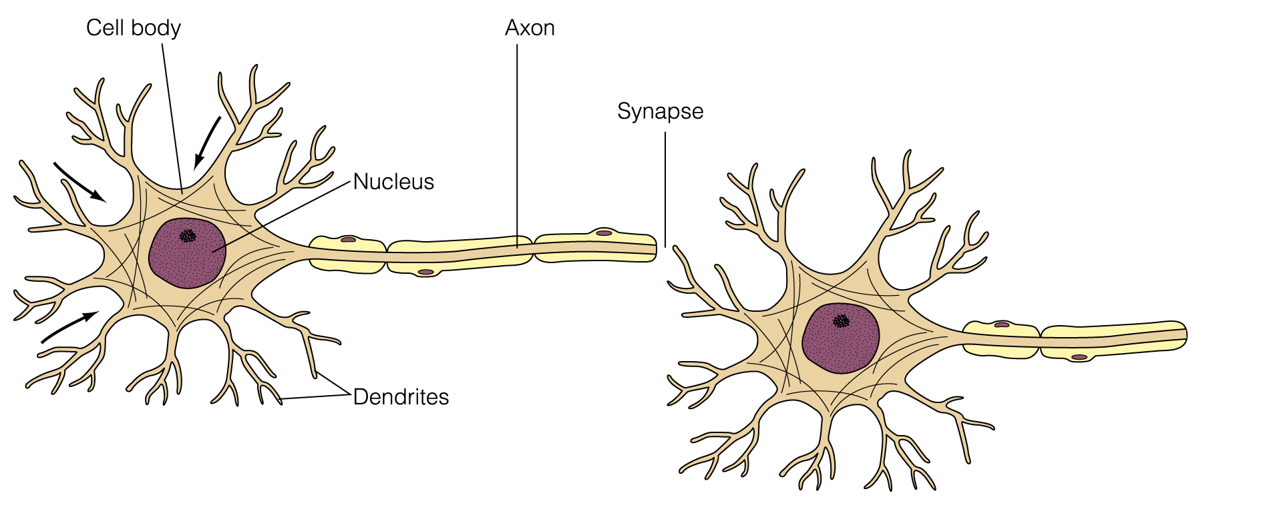
Neural Network
Figure 13.6 A biological neuron
Notes:
replace with new figure

Slide 30
Neural Network
Neuron
A single cell that conducts a chemically-based electronic signal
At any point in time a neuron is in either an excited state or an inhibited state
Excited state
Neuron conducts a strong signal
Inhibited state
Neuron conducts a weak signal

Slide 31
Neural Network
Pathway
A series of connected neurons
Dendrites
Input tentacles
Axon
Primary output tentacle
Synapse
Space between axon and a dendrite

Slide 32
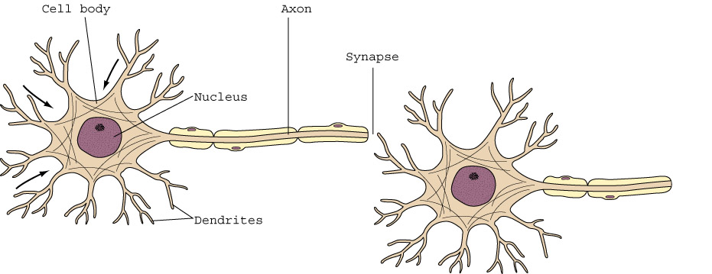
Neural Network
Chemical composition of a synapse tempers
the strength of its input signal
A neuron accepts many input signals, each
weighted by corresponding synapse

Slide 33
Neural Network
The pathways along the neural nets are in a constant state of flux
As we learn new things, new strong neural pathways in our brain are formed

Slide 34
Artificial Neural Networks
Each processing element in an artificial neural net is analogous to a biological neuron
  An element accepts a certain number of input values (dendrites) and produces a single output value (axon) of either 0 or 1
  Associated with each input value is a numeric weight (synapse)

Slide 35
Artificial Neural Networks
  The effective weight of the element is the sum of the weights multiplied by their respective input values
    v1 * w1 + v2 * w2 + v3 * w3
  Each element has a numeric threshold value
  If the effective weight exceeds the threshold, the unit produces an output value of 1
  If it does not exceed the threshold, it produces an output value of 0

Slide 36
Artificial Neural Networks
Training
The process of adjusting the weights and threshold values in a neural net
How does this all work?
Train a neural net to recognize a cat in a picture
Given one output value per pixel, train network to produce an output value of 1 for every pixel that contributes to the cat and 0 for every one that doesn't

Slide 37
Natural Language Processing
Three basic types of processing occur during human/ computer voice interaction
Voice synthesis
Using a computer to recreate the sound of human speech
Voice recognition
Using a computer to recognize the words spoken by a human
Natural language comprehension
Using a computer to apply a meaningful interpretation to human communication

Slide 38
Voice Synthesis
One Approach to Voice Synthesis
Dynamic voice generation
A computer examines the letters that make up a word and produces the sequence of sounds that correspond to those letters in an attempt to vocalize the word
Phonemes
The sound units into which human speech has been categorized

Slide 39
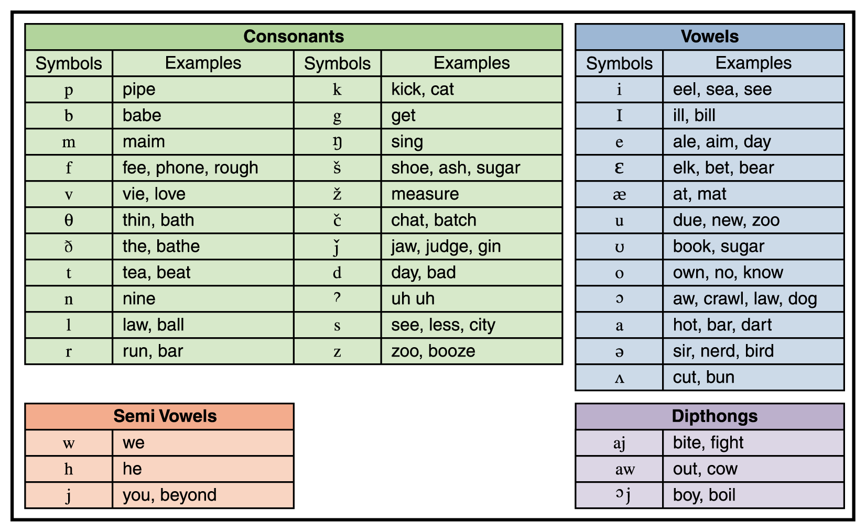
Voice Synthesis
Figure 13.7 Phonemes for American English

Slide 40
Voice Synthesis
Another Approach to Voice Synthesis
Recorded speech
A large collection of words is recorded digitally and individual words are selected to make up a message
Many words must be recorded more than once to reflect different pronunciations and inflections
Common for phone message:
For Nell Dale, press 1
For John Lewis, press 2

Slide 41
Voice Recognition
Problems with understanding speech
  Each person's sounds are unique
  Each person's shape of mouth, tongue, throat, and nasal cavities that affect the pitch and resonance of our spoken voice are unique
  Speech impediments, mumbling, volume, regional accents, and the health of the speaker are further complications

Slide 42
Voice Recognition
Other problems
  Humans speak in a continuous, flowing manner, stringing words together
  Sound-alike phrases like “ice cream” and “I scream”
  Homonyms such as “I” & “eye” or “see” & “sea”
Humans clarify these situations by context, but that requires another level of comprehension
Voice-recognition systems still have trouble with continuous speech

Slide 43
Voice Recognition
Voiceprint
The plot of frequency changes over time representing the sound of human speech
A human trains a voice-recognition system by speaking a word several times so the computer gets an average voiceprint for a word
Used to authenticate the declared
sender of a voice message

Slide 44
Natural Language Comprehension
Natural language is ambiguous!
Lexical ambiguity
The ambiguity created when words have multiple meanings
Syntactic ambiguity
The ambiguity created when sentences can be constructed in various ways
Referential ambiguity
The ambiguity created when pronouns could be applied to multiple objects

Slide 45
Natural Language Comprehension
What does this sentence mean?
  Time flies like an arrow.
  Time goes by quickly
  Time flies (using a stop watch) as you would time an arrow
  Time flies (a kind of fly) are fond of an arrow
Silly?
Yes, but a computer
wouldn't know that

Slide 46
Natural Language Comprehension
Lexical ambiguity
  Stand up for your country.
  Take the street on the left.
Syntactic ambiguity
  I saw the bird watching from the corner.
  I ate the sandwich sitting on the table.
Referential ambiguity
  The bicycle hit the curb, but it was not damaged.
  John was mad at Bill, but he didn't care.
Can you think
of
some others?

Slide 47
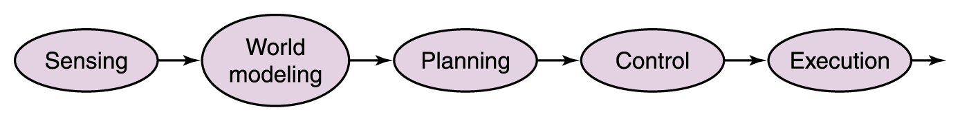
Robotics
Mobile robotics
The study of robots that move relative to their environment, while exhibiting a degree of autonomy
Sense-plan-act (SPA) paradigm
The world of the robot is represented in a complex semantic net in which the sensors on the robot are used to capture the data to build up the net
Figure 13.8 The sense-plan-act (SPA) paradigm

Slide 48
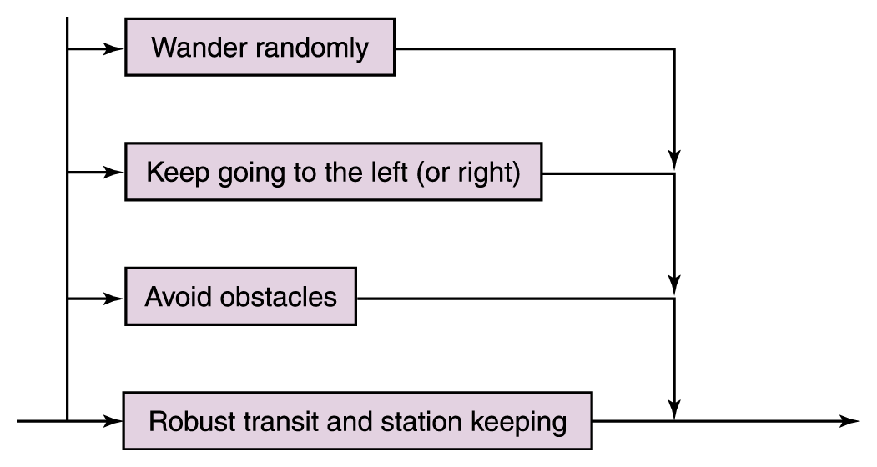
Subsumption Architecture
Rather than trying to model the entire world all the time, the robot is given a simple set of behaviors each associated with the part of the world necessary for that behavior
Figure 13.9
The new control paradigm

Slide 49
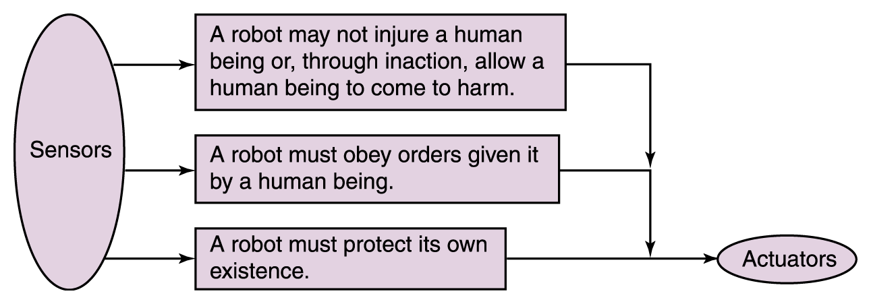
Subsumption Architecture
Figure 13.10 Asimov’s laws of robotics are ordered.

Slide 50
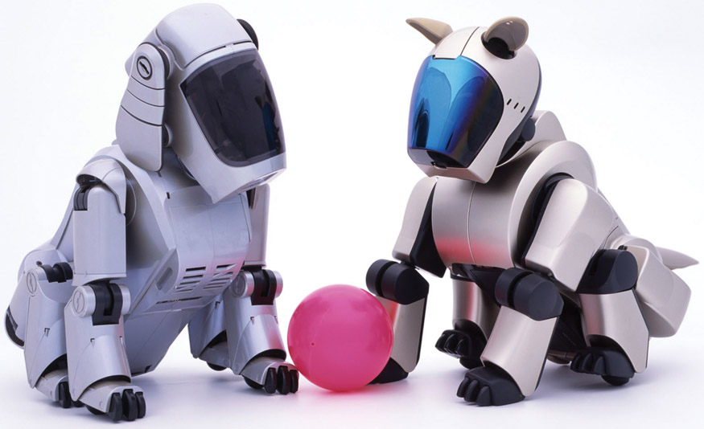
Robots
Sony's Aibo
© Chris Willson/Alamy

Slide 51
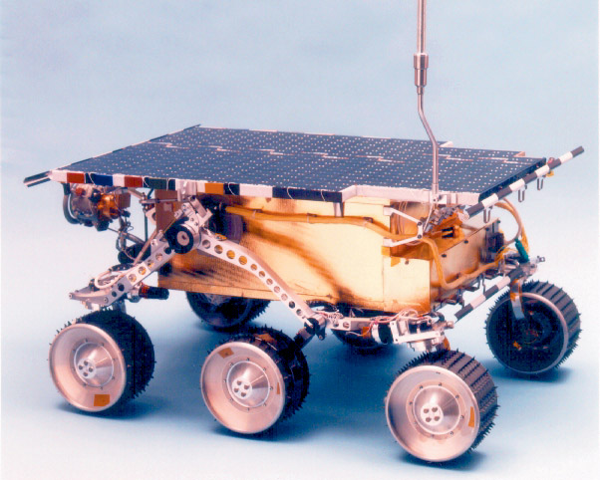
Robots
Sojourner
Rover
Courtesy of NASA/JPL-Caltech.

Slide 52
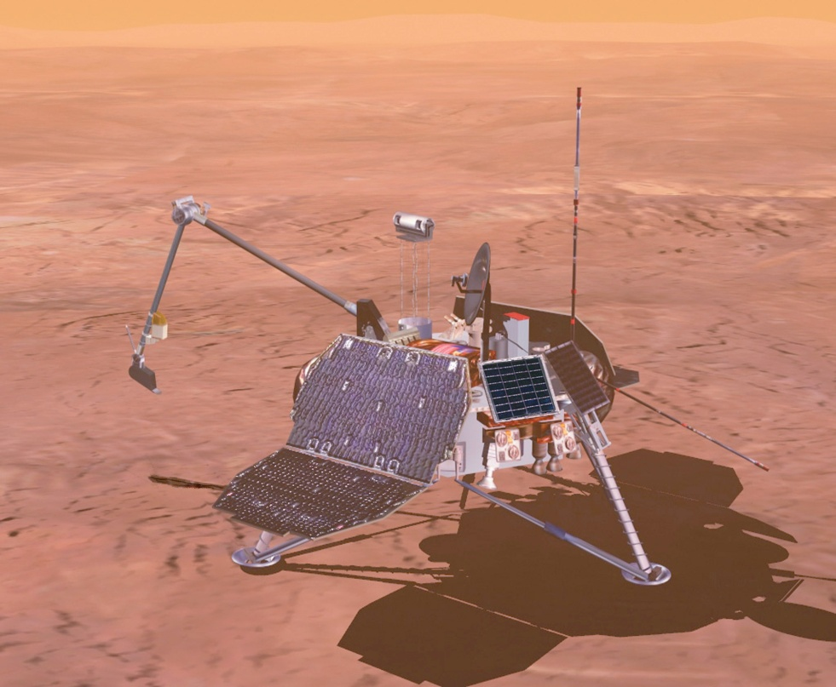
Robots
Spirit or
Opportunity Rover
Courtesy of NASA/JPL-Caltech.

Slide 53
Ethical Issues
Politics and the Internet: Public’s View
Have you ever used the Internet to get information on a political candidate?
How can the Internet increase political extremism?
How can you differentiate good political information from bad?

Slide 54
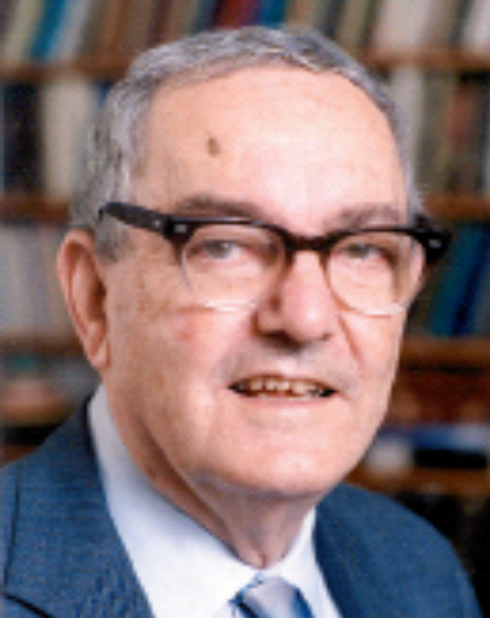
Who am I?
I'm another of
those who
looks like I
don't belong
in a CS book.
For what did
I win a Nobel
Prize? In
what other
fields did I do
research?
Courtesy of Carnegie Mellon University

Slide 55

Do you know?
What language is known as the AI language?
How is the PKC expert system different from most other medical expert systems?
Did natural language translation prove to be as easy as early experts predicted?
What is the name of the program that acts as a neutral psychotherapist?

