Slide 1
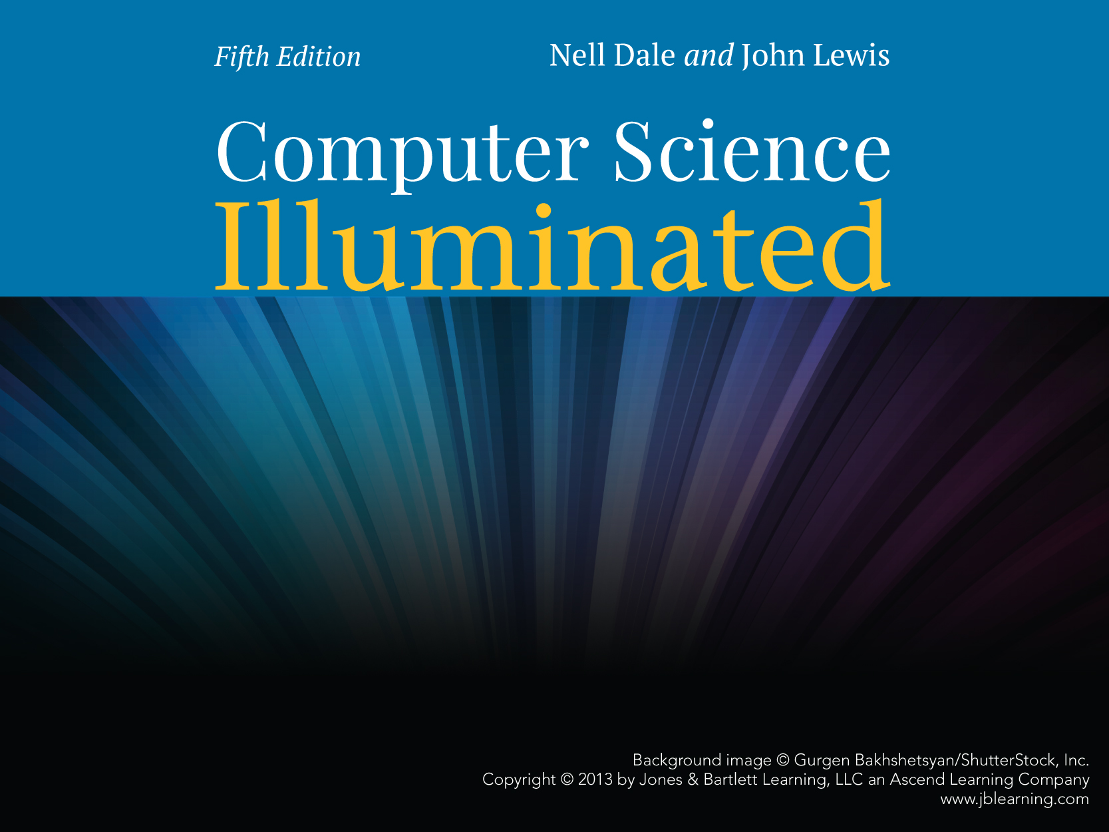
Chapter 16
The World Wide Web

Slide 2
Chapter Goals
Compare and contrast the Internet and the World Wide Web
Describe general Web processing
Write basic HTML documents
Describe several specific HTML tags and their purposes

Slide 3
Chapter Goals
Describe the processing of Java applets and Java server pages
Compare and contrast HTML and XML
Define basic XML documents and their corresponding DTDs
Explain how XML documents are viewed

Slide 4
The World Wide Web
The Web
An infrastructure of information combined and the network software used to access it
Web page
A document that contains or references various kinds of data
Links A connection between one web page and another
What are the links used for?

Slide 5
The World Wide Web
Website
A collection of related web pages
Web browser
A software tool that retrieves and displays eb pages
Web server
A computer set up to respond to requests for web pages

Slide 6
The World Wide Web
Uniform Resource Locator (URL)
A standard way of specifying the location of a Web page, containing the hostname, "/", and a file
What is the relationship between the Internet and the Web?

Slide 7
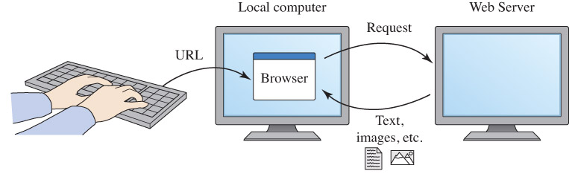
The World Wide Web
Why is the expression
"visiting a website"
confusing?
Figure 16.1 A browser retrieving a Web page

Slide 8
Search Engines
Search Engine
A website that helps you find other websites
Can you name at least two?
How do they work?

Slide 9
Instant Messaging
Instant messaging (IM)
An application that allows people to send and receive messages in real time
  Both sender and receiver must have an IM running
  Most IM applications use a proprietary protocol that dictates the precise format and structure of the messages sent
  Instant messages are not secure

Slide 10
Weblogs
Blog or Weblog
An online journal or newsletter that is frequently updated and intended for public consumption
Do you have a blog?
Do you read blogs?

Slide 11
Cookies
Cookie
A small text file that a web server stores on your local computer’s hard disk
  A cookie contains information about your visit to the site
  Cookies can be used
    to determine number of unique visitors to the site
    to customize the site for future visits
    to implement shopping carts that can be maintained from visit to visit
  Cookies are not dangerous

Slide 12
HTML
Hypertext Markup Language (HTML)
The language used to create or build a Web page
Markup language
A language that uses tags to annotate the information in a document
Tags
The syntactic element in a markup language that indicates how information should be displayed

Slide 13
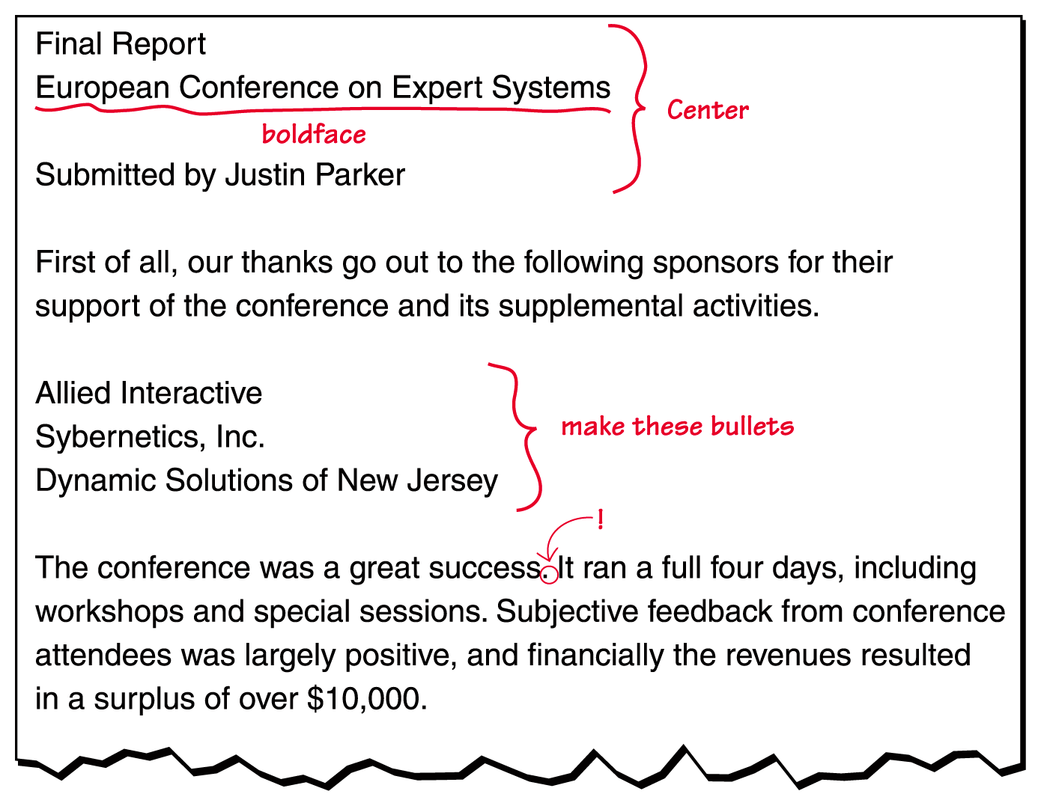
HTML
Figure 16.2
A marked-up document

Slide 14
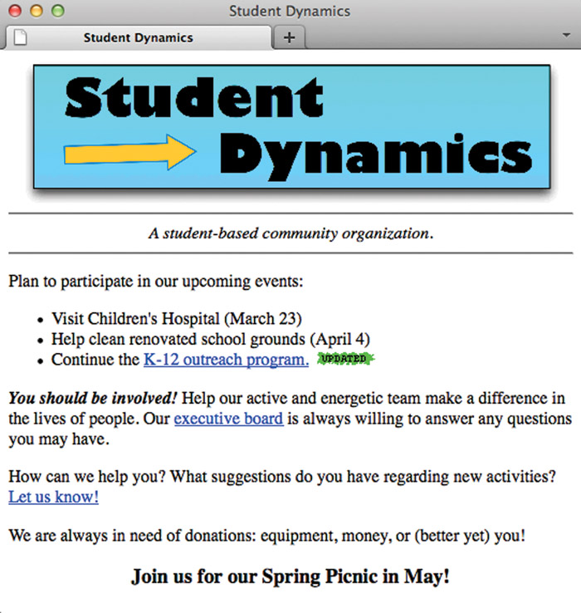
HTML
Figure 16.3
The Student Dynamics Web page as displayed in Netscape Navigator

Slide 15
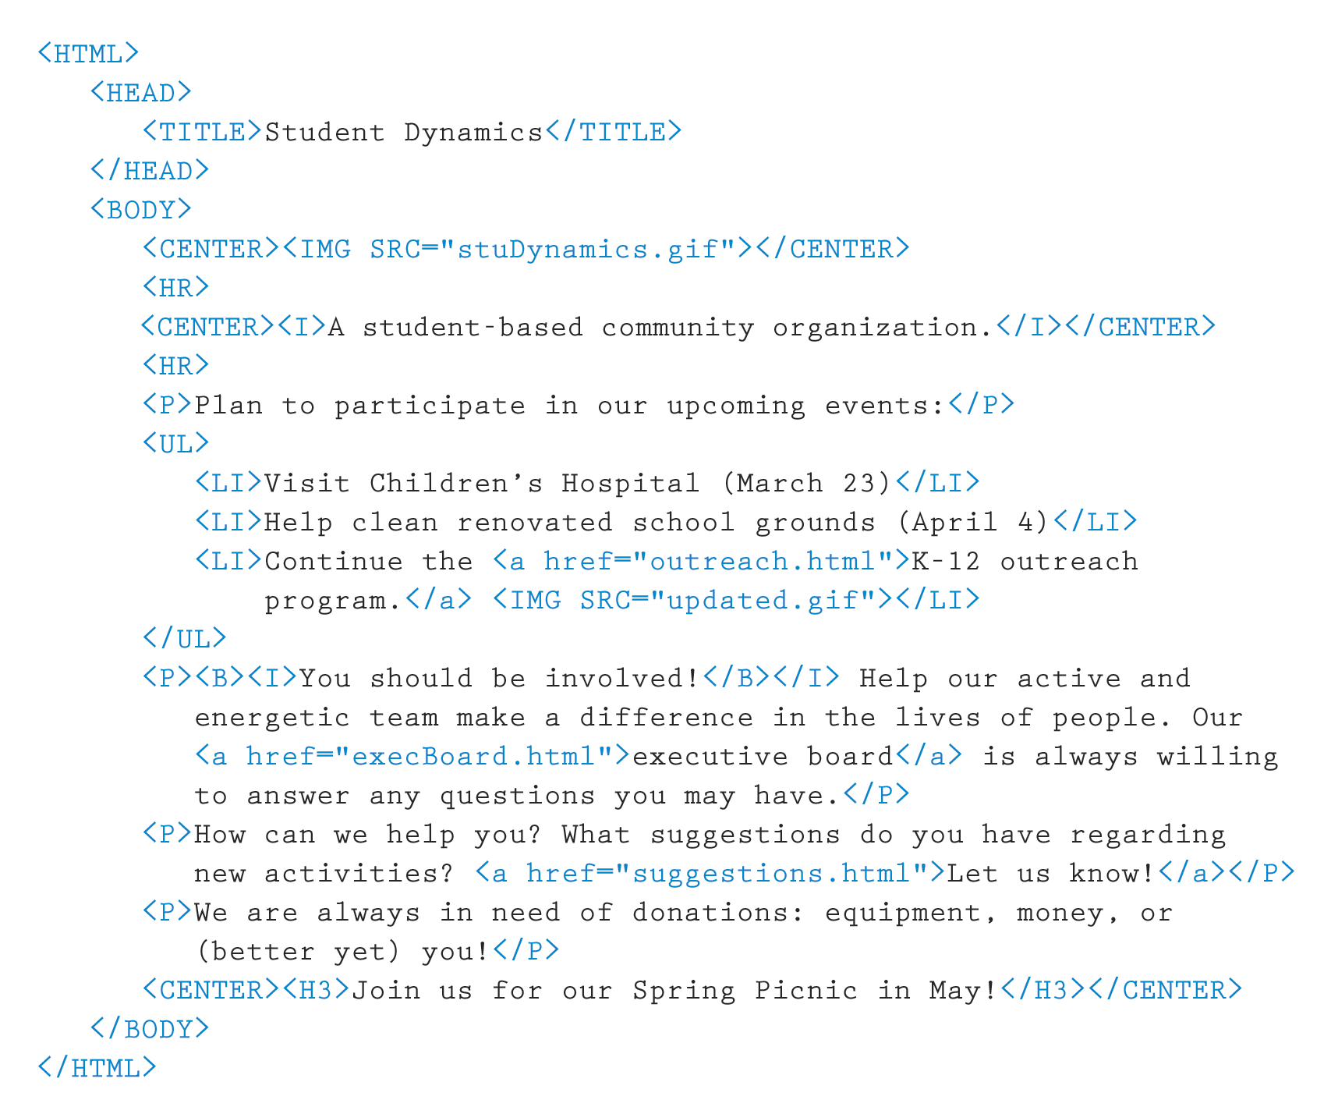
HTML
Figure 16.4
The HTML document defining the Student Dynamics Web page

Slide 16
HTML
Tags are enclosed in angle brackets
(<. . . >)
Words such as HEAD, TITLE, and BODY are called elements and specify the type of the tag
Tags are often used in pairs, with a start tag such as <BODY> and a corresponding end tag with a / before the element name, such as </BODY>

Slide 17
HTML
The browser determines how the page should be displayed based on the tags
The browser
  Ignores the way we format the HTML document using carriage returns, extra spaces, and blank lines
  Takes into account the width and height of the browser window
  Reformats the contents to fit your browser window

Slide 18
Basic HTML Formatting
<P> . . . </P> specify that text should be treated as a separate paragraph
<CENTER> . . . </CENTER> center information in the browser window
<B>…</B> bold information
<I>…</I> italicize information
<HR> insert horizontal rule across page

Slide 19
Basic HTML Formatting
<UL>…</UL> unordered list
<LI>…</LI> list item
<H1>…</H1> information as H1 head
…
<H8>…</H8> information as H8 head

Slide 20
Images and Links
Attribute
Part of a tag that provides additional information about the element
attribute-name = value
<IMG SRC = "myPicture.gif">
inserts the image stored in file "myPicture.gif"

Slide 21
Images and Links
A link is specified using the element A, (which stands for anchor) and attribute HREF that specifies the URL of the destination document.
<P><A HREF="http://www.cs.utexas.edu/users/ndale/labs/factorial/FactByte.htm">Factorial-Byte</A></P>

Slide 22
HTML5
New Tags
<section> to define section of pages
<header> to define the header of a page
<footer> to define the footer of a page
<nav> to define the navigation elements on a page
<article> to define an article or primary content of a page
<aside> to define secondary content that might appear in a sidebar
<figure> to define images that annotate an article

Slide 23
Java Applets
Java applet
A Java program designed to be embedded into an HTML document, transferred over the Web, and executed in a browser
  <P><APPLET code = "FactByte.class" width=250 height=150></APPLET></P>

Slide 24
Java Applets
Example
Contents of FactByte.htm:
<H1>Factorial with Byte Result</H1>
<P>Enter increasing values beginning with 0 and record the results of the Factorial of your input. At some point, the answer will seem strange. Record what seems strange about the answer and return to the previous page. </P>
<P><HR></P>
<P><APPLET code = "FactByte.class" width=250 height=150></APPLET></P>
FactByte.class
contains the
Java applet

Slide 25
Java Server Pages
JSP Scriptlet
A portion of code embedded in an HTML document designed to dynamically contribute to the content of the web page
Java Server Page
A web page that has a JSP scriptlet interwoven among the HTML content

Slide 26
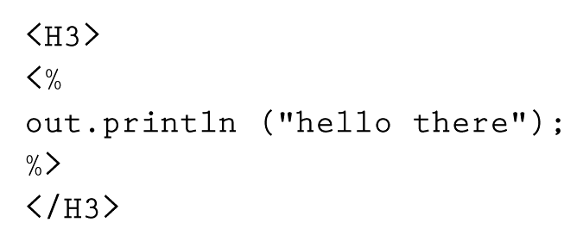
Java Server Pages
A JSP scriptlet is encased in special tags beginning with <% and ending with %>
Imagine JSP scriptlets as having the expressive power of a full programming language

Slide 27
Java Server Pages
JSPs are executed on the server side where the web page resides
By the time it arrives at your computer, all active processing has taken place, producing a static (though dynamically created) web page
JSPs are particularly good for coordinating the interaction between a web page and an underlying database
Compare and contrast Java
applets and JSP scriptlets

Slide 28
XML
Extensible Markup Language (XML)
A language that allows the user to describe the content of a document
  HTML describes how a document should look
  XML describes a document's meaning
Metalanguage
A language for talking about, or defining, other languages
XML is a metalanguage

Slide 29
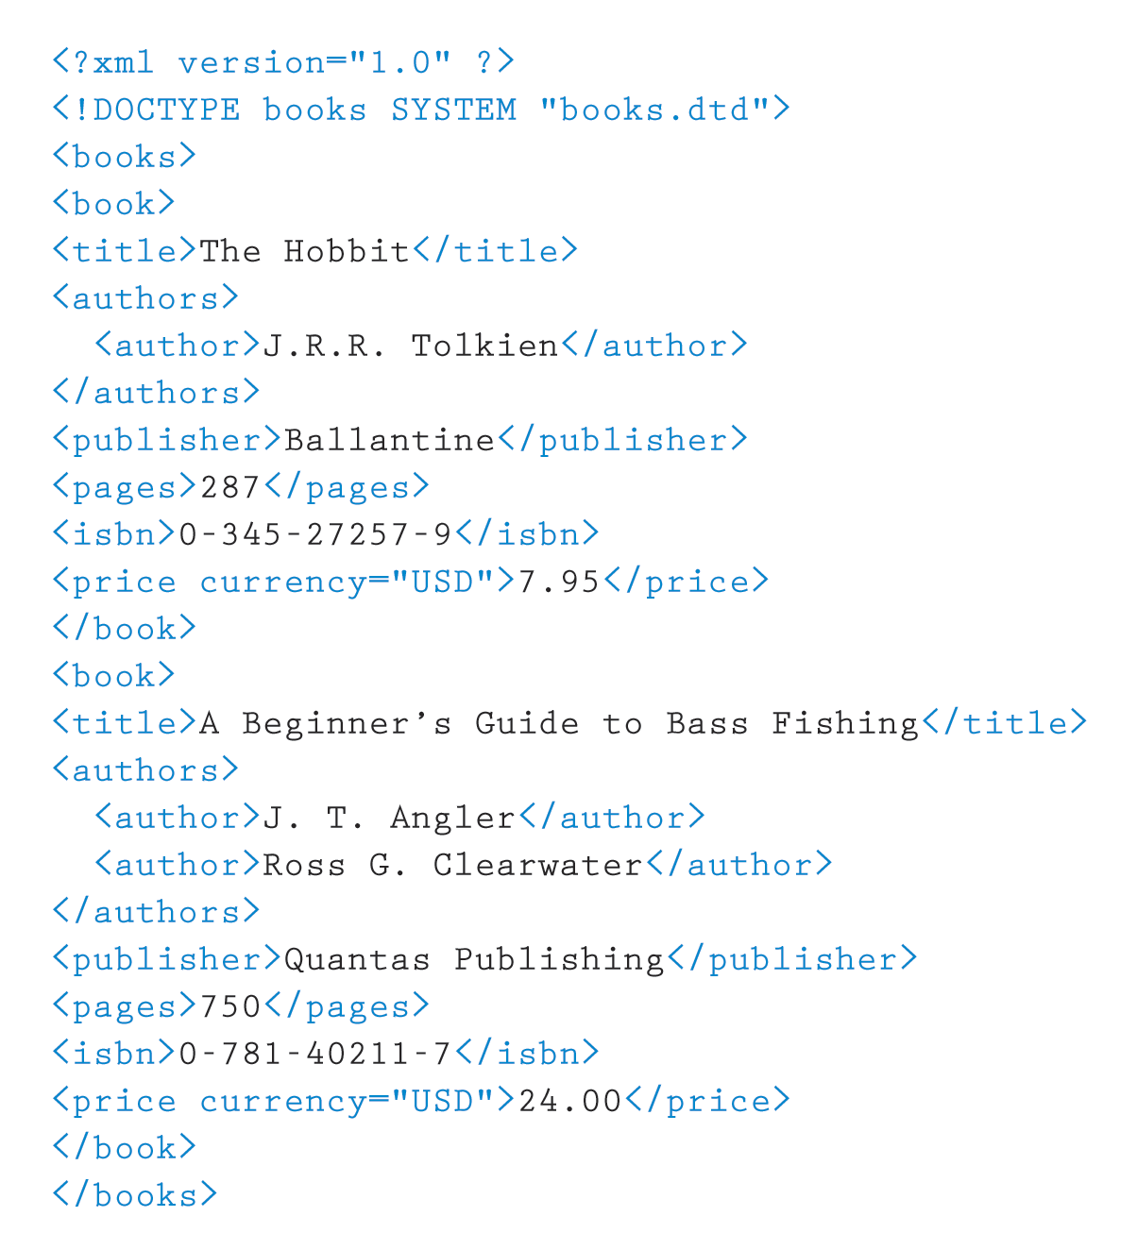
XML
Like HTML, an XML document is made up of tagged data
Figure 16.5 An XML document containing data about books

Slide 30
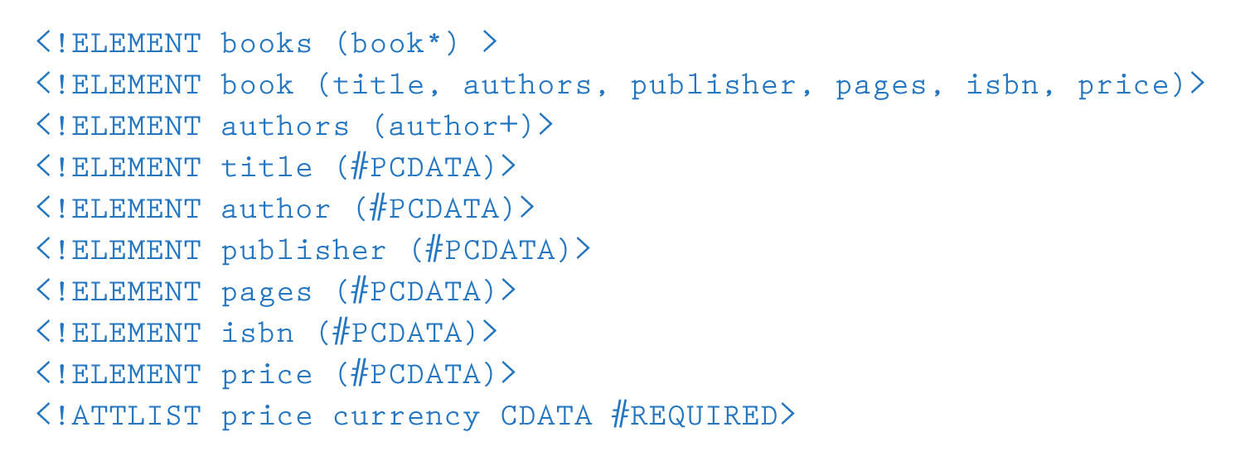
XML
Document Type Definition (DTD)
A specification of the organization of the document
The structure of a particular XML document is described by its corresponding DTD document
Figure 16.6 The DTD document corresponding to the XML books document

Slide 31
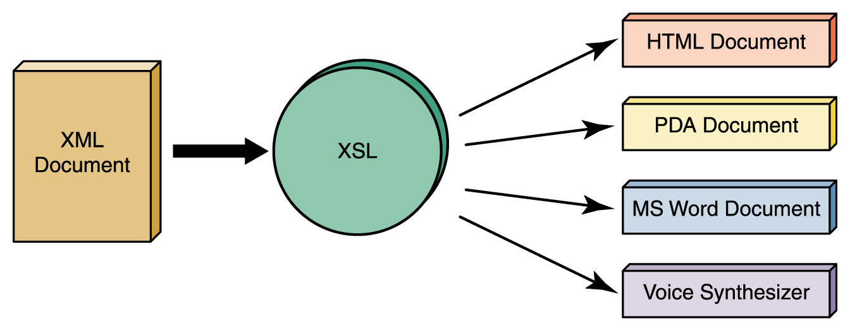
XML
XML represents a standard format for organizing data without tying it to any particular type of output
Extensible Stylesheet Language (or XSL)
A language for defining transformations from XML documents to other output formats
Figure 16.7
An XML document can be transformed into many output formats

Slide 32
Ethical Issues
Gambling and the Internet
  When did gambling explode on the Internet?
  Internet sites provide what types of gambling?
  Why is Internet gambling a problem for the states?

Slide 33

Who am I?
Bill Gates
and I
have
something
in common.
Do you
know what
it is?
© Hank Morgan/Photo Researchers, Inc.

Slide 34

Do you know?
What does the expression "dancing spiders of Google" mean?
What do computers have to do with "going green"?
Why are standards essential?

