Slide 2
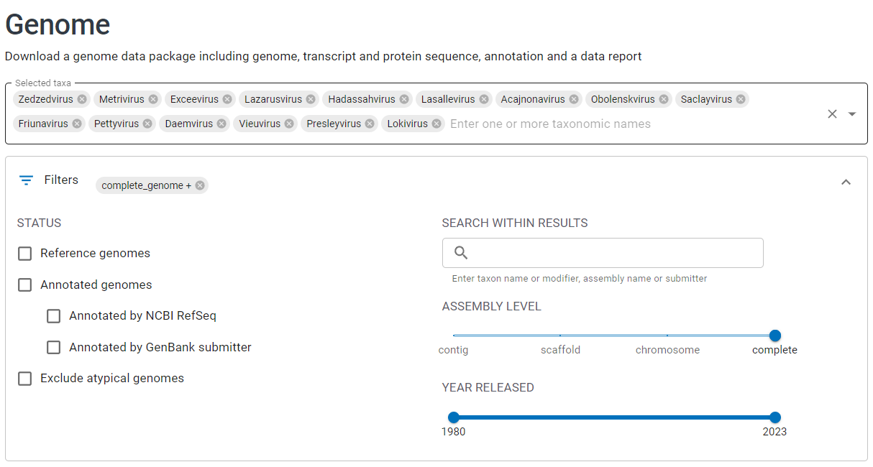
169
2 de maio 2023
https://www.ncbi.nlm.nih.gov/datasets/genome/

Slide 3
169 genomas de Acinetobacter
Corridas manuais
Instalação e script
API
PhageLeads
PhageAI
123 virulentos
45 temperados
PhaTYP
161 virulentos
8 temperados
PHACTS

Slide 4
169 genomas de Acinetobacter
Corridas manuais
Instalação e script
API
PhageLeads
PhageAI
123 virulentos
45 temperados
PhaTYP
161 virulentos
8 temperados
PHACTS
 |  | Prediction accuracy
Genbank name | PhageLeads | PhageAI | PhaTYP | PHACTS
GCA_028515195.1 | Predicted 2 genes | 72.6 | 0.9916 | 0.526
GCA_027582695.1 | Predicted 1 genes | 84.2 | 0.9141 | 0.512
GCA_028515145.1 | Predicted 2 genes | 79.6 | 0.5026 | 0.521
GCA_014656645.1 | Predicted 2 genes | 87.7 | 0.9989 | -
GCA_002605545.1 | Predicted 2 genes | 90.8 | 0.9998 | 0.531
GCA_028514995.1 | Predicted 2 genes | 78.8 | 0.9997
GCA_004989725.1 | Predicted 2 genes | 86.6 | 0.9842
GCA_028515085.1 | Predicted 1 genes | 93.9 | 0.5752
mean | - | 85.4 | 98.8

