Slide 1
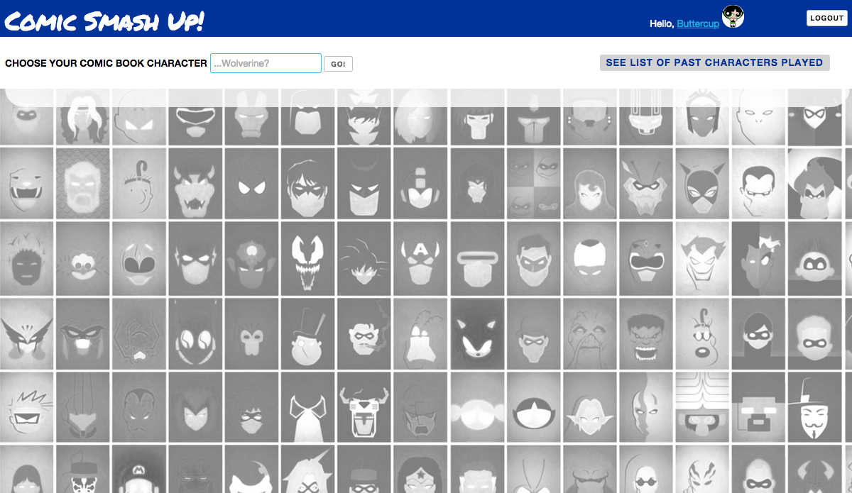
Comic SmashUp is a comic book story-generator app, where you can search for your favorite comic book character and have them battle against a random comic book opponent.
Here how to start:
Pick a favorite comic book character and enter it here. If no character is found, don’t fret. Just search again!
Need ideas? You can see what other users have played by clicking here.

Slide 2

Once you select a character, a random opponent from any comic book will be chosen for you. Now it’s up to you to start the story!
USE POWER
Select this to use one of your character’s special abilities. Hope you hit the target!
CALL FRIENDS
Select this to call for one of your character’s team alliances. Will they come to help?
HELP OUT
Even you can join the fight! Select this to use your character’s special powers.

Slide 3

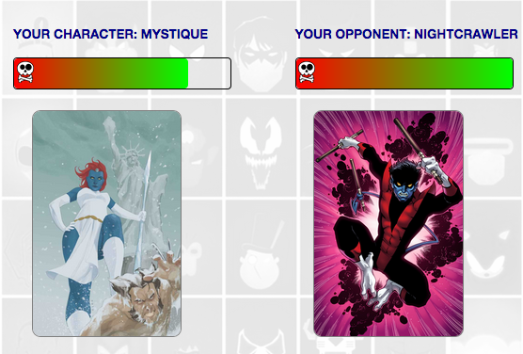
Each move will either be a hit or a miss.
If hit, the character’s health meter will go down until a winner is still standing!

Slide 4
Enter a character to get started!

Slide 5
Once you select a character, a random opponent from any comic book will be chosen for you. Now it’s up to you to start the story!

