Slide 1
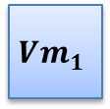
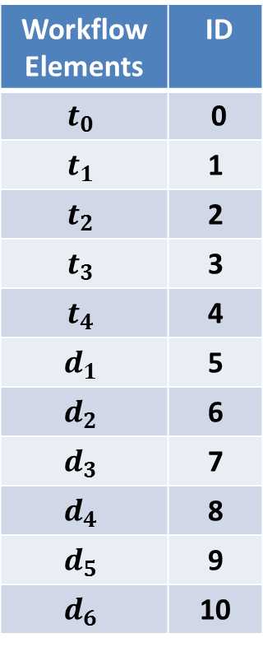
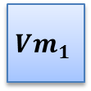









Workflow Elements | ID
$$t_{0}$$ | 0
$$t_{1}$$ | 1
$$t_{2}$$ | 2
$$t_{3}$$ | 3
$$t_{4}$$ | 4
$$d_{1}$$ | 5
$$d_{2}$$ | 6
$$d_{3}$$ | 7
$$d_{4}$$ | 8
$$d_{5}$$ | 9
$$d_{6}$$ | 10
Allocation:
0
1
2
3
4
5
6
7
8
9
10
$$Vm_{3}$$
$$Vm_{1}$$
$$Vm_{1}$$
$$Vm_{2}$$
$$Vm_{2}$$
$$Vm_{3}$$
$$Vm_{1}$$
$$Vm_{3}$$
$$Vm_{2}$$
$$Vm_{3}$$
$$Vm_{3}$$
Ordering:
0
1
2
3
4

Slide 2


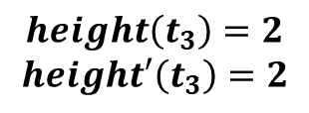
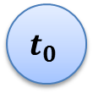
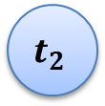

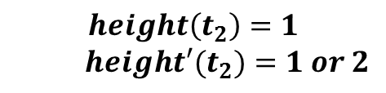
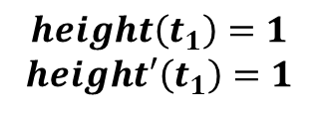



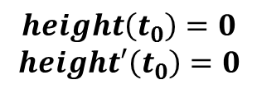
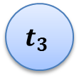
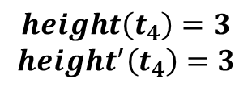



$$height\left(t_{0}\right)=0$$
$$height′\left(t_{0}\right)=0$$
$$t_{0}$$
$$d_{0}$$
$$d_{1}$$
$$d_{2}$$
$$height\left(t_{1}\right)=1$$
$$height′\left(t_{1}\right)=1$$
$$t_{1}$$
$$t_{2}$$
$$height\left(t_{2}\right)=1$$
$$height′(t_{2})=1 or 2$$
$$d_{3}$$
$$d_{4}$$
$$height\left(t_{3}\right)=2$$
$$height′\left(t_{3}\right)=2$$
$$t_{3}$$
$$d_{5}$$
$$t_{4}$$
$$height\left(t_{4}\right)=3$$
$$height^{′}\left(t_{4}\right)=3$$
$$d_{6}$$

Slide 3
















$$t_{0}$$
$$d_{0}$$
$$vm_{1}$$
$$d_{1}$$
$$d_{2}$$
$$t_{1}$$
$$t_{2}$$
$$d_{3}$$
$$d_{4}$$
$$t_{3}$$
$$vm_{2}$$
$$vm_{3}$$
$$d_{5}$$
$$t_{4}$$
$$d_{6}$$

Slide 4
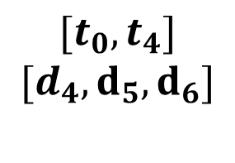

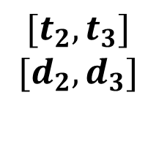
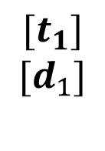


$$vm_{1}$$
$$[t_{1}]$$
$$[d_{1}]$$
$$[t_{2}, t_{3}]$$
$$[d_{2}, d_{3}]$$
$$[t_{0}, t_{4}]$$
$$[d_{4}, d_{5}, d_{6}]$$
$$vm_{2}$$
$$vm_{3}$$

Slide 5
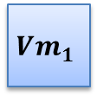
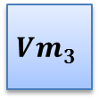

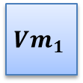
















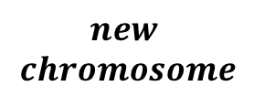















0
1
2
3
4
5
6
7
8
9
10
$$parent_{1}$$
$$Vm_{3}$$
$$Vm_{1}$$
$$Vm_{1}$$
$$Vm_{2}$$
$$Vm_{2}$$
$$Vm_{3}$$
$$Vm_{1}$$
$$Vm_{3}$$
$$Vm_{2}$$
$$Vm_{3}$$
$$Vm_{3}$$
0
1
2
3
4
5
6
7
8
9
10
$$parent_{2}$$
$$Vm_{1}$$
$$Vm_{3}$$
$$Vm_{2}$$
$$Vm_{1}$$
$$Vm_{3}$$
$$Vm_{1}$$
$$Vm_{2}$$
$$Vm_{3}$$
$$Vm_{3}$$
$$Vm_{1}$$
$$Vm_{3}$$
0
1
2
3
4
5
6
7
8
9
10
$$new$$
$$chromosome$$
$$Vm_{3}$$
$$Vm_{1}$$
$$Vm_{1}$$
$$Vm_{2}$$
$$Vm_{3}$$
$$Vm_{1}$$
$$Vm_{2}$$
$$Vm_{3}$$
$$Vm_{3}$$
$$Vm_{1}$$
$$Vm_{3}$$

Slide 6


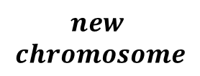
$$parent_{1}$$
0
1
2
3
4
5
6
$$parent_{2}$$
0
4
3
2
1
5
6
$$new$$
$$chromosome$$
0
1
2
4
3
5
6

Slide 7




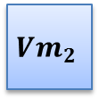






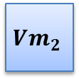










0
1
2
3
4
5
6
7
8
9
10
$$Vm_{3}$$
$$Vm_{1}$$
$$Vm_{1}$$
$$Vm_{2}$$
$$Vm_{2}$$
$$Vm_{3}$$
$$Vm_{1}$$
$$Vm_{3}$$
$$Vm_{2}$$
$$Vm_{3}$$
$$Vm_{3}$$
0
1
2
3
4
5
6
7
8
9
10
$$Vm_{1}$$
$$Vm_{1}$$
$$Vm_{1}$$
$$Vm_{3}$$
$$Vm_{2}$$
$$Vm_{2}$$
$$Vm_{1}$$
$$Vm_{3}$$
$$Vm_{2}$$
$$Vm_{1}$$
$$Vm_{3}$$
Vm is flipped

Slide 8











...
0
1
2
3
4
5
6
7
8
9
10
$$Vm_{3}$$
$$Vm_{1}$$
$$Vm_{1}$$
$$Vm_{2}$$
$$Vm_{2}$$
$$Vm_{3}$$
$$Vm_{1}$$
$$Vm_{3}$$
$$Vm_{2}$$
$$Vm_{3}$$
$$Vm_{3}$$
...

Slide 9







x
$$height^{′}$$
$$0$$
$$1$$
$$1$$
$$2$$
$$2$$
$$2$$
$$3$$
0
1
2
4
3
5
6
x

Slide 10






0
1
2
3
4
5
6
7
8
9
10
$$Vm_{3}$$
$$Vm_{1}$$
$$Vm_{1}$$
$$Vm_{2}$$
$$Vm_{2}$$
$$Vm_{3}$$
$$Vm_{1}$$
$$Vm_{3}$$
$$Vm_{2}$$
$$Vm_{3}$$
$$Vm_{3}$$
...
$$Vm_{1}$$
$$Vm_{2}$$
$$Vm_{3}$$
$$Vm_{1}$$
$$Vm_{2}$$
$$Vm_{3}$$

Slide 11




















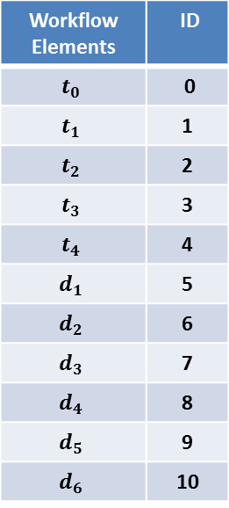


Workflow Elements | ID
$$t_{0}$$ | 0
$$t_{1}$$ | 1
$$t_{2}$$ | 2
$$t_{3}$$ | 3
$$t_{4}$$ | 4
$$d_{1}$$ | 5
$$d_{2}$$ | 6
$$d_{3}$$ | 7
$$d_{4}$$ | 8
$$d_{5}$$ | 9
$$d_{6}$$ | 10
0
1
2
3
4
5
6
7
8
9
10
$$Vm_{3}$$
$$Vm_{1}$$
$$Vm_{2}$$
$$Vm_{2}$$
$$Vm_{2}$$
$$Vm_{3}$$
$$Vm_{3}$$
$$Vm_{3}$$
$$Vm_{2}$$
$$Vm_{3}$$
$$Vm_{3}$$
0
1
2
3
4
$$t_{0}$$
$$d_{0}$$
$$vm_{1}$$
$$d_{1}$$
$$d_{2}$$
$$t_{1}$$
$$t_{1}$$
$$t_{2}$$
$$d_{3}$$
$$d_{4}$$
$$t_{3}$$
$$t_{0}$$
$$t_{2}$$
$$d_{5}$$
$$t_{4}$$
$$d_{1}$$
$$d_{2}$$
$$vm_{2}$$
$$vm_{3}$$
$$d_{6}$$

