Slide 1
INTRODUCTION / TEAM 2
Historical Stock Analysis
●
●
Does diversification survive a closer look?
●
230,111
49
20 years
ticker-days
global tickers
2006–2026
Karthikeyan M · Mirthula M · Lakshmi Mayuri Kavya N
HISTORICAL STOCK ANALYSIS / INTRODUCTION
1
Notes:
Speaker: Mirthula M | Target: 0:20
Open with the umbrella question. Explain that the project is not forecasting prices; it tests whether apparent diversification remains meaningful across technology groups and crisis periods.
[Sources]
Local dataset: data/stock_data.csv. Assignment brief: half-way-presentation/docs/assignment/Project_Status_Presentation.pdf

Slide 2
● INTRODUCTION
2
What we analyzed and how
230,111 daily company records; Python tested the hypotheses and R replicated the monthly analysis.
230,111 rows
8 columns
0 missing values
2006-01-02 → 2026-02-20
Date | Ticker | Open | Adj Close | Volume
2026-02-20 | AAPL | 258.97 | 264.58 | 4,20,44,900
2026-02-20 | 005930.KS | 1,90,000 | 1,90,100 | 2,42,13,880
2026-02-20 | MC.PA | 541.40 | 554.70 | 9,29,807
Returns and index-to-100 values make currencies and price scales comparable.
HISTORICAL STOCK ANALYSIS / INTRODUCTION
2
Notes:
Speaker: Mirthula M | Target: 0:50
Introduce the dataset through one row: date, ticker, opening price, adjusted closing price, and volume. Then explain the workflow briefly: Python cleaned, transformed, visualized, and tested the hypotheses; R replicated the analysis and prepared monthly summaries. Because currencies and price scales differ, comparisons use returns or index-to-100 values rather than raw prices.
[Sources]
Local dataset: data/stock_data.csv. Shape, date range, missing-value count, and example rows verified directly from the CSV on 2026-08-25.

Slide 3
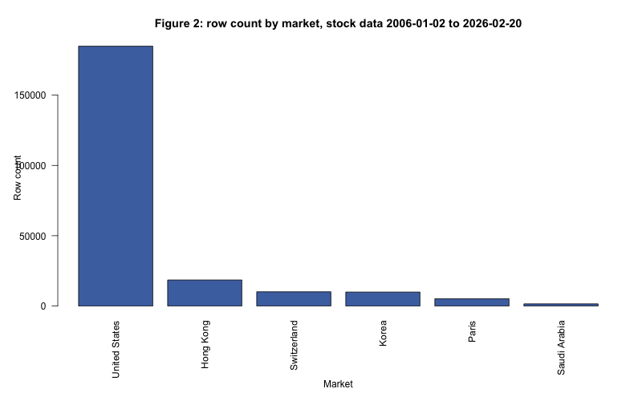
● HYPOTHESIS SETUP
3
Three hypotheses guide the analysis
Each hypothesis tests one part of the same diversification question.
01
H1 · AI-rally concentration
The selected chip/AI group will outperform the selected broader-tech group during the AI rally.
02
H2 · Regional diversification during crises
Average regional correlations will be higher in crisis periods than in calm years.
03
H3 · Volatility and volume during panic periods
Volatility and trading volume will rise during panic periods relative to the calm baseline.
Together, H1 tests concentration; H2 and H3 test whether diversification weakens under stress.
HISTORICAL STOCK ANALYSIS / HYPOTHESIS SETUP
3
Notes:
Speaker: Mirthula M | Target: 0:55
State each hypothesis before discussing the tests. H1 asks whether the selected chip/AI group outperformed the selected broader-tech group during the AI rally. H2 asks whether regional correlations increased during crises compared with calm years. H3 asks whether volatility and volume rose during panic periods. Together, they test whether apparent diversification becomes thinner during concentrated rallies and market stress.
[Sources]
Hypothesis definitions: assignment_3/analysis.ipynb, extra_credit_1/analysis.ipynb, and AGENTS.md.

Slide 4
● HYPOTHESIS SETUP
4
How we test the three hypotheses
One technology comparison and three crisis measures, using adjusted prices.
TECHNOLOGY GROUPS
MARKET PERIODS
Chip / AI
Calm baseline
NVDA · AVGO · TSM · ASML · AMD · MU · LRCX
2015–2017 · no major global shock
2008 crisis
Broader tech
Housing collapse, mortgage losses, and a global banking shock
2020 crash
AAPL · MSFT · GOOGL · AMZN · META · NFLX · ORCL · CSCO
Pandemic lockdowns triggered a sudden global selloff
2022 drawdown
Indexed value = 100 × Adj Close / starting Adj Close
Inflation and rapid rate hikes drove a slower drawdown
Measures: correlation, volatility, and volume relative to calm
HISTORICAL STOCK ANALYSIS / HYPOTHESIS SETUP
4
Notes:
Speaker: Mirthula M | Target: 0:55
Explain the periods in plain language. The 2008 crisis followed a housing boom: falling home prices created mortgage losses, damaged banks, and disrupted credit markets worldwide. The 2020 crash was the sudden market selloff around the first COVID-19 lockdowns. The 2022 drawdown was slower and occurred amid high inflation and rapid interest-rate increases. We compare all three with calm 2015–2017. Correlation means how closely markets move together; volatility means the size of price movements; volume means the number of shares traded. H1 separately compares the selected technology baskets using indexed adjusted prices and mean daily returns. Then hand over to Karthikeyan.
[Sources]
Group and period definitions: assignment_3/analysis.ipynb and extra_credit_1/analysis.ipynb. 2008 crisis context: Federal Reserve History, https://www.federalreservehistory.org/essays/great-recession-and-its-aftermath. Preis et al. (2012): https://www.nature.com/articles/srep00752. Morningstar (2026): https://www.morningstar.com/stocks/three-years-ai-stock-market-boom-charts. J.P. Morgan (2026): https://www.jpmorgan.com/insights/markets-and-economy/top-market-takeaways/tmt-is-it-all-one-big-ai-trade.

Slide 5
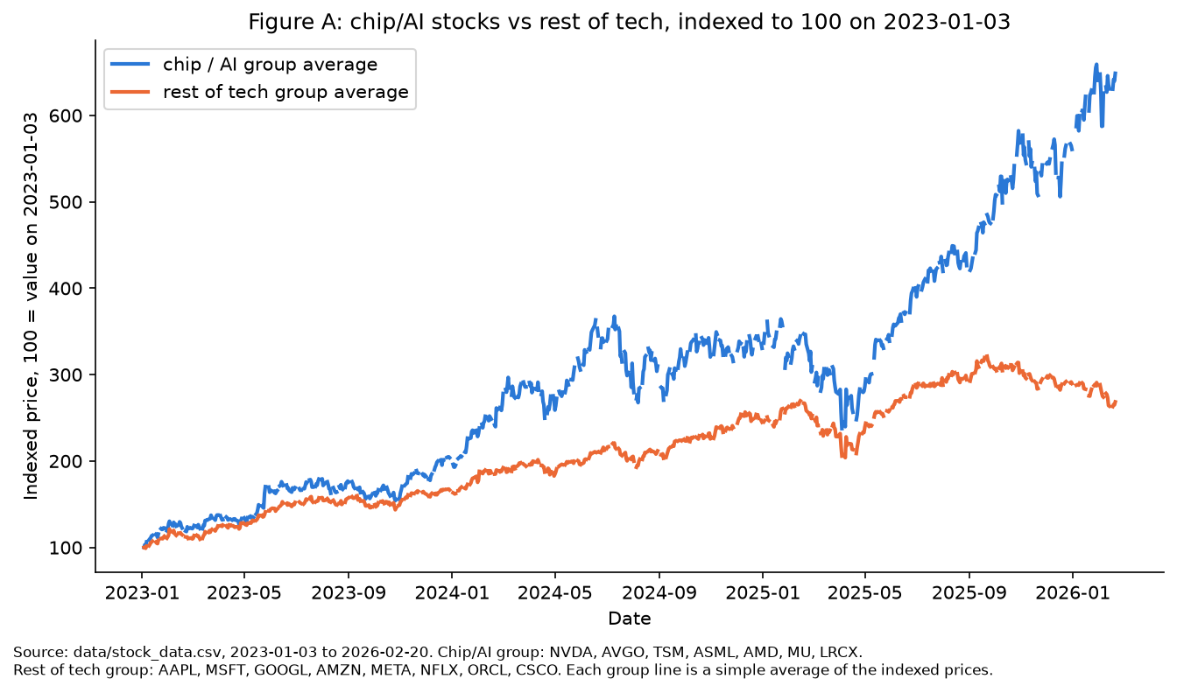
● HYPOTHESIS 1
5
The selected chip/AI group pulled decisively ahead
Indexed group averages from 2023-01-03 to 2026-02-20.
+549%
chip / AI group
+168%
broader-tech group
0.26% vs 0.14%
mean daily return
Welch p = 0.0073
Conclusion: H1 is supported for these selected groups—not for every company linked to AI.
HISTORICAL STOCK ANALYSIS / HYPOTHESIS 1
5
Notes:
Speaker: Karthikeyan M | Target: 1:00
Start with index-to-100: every stock begins at the same value, so the chart compares percentage growth rather than currencies or raw share prices. Adjusted Close is used because it accounts for splits and dividends. Then give the result: the selected chip/AI group gained about 549% on average versus about 168% for the selected broader-tech group. Mean daily returns were 0.26% versus 0.14%, and Welch p = 0.0073 indicates a statistically meaningful difference under this test. State the boundary carefully: this supports H1 for these selected groups; it does not prove the entire AI economy is narrow or establish causality.
[Sources]
Chart: assignment_3/figures/figure_a_ai_rally.png. Statistical check: extra_credit_1 output. Local dataset: data/stock_data.csv.

Slide 6
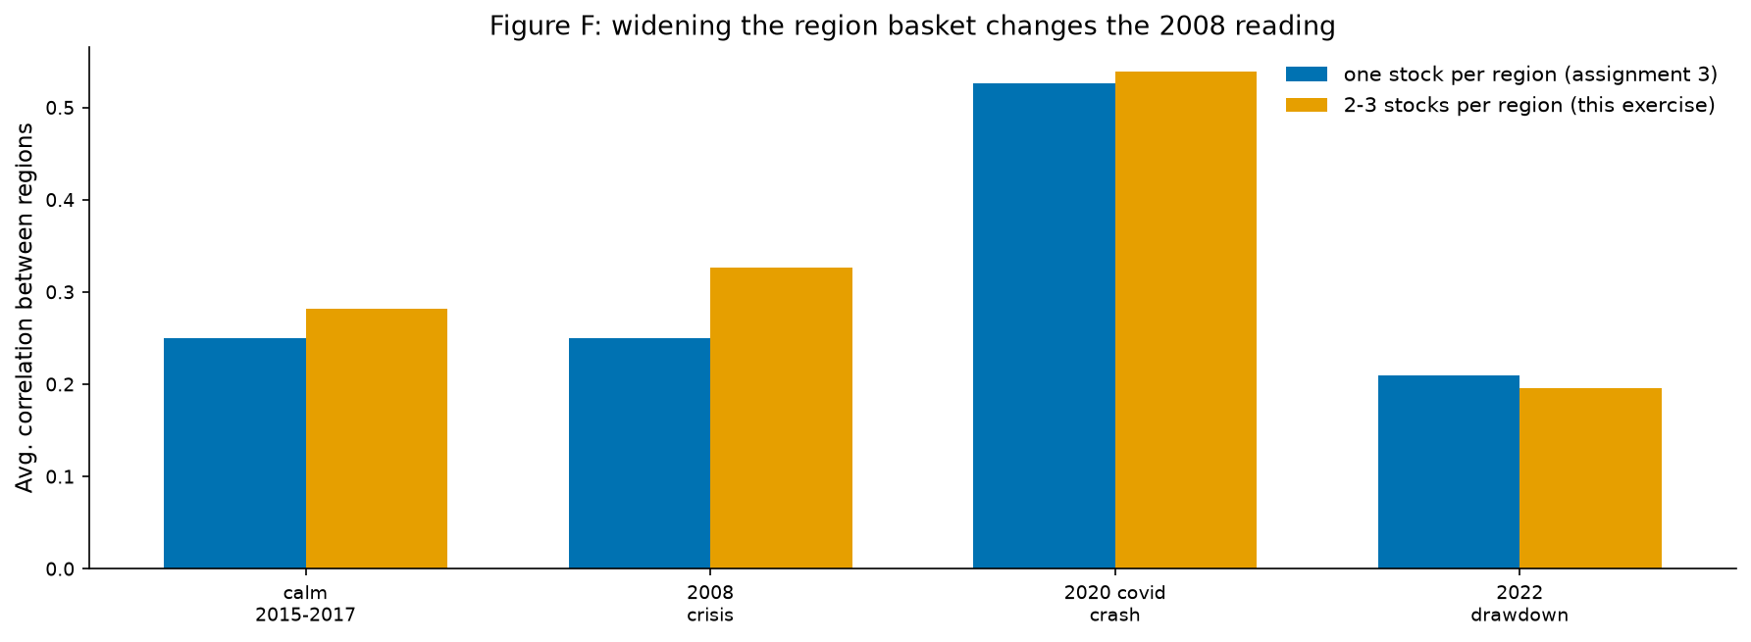
● HYPOTHESIS 2
6
Regional diversification weakened most in the 2020 crash
Average pairwise correlations after widening the available regional baskets.
0.282
calm
0.326
2008
0.539
2020
The 2008 estimate became more crisis-like after widening the basket, but Paris still has one stock and Korea/Switzerland remain sector-narrow.
Conclusion: H2 is strongly supported for 2020 and directionally supported for 2008.
HISTORICAL STOCK ANALYSIS / HYPOTHESIS 2
6
Notes:
Speaker: Karthikeyan M | Target: 1:00
Explain correlation simply: a value closer to 1 means regional returns move together, so they provide less protection from one another. The widened regional basket averaged about 0.282 in calm years, 0.326 in 2008, 0.539 in 2020, and 0.196 in 2022. Therefore, the evidence is strongest for the sudden 2020 crash. The higher 2008 value is supportive but more qualified. Keep the limitation visible: Paris still has one stock, while Korea and Switzerland remain sector-narrow, so this is not a universal law about every regional market.
[Sources]
Chart: extra_credit_1/figures/ec1_f_widened_basket.png. Calculations use data/stock_data.csv and the widened-basket method documented in extra_credit_1.

Slide 7
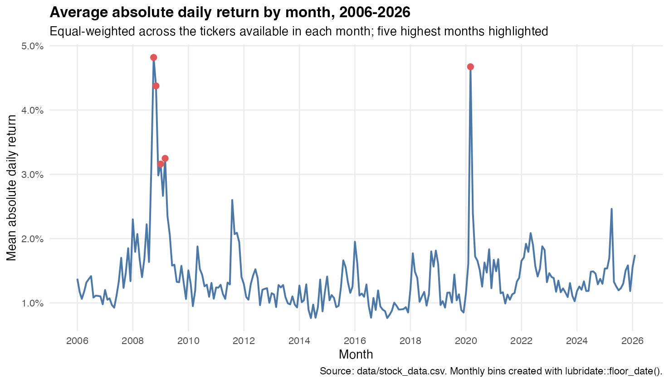
● HYPOTHESIS 3
7
Panic months produced the largest volatility spikes
Equal-weighted mean absolute daily return by month across available tickers.
OCT 2008
4.82%
MAR 2020
4.67%
Independent monthly aggregation reaches the same crisis conclusion.
HISTORICAL STOCK ANALYSIS / HYPOTHESIS 3
7
Notes:
Speaker: Karthikeyan M | Target: 1:00
Define volatility here as the average absolute daily return within each month: larger values mean larger day-to-day price movements, regardless of direction. The R-based check found the largest monthly spikes in October 2008 at 4.82% and March 2020 at 4.67%. The regional analysis also found volume around 2.7 times the calm level in 2008 and 1.7 times in 2020, but only 0.9 times in 2022. Treat volume as supporting evidence because share-count volume is affected by splits and is not directly comparable across companies.
[Sources]
Chart: assignment_5/part_2/figures/b2_monthly_absolute_return.png. Monthly bins created in R with lubridate::floor_date(); source data/stock_data.csv.

Slide 8
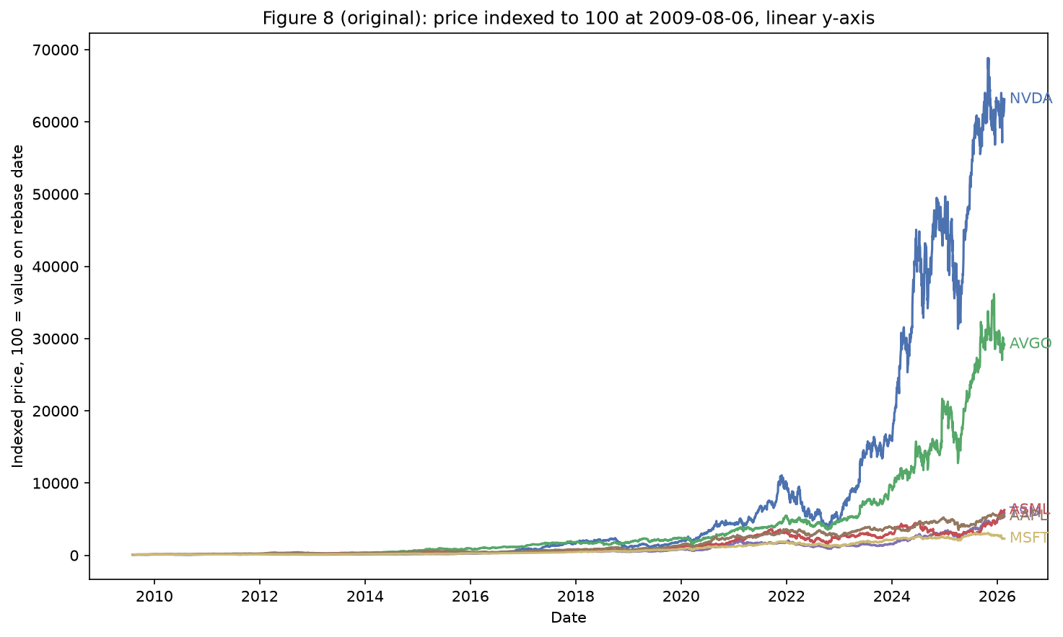
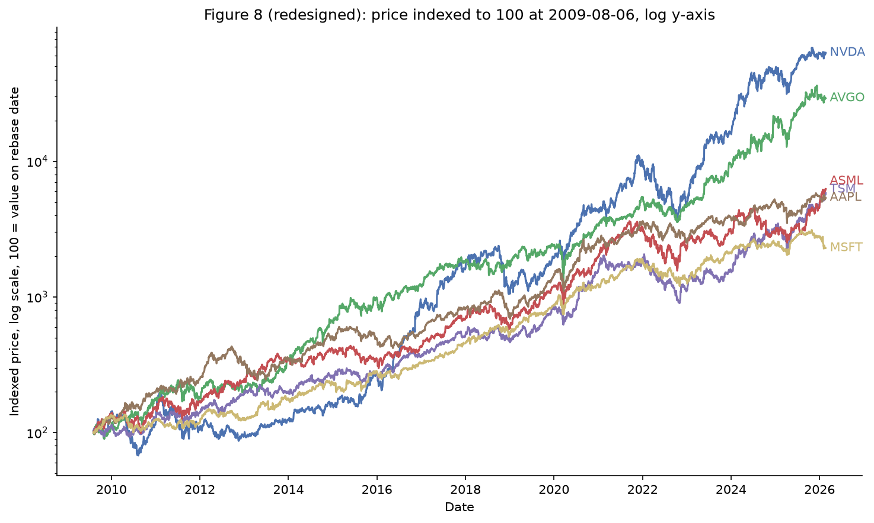
● CONCLUSION
8
A log scale reveals the growth stories hidden by the linear chart
Same data and rebasing; only the visual encoding changes.
BEFORE · LINEAR
AFTER · LOG
NVDA and AVGO dominate the absolute range, compressing four lines near the baseline.
Equal vertical distance now represents equal proportional change; all six series remain legible.
Principles applied: appropriate scale · direct labels · less non-data ink · better pre-attentive separation
HISTORICAL STOCK ANALYSIS / CONCLUSION
8
Notes:
Speaker: Lakshmi Mayuri Kavya N | Target: 1:00
This is a design lesson, not a new calculation. On a linear axis, equal vertical distances represent equal point changes, so the fastest-growing series compresses the others. On a log axis, equal vertical distances represent equal proportional changes, making percentage growth easier to compare. The underlying data and index-to-100 rebasing do not change. Direct labels also reduce the need to search between lines and a legend.
[Sources]
Before/after charts: extra_credit_1/figures/ec1_a_before.png and extra_credit_1/figures/ec1_a_after.png. Both use data/stock_data.csv.

Slide 9
● CONCLUSION
9
Diversification is thinner when it matters most
All three hypotheses support the central story, within clear limits.
01
Technology leadership was concentrated
The selected chip/AI group gained 549% versus 168% for broader tech.
02
Regional protection weakened in sudden stress
Average correlation peaked at 0.539 in the 2020 crash.
03
Volatility independently confirmed the panic signal
October 2008 and March 2020 were the largest monthly spikes.
What we can claim: patterns in this dataset. What we cannot claim: causality, forecasting, or a universal market law.
HISTORICAL STOCK ANALYSIS / CONCLUSION
9
Notes:
Speaker: Lakshmi Mayuri Kavya N | Target: 0:55
Resolve the opening question directly. The dataset shows diversification, but technology gains and crisis co-movement make it thinner than the surface suggests. Finish with the boundary: this is descriptive evidence, not causal proof or a forecast.
[Sources]
Synthesis of slides 7–9 using data/stock_data.csv and the cited project outputs.

Slide 10
● CONCLUSION
10
Make the evidence explorable
The dashboard keeps every assumption visible as a filter.
POWER BI / TABLEAU
R WRANGLING
One overview
Long-form by design
Filter by ticker group, region, and crisis period; compare indexed performance, correlations, and monthly volatility.
Use parsed dates, month bins, and one Ticker field so color, grouping, and filters remain consistent.
OPEN RISKS
unequal regional coverage · share-count volume · removed original Kaggle page · no causal interpretation
Success means the user can reproduce each headline and see where the evidence becomes uncertain.
HISTORICAL STOCK ANALYSIS / CONCLUSION
10
Notes:
Speaker: Lakshmi Mayuri Kavya N | Target: 0:50
Describe the dashboard as the next analytical interface, not just a prettier report. The filters should let users change the group and period while retaining the same return, correlation, and volatility definitions.
[Sources]
Dashboard plan derived from assignment_5/part_2 long-form outputs and the Assignment 6 brief. Kaggle source caveat documented in AGENTS.md.

