Slide 1
PROJECT STATUS / TEAM 2
Historical Stock Analysis
●
●
Does diversification survive a closer look?
●
230,111
49
20 years
ticker-days
global tickers
2006–2026
Karthikeyan M · Mirthula M · Lakshmi Mayuri Kavya N
HISTORICAL STOCK ANALYSIS / OPENING
1
Notes:
Open with the umbrella question. Explain that the project is not forecasting prices; it tests whether apparent diversification remains meaningful across technology groups and crisis periods.
[Sources]
Local dataset: data/stock_data.csv. Assignment brief: half-way-presentation/docs/assignment/Project_Status_Presentation.pdf

Slide 2
● DATA
2
Each row is one company on one trading day
The file combines price, return-ready closing values, and trading activity.
230,111 rows
8 columns
0 missing values
2006-01-02 → 2026-02-20
Date | Ticker | Open | Adj Close | Volume
2026-02-20 | AAPL | 258.97 | 264.58 | 4,20,44,900
2026-02-20 | 005930.KS | 1,90,000 | 1,90,100 | 2,42,13,880
2026-02-20 | MC.PA | 541.40 | 554.70 | 9,29,807
Same columns, different exchanges and currencies—so the analysis cannot compare raw prices directly.
HISTORICAL STOCK ANALYSIS / DATA
2
Notes:
Walk through one row: date, company identifier, a daily opening value, adjusted closing value, and number of shares traded. Point out the Samsung row to show why raw levels across currencies are not comparable.
[Sources]
Local dataset: data/stock_data.csv. Shape, date range, missing-value count, and example rows verified directly from the CSV on 2026-08-25.

Slide 3
● DATA
3
Eight fields describe price movement and activity
Adjusted Close is the analytical anchor because it includes split and dividend adjustments.
Field | Plain-language meaning | How we use it
Date | Trading day | Time windows and monthly bins
Ticker | Company and exchange symbol | Grouping by company, region, or sector
Open | First traded price of the day | Daily price context
High | Highest traded price that day | Intraday range
Low | Lowest traded price that day | Intraday range
Close | Final traded price; split-adjusted here | Price display only
Adj Close | Close adjusted for splits and dividends | Returns and indexed growth
Volume | Shares changing hands | Trading-activity signal
HISTORICAL STOCK ANALYSIS / DATA
3
Notes:
Keep this fast. Emphasize only three ideas: ticker identifies the company and exchange, adjusted close is used for return calculations, and volume measures activity rather than value.
[Sources]
Column definitions are documented in assignment_2/analysis.ipynb and verified against data/stock_data.csv.

Slide 4
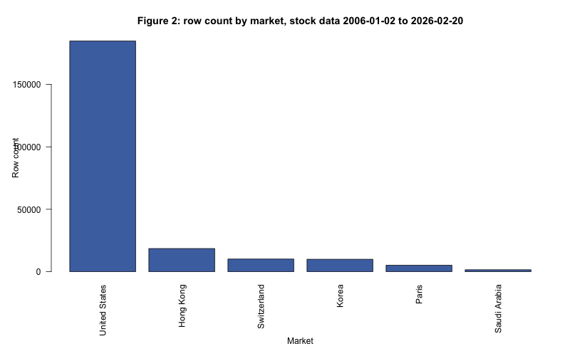
● DATA
4
The file is complete, but the coverage is not balanced
Data quality is more than missing values: currencies, calendars, listing dates, and representation all matter.
0
missing fields
0
duplicate Date–Ticker pairs
1,706
zero-volume rows
US rows dominate; Paris and Saudi Arabia each represent one company.
Decision: compare returns or index every series to 100 on a shared valid date.
HISTORICAL STOCK ANALYSIS / DATA
4
Notes:
Explain why a complete file can still be biased. The United States dominates the row count. Some exchanges have different holidays and some companies list later. We therefore use returns or rebased values, not raw cross-currency prices.
[Sources]
Market-count chart: assignment_4/figures/fig2_market_counts.png. Data audit from data/stock_data.csv: 0 missing values, 0 duplicate Date–Ticker pairs, and 1,706 zero-volume rows.

Slide 5
● QUESTION
5
Three hypotheses test one diversification story
Related work suggested where diversification may weaken; our dataset lets us test the pattern directly.
H1
Was the post-2023 technology rally broad?
Test: selected chip/AI names should outperform a broader-tech comparison group.
H2
Does regional diversification weaken during sudden crashes?
Test: average cross-region correlation should rise above calm-period levels.
H3
Do volatility and volume confirm the panic periods?
Test: crisis periods should show larger price swings and stronger trading activity.
Preis: correlations rise under stress · Morningstar: semiconductors led the AI boom · J.P. Morgan: the broader AI ecosystem is wider than seven stocks
HISTORICAL STOCK ANALYSIS / QUESTION
5
Notes:
Present H1 to H3 as a chain, not three unrelated questions. Preis et al. motivates the crisis-correlation test. Morningstar motivates examining semiconductor leadership. J.P. Morgan prevents us from overgeneralizing the seven-stock AI group to the entire AI economy.
[Sources]
Preis et al. (2012): https://www.nature.com/articles/srep00752
Morningstar (2026): https://www.morningstar.com/stocks/three-years-ai-stock-market-boom-charts
J.P. Morgan (2026): https://www.jpmorgan.com/insights/markets-and-economy/top-market-takeaways/tmt-is-it-all-one-big-ai-trade

Slide 6
● APPROACH
6
We separated cleaning, transformation, testing, and communication
Python explored and tested the hypotheses; R replicated the EDA and prepared long-form monthly data.
01
Clean
02
Transform
parse dates · sort by ticker · audit missing and duplicate rows
daily returns · index-to-100 · monthly absolute returns
03
Test
04
Communicate
group performance · Welch t-test · crisis correlations
takeaway titles · direct labels · honest limitations
PYTHON
EDA, visualization, hypothesis testing, interactive prototypes
R
replication, reshaping, lubridate monthly bins, dplyr/data.table
HISTORICAL STOCK ANALYSIS / APPROACH
6
Notes:
Explain the pipeline in order. The important analytical choice is to compute returns or indexed performance before comparing tickers. R then produces the long-form and monthly tables needed for the dashboard.
[Sources]
Python workflow: assignment_2/analysis.ipynb, assignment_3/analysis.ipynb, extra_credit_1/analysis.ipynb. R workflow: assignment_4/analysis.R and assignment_5/part_2/analysis.R.

Slide 7
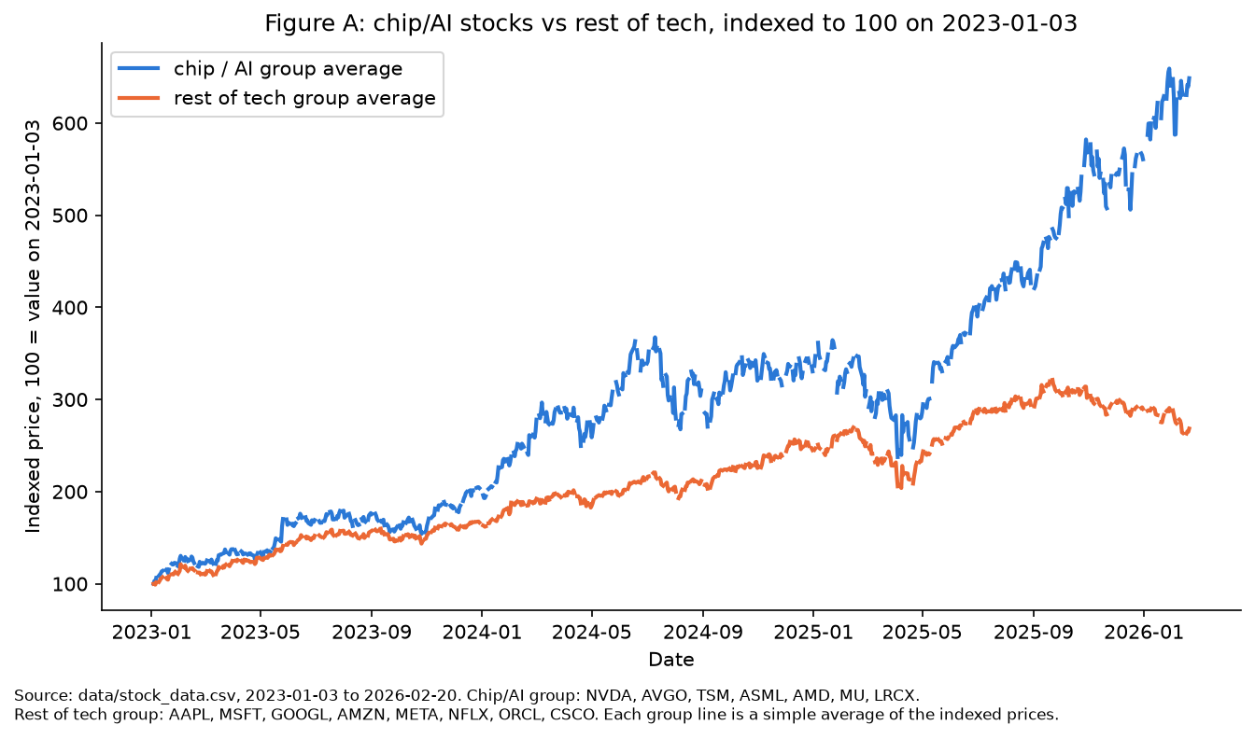
● FINDING 1
7
The selected chip/AI group pulled decisively ahead
Indexed group averages from 2023-01-03 to 2026-02-20.
+549%
chip / AI group
+168%
broader-tech group
0.26% vs 0.14%
mean daily return
Welch p = 0.0073
Conclusion: H1 is supported for these selected groups—not for every company linked to AI.
HISTORICAL STOCK ANALYSIS / FINDING 1
7
Notes:
Lead with the visual gap, then the group-level returns and statistical check. State the boundary carefully: the selected seven chip/AI stocks outperformed the selected eight broader-tech stocks. This does not prove the whole AI economy is narrow.
[Sources]
Chart: assignment_3/figures/figure_a_ai_rally.png. Statistical check: extra_credit_1 output. Local dataset: data/stock_data.csv.

Slide 8
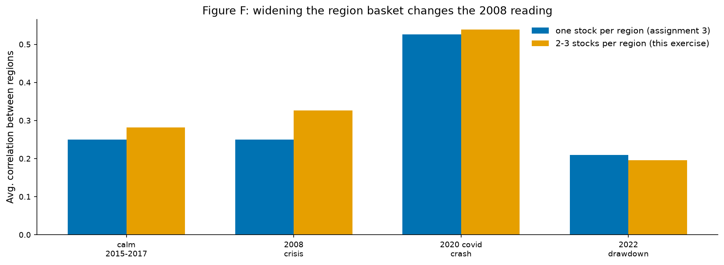
● FINDING 2
8
Regional diversification weakened most in the 2020 crash
Average pairwise correlations after widening the available regional baskets.
0.282
calm
0.326
2008
0.539
2020
The 2008 estimate became more crisis-like after widening the basket, but Paris still has one stock and Korea/Switzerland remain sector-narrow.
Conclusion: H2 is strongly supported for 2020 and directionally supported for 2008.
HISTORICAL STOCK ANALYSIS / FINDING 2
8
Notes:
Explain correlation in one sentence: values closer to one mean regions move more together. The widened basket lifts 2008 from about 0.25 to 0.326 and leaves 2020 as the clearest diversification failure. Keep the regional-coverage limitation visible.
[Sources]
Chart: extra_credit_1/figures/ec1_f_widened_basket.png. Calculations use data/stock_data.csv and the widened-basket method documented in extra_credit_1.

Slide 9
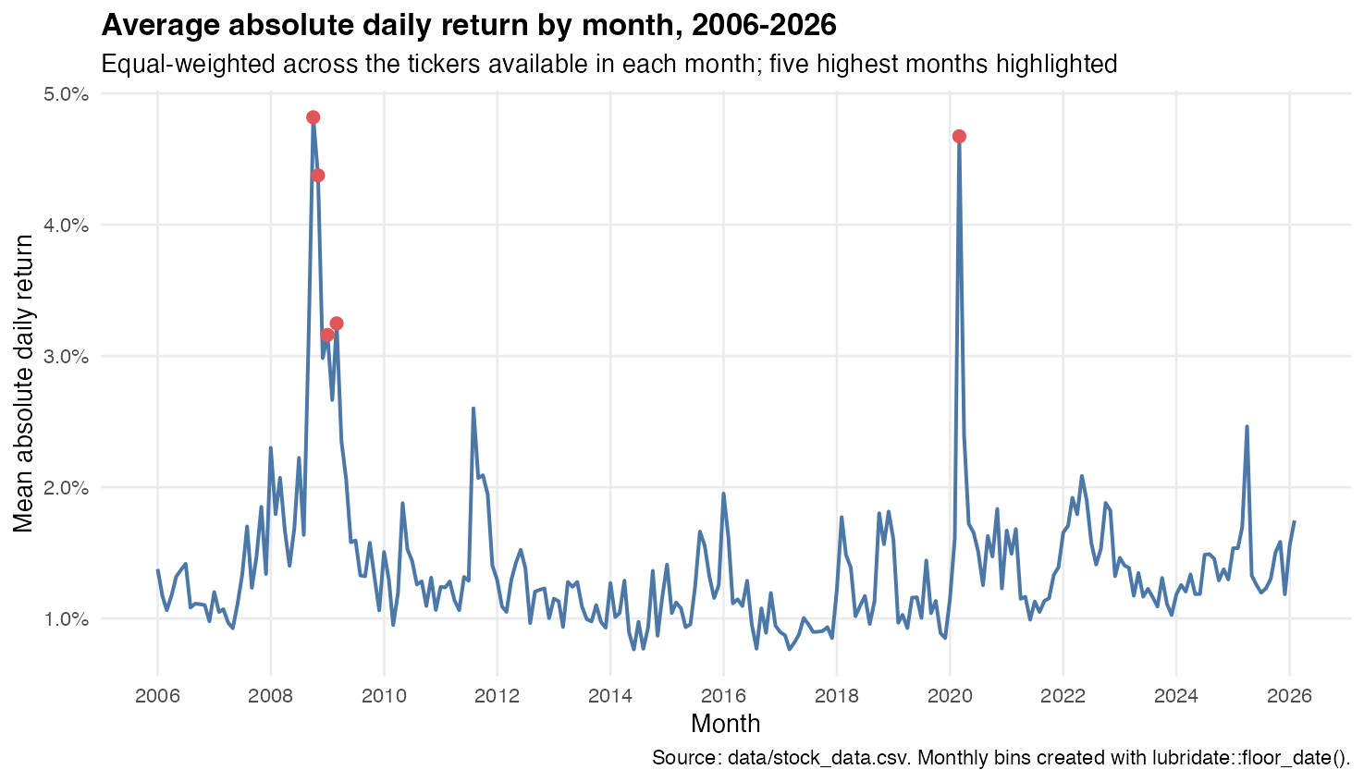
● FINDING 3
9
Panic months produced the largest volatility spikes
Equal-weighted mean absolute daily return by month across available tickers.
OCT 2008
4.82%
MAR 2020
4.67%
Independent monthly aggregation reaches the same crisis conclusion.
HISTORICAL STOCK ANALYSIS / FINDING 3
9
Notes:
The chart is a separate R-based check. October 2008 and March 2020 are the two largest monthly volatility spikes. This supports the panic-period story without relying on the regional-correlation basket.
[Sources]
Chart: assignment_5/part_2/figures/b2_monthly_absolute_return.png. Monthly bins created in R with lubridate::floor_date(); source data/stock_data.csv.

Slide 10
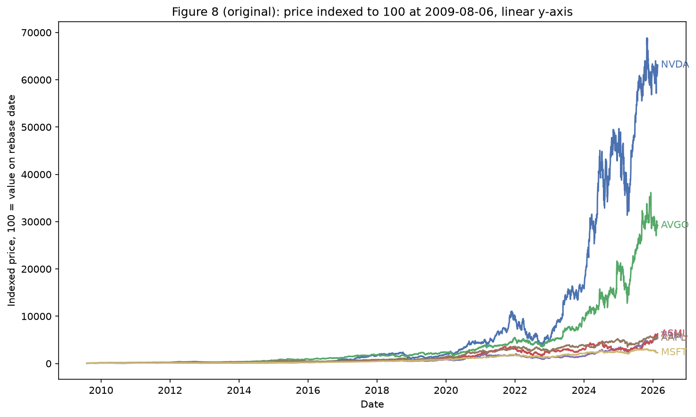
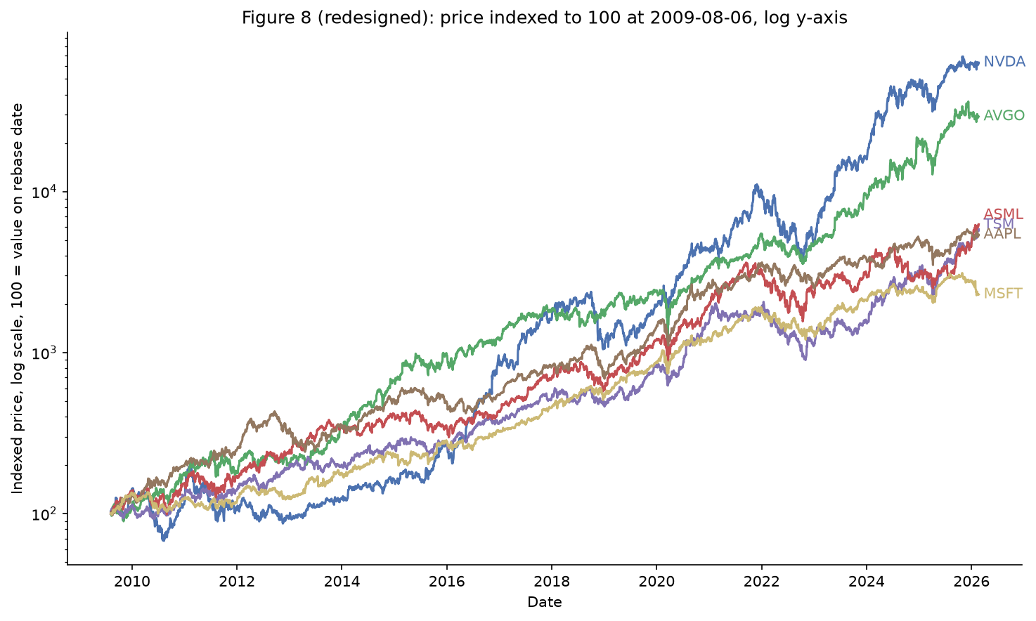
● DESIGN EVOLUTION
10
A log scale reveals the growth stories hidden by the linear chart
Same data and rebasing; only the visual encoding changes.
BEFORE · LINEAR
AFTER · LOG
NVDA and AVGO dominate the absolute range, compressing four lines near the baseline.
Equal vertical distance now represents equal proportional change; all six series remain legible.
Principles applied: appropriate scale · direct labels · less non-data ink · better pre-attentive separation
HISTORICAL STOCK ANALYSIS / DESIGN EVOLUTION
10
Notes:
This slide is explicitly about design principles, not decoration. On a linear axis, extreme absolute growth compresses the other lines. A log axis makes proportional changes comparable. Direct labels and fewer spines reduce search effort and non-data ink.
[Sources]
Before/after charts: extra_credit_1/figures/ec1_a_before.png and extra_credit_1/figures/ec1_a_after.png. Both use data/stock_data.csv.

Slide 11
● CONCLUSION
11
Diversification is present—but thinner when it matters most
The three hypotheses agree on the central story while keeping their boundaries visible.
01
Technology leadership was concentrated
The selected chip/AI group gained 549% versus 168% for broader tech.
02
Regional protection weakened in sudden stress
Average correlation peaked at 0.539 in the 2020 crash.
03
Volatility independently confirmed the panic signal
October 2008 and March 2020 were the largest monthly spikes.
What we can claim: patterns in this dataset. What we cannot claim: causality, forecasting, or a universal market law.
HISTORICAL STOCK ANALYSIS / CONCLUSION
11
Notes:
Resolve the opening question directly. The dataset shows diversification, but technology gains and crisis co-movement make it thinner than the surface suggests. Finish with the boundary: this is descriptive evidence, not causal proof or a forecast.
[Sources]
Synthesis of slides 7–9 using data/stock_data.csv and the cited project outputs.

Slide 12
● WHAT'S NEXT
12
Make the evidence explorable
The dashboard keeps every assumption visible as a filter.
POWER BI / TABLEAU
R WRANGLING
One overview
Long-form by design
Filter by ticker group, region, and crisis period; compare indexed performance, correlations, and monthly volatility.
Use parsed dates, month bins, and one Ticker field so color, grouping, and filters remain consistent.
OPEN RISKS
unequal regional coverage · share-count volume · removed original Kaggle page · no causal interpretation
Success means the user can reproduce each headline and see where the evidence becomes uncertain.
HISTORICAL STOCK ANALYSIS / WHAT'S NEXT
12
Notes:
Describe the dashboard as the next analytical interface, not just a prettier report. The filters should let users change the group and period while retaining the same return, correlation, and volatility definitions.
[Sources]
Dashboard plan derived from assignment_5/part_2 long-form outputs and the Assignment 6 brief. Kaggle source caveat documented in AGENTS.md.

Slide 13
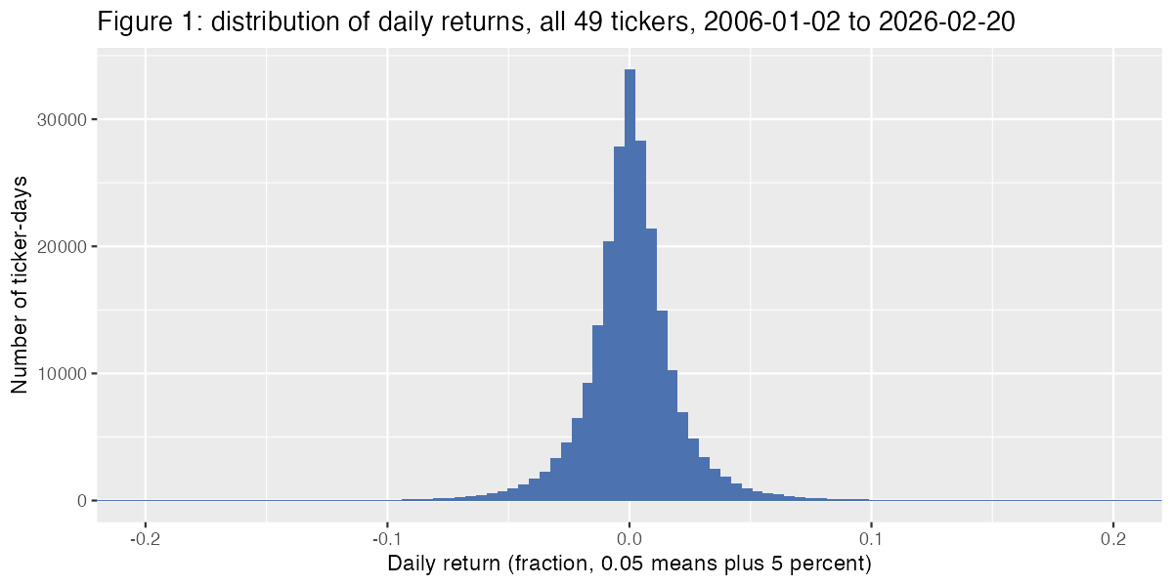
● APPENDIX
13
Descriptive statistics reveal scale—not comparable company value
Raw price summaries mix six currencies, so they are useful for auditing but not for ranking companies.
MEDIAN
48.45
13.3M
Adj Close
daily volume
AUDIT RANGE
Adj Close: 0.135 to 949,000
Volume: 0 to 18.81B shares
The heavy-tailed return distribution is why crisis periods deserve separate analysis.
HISTORICAL STOCK ANALYSIS / APPENDIX
13
Notes:
Use only if asked about basic EDA or descriptive statistics. The median adjusted close is 48.45 and median daily volume is 13.3 million shares, but raw price statistics are not comparable across currencies. The daily-return histogram shows most observations near zero with long tails.
[Sources]
Histogram: assignment_4/figures/fig1_daily_return_hist.png. Summary statistics calculated from data/stock_data.csv on 2026-08-25.

Slide 14
● APPENDIX
14
Definitions behind the headline results
These choices keep each claim reproducible and appropriately narrow.
H1 GROUPS
H2 PERIODS
Chip / AI
Calm
2015–2017
NVDA · AVGO · TSM · ASML · AMD · MU · LRCX
2008 crisis
calendar year 2008
Broader tech
2020 crash
February–April 2020
AAPL · MSFT · GOOGL · AMZN · META · NFLX · ORCL · CSCO
2022 drawdown
calendar year 2022
Indexed value = 100 × Adj Close / Adj Close on shared start date
Correlation = average pairwise Pearson correlation of daily returns across regional baskets
HISTORICAL STOCK ANALYSIS / APPENDIX
14
Notes:
Use for methodology questions. State the exact H1 group definitions and the H2 time windows. Indexed performance uses adjusted close and a shared start date. Regional correlation is the average of pairwise daily-return correlations.
[Sources]
Definitions documented in assignment_3/analysis.ipynb, extra_credit_1/analysis.ipynb, and data/stock_data.csv.

