Slide 1
HISTORICAL STOCK ANALYSIS
Is diversification
thinner than it looks?
Team 2 | Project status presentation
Karthikeyan M Mirthula M Lakshmi Mayuri Kavya N
49 global tickers | 2006-2026
Notes:
Open with the central tension: the dataset looks globally diversified, but the analysis asks whether that diversification survives closer inspection. Introduce the team and dataset in one breath.
[Sources]
data/stock_data.csv; project records in AGENTS.md

Slide 2
THE QUESTION
Diversification looks broad until we test it
H1
Was the post-2023 tech rally broad - or concentrated in selected chip and AI names?
H2
Do different regions move together when a sudden crisis arrives?
H3
Do volatility and trading volume reveal the same panic pattern?
One story: diversification weakens when attention and fear concentrate.
Notes:
Present the three hypotheses as one connected story, not three separate projects. H1 tests concentration within technology. H2 and H3 test concentration during crisis periods.
[Sources]
assignment_3/docs/submissions/26120004_Team2_Assignment3.docx

Slide 3
RELATED WORK
Prior work sharpened the question - it did not settle it
72 years
423.9%
148 firms
Stock correlations tend to rise under market stress.
Semiconductors outpaced the broader US market in the AI boom.
A wider AI ecosystem suggests the boundary matters.
Our contribution is narrower: test these ideas on the companies and periods actually present in our dataset.
Notes:
Preis and colleagues show that diversification can weaken under stress. Morningstar supports the narrow rally argument, while J.P. Morgan shows that the result changes when AI is defined more broadly. That disagreement is why the deck states the selected groups explicitly.
[Sources]
https://www.nature.com/articles/srep00752
https://www.morningstar.com/stocks/three-years-ai-stock-market-boom-charts
https://www.jpmorgan.com/insights/markets-and-economy/top-market-takeaways/tmt-is-it-all-one-big-ai-trade

Slide 4
DATA + APPROACH
We analyzed the same dataset twice - in Python and R
230,111
49
2006-2026
ticker-days
global tickers
daily observations
Python
R
EDA, hypotheses, crisis comparisons, statistical checks
Replication, reshaping, date parsing, monthly grouping
Notes:
The same 230,111 rows were explored in Python and then replicated and reshaped in R. This gives the analysis a useful consistency check rather than two unrelated workflows.
[Sources]
data/stock_data.csv; assignment_2/analysis.ipynb; assignment_4/analysis.R; assignment_5/part_2/analysis.R

Slide 5
DATA QUALITY
The honest comparison required four deliberate choices
01
Mixed currencies
Use returns or index every series to 100.
02
Different start dates
Rebase only when every plotted ticker exists.
03
Uneven regional coverage
Paris is one stock; some regional claims stay provisional.
04
1,706 zero-volume rows
R surfaced a quality issue that the first Python chart did not.
Notes:
Do not dwell on every data-cleaning step. Explain the consequence: raw prices would be misleading across currencies, and regional evidence is limited by the number of stocks available.
[Sources]
data/stock_data.csv; assignment_4/analysis.R

Slide 6
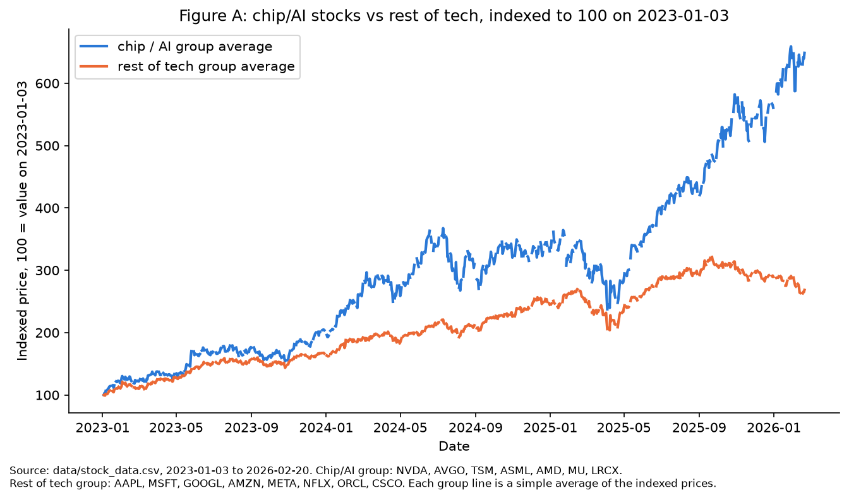
FINDING 1
Chip and AI names pulled away
+549%
vs +168%
Notes:
Both groups begin at 100 on 3 January 2023. The selected chip and AI basket ends near 649, while the selected broader-tech basket ends near 268. The statistical check also found 0.26% versus 0.14% mean daily return, with p = 0.0073. Keep saying selected groups.
[Sources]
data/stock_data.csv; assignment_3/analysis.ipynb; extra_credit_1/analysis.ipynb

Slide 7
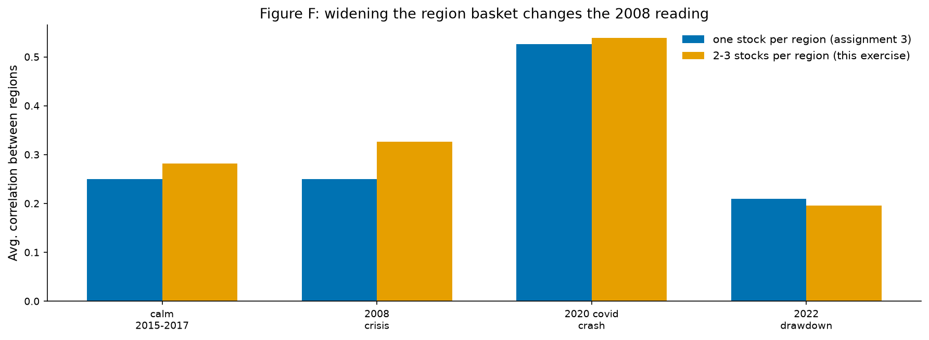
FINDING 2
Regional correlation rose most sharply in 2020
CALM 0.282
2008 0.326
2020 0.539
2022 0.196
Notes:
Widening the baskets makes 2008 more distinct from calm years, but 2020 remains the clearest case of regional co-movement. Be honest that Paris still has one stock, while Korea and Switzerland remain sector-narrow.
[Sources]
data/stock_data.csv; extra_credit_1/analysis.ipynb

Slide 8
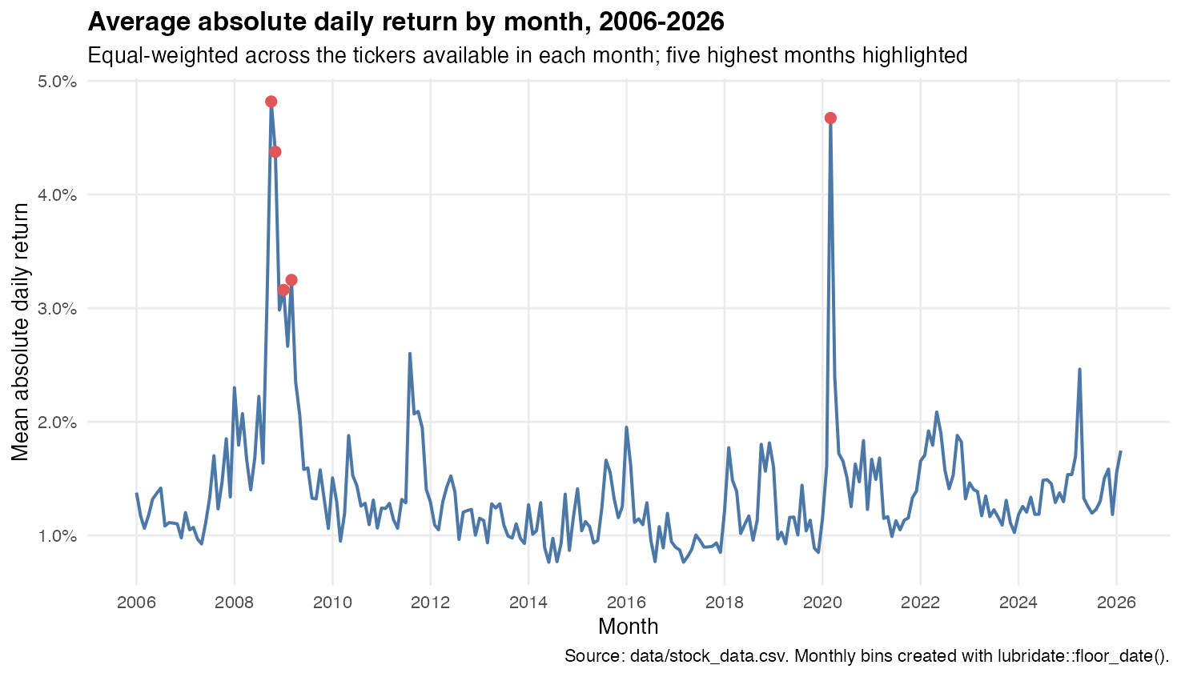
FINDING 3
Volatility peaked in 2008 and 2020
OCT 2008 4.82% MAR 2020 4.67%
Notes:
This R-based monthly view independently confirms the same two panic periods. October 2008 has 4.82% mean absolute daily return and March 2020 has 4.67%, equal-weighted across available tickers.
[Sources]
data/stock_data.csv; assignment_5/part_2/analysis.R

Slide 9
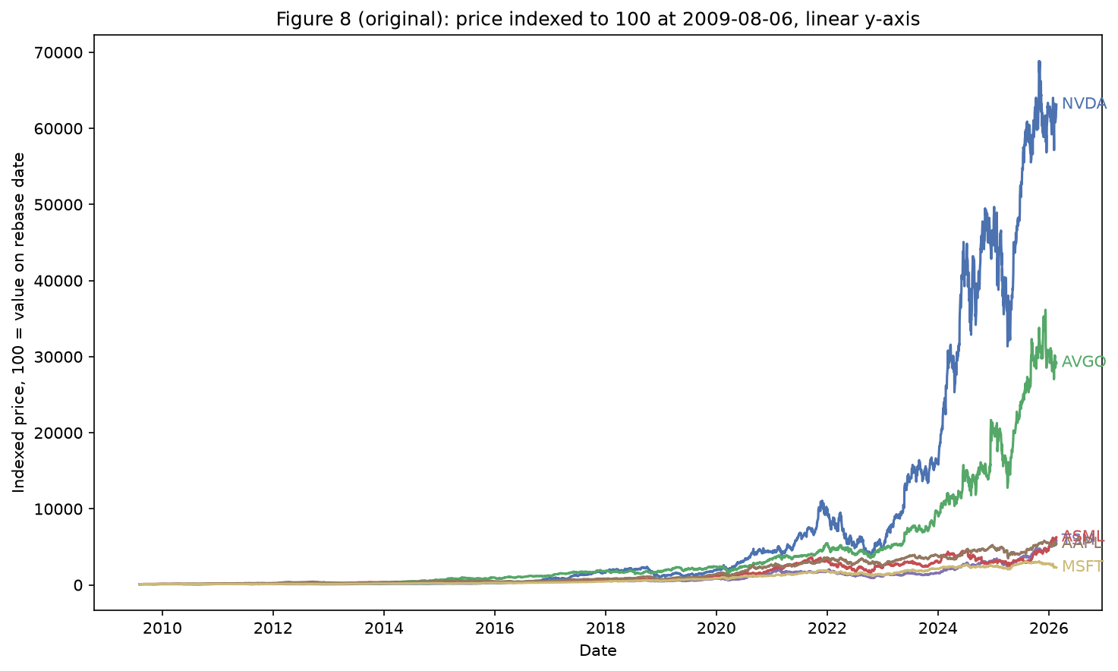
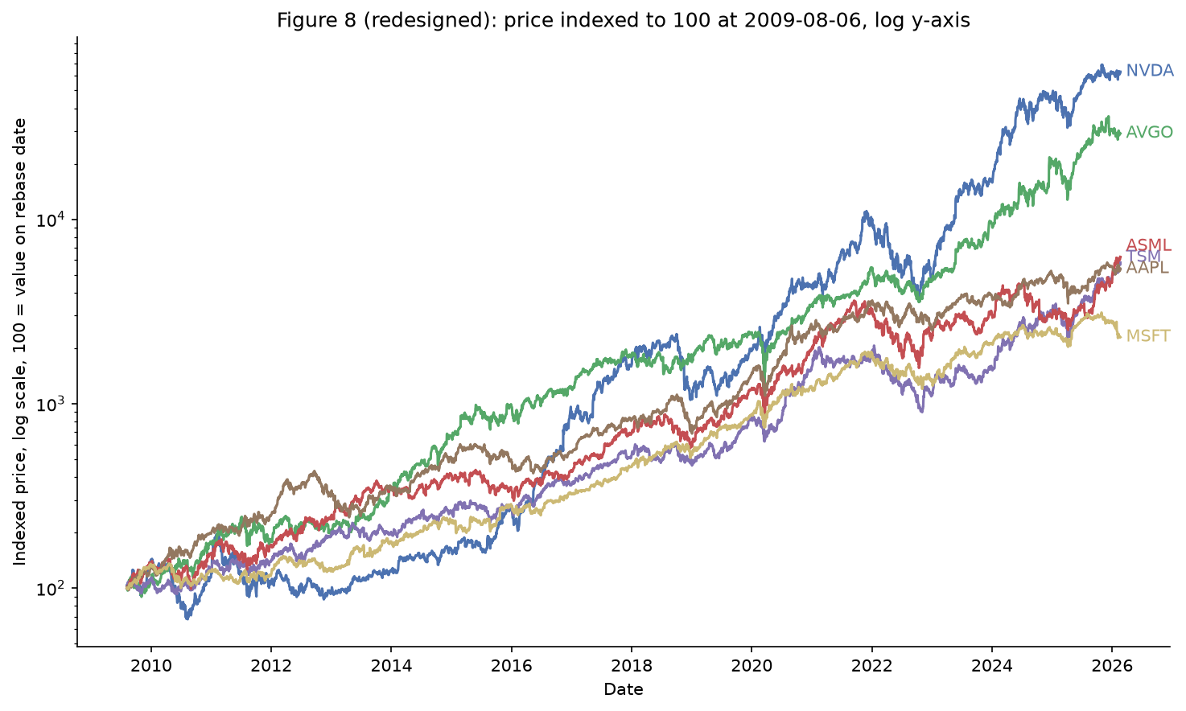
DESIGN EVOLUTION
A log scale recovered the stories hidden at the bottom
BEFORE
AFTER
Linear scale
Log scale
Four lines flatten near zero; end labels collide.
Equal distance means equal proportional change; every line remains legible.
Notes:
Name the principles. The linear chart emphasizes absolute distance even though the question is proportional growth. The log scale makes equal vertical distance mean equal percentage change. The redesign also separates direct labels and removes unnecessary borders.
[Sources]
extra_credit_1/analysis.ipynb; assignment_2/analysis.ipynb

Slide 10
WHAT'S NEXT
Let the audience test
the story for themselves.
Power BI / Tableau
R wrangling
Filter by ticker group, region, and crisis period.
Keep long-form data and month-binned dates ready for interaction.
The goal is an interactive explanation - not a prediction model.
Notes:
Close by resolving the opening question. The evidence suggests diversification is conditional, not absent. The next deliverable should let an audience explore those conditions through group, region, and period filters. End here rather than with a generic thank-you slide.
[Sources]
assignment_5/part_2/analysis.R; half-way-presentation/PRESENTATION_PLAN.md

