Slide 1
Green U
Team 18

Slide 2
Our Objective
Aligned with Rare’s goal to create an app that can help track and incentivize our generation to create eco-friendly habits
Create an app that not only incentivizes people to be more eco-friendly but be competitive about it
College-focused: Inspire college students to be more conscious of the environment through competing individual and collegiate leaderboards

Slide 3








Built with

Slide 4
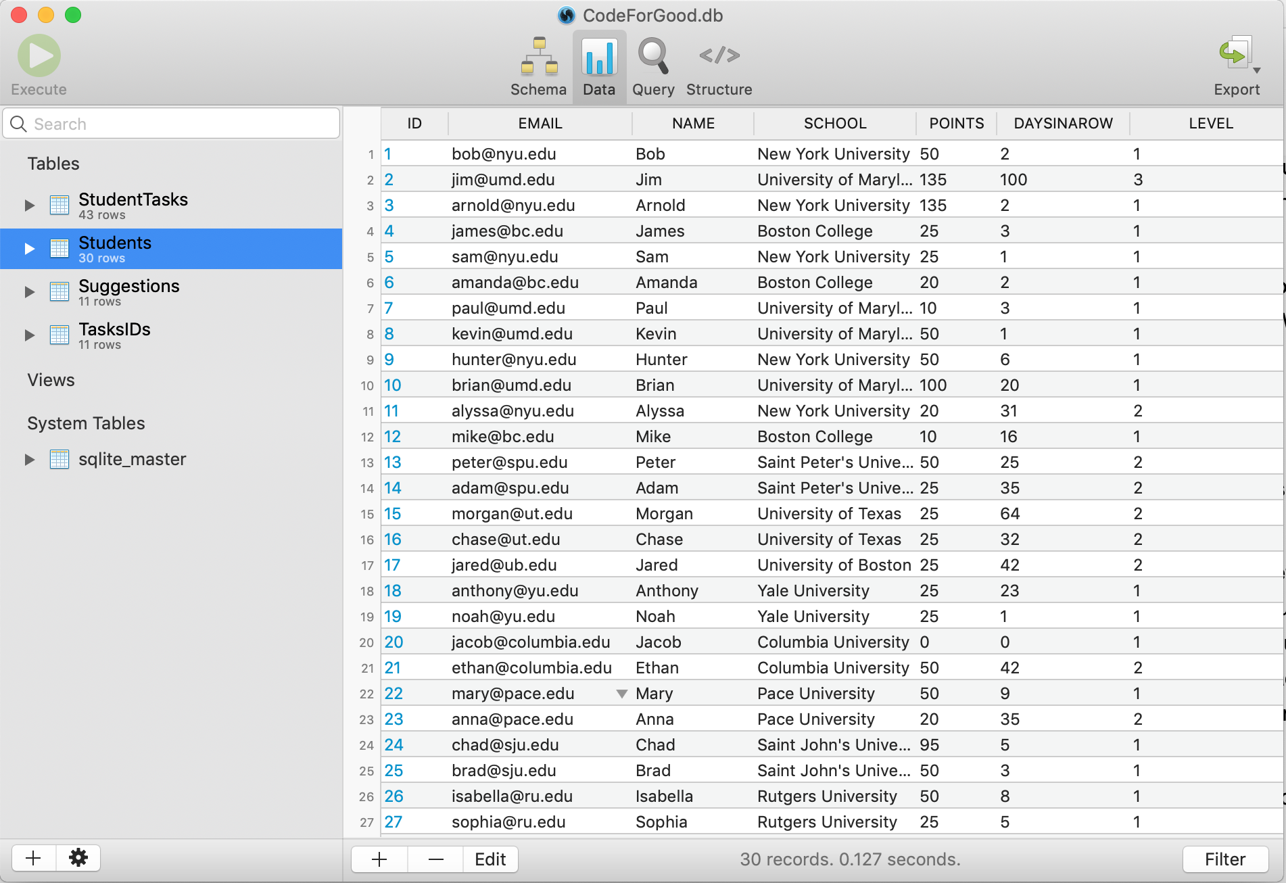
An example of our SQLite database

Slide 5
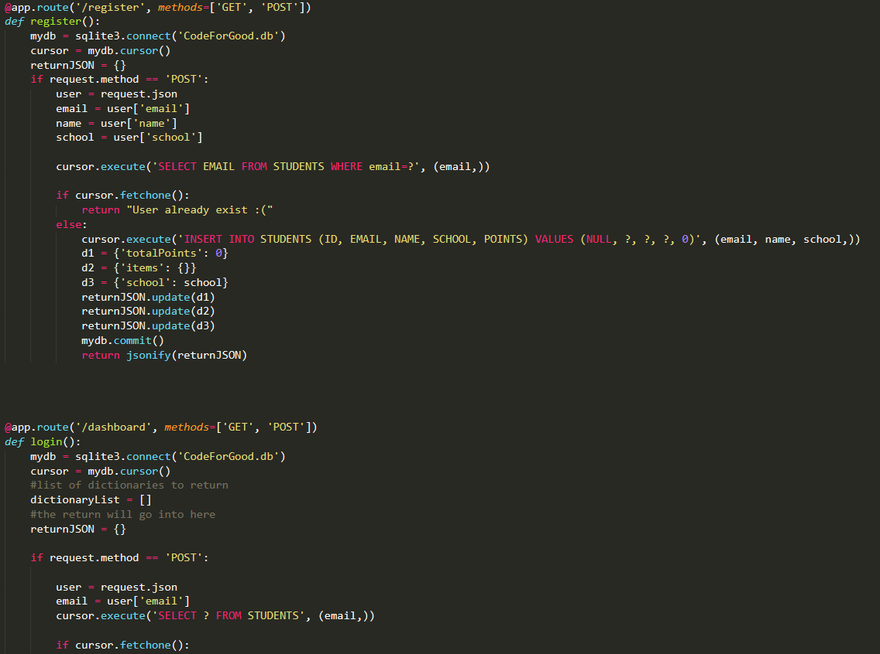
A snippet of our Python-based
API

Slide 6
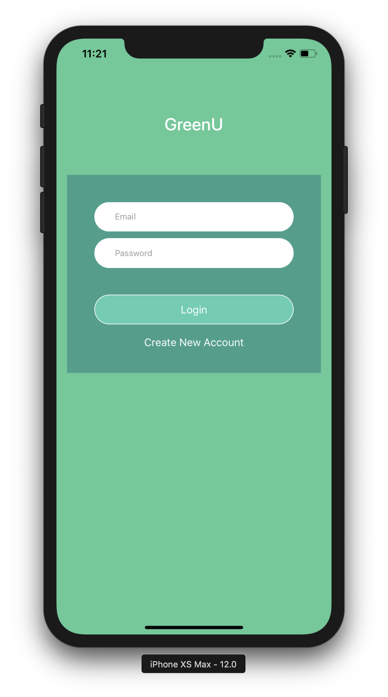
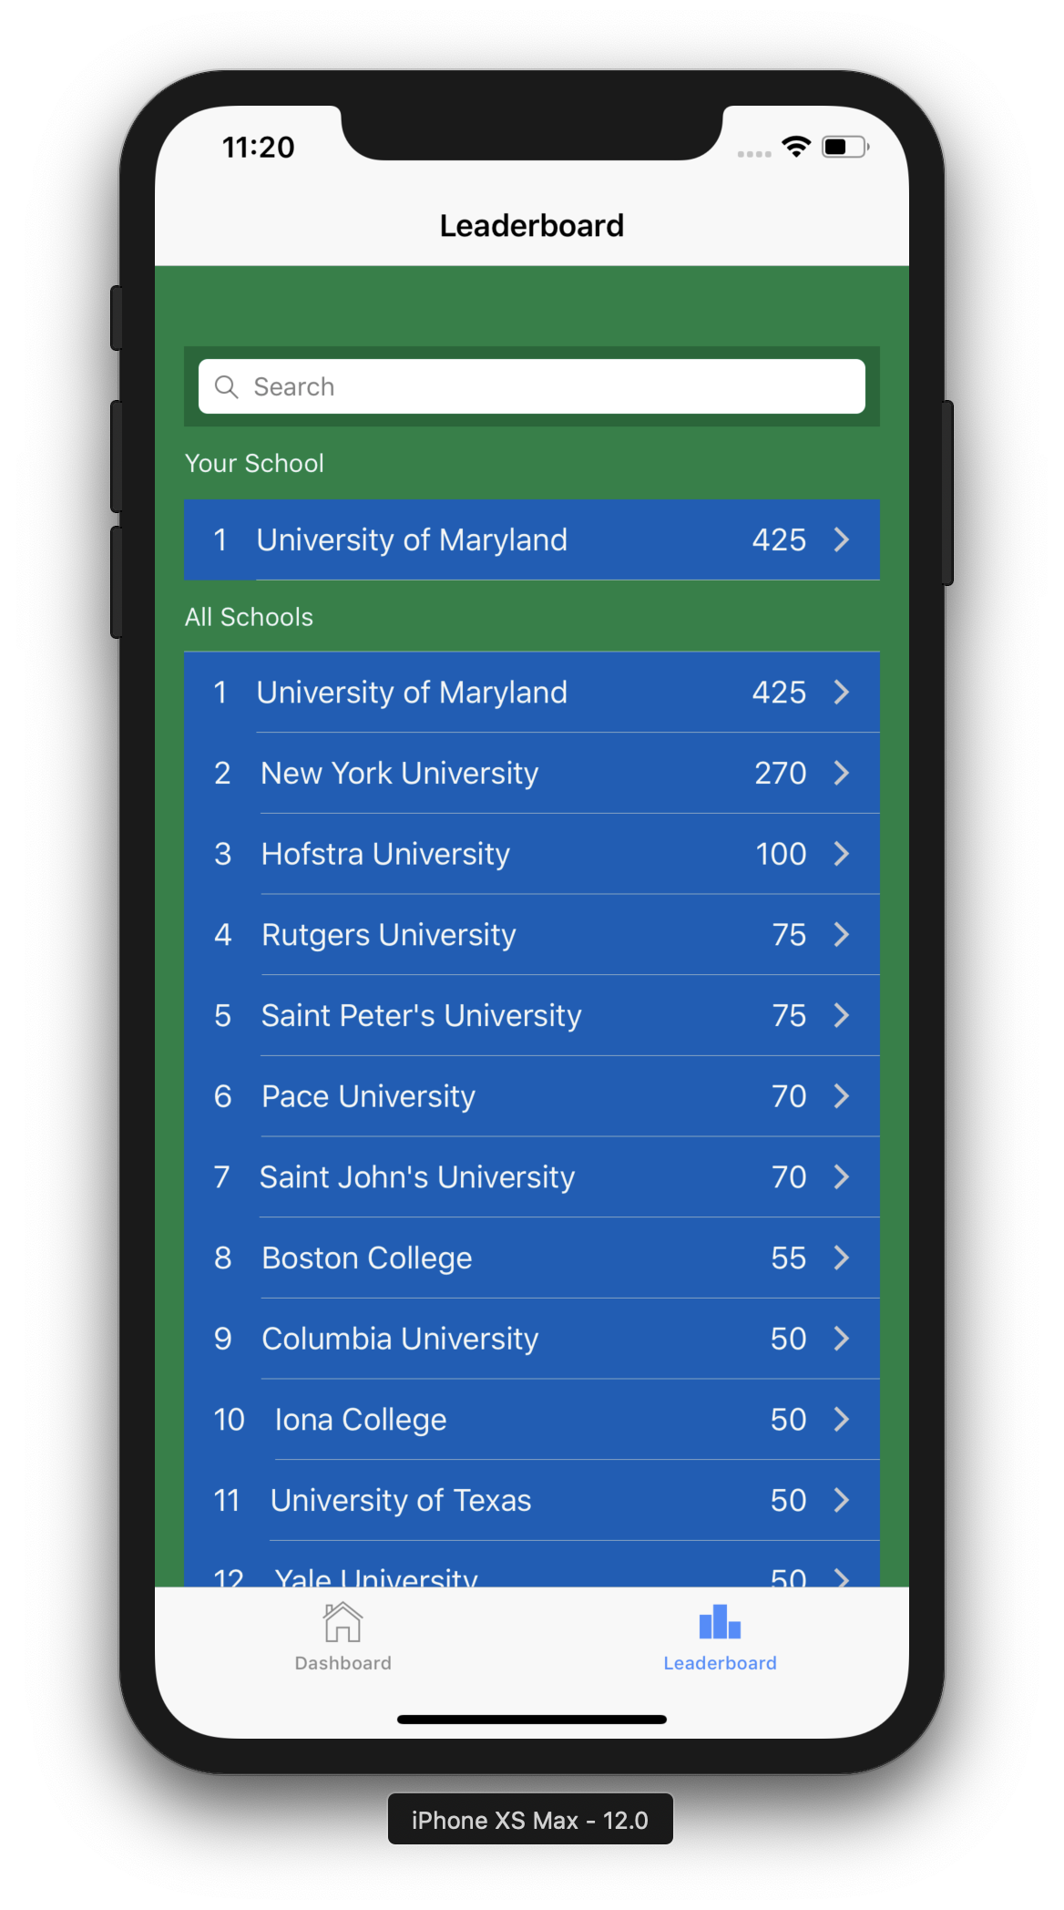
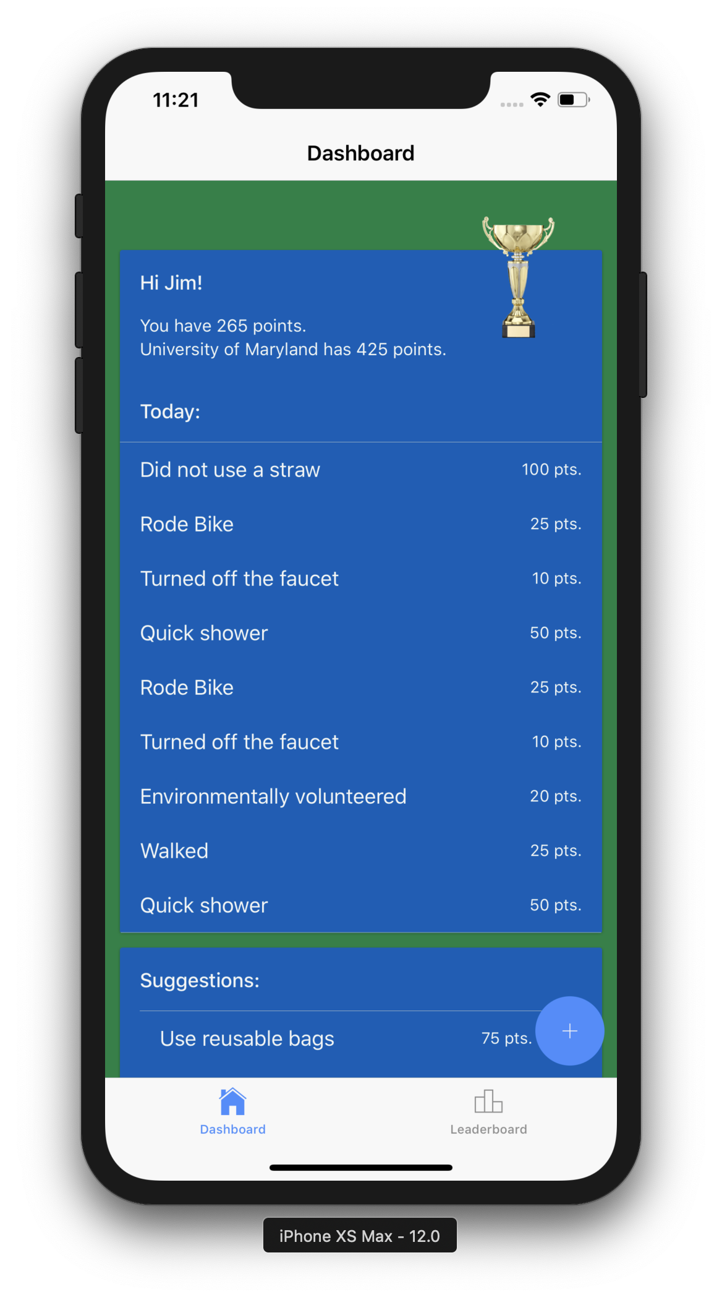

Slide 7
Our Pitch
Our app has real world applications and encourages consistent use
Green U hits what Rare wants for their organization - nudging and rewarding users for taking positive actions
We have a stable platform that we can easily add more features onto - social media implementations, sponsorships, and collecting data

