Slide 1
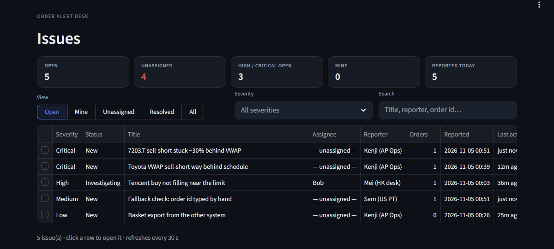
Order Alert
QUANT & SUPPORT · ORDER EXECUTION
From “something is wrong with my order” to a diagnosed issue in minutes, without waiting for IT
The team's issue board
Notes:
Order Alert closes the gap between the trading platform and our team: users report order problems in a form, a watchdog does the first kdb+ lookups, and the team triages and analyses in one app.

Slide 2
Today, order problems reach us late and incomplete
1
2
3
The platform can't alert us
Details get lost on the way
Every lookup starts by hand
Nothing tells Quant & Support when an order fails or stalls in the market, and IT can't add it for now.
Problems arrive by chat or phone, often without the order id, the time or a screenshot.
Someone re-types ids into kdb+ queries before the real investigation can even begin.
Goal: every order problem reaches the team as a complete, owned issue with the kdb+ data already pulled.
Notes:
Three pains: no alerting from the platform, information lost in chat, and manual kdb+ lookups before any analysis.

Slide 3
Three pieces, joined by a folder on the shared drive
1
2
3
4
Order Alert form
Shared drive
Watchdog
Order Alert Desk
HTML page opened from a desktop icon. Nothing to install.
inbox/ receives tickets; processed/ holds one folder per issue.
Parses the rows, queries kdb+, writes the report, emails the team.
Board, issue handling and order analysis for the team.
On the user's PC
Existing share
Python on a server
Streamlit on a server
Users install nothing. Python runs only on our servers; a small notifier on each team PC watches the share. kdb+ is queried with pykx: RDB for today, HDB for prior days.
Notes:
The share is the only integration point, so it works without IT changing the platform. One config.toml drives both the watchdog and the Desk.

Slide 4
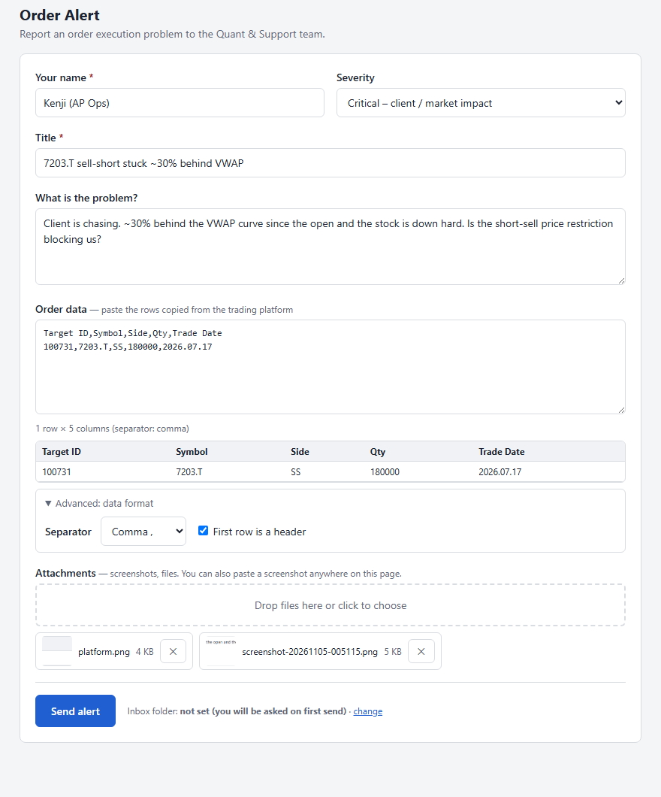
Reporting an order problem takes under a minute
1
Paste the rows from the platform
A live table preview shows what we will receive; a wrong separator is spotted and fixed in one click.
2
Add screenshots
Ctrl+V anywhere on the page, drag & drop, or choose files.
3
Send
The ticket is written straight into the shared inbox. No folder access? It downloads instead.
4
Other systems welcome
Separator and header options sit under a collapsed “Advanced” section.
Notes:
The form is a single HTML file on the share. The desktop icon opens it in an Edge app window, so it feels like an application.

Slide 5
The watchdog does the first lookups for us
1
Claims each new ticket
Atomic rename, so several watchdogs can share one inbox safely.
ONE-LINE STATUS PER ORDER
6758.T buy 1000 VWAP, filled 400/1000 (40%), state=working, 2 child orders, 1 alerts (last: behind schedule)
2
Finds the orders
id_target under whatever header the platform uses (configurable aliases).
3
Queries kdb+
target, target_state, workorder, execution and alerts for each order.
Example from the test suite
4
Files and notifies
Report + CSVs in the issue folder; email to the team with a link to the Desk.
Pasted text never reaches q directly: only validated integers, dates and plain symbols are substituted into the query templates.
Notes:
If kdb+ or email is down the ticket is still filed and visible in the Desk; failures are written next to it rather than lost.

Slide 6
The Desk shows what is open and who is handling it
At a glance
Open, unassigned, high/critical, mine, reported today.
Views for each role
Open · Mine · Unassigned · Resolved · All, plus severity and search.
Always current
Refreshes every 30 s. New tickets appear with no action from anyone.
Most urgent first: open issues by severity, then newest. Click a row to open it.
Notes:
Everyone picks their name in the sidebar; that name is recorded on every action.

Slide 7
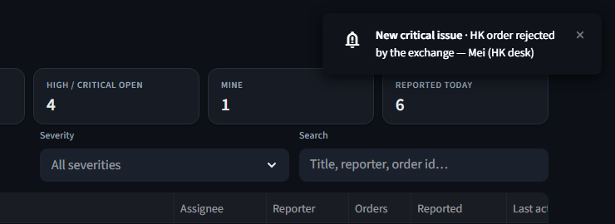


New issues reach the team without anyone watching their inbox
Order Alert
New order issue - CRITICAL
HK order rejected by the exchange
Reported by Mei (HK desk)
Order Alert Desk
Open in Desk
Dismiss
Inside the Desk: pop-up, chime, and the unassigned count in the tab title
On every team member's PC
Branded
“Order Alert” with its own logo and a severity badge, not a PowerShell pop-up.
One click to the issue
Opens it in the Desk. Urgent ones stay on screen until dismissed.
Reminders
If a high/critical issue is still unassigned after 10 min. Stops once someone takes it.
Notes:
The notifier is a PowerShell script on the share: nothing to install. Each member runs install-notifier.ps1 once and it starts at every logon. The notification is shown here as drawn from the real one; everyone can mute or tune it in Windows Settings > Notifications like any app.

Slide 8
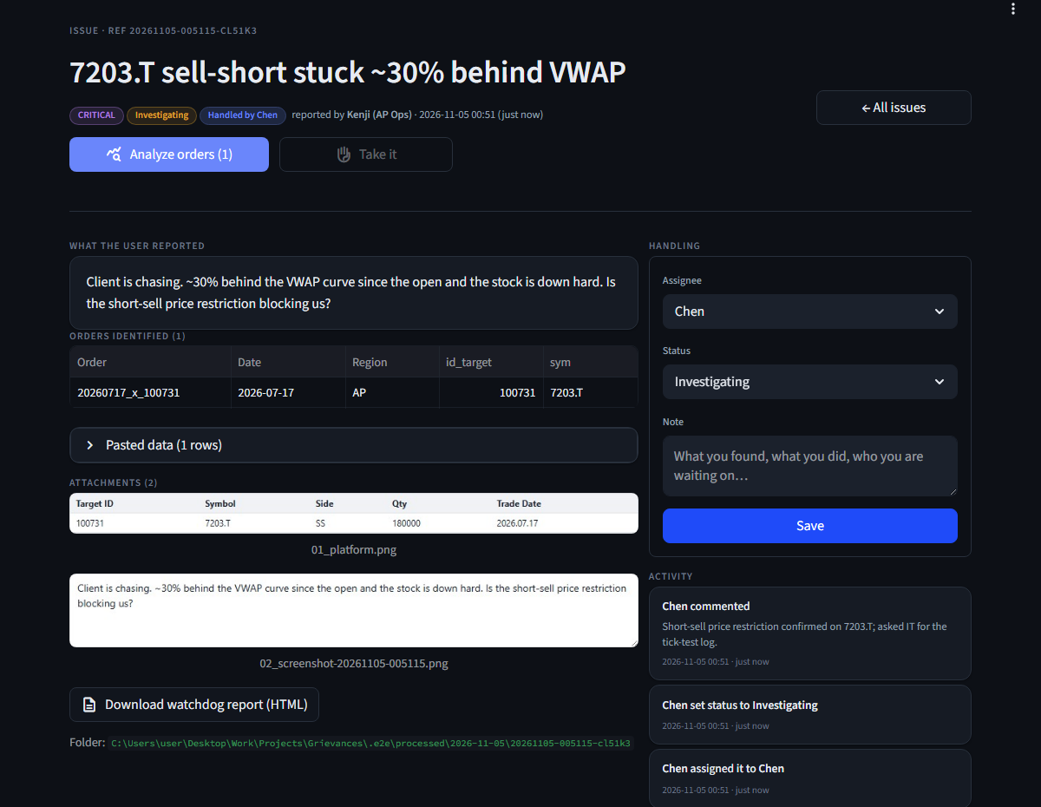
Each issue carries the full report, its owner and its history
1
Everything the user sent
Description, the orders found, the pasted rows and the screenshots.
2
Take it
One click assigns the issue to you and moves it to Investigating.
3
Status and notes
Saved to a shared activity log with who and when; nobody overwrites anyone.
4
Analyze orders
Opens the order-monitor view on the reported orders.
Notes:
Handling state is an append-only log in the issue folder, so concurrent edits are safe and the history doubles as an audit trail.

Slide 9
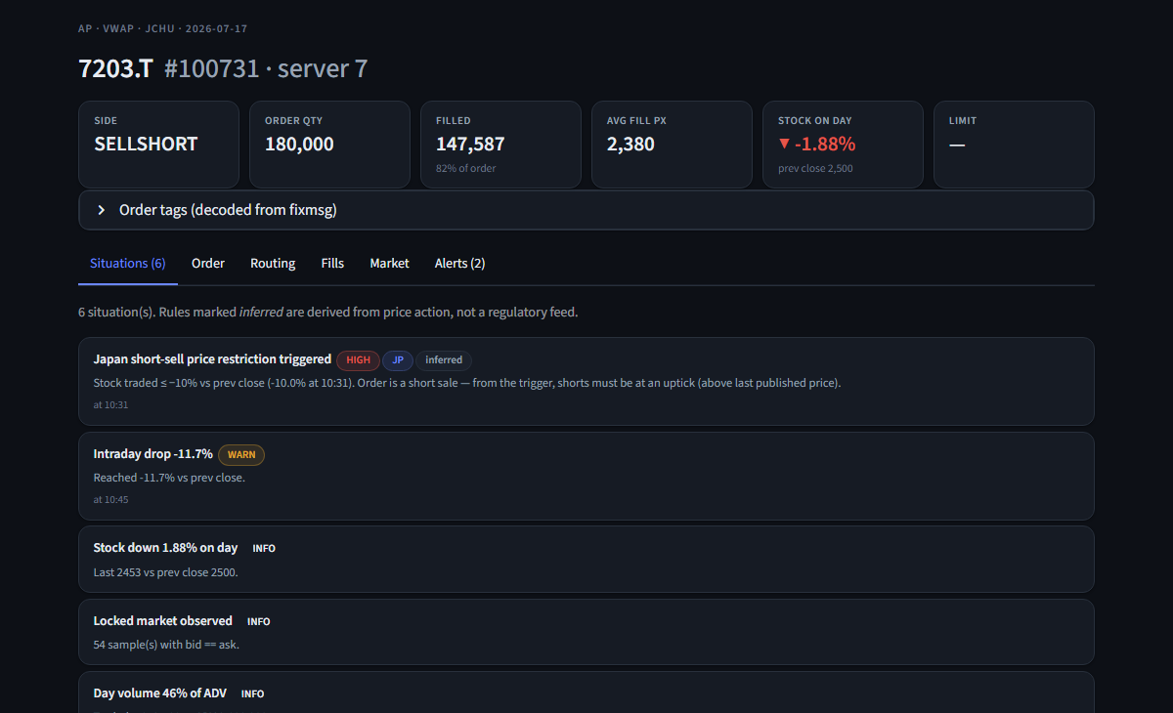
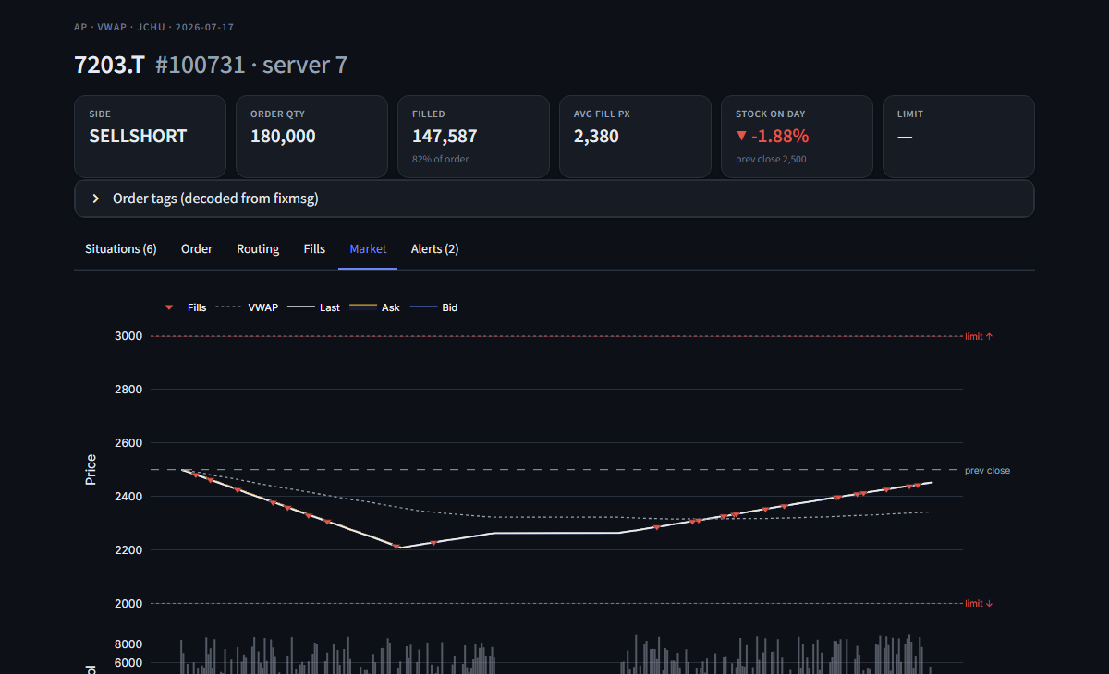
Analyze orders opens the order-monitor view
Situations — rules flag what is going on, e.g. the Japan short-sell price restriction
Market — bid/ask, last and VWAP with our fills and the price-limit band
Also Order, Routing, Fills and Alerts tabs. Live RDB for today, HDB for prior days, or demo data.
Notes:
This reuses the Algo Order Monitor's providers, rules engine and charts, so the analysis matches what the team already knows.

Slide 10
Tested end to end in a real browser, from form to analysis
18/18
18
4
end-to-end checks
unit & page tests
components covered
What the browser test does
Fills the form, fixes a wrong separator, attaches a file and a pasted screenshot
Sends to the inbox, and checks the download fallback
Runs the watchdog and checks the issue folder
Checks desktop notifications and reminders
Opens the board, takes the issue, saves a note, analyzes the order, sees a live alert
Found and fixed by testing
A crashed write could swallow the next activity entry
Error message stayed after the user fixed the form
Note box kept its text after saving (risk of saving twice)
Notification text garbled by PowerShell's encoding
Notes:
Real kdb+ and SMTP were not available in the test environment: the kdb+ path is covered with a fake connection, order analysis with demo data.

Slide 11
To go live
1
Confirm the platform copy
Header name of id_target and the separator.
2
Set up the share
Folders, the form and its desktop icon; each team member installs the notifier once.
3
Deploy on a server
Watchdog + Desk with pykx; kdb+ endpoints and SMTP in config.toml.
4
Pilot with one desk
Collect feedback, then roll out to everyone.
Notes:
Nothing here needs IT to change the trading platform.

