Slide 1
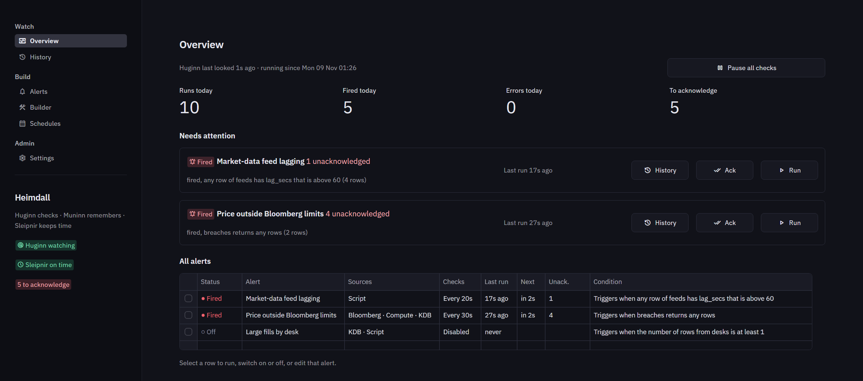
Heimdall
Alerts over KDB, Bloomberg and our own scripts, checked around the clock
Huginn checks Muninn remembers
Sleipnir keeps time Bifrost is where we work
Notes:
Heimdall is the alerting half of KdbMonitor, rebuilt as a service. In Norse myth Heimdall keeps watch over the Bifrost bridge; Odin's ravens Huginn and Muninn fly out and report back; Sleipnir is his horse. Each name is one part of the system.

Slide 2
Alerting outgrew the dashboard
KdbMonitor today
Heimdall
Checks run only while a browser is open
Close the tab and nothing is watched.
Alerting lives inside the Streamlit app
Engine, storage and UI are one program.
KDB queries only
Bloomberg limits and our scripts cannot take part.
A service that never sleeps
Huginn checks every alert on its interval, browser or not.
Built and read in Bifrost, run by Huginn
The app only talks to the service's API.
KDB, Bloomberg and scripts, chained
One step's result feeds the next, with full history and schedules.
Dashboards stay in KdbMonitor; Heimdall takes over alerting.
Notes:
Dashboards stay in KdbMonitor. Heimdall takes over alerting only, and changes its shape: from a page that checks while it is open, to a service that always checks.

Slide 3
Four parts, one job each
KDB servers
pykx, host and port
Bifrost
Huginn
HTTP
Streamlit app: build alerts, watch them, read and clean history
HTTP API and the engine: runs alerts, records runs, sends email
BbgRelay
Bloomberg bdp and snap
Registered scripts
run on Huginn's machine
Sleipnir
Muninn
Scheduler: switches alerts on, off, or runs them on cron
SQLite store: alerts, schedules, every run and change
SMTP
email notifications
Only Huginn touches the database, and every check and test run happens on Huginn's machine.
Notes:
Bifrost and Sleipnir never open the database: they go through Huginn's API, protected by a token. Because test runs also execute on Huginn, what you see in the Builder is what the service will see.

Slide 4
An alert is a chain of steps
1
KDB
2
Bloomberg
3
Script
4
Compute
Guided query or raw q against a KDB connection
bdp or snap through BbgRelay, one line per security
A registered script; reads JSON, CSV, a value or the exit code
Join earlier tables, derive columns, keep rows that match
Later steps use earlier results
{{orders.sym}}
in q: `AAPL`MSFT in a security line: one line per value
{{orders.sym[0]}}
the first value alone
{{table:orders}}
the whole table, to join against in q
{{rows:orders}}
the row count
Notes:
The condition judges one step's table, by default the last. A Bloomberg line such as {{orders.sym}} US Equity keeps sym beside security in its result, so a compute step can join it straight back.

Slide 5
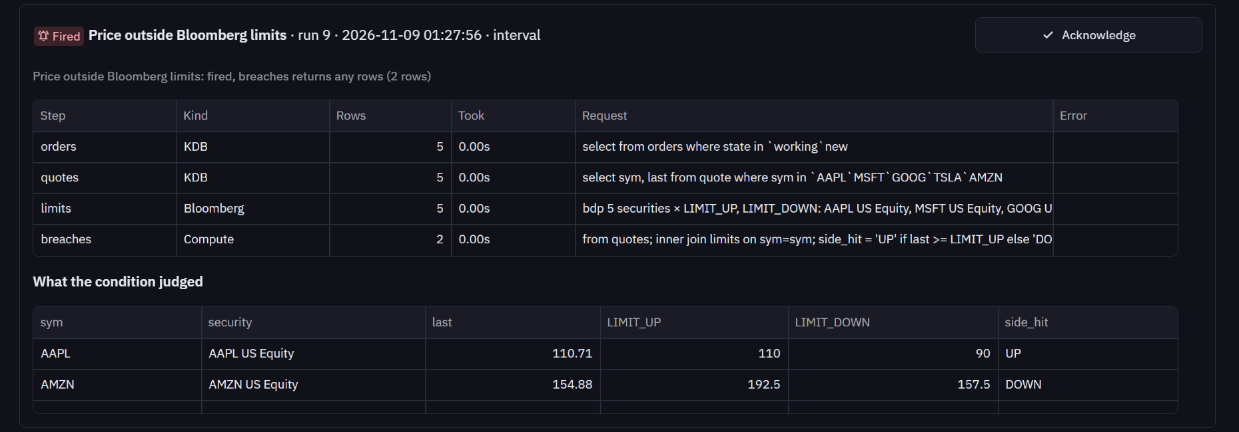
Example: a stock trading through its Bloomberg limit
orders KDB
quotes KDB
limits Bloomberg
breaches Compute
working orders
last price of those syms
LIMIT_UP, LIMIT_DOWN
last beyond a limit
Notes:
This is one of the demo alerts, shown as a recorded run in History. Every step's resolved request is kept, and the table the condition judged: here AAPL above its limit up and AMZN below its limit down.

Slide 6
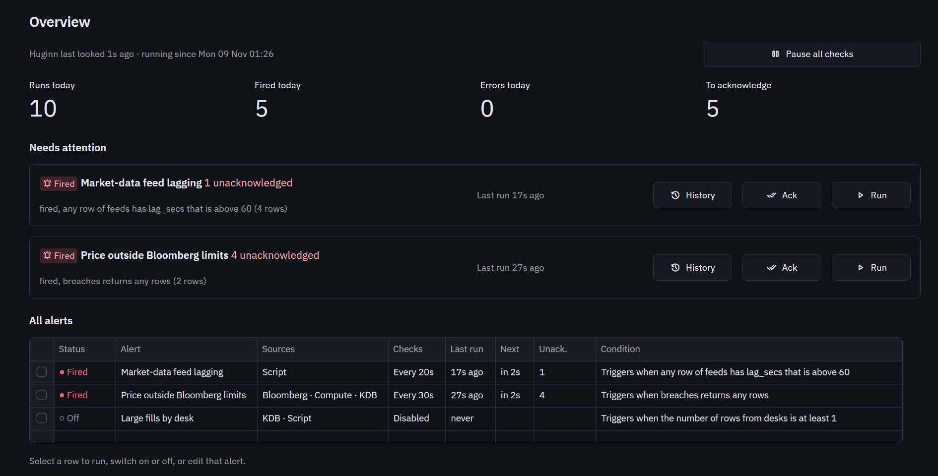
Overview: what needs attention now
Needs attention
Alerts that fired or keep failing, with History, Acknowledge and Run beside each.
Today at a glance
Runs, firings, errors, and what is still unacknowledged.
Every alert
Its last and next check; select one to run, switch on or off, or edit.
Notes:
The page refreshes every ten seconds. The sidebar shows whether Huginn is answering and whether Sleipnir has checked in.

Slide 7
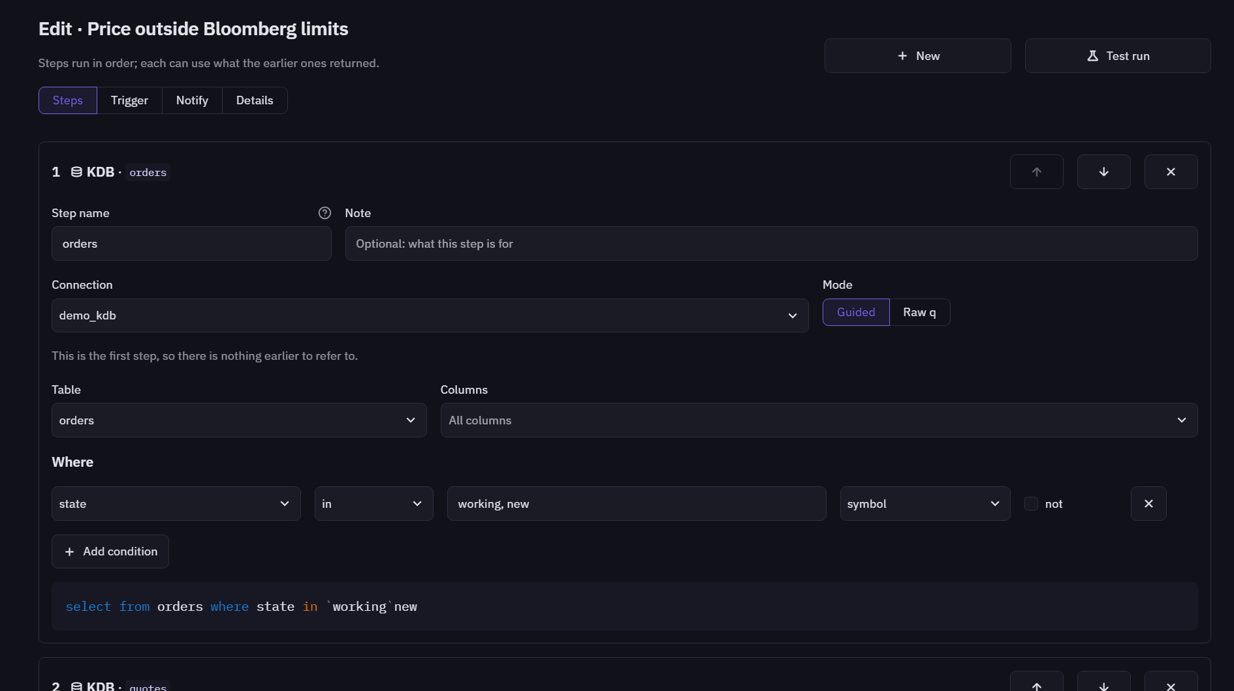
Builder: build it, test it, then save it
Steps in order
Each step names itself; later steps refer to it.
Test run
Runs the chain on Huginn. Nothing is recorded or emailed, and each step's columns are offered to the next.
Save only when ready
Problems Huginn finds are listed and Save stays disabled until they are fixed.
Notes:
Trigger, Notify and Details are the other sections: when it fires, who gets the email, and how often Huginn checks it.

Slide 8
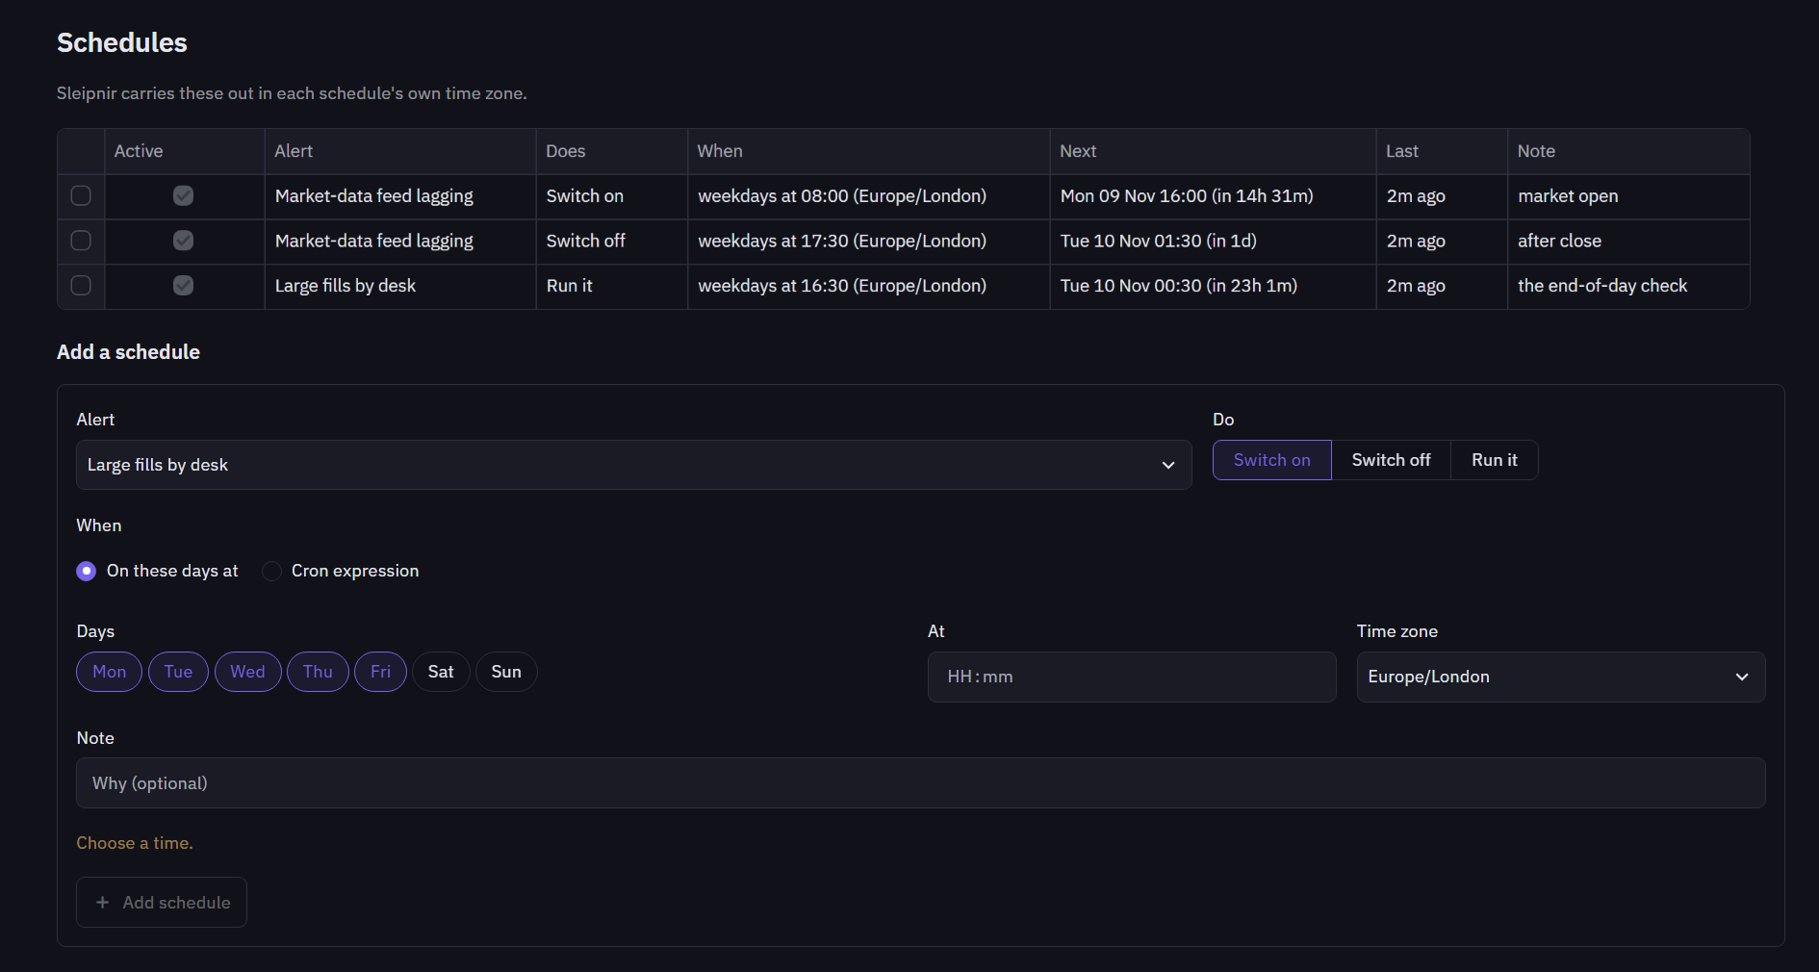
Schedules: Sleipnir keeps time
Switch on, switch off, or run
At given days and time, or any cron expression.
In the desk's own time zone
Europe/London, Asia/Tokyo; daylight saving is handled.
Safe after downtime
Only the latest missed on or off is applied; a run more than five minutes late is skipped and noted.
Notes:
A typical use is switching an alert on at the open and off after the close, or running an end-of-day check at 16:30.

Slide 9
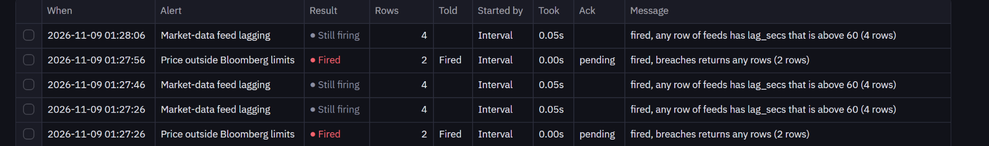
History: every check is kept, and can be cleaned
Older than N days
Keep the newest N
One alert, entirely
Automatically
Remove runs before a date, for all alerts or one.
Per alert, so busy alerts do not crowd out quiet ones.
Including alerts already deleted.
Huginn applies the policy every hour.
The count to be removed is shown before you confirm, and unacknowledged firings can be protected.
Notes:
A firing is the run that starts an episode, or one that sent an email. Only firings wait to be acknowledged, so an alert that stays true for an hour asks once, not once per check. Every change (edits, schedule actions, cleanups) is recorded too.

Slide 10
Safe by design
✓
Registered scripts only
✓
Guarded expressions
An alert names a script an administrator approved. No shell, and each parameter is one argument, so a shared alert cannot run anything new.
Compute expressions are checked node by node: columns, numbers, arithmetic, comparisons and a few functions. Nothing else runs.
✓
A token on the API
✓
Secrets stay out of storage
Bifrost and Sleipnir present it on every call; Huginn warns if it listens on the network without one.
The database and config hold only the names of environment variables, never passwords or tokens.
Notes:
Imported alerts always arrive switched off, so someone looks before they run.

Slide 11
Tested from a single function to the whole system
65
Unit
References, guarded expressions, scripts, compute, conditions, cron, validation, the demo chains.
tests, all passing, in about a minute
Integration
Engine, Muninn, the API, Sleipnir and every Bifrost page, wired together in one process.
End to end
The real Huginn, Sleipnir, Bifrost and BbgRelay's fake Bloomberg, with a mail server: every step kind, email, error and recovery, a cron schedule, cleanup, a restart.
KDB runs against the built-in mock in tests: a real kdb+ needs a licence and a server.
Notes:
Run them with: .venv\Scripts\python -m pytest. Add -m "not e2e" for the fast unit and integration tests only.

Slide 12
Getting started
Next steps
git clone https://github.com/kas77000/heimdall.git
cd heimdall
python -m venv .venv
.venv\Scripts\pip install -e ".[dev,kdb]"
.venv\Scripts\python -m heimdall all --demo
Run it against the real KDB servers
Same connections as KdbMonitor.
Connect the production BbgRelay
Limits and prices from the Terminal.
Register the desk's scripts
Then build the first real alerts.
Run it as a service
Task Scheduler setup is in the guide.
Bifrost opens at localhost:8501 with three working demo alerts. The full guide is docs/SETUP.md.
Notes:
Teams and Slack notifications were left out on purpose for now; email is the only channel.

