Slide 1

ACIT4280 Privacy by Design
Group Assignment 1A
Analysis of 3rd-party Data Sharing and Data Tracking and of GDPR Compliance of Norwegian Web Sites
Our questions
Article 6(1) GDPR
When a front page loads, how many third parties does it contact, and in which countries do those servers appear to be located?
When a site processes personal data, has it named a GDPR Article 6 lawful basis, and does the ICO tool agree?
Six lawful bases for processing personal data:
Consent (a)
Contractual necessity (b)
Legal obligation (c)
Vital interests (d)
Public task (e)
Legitimate interests (f)
Humna Akhtar · Mithun Chandra Debnath · Karina Sætersdal Nilssen
3 September 2026
Notes:
Part 1 measures contact. Part 2 tests one purpose at a time.

Slide 2
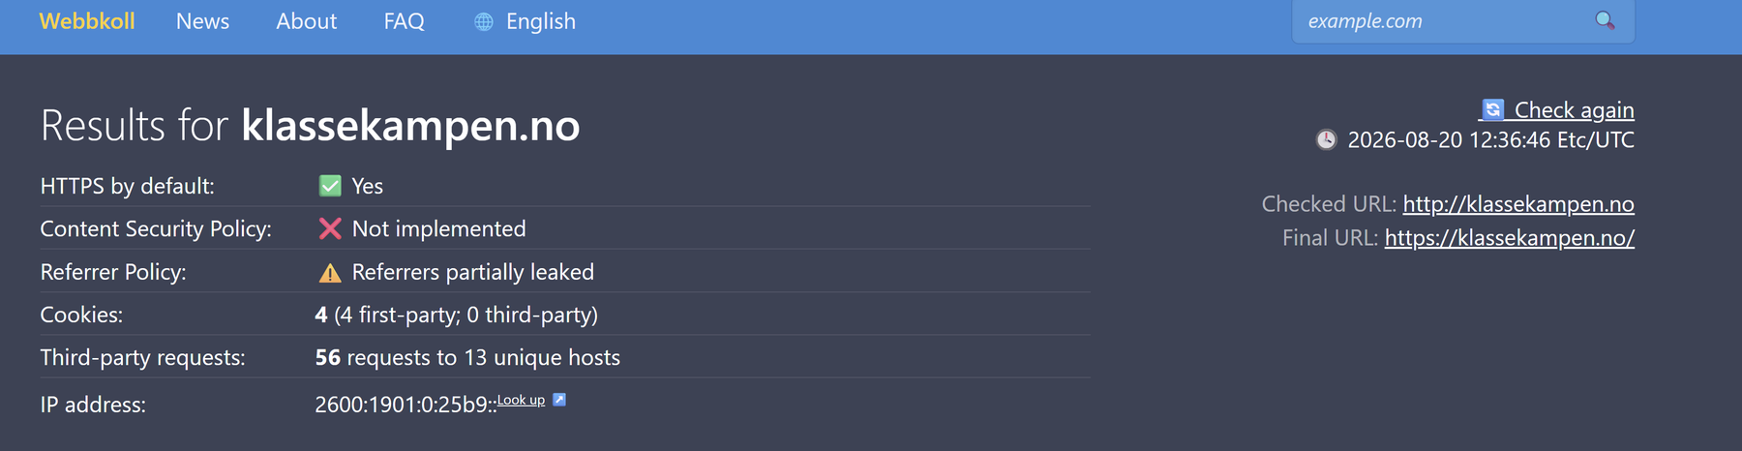

The report
Two questions and how we measured
Part 1 · Webbkoll
Part 2 · ICO
• 18 sites: cookies, requests, KeyCDN country
• One clean load per site; rank on Table 2 (20 Aug)
• KeyCDN = IP geolocation guess, not legal transfer proof
• Five sites, one purpose per run
• Notice vs ICO Word report (26 Aug 2026)
• Yes if notice and ICO agree
• Partial if consent is INCONCLUSIVE
• Tax, cookies, checkout and marketing are different purposes
ACIT4280 Group Assignment 1A | 3 Sep 2026
2 / 14
Notes:
Webbkoll records one load. ICO tests one purpose at a time. Contact and lawful basis are different questions.

Slide 3
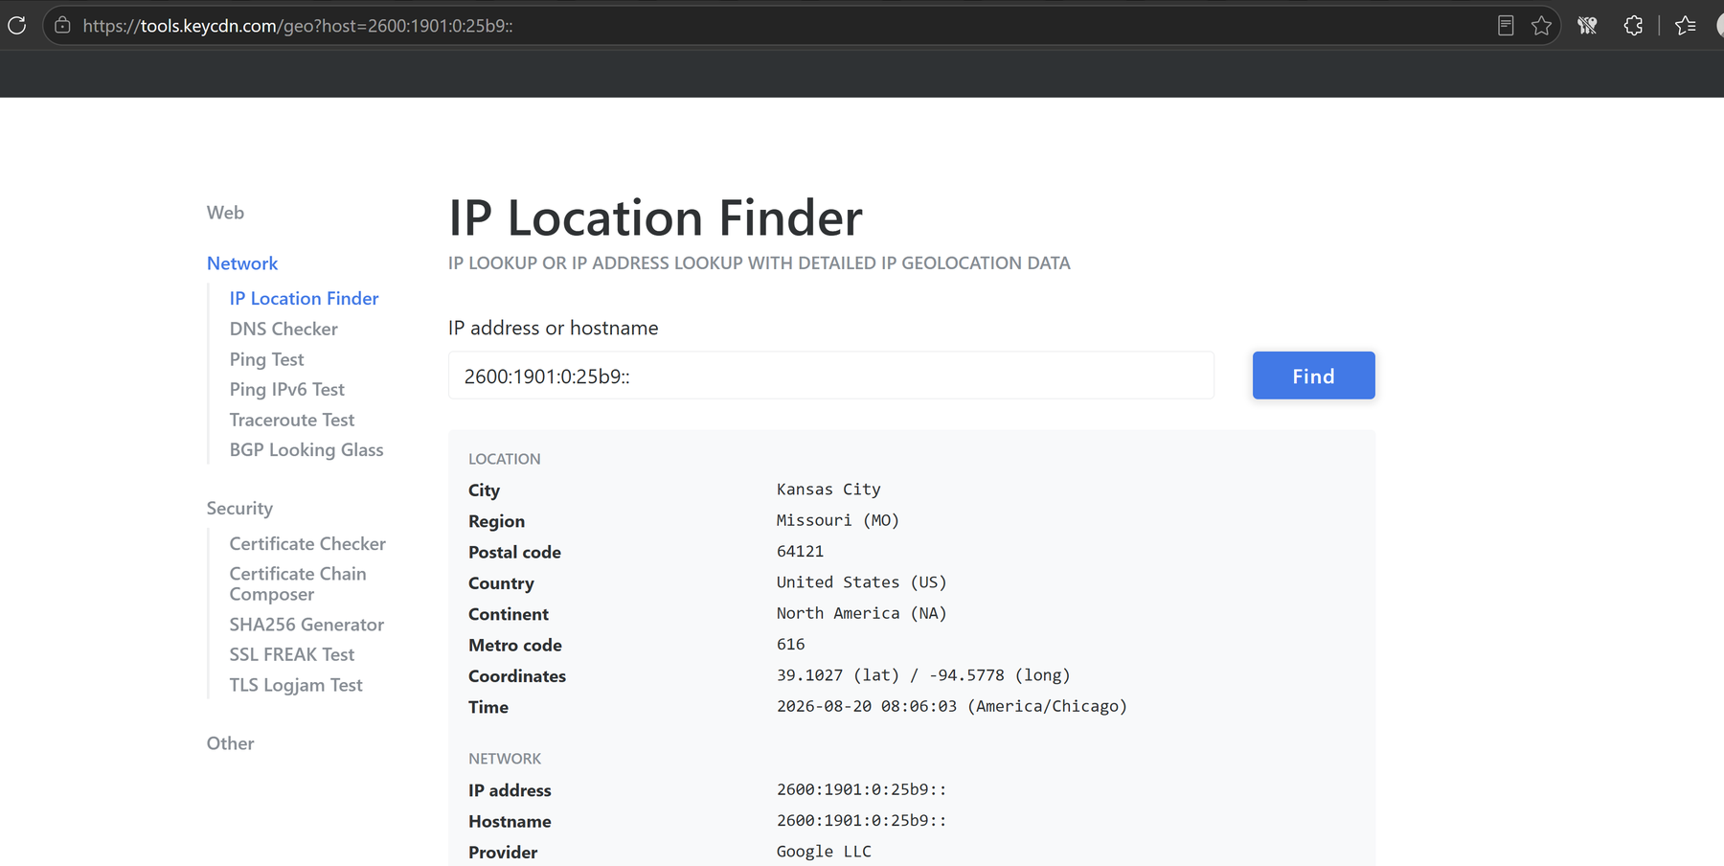
Part 1
What Webbkoll shows and key findings
What Webbkoll shows
Key findings
Cookies, third-party requests and server country.
Many requests does not mean many cookies.
• fotball.no: 113 requests, zero third-party cookies.
• 17 of 18 sites: zero third-party cookies. ikea.no had 2.
• lanekassen.no (1) and altinn.no (5): quietest e-government pages.
• document.no: widest country list (6 excluding Norway).
• News/media contacted the most. Government the fewest.
• babyshop.no: 45 on first scan, 101 on repeat scan.
ACIT4280 Group Assignment 1A | 3 Sep 2026
3 / 14
Notes:
Webbkoll counts contact on one load. Cookies and requests are separate measures.

Slide 4
Part 1 · Table 4
Highest and lowest third-party requests
Highest five
Lowest five
1 fotball.no
1 lanekassen.no
Sport · 113 requests · 5 countries
Government · 1 request
2 worldofwarcraft.com
2 altinn.no
News/media · 90 · 4
Government · 5
3 document.no
3 nrk.no
News/media · 51 · 6 (widest list)
News/media · 7
4 aftenposten.no
4 spotify.no
News/media · 48 · 5
News/media · 10
5 klassekampen.no
5 skiforeningen.no
News/media · 46 · 2
Sport · 14
ACIT4280 Group Assignment 1A | 3 Sep 2026
4 / 14
Notes:
fotball.no has 113 requests and zero third-party cookies. document.no has the widest country list (6).

Slide 5
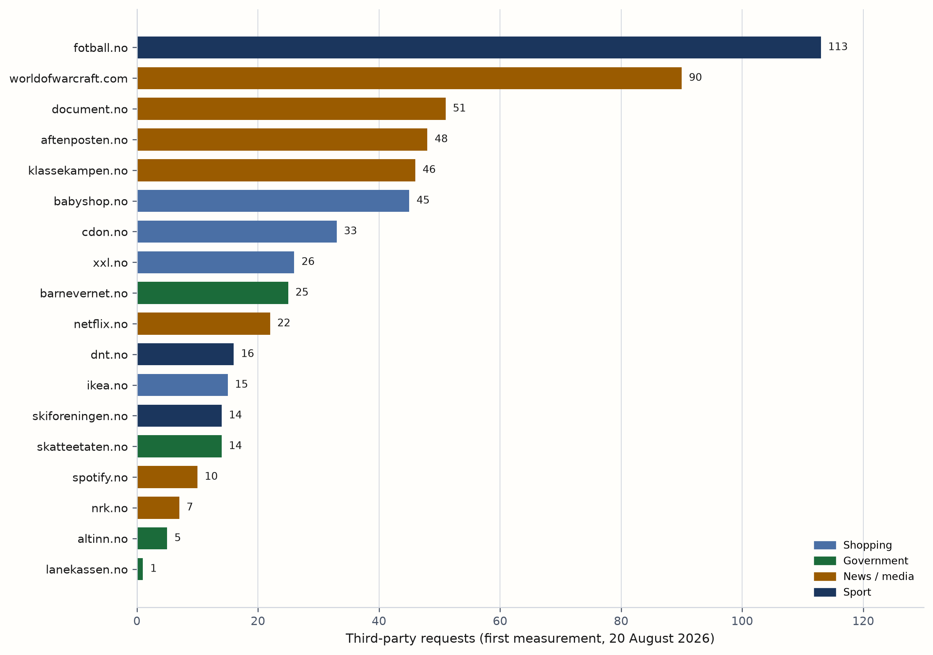
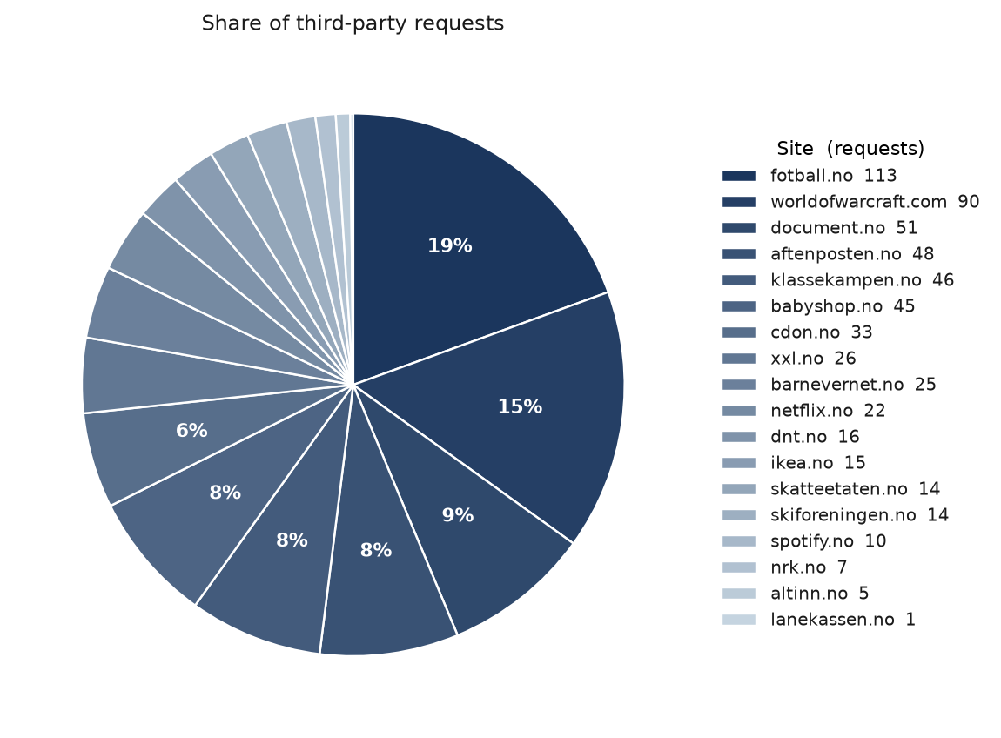
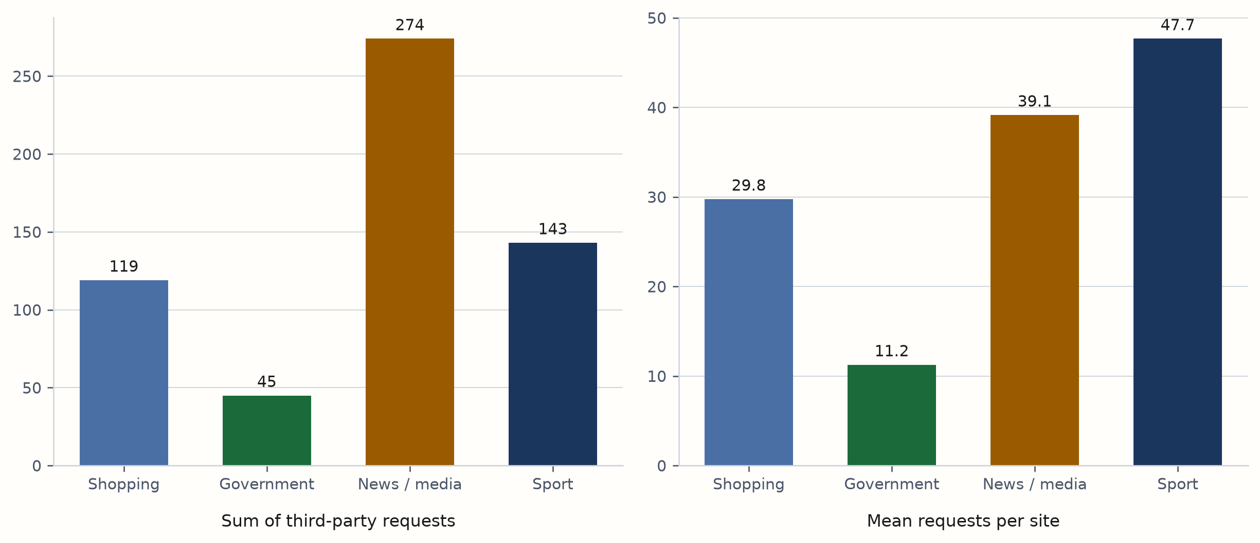
Part 1 · Figures 2 to 4
Third-party requests by site and sector
News/media is the highest sector. Government is the lowest.
ACIT4280 Group Assignment 1A | 3 Sep 2026
5 / 14
Notes:
fotball.no 113. lanekassen.no 1. The pie is request share, not cookies.

Slide 6
Part 2
ICO: one purpose at a time
One purpose per ICO run (26 Aug 2026). Yes if notice and ICO agree; Partial if consent is INCONCLUSIVE.
Tax, cookies, checkout and marketing are different purposes.
Service
Purpose
ICO
Match
skatteetaten.no
Tax / folkeregister
Legal obligation + public task
Yes
skatteetaten.no
Optional cookies
Consent INCONCLUSIVE
Partial
netflix.no
Paid streaming
Contract
Yes
fotball.no
Name + club, 13+
Legitimate interests
Yes
document.no
Google Signals
Consent INCONCLUSIVE
Partial
babyshop.no
Checkout
Contract
Yes
ACIT4280 Group Assignment 1A | 3 Sep 2026
6 / 14
Notes:
Each row is one purpose from Table 1a. Partial means consent INCONCLUSIVE.

Slide 7
Part 2 · Table 5
Four match, two consent tests Partial
Four core purposes match the notice: tax, paid streaming, match history, checkout.
Two consent tests are Partial: Skatteetaten optional cookies and document.no Google Signals.
In both cases the notice claims consent, but the ICO marks consent INCONCLUSIVE.
Skatteetaten does not spell out clearly enough who processes the optional cookies and how to refuse them. document.no points users to Google ad settings; the ICO says that is not a clear, separate consent request, and Pluss terms bundle the notice.
ACIT4280 Group Assignment 1A | 3 Sep 2026
7 / 14
Notes:
Partial is not a court finding. It means the consent wording did not pass the ICO checklist.

Slide 8

Part 2
skatteetaten.no: two purposes
Purpose
Tax and National Population Register data
Notice
The law requires this processing. Opt-out is generally not possible.
ICO result
Legal obligation and public task APPROPRIATE. Consent NOT APPROPRIATE.
Match: Yes
Government
Purpose
Optional statistics cookies
Notice
Skyra, Matomo, Google Analytics and Siteimprove. The notice claims consent.
ICO result
Consent INCONCLUSIVE. No basis APPROPRIATE.
Match: Partial
ACIT4280 Group Assignment 1A | 3 Sep 2026
8 / 14
Notes:
Two purposes in the notice, two ICO runs. Figure 7 in the report splits the privacy notice from the cookie page.

Slide 9

Part 2
netflix.no: paid streaming
Purpose
Account and payment data for the paid subscription
Notice
EEA/UK privacy statement: contractual necessity to provide the service.
ICO result
Contract APPROPRIATE. Consent marked likely invalid for this purpose.
Match: Yes
News / media
ACIT4280 Group Assignment 1A | 3 Sep 2026
9 / 14
Notes:
One purpose, one basis. Ads and marketing in the same notice were left out.

Slide 10

Part 2
fotball.no: match history
Purpose
Player name and club on public match history (13+)
Notice
NFF publishes active players with club opt-out. Not a public authority.
ICO result
Legitimate interests APPROPRIATE. Public task does not fit.
Match: Yes
FIKS membership is a different purpose and was not this ICO run.
Sport
ACIT4280 Group Assignment 1A | 3 Sep 2026
10 / 14
Notes:
fotball.no has the highest Webbkoll request count. Contact and lawful basis are separate questions.

Slide 11

Part 2
document.no: Google Signals
Purpose
Google Signals advertising analytics
Notice
Article 6 is not named. Collection runs with Google login and ad personalization.
ICO result
Consent INCONCLUSIVE. No basis APPROPRIATE.
Match: Partial
The choice sits in Google settings. Document Pluss terms also bundle the notice.
News / media
ACIT4280 Group Assignment 1A | 3 Sep 2026
11 / 14
Notes:
Contract and legitimate interests do not fit this advertising purpose.

Slide 12

Part 2
babyshop.no: checkout
Purpose
Checkout and order fulfilment
Notice
Name, address, contact, order and payment to deliver goods. Sales terms = purchase contract.
ICO result
Contract APPROPRIATE. Article 6(1)(b) is not labeled in the notice.
Match: Yes
Marketing and profiling stay a separate purpose.
Shopping
ACIT4280 Group Assignment 1A | 3 Sep 2026
12 / 14
Notes:
Same pattern as Netflix: contract for the core transaction.

Slide 13
Close
What the report shows
• We measured how much 18 sites contact others on load, and we checked whether five of them have a valid GDPR basis for one specific purpose.
• Many sites reach out to many others without setting cookies.
• Four of five ICO purposes match the notice.
• In two places where the site claims consent, the ICO is not satisfied with how consent is formulated.
ACIT4280 Group Assignment 1A | 3 Sep 2026
13 / 14
Notes:
Part 1 is contact. Part 2 is one purpose and one basis at a time.

Slide 14
¿Questions?
ACIT4280 Privacy by Design · Group Assignment 1A

