Slide 1
Maharishi International University
ACH Payment System Integration
MSD, Project @MIU 07/29/2021
Prepared by Kasahun Tehone

Slide 2
General objective
ACH (Automated Clearing House) payment custom implementation client side with Angular and Server side with Node Js

Slide 3
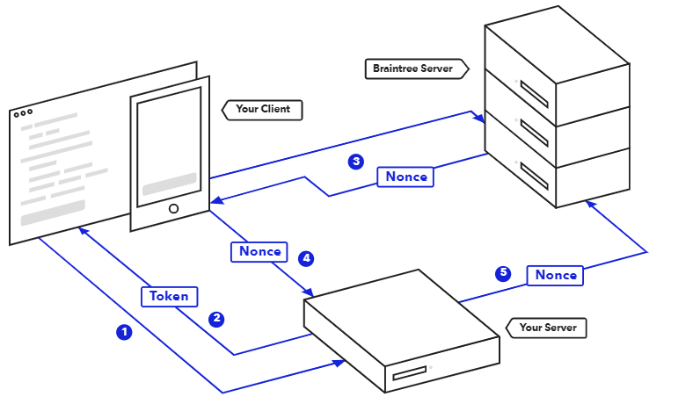
ACH payment flow daigram
User

Slide 4
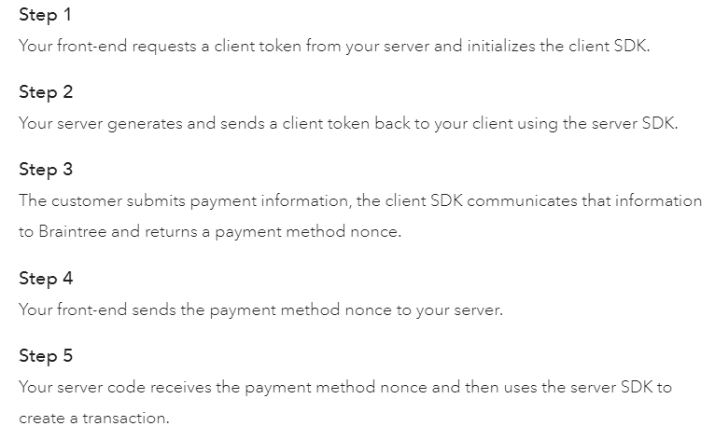

Slide 5
Accepting ACH payments consists of four concepts:
Tokenizing
Vaulting
Verifying
Transacting
Tokenizing is the process of exchanging raw payment information
Vaulting is the process of exchanging a one-time-use payment method nonce

Slide 6
Implementation

