Slide 1
Moving into Design
Based on Chapter 12
Bennett, McRobb and Farmer
Object Oriented Systems Analysis and Design Using UML
4th Edition, McGraw Hill, 2010

Slide 2
In This Lecture You Will Learn:
The difference between analysis and design
The difference between logical and physical design
The difference between system and detailed design
The characteristics of a good design
The need to make trade-offs in design

Slide 3
How is Design Different from Analysis?
Design states ‘how the system will be constructed without actually building it’
(Rumbaugh, 1997)
Analysis identifies ‘what’ the system must do
Design specifies ‘how’ it will do it

Slide 4
How is Design Different from Analysis?
The analyst seeks to understand the organization, its requirements and its objectives
The designer seeks to specify a system that will fit the organization, provide its requirements effectively and assist it to meet its objectives

Slide 5
How is Design Different from Analysis?
As an example, in the Agate case study:
  analysis identifies the fact that the Campaign class has a title attribute
  design determines how this will be entered into the system, displayed on screen and stored in a database, together with all the other attributes of Campaign and other classes

Slide 6
When Does Analysis Stop and Design Start?
In a waterfall life cycle there is a clear transition between the two activities
In an iterative life cycle the analysis of a particular part of the system will precede its design, but analysis and design may be happening in parallel
It is important to distinguish the two activities and the associated mindset
We need to know ‘what’ before we decide ‘how’

Slide 7
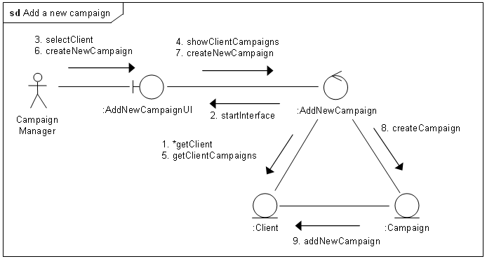
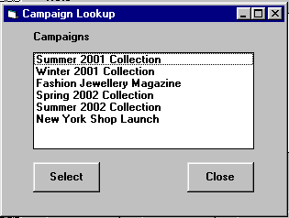
Requirements
Analysis
Design
2. To record the details of each campaign for each client. This will include the title of the campaign, planned start and finish dates, estimated costs, budgets, actual costs and dates, and the current state of completion.
Campaign
– actualCost : Currency
– adverts : Advert[ ]
– campaignFinishDate : Date
– campaignStaff : StaffMember[ ]
– campaignStartDate : Date
– client : Client
– completionDate : Date
– datePaid : Date
– estimatedCost : Currency
– manager : StaffMember
– title : String
– uniqueID : GUID
Add a new
campaign
Campaign
Manager
<<entity>>
Campaign
actualCost
+ addNewAdvert(Advert)
+ assignStaff(StaffMember)
+ checkCampaignBudget( ) : Currency
+ completeCampaign( )
+ getCampaignAdverts( ) : Advert[ ]
+ getCampaignCost( ) : Currency
+ getCampaignDetails( ) : String[ ]
+ getCampaignStaff( ) : StaffMember[ ]
+ getOverheads( ) : Currency
+ recordPayment(Currency)
estimatedCost
campaignFinishDate
campaignStartDate
completionDate
datePaid
title
addNewAdvert()
assignStaff()
createNewCampaign()
CREATE TABLE Campaigns
(VARCHAR(30) uniqueID PRIMARY KEY NOT NULL,
FLOAT actualCost,
DATE campaignFinishDate,
DATE campaignStartDate,
VARCHAR(30) clientID NOT NULL,
DATE completionDate,
DATE datePaid,
FLOAT estimatedCost,
VARCHAR(30) managerID,
VARCHAR(50) title);
CREATE INDEX campaign_idx ON Campaigns (clientID, managerID, title);
completeCampaign()
getCampaignAdverts()
getCampaignCost()
getCampaignStaff()
recordPayment()

Slide 8
Traditional Design
Making a clear transition from analysis to design has advantages
  project management—is there the right balance of activities?
  staff skills—analysis and design may be carried out by different staff
  client decisions—the client may want a specification of the ‘what’ before approving spending on design
  choice of development environment—may be delayed until the analysis is complete

Slide 9
Design in the Iterative Life Cycle
Advantages of the iterative life cycle include
  risk mitigation—making it possible to identify risks earlier and to take action
  change management—changes to requirements are expected and properly managed
  team learning—all the team can be involved from the start of the project
  improved quality—testing begins early and is not done as a ‘big bang’ with no time

Slide 10
Seamlessness
The same model—the class model—is used through the life of the project
During design, additional detail is added to the analysis classes, and extra classes are added to provide the supporting functionality for the user interface and data management
Other diagrams are also elaborated in design activities

Slide 11
Logical and Physical Design
In structured analysis and design a distinction has been made between logical and physical design
Logical design is independent of the implementation language and platform
Physical design is based on the actual implementation platform and the language that will be used

Slide 12
Logical and Physical
Design Example
Some design of the user interface classes can be done without knowing whether it is to be implemented in Java, C++ or some other language-types of fields, position in windows
Some design can only be done when the language has been decided upon — the actual classes for the types of fields, the layout managers available to handle window layout

Slide 13
Logical and Physical Design
It is not necessary to separate these into two separate activities
It may be useful if the software is to be implemented on different platforms
Then it will be an advantage to have a platform-independent design that can be tailored to each platform

Slide 14
Model Driven Architecture
Note the MDA Initiative
  Generate platform-specific models (PSMs) from platform-independent models (PIMs)
This is discussed in more detail in Chapter 13

Slide 15
System Design and Detailed Design
System design deals with the high level architecture of the system
  structure of sub-systems
  distribution of sub-systems on processors
  communication between sub-systems
  standards for screens, reports, help etc.
  job design for the people who will use the system

Slide 16
System Design and Detailed Design
Traditional detailed design consists of four main activities
  designing inputs
  designing outputs
  designing processes
  designing files and database structures

Slide 17
System Design and Detailed Design
Traditional detailed design tried to maximise cohesion
  elements of module of code all contribute to the achievement of a single function
Traditional detailed design tried to minimise coupling
  unnecessary linkages between modules that made them difficult to maintain or use in isolation from other modules

Slide 18
System Design and Detailed Design
Object-oriented detailed design adds detail to the analysis model
  types of attributes
  operation signatures
  assigning responsibilities as operations
  additional classes to handle user interface
  additional classes to handle data management
  design of reusable components
  assigning classes to packages

Slide 19





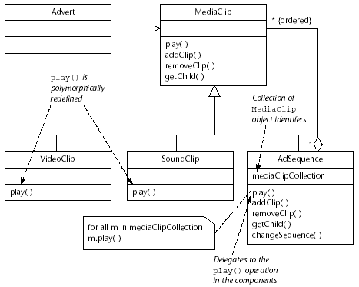
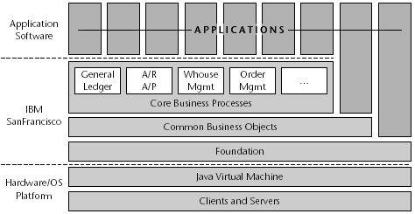


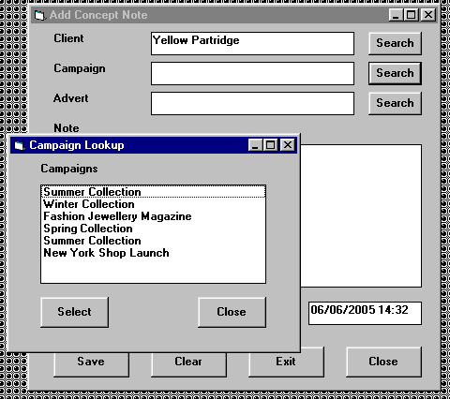
Enterprise Architecture
Alignment of IT architecture to business strategy and structure, and existing IT
System Architecture
Agate Boundary
sd Broker-based client–server communication
Agate Control Client
:Client
callServer
:ClientSide
Proxy
:Broker
:ServerSide
Proxy
:Server
sendRequest
packData
Agate Control Server
sendRequest
findServer
requestService
unpackData
Agate Domain
service
response
Agate Business
Objects
Agate Value
Objects
sendResponse
sendResponse
packData
Agate Database
response
unpackData
Meeting users’ requirements and determining the high-level structure of the system
System Design
Global
Catalogue
Data
Local Data
Catalogues
Data
Choosing technologies and frameworks, setting standards, and applying patterns
Detailed Design
Agate Boundary
Agate Control Client
CheckCampaignBudgetUI
CheckCampaignBudgetClient
ListCampaigns
«interface»
java::awt::event::ItemListener
+ listAllCampaigns(CampaignLister)
+ listCampaigns(CampaignLister, Client)
+ itemStateChanged(ItemEvent)
Agate Entity
Agate Control Server
«use»
Agate Domain
ListClients
ListCampaigns
sd Check campaign budget
«interface»
CampaignLister
CheckCampaignBudgetUI
+ addCampaignName(String)
+ clearAllCampaignNames( )
+ removeCampaignName(String)
- clientLabel : JLabel
Client
Campaign
CheckCampaignBudgetServer
:CheckCampaign
Budget
- campaignLabel : JLabel
CheckCampaignBudget
- budgetLabel : JLabel
- checkButton : JButton
ControllerFactory
:CheckCampaign
BudgetUI
- closeButton : JButton
Advert
CheckCampaign
BudgetUI( this )
- budgetTextField : JTextField
:ListClients
- clientComboBox : JComboBox
ccbUI :=
CheckCampaignBudgetUI
ListClients
«interface»
ClientLister
- campaignComboBox : JComboBox
loop
lc := ListClients
+ enable( )
+ enableCheckButton( )
+ getSelectedClient( )
+ getSelectedCampaign( )
+ setBudget(Currency)
+ addCampaignName(String)
+ clearAllCampaignNames( )
+ removeCampaignName(String)
+ addClientName(String)
+ clearAllClientNames( )
+ removeClientName(String)
+ itemStateChanged(ItemEvent)
[For all clients]
listAllClients( ccbUI )
+ addClientName(String)
+ clearAllClientNames( )
+ removeClientName(String)
Agate Data Management
enable
addClientName( name )
«use»
RelationalBroker
disableCampaignList
ListClients
ClientBroker
CampaignBroker
disableCheckButton
+ listAllClients(ClientLister)
AdvertBroker
Designing user interfaces, interactions, classes, data storage

Slide 20
Qualities of
Design
Functional
Reusable
Efficient
Usable
Economical
Maintainable
Agate
Design
Reliable
Manageable
Secure
Buildable
Flexible
General

Slide 21
Qualities of Design
Functional—system will perform the functions that it is required to
Efficient—the system performs those functions efficiently in terms of time and resources
Economical—running costs of system will not be unnecessarily high
Reliable—not prone to hardware or software failure, will deliver the functionality when the users want it

Slide 22
Qualities of Design
Secure—protected against errors, attacks and loss of valuable data
Flexible—capable of being adapted to new uses, to run in different countries or to be moved to a different platform
General—general-purpose and portable (mainly applies to utility programs)
Buildable—Design is not too complex for the developers to be able to implement it

Slide 23
Qualities of Design
Manageable—easy to estimate work involved and to check of progress
Maintainable—design makes it possible for the maintenance programmer to understand the designer’s intention
Usable—provides users with a satisfying experience (not a source of dissatisfaction)
Reusable—elements of the system can be reused in other systems

Slide 24
Prioritizing Design Trade-offs
Designer is often faced with design objectives that are mutually incompatible.
It is helpful if guidelines are prepared for prioritizing design objectives.
If design choice is unclear users should be consulted.

Slide 25
Trade-offs in Design
Design to meet all these qualities may produce conflicts
Trade-offs have to be applied to resolve these
Functionality, reliability and security are likely to conflict with economy
Level of reliability, for example, is constrained by the budget available for the development of the system

Slide 26
Trade-offs in Design
Design objectives may conflict with constraints imposed by requirements
The requirement that the system can be used in different countries by speakers of different languages will mean that designers have to agree a list of all prompts, labels and messages and refer to these by some system of naming or numbering
This increases flexibility and maintainability but increases the cost of design

Slide 27
Measurable Objectives in Design
In Chapter 6, non-functional requirements were described
How can we tell whether these have been achieved?
Measurable objectives set clear targets for designers
Objectives should be quantified so that they can be tested

Slide 28
Measurable Objectives in Design
To reduce invoice errors by one-third within a year
How would you design for this?

Slide 29
Measurable Objectives in Design
To reduce invoice errors by one-third within a year
How would you design for this?
  sense checks on quantities
  comparing invoices with previous ones for the same customer
  better feedback to the user about the items ordered

Slide 30
Measurable Objectives in Design
To process 50% more orders at peak periods
How would you design for this?

Slide 31
Measurable Objectives in Design
To process 50% more orders at peak periods
How would you design for this?
  design for as many fields as possible to be filled with defaults
  design for rapid response from database
  design system to handle larger number of simultaneous users

Slide 32
Summary
In this lecture you have learned about:
The difference between analysis and design
The difference between logical and physical design
The difference between system and detailed design
The characteristics of a good design
The need to make trade-offs in design

Slide 33
References
More detail about design is provided in Chapters 13 to 18
In particular, Chapter 14 covers Class Design
(For full bibliographic details, see Bennett, McRobb and Farmer)

Slide 34
References
Rumbaugh et al (1991)
Yourdon (1994)
Jacobson et al. (1995)
Meyer (1997)
Somerville (2007)
Pressman (2009)
(For full bibliographic details, see Bennett, McRobb and Farmer)

