Slide 1
Data Management Design
Based on Chapter 18
Bennett, McRobb and Farmer
Object Oriented Systems Analysis and Design Using UML
4th Edition, McGraw Hill, 2010

Slide 2
In This Lecture You Will Learn:
The different ways of storing persistent objects
The differences between object and relational databases
How to design data management objects
How to extend sequence diagrams to include data management objects

Slide 3
Persistence
Some objects are transient, exist in memory and are discarded when an application terminates
Some objects must exist from one execution of an application to another or be shared among different instances of applications. Such objects are persistent objects
Notes:
Examples of transient objects include instances of boundary and control classes and the objects used in applications like on-screen calculators. (Note for computer science students, the objects in a calculator may include things like stacks and registers, not just digits or floating point numbers.)
Persistent objects include the books, borrowers and loans in a library system. A loan of a book to a borrower may be created on one occasion on one machine, and is accessed from another machine on another occasion, for example to send out overdue book reminders.

Slide 4
Persistence Mechanisms
Files hold data, typically on magnetic media such as disks and tapes
Database management systems (DBMS) hold tables of data (relational DBMS) or objects (object DBMS)
DBMS use files to store data or objects, but they hide the physical processes for storing data beneath a layer of abstraction
Objects can also be serialized directly to files

Slide 5
Persistence Architecture
The choice of the architecture for persistence is a system design issue
The design of storage for specific classes and associations within the framework of that architecture is a class design issue
The overall design may be constrained by having to operate with existing systems or using existing DBMS

Slide 6
Persistence Design Questions
Can files be used for some storage?
Is it truly an O-O system or just an interface to a relational database using Java or C++?
Will the system use an existing DBMS?
Will it use a relational DBMS?
Will it use an object DBMS?

Slide 7
Persistence Design Questions
What is the logical layering of the system?
What is the physical layering of the system?
Is the system distributed? Does this include distributed data storage?
What protocols will be used to communicate within the system?

Slide 8
File Systems
Files and record structures
Fixed length (padded)
Variable length (delimited)
Header and detail
Tagged data (XML)
12345678901234567890123456789012345
Simon Bennett Leice
ster GB 21322012002
”Simon”,”Bennett”,”Leicester”,”GB”,213,”22-01-2002”
1,”Simon”,”Bennett”
2,1,”0077098641”,2002
2,2,”0077096738”,2001
<author>
<forename>Simon</forename>
<surname>Bennett</surname>
</author>
Notes:
Ask what kind of design trade-offs might have to be made with these different kinds of file record structures.
Fixed length – easy to process, but wastes storage
Variable length – more difficult to process (looking for delimiters), but saves storage space
Header and detail – allows for structure in data, may need line type and line no.
Tagged data – self-describing, but storage overhead for tags.

Slide 9
File Systems
File organization
Serial—new records appended
Sequential—records ordered in file, usually according to a numeric key
Random—uses an algorithm to convert a key to an address in the file

Slide 10
File Types
Master files
Transaction files
Index files
Temporary file or work files
Backup files
Parameter files
Notes:
Students may be familiar with the temporary files that are helpfully left by certain applications (that must remain nameless) cluttering up the temp directories on their hard disks.

Slide 11
Database Management
Systems (DBMS)
Problems with files:
  redundancy—number of files grows with applications, and data is duplicated
  inconsistency—data is updated in one application’s files, but not in another’s
  maintenance problems—changes to data structures mean changes to many programs
  difficulty combining data—business needs may mean users want data from different applications

Slide 12
DBMS
Corporate database consolidates data for different applications
Each application then has its own view of a subset of the data
Application 1
Database
Application 2

Slide 13
DBMS Schema
Ultimately data in databases is stored in files, but their structure is hidden from developers
External Schema
The view on data used by
application programs.
Conceptual Schema
The logical model of data that is
separate from how it is used.
Internal Schema
The physical storage of data in
files and indexes.

Slide 14
DBMS Features
Data Definition Language (DDL)
Data Manipulation Language (DML)
Integrity Constraints
Transaction Management
Concurrency
Security
Tuning of Storage

Slide 15
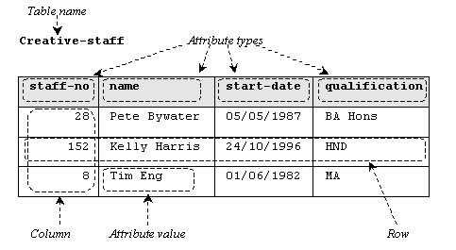
Types of DBMS
Relational—represent data in tables
  tables consist of rows of data organized in columns

Slide 16
Types of DBMS
Object—store objects as objects
  designed to handle complex nested objects for graphical and multimedia applications
Object-relational—hybrid databases that can store data in tables but can also store objects in tables

Slide 17
Objects in Relational Model
Classes with simple data structure become tables
Object IDs become primary keys
Where classes contain another class as an attribute create a table for the embedded class
For collections create two tables, one for the objects in the collection, the other to hold Object IDs of the containing objects and the contained objects

Slide 18
Alternative Approach
One-to-many associations can be treated like collections
Many-to-many associations become two separate tables for the objects and a table to hold pairs of Object IDs
One-to-one associations are implemented as foreign-key attributes—each class gains an extra attribute for the Object ID of the other

Slide 19
Alternative Approach
To implement inheritance
  only implement the superclass as a table including all subclass attributes
  only implement the subclasses as tables, duplicating superclass attributes in each
  implement superclass and subclasses as tables with shared primary keys
Each approach has disadvantages

Slide 20
Object DBMS
ODBMS have the advantage that objects can be stored directly
Object Data Management Group (ODMG) standard
Not all object databases conform to the standard
Object databases are closely linked to programming languages with ways of navigating through the database

Slide 21
Designing Data
Management Classes
Alternatives (two in bold are covered here):
  add save and retrieve operations to classes
  make save and retrieve class-scope methods
  allow all persistent objects to inherit from a PersistentObject superclass
  use collection classes to manage persistence
  use broker classes to manage persistence
  use a parameterized class to handle persistence for different classes

Slide 22
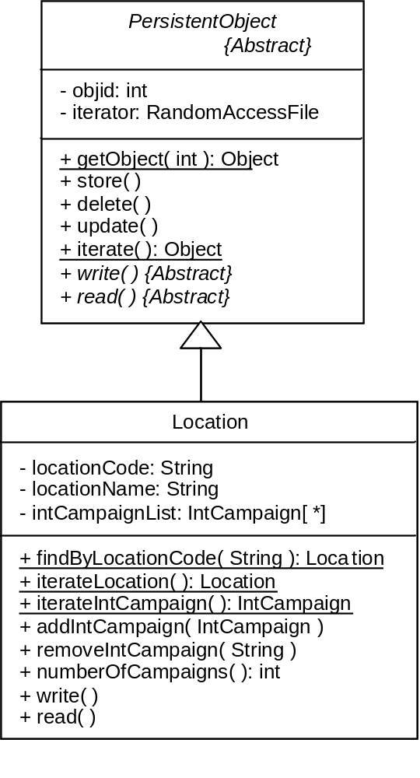
PersistentObject
Create an abstract superclass and make all persistent classes inherit from it

Slide 23
Database Broker
Use a broker class responsible for materializing instances of each class from the database
materializes
Location
LocationBroker
-
instance: LocationBroker
-
LocationBroker( )
+ instance( ): LocationBroker
+ findByLocationCode( String ): Location
+ iterateLocation( ): Location

Slide 24
Using a Framework
Why develop a framework when you can use an existing one?
Object-table mappings
  JDO
  Hibernate
Standard APIs to map attributes of classes to columns in a relational database table using XML persistence descriptors

Slide 25
Summary
In this lecture you have learned about:
The different ways of storing persistent objects
The differences between object and relational databases
How to design data management objects
How to extend sequence diagrams to include data management objects

Slide 26
References
Silberschatz, Korth and Sudarshan (2005)
Howe (2001)
Roos (2003)
Connolly and Begg (2010)
(For full bibliographic details, see Bennett, McRobb and Farmer)

