Slide 1



DICTIONARY
LJ INSTITUTE OF ENGINEERING AND TECHNOLOGY
SYSTEM
PREPARED BY :
NAME : MASRANI KASAK ATULBHAI
ROLL NO. : 1
ENROLLMENT NO. : 23002170110083
BATCH : D1
BRANCH : CE
Notes:
To use this title animation slide with a new image simply 1) move the top semi-transparent shape to the side, 2) delete placeholder image, 3) click on the picture icon to add a new picture, 4) Move semi-transparent shape back to original position, 5) Update text on slide.

Slide 2
PROJECT OUTLINES
Introduction
Purpose of the project
Flow – Chart
ER Diagram
Use Case Diagram
Functionalities
Used Data Structure
Procedures
References
Merits & Demerits
Future Scope

Slide 3
INTRODUCTION
Additional Feature
The system also records user history and provides additional word data like
Pronounciation
Part Of Speech
Synonyms
Antonyms
Hypernyms
Hyponyms
Sentence examples
A dictionary system that provides various features such as:
searching for words
suggesting words
reading the dictionary
creating a short note
printing the short note

Slide 4
PURPOSE
A dictionary system's purpose is to:
“Language learning”
Assists language learners by offering translations, pronunciation guides, and example sentences.
“Communication / Entertainment”
“Word reference”
Provides definitions, meanings, and explanations for words.
Helps writers, communicators, and students improve their writing, grammar, and vocabulary.
“Language preservation”
Preserves and documents languages, dialects, and regional variations for cultural and historical significance.
“Research”
Supports researchers, scholars, and students in understanding complex terms, concepts, and theories.
“Knowledge graph”
Builds a knowledge graph, connecting words, concepts, and relationships to enable semantic search and AI applications.

Slide 5
FLOW - CHART
Start
Take User Choices
Register
Login
Exit
Take User Name
Stop
If exists?
Take user details
Valid ?
No
Yes
No
Yes
Add user & notify
Show Error
Print message

Slide 6
Login
Take username and password
Verify user?
No
Yes
Record Login Time
Display Login Success
Login Failed
Select Operation
Search Word
Suggest Word
Read Word
Short Note
Print Short Note
Return
Take User Choice
Take User Choice

Slide 7
Search Word
Suggest frequent searches
Take User Search
Word Found?
No
Word Not Found
Yes
Record Word Search
Print Word Meaning
Give User Choices
Select Operation
Want to Know Synonyms?
Want to Know Antonyms?
Want to Know Hypernym?
Want to Know Hyponyms?
Want to Know Use in Sentence?
Return
Display Synonyms
Display Antonyms
Display Hypernyms
Display Hyponyms
Display Sentence
Select Operation
Record History
Record History
Record History
Record History
Record History

Slide 8
Suggest Word
Take Word
Word exists?
Yes
No
Display Word Exists
Record History
Yes
Word Already Suggested?
No
Record History
Display Word Already Suggested
Suggest Word to Database
Record History
Select Operation
Record History
Read Words
Take User Input
Input = ‘O’?
No
Input = ‘E’?
Yes
End Reading
Yes
No
Add Word To Short Note
Read Next Word
Select Operation

Slide 9
Short Note
Choices
Add Word
Remove Word
Change Word
Display Note
Return
Take Word
Take Word
Take Word
Select Operation
No
Word Exists
No
If Empty?
If Empty?
If Empty?
Old & new same?
Yes
Yes
No
Yes
No
Yes
Display Empty Note
Yes
No
Print Message
Take Meaning
Remove Word
Display Empty Note
Display Empty Note
Remove Word
Display error
Add Word to Note
Replace word

Slide 10
Print Short Note
If Empty?
Display Message
Create File
If File Creation Success?
Display Error
Print File Name And Path
Record History
Select Operation

Slide 11
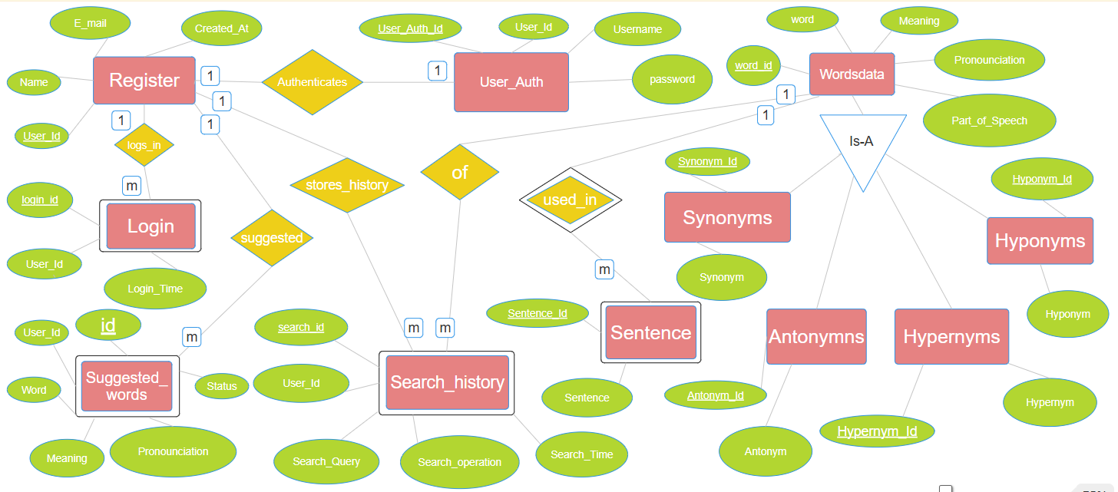
ER Diagram

Slide 12
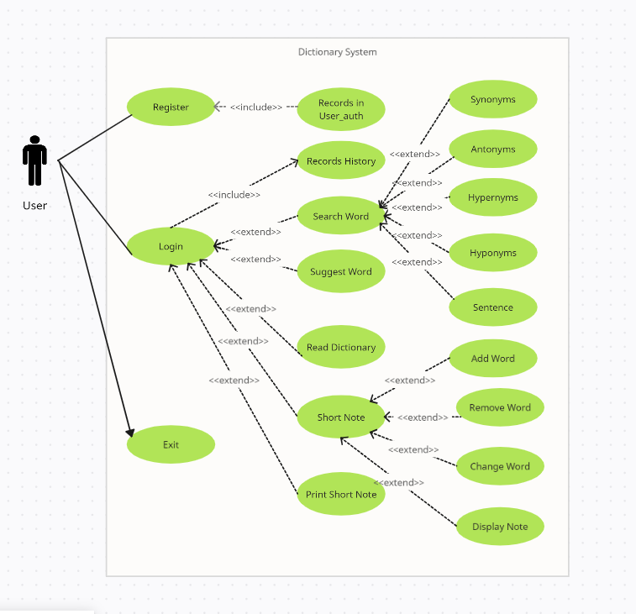
USE CASE
DIAGRAM

Slide 13
Functionalities
This Java program implements a dictionary system with the following functionalities:
User Authentication: Users can register, log in, and authenticate themselves.
Word Search: Users can search for words, and the system displays the word's meaning, pronunciation, and part of speech.
Word Suggestion: Users can suggest new words to add to the dictionary.
Dictionary Reading: The system allows users to read the dictionary, and they can add words to a short note or quick revision list
Short Note Management: Users can create, modify, and print their personilzed short notes.
Word Data: The system provides additional information about words, including synonyms, antonyms, hypernyms, hyponyms, and example sentences.

Slide 14
JAVA
Exception Handling: The code uses try-catch blocks to handle exceptions that may occur during database operations.
Object-Oriented Programming (OOP) Concepts: The code defines classes (e.g., WordsListClass, Dictionary, User, LoginRegister)
File Input/Output: The code writes to a file using BufferedWriter and FileWriter.
User Input: The code uses Scanner to get user input.
String class methods
Math class methods
Validates User Input for Integer data type
Automatic generates unique Username

Slide 15
DATA
STRUCTURE
Doubly LinkedList: Used to implement the revision list for short notes (revision).
- Add Word
- Remove Word
- Replace Word
- Print Short Note
Queue: Used to store frequently searched words (queue).
Array List: Used to store the list of words (wordList).
Collections: - None explicitly used, but collections are used internally by the PreparedStatement and ResultSet classes

Slide 16
DATABASE
MySQL database to store and retrieve word definitions, synonyms, antonyms, hypernyms, hyponyms, and sentence examples.
User History: The code records user actions in the database, such as searching for words, viewing synonyms, antonyms, hypernyms, hyponyms, and sentence examples.
Stored Procedures: The code uses stored procedures to retrieve word data, such as synonyms, antonyms, hypernyms, hyponyms, and sentence examples.
Database Connection: The code establishes a connection to a MySQL database using the DriverManager class.
Relational database (e.g., MySQL) used to store user data, with tables register, user_auth, and login.

Slide 17
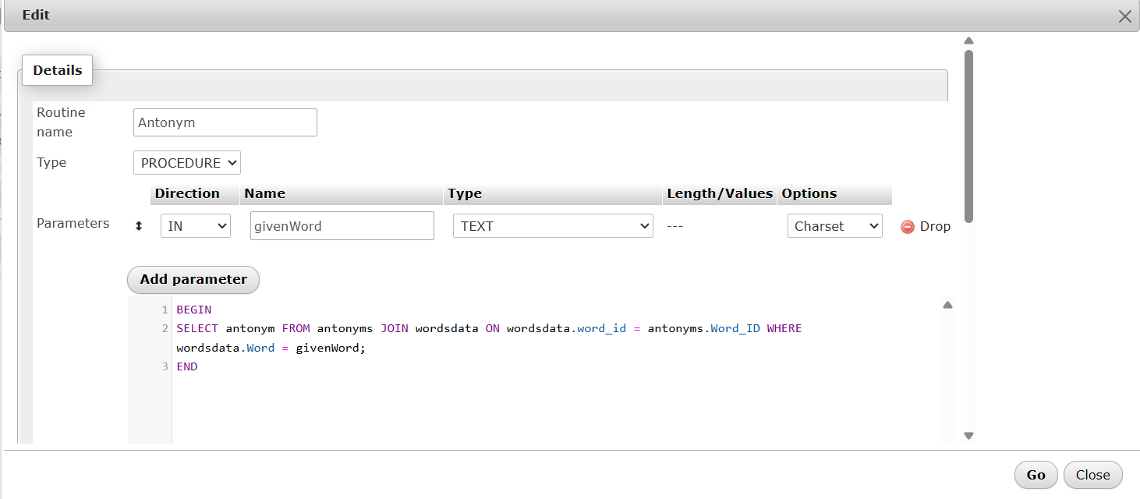
PROCEDURE
Procedures Used for displaying synonym, antonyms, hypernyms, hyponyms and sentence of searched word.
One of 5 five procedure is shown here.

Slide 18
MERITS - DEMERITS
Merits
Demerits
User-friendly
Search functionality
Note-taking
Customization
Data Analysis
Scalability
Printable notes
High Development Costs
Complexity
Dependence on Technology
Data Security
Maintenance
Limited words
No multimedia support

Slide 19
REFERENCES
Oxford Dictionaries
Google Dictionary
The Free Dictionary
TOOLS USED
Visual Studio Code
MySQL
Xampp
ChatGPT

Slide 20
FUTUTRE SCOPE
Machine Learning-based Suggestions: Implement machine learning algorithms to provide personalized word suggestions based on user behavior and preferences.
Multimedia Support: Add audio and video pronunciations, images, and examples to enhance user understanding and engagement.
Integrations and APIs: Develop APIs for integrating the dictionary with other applications, such as language learning platforms, writing tools, and more.

Slide 21
THANK YOU
Neal Creative | click & Learn more

