Slide 1



WanderWrite
LJ INSTITUTE OF ENGINEERING AND TECHNOLOGY
A Blogging Platform
Notes:
To use this title animation slide with a new image simply 1) move the top semi-transparent shape to the side, 2) delete placeholder image, 3) click on the picture icon to add a new picture, 4) Move semi-transparent shape back to original position, 5) Update text on slide.

Slide 2
PROJECT OUTLINES
Introduction
Key Features
Website Structure
Functionalities
Technology Stack
Merits & Demerits
Future Enhancements

Slide 3

INTRODUCTION
Purpose:
A dynamic and user-friendly blogging platform designed to help users share their stories, gain exposure, and connect with a global audience.
It provides a seamless experience for both bloggers and readers, fostering creativity and engagement.
Target Audience
Bloggers
Readers
Content creators
Anyone passionate about writing travel, lifestyle and technology

Slide 4
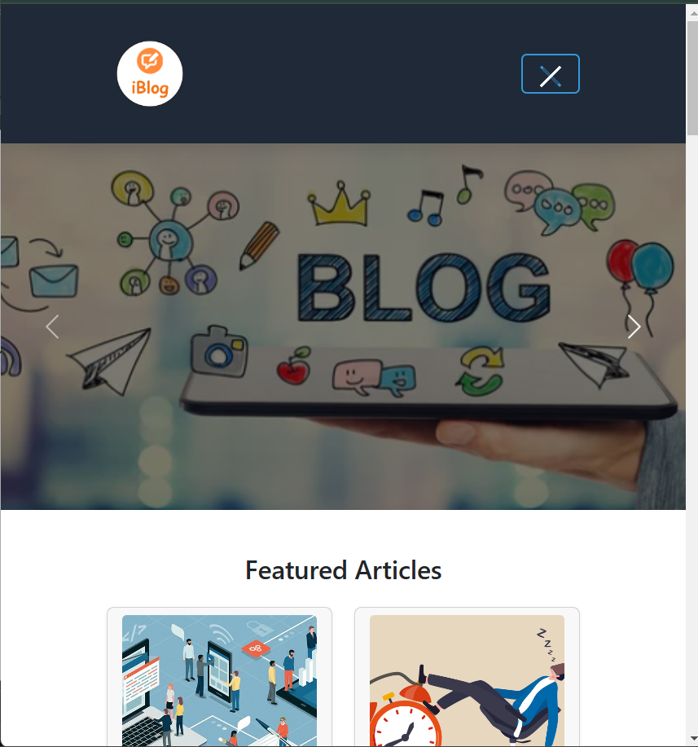
KEY FEATURES
Dynamic Content: Carousel, modal popups, filterable blog posts.
User Authentication & Authorization
Responsive Design: Works on all devices.
User-Friendly Interface: Intuitive navigation.
Articles : Articles based on real life topics.
Contact Form and Map Integration: For user engagement.
Store Page: For purchasing merchandise.
4

Slide 5
WEBSITE STRUCTURE
Navigation Flow:
Home
Pages:
🏠 Home
📝 Blog
📄 Blog Post
🛒 Store
📞 Contact
ℹ️ About
Blog
Blog Posts
Store
Contact
About
Sign Up
Login

Slide 6
FUNCTIONALITIES
User-Friendly Interface
Responsive Design: Works seamlessly on desktop, tablet, and mobile devices.
Intuitive Navigation: Easy-to-use menus and navigation bars for a smooth user experience.
Blog Creation and Management
Rich Text Editor: Allows users to create and format blog posts with ease.
Media Integration: Supports images.

Slide 7
User Engagement Features
Comments Section: Readers can leave comments and interact with the author.
Social Sharing: Easy sharing of blog posts on social media platforms.
Newsletter Subscription: Readers can subscribe to newsletters for updates.
Dedicated Blog View
Full blog content display
Comment Section
Sidebar with Blog Recommendations
Newsletter Subscription Section
Call-to-Action (CTA) Button

Slide 8
TECHNOLOGY
STACK
Frontend Technologies
📌 HTML – The foundational markup language that structures web pages.
🎨 CSS – Styles and enhances the layout to create a visually engaging user interface.
⚡ JavaScript – Enables interactivity and dynamic behavior, making the website responsive and user-friendly.
🚀 Bootstrap – A powerful frontend framework for building mobile-first, responsive designs efficiently.

Slide 9
2. Backend Technology
🖥️ Node.js – A high-performance runtime environment that enables server-side execution of JavaScript, allowing for scalable and efficient backend development..
3. Database
🗄️ MySQL – A powerful relational database management system (RDBMS) used for efficiently storing, managing, and retrieving structured data.
4. Additional Tools
📜 jQuery - A JavaScript library that simplifies DOM manipulation and event handling.
🗺️ Google Maps API - Integrated for location-based services, such as displaying maps and routes.

Slide 10
MERITS
✅ Merits
User-friendly Interface
Engaging UI with Carousel & Accordions
Secure Blog Creation
Authentication
Scalable & Expandable

Slide 11
DE-MERITS
❌ De-Merits
Plain Text Password Storage (Security Concern)
No Video Upload for Blogs
Less Social Media Sharing Features
Might Require Optimization for Large-Scale Use

Slide 12
Future Improvements
🔒 Implementing bcrypt for password hashing
🎥 Enabling video uploads for blog posts
🔍 Enhancing search & filtering features
🧠 Integrating AI for Personalized Content Recommendations

Slide 13
THANK YOU
Neal Creative | click & Learn more

