Slide 1

Airbnb_sprint 2
Group 6:
Rohit Totlani - 8914803
Pradeepti Kasam - 8965985
Mohammed Benkhial - 8928209

Slide 2

AGENDA
Overview
Introduction
Distribution of Airbnb prices
Airbnb Listing availability
Listings per neighborhood
Listings per type of room
Top 10 hosts

Slide 3

Introduction

Slide 4
Airbnb Dataset
Number of rows: 48895
Number of columns: 16

Slide 5
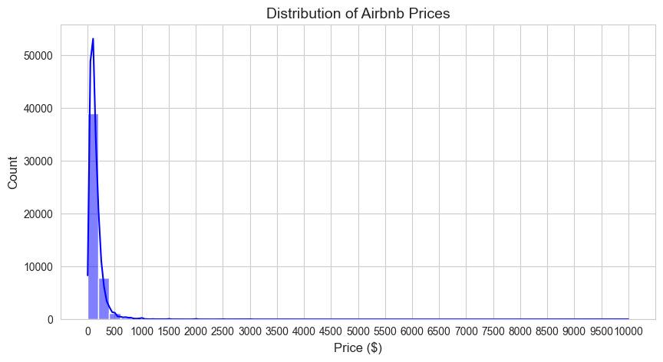
Distribution of Airbnb prices

Slide 6

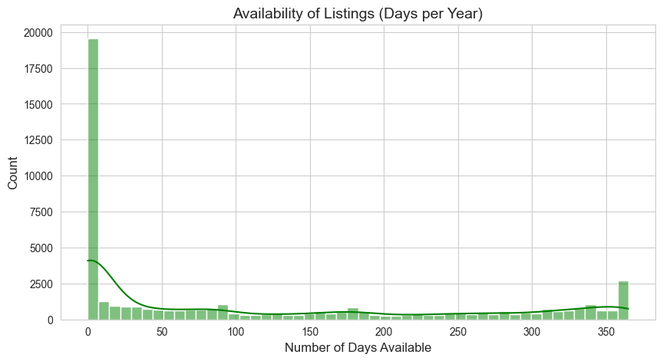
Airbnb Listing availability

Slide 7

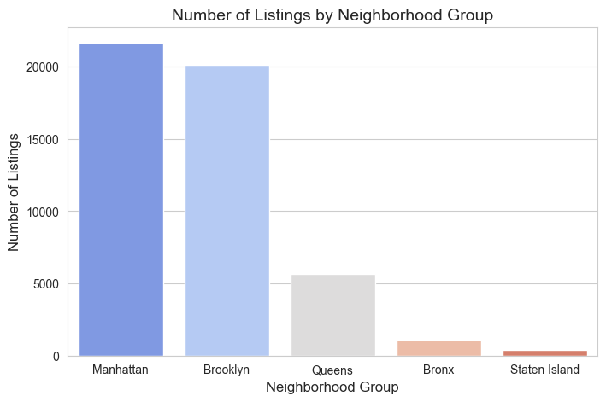
Listings per neighborhood

Slide 8
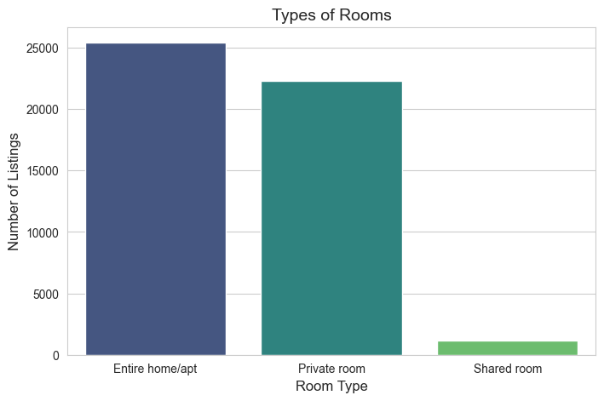
Listings per type of room

Slide 9
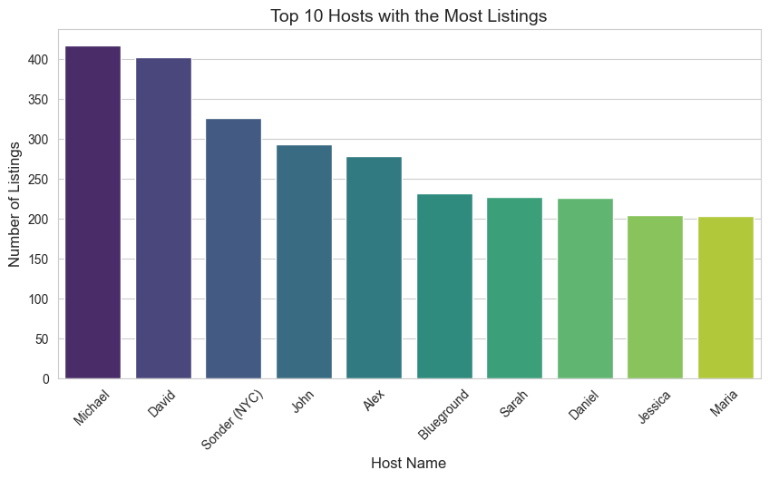
Top 10 hosts with most listings

Slide 10
Missing Values
name 16
host_name 21
last_review 10052
reviews_per_month 10052

Slide 11
Outlier Detection Using IQR Method
Outliers Detected for Price 2972

Slide 12
Handling Outliers:
Capping the price with lower bound and upper bound

Slide 13
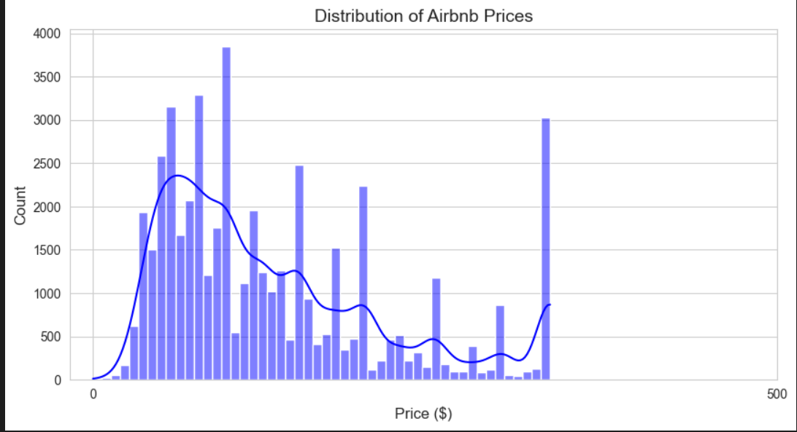
Plot price distribution after handling outliers

Slide 14
AI Models Used
Model | Accuracy
Linear Regression | 44.28%
Polnomial Regression | 47.28%
Random Forest | 46.59%
GridSearchCV | 51.28%
XGBoost | 51.46%

Slide 15
Inspiration

Slide 16
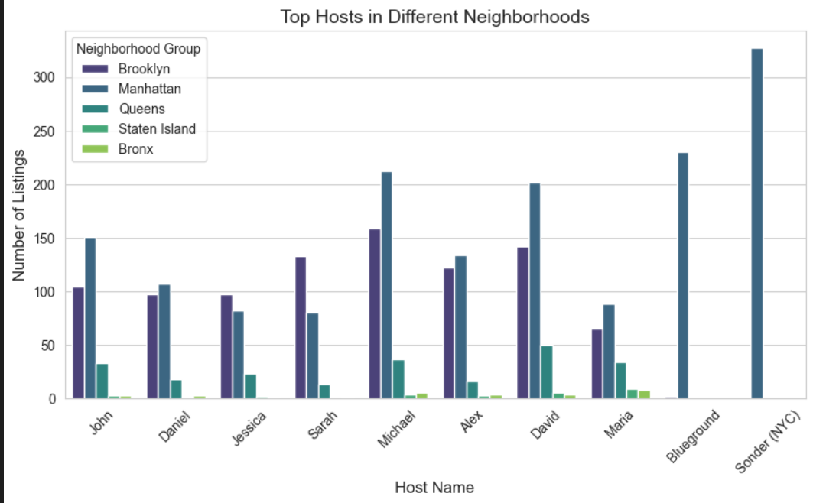
What can we learn about different hosts and areas?

Slide 17
large property management companies operate more listings in Manhattan.
Several hosts have a significant number of listings in Brooklyn (purple), second only to Manhattan.
Airbnb activity is less concentrated in Queens, Staten Island, and Bronx.
The highest number of listings belong to Sonder (NYC) and Blueground, which are well-known corporate Airbnb operators.
Investors may want to focus on Manhattan and Brooklyn, as they have the highest number of listings.

Slide 18
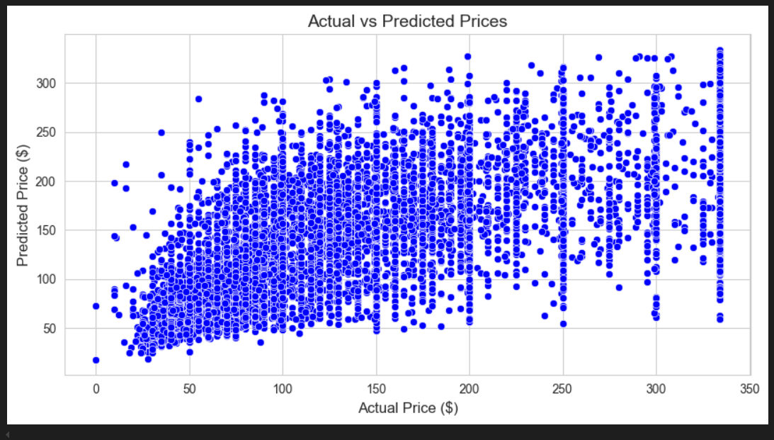
What can we learn from predictions? (ex: locations,prices, reviews, etc)

Slide 19
There is a clear upward trend, indicating that as actual prices increase, predicted prices also tend to increase.
The spread of points suggests that predictions are not perfectly aligned with actual values.
The model appears to underestimate high actual prices, as many high-priced listings (above $200) have predicted values significantly lower.
For low actual prices (under $50), some predicted prices seem to be higher than actual values, meaning the model is overestimating cheaper listings.

Slide 20
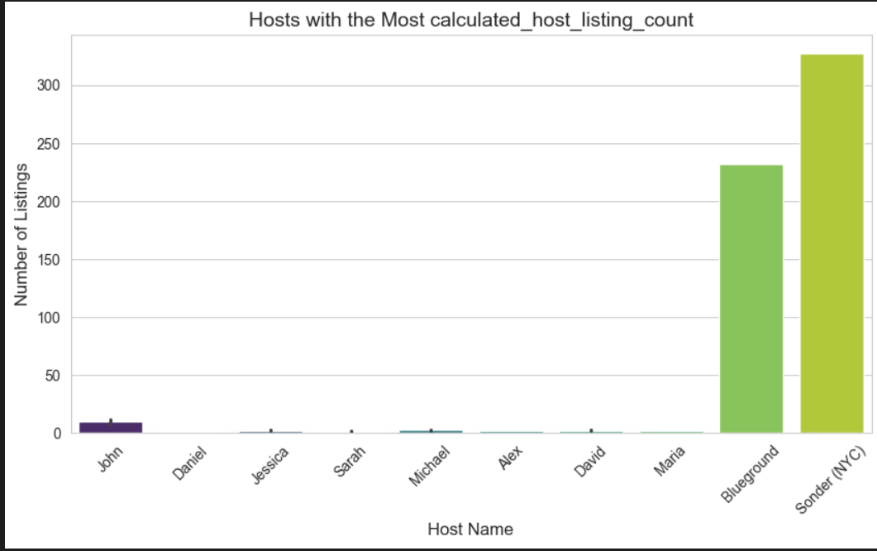
Which hosts are the busiest and why?

Slide 21
The most busiest hosts based on the number of listings they manage are
Sonder (NYC) – 327 listings
Blueground – 232 listings
Sonder & Blueground: These are professional property management companies specializing in short-term rentals.
Prime Locations: These hosts likely operate in high-demand areas such as Manhattan.

Slide 22
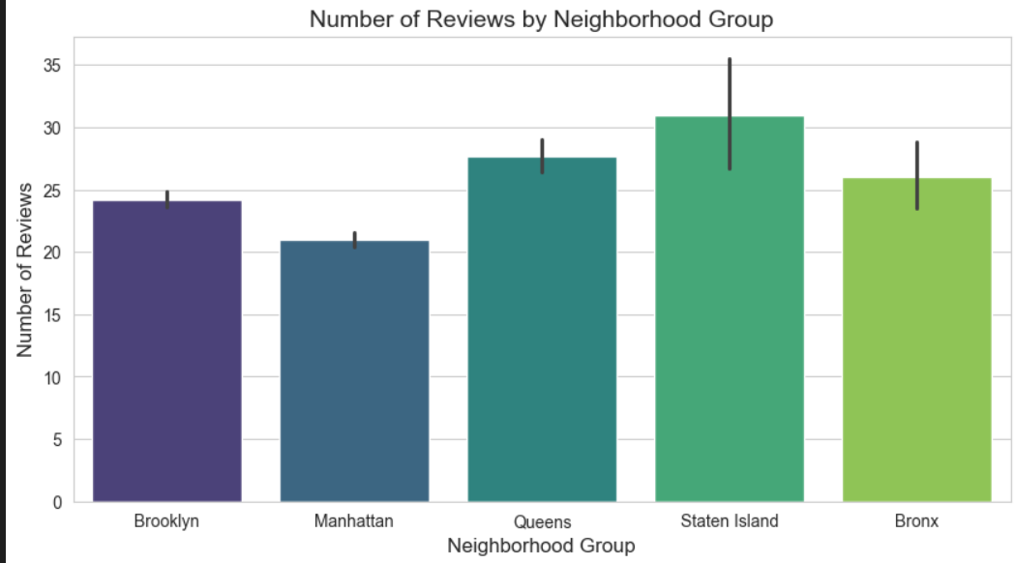
Is there any noticeable difference of traffic among different areas and what could be the reason for it?

Slide 23
Manhattan is a prime tourist hub with expensive accommodations, which might lead to fewer bookings per listing despite high foot traffic. Luxury stays often have fewer but more exclusive reviews.
Brooklyn is popular among younger travelers and digital nomads, leading to moderate but steady review counts.
Price Sensitivity:
Staten Island may attract budget-conscious travelers, resulting in longer stays and more reviews per booking. Its affordability compared to Manhattan could explain the higher review counts.
Queens has a mix of affordable listings and proximity to airports (JFK, LaGuardia), attracting transient visitors who leave quick reviews.
Bronx may have fewer listings overall, but those available might cater to niche markets or long-term stays, boosting review numbers.

Slide 24

THANK YOU
Group 6:
Rohit Totlani - 8914803
Pradeepti Kasam - 8965985
Mohammed Benkhial - 8928209

