Slide 1

Severstal Steel Defect Detection
Group 6
Mohammed Benkhial -8928209
Rohit Totlani - 8914803 Pradeepti Kasam - 8965985

Slide 2
Dataset
https://www.kaggle.com/c/severstal-steel-defect-detection/overview

Slide 3
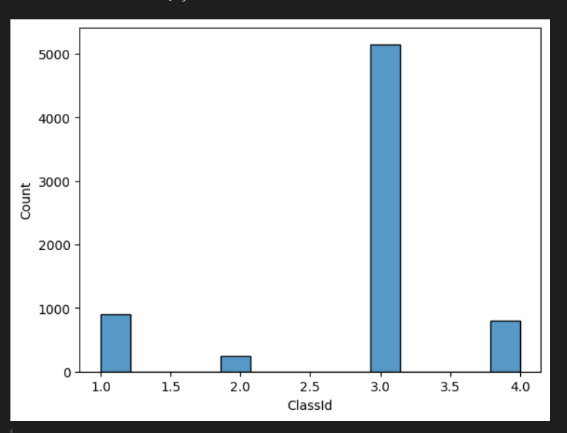
Class Label Count
Class 1, 2, 3,4 are the defect classes.
From the visualization its clear that class 3 is the most occurred defect.

Slide 4
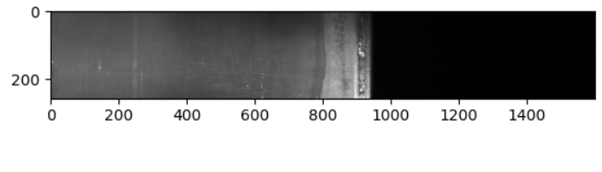
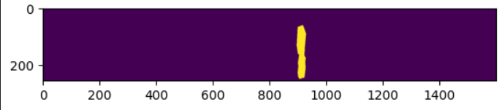
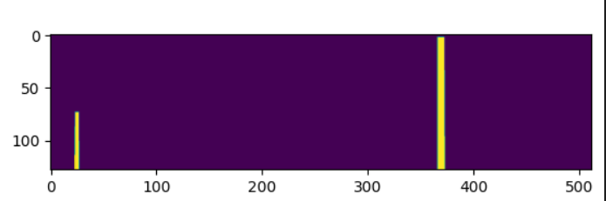
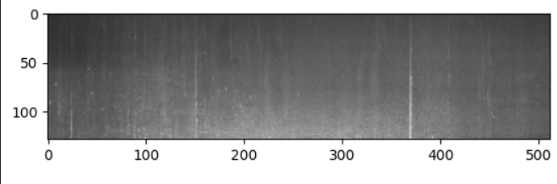
Sample image Before Masking
Sample image After Masking

Slide 5
U-Net Model
U-Net is used due to its powerful segmentation capabilities.
Its encoder-decoder architecture efficiently captures both low-level and high-level features, allowing precise localization of defects.
The skip connections help retain fine details, making it ideal for detecting small and complex surface defects in steel images.

Slide 6
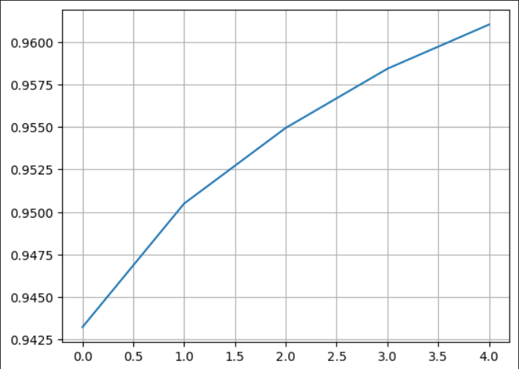
Accuracy Based on Epocs

Slide 7
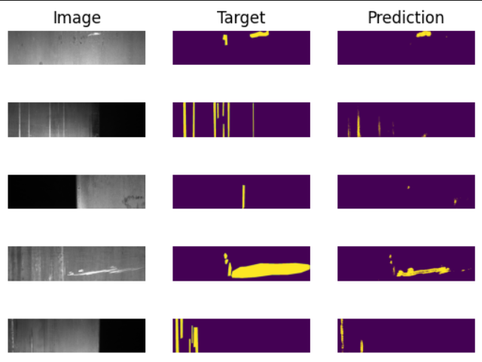
Ground Truth vs. Model Prediction

Slide 8

Conclusion :
In summary, the U-Net model effectively detects defects in steel sheets, achieving an accuracy of 96%.

Slide 9

Thank You

