Slide 1
TEXT CONTENT ANNOTATION AND RETRIEVAL FOR REGIONAL LANGUAGES
Portfolio3 – Project Presentation
SENG8100 – Agile Software Prototyping
Pradeepti Kasam - 8965985

Slide 2

PROBLEM STATEMENT
Advancements in Major Languages: Text annotation and retrieval systems have progressed significantly for widely spoken languages.
Lack of Regional Language Tools: Limited effective tools are available for regional languages.
Underrepresentation: Multilingual models are highly tuned for global languages, leaving regional languages underserved.

Slide 3
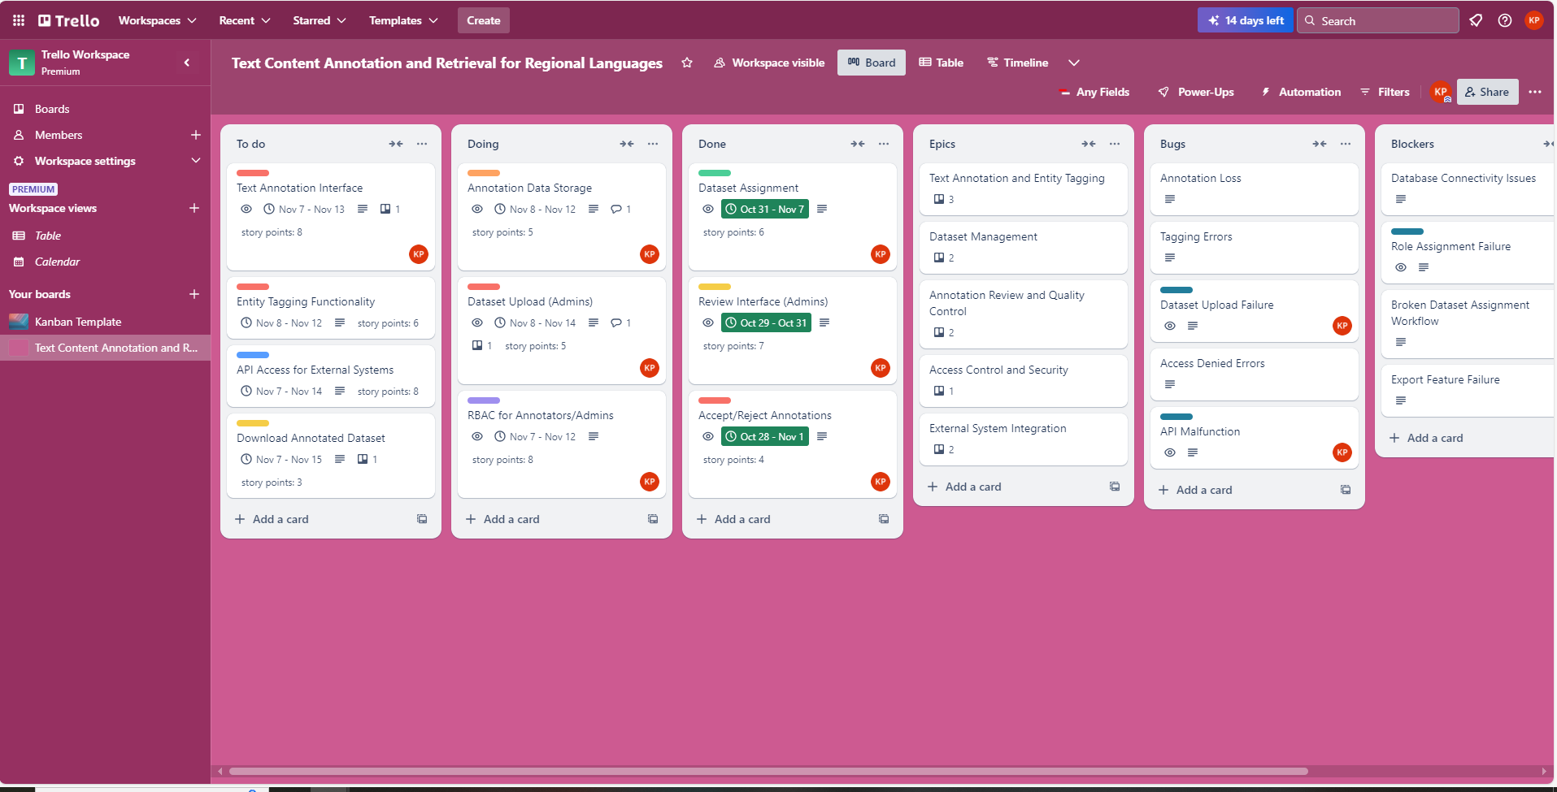
TRELLO DASHBOARD

Slide 4
Users of the Application
Admin
Annotators
Researchers

Slide 5
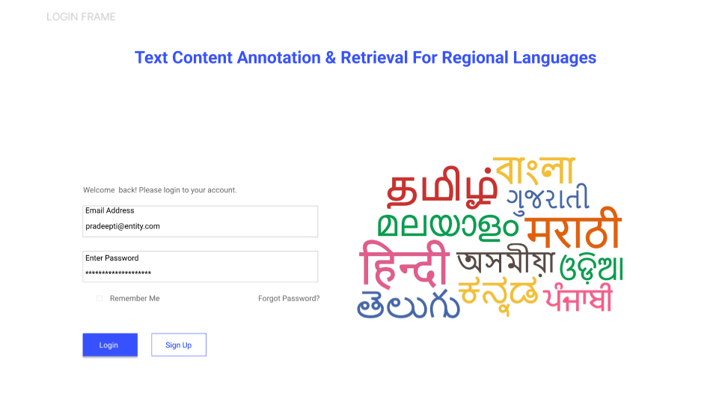
LOGIN PAGE

Slide 6
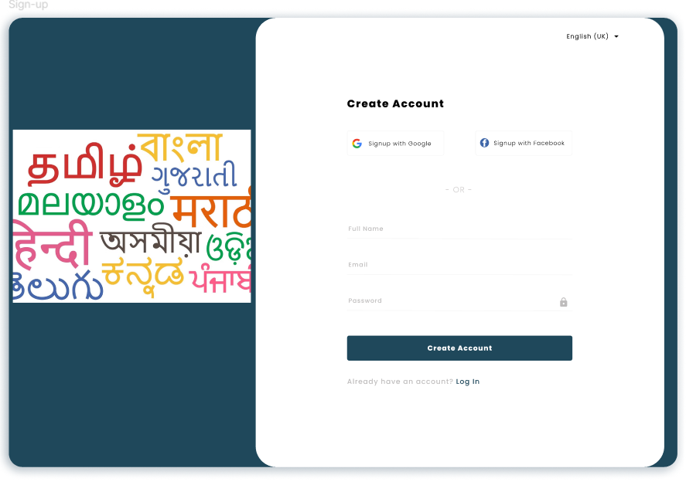
SIGN-UP PAGE

Slide 7
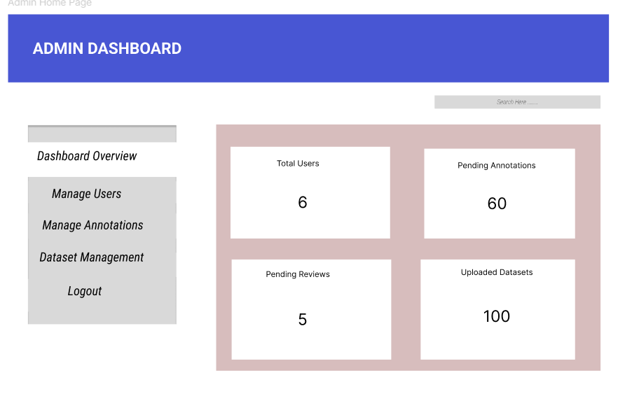
ADMIN DASHBOARD
Notes:
RBAC for Annotators
Feedback to Annotators: As an admin, I want to give feedback to annotators on rejected annotations.
AI :
Sentiment Analysis Integration : As an admin, I want to integrate sentiment analysis for specific datasets to analyze emotional tone in text.
AI-Based Annotation Error Detection : As an admin, I want AI to flag potential errors in annotations for review before finalizing them.

Slide 8
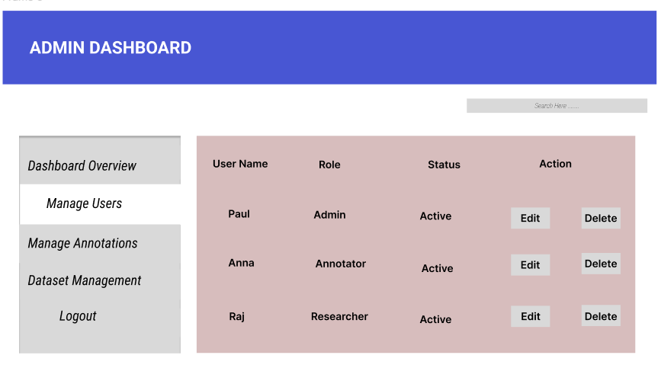
ADMIN DASHBOARD - Manage Users Page

Slide 9
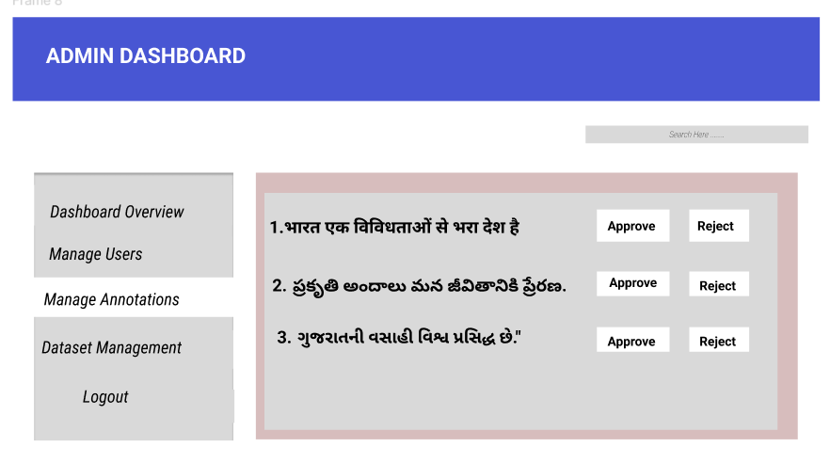
ADMIN DASHBOARD – Manage Annotations

Slide 10
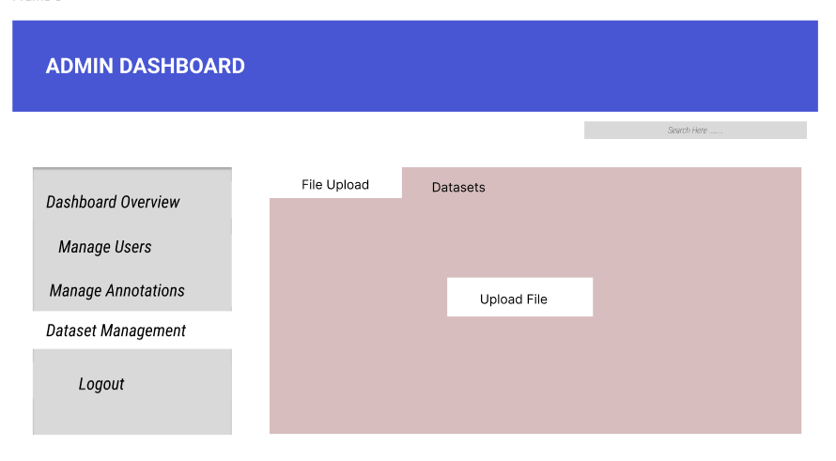
ADMIN DASHBOARD – Dataset Management

Slide 11
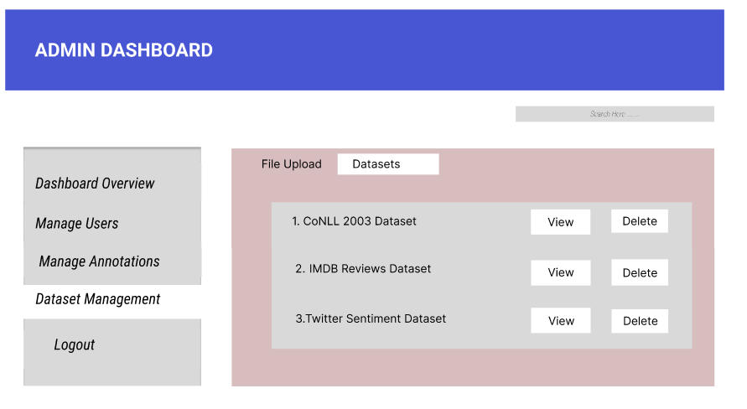
ADMIN DASHBOARD – Dataset Management

Slide 12
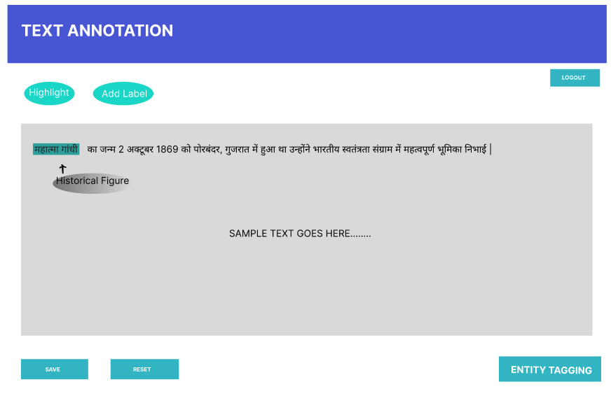
TEXT ANNOTATION INTERFACE
Notes:
use of AI :
AI-Powered Annotation Suggestions : As an annotator, I want AI-based suggestions for possible annotations to speed up the labeling process.
Real-Time Chat for Annotators :As an annotator, I want to chat with other annotators in real-time to discuss specific datasets.
Text Preprocessing Suggestions : As an annotator, I want to receive preprocessing suggestions (e.g., tokenization, stop-word removal) to improve annotation accuracy.

Slide 13
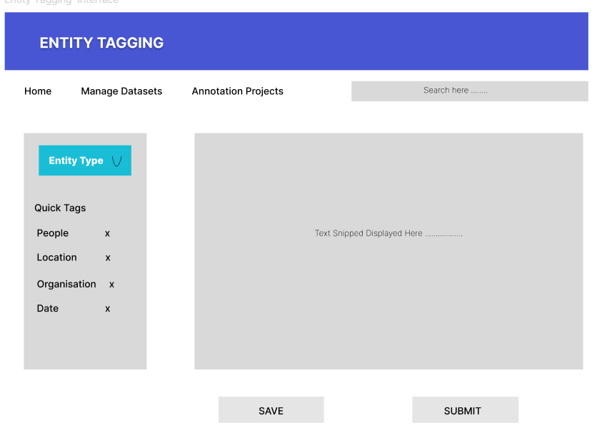
ENTITY TAGGING FUNCTIONALITY
Notes:
Dropdown or button group for selecting predefined entity types like Person, Location, Organization, Date, etc.
Add Custom Tag button for additional flexibility.

Slide 14
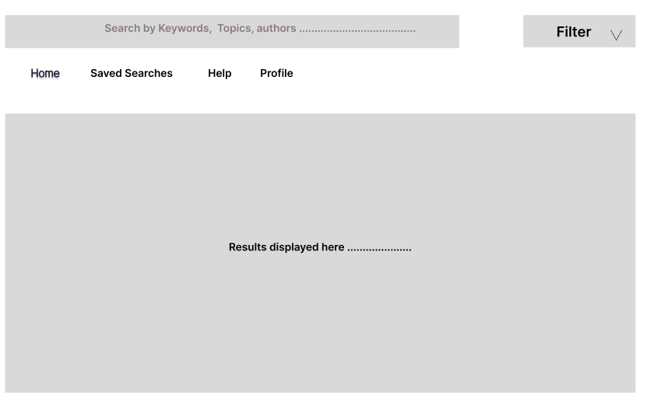
SEARCH PAGE
Notes:
Multilingual Search : As an annotator, I want to search through the text in multiple languages to easily locate sections for annotation.
Include a dropdown for filters (e.g., "All Fields," "Title," "Abstract," "Author").

Slide 15
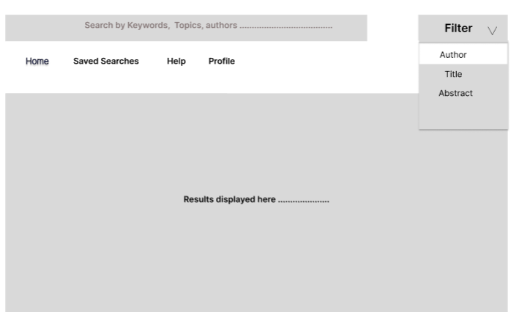
SEARCH PAGE – With Filter
Notes:
Multilingual Search : As an annotator, I want to search through the text in multiple languages to easily locate sections for annotation.
Include a dropdown for filters (e.g., "All Fields," "Title," "Abstract," "Author").

Slide 16
Discussion
The application’s primary goal is to:
Enable efficient tagging and annotation of text data in various regional languages, addressing linguistic nuances.
Provide a robust mechanism for retrieving annotated content, enhancing search and accessibility for native language users.
Support applications like sentiment analysis, content moderation, and language-specific information retrieval systems.

Slide 17
Future Scope
Expanded Language Support: Incorporate more regional languages and dialects to broaden the application’s reach.
AI-Driven Improvements: Leverage NLP advancements like transformers for better annotation accuracy and context comprehension.
Cross-Platform Integration: Enable integration with mobile apps, web platforms, and voice-based interfaces.
User Personalization: Develop features for user-specific annotations and retrieval tailored to individual preferences and contexts.

Slide 18
Link for WireFrames :
https://www.figma.com/design/HuZw3QTV9jlFbfWBbSWX29/Text-Annotation-and-retrieval-for-regional-language?node-id=0-1&node-type=canvas&t=tVSjAowNJtl0yhNt-0

Slide 19

THANK YOU

