Slide 1
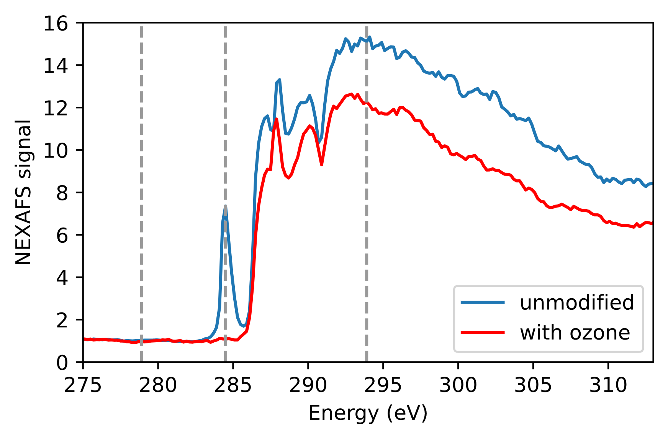
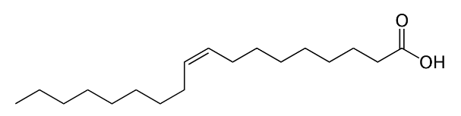
Known core: NaCl, diameter ~50 nm
Known shell: oleic acid (C₁₈H₃₄O₂), outer diameter ~1 um
Possible that the NaCl core does not contribute much to scattering, I’m not sure
Possible that the oleic acid is not uniform, e.g. has its own core-shell structure:
NEXAFS of oleic acid across the carbon K edge shows a clear C-C double-bond peak and step in signal, as expected. (Disregard the “with ozone” data for now.)
I don’t have a measurement for NaCl but its properties should be fairly constant in this range
NaCl
oleic acid, behavior 1
oleic acid, behavior 2
I can’t guarantee spherical symmetry but it seems likely enough to try models that assume it

Slide 2
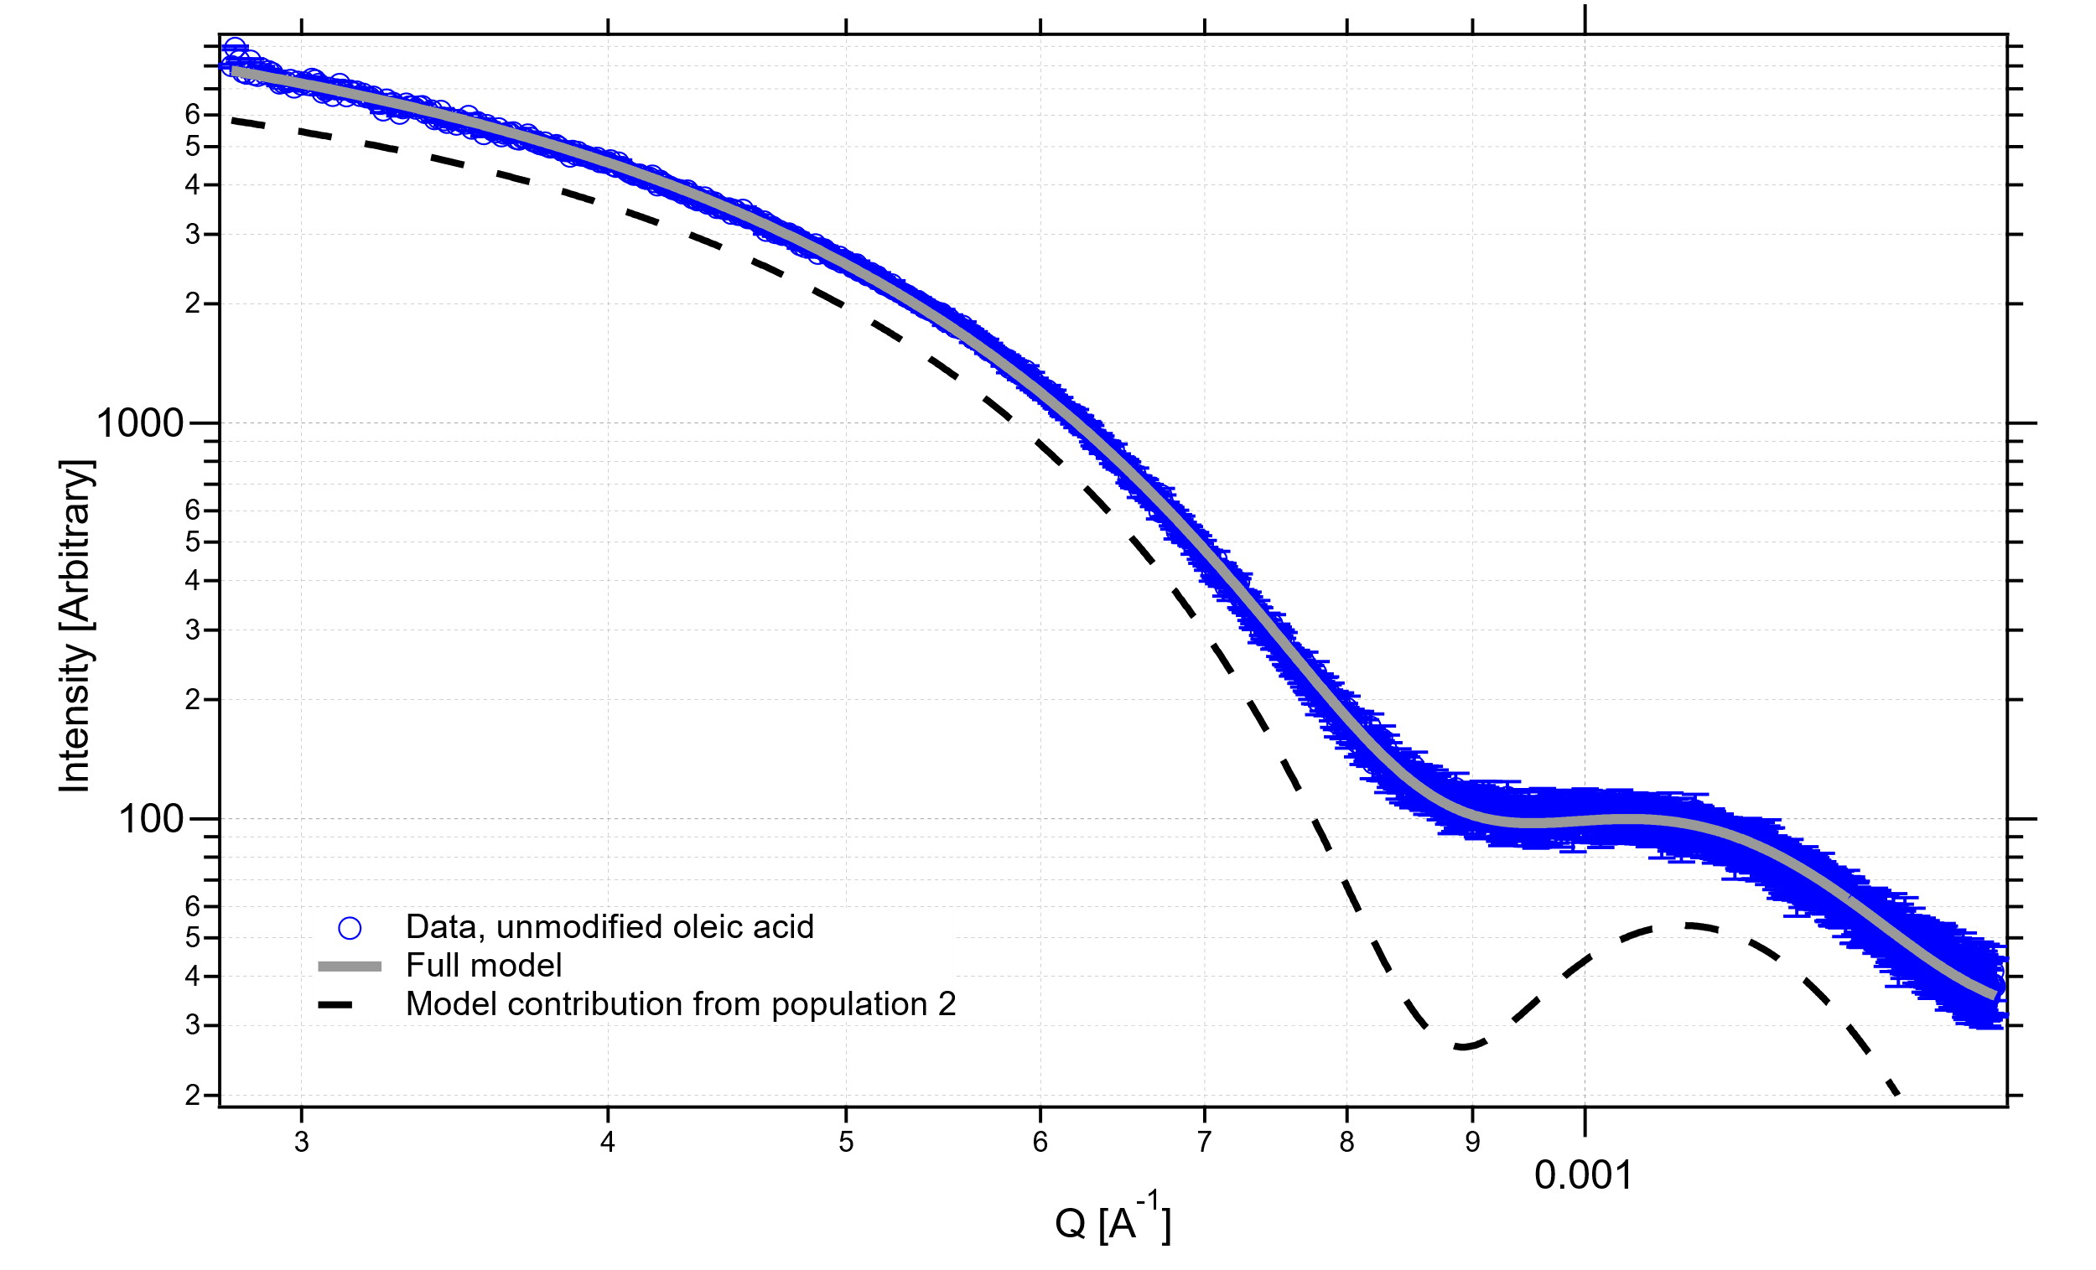
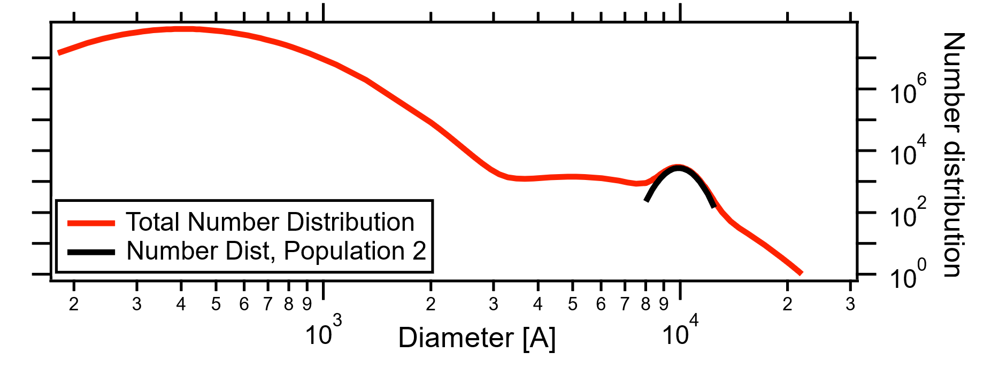
My first pass at fitting: treated particles as uniform (non-interacting) spheres
Modeled my signal as a sum of signal from 3 size distributions (of spheres), adding up to the overall size distribution shown in red
Most of the obvious shape comes from the component with a diameter near 1 um (black line in inset plot; dashed line on main plot)
Trying to model the NaCl core didn’t make an obvious difference

Slide 3
My first pass at fitting: treated particles as uniform (non-interacting) spheres
Curves at different energies have clearly different size-related features
With naïve modeling (not adjusting for different optical constants at different energies), particles look larger when in resonance with the C edge
My fits gave a difference in diameter of nearly 100 nm, which doesn’t make physical sense
Cheng said this behavior makes sense for a core-shell structure with contrast between layers changing as energy changes

Slide 4
I don’t have tools that let me consider the changing optical properties near the carbon K-edge in a way I trust
I know that it’s possible to estimate optical constants from the NEXAFS (I think I sent you a csv) and I’m hoping that information will be enough to come up with a plausible model
If I were doing the modeling, I’d start with the known NaCl core and the rest of the particle as uniform oleic acid, and if that didn’t work see if it was possible to come up with a core-shell structure (with a larger core, or similar) that did make the model make sense
I realize that’s quite open-ended, and understand if you don’t have time to do the second part

Slide 5
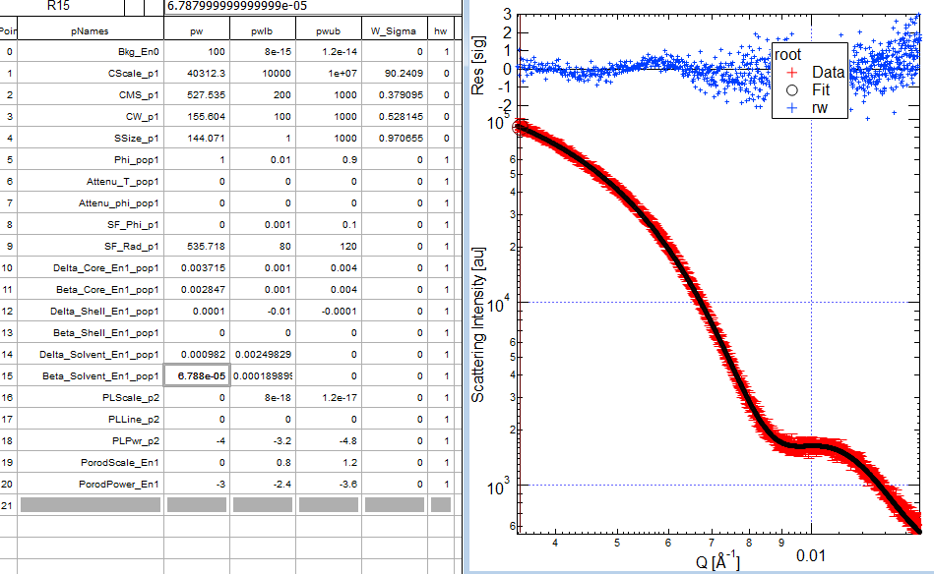
Fitting parameters

Slide 6
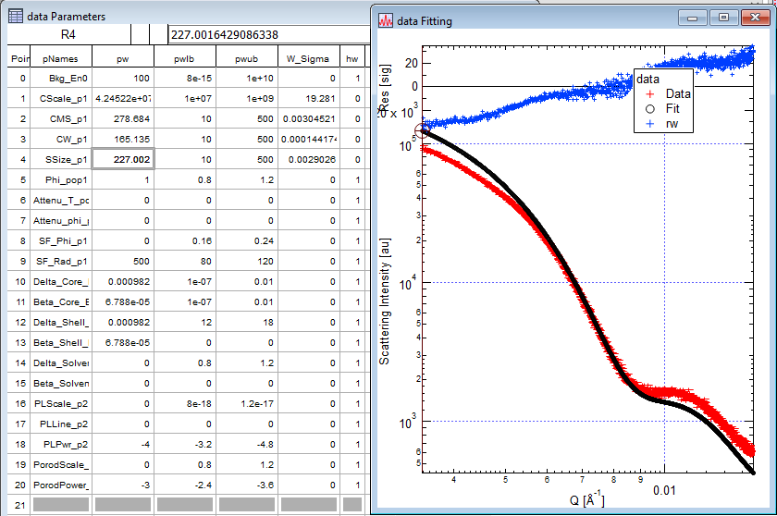

Slide 7
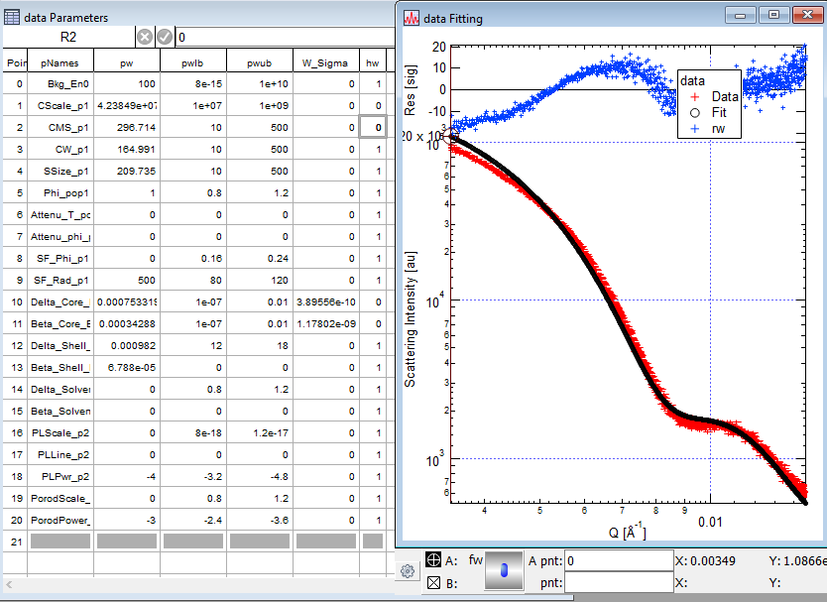
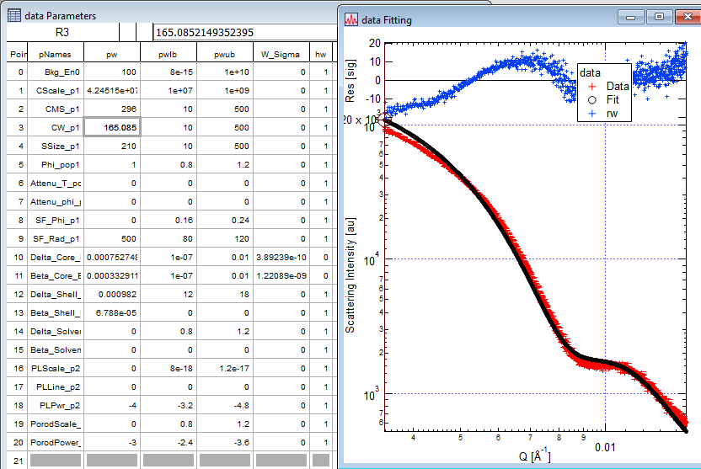

Slide 8
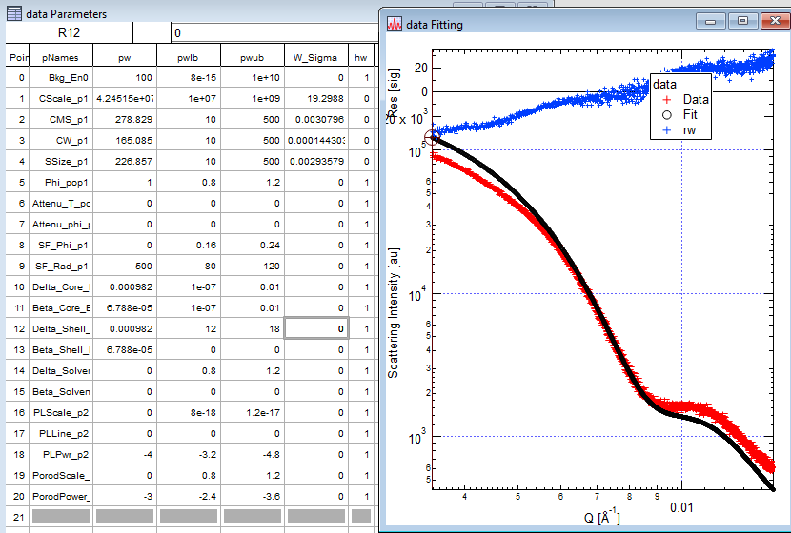

Slide 9
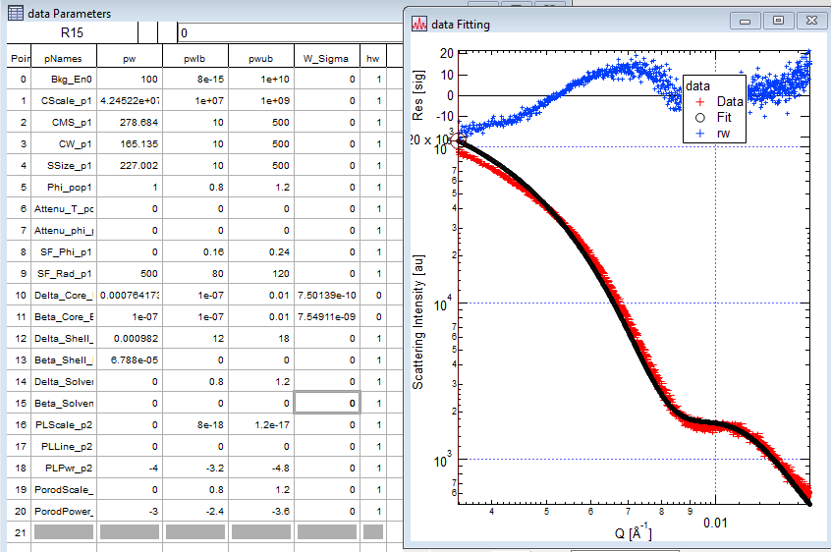

Slide 10
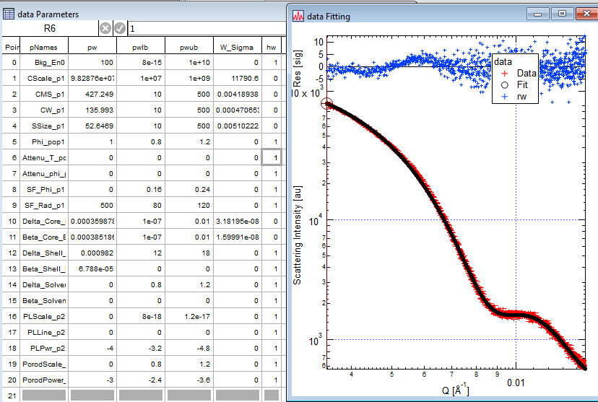

Slide 11
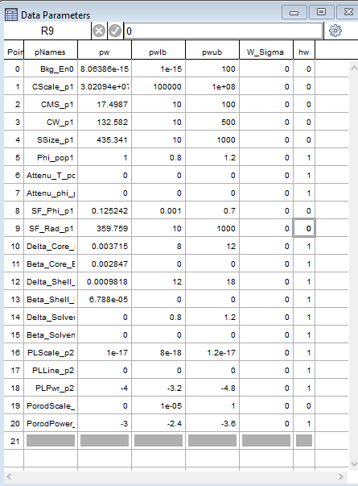
278.9 eV

