Slide 1

HERCODE x ZENLINE
Build the retail radar
Spot the outdoor opportunity before it becomes obvious. Turn messy global signals into a recommendation a Swiss retailer could act on.
Signals
Evidence
Action
June 19, 2026 | Teams of 2-4 | Submit your fork by 16:30 CEST
Notes:
Frame the challenge as a real retail problem: retailers need to identify opportunities before clean sales history exists.

Slide 2
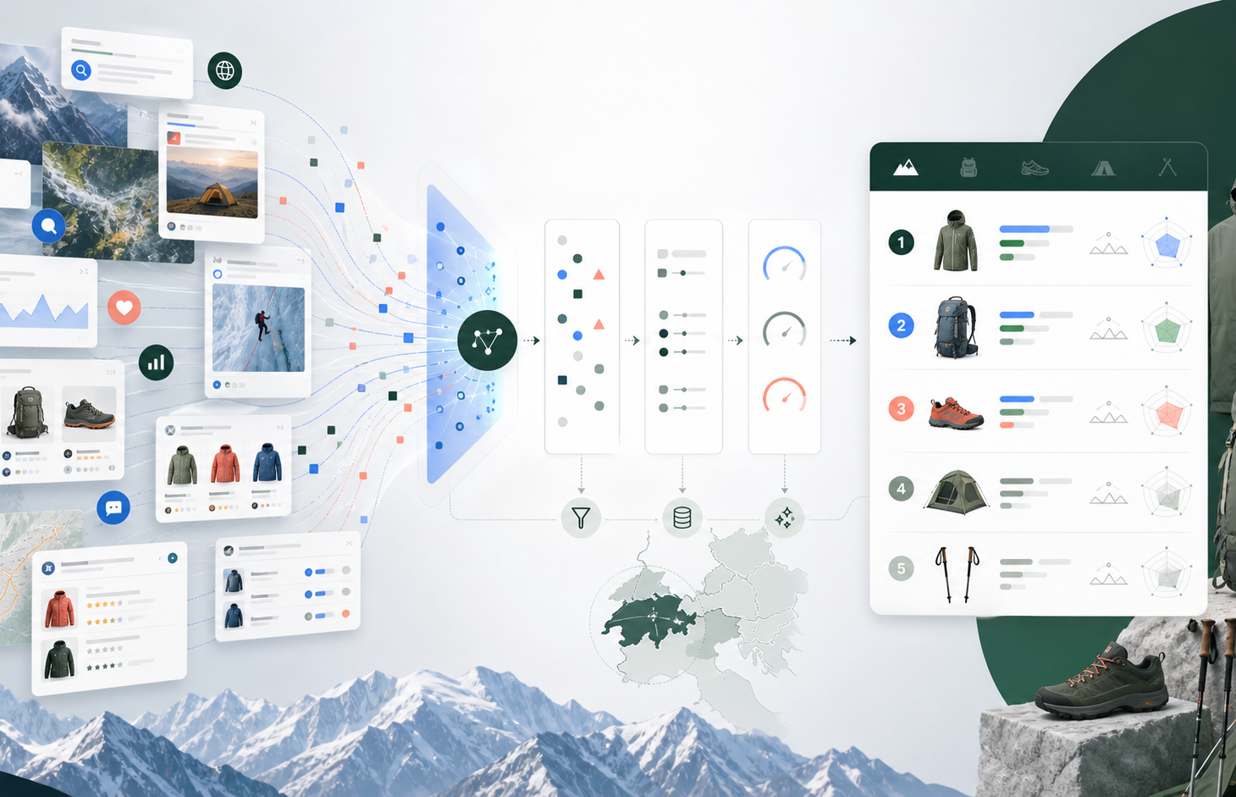
The Challenge
Build a reusable opportunity-detection flow for a Swiss outdoor retailer.
1
Collect
2
Normalize
Web, trends, social, marketplaces, competitors, custom data.
Deduplicate sources and preserve URLs, markets, and limitations.
3
Score
4
Recommend
Rank signals by strength, confidence, transferability, and gaps.
Tell the retailer what to test, buy, launch, or monitor next.
Starter case
Find outdoor opportunities for Switzerland/DACH: products, services, materials, occasions, assortment gaps, or community-led ideas.
Reusable beyond outdoor.
Notes:
Explain that teams can improve one module: source collection, scoring, dashboard, API, report, or handoff. They do not need to build an entire enterprise system.

Slide 3
What to submit
Fork the repo, build your solution, and make the output easy for the jury to inspect.
Code + setup
Evidence trail
How to win
Scripts, notebook, dashboard, API, or workflow with run instructions.
URLs, source names, data files, screenshots, and confidence notes.
Real signal
Source-backed
CH/DACH fit
Ranked opportunities
Demo artifact
Clear action
What appears first, why it matters, and what to do next.
Visualization, dashboard explanation, or optional short video walkthrough.
Reusable system
Pre-submit 15:00 CEST
Final fork due 16:30 CEST
Repo: zenline-ch/hercode-zenline-hackathon
Notes:
Close with the concrete submission path: fork the repo, complete SUBMISSION.md, push final work before 16:30, and include visuals or a short video if available.

