Slide 1
Maven

Slide 2
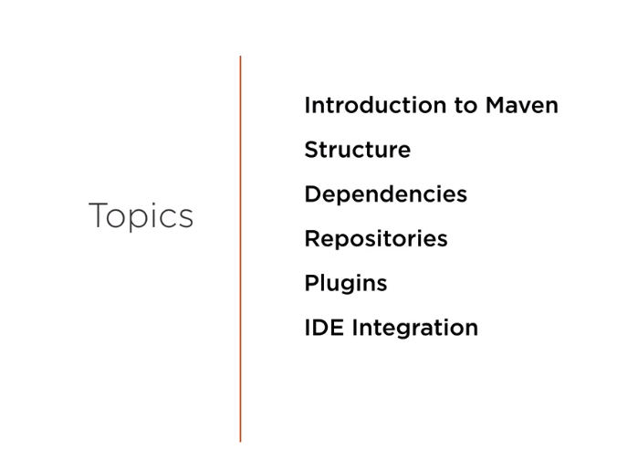

Slide 3
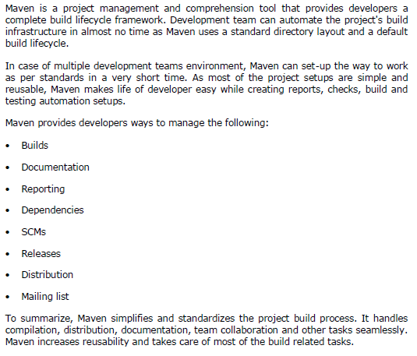
What is Maven?

Slide 4
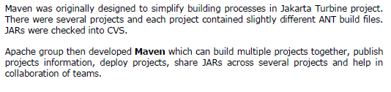
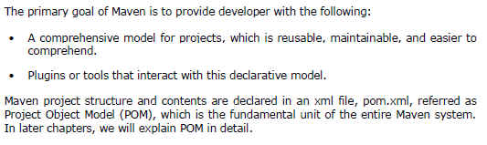
Objective

Slide 5
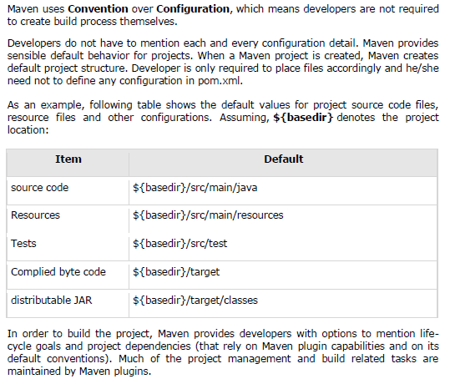
Convention over Configuration
Notes:
Developers can build any given Maven project without the need to understand how the individual plugins work.

Slide 6
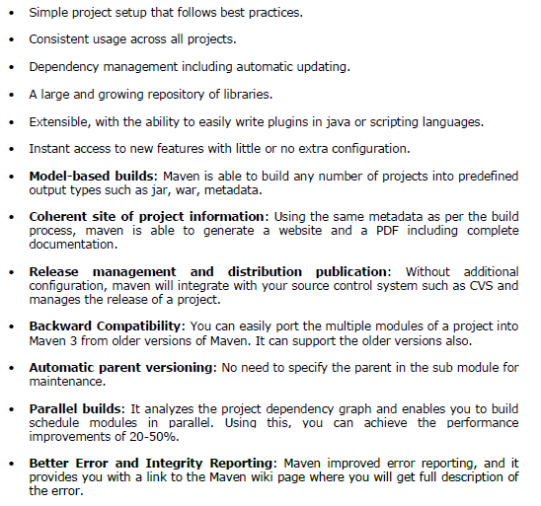
Features of Maven

Slide 7
Installing on windows
1. Get Maven:
Download the maven archive from here: http://maven.apache.org/download.cgi
Unzip it to a folder. In this article, we are using C:\opt\apache-maven-3.6.3
2. Add MAVEN_HOME system variable:
> In “Environment variables” dialog, System variables, Clicks on the New... button and
add a MAVEN_HOME variable and point it to C:\opt\apache-maven-3.6.3\
> Add %MAVEN_HOME%\bin To PATH:
In system variables, find PATH, clicks on the Edit... button.
In “Edit environment variable” dialog, clicks on the New button and add this %MAVEN_HOME%\bin
3. Verification: mvn -version

Slide 8
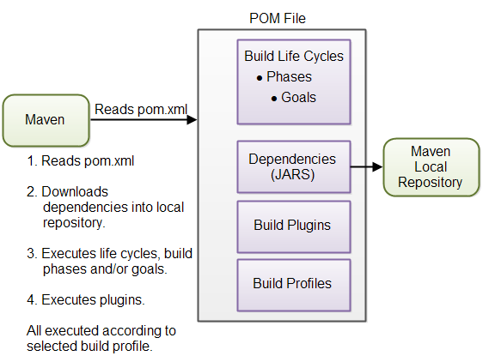
Overview of Maven core concepts.

Slide 9
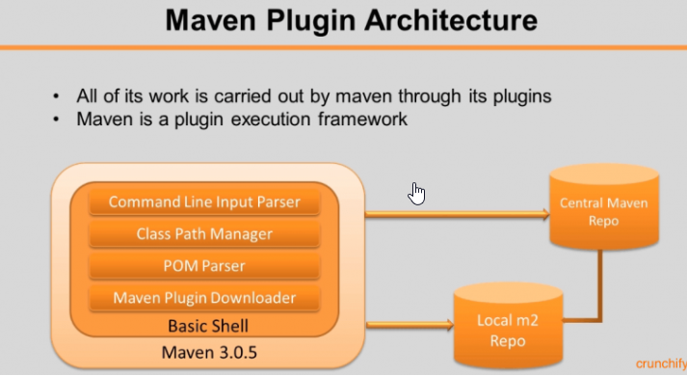

Slide 10
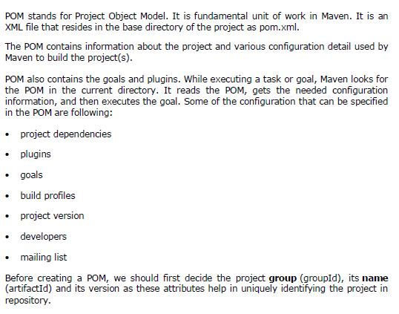
APACHE MAVEN — POM

Slide 11
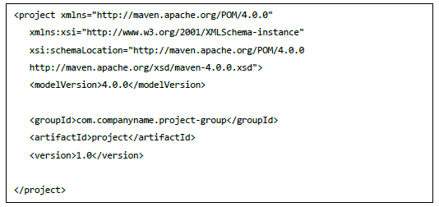
POM Example

Slide 12
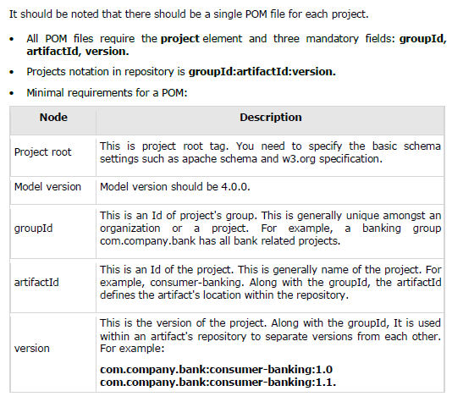
POM Example

Slide 13
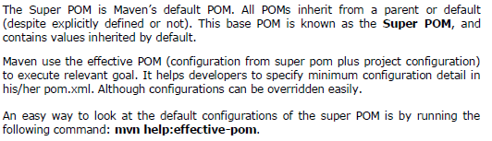
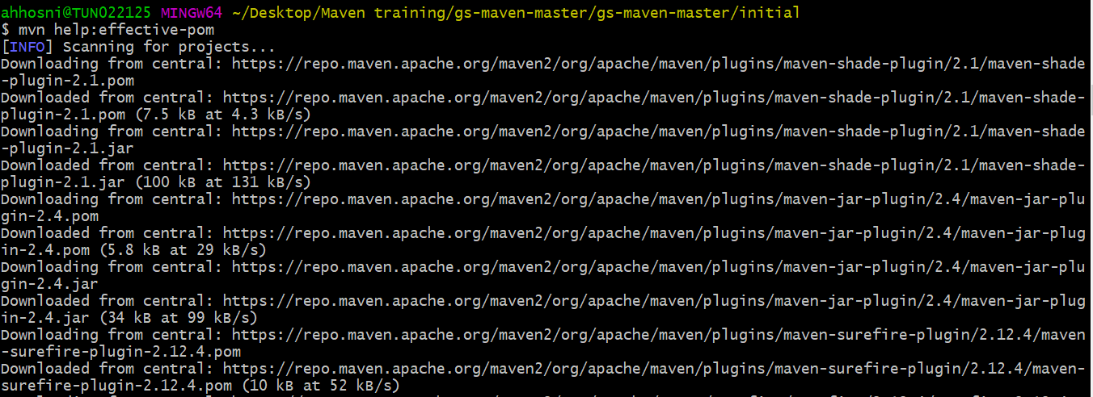
Super POM

Slide 14
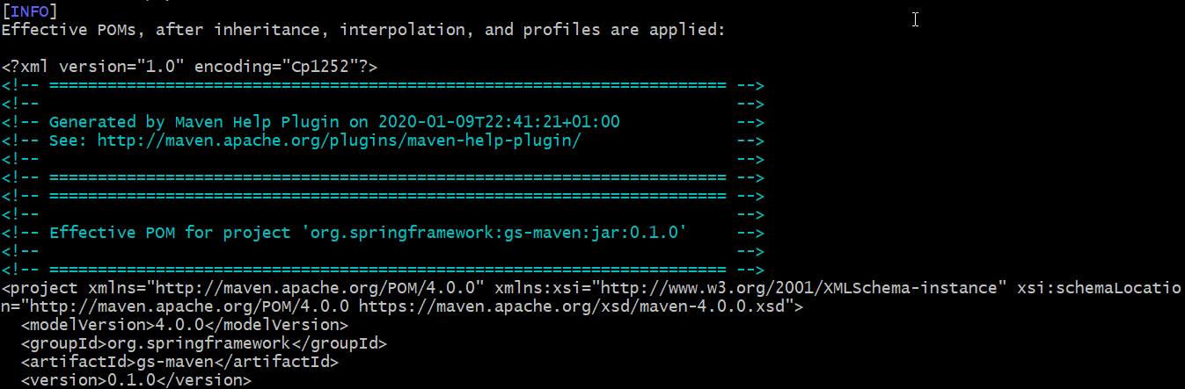
Super POM
Maven will start processing and display the effective-pom:

Slide 15
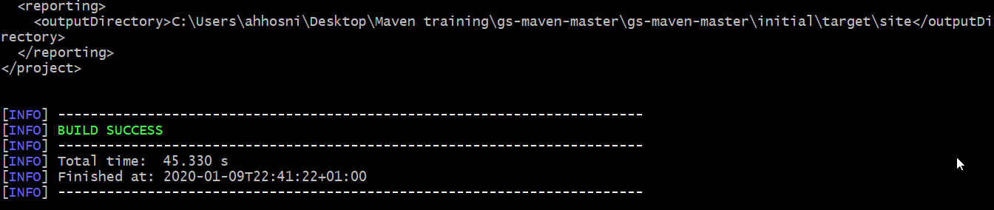
Super POM
In the displayed pom.xml, you can see the default project source folders structure, output directory, plug-ins required, repositories, reporting directory, which Maven will be using while executing the desired goals.
Maven pom.xml is also not required to be written manually. Maven provides numerous archetype plugins to create projects, which in order, create the project structure and pom.xml

Slide 16
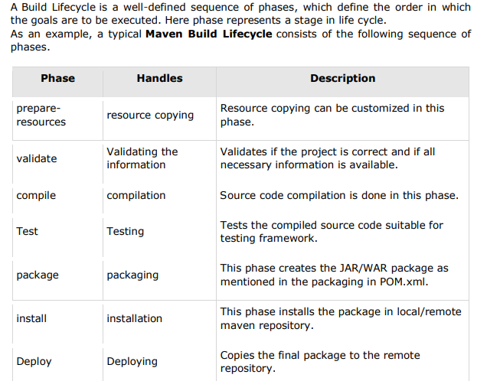
APACHE MAVEN — BUILD LIFE CYCLE

Slide 17
APACHE MAVEN — BUILD LIFE CYCLE
There are always pre and post phases to register goals, which must run prior to, or after a particular phase. When Maven starts building a project, it steps through a defined sequence of phases and executes goals, which are registered with each phase.
Maven has the following three standard lifecycles:
clean
default(or build)
site
A goal represents a specific task which contributes to the building and managing of a project. It may be bound to zero or more build phases.
A goal not bound to any build phase could be executed outside of the build lifecycle by direct invocation.

Slide 18
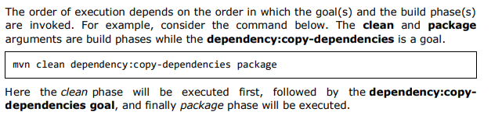
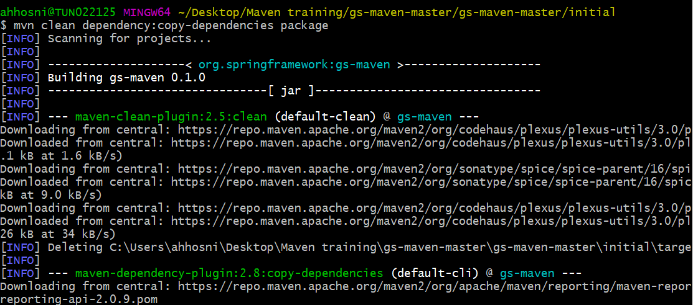
APACHE MAVEN — BUILD LIFE CYCLE

Slide 19
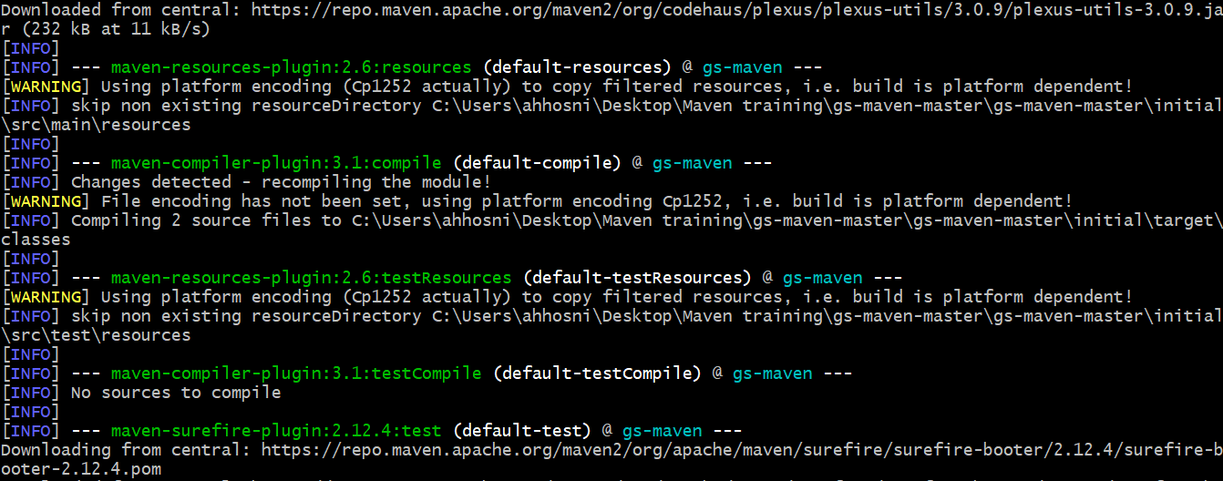
APACHE MAVEN — BUILD LIFE CYCLE

Slide 20
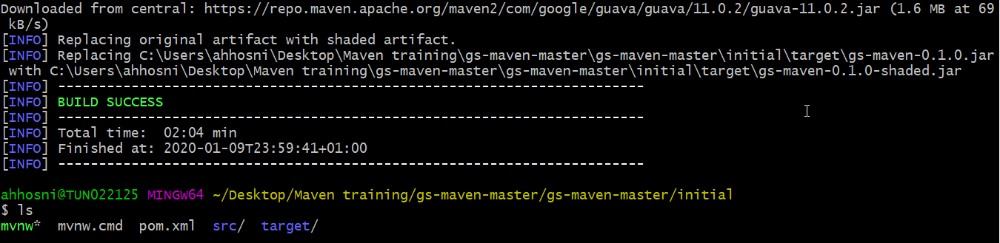
APACHE MAVEN — BUILD LIFE CYCLE

Slide 21
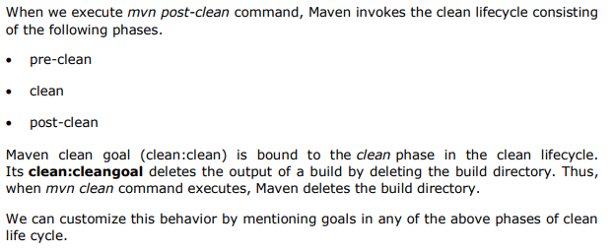
Clean Lifecycle

Slide 22
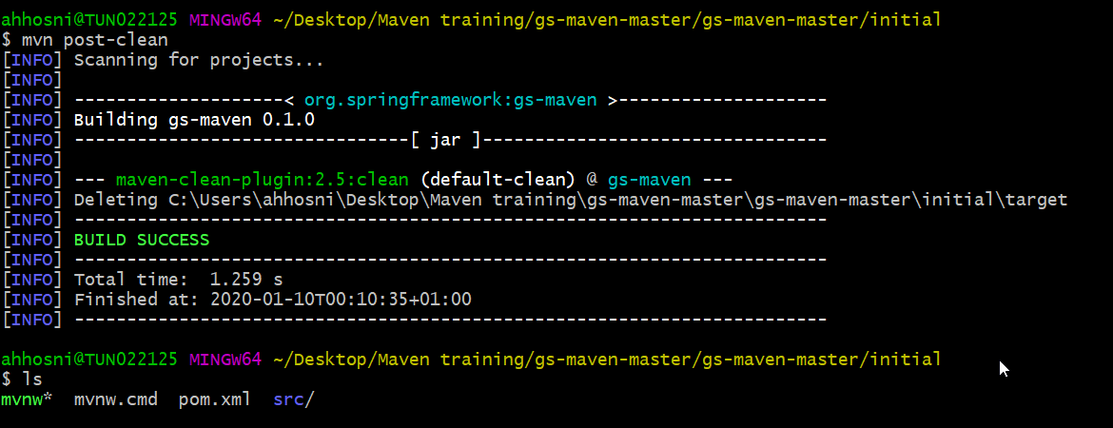
Clean Lifecycle
Notes:
You can try tuning mvn clean command, which will display pre-clean and clean. Nothing will be executed for post-clean phase

Slide 23
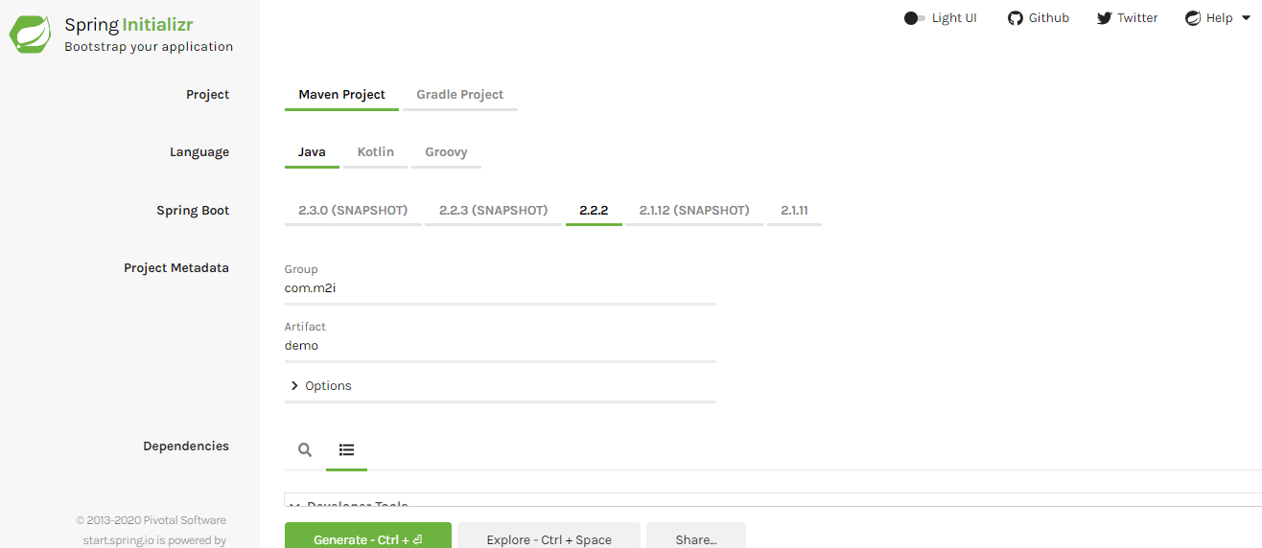
Hello World using Spring initializer
Notes:
Go to https://start.spring.io/

Slide 24
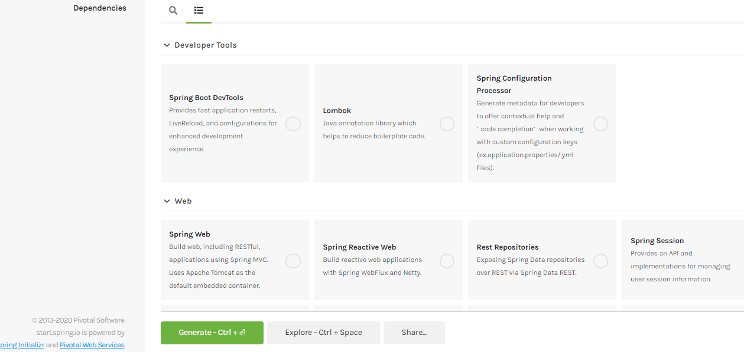
Hello World using Spring initializer

Slide 25
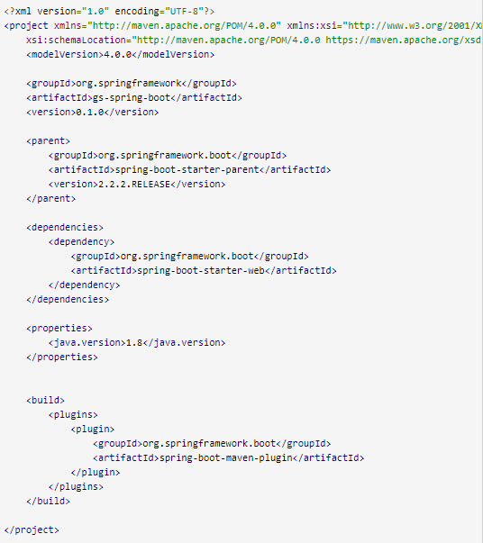
Hello World using Spring initializer: pom.xml

Slide 26
Hello World using Spring initializer: pom.xml

Slide 27
Lab #1: Create a multi-module project
Lab sources are available in: maven-examples/java-multi-modules
We'll use Maven to manage a Multi-module project containing four modules :
1-Password module – Interface only.
2-Password md5 module – Password module implementation, MD5 password hashing.
3-Password sha module – Password module implementation, SHA password hashing.
4-Web module – A simple MVC web app to hash an input with either MD5 or SHA algorithm.
The module dependency:
$ password
$ password <-- password-md5
$ password <-- password-sha
$ web <-- (password-md5 | password-sha) <-- password
Notes:
Maven, Spring MVC, thymeleaf, a simple MVC web app to hash a string with either MD5 or the SHA-256 algorithm
$ cd java-multi-modules
$ mvn install
$ mvn -pl web jetty:run

Slide 28
Lab #1: Create a multi-module project
Here few commands to a build a multi-module project, for examples :
$ mvn -pl password compile # compile password module only
$ mvn -pl password-sha compile # compile password-sha module, also dependency - password
$ mvn -pl web compile # compile web module only
$ mvn -am -pl web compile # compile web module, also dependency - password-sha or password-md5, password
$ mvn -pl web jetty:run # run web module with Jetty
$ mvn compile # compile everything
Try to launch only the web module:
mvn -pl web jetty:run
And check the error Message.

Slide 29
Lab #1: Create a multi-module project
To fix the error, you need to build modules first:
> mvn compile : uses the standard mvn compile to compile all the modules, Maven will decide the build order
> mvn install : Install all the modules into the local repository.
OR
> mvn -am -pl web compile : add -am to compile the web module and also its dependency modules (password-sha and password).
THEN
> mvn -pl web jetty:run : Test the web module with mvn -pl web jetty:run command.
HIT: http://localhost:8080

Slide 30
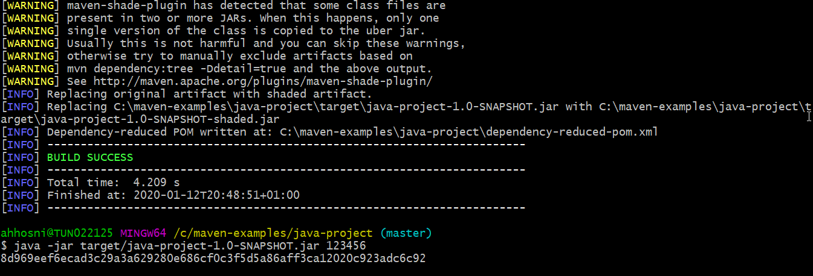
Lab #2: Create a Java project
* Lab sources are available in: maven-examples/java-project
A simple Java project to hash a string with the SHA-256 algorithm. Using Maven 3 and Apache Commons Codec.
Notes:
$ cd java-project
$ mvn package
$ java -jar target/java-project-1.0-SNAPSHOT.jar 123456
Output:
8d969eef6ecad3c29a3a629280e686cf0c3f5d5a86aff3ca12020c923adc6c92

Slide 31
Lab #3: Using profiles
* Lab sources are available in: maven-examples/maven-profiles
We will show few Maven profile examples to pass different parameters (server or database parameters) for different environments (dev, test or prod).
A simple profile to skip the unit test:
<!-- skip unit test -->
<profile>
<id>xtest</id>
<properties>
<maven.test.skip>true</maven.test.skip>
</properties>
</profile>
To activate a profile, add -P option:
> mvn package -Pxtest
Notes:
# default profile id is 'dev’
$ mvn package
$ java -jar target/example1-1.0.jar db.password:8d969eef6ecad3c29a3a629280e686cf0c3f5d5a86aff3ca12020c923adc6c92
db.driverClassName:com.mysql.jdbc.Driver
db.username:mkyong
db.url:jdbc:mysql://localhost:3306/dev

Slide 32
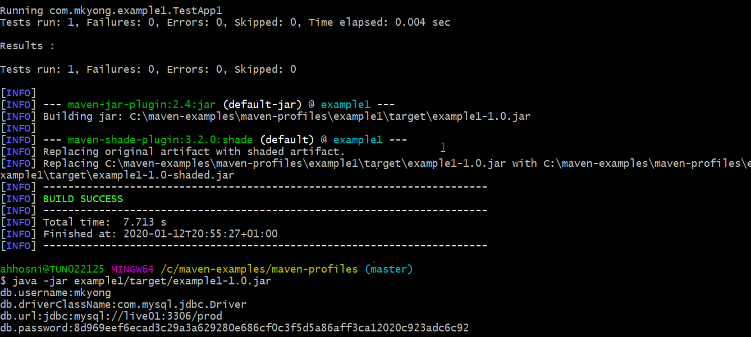
Lab #3: Using profiles
Test the example 1 with profile ‘prod’
# enable profile id 'prod' with -P prod or -D env=prod
$ mvn package -P prod Or $ mvn package -D env=prod
java -jar example1/target/example1-1.0.jar

Slide 33
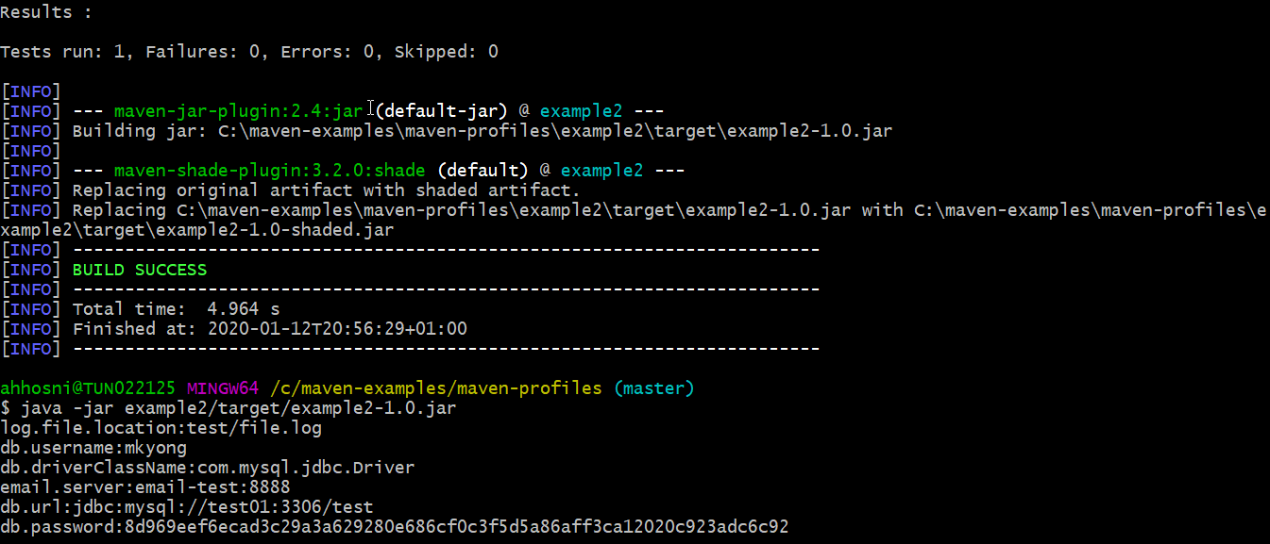
Lab #3: Using profiles
Test the example 1 with profile ‘test’
$ mvn package -P test
$ java -jar target/example2-1.0.jar

Slide 34
Lab #4: How to run Unit Test
Lab sources are available in: maven-examples/maven-unit-test
# Run all the unit test classes.
$ mvn test
# Run a single test class.
$ mvn -Dtest=TestApp1 test
# Run multiple test classes.
$ mvn -Dtest=TestApp1,TestApp2 test
# Run a single test method from a test class.
$ mvn -Dtest=TestApp1#methodname test
# Run all test methods that match pattern 'testHello*' from a test class.
$ mvn -Dtest=TestApp1#testHello* test
# Run all test methods match pattern 'testHello*' and 'testMagic*' from a test class.
$ mvn -Dtest=TestApp1#testHello*+testMagic* test

Slide 35
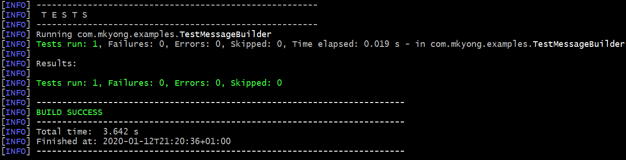
Lab #4: How to run Unit Test
Run a single test method testHelloWorld() from the test class TestMessageBuilder
$ mvn -Dtest=TestMessageBuilder#testHelloWorld test

Slide 36
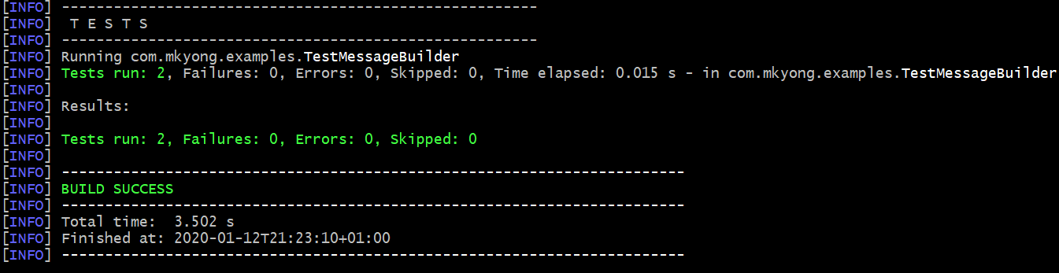
Lab #4: How to run Unit Test
Run a single test class TestMessageBuilder
$ mvn -Dtest=TestMessageBuilder test

Slide 37
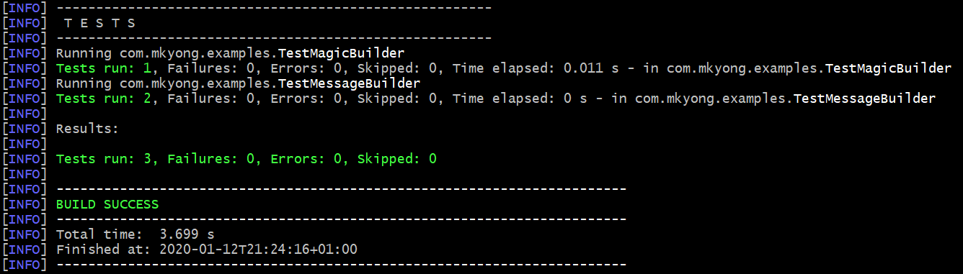
Lab #4: How to run Unit Test
Run all tests
$ mvn test

Slide 38
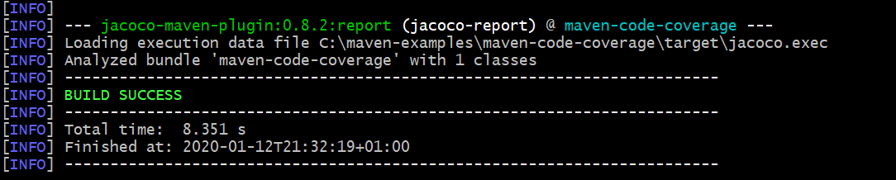
Lab #5: JaCoCo code coverage example
Lab sources are available in: maven-examples/maven-code-coverage
We'll use a JaCoCo Maven plugin to generate a code coverage report for a Java project.
JaCoCo is an actively developed line coverage tool, that is used to measure how many lines of our code are tested.
we'll use JUnit 5.3.1 and jacoco-maven-plugin 0.8.2 maven plugins.
Run mvn test, the JaCoCo code coverage report will be generated at target/site/jacoco/*

Slide 39
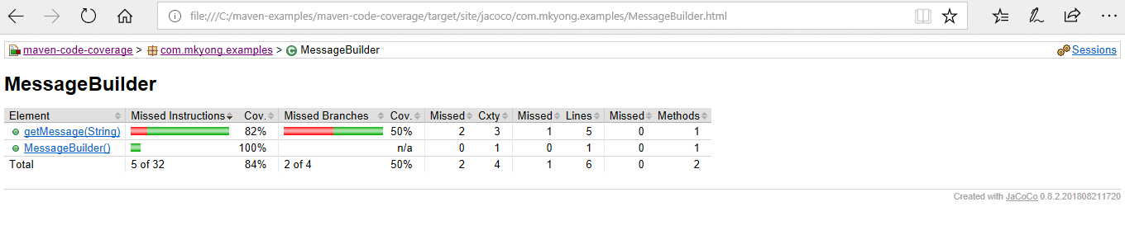
Lab #5: JaCoCo code coverage example
Open the target/site/jacoco/index.html file, review the code coverage report :

Slide 40
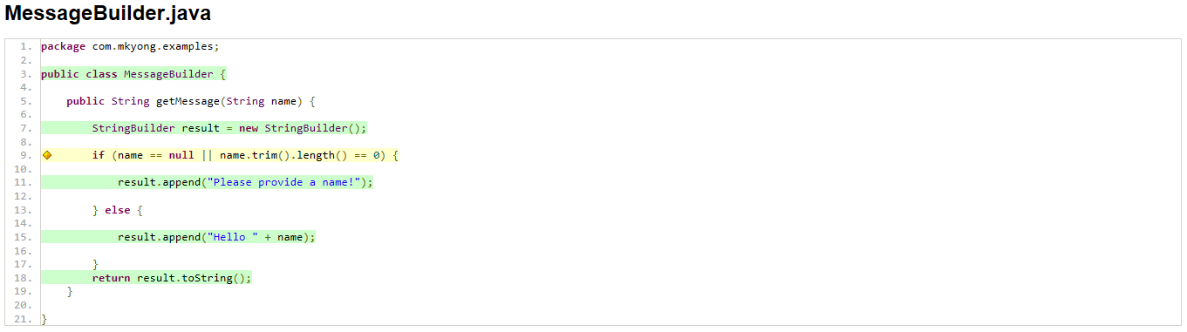
Lab #5: JaCoCo code coverage example
Adding one more test for the red line:
@Test
public void testNameEmpty() {
MessageBuilder obj = new MessageBuilder();
assertEquals("Please provide a name!", obj.getMessage(" "));
}

Slide 41
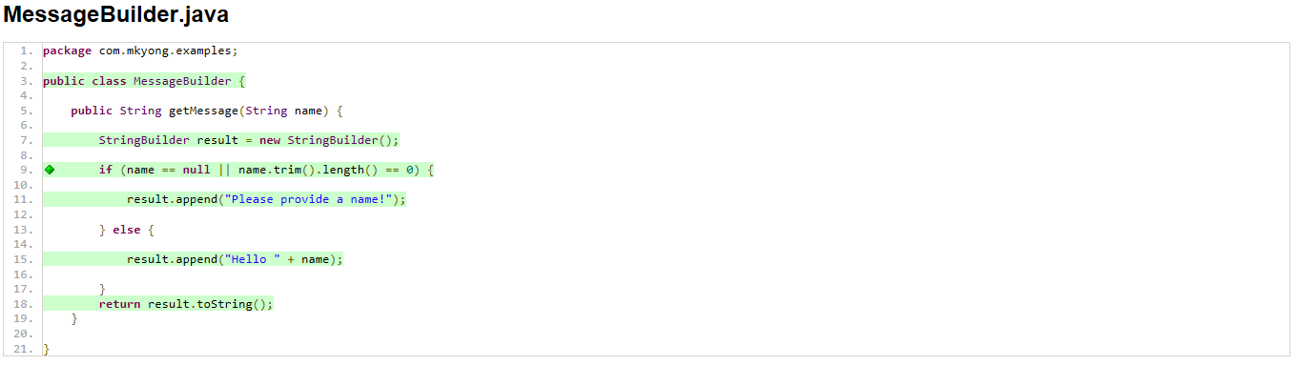
Lab #5: JaCoCo code coverage example
Add one more test for the yellow line if condition:
@Test
public void testNameNull() {
MessageBuilder obj = new MessageBuilder();
assertEquals("Please provide a name!", obj.getMessage(null));
}

Slide 42
Lab #6: JaCoCo code coverage example
Lab sources are available in: maven-examples/maven-static-code-analysis
Let's use Maven PMD Plugin to analyze the Java code:
> Define the maven-pmd-plugin in the reporting tag, so that mvn site will generate the PMD report.
> mvn compile site to generate a Maven site for the Java project, the PMD report will be generated and integrated into the Maven site automatically.
> PMD Report: Review the report at target/site/pmd.html
We’ll also define the spotbugs-maven-plugin in the reporting tag. So that mvn site will generate the SpotBugs report as well
Notes:
The example has a simple Java code, with an unused field ‘abc’ and a performance issue in the “+ string” loop.
Later, SpotBugs will be able to detect it and showing it on the report.

Slide 43
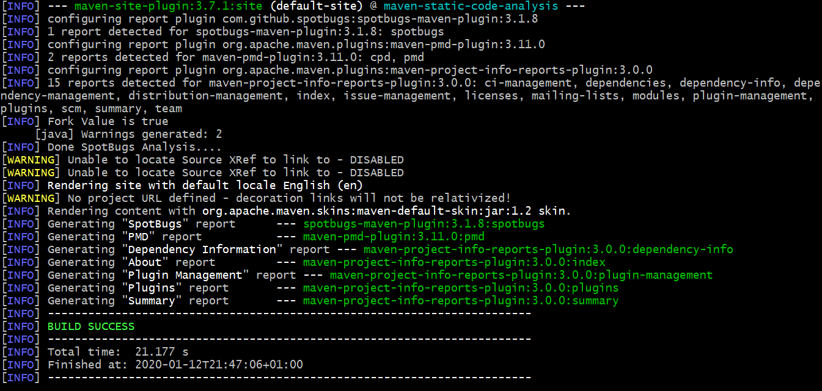
Lab #6: Static Code Analysis

Slide 44
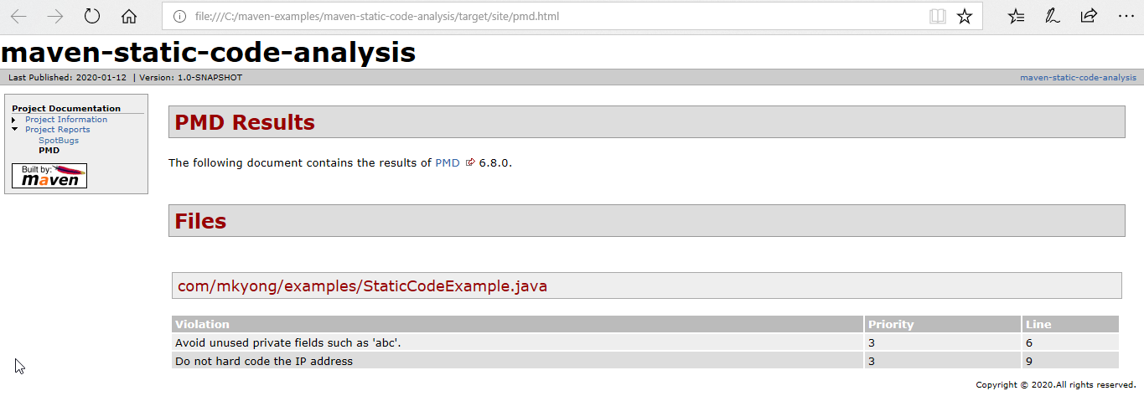
Lab #6: Static Code Analysis
View report at target/site/pmd.html:

Slide 45
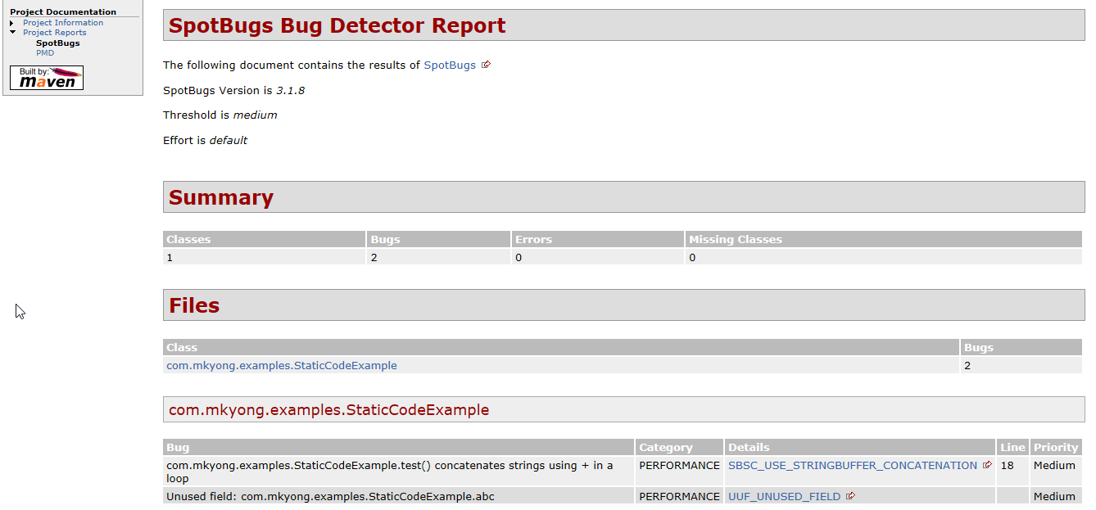
Lab #6: Static Code Analysis
View report at target/site/spotbugs.html:

Slide 46
Lab #7: Spring Boot, MySQL, JPA, Hibernate Restful CRUD API
Step 1 : Click Switch to full version on http://start.spring.io page.
Step 2 : Enter the details as follows -
Group : com.example
Artifact : easy-notes
Name : easy-notes
Description : Rest API for a Simple Note Taking Application
Package Name : com.example.easynotes
Packaging : jar (This is the default value)
Java Version : 1.8 (Default)
Dependencies : Web, JPA, MySQL, DevTools
Click Generate Project to generate and download your project.

Slide 47
Lab #7: Spring Boot, MySQL, JPA, Hibernate Restful CRUD API
Lab sources are available in: maven-examples/spring-boot-mysql-rest-api-tutorial
> mvn spring-boot:run
OR
> mvn package then java –jar target/easy-notes-1.0.0.jar
The application will start at Spring Boot’s default tomcat port 8080.
Testing the APIs:
Creating a new Note using POST /api/notes API
Retrieving all Notes using GET /api/notes API
Retrieving a single Note using GET /api/notes/{noteId} API
Updating a Note using PUT /api/notes/{noteId} API
Deleting a Note using DELETE /api/notes/{noteId} API

Slide 48
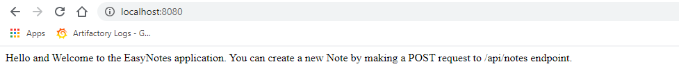
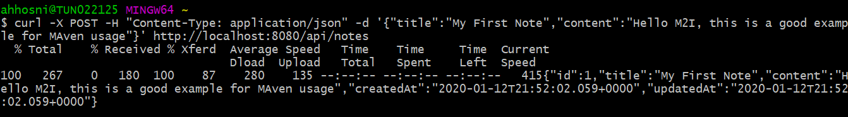
Lab #7: Spring Boot, MySQL, JPA, Hibernate Restful CRUD API
> curl -X POST -H "Content-Type: application/json" -d '{"title":"My First Note","content":"Hello M2I, this is a good example for MAven usage"}' http://localhost:8080/api/notes
> http://localhost:8080/api/notes
Notes:
Mysql config in src/main/resources/application.properties

Slide 49
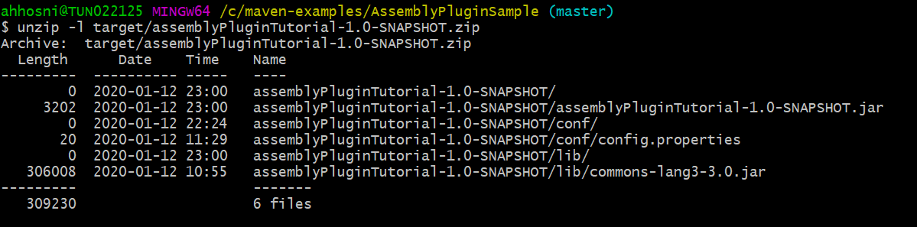
Lab #8: Using the Maven Assembly Plugin to build a ZIP distribution
We are planning to create a zip archive with all the required files, we need to create an assembly descriptor mentioning the required files that we need for the final zip distribution.
Creating an assembly descriptor: Created zip.xml file under src/main/assembly.
Building the program (mvn clean install) will create the final assemblyPluginTutorial-1.0-SNAPSHOT.zip in the target directory.
Notes:
Lab sources are available in: maven-examples/AssemblyPluginSample

Slide 50
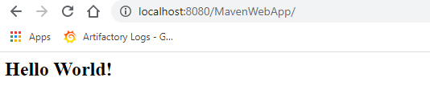
Lab #9: Using the Maven Assembly Plugin to build a ZIP distribution
mvn tomcat7:run-war
Then hit:
- http://localhost:8080/MavenWebApp/
-http://localhost:8080/MavenWebApp/resource/hello/SayHello?inputName=m2iformation
- http://localhost:8080/MavenWebApp/resource/swagger.json
- http://localhost:8080/MavenWebApp/swagger/index.html
Notes:
Lab sources are available in: maven-examples/MavenWebAppRestSwaggerSample

