Slide 1
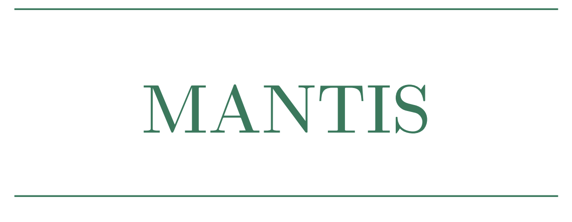
Mach-Zehnder Adjoint-trained Neural network for Two-class Image Separation
Project Presentation
Tim Gühring ● Leah Haase

Slide 2
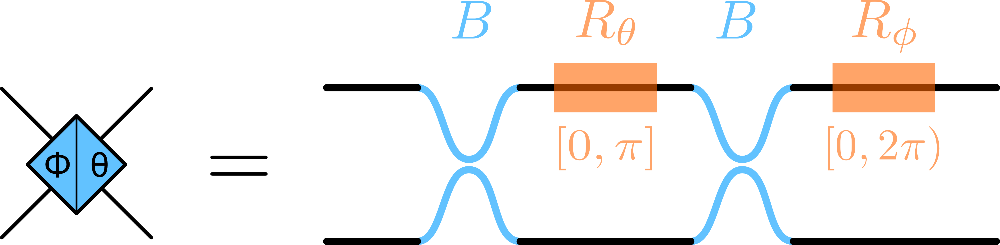
Classifying using MZI Meshes

Slide 3
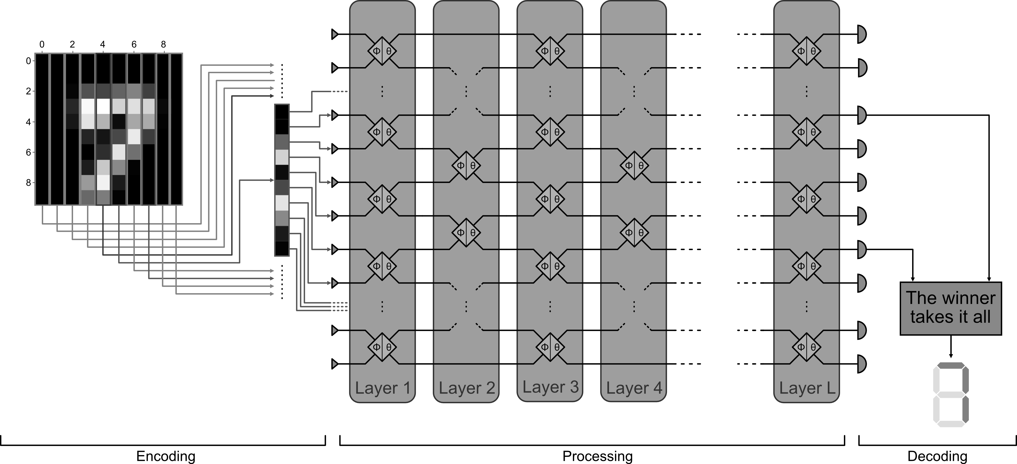
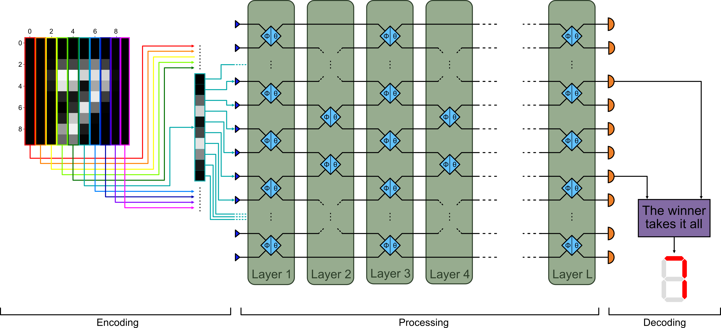

Slide 6
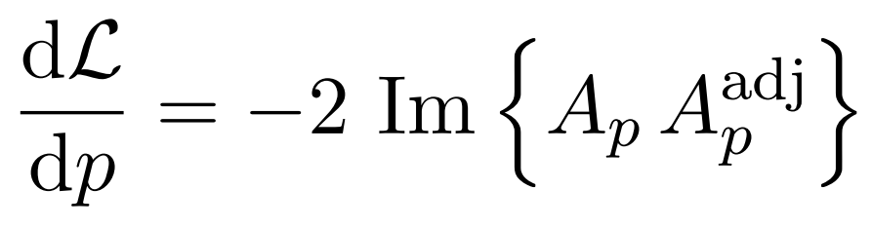
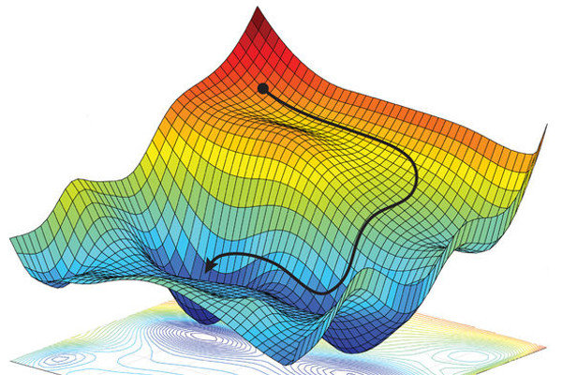
Learning via Adjoint-based Backpropagation
Notes:
A_p: complex field amplitude for feed-forward propagation
A_p^adj: Adjoint field amplitude, achieved by propagating the error field from the detector side

Slide 7
Learning via Adjoint-based Backpropagation
Notes:
A_p: complex field amplitude for feed-forward propagation
A_p^adj: Adjoint field amplitude, achieved by propagating the error field from the detector side

Slide 8
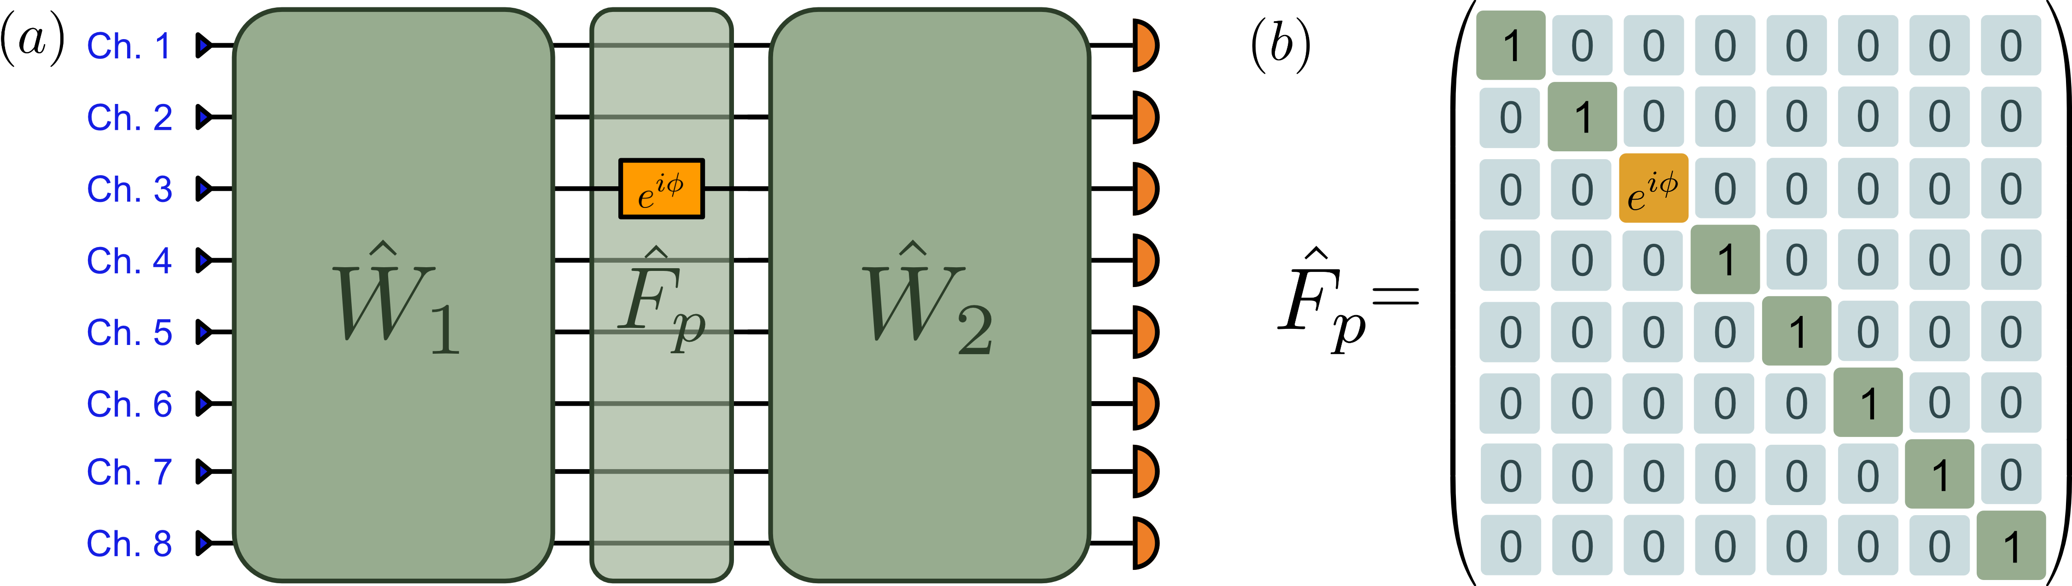
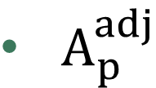

Learning via Adjoint-based Backpropagation
$A_{p}$
$A_{p}^{adj}$
Notes:
Partition of MZI mesh into preceding mesh, layer with parameter F_P and subseq. Mesh

Slide 9
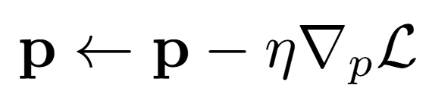
Learning via Adjoint-based Backpropagation
Notes:
Parameters get updated

Slide 10
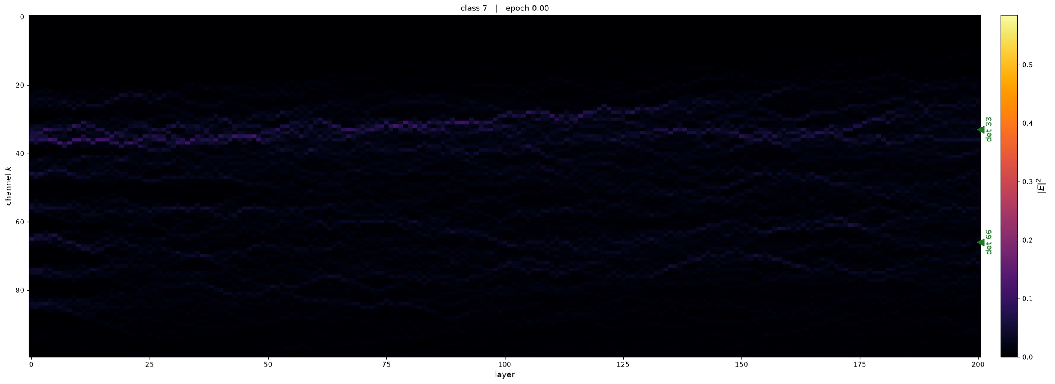
Learning via Adjoint-based Backpropagation

Slide 11

Linear Regression shows high accuracy
Highest value for $m=6$
  Test-accuracy: 99.75%
  Confusion matrix: $\left(\begin{matrix}199 & 1 \\ 0 & 200\end{matrix}\right)$
$⇒$ 7 and 1 are linear separable

Slide 12
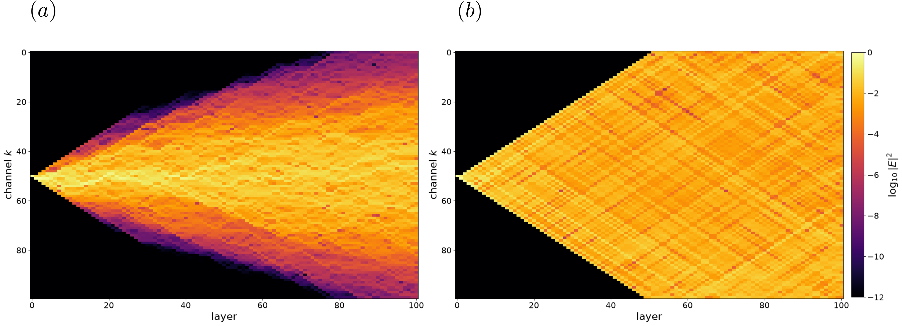
Parameter initialization accelerates convergence

Slide 13
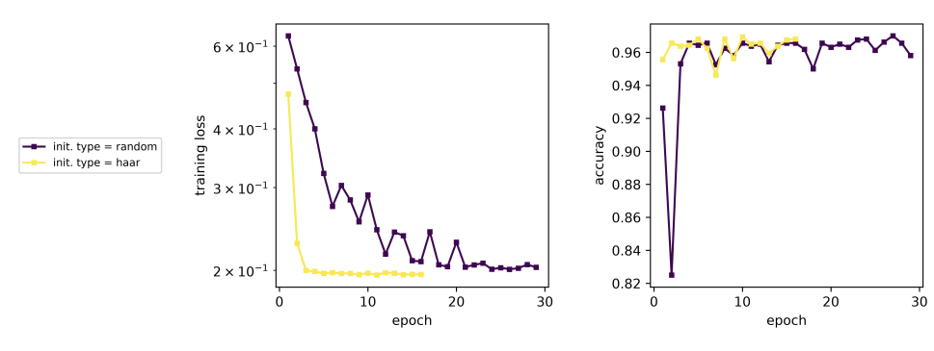
Parameter initialization accelerates convergence

Slide 14
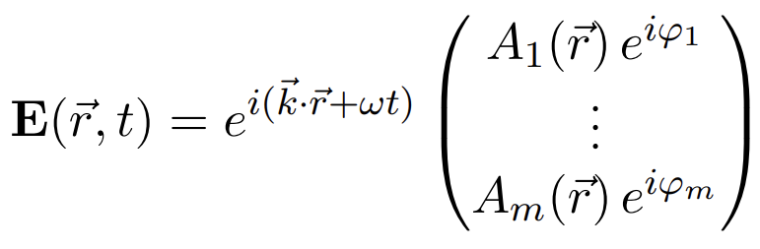
Phase-encoding improves accuracy
Amplitude encoding
Phase encoding

Slide 15
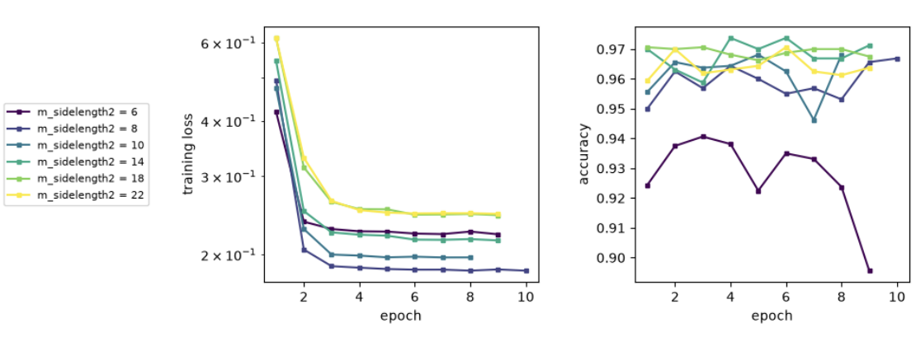
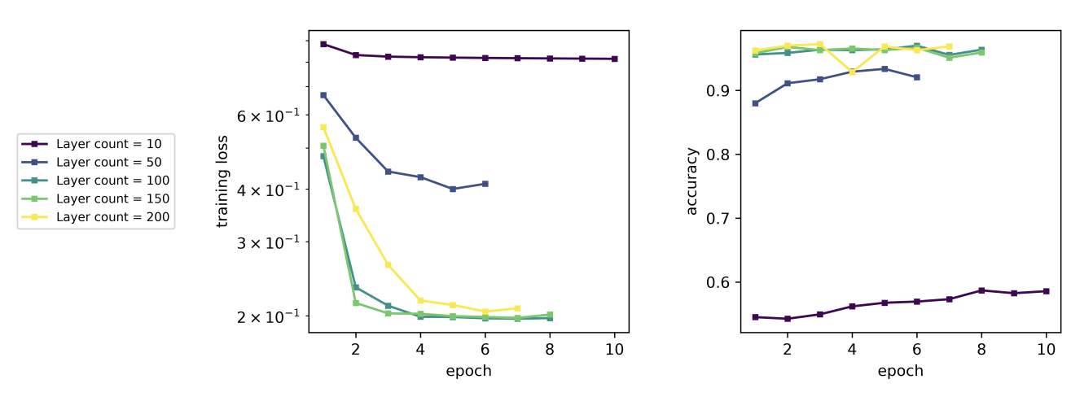
Bias-Variance Trade-Off

Slide 16
Bias-Variance Trade-Off
Bias:
  Only unitary matrices
  Limited to detection non-linearity
Variance:
  Thermal and detector noise
  Fabrication imperfections
  Losses
Notes:
Parameter get updated

