Slide 1
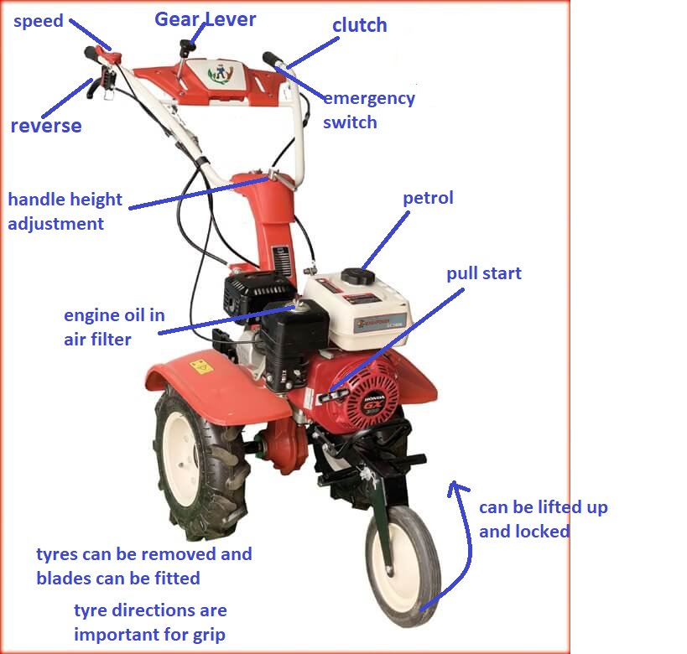

1 | 2
3 | 4
tex
$$A=πr^{2}$$

