Slide 1
slide |  | slide |  | slide
1-3 | Table of contents | 10 | blank
4 | Title slide | 11 | Content with caption
5 | Title and content slide | 12 | Picture with caption
6 | Section header | 13
7 | Two content
8 | Comparison
9 | Title only

Slide 2
slide |  | slide |  | slide
1 | Table of contents
2

Slide 3
slide |  | slide |  | slide
1 | Table of contents
2

Slide 4
Slide with title

Slide 5
Slide with title

Slide 13
Some textbox

Slide 14

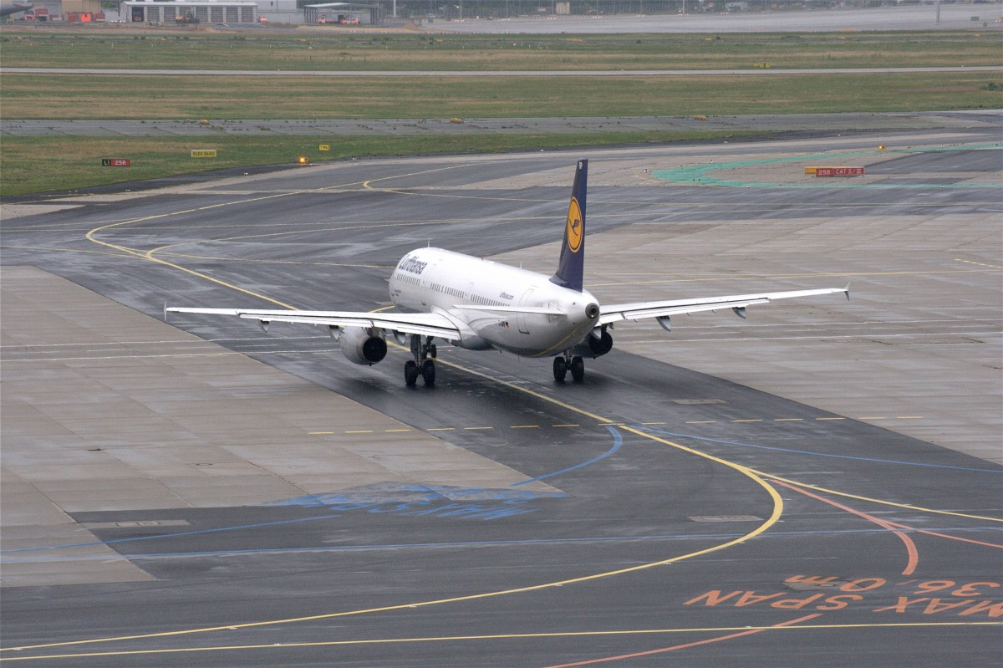

Slide 18
Notes:
Some notes

