Slide 1
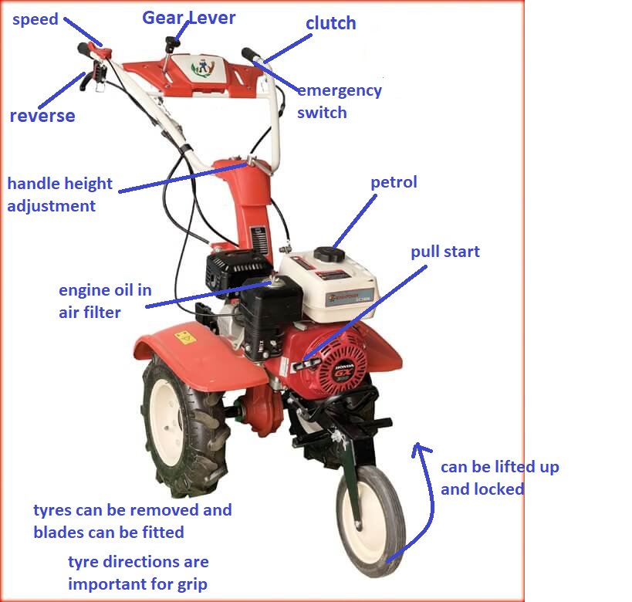

tex
$$A=πr^{2}$$

