Slide 1


Team Details
  Team name: Kataribe
  Team leader name: Tanguy Pemeja
  Problem Statement: Sustainability & Social Impact

Slide 2
Brief about the idea
kataribe 語り部
6.72M
people aged 65 and over live alone in Japan
2020 census · Cabinet Office, Annual Report on the Ageing Society
A voice AI that talks with an elderly person for a few minutes a day, and turns their memories into a life story their family can read and hear.
THE PROBLEM
Many Japanese seniors spend their days alone, and their families never find the time or the courage to ask about their lives. The stories go unrecorded.
¥220,000
for one professionally written self-history (自分史), made once, by hand
親の雑誌 (Kokoromi), price incl. tax
THE IDEA
A kataribe is the traditional keeper of oral history. Ours listens, remembers what was said, and plans what to ask next, always in the person's own words.
WHO BENEFITS
The senior: being listened to, memory work, a story that lasts. The family: stories they never asked about, and a reason to call.

Slide 3
Opportunities
The senior leads. The AI plans what to ask. The family can join.
How different is it from any of the other existing ideas?
Memoir AIs (Tell Mel, Storyworth, Remento) rewrite a parent's words into chapters, and the family chooses who receives them.
Companion AIs (茶の間 Cotomo) keep seniors company, but no life story comes out.
A human-written self-history costs ¥220,000, and is made once.
How will it be able to solve the problem?
A few minutes of conversation a day in natural Japanese. Nothing to install, open or type.
Each talk becomes stories, people and places on a life timeline. The gaps plan the next talk.
Relatives read what she shared, hear her voice, and send questions she is asked next time.
USP of the proposed solution
She decides what is shared. Consent is kept as her own words, checked against the recording.
Faithful, not rewritten. Every quote is verified word for word and plays in her own voice.
Built for Japanese: honorific register, names spelled from her profile, patience for long pauses.

Slide 4








List of features offered by the solution
Talks in Japanese
Gemini Live, native audio. Waits through long pauses for thought: 5 s, not 0.8 s.
Remembers last time
Opens by recalling last time, then asks what it planned to ask.
Stories, not transcripts
Each talk becomes stories with people, places and a life stage.
Never invents
A quote not found word for word in the transcript is dropped.
Plans from the gaps
Finds thin life stages and people never described, and plans the next three questions.
Consent per story
Shared only if she said yes, in words found in the recording. Private by default.
Family page, her voice
Chapters by life stage. Every quote plays as a clip of her own answer.
The family asks back
Relatives send questions and the AI says who is asking. Refused topics are never asked.

Slide 5
Process flow diagram or Use-case diagram
Every session
The family
1
Talk
5–10 min in Japanese with Gemini Live. She leads, it follows.
2
Store
A stereo recording and both transcripts, per session.
3
Extract and verify
Stories, people, places. Quotes and consent checked verbatim.
next session
6
Plan the next talk
Story so far, three questions, and topics to avoid.
5
Find gaps
Thin life stages, people never described, stories cut short.
4
Timeline
Stories placed on life stages: childhood, work, marriage…
up to two a session
only what she shared
Screened
A question touching a topic she refused is quietly held back.
Family asks back
A relative writes a question and who they are: 孫のゆか.
Family reads
Only stories she agreed to share, each quote in her voice.

Slide 6

Wireframes/Mock diagrams of the proposed solution (optional)
Family page
語り部
田中ハル
1947年生まれ · 長野
こんにちは、ハルさん
1
Her stories as chapters, by life stage
1
子供時代
1
今日のお話 · お父様の織物工場
2
織物工場のこと
2
Her own words, and a clip of her answer to play
「父は村で小さな織物の工場をやっておりました。」
2
3
3
Ask her something; she hears who is asking
おわる
4
Ask 田中ハル something
3
The family page is built. The tablet screen is the next step: today the prototype starts from a Talk button.
Senior's tablet: nothing to open, tap or type
Send question
1
Greets her by name
2
One topic, from last time
3
Listens, and waits
4
One big button to stop

Slide 7







Architecture diagram of the proposed solution
Senior's tablet
React web app
Mic in at 16 kHz, voice out at 24 kHz
Records the talk in stereo: her voice left, the AI right
Holds only a short-lived token, which cannot change the prompt
Voice, both ways, with that token
Gemini Live API
gemini-3.8-live: native audio, built-in transcription
2
Cloud Run
FastAPI and the web app, in one container
1
Session start
Her story so far and family questions, locked into a short-lived Live token
Firestore
People, sessions, stories, plans
3
Recording upload
Stereo WAV in parts, joined in Cloud Storage
Cloud Storage
Recordings, then clips
4
Processing
Extract → verify → screen → plan, after every session
Gemini 3.8 Flash
Extraction, screening, planning
Family's phone
The family page: shared stories, her voice
5
Family API
Shared stories only; clips cut from her own channel

Slide 8
Technologies to be used in the solution
Google AI
Gemini 3.8 Live: real-time Japanese voice, native audio, built-in transcription
Gemini 3.8 Flash: extraction, screening, planning, and judging the evals
Google Gen AI SDK, Python and JavaScript; ephemeral tokens
Google Cloud
Cloud Run: the API and the web app in one container
Firestore: people, sessions, stories, plans, questions
Cloud Storage: recordings, uploaded in parts
Application
React 19, Vite, TypeScript
Web Audio worklet: 16 kHz capture, stereo recording
FastAPI on Python 3.13, managed with uv
Quality
pytest and Playwright against the live API, with synthesized Japanese speech
AI-vs-AI sparring: three personas, real audio both ways
GitHub Actions: checks on every push, the live eval nightly
One rule across the stack The model never speaks for her. Gemini extracts the stories; plain code then checks every quote, and every yes to sharing, against the transcript.

Slide 9
Estimated implementation cost (optional)
Item | Basis | Per session
Gemini Live, audio in | $0.005 a minute, for all 10 minutes | $0.050
Gemini Live, audio out | $0.018 a minute, about 2.5 minutes spoken | $0.045
Gemini Flash processing | ≈ 15k tokens in, 3k out, across four passes | $0.023
Recording storage | 58 MB of WAV, at ≈ $0.023 per GB-month | < $0.002
Cloud Run, Firestore | Scale to zero; free tiers at this scale | ≈ $0
Total |  | ≈ $0.12
≈ $0.12
per 10-minute conversation, in AI and cloud, at list prices
≈ ¥6,400
for a year of daily conversations, per person
Under 3% of one ¥220,000 self-history written by hand.
Audio is billed for the whole time a session is open, silence included. Rates are Google's list prices as of 23 Sep 2026, kept in backend/costs.py; the Flash token counts are estimates. Yen at ¥150 to the dollar.

Slide 10
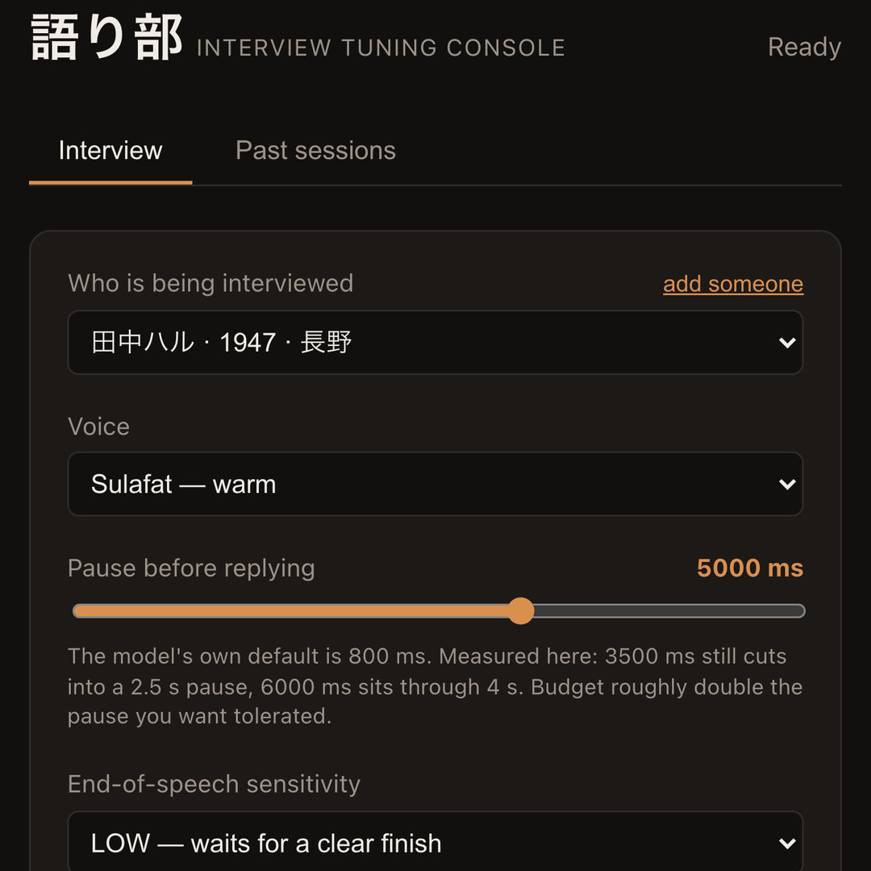
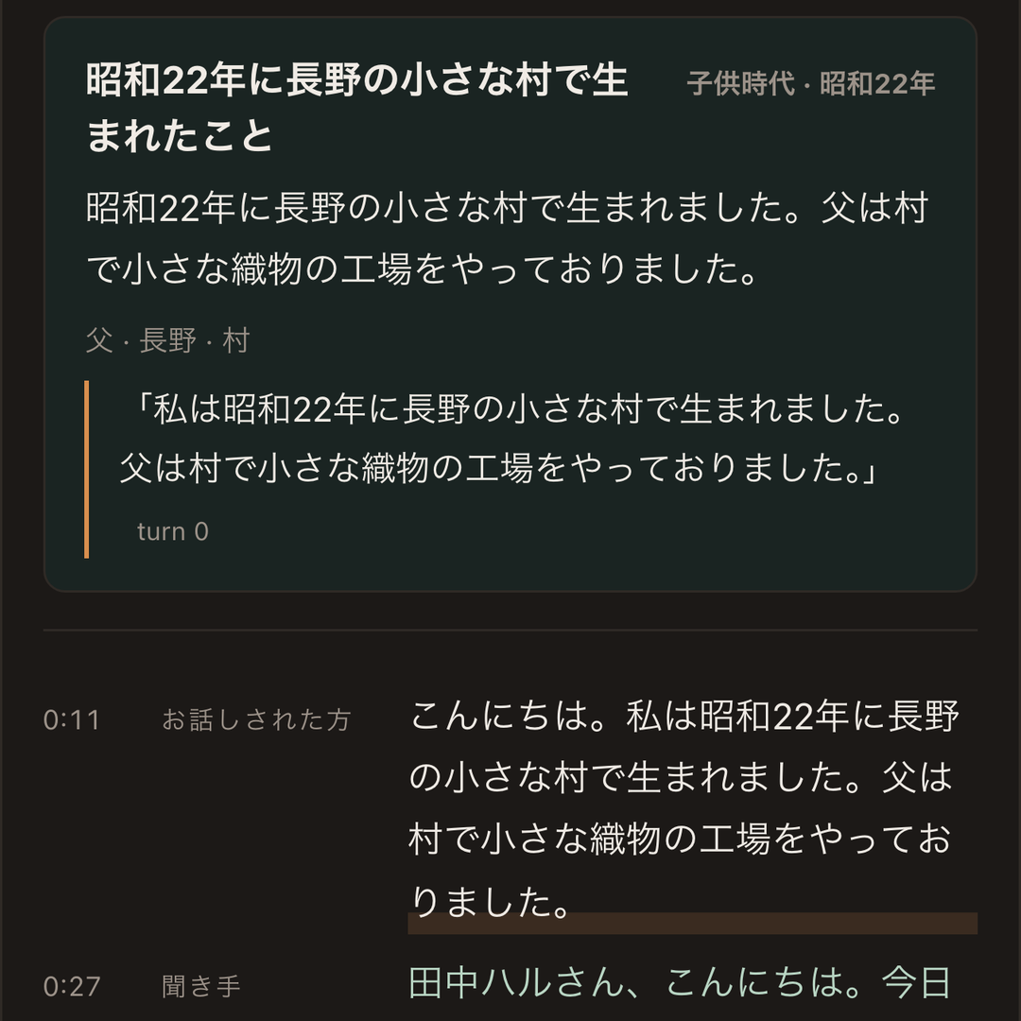
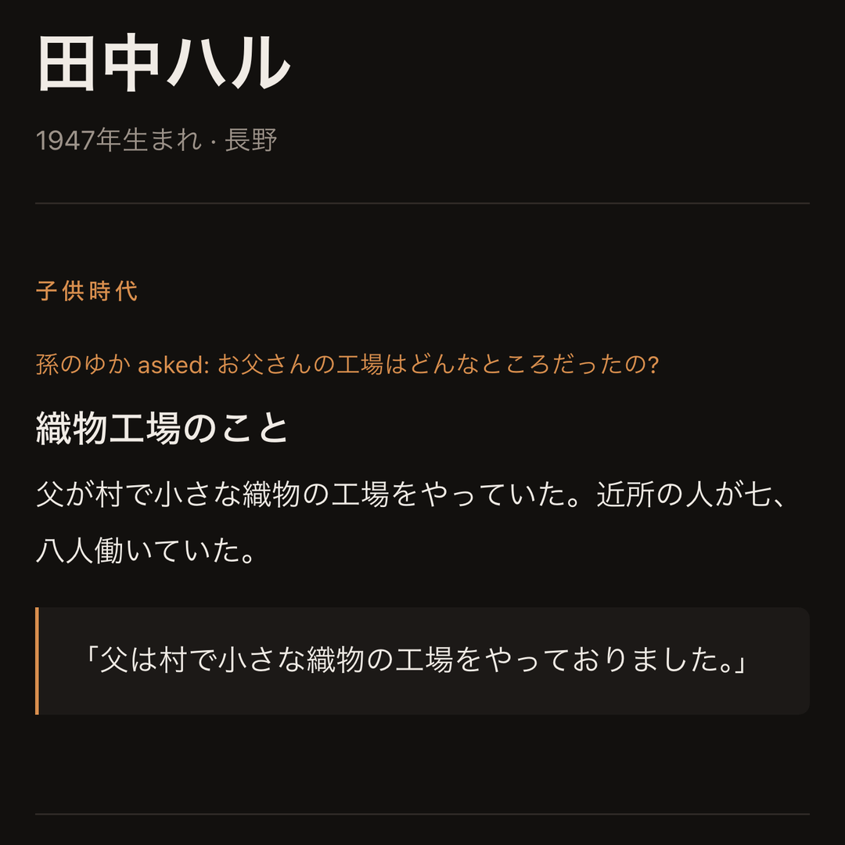
Snapshots of the prototype
Test persona 田中ハル, voiced by synthesized speech
Interview console
Who is being interviewed, which voice, and how long to wait: 5 s, measured, against the model's 0.8 s default.
After the session
A story extracted from a live session: life stage, people, places, and her quote matched to the turn it came from.
Family page
Her granddaughter's question, the story that answers it, and her own words, one tap from her voice.

Slide 11
Prototype Performance report/Benchmarking
12 / 12
Consent: a clear yes shared the story; a no, a hesitation or never being asked kept it private
9 / 9
Family questions: answered, never raised, or let pass, each reported correctly
6 / 6
Openings that recall last time, then put the family's question
6 min
A browser session with no drop, 34 transcript entries. Run every night
How long it waits before replying
How it is measured
Real models, three runs a case. Japanese speech is streamed at the Live API in real time; replies are graded by rules and by a model judging them against the interviewer's own prompt.
AI-vs-AI sparring: three personas press a long pause, a refused topic, a change of subject.
Family questions about a topic she refused, the war and the evacuation, were held back; the rest went through. 3 of 3.
Not yet measured: elderly voices and dialect. A native speaker reviews with the demo take.
Patience setting | Pause in speech | Result
3,500 ms | 1.5 s | Waited
3,500 ms | 2.5 s | Cut in
6,000 ms | 2.5 s | Waited
6,000 ms | 4.0 s | Waited
Default set to 5,000 ms. The model's own is 800 ms.

Slide 12



Additional Details/Future Development (if any)
Next, on the same tablet
It notices her sitting nearby, so there is no button at all
Names it is unsure of kept in kana; the family fixes the spelling in one tap
A message to the family when a new story lands
New channels, the same brain
Phone and landline
Smart speakers
Inside the companion robots Japanese families already buy
Beyond the family
Sharing with whoever she chooses: a friend, a care worker, a local archive
Municipalities as payers: Yokosuka City has trialled conversation AI for seniors since 2025
A printed book of her stories
How it scales Every channel plugs into the same backend. Cloud Run scales to zero and out. Gemini moves to Vertex AI in a Japanese region, behind one adapter, when data residency matters.

Slide 13

Provide links to your:
GitHub Public Repository: github.com/tpemeja/kataribe
Demo Video Link (3 Minutes): TBD
Final Product Link: TBD
The code, the tests, and the plan behind them
Built in the open over four weeks, from the first commit on 22 Sep 2026.

Slide 14

Community benefit and business case
For her
Being listened to, a few minutes every day
Reminiscence (回想法) is established practice in Japanese elderly care
A life story that lasts, in her own words
For her family
Stories they never found the time to ask about
Her voice behind every quote
A reason to call, and to ask more
For the community
Many of the 6.72 million who live alone have nobody nearby. The interviewer plans its own questions, so no family is needed
A local archive is the original kataribe
Who pays
Families
A subscription, against a ¥220,000 one-off book
Municipalities and care providers
Preventive care and reminiscence programmes
Cost to serve
≈ ¥530 a month for a daily conversation

Slide 15


