Slide 1

ASSIGNMENT GUIDELINES
Make the changes in the PPT as you solve the parts
This file contains the template for all the parts of the project.
Check the instructions added in the note section of every slide for clarity.
Don’t move around any image or text box
If you require more/lesser elements, be careful when you copy/delete the existing ones.

Slide 2
ASSIGNMENT Name: …Jayshree Kasera………………………..
Problem Statement The sales pipeline conversion percentage at TechnoServe (a tech SaaS startup) has dropped from 35% at the end of last fiscal (FY 2017-18) to 25% at present.
Assignment Objective
Understand the problem, come up with a hypothesis for low conversions faced by TechnoServe, and analyse the dataset provided to arrive at possible solutions to increase it.
Notes:
Problem Statement

Slide 3
PART I : 1. Understanding the Problem Sales Pipeline Conversion at a SaaS Startup
Who?
A Tech SaaS startup, Techno Serve.
What?
Faced with low conversion rates in sales pipeline.
When?
From the first quarter of the fiscal year 2018-2019.
Where?
Among the possible customers or the leads of the company.
How?
The company needs to identify the reason for the drop in conversion rates .
The product offered is not solving the customer problems.

Slide 4
PART I : 2. Understanding the Problem Sales Pipeline Conversion at a SaaS Startup
Situation
What are the products offered by the company?
What are the strength of the sales team at TechnoServe?
How much sales pipeline conversion is targeted?
What will be the length of the project?
Problem
Is the team skilled to sell the products in the market?
How does TechnoServe identify the leads in the market?
What are the causes of low sales pipeline conversion rates?
Implication
What is the impact of the problem on the startup?
Does low pipeline conversion impact your targets of the future?
How does low pipeline conversion restrict your growth in the market?
Need-Payoff
What is the increase in revenue expected if the problem is solved?
Will there be an increase in the market share of the company?
Notes:
Provide at least three questions under each branch.

Slide 5
PART II : Formulating Hypotheses Sales Pipeline Conversion at a SaaS Startup
Framework Used
Fishbone diagram
Reason for using the selected framework
This framework is effective in breaking down complex problems into smaller, more manageable components.
How you have used the framework here
The problem has been divided into the five Ps in the framework.
Notes:
All the frameworks that are used should be mentioned.
A suitable reason is a must to provide here

Slide 6
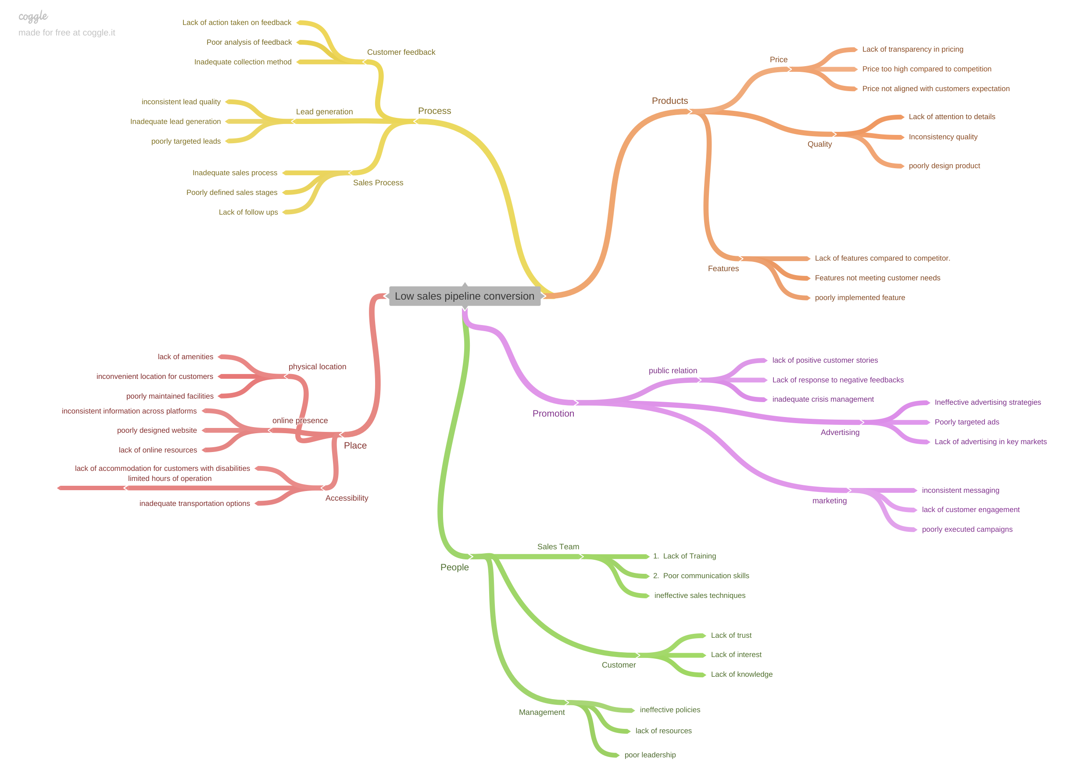
PART II : Formulating Hypotheses Sales Pipeline Conversion at a SaaS Startup
Notes:
Use the “download as” feature of Coggle if you are using the tool.
Provide one image with complete tree along with separate elements where the text is readable.
Copy the slide if you require more space

Slide 7
PART II : Formulating Hypotheses Sales Pipeline Conversion at a SaaS Startup
Branch 1 Low sales pipeline conversion
People
1. sales team- lack of training
2. customers- lack of knowledge
3. Management- Lack of resources.
Branch 2 Low sales pipeline conversion
Process
Lead generation- Inadequate lead generation.
Sales process- Lack of follow ups
Customer Feedback- Inadequate collection process
Notes:
Each branch must follow this naming pattern: Problem – Branch 1 – Sub-branch 1 – Sub-branch 2 – …… – Hypotheses
There must be minimum 10 hypotheses in total and at least 1 in each branch.

Slide 8
PART II : Formulating Hypotheses Sales Pipeline Conversion at a SaaS Startup
Branch 3 Low sales pipeline conversion
Product
Quality- Inconsistent quality.
Features- Poorly implemented features
Price- Lack of transparency in pricing.
Branch 4 Low sales pipeline conversion
Place
Physical Location- inconvenient location for customers
Online presence- poorly designed website
Accessibility- Limited hours of operation
Type your answer here
Notes:
Each branch must follow this naming pattern: Problem – Branch 1 – Sub-branch 1 – Sub-branch 2 – …… – Hypotheses
There must be minimum 10 hypotheses in total and at least 1 in each branch.

Slide 9
PART II : Formulating Hypotheses Sales Pipeline Conversion at a SaaS Startup
Branch 5 Low sales pipeline conversion
Promotion
Advertising- Poorly targeted ads
Marketing- Lack of customer engagement
Public relation- Lack of positive customer stories
Notes:
Each branch must follow this naming pattern: Problem – Branch 1 – Sub-branch 1 – Sub-branch 2 – …… – Hypotheses
There must be minimum 10 hypotheses in total and at least 1 in each branch.

Slide 10
PART III A : Generating Insights Sales Pipeline Conversion at a SaaS Startup
Variable
Overall technology primary conversion average won rates shows21%
Overall opportunity size (USD) Average won rate show 16%
Overall B2B Sales medium conversion average won rate show 19%
Insights if any
Technology primary legacy modernization rate shows lower conversation at 12%
Online leads shows lower conversion won rate that is 6%
Last year ERP Implementation shows no business with highest counting as 43790
The cities Kolkata and Pune shows lower conversion rate that is 21% and 19% respectively
Pattern of Insight
Overall technology primary- last year no business shows at counting of 69208
Overall conversion average won rate city basis is 22%
Notes:
Analyse the variables in the dataset, find the insights and mention the pattern of insights in the data. Make more copies of this slide if needed.

Slide 11
PART III A : Generating Insights Sales Pipeline Conversion at a SaaS Startup
Variable under consideration:
Technology primary- Conversion rate (%)
Overall technology primary conversion average won rates shows 21% that is loss of 79%
Technology primary- analytics shows higher won conversion rate at 26%
Technology primary – Legacy modernization shows lower won conversion rate at 12%
Notes:
For each variable that produced an interesting insight, explain you analysis bit here – the results you got from excel and the necessary visualisations. Note: it is compulsory for you to mention the results of the analysis on these variables - 'Technology Primary', 'B2B Sales Medium', 'Client Revenue Sizing', 'Opportunity Sizing' and 'Business from Client last year’.

Slide 12
PART III A : Generating Insights Sales Pipeline Conversion at a SaaS Startup
Variable under consideration:
Technology primary of conversion rate by opportunity
Size (USD)
Overall opportunity size (USD) Average won rate show 1%
1. ERP Implementation shows higher conversion won rate at 62%
2. Legacy Modernization shows lower conversion won rate at 37%
Notes:
For each variable that produced an interesting insight, explain you analysis bit here – the results you got from excel and the necessary visualisations. Note: it is compulsory for you to mention the results of the analysis on these variables - 'Technology Primary', 'B2B Sales Medium', 'Client Revenue Sizing', 'Opportunity Sizing' and 'Business from Client last year’.

Slide 13
PART III A : Generating Insights Sales Pipeline Conversion at a SaaS Startup
Variable under consideration:
B2B sales medium – conversion rate %
Overall B2B sales medium conversion average won rate show95 %
Enterprises seller shows higher won percentage rate at 70%
Online leads shows lower 90% won conversion rate
Notes:
For each variable that produced an interesting insight, explain you analysis bit here – the results you got from excel and the necessary visualisations. Note: it is compulsory for you to mention the results of the analysis on these variables - 'Technology Primary', 'B2B Sales Medium', 'Client Revenue Sizing', 'Opportunity Sizing' and 'Business from Client last year’.

Slide 14
PART III A : Generating Insights Sales Pipeline Conversion at a SaaS Startup
Variable under consideration:
No Business from client last year – counting basis
• Overall technology primary- Last year no business shows at counting of 69208
• Last year ERP Implementation shows no business with highest counting as 43790
• Last year no business shows legacy modernization and analytics at counting 594 and 272 respectively
Notes:
For each variable that produced an interesting insight, explain you analysis bit here – the results you got from excel and the necessary visualisations. Note: it is compulsory for you to mention the results of the analysis on these variables - 'Technology Primary', 'B2B Sales Medium', 'Client Revenue Sizing', 'Opportunity Sizing' and 'Business from Client last year’.

Slide 15
PART III A : Generating Insights Sales Pipeline Conversion at a SaaS Startup
Recommendations
Management should take innovation and new technology on higher priority
II. Management should invest in hiring new techno persons and talented on for the role of technology consultant
III. This investment will add prospective in company’s product and it will help to increase the won rate in future
Corresponding Insights
Overall technology primary conversion average loss rate that is loss of 79%
Technology primary legacy modernization rate shows lower conversation at 12%, Online leads shows lower conversion won rate that is 6%
Last year ERP Implementation shows no business with highest counting as 43790
Kolkata and Pune shows lower conversion rate that is 21% and 19% respectively
Interviewed the customers (new and exiting): they are not ready to buy the product because they are not new in technology and innovations
The main root cause of sales pipeline conversion percentage at Techno Serve (a tech SaaS startup) has dropped from 35% at the end of last fiscal (FY 2017-18) to 25% at present PART III B : Presenting Finding
Notes:
For each recommendation explain the insights that form the reasoning for giving that recommendation. Make more copies of this slide if necessary.

Slide 16
PART III B : Presenting Findings Sales Pipeline Conversion at a SaaS Startup
Higher sales pipeline conversion rate
Customer needs new features and innovation
Customer can afford the product
Customer finds feature and innovation in competitors
Old buying decisions on clients
No innovation hence lower conversion rates
New technology and innovation
sales team neglects customer needs
Notes:
You are free to use the elements and boxes mentioned previously. Make sure you’re using the pyramid principle, data visualization, visual design principle and storyboarding concepts to design these slides.

Slide 17
Sales pipeline conversion at SaaS Startup
THANKYOU

