Slide 1
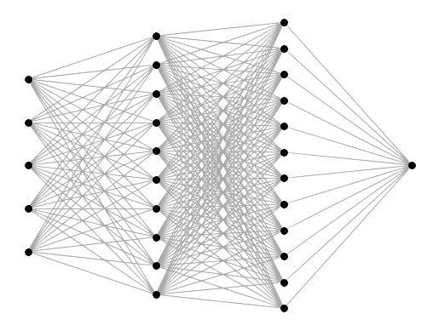
Current-Mirror-Based VMM for Neural Network Applications
Alessio Fontana
a.fontana19@studenti.unipi.it

Slide 2
Outline
01
02
03
04
Introduction
Simulations
Analog VMM for Neural Networks
CM-Based Analog Multiplication
FGCM Characterization
Multiplication Factor vs Floating-Gate Charge
ENOB Analysis of the FGCM
Layout
Backup
Floating-Gate Cell
4×4 Analog VMM
Extra simulations
DRC and LVS Verification

Slide 3
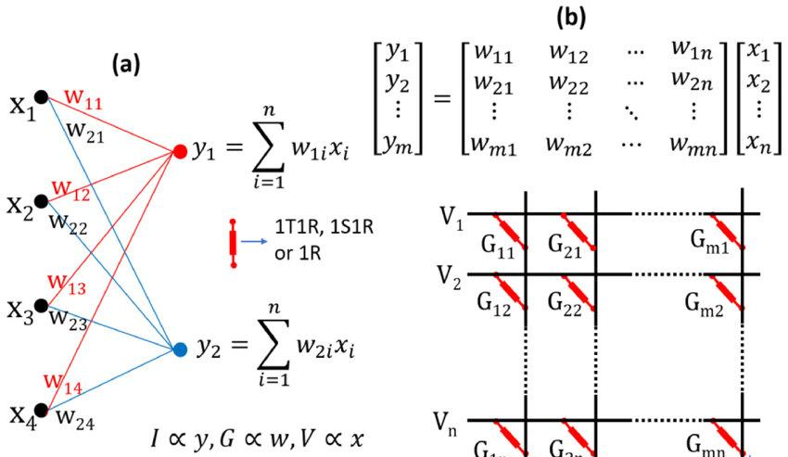
Analog VMM for Neural Networks
All kinds of Neural Networks rely on vector–matrix multiplications
Digital implementations are memory- and energy-bound
Analog current-mode VMM enables: in-memory computation, massive parallelism, low-energy MAC operations
Programmable current mirrors naturally implement weighted current multiplication
Image adapted from: “Device and materials requirements for neuromorphic computing”, Journal of Physics, 2019.
Notes:
Dire come mai si può dire che gamma fa solo il rapporto degli R (ovvero perchè Cv = Cx e Rv = Rx)

Slide 4
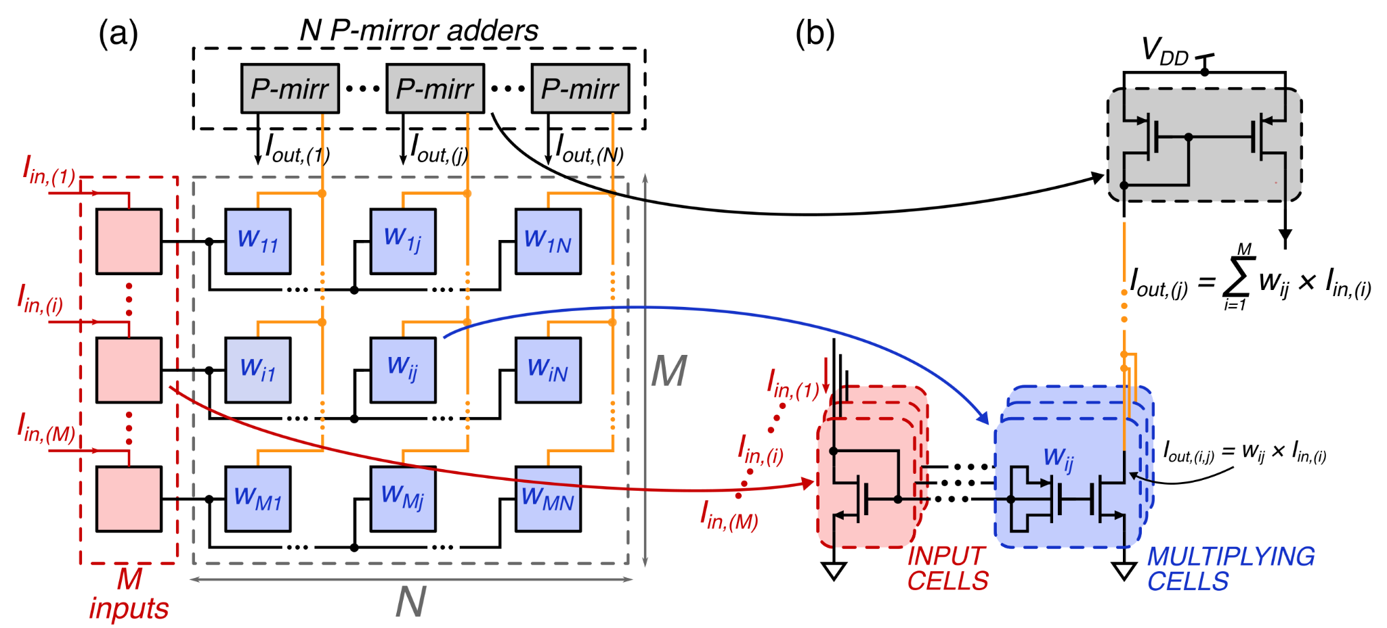
Current-Mirror-Based Analog Multiplication
Weight stored as floating-gate charge
Building block: FGCM (Floating-Gate Current Mirror)
Image from: “Analog Vector-Matrix Multiplier Based on Programmable Current Mirrors for Neural Network Integrated Circuits”, IEEE Access, 2020.

Slide 5
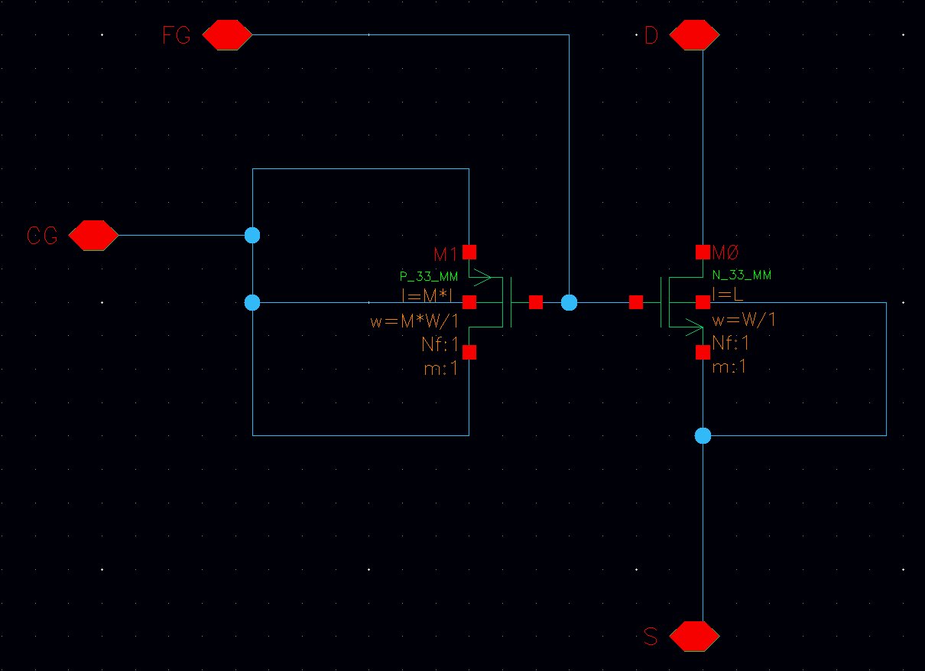
Simulation Setup – FGCM Characterization
Floating-Gate cell - schematic
Cadence Virtuoso
Schematic Editor
UMC_18_CMOS: PDK UMC 018 library
PCAP P_33_MM with
width: M*W ; length: M*L
NMOSN_33_MMwith
width: W ; length: L

Slide 6
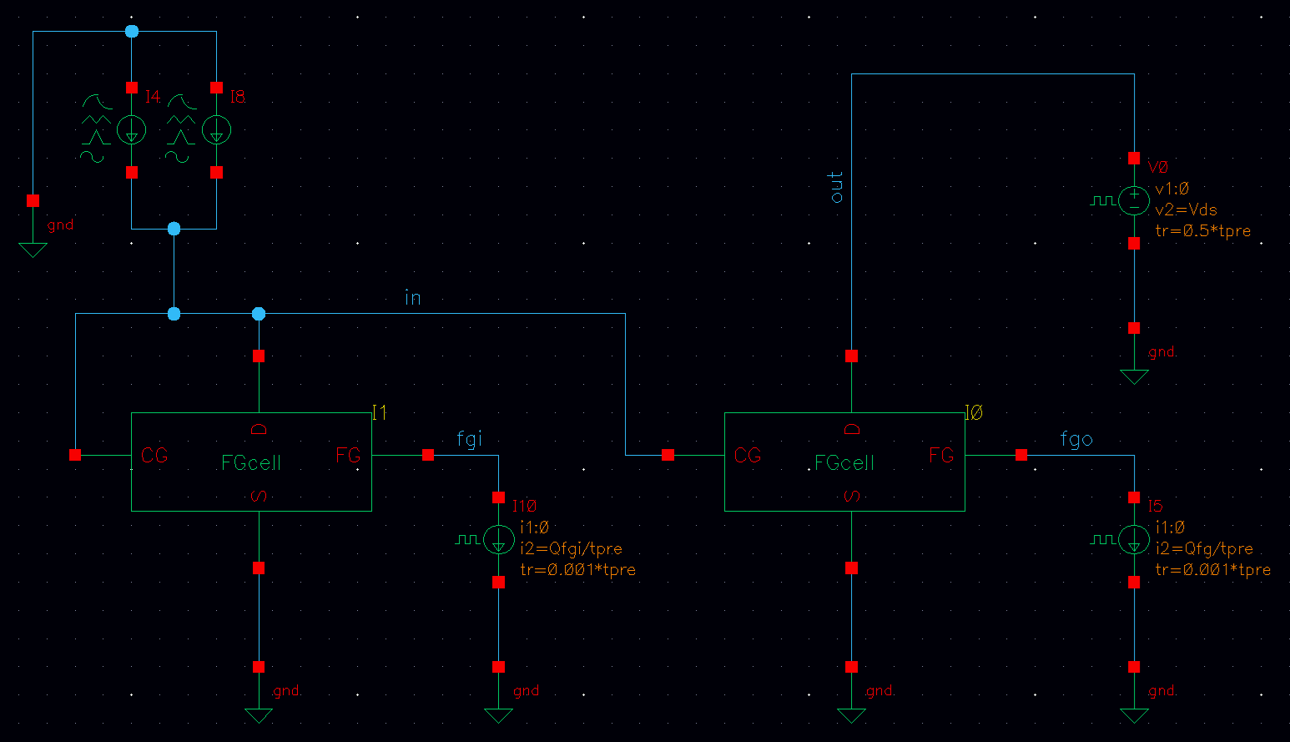
Simulation Setup – FGCM Characterization
Floating-Gate CM - schematic
Floating-Gate charge
Pulse to generate offset
Parameters
Sine (input)
Qfgi
Qfg
Ipk
fre
Vds
L
W
M
tpre
I_{out}

Slide 7
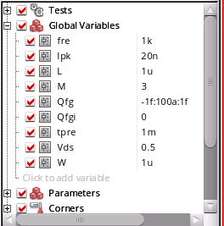
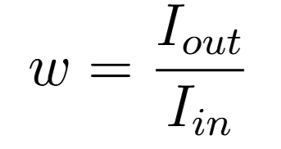
Multiplication Factor vs FG Charge
Study of the multiplication factor of a FGCM cell
Input cell: null floating-gate charge
Weight programmed by tweaking the floating-gate charge of the output FG cell (linear sweep)
Transient analysis 0-26ms, conservative
Goal: evaluate monotonicity and usable range

Slide 8
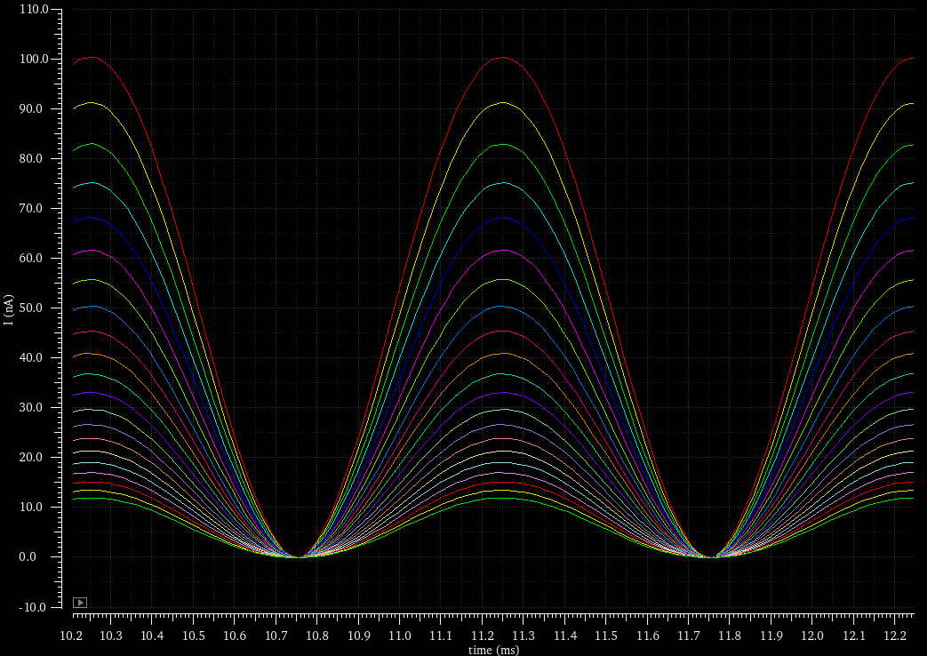
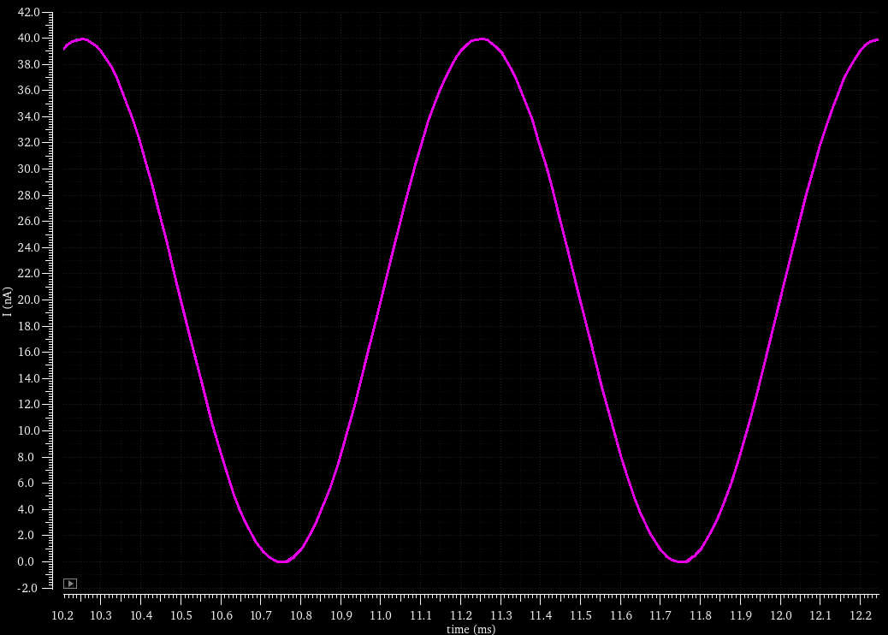
Multiplication Factor vs FG Charge
I_{out}(Qfg = -1fC)
I_{in}
I_{out}(Qfg = +1fC)

Slide 9
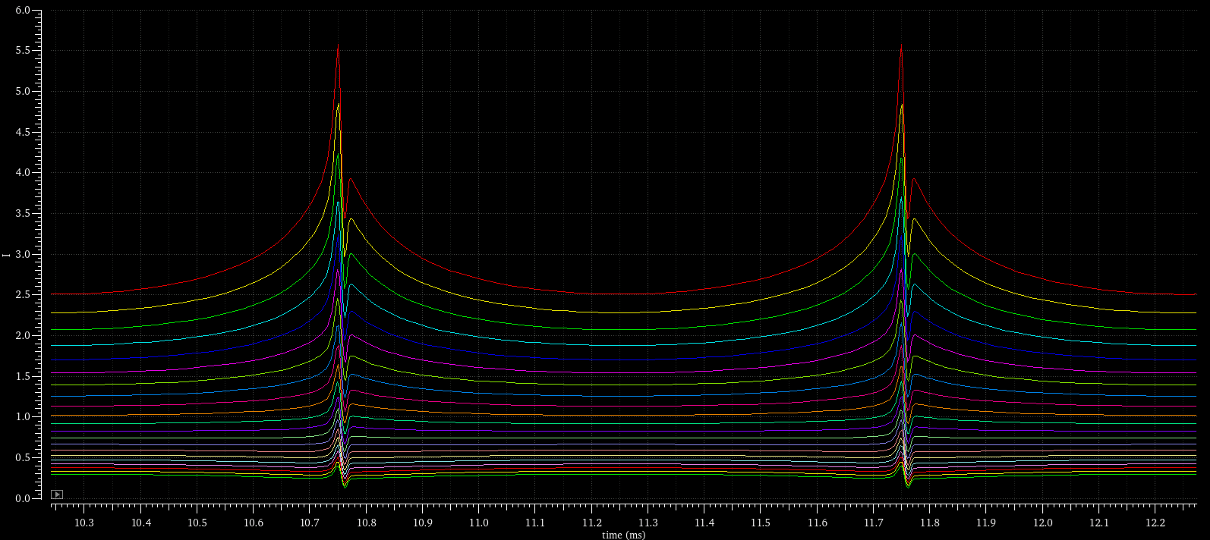
Multiplication Factor vs FG Charge
Non-linearity around zero
Mult. factor increases with the diminishing of Qfg (monotonic)
Qfg = -100aC

Slide 10
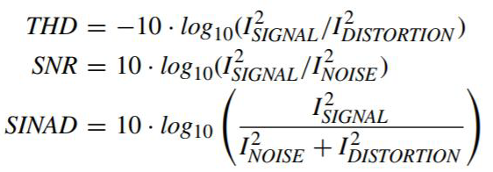
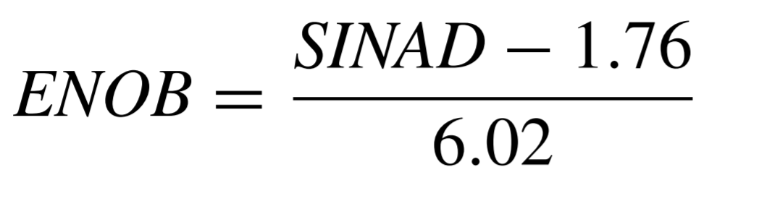
ENOB Analysis of the FGCM
Study of the Effective Number Of Bits as performance metric
Effective resolution of analog multiplication
Floating-gate charge of the output FG cell: Qfg = -80aC
Same parameter values as previous analysis
Parameter sweep: M (1-10, 10 steps)

Slide 11
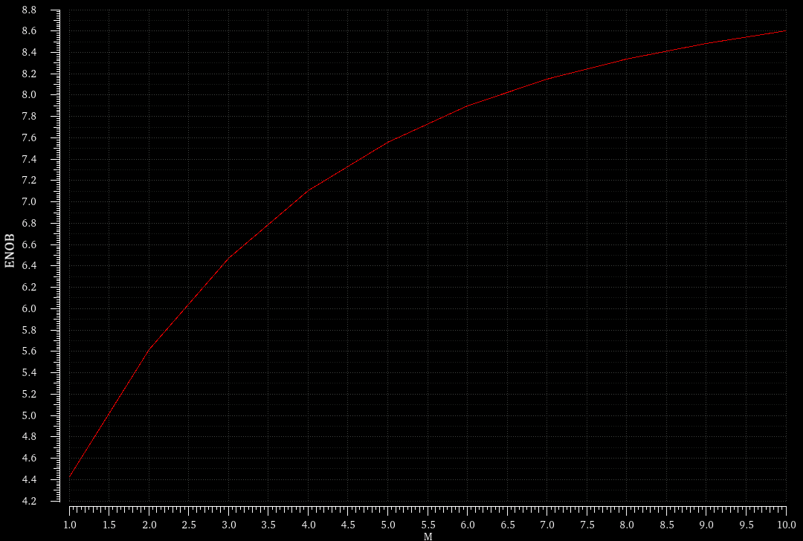
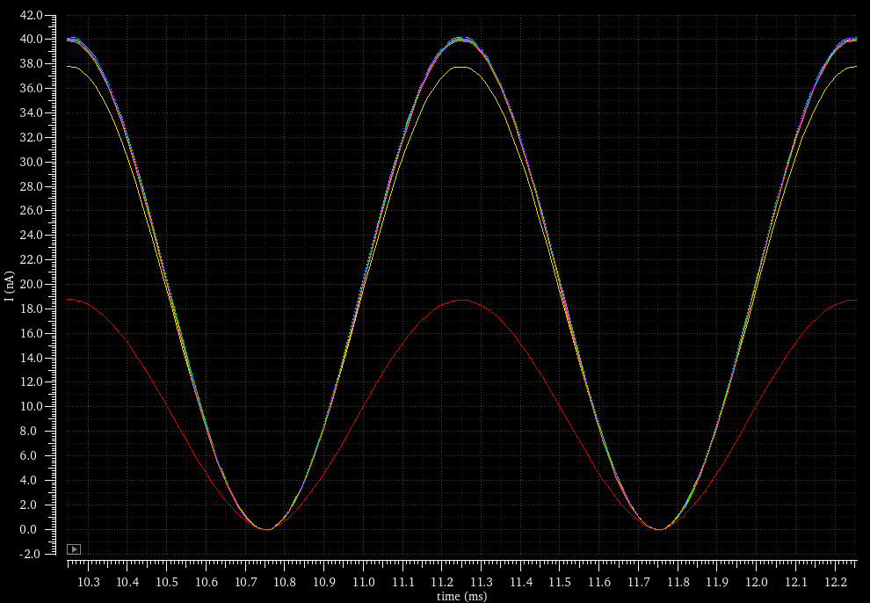
ENOB Analysis of the FGCM
Output current
M=3,…10
M=2
M=1

Slide 12
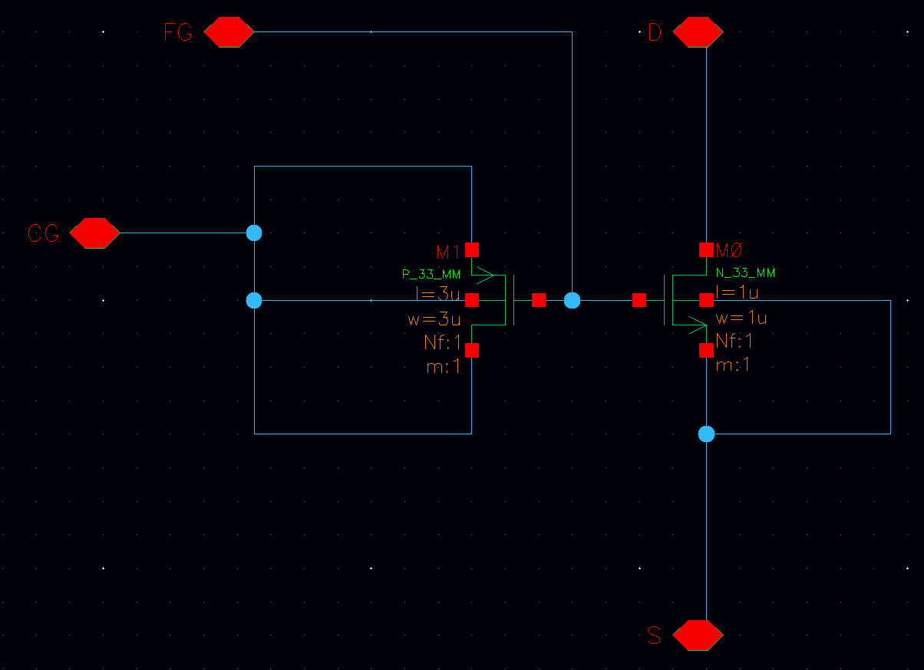
Layout of the Floating-Gate Cell
Floating-Gate cell - schematic
Cadence Virtuoso
Schematic Editor
UMC_18_CMOS: PDK UMC 018 library
Used for verifications
PCAP P_33_MM with
width: 3µm ; length: 3µm
NMOSN_33_MMwith
width: 1µm ; length: 1µm

Slide 13
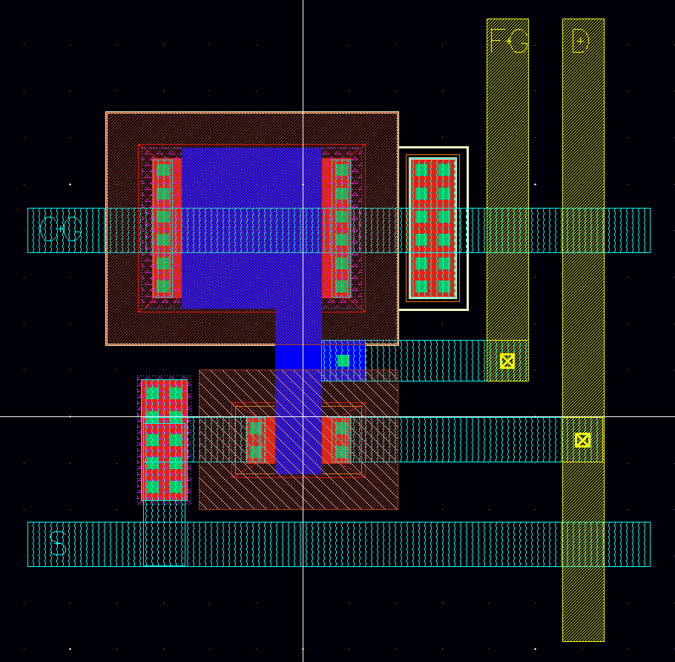
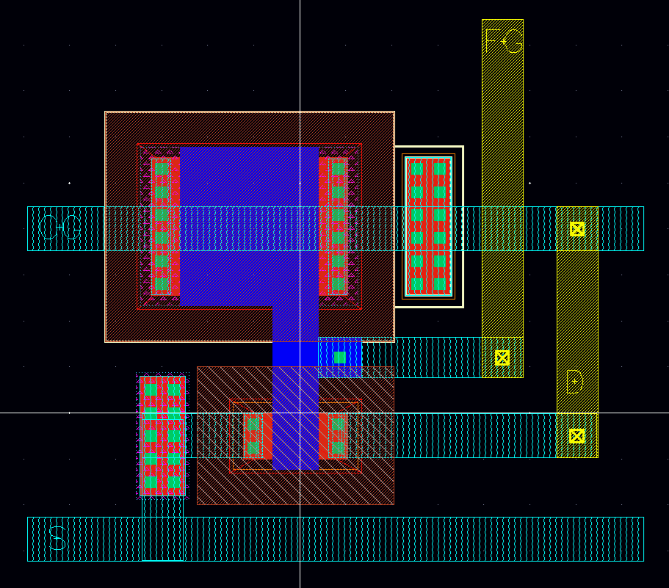
Layout of the Floating-Gate Cell
FG Cell
FG Input Cell
N-Well tap
Substrate tap

Slide 14
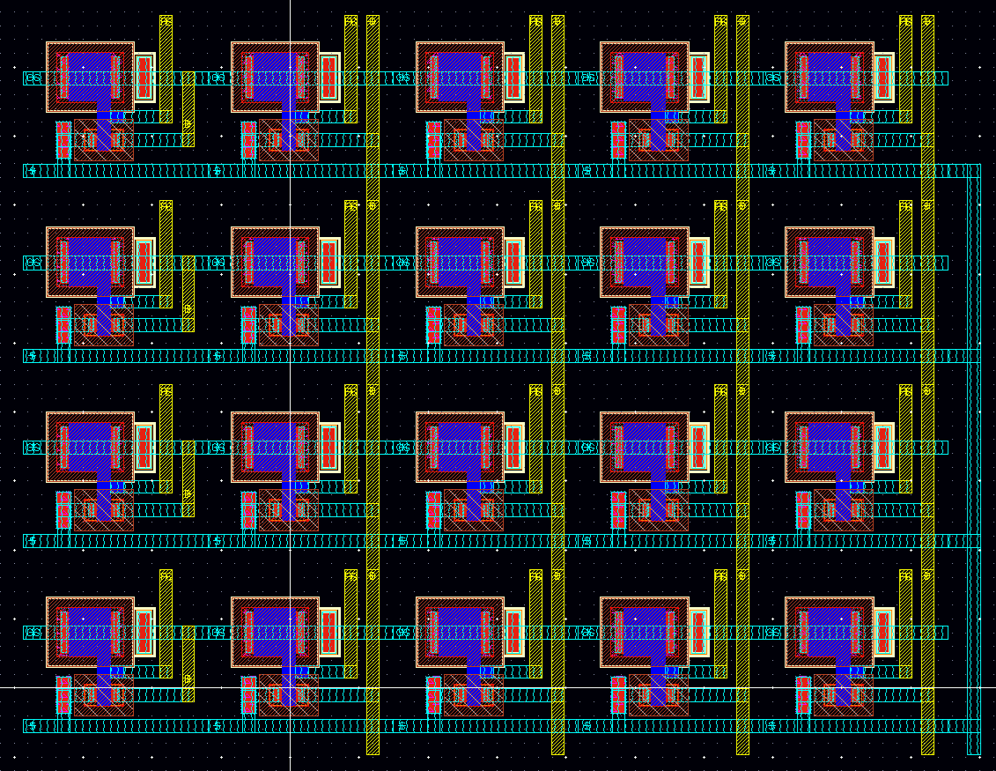
Layout of the 4×4 CMVMM
4x4 Analog Vector Matrix Multiplier
Output currents on D Metal2 lines to P-Mirrors
4 input cells (short circuit between D and CG)
Input currents on CG Metal1 lines
Modular structure
Scalable
architecture

Slide 15
Thanks for the attention!
References
[1] M. Paliy et al., “Analog Vector-Matrix Multiplier Based on Programmable Current Mirrors for Neural Network Integrated Circuits”, IEEE Access, 2020.

Slide 16
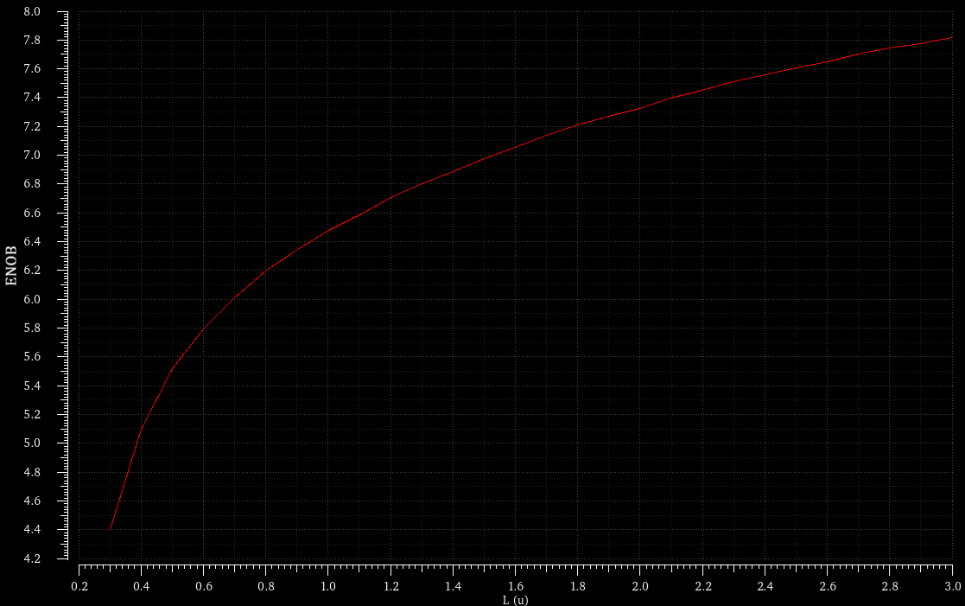
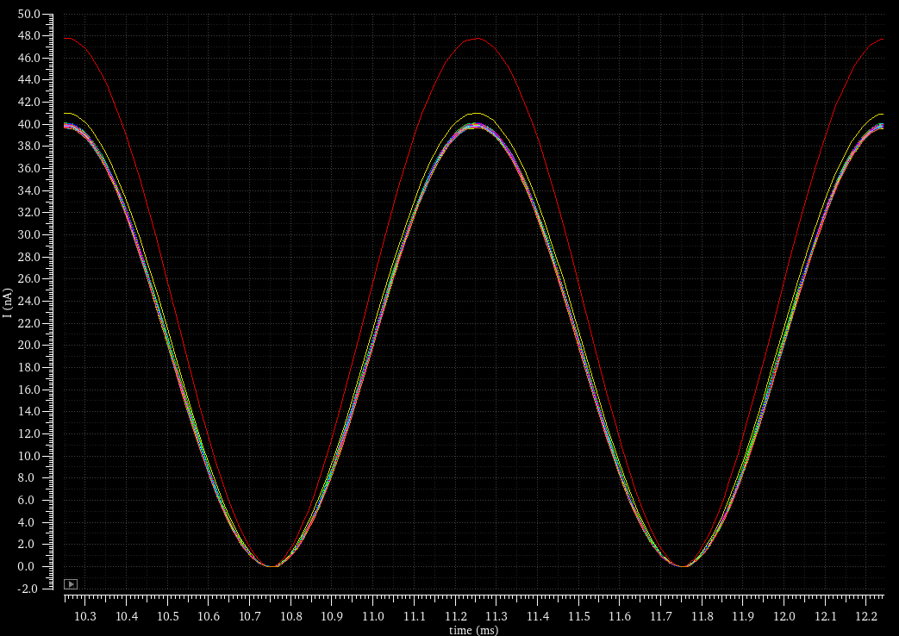
Backup n.1: extra simulations
Output current
L=300nm
Study of ENOB vs L
Floating-gate charge of the output FG cell: Qfg = -80aC
Parameter sweep: L (100nm-3µm, steps of 100nm)
L=400nm
L=0.5,...3µm

Slide 17
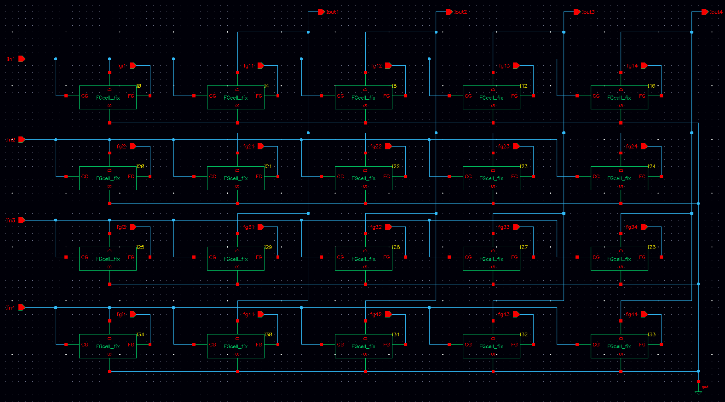
Backup n.2: DRC & LVS Verification

Slide 18
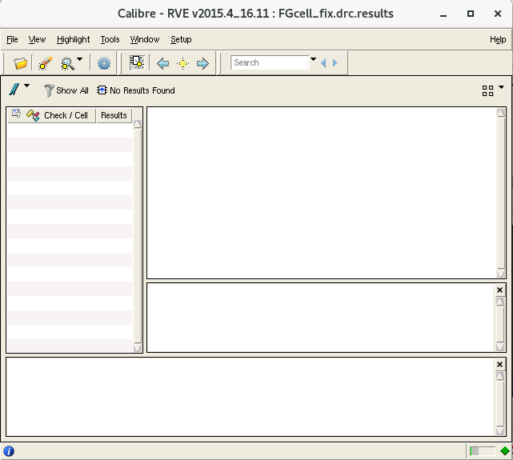
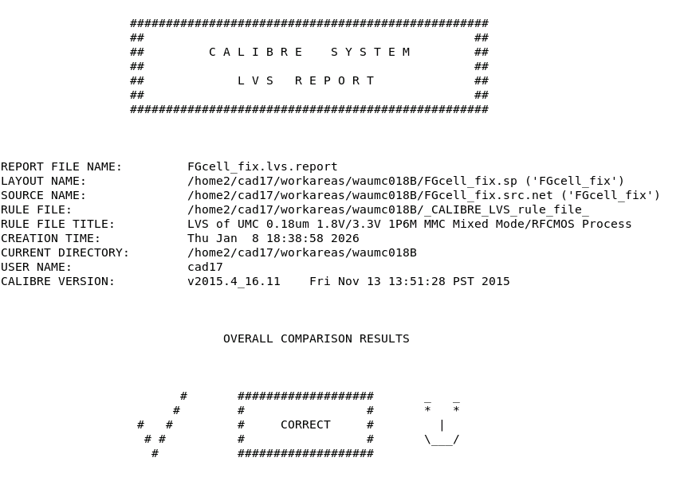
Backup n.2: DRC & LVS Verification

