Slide 1
User input text prediction using NLP Techniques
Kasey Martin

Slide 2
It is not that we have a short space of time, but that we waste much of it. Life is long enough, and it has been given in sufficiently generous measure to allow the accomplishment of the very greatest things if the whole of it is well invested. But when it is squandered in luxury and carelessness, when it is devoted to no good end, forced at last by the ultimate necessity we perceive that it has passed away before we were aware that it was passing. So it is—the life we receive is not short, but we make it so, nor do we have any lack of it, but are wasteful of it.
- Seneca

Slide 3
Given this grim reality, therefore, we must save time by any means

Slide 4

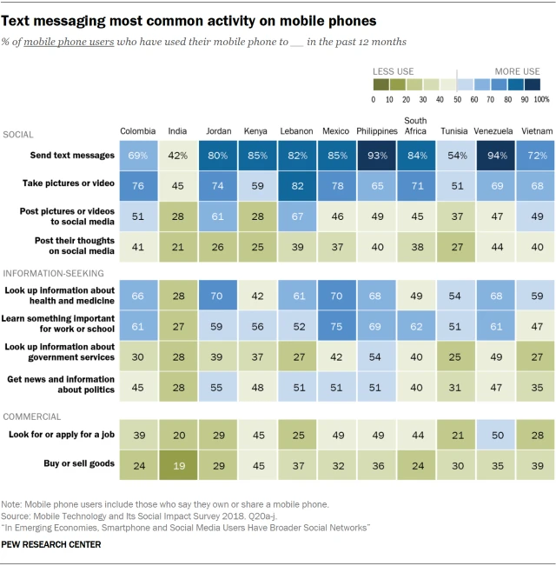

Slide 5
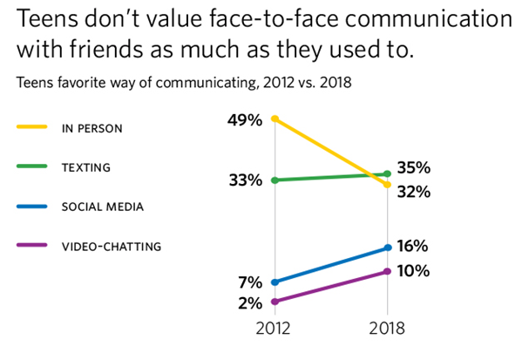

Slide 6
User Input Text Prediction
A means to save time
Identify patterns in user input
Make texting/chatting faster by reusing those patterns – hence the prediction
In the realm of NLP

Slide 7
What is NLP?

Slide 8
Natural Language Processing
Subfield of Computer Science, Linguistics and Artificial Intelligence
Understanding and Processing “Natural Language”

Slide 9
NLP Concepts
Tokens
Basic blocks; words
Document
Collection of tokens
Corpus
Collection of documents

Slide 10
Excerpt from ancient Gnash text
I hate you I love you
I hate that I love you
Don't want to, but I can't put
Nobody else above you
I hate you I love you
I hate that I want you
You want her, you need her
And I'll never be her

Slide 11
NLP Concepts
N-grams
N-number of adjacent tokens in a sequence
Bi-grams
N-gram where N=2
(I, hate), (hate, you), (you, I), (I, love), (love, you)
Tri-grams
N-gram where N=3
(I, hate, you), (hate, you, I), (you, I, love), (I, love, you)

Slide 12
NLP Concepts
Markov Chains
Mathematical model for representing events statistically
Probability of an event occurs given that the state of the previous event

Slide 13
Markov Chain Example
Given:
I hate you I love you
I hate that I love you

Slide 14
Resulting Markov Chain
{'i': {'values': ['hate', 'love'],
'counts': [2, 2],
'probability': [0.5, 0.5]},
'hate': {'values': ['you', 'that'],
'counts': [1, 1],
'probability': [0.5, 0.5]},
'you': {'values': ['i'], 'counts': [1], 'probability': [1.0]},
'love': {'values': ['you'], 'counts': [2], 'probability': [1.0]},
'that': {'values': ['i'], 'counts': [1], 'probability': [1.0]}}

Slide 15
Markov Model Training
Input: string document
Split strings into bigrams
For each bigram:
First token is a key in our Markov model, second token is a possible value
Count times the second token appears in your corpus
Calculate probabilities when all bigrams have been consumed by model

Slide 16
Model Usage
Input: token
If token in our model
Return 3 highest probable tokens
Else
Return null

