Slide 1

What could you say about these songs from listening for a few seconds?
Sample 1
Sample 2
Notes:
I am going to play a few samples of songs for you
When you are listening to them I want you to think about what you could say about the songs from only listening for a few seconds
How are songs different? - ask audience
Could you tell which one is faster or slower? How do you know?
Our brains are able to listen to these songs for only a short period of time and are able to make multiple conclusions about the music
For this project I set out to investigate how some of the same deductions about music, could be made with a computer using machine learning

Slide 2
Using Machine Learning to Determine Musical Elements
Kasey Simmons
April 23, 2024
Notes:
My name is Kasey Simmons and for my capstone project I created a machine learning program that takes in songs and predicts musical elements.

Slide 3
Research Question
What are some of the techniques that computers use to understand music and how do they work?
Notes:
For this project I set out to understand how neural networks might be used to extract information from music files.
I was curious about this as many music streaming services base their recommendation systems based on song data. And machine learning is becoming more prevalent in the field of Music information Retrieval.

Slide 4
What I did for this project
Tried to teach computers how to extract information from music
Created neural networks identifying genre and tempo from music
Notes:
Because I was curious about this research question, for this project I
Tried to teach computer using deep learning neural networks how to identify two musical elements from songs, genres and tempo.

Slide 5
Agenda
Brief Overview of Neural Networks
Program Methodology
Implementation
Results
Challenges
Further Research
Notes:
So what I am going to talk about today
a brief overview of neural networks, and then get
into my research process looking at the methodology and implementation,
walking through the results, and then ending with the challenges and some ideas for further research

Slide 6
What is a Neural Network?
Machine learning algorithm loosely modeled after the human brain
Nodes are interconnected and organized into layers
Notes:
So what is a neural network?
Neural networks are supervised machine learning algorithms.
That make decisions similarly to the human brain, where the node or neurons mimic biological neurons and are interconnected and arranged into layers
to identify patterns, weigh options, and arrive at conclusions.
These networks are composed of an input layer that takes the initial data, hidden layers in the middle that are responsible for the performance and complexity, and then an output layer that holds the output to the problem. So in my case, the input layer is taking in the song data, and the output layer would provide the songs genre or tempo

Slide 7
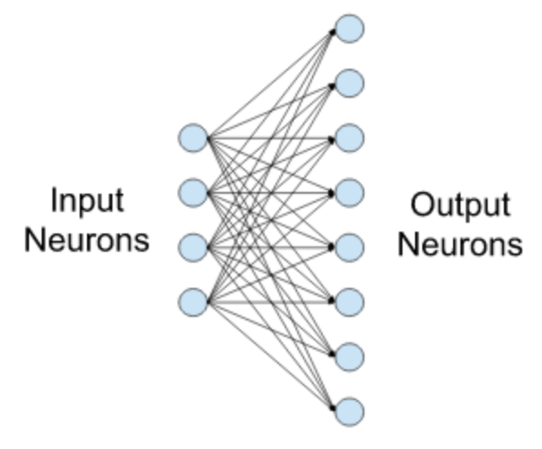
What is a layer?
Each input node is connected to an output node
As nodes are activated, data is sent to the next layer
Notes:
A layer in a neural network is made up of neurons, where these neurons receive input, perform some processing and produce output
Similar to biological neurons, these neurons also only fire in certain conditions, called the threshold, which differ from neuron to neuron.
Along with the threshold, each neuron also has a weight, which determines the importance of any given variable, a bias, which is the negative threshold, and an activation function that transforms the combined input.
As the model is learning, the weights and biases are adjusting trying to minimize the loss.

Slide 8
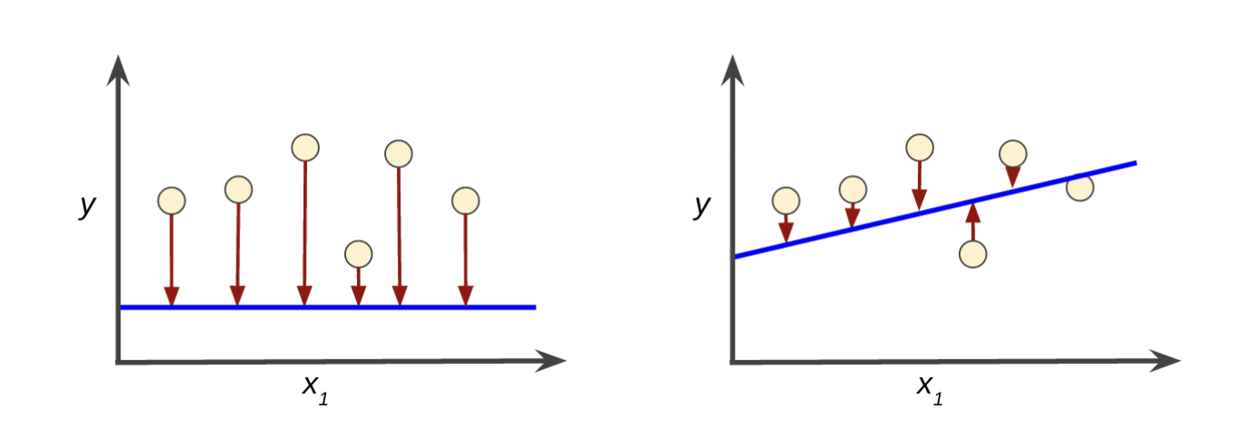
What is loss?
Higher loss
Lower loss
Notes:
A loss of a model tells how far off the prediction from the model is to the actual datapoint
The goal of training these models is to find the set of weights and biases that have the lowest loss on average for the dataset,
indicating the ability to make more accurate predictions

Slide 9
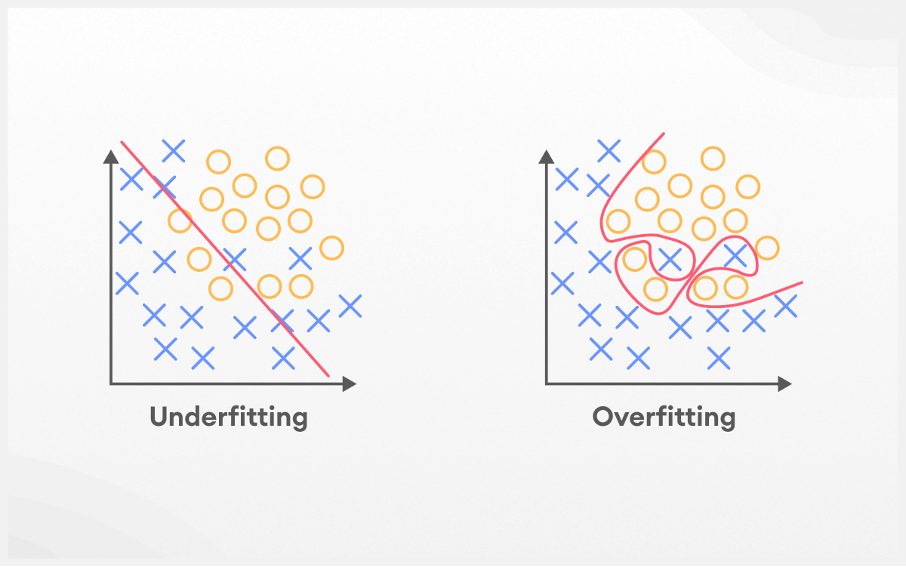
Underfitting vs. Overfitting
Notes:
Basically the overall goal of neural networks and machine learning models in general is to make generalizations as accurately as possible.
For a model to be able to do this, it means that the model can not be overfit or underfit to the training data.
Underfitting is when the model is not specific enough to be useful. And Overfitting is when the model is too specific to the training data to be useful on unknown data.

Slide 10
Key Decisions & Ideas
Input data
Activation Functions
Number of Epochs
Set up of the network
Notes:
As I began this research project some of the ideas i had to think about were
the input data, in this case the music, where i was getting it from and how i was going to input it into the neural network
The activation functions being used
I had to think about the number of epochs, how long the model was training for,
And the set up of the network itself, such as how many layers
As I had no previous knowledge or experience with machine learning or neural networks, most of these decisions were made with a lot of research into similar projects
and with a lot of trial and error

Slide 11
Methodology
Created neural networks using python, tensorflow, and the tf.keras API
Used librosa python package for handling of audio files
Notes:
To create the neural networks in this project I used python, and the tensorflow and keras APIs
Tensorflow is an open source platform used to develop and train machine learning models
I also used librosa python package for handling of the audio files

Slide 12
Librosa
Python package for music and audio analysis
Used in this presentation for converting input data and for comparing model predictions
Notes:
Librosa is a python package that was used in many stages of this project for music and audio analysis
I used librosa for prepping and converting the input data and also for comparing model predictions

Slide 13
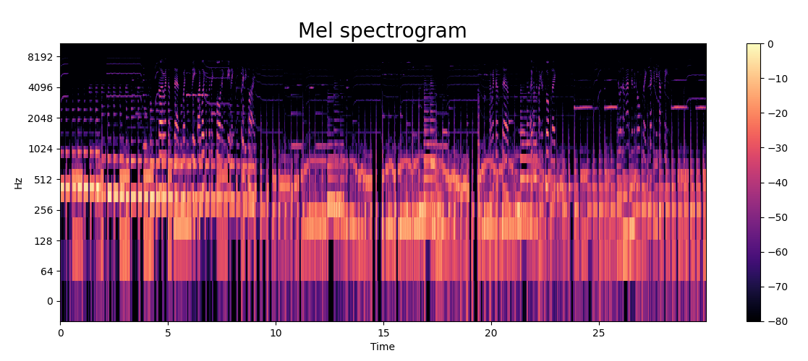
Input Data
Notes:
The input data used for this project was a dataset of music from the Free Music Archive. Which is a labeled dataset of around 100,000 songs.
Based on the prior research studies dealing with audio music files and neural networks, I found that the common practice was to convert the audio files into images. And then build the networks using the images as the input data.
The songs in this project were all converted into mel spectrograms, which is a visual representation of the frequencies of the audio file over time, and the decibel level is depicted by different colors on the image.
This is an example mel spectrogram that was generated for this project.
Mel spectrograms are the common practice because the decibel level is calculated using a logarithmic scale, which mirrors the way that humans hear the loudness of a sound

Slide 14
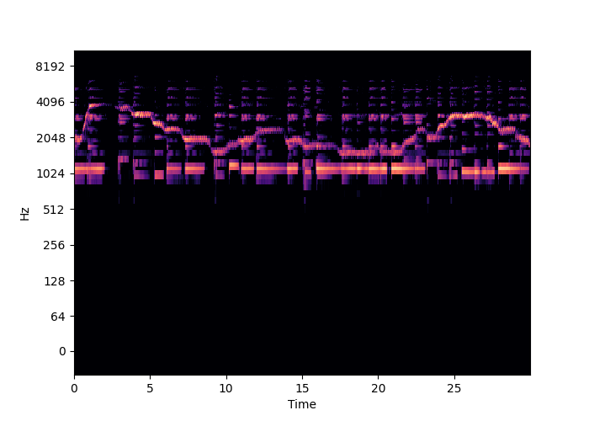
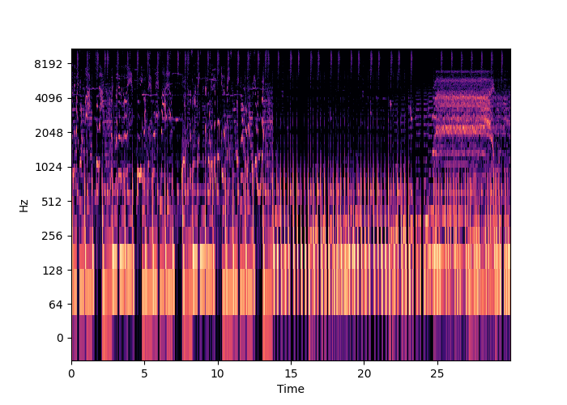
Input Data
Old Time Historic
Metal
Notes:
Just as a visual aid to show some differences between some spectrograms for different genres
On the left is a spectrogram for a song in the genre labeled old time historic
And on the right is a spectrogram for a song that is considered metal

Slide 15
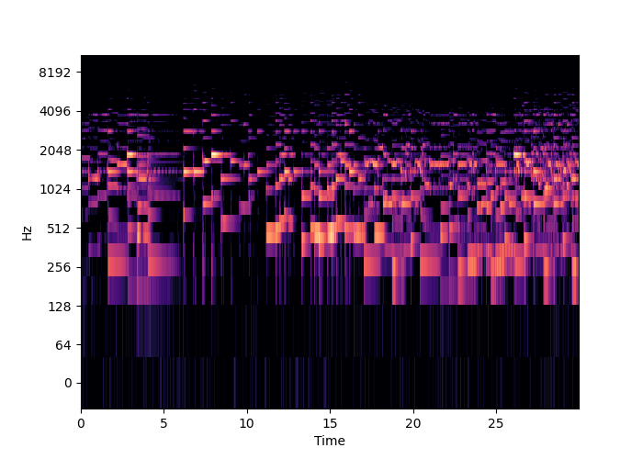
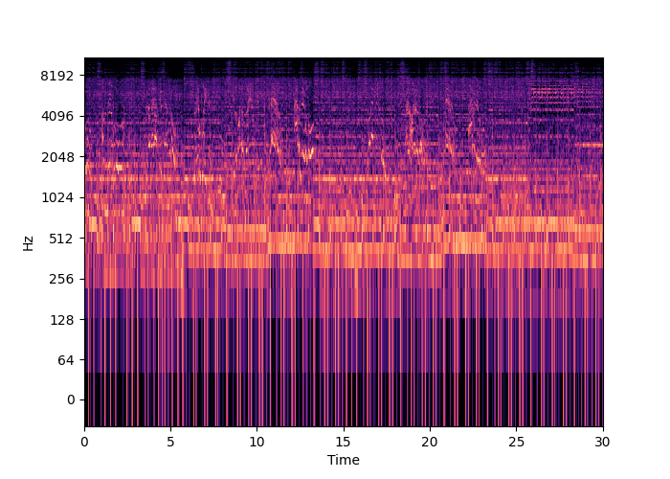
Input Data
52 bpm
191 bpm
Notes:
And here is a comparison for tempo
One is of a song that is a slower tempo that is 52 beats per minute and as compared to a faster song that is 191 beats per minute

Slide 16
Datasets
Training
Used during training to look for patterns and connections
Validation
Used during training phase for unbiased evaluation of the model
Testing
Used after training completes to assess the model on unseen data
Notes:
With in the dataset itself, for machine learning it is broken into three parts
The training data is the data that the model is actually training with to learn from and look for patterns and connections
The validation set is used during the training phase of the model to provide an unbiased evaluation of the model's performance and to help fine-tune the model's parameters.
The test set is used after the model has been fully trained to assess the model's performance on completely unseen data.

Slide 17
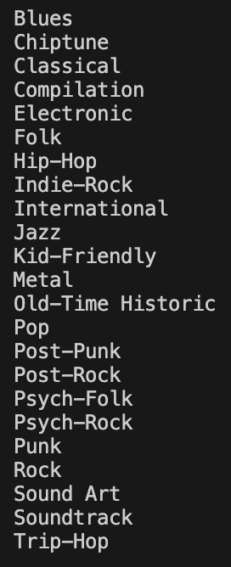
Genre Models
Classifying song into 22 main genres
Iterative process
Notes:
My genre model classified the songs into 22 main genres
It was an iterative process where I created multiple variations of neural networks aiming for the best accuracy. I would do some research, try out an idea and train the model, and then wait to see the results and then go back to do more research.
The most successful model i created for genre had an accuracy of about 68% on the testing or unknown dataset.

Slide 18
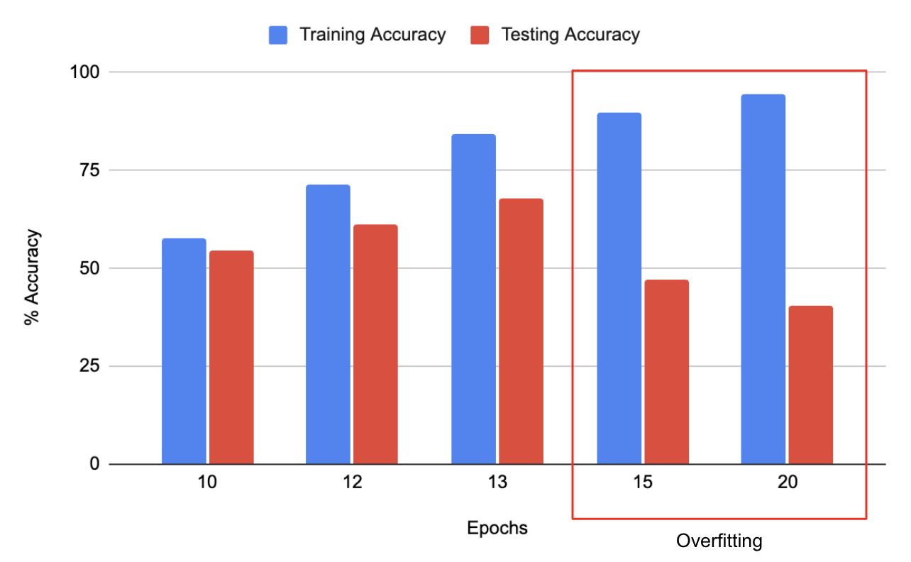
Genre Models
Notes:
Here is a graph showing some of the results from that model
Along the x axis is the number of epochs, or how many passes over the data the training set did, so how long that model was training.
And on the y axis is the percent accuracy
I thought this was a good visual example to show when you can see the model becoming overfit to the training data, as you can see the models testing and training datasets are both increasing in accuracy up until about 13 epochs, then the testing accuracy was still increasing and the training data accuracy began dropping

Slide 19
Genre results
Genre
Genre Model | Pop
Actual Genre | Pop
Sample 1
Notes:
Here are some examples of the results from my best genre model.
Here is the clip from the first song again
My model did correctly classify this song as pop.

Slide 20
Genre results
Genre
Genre Model | Pop
Actual Genre | Rock
Sample 2
Notes:
Here is the second clip again
My model did classify this song as pop, while the actual label for this song is rock.
I did think was interesting for genre to see classification results because genre labels are more subjective
I also reached out to the music department here at UNCA to see if they had any music I could run my models on. The genre results were interesting because the music that the music department shared was mostly student performances and covers of songs.

Slide 21
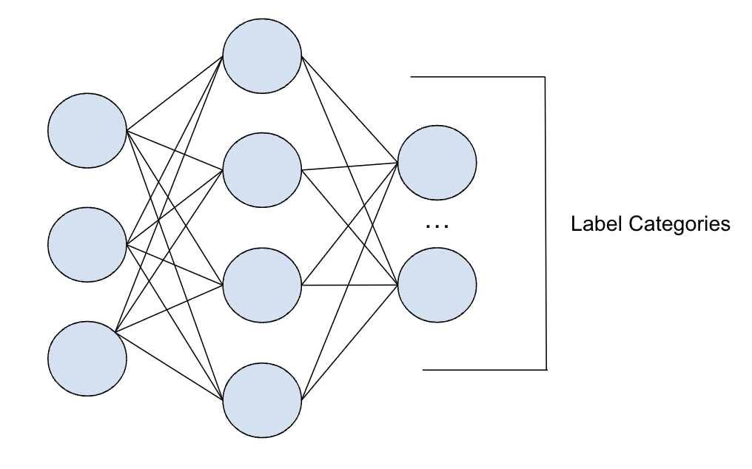
Tempo Models
Started with a Classification model
Discrete data
Model categorizes into one of the labeled categories
Measured more on accuracy
Not what I needed for tempo
Notes:
The process of creating my models for tempo did not go as smooth as the process of creating models for genre.
I actually started with a more classification based model, where the model would categorize the data into one of the labeled categories - in this case the average beats per minute for the songs
This posed some problems as while there were a lot of labels included in this data set ranging from 13 bpm up to 251 bpm, there wasn’t an infinite amount of labels of every possible beats per minute
Classification models are used with discrete labels in order to categorize the data.
Because of this, classification models are measured a lot on accuracy, where the percentage is coming from how many datapoints are labeled into the correct category
In neural networks, the output layer for classification models has one node for every label, and it outputs a probability for each category, to get results you then just get the category with the highest probability
This wasnt what i needed for tempo which is more continuous data

Slide 22
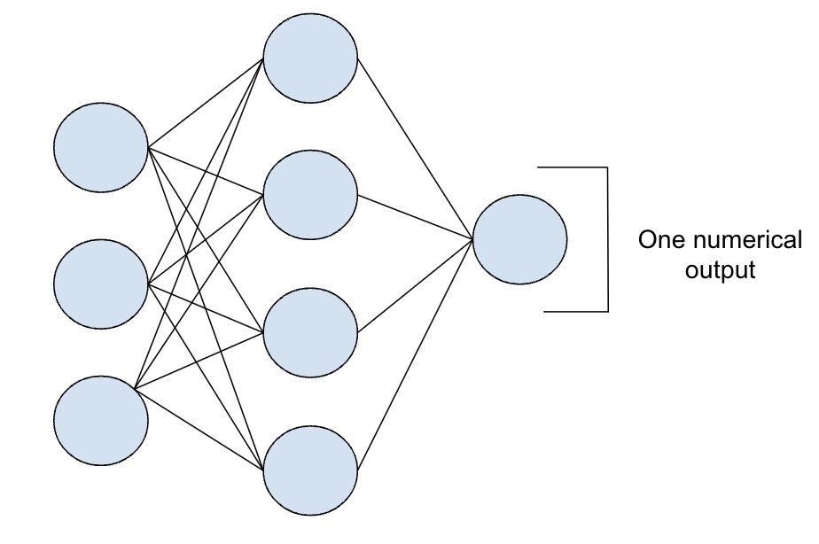
Tempo Models
Switched to a Regression model
Used with continuous numerical data
Measured more on loss
What I needed for tempo
Notes:
So I then changed gears and started more models that were more regression based models
These models instead of classifying the songs into one of the labeled categories, would be used with continuous numerical data
These models are based more on the loss of the model versus the accuracy because for continuous models it matters how close to the prediction is to the actual datapoint.
In the case of tempo, if a song was 180 beats per minute but a model predicted it to be 181 beats per minute.
While that is not the exact prediction it is a lot closer than if my model were to predict the tempo of the song to be 60 beats per minute.
I again was iterating through the process of doing research, trying new ideas, and seeing the results.
My best tempo model had a loss root mean squared error of around 21, which means that on average the models was off by about 21 beats per minute in its predictions.
I experimented a lot with some ideas for tempo to try to get the best models, and some takeaways i thought were interesting were that I had one of the biggest drops in loss when i changed how i was inputting the data. Instead of using the built in tensorflow function that built the datasets for me, i changed to manually building the datasets myself because after some research I found that there was another way to classify the data labels that was more in line with what I needed

Slide 23
Tempo results
Tempo
Tempo Model | 147 bpm
Librosa | 172 bpm
Actual | 174 bpm
Sample 1
Notes:
I also ran the two songs from the beginning of this presentation into the best tempo model
And i also compared the results to a function in the librosa library that determines the tempo
My model determined this song to be 147 beats per minute
The librosa function determined it to be 172 beats per minute
The actual beats per minute of this song was 174 beats per minute

Slide 24
Tempo results
Tempo
Tempo Model | 133 bpm
Librosa | 99 bpm
Actual | 100 bpm
Sample 2
Notes:
Here is the second song again
My model said this song was 133 beats per minute
The librosa function said the tempo was 99 beats per minute
And the actual tempo was around 100 beats per minute

Slide 25
Challenges
Required a lot of trial and error
Training process was time consuming
Prepping the data always took longer than expected
Creating genre models went much smoother than creating tempo models
Notes:
I personally learned a lot from this project, especially because I had no previous experience with machine learning
But because this was a brand new topic for me, I did hit some road bumps throughout the research and implementation process
I learned that for me at least, a lot of this process was a lot of trial and error, no matter how much research I was doing, there wasn’t always a definite answer or solution as each model is problem specific and I wouldn’t always know if something was going to improve the models unless i tried it
Because this process involved trial and error, the training process was also time consuming
I spent a lot of time waiting to see the results which sometimes 10-12 hours
Another challenge for me was that prepping the data for the models always took longer than I expected it to,
Because not every song in the dataset had a label for tempo or genre, it took time to prep organize the input data
I also overall had a smoother time creating models for identifying the songs genre as opposed to the songs tempo
I am not sure if this is because genre was just easier to predict based on the dataset I used, or if because I actually started on making the models for tempo first, so i had a deeper understanding when i started on genre

Slide 26
Further Research
Use a larger data set
Identify more musical elements
Try various input data instead of a spectrogram
Notes:
Some ideas for further research are
I would have liked to be able to incorporate more data to see if the results can improve
not every song was labeled for tempo and/or genre, so i didn’t ever have the full dataset to create the models
I also would’ve liked to explore making models identifying more musical elements other than just genre and tempo, I would really like to explore identifying instruments heard in a song
I would also like to try some different input data instead of a spectrogram, to see how the results compared.

Slide 27
Questions?
Notes:
Does anyone have any questions?
I am not sure about that, but that is a great idea for further research
I do not have that in these slides but I would be happy to show you after

Slide 28
Sources
https://developers.google.com/machine-learning/crash-course/descending-into-ml/training-and-loss
https://machinehack.com/story/demystifying-training-of-linear-layers-in-neural-networks#:~:text=Linear%20layers%E2%80%94also%20known%20as,vector%20through%20a%20linear%20function.
https://www.zendesk.com/blog/machine-learning-and-deep-learning/
https://ischoolonline.berkeley.edu/blog/what-is-machine-learning/
https://developers.google.com/machine-learning/crash-course
https://machinehack.com/story/demystifying-training-of-linear-layers-in-neural-networks#:~:text=Linear%20layers%E2%80%94also%20known%20as,vector%20through%20a%20linear%20function.
https://developers.google.com/machine-learning/crash-course/descending-into-ml/training-and-loss

Slide 29
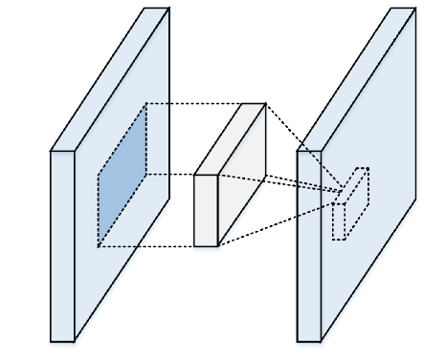
Convolutional Linear Layer
Designed to work with images and other spatial data
Extracts features from images
Notes:
Another type of layer used in the neural networks in this project is a convolutional linear layer, used mostly used with images
A Convolutional linear layer look at regions of the image by sliding a window across it extracting new features from the image
You specify size of the window moving over the image by the kernel parameter
Weights in the kernel are multiplied by pixel values to return the output as set of features to then be used in the next layers

Slide 30
ReLU
Rectified Linear Unit
Most popular activation function for training deep learning models
Introduce non-linearity and enable the network to learn complex patterns
Notes:
Linear function that maps negative values to zero and the positive values are returned.
avoids the vanishing gradient problem
easier to optimize when its behavior is linear or close to linear.

Slide 31
What is Machine Learning?
Notes:
To start off In case you are unfamiliar with machine learning, I will do a brief introduction

Slide 32
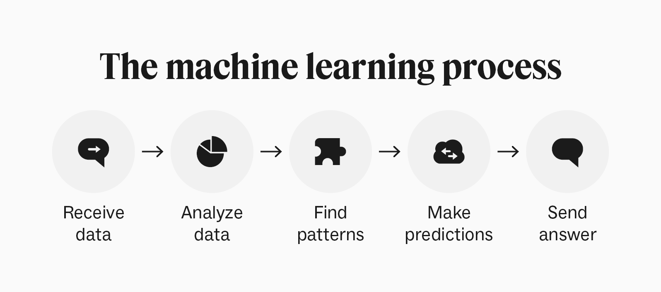
What is machine learning?
Notes:
The basic concept of Machine learning in terms of data science involves using statistical learning and optimization methods that let computers analyze datasets and identify patterns
In other words the computer is given both input and output data.
You then let computer then train itself to find patterns and make predictions about the data
Machine learning is an Iterative process, you see the results, might make some changes and retrain
Once you have a final model, you can use it to make predictions on unknown data
Some popular uses of Machine Learning you might be familiar with are recommendation systems and spam filters

Slide 33
Results
Notes:
For the testing and results of this project, I used the accuracies and loss of the models to help determine the models accuracy and also compared results against a function in the librosa python package that determines the tempo of songs, and also compared results against the documented data about the songs from the spotify api
I did also reach out to the music department to see if they had any music that I would be able to run my models on. They did share student performances with me. Since these performances were covers of songs, the results were very varied
Librosa description

Slide 34
Results
Tempo
Tempo Model | 147 bpm
Librosa | 172 bpm
Actual | 174 bpm
Genre
Genre Model | Pop
Actual | Pop
Sample 1
Notes:
Let’s look at some example results for the two songs we listened to at the beginning of the presentation
Let me play the first sample again
The first song has an actual average beats per minute of 174, my tempo model predicted the tempo to be 147 beats per minute
The function in the librosa package that can predict the tempo of songs determined that the tempo to be 172 beats per minute
This first sample’s main genre is pop and the my model did correctly identify the genre as pop

Slide 35
Results
Tempo
Tempo Model | 133 bpm
Librosa | 99 bpm
Actual | 100 bpm
Genre
Genre Model | Pop
Actual | Rock
Sample 2
Notes:
Here is the second sample again
This song has an actual average beats per minute of 100 and my model predicted the tempo to be 133 beats per minute
On this song, the librosa function predicted that the tempo of the song to be 99 beats per minute
The second samples main genre is considered rock and my model did identify it as pop
Pop was definitely the most over identified genre in my model for genre, but it also was the category that had the most data

Slide 36
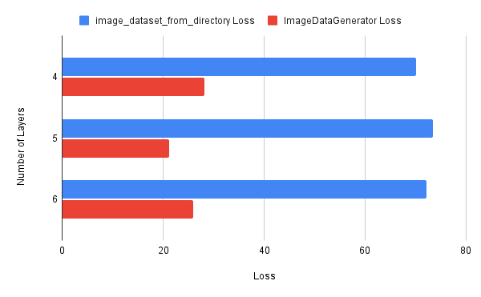
Tempo Models
Notes:
I ultimately got better results from the regression models
The results varied depending on the set up of the network
As I iterated through the process I changed variables such as the number of layers, the number of nodes within the layers, how long the model trained for, and even the order of the layers in order to fine tune the models
And even within the variations of the regression models i had.. changes such as how i was reading in the data affected the results of the model
Here is some data from when i changed how I was reading in the data. I changed from loading the data with the tensorflow function image dataset from directory
This function creates the training, validation, and datasets for you using the folder names and the data labels
And I instead changed to building an image data generator and creating the training, validation, and testing manually,
using this way to read in the data, i could specify different label types than the previous function and was able to specify that the label names were raw data which was more in line with what was necessary for a regression model
I used the exact same layers in both of these models but you can see the drastic difference in the loss, which we want as low as possible.
My most successful model for tempo had a root mean squared error loss of about 21 the testing data. This meant that on average the predictions were off by an average of 21 beats per minute.
I also did try to create a tempo model using waveform graphs instead of spectrograms, but used way too long of a sound sample creating waveforms that looked all almost identical and therefore got pretty terrible results
Show one run of data

Slide 37
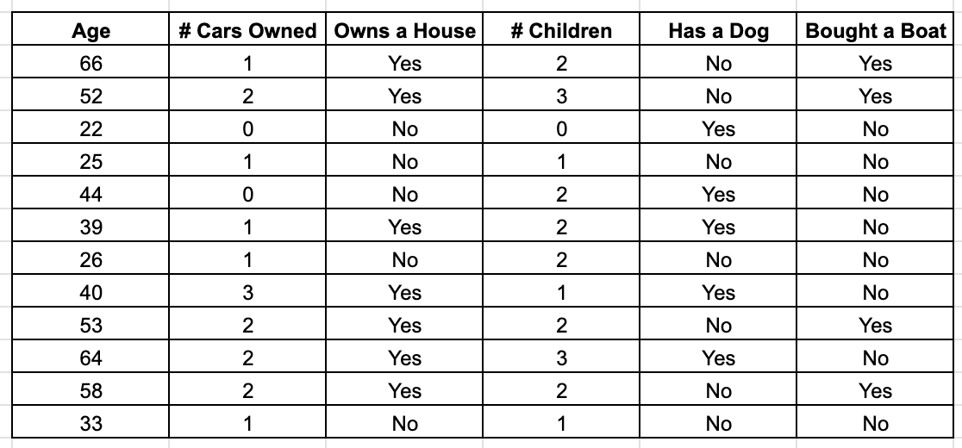
What is machine learning?
Notes:
Let’s say you were working at a company that sells boats and you wanted to find customers to send promotional emails to.
You would want to find customers who might be interested in purchasing a boat. One way to do that would be to look at data of past customers to see if there are any generalizations to be made about who would or would not buy a boat.
You might start by looking at who did buy a boat and looking for commonalities between the customers.

Slide 38
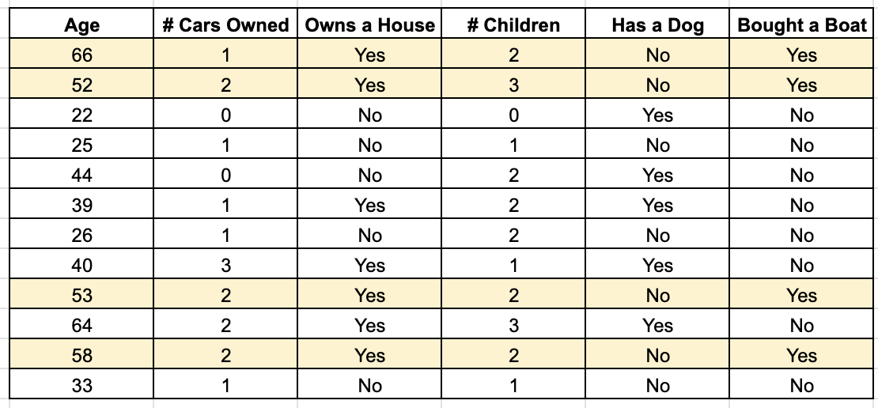
What is machine learning?
Notes:
There are different connections you could make from this dataset.
You might look at this data set and say:
All customers who are at least 52 years old, who own 1 or 2 cars and a house, who also have 2 to 3 children, and do not have a dog would buy a boat.
Although this model is 100% accurate with this tiny data set, we know that those are too specific of parameters to make predictions on. I am sure we all know of someone who owns a boat but doesn’t meet those exact parameters. Even though those parameters might be perfectly accurate for this dataset, it probably wouldn’t be super useful on a set of data of unknown new customers. This would be an example of an overfit model, where the model generalization is too specific to the training dataset.
But on the other hand, an example of an under fit model, would be if you just used one parameter and said, if you own a house you would buy a boat. While again, all of the customers from this small data set who bought a boat also own a house, we can see even in this tiny dataset there are more customers who own a house who did not buy a boat. And again I am sure we all know many people who own a house but do not own a boat. This model probably also wouldn’t be useful to make generalizations about unknown customers.
The goal of machine learning is to find the “sweet spot” so to say between and underfit and an overfit model. Where the model is specific enough to be useful in making predictions but not overly specific to the training data.

Slide 39
Underfitting vs Overfitting
Notes:
The overall goal of machine learning models is to make generalizations as accurately as possible.
For a model to be able to do this, it means that the model can not be overfit or underfit to the training data.
Underfitting is when the model is not specific enough to be useful.
Show one at a time - talk about each in the context of music - 30 seconds
Overfitting is when the model is too specific to the training data, and therefore also isn’t very useful on unknown data.
To demonstrate overfitting vs underfitting lets look at a quick example

Slide 40
Research Question
What are some of the techniques with computers used to understand music and how do they work?
Notes:
Looking back at my initial research question
I do think that computers can learn and extract information from music using machine learning
While my models for either musical element were not exceptionally accurate, I think that with more expertise, data, and time even more accurate models can be made

