Slide 1
SOC 106 · Spring 2026
Does Parental Education Shape Children's Educational Attainment?
Alex Rivera · May 5, 2026

Slide 2
Motivation & Research Question
Slide 1 of 3
WHY IT MATTERS
HYPOTHESES
Education is the primary mechanism through which socioeconomic advantage is passed across generations. We know parental SES matters — but do mothers and fathers matter equally? And equally for sons and daughters?
H₀ (Null hypothesis)
No differential effect of parent gender — parental education predicts equally regardless of which parent or child gender.
H₁ — Patriarchal Model
RESEARCH QUESTION
Father's education predicts children's attainment more strongly than mother's, regardless of child gender — reflecting traditional male-breadwinner stratification.
Does parental education predict children's educational attainment, and does this relationship differ by the gender of the parent and the child?
THEORY / PRIOR WORK
H₂ — Gender-Matching Model
Status attainment theory (Blau & Duncan 1967) vs. gender-socialization theory (Ridgeway 2011) — children may model same-gender parents more strongly.
Parental influence is gender-matched: father's education matters more for sons, mother's for daughters. Expected direction: positive interaction between parent and child gender.

Slide 3
Data, Variables & Method
Slide 2 of 3
DATA
KEY VARIABLES
Source: General Social Survey (GSS), attain subset Sample: U.S. adults; n ≈ 1,517 with complete cases Unit of analysis: Individual respondent
Role
Variable
Measurement
Outcome (DV)
educ
Years of education, 0–20
METHOD
Key predictor (IV)
paeduc
Father's years of education, 0–20
Model: OLS regression with interaction term educ ~ paeduc + maeduc + sex_f + paeduc×sex_f + maeduc×sex_f + age + race_f Why OLS? Outcome is continuous (0–20 yrs); interaction terms directly test H₂. Data prep: Listwise deletion for missing parental education. Race recoded to White / Non-white.
Key predictor (IV)
maeduc
Mother's years of education, 0–20
Moderator
sex_f
Male / Female (ref = Male)
Controls
age, race_f
Age in years; White / Non-white

Slide 4
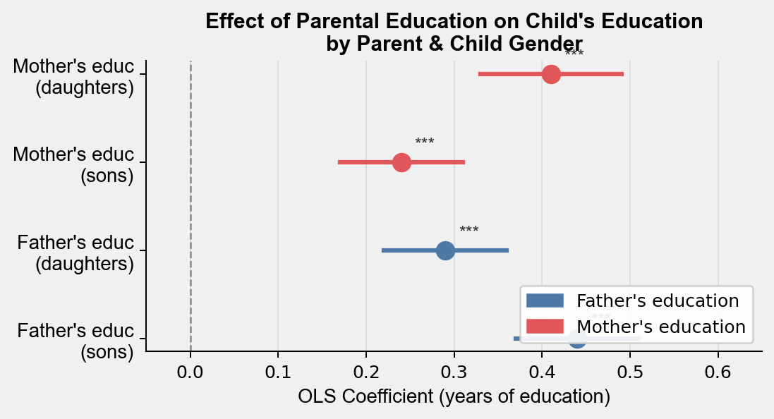
Results & Takeaways
Slide 3 of 3
MAIN FIGURE
KEY FINDINGS
H₀ rejected
Parental gender does matter — effects are not symmetric across parents.
H₁ not supported
Father's education is not uniformly stronger — it predicts significantly more for sons (β = 0.44) than daughters (β = 0.29).
H₂ partially supported
Gender-matched pattern holds: mother's educ stronger for daughters (β = 0.41 vs. 0.24 for sons). All differences p < .001.
MAIN TAKEAWAY
LIMITATIONS
QUESTION FOR CLASS
Same-gender parents are stronger educational role models — consistent with gender-socialization theory.
Cross-sectional data; no causal claim. Missing parental education may be non-random and likely underestimates effects.
Should I run separate models by gender rather than one interaction model?

