Slide 1

Santander Customer Satisfaction
CIS 508: Machine Learning in Business – Assignment 1
Kashyap Mehta

Slide 2
Problem Statement
In the Santander Customer Satisfaction prediction problem, the main objective is to predict the satisfaction level of customers based on various features provided in the dataset. The dataset consists of numerous features that represent different aspects of customer behavior and interactions with the bank.

Slide 3
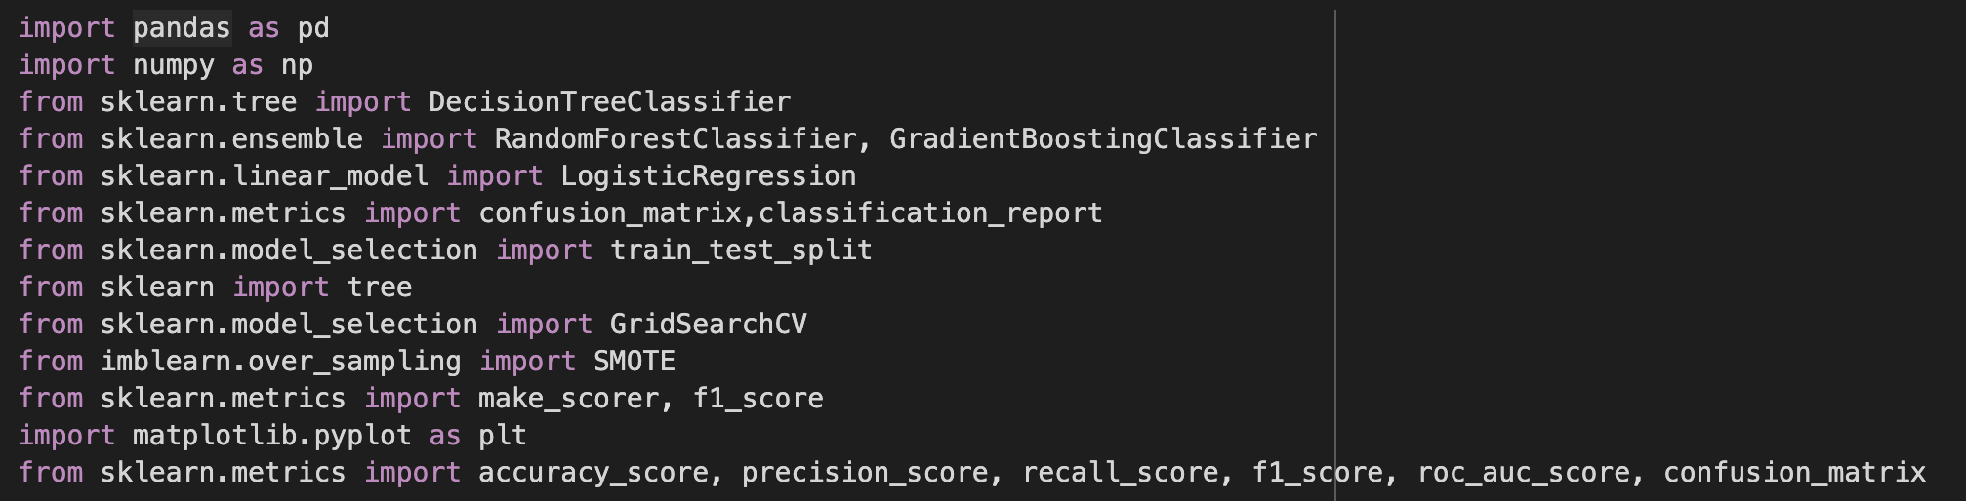
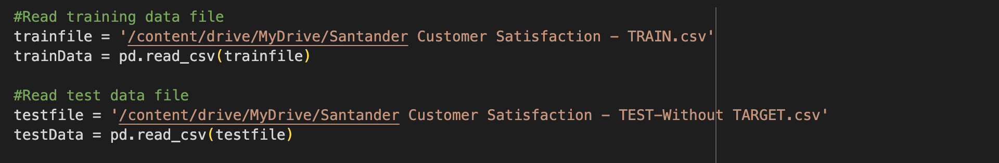
Exploratory Data Analysis (EDA)
Libraries Used
Reading the Dataset Files

Slide 4
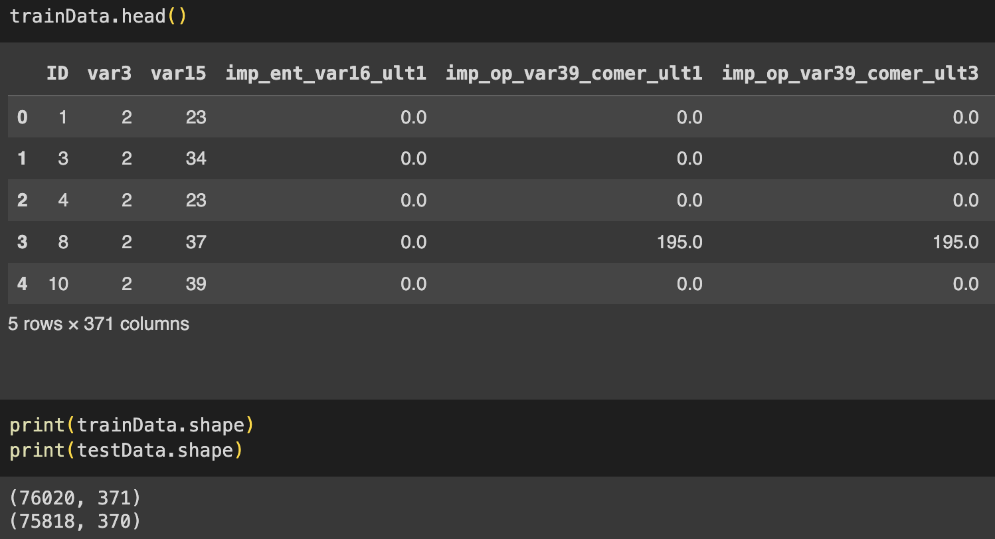
Exploratory Data Analysis (EDA)
Data Shape

Slide 5
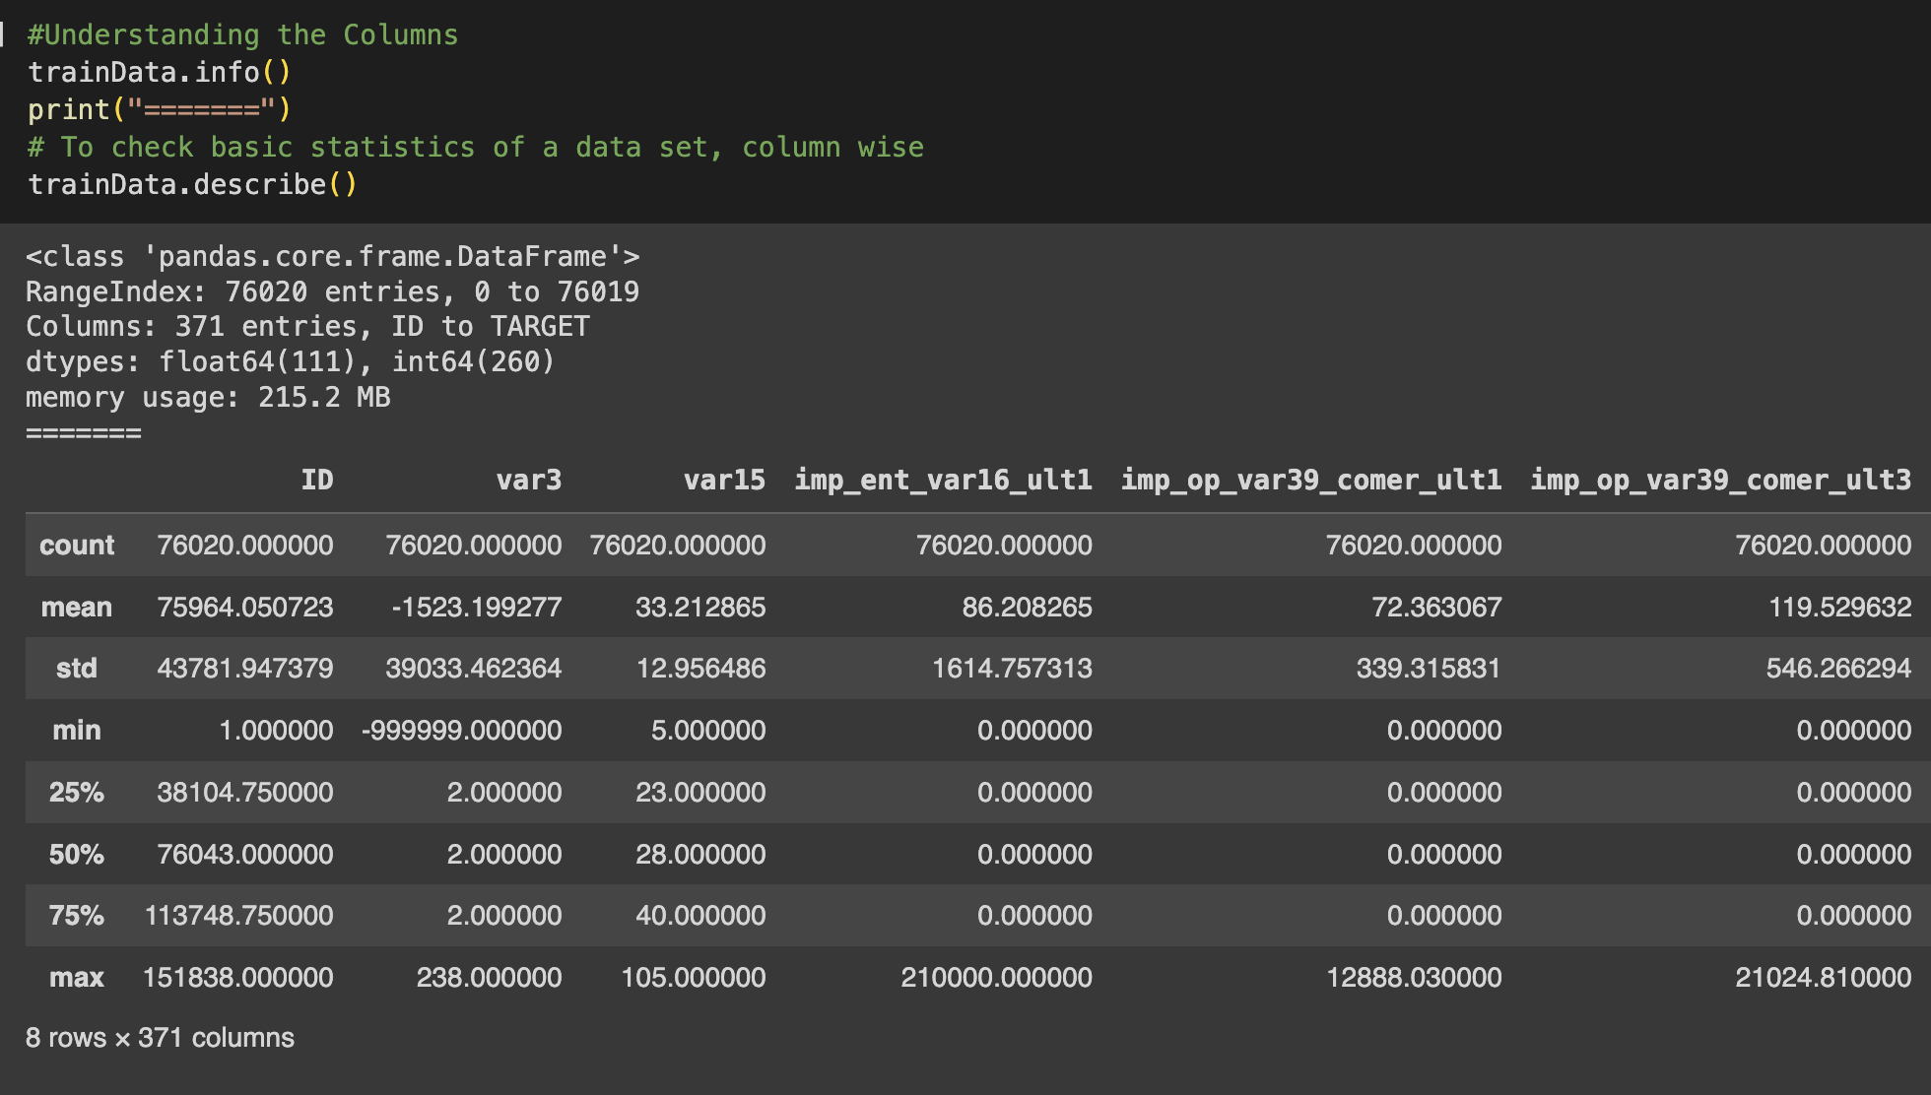
Exploratory Data Analysis (EDA)
Descriptive Statistics of the Columns

Slide 6
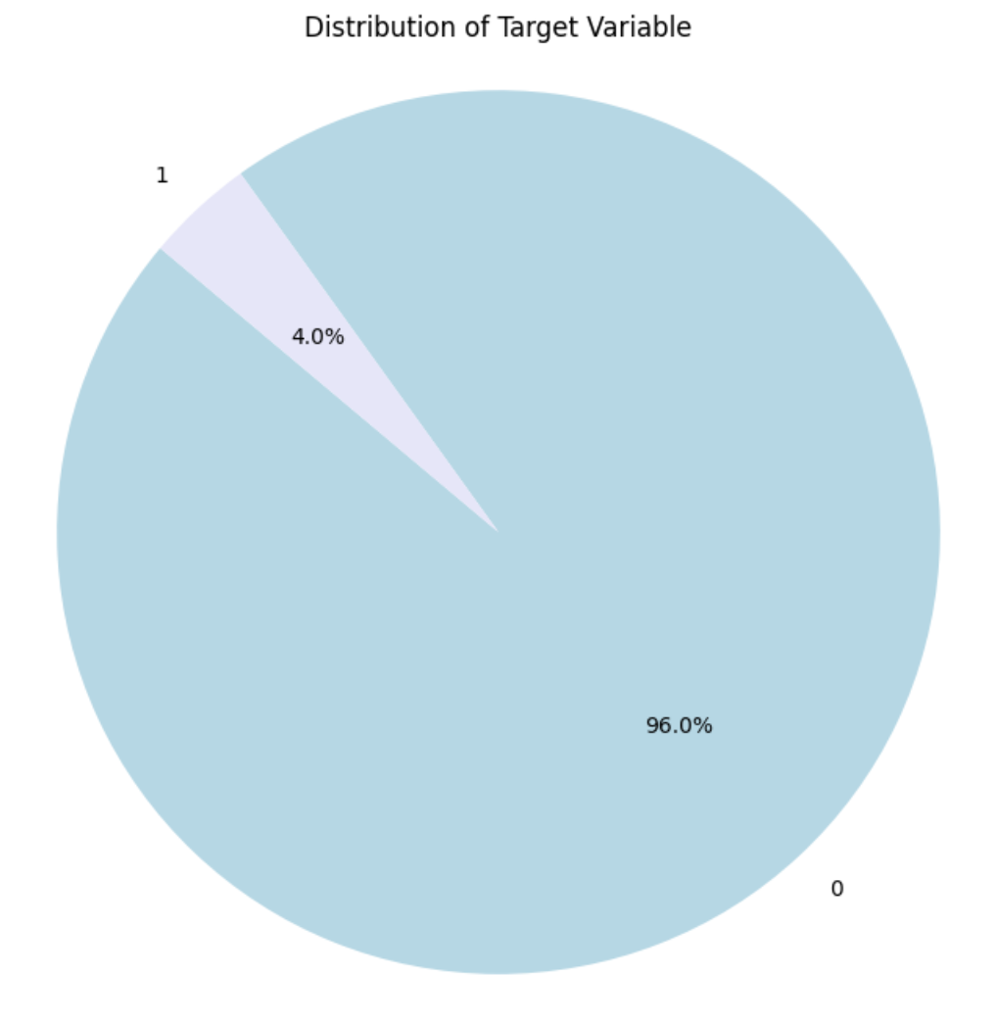
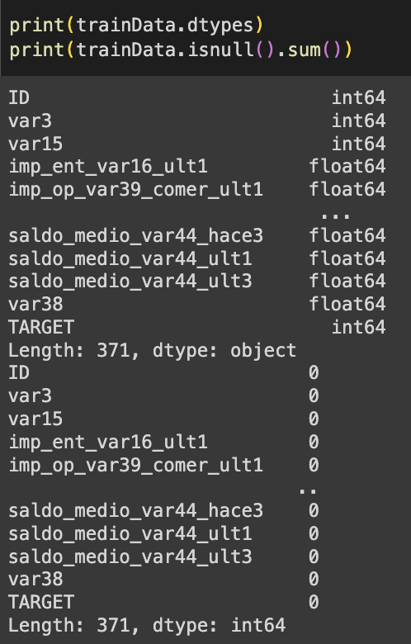
Exploratory Data Analysis (EDA)
Class Distribution (Imbalanced Dataset)
Check Data Types and Missing Values

Slide 7
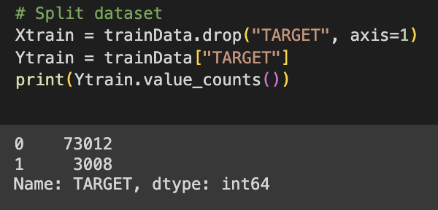
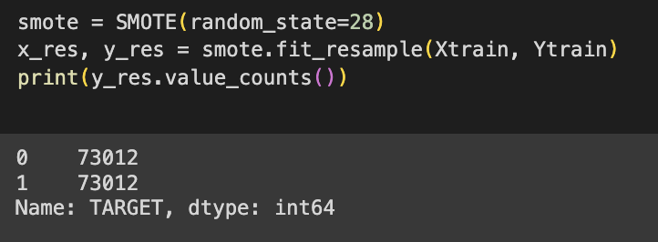
Pre-processing data
SMOTE OVERSAMPLING TO BALANCE THE TRAINING DATASET

Slide 8
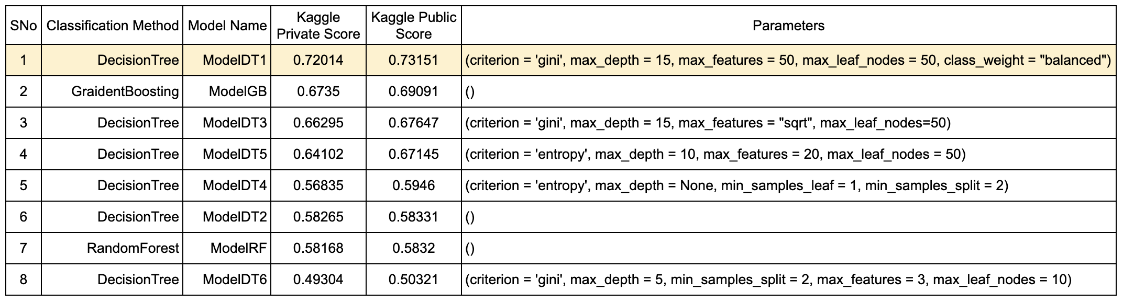
Model Training, Evaluation & parameter tuning

Slide 9
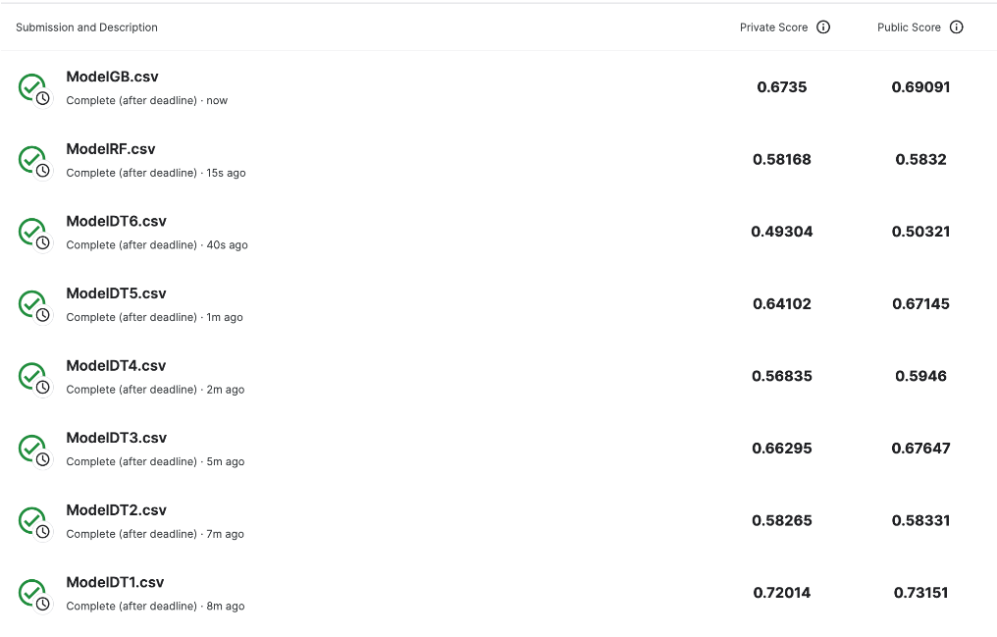
Model Training, Evaluation & parameter tuning

Slide 10
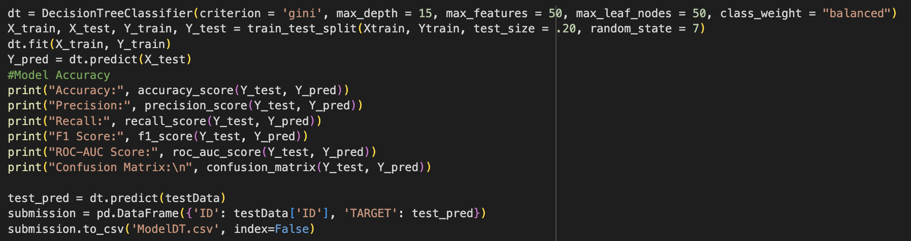
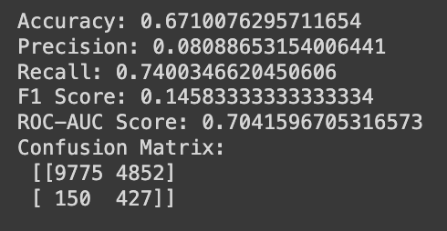
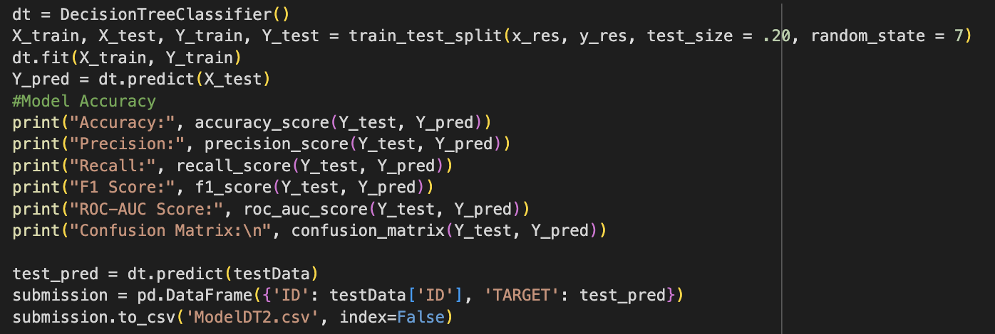
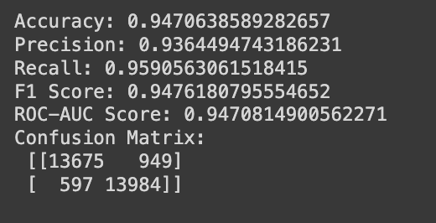
Model Training, Evaluation & parameter tuning
ModelDT1
ModelDT2

Slide 11
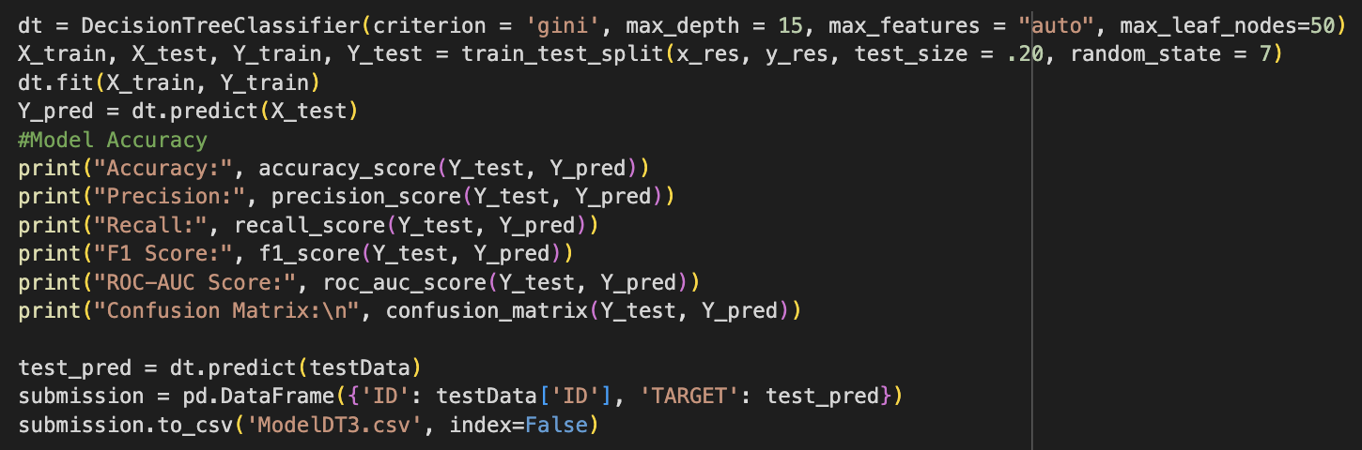
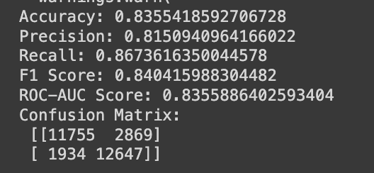
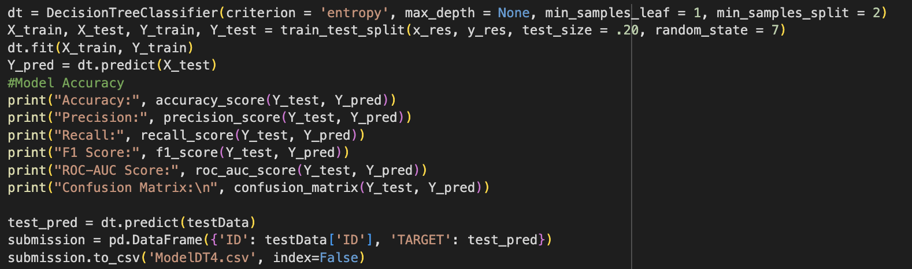
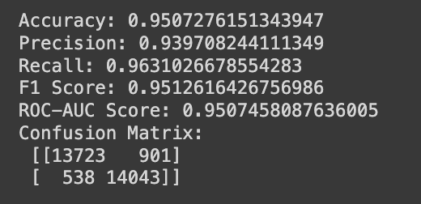
Model Training, Evaluation & parameter tuning
ModelDT3
ModelDT4

Slide 12
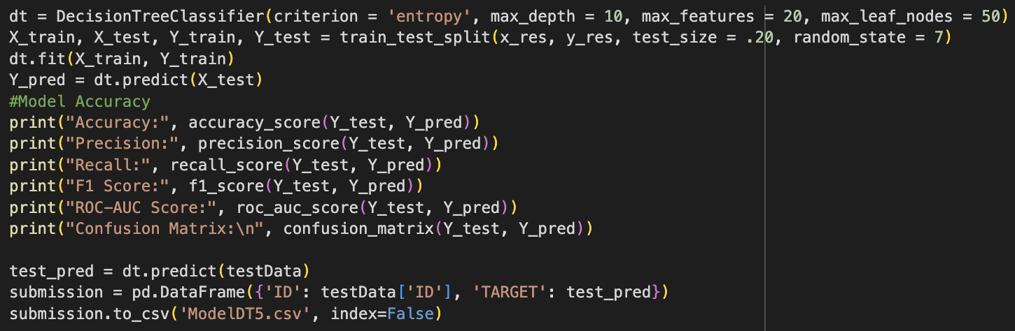
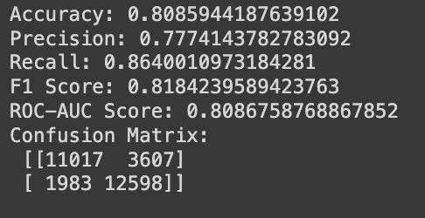
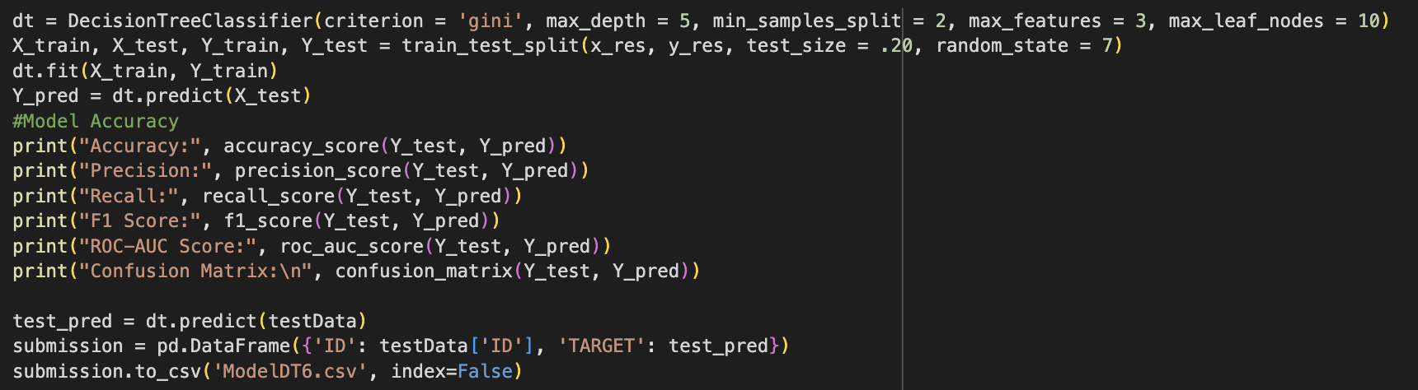
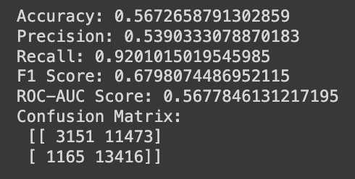
Model Training, Evaluation & parameter tuning
ModelDT5
ModelDT6

Slide 13
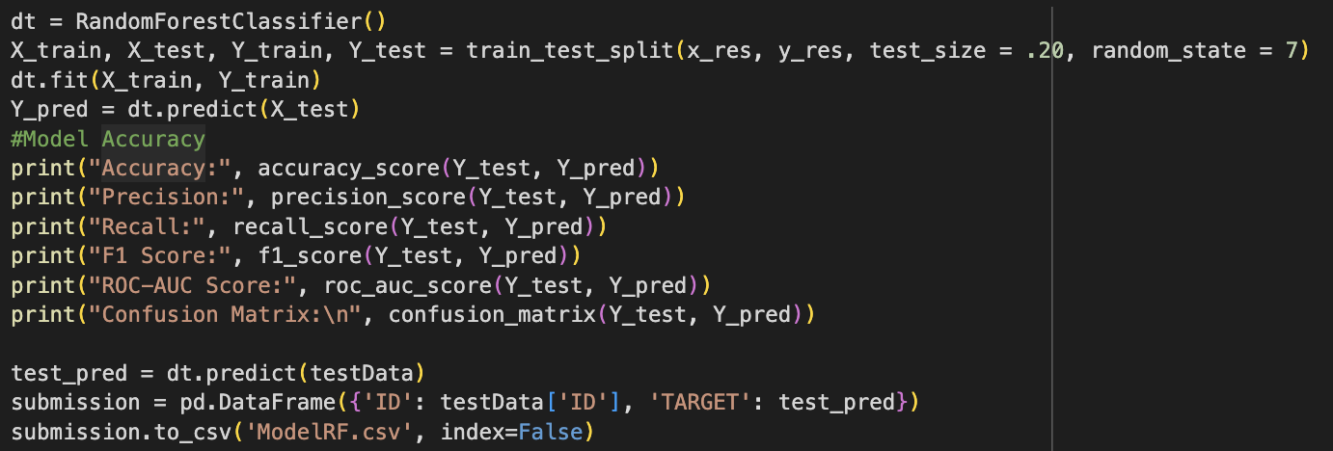
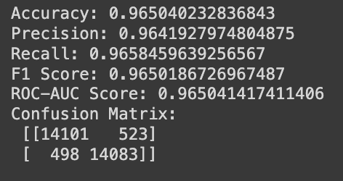
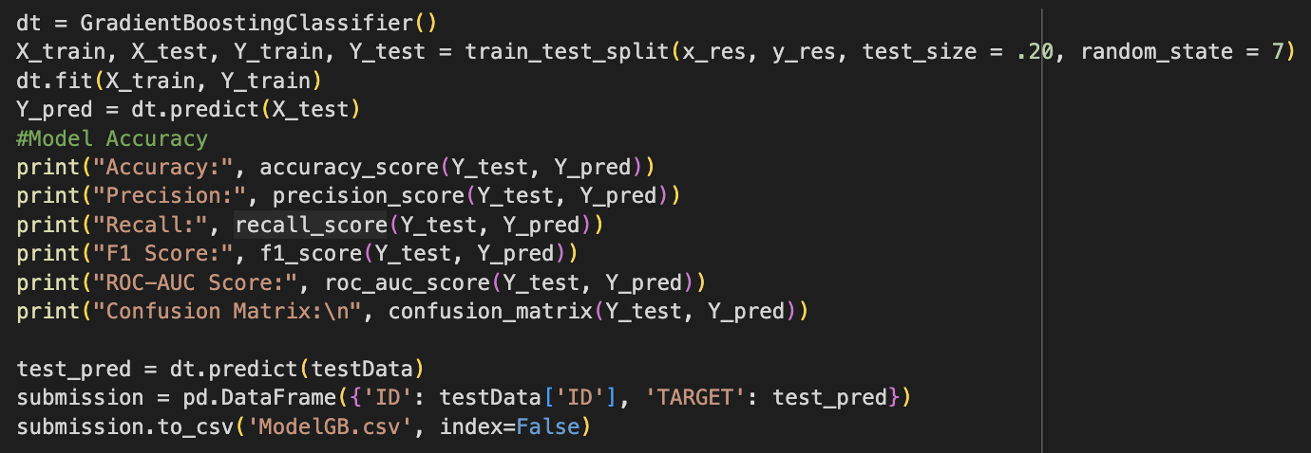
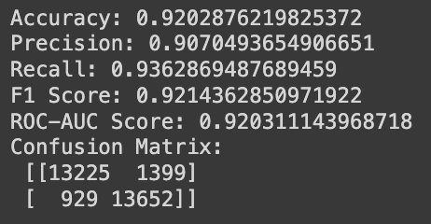
Model Training, Evaluation & parameter tuning
ModelRF
ModelGB

Slide 14
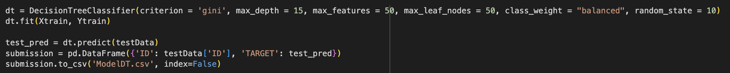
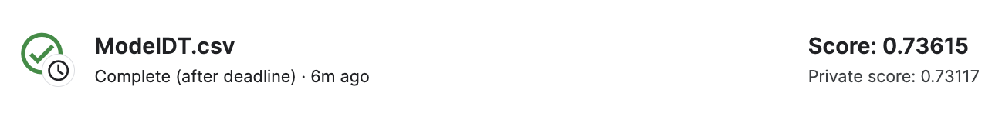
Model Training, Evaluation & parameter tuning
Special Case:
- Without using the test-train-split function.
- Using the entire dataset to maximize the training of the model
- Not using any pre-processing on the training data
- Highest Score

Slide 15
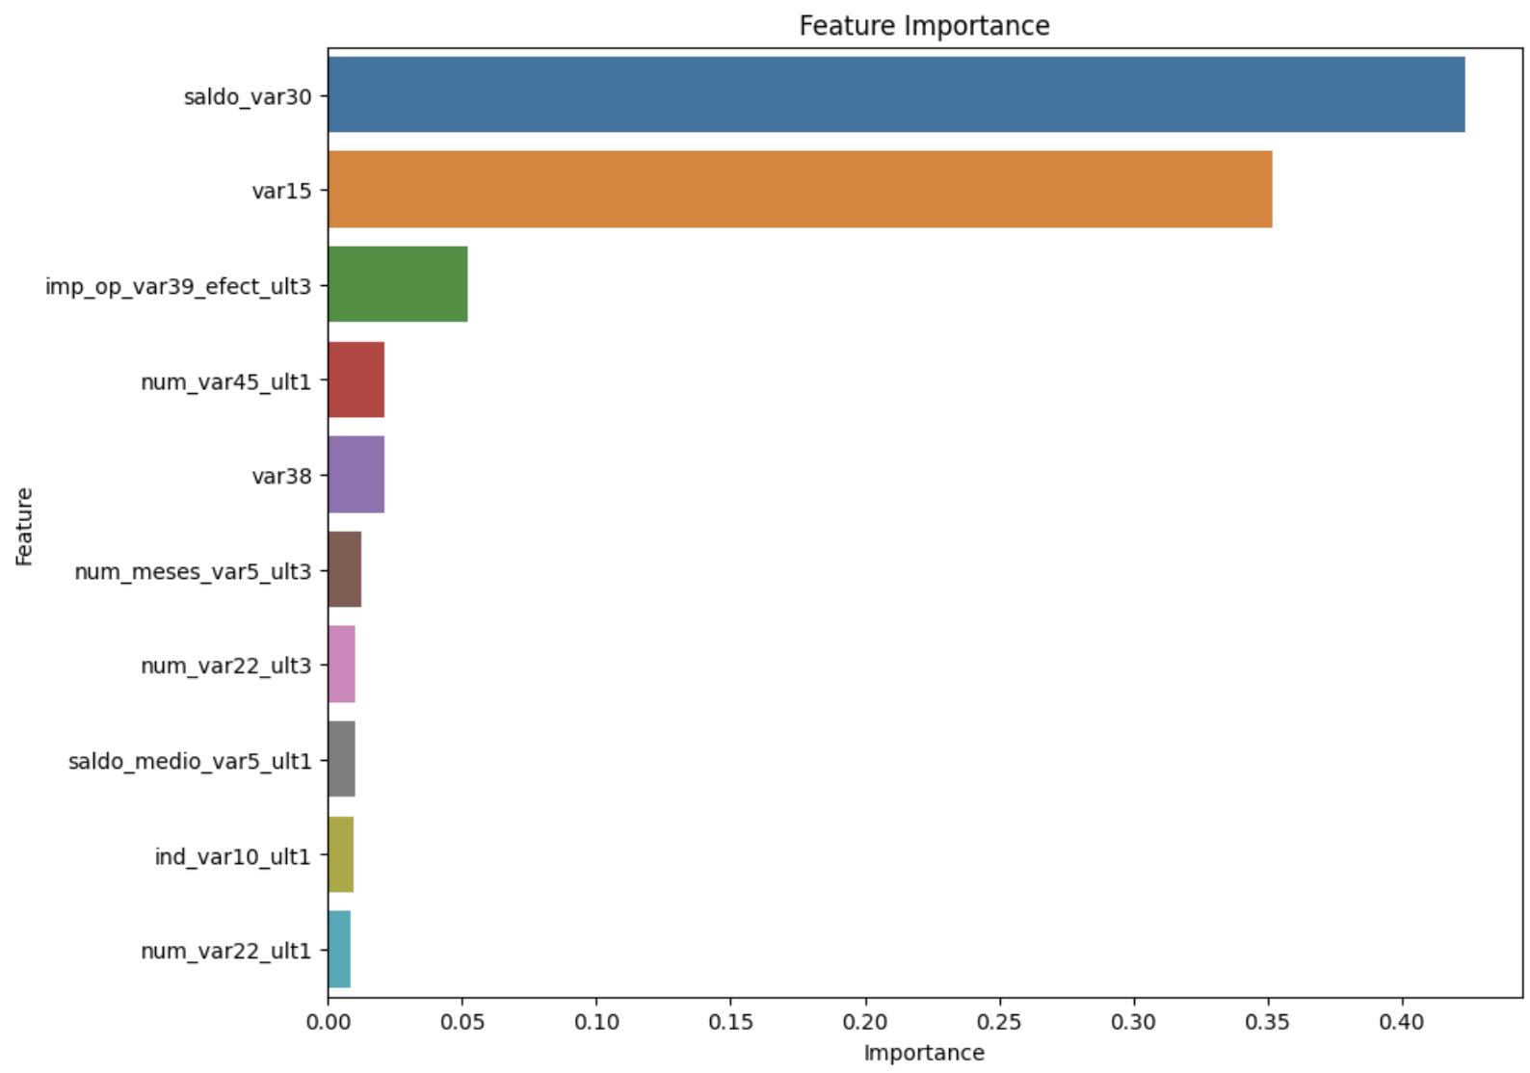
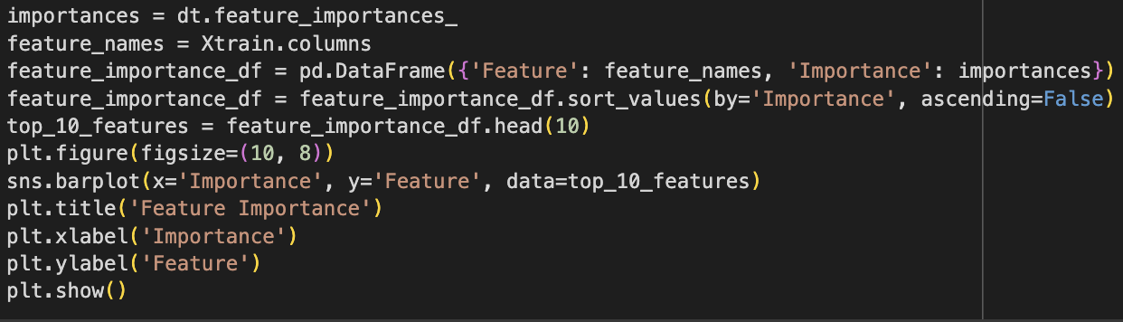
Model Training, Evaluation & parameter tuning
Top 10 Features that impact the Decision Tree Model

Slide 16
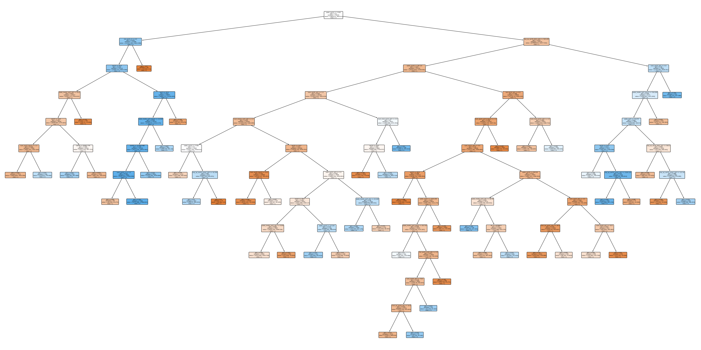
Model Training, Evaluation & parameter tuning
Decision Tree

Slide 17
hard problem from a machine learning point of view
The Santander Customer Satisfaction dataset presents a unique set of challenges for predictive modeling, primarily due to its heavily imbalanced classes, high dimensionality, and lack of explicit feature information. With satisfied customers significantly outnumbering the unsatisfied ones (73,012 to 3,008), models are at risk of exhibiting a strong bias towards predicting satisfaction, which could lead to high accuracy but poor performance in identifying unsatisfied customers. This imbalance necessitates the adoption of advanced resampling techniques, such as SMOTE, and the utilization of more nuanced performance metrics like the F1 score, precision-recall curves, and ROC-AUC scores.
The high dimensionality of the dataset further complicates the modeling process, increasing the risk of overfitting and making the selection of relevant features challenging. The absence of clear feature descriptions hinders the application of domain knowledge, which is often crucial for effective feature engineering.
In summary, the Santander Customer Satisfaction prediction task is a complex machine learning problem, demanding careful handling of imbalanced data, meticulous model evaluation, and thoughtful feature selection and engineering. Addressing these challenges is essential for developing a model that not only performs well but also generalizes effectively to unseen data, ensuring reliable identification of both satisfied and unsatisfied customers.

