Slide 1
Digital Portfolio
STUDENT NAME: Daniya kashaf
REGISTER NO AND NMID: 31224U09024/64A9EC7BAC01951AD194D6CA903B
DEPARTMENT: BCA
COLLEGE: COLLEGE/ UNIVERSITY:Islawomen's art and science college /Thiurvalluvar University .

Slide 2
PROJECT TITLE:
INTERACTIVE DIGITAL PORTFOLIO USING FONT AND WEB DEVELOPMENT

Slide 3


AGENDA
Problem Statement
Project Overview
End Users
Tools and Technologies
Portfolio design and Layout
Features and Functionality
Results and Screenshots
Conclusion
Github Link
3/21/2024 Annual Review

Slide 4

PROBLEM STATEMENT
Resumes and generic portfolios don’t fully reflect a designer’s creativity or growth.
A personalized, visually engaging portfolio was needed to showcase both design and coding skills.
This site highlights key projects, UI/UX strengths, and debugging abilities in a clean, interactive format.
It helps communicate professionalism and stand out in a competitive field.

Slide 5

PROJECT OVERVIEW:
Personal Portfolio Website: Built using HTML, CSS, and JavaScript to present my skills, bio, and contact details in a professional layout.
E-commerce Website: Designed a responsive, modern shopping interface with user-friendly navigation and visual appeal.
Blog Template: Developed a minimalistic, client-focused blog layout emphasizing readability and clean structure.

Slide 6

WHO ARE THE END USERS?
Recruiters and hiring managers use it to evaluate your design and coding skills.
Clients and businesses view it to decide if you're the right fit for their web projects.
Mentors and instructors refer to it for tracking your progress and giving feedback.
Peers and collaborators explore it to exchange ideas or work together.
Reviewers and judges assess it for competitions or academic evaluations

Slide 7

TOOLS AND TECHNIQUES:
HTML & CSS – For structuring content and styling layouts with responsiveness JavaScript – To add interactivity and dynamic behavior to elements. VS Code – Likely used as the code editor for development. Chrome DevTools – For debugging and refining layout and responsiveness. GitHub – Possibly used for version control and hosting project links.

Slide 8
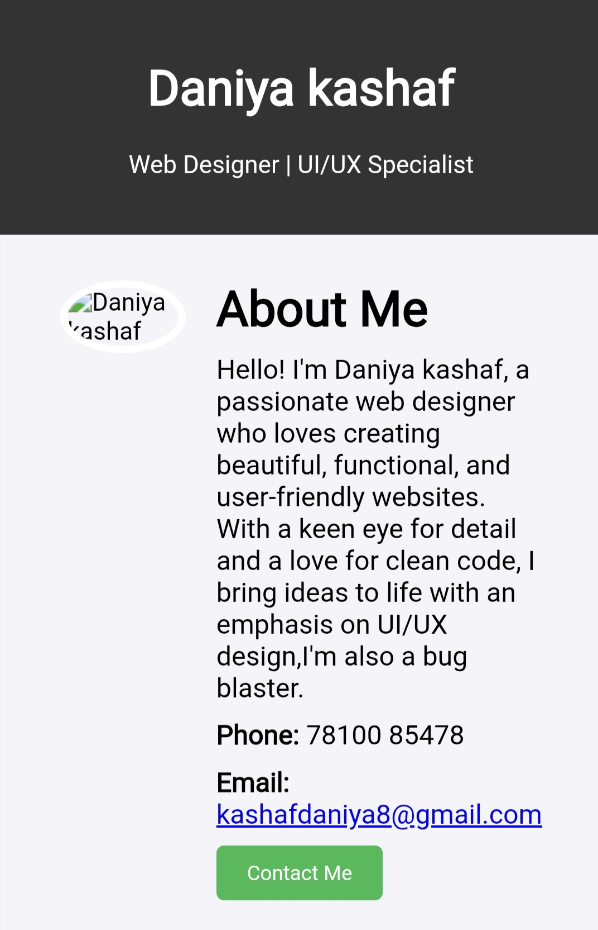
POTFOLIO DESIGN AND LAYOUT
8

Slide 9
FEATURES AND FUNCTIONALITY:
Displays your bio, projects, and skills clearly
Includes contact options and project links
Uses responsive design for mobile and desktop
Offers smooth navigation and clean layout for easy viewing

Slide 10
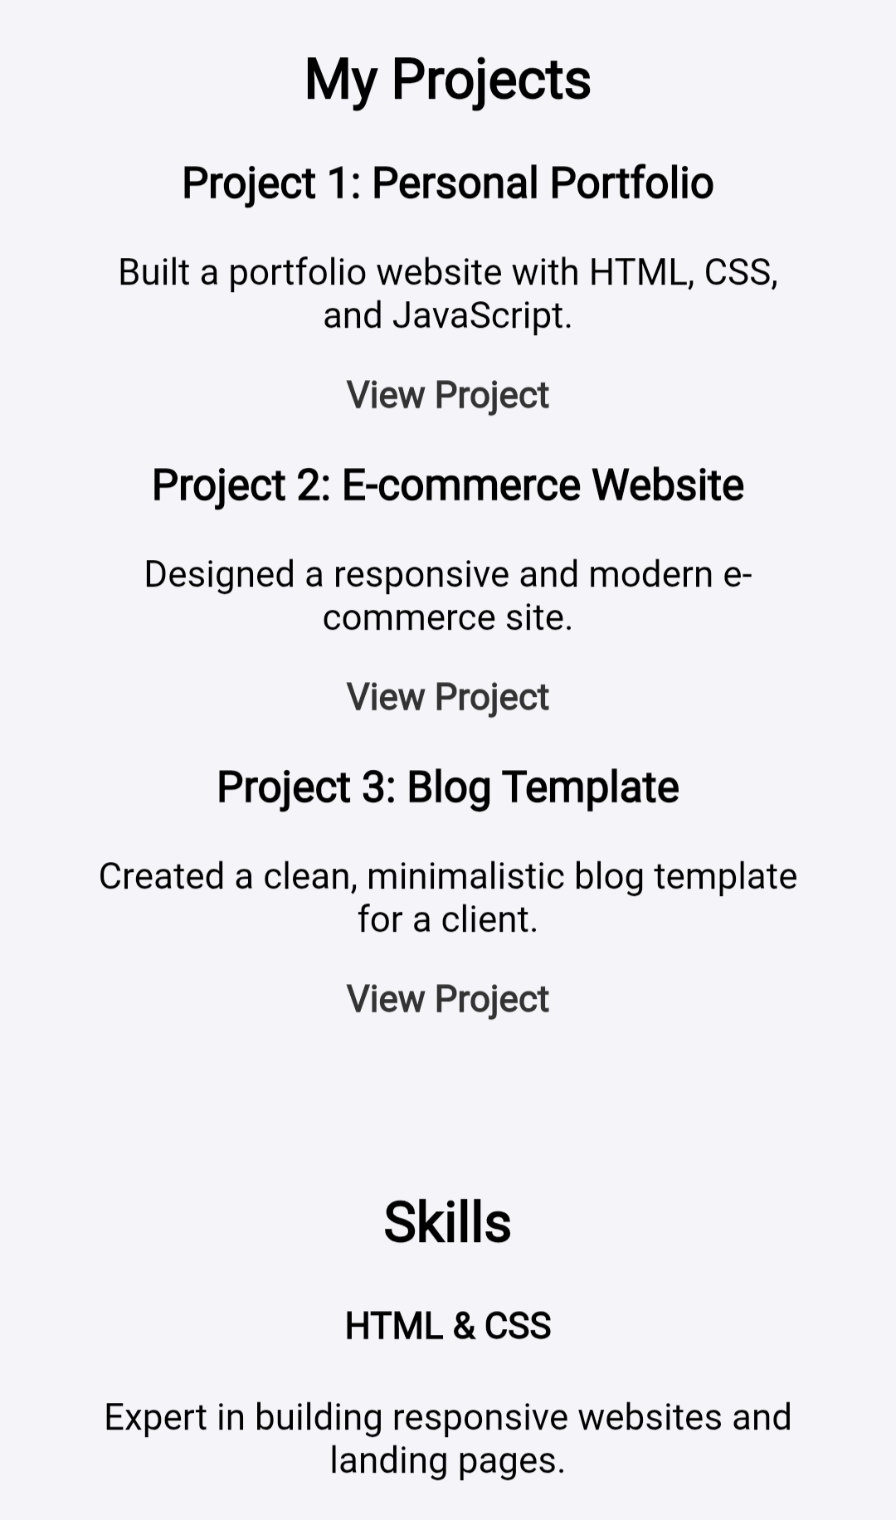
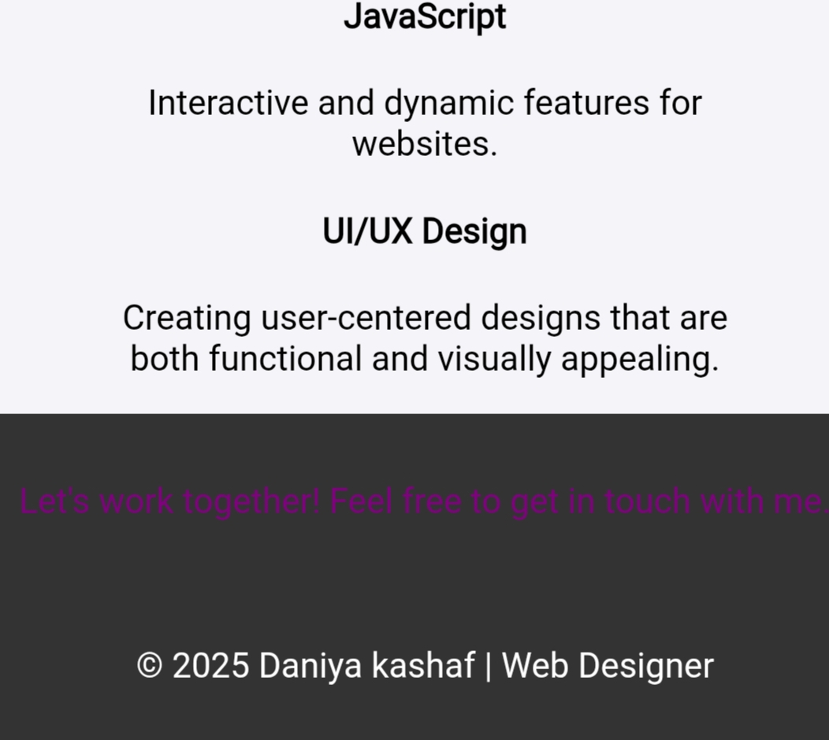

RESULTS AND SCREENSHOTS
3/21/2024 Annual Review
10

Slide 11
CONCLUSION:
This portfolio reflects my growth as a web designer and UI/UX specialist in training. Through clean layouts, responsive design, and user-focused projects, I’ve combined technical skills with creative thinking to build professional, engaging web experiences. It serves as both a showcase of my capabilities and a foundation for future opportunities in design and development.
11

Slide 12
GITHUB LINK:

