Slide 1
APOLLO-M
An AI Framework for Forecasting Instability in Digital Communities
Kashaf Fatima (84381) Rizwan Saleem (84010) Aaqib Mehmood (82081)
Supervisor: Mr. Saghir Ahmed
Mid-Year Evaluation · Final Year Project
Live: apollo-m.streamlit.app
Notes:
Good morning. We are presenting APOLLO-M, a framework that forecasts instability in online communities. I am Kashaf, with Rizwan and Aaqib, supervised by Mr. Saghir Ahmed. Everything you will see is deployed and publicly reachable, so you can open it yourself.

Slide 2
What We Will Cover
1
The problem we are solving
6
Running on real Reddit data
2
Our idea
7
Who would use it, and why
3
What we built
8
Industry and the SDGs
4
Our key finding
9
Timeline and limitations
5
Does it actually predict?
10
Next steps
Notes:
I will start with the problem, then our idea, then what we built. The middle of the talk is our main result and the evidence behind it. At the end: who would use this, our timeline, what we cannot yet claim, and where we go next.

Slide 3
The Problem
Online communities can break down. Hostility rises, the people worth keeping leave, and moderators are left firefighting.
• Today's tools judge one comment at a time, after it is posted.
• They describe how a community looks now — not where it is heading.
• By the time a dashboard turns red, the harm has already happened.
Moderators are given volume, not priority.
the gap we set out to close
Notes:
Online communities do break down. Hostility rises, the good members leave, and moderators are left firefighting. The tools that exist judge one comment at a time, after it is posted. They describe the present. Nobody tells a moderator which community is heading downhill.

Slide 4
Our Idea — a Lesson from Universe 25
From 1968 to 1973, John Calhoun gave a mouse colony unlimited food, water and safety — but limited space. The population grew, then collapsed. The collapse was described in detail afterwards. Nothing measured it coming.
Online communities have the same problem — but they are fully recorded.
every comment, every author, every timestamp
• So the early warning signs are already in the data. Nobody was looking for them.
• We treat instability as something to forecast, not something to classify.
Notes:
Our starting point was Universe 25. Calhoun gave mice everything except space, and the colony collapsed. It was described afterwards; nothing measured it coming. Online communities have the same problem, except everything is recorded. So the warning signs are already in the data. We treat this as forecasting, not classification.

Slide 5
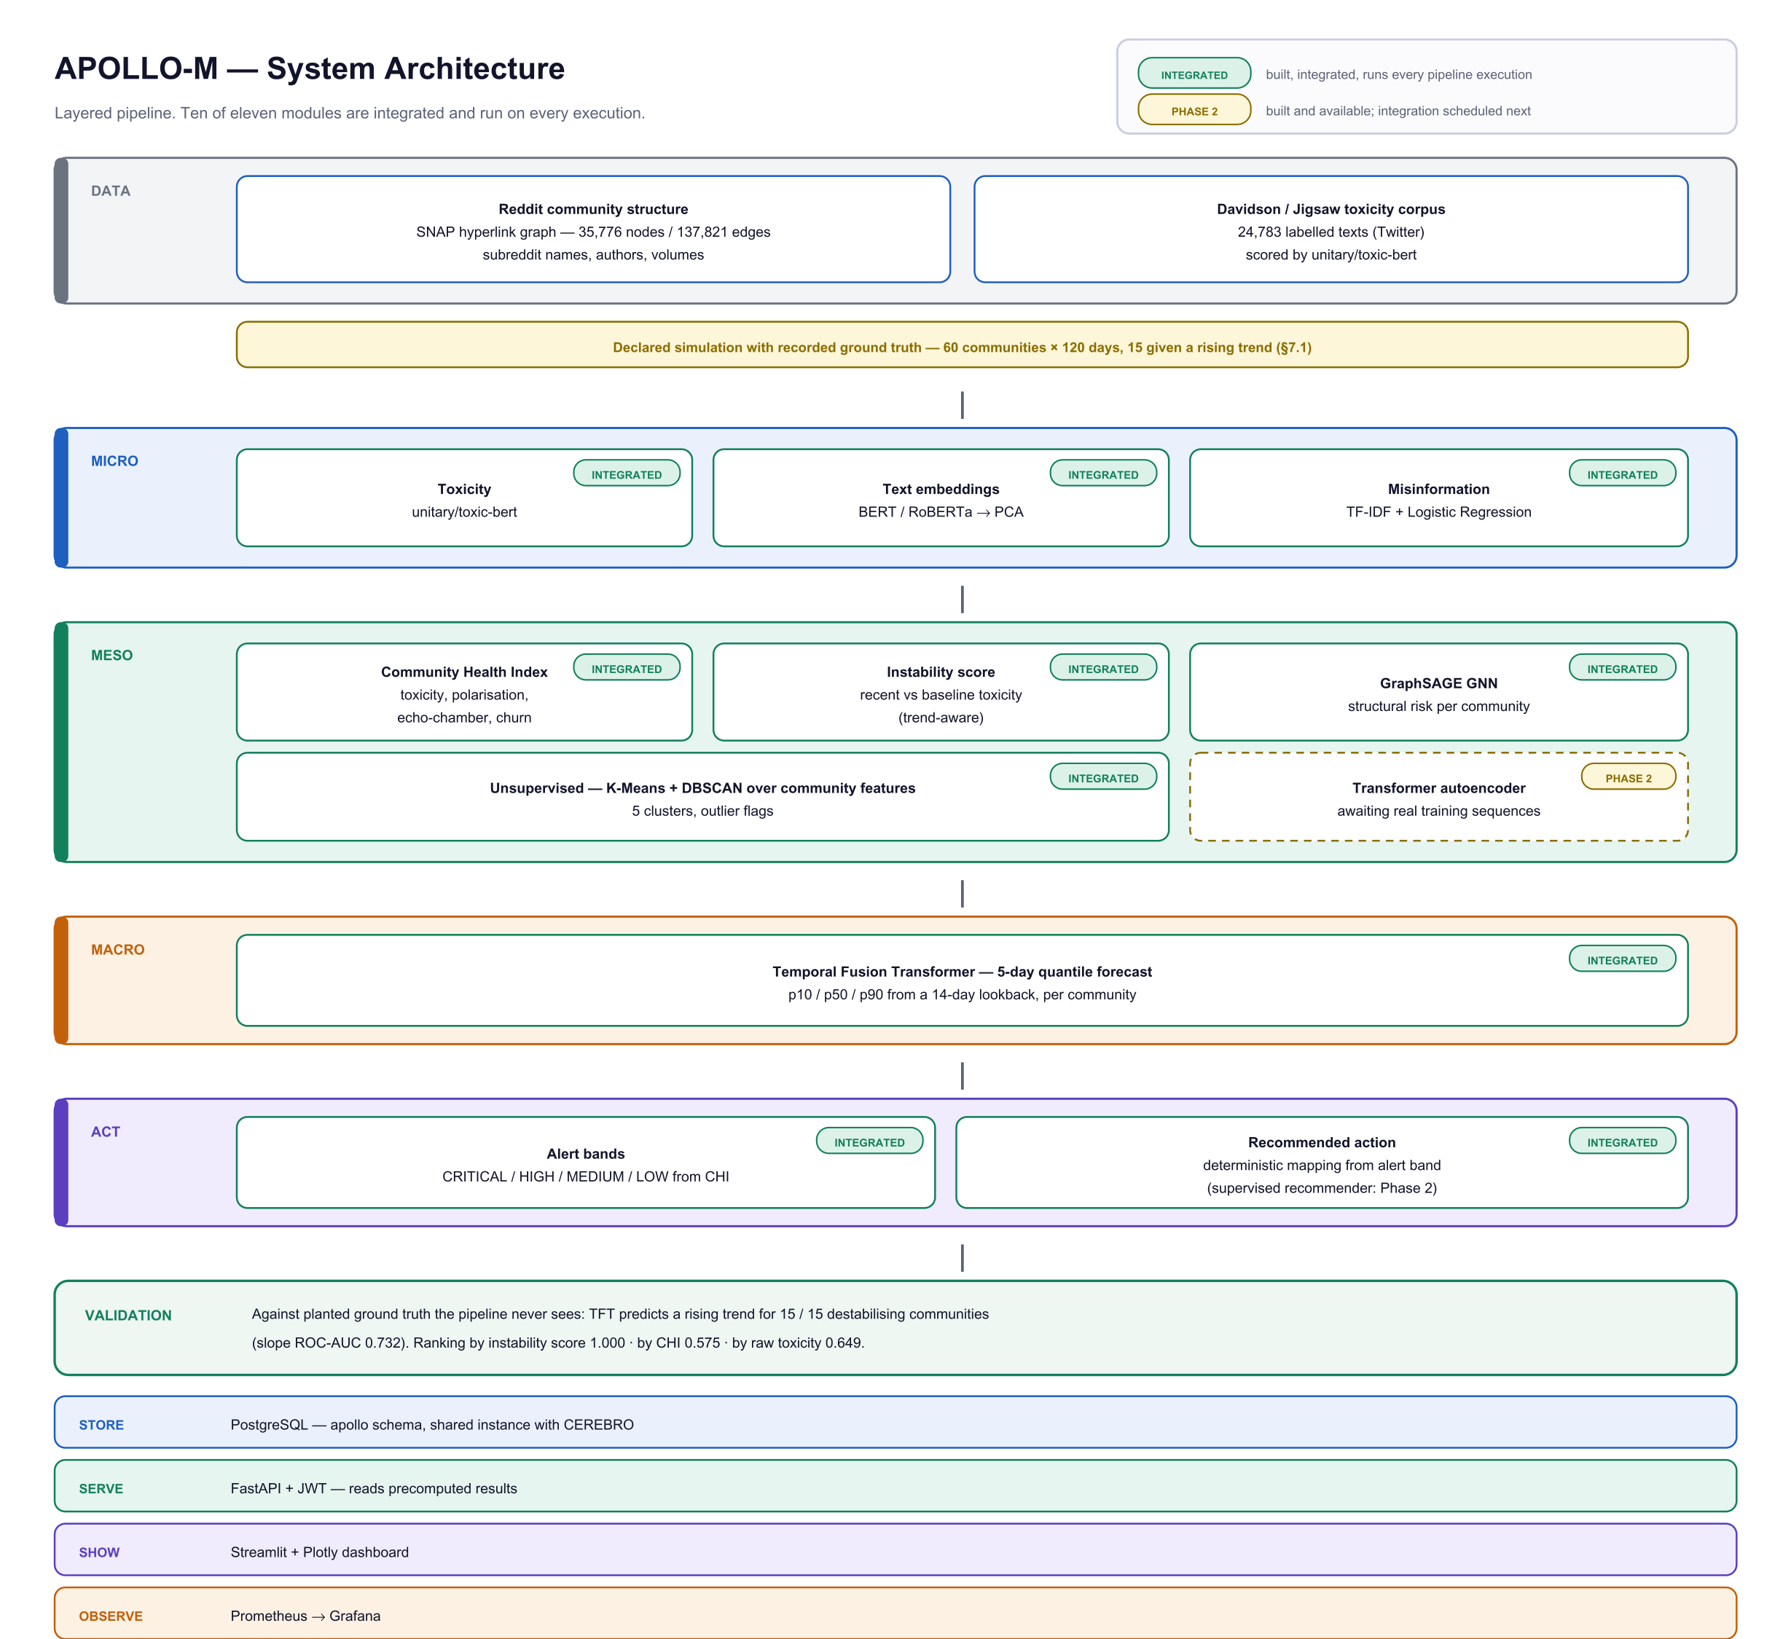
What We Built
Five layers.
Each one is measured on its own, so we can say which part works and which does not.
Deterministic code and trained models make every decision. The language model only writes the explanation — it never changes a score.
Notes:
Five layers. We score each comment, roll that up per community, group similar communities, forecast five days ahead, and raise a graded alert. The rule we followed throughout: code and trained models make every decision, and the language model only writes the explanation.

Slide 6
How It Works — in Plain Terms
MICRO
Score every comment for toxicity
toxic-bert
MESO
Combine them into a health score per community
health index + instability
PATTERN
Group similar communities without labels
K-Means, DBSCAN
MACRO
Forecast the next five days, with confidence bands
Temporal Fusion Transformer
ACT
Raise a graded alert and a recommended action
four alert bands
Notes:
In plain terms: micro scores comments with toxic-bert. Meso turns that into a health score. The pattern layer clusters communities with no labels. Macro forecasts with a Temporal Fusion Transformer, and gives confidence bands, not one number. Act turns it into an alert and a recommended action.

Slide 7
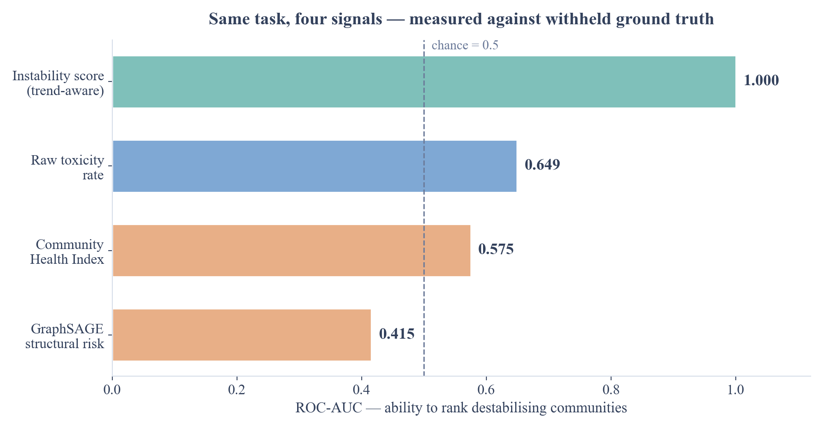
Our Key Finding
We tested our own health score — it did worse than an ingredient inside it.
A health score says how bad a community is now. Instability is how fast it is changing.
Notes:
This is our main result, and it is not the one we expected. We hid unstable communities in the data and asked each signal to rank them. Our own Community Health Index scored 0.575 — worse than raw toxicity, which is one of its own ingredients. The reason is that a health score says how bad things are now; instability is about how fast they are changing. Once we measured change, we got 1.000.

Slide 8
The Same Failure, Found Twice
Our graph model was built separately, with different inputs. It scored below chance on the very same task.
0.575
Community Health Index
0.415
GraphSAGE structural risk
• Both were trained on how a community looks now, not on how it is changing.
• One weak score could be a mistake in one formula.
• Two, built independently, show that the whole type of measure is wrong.
Notes:
Then we checked it against our graph model, which was built separately with different inputs. It scored 0.415, below chance, and for exactly the same reason. One weak score could be a bug in one formula. Two, arrived at independently, mean the whole type of measure is wrong for this task. That generalisation is what makes it a finding.

Slide 9
Does It Actually Predict?
We hid 15 destabilising communities among 60. The forecaster never sees the answer key.
15 / 15
found correctly
0.732
trend ranking (ROC-AUC)
5 days
forecast horizon
• The predicted direction was right for every planted community.
• Predicted daily trend: getting worse +0.0024 · stable +0.0009 · improving −0.0008
• Missing a community that is deteriorating costs far more than checking a quiet one, so we tune for recall.
Notes:
Yes. We planted 15 destabilising communities among 60, and the forecaster never sees which. It got the direction right for all 15, and ranked them at 0.732. We tune for recall on purpose: missing a community that is deteriorating costs far more than checking a quiet one that turns out fine.

Slide 10
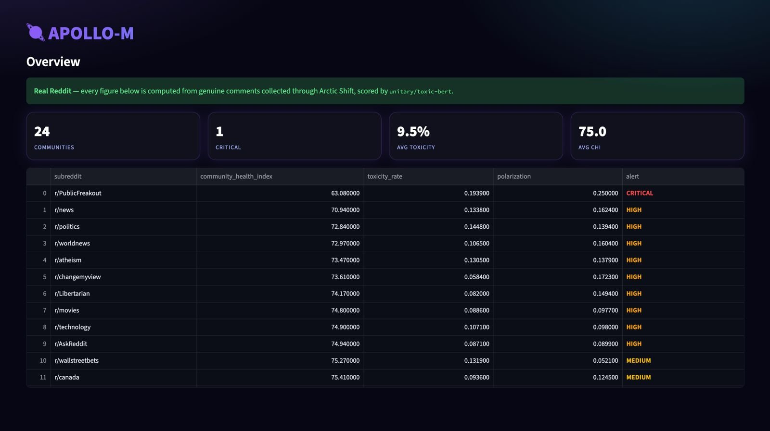
It Runs on Real Reddit Data
116,854
real comments
24
communities
64,416
real authors
40
days of history
Collected through Arctic Shift — no API key needed. r/PublicFreakout came out least healthy, and we never told it to.
Notes:
This is not only simulation. We collected 116,854 genuine Reddit comments across 24 communities over 40 days, through Arctic Shift, with no API key. The whole pipeline runs on it. r/PublicFreakout came out least healthy — we never told the system that, it found it.

Slide 11
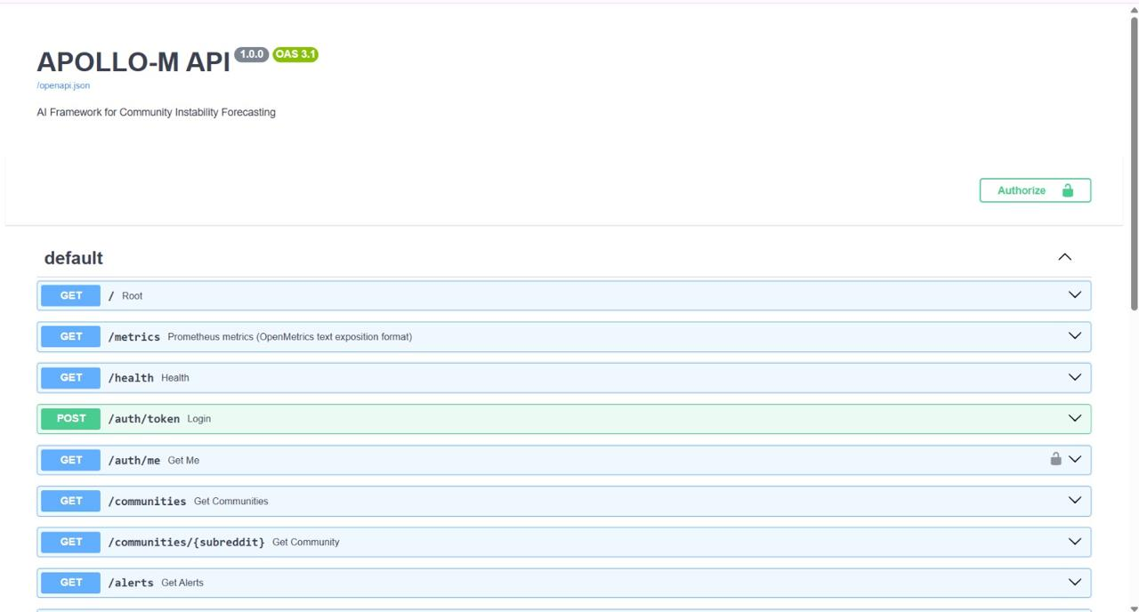
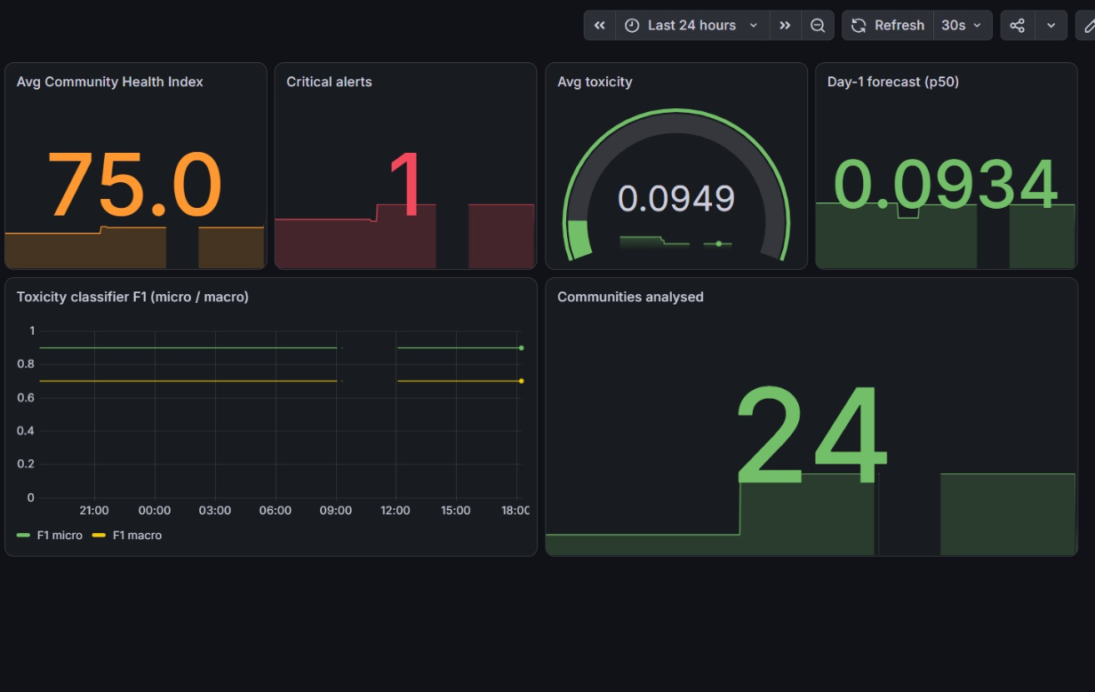
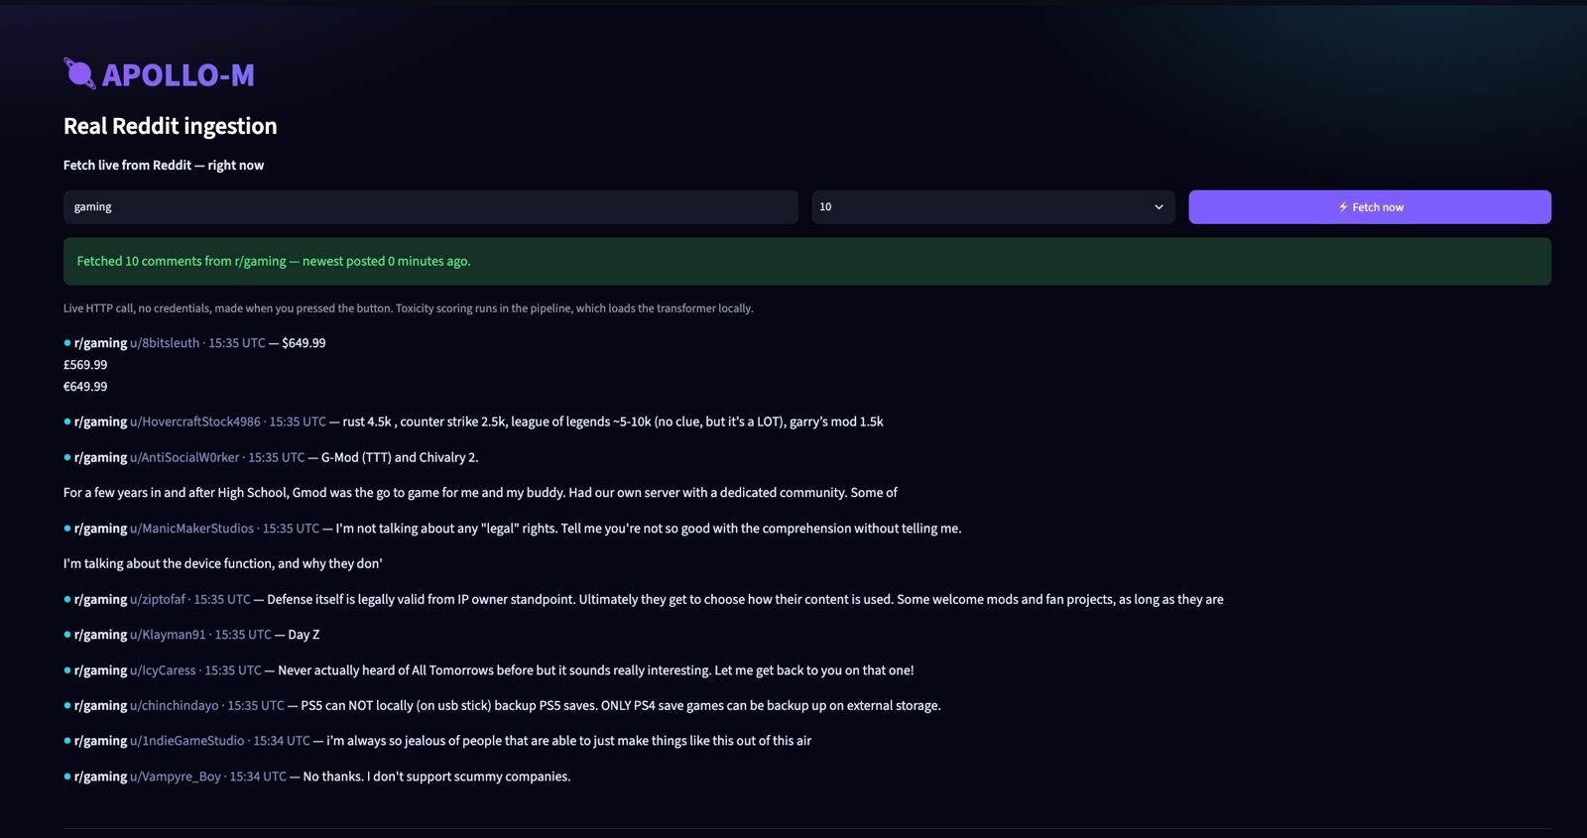
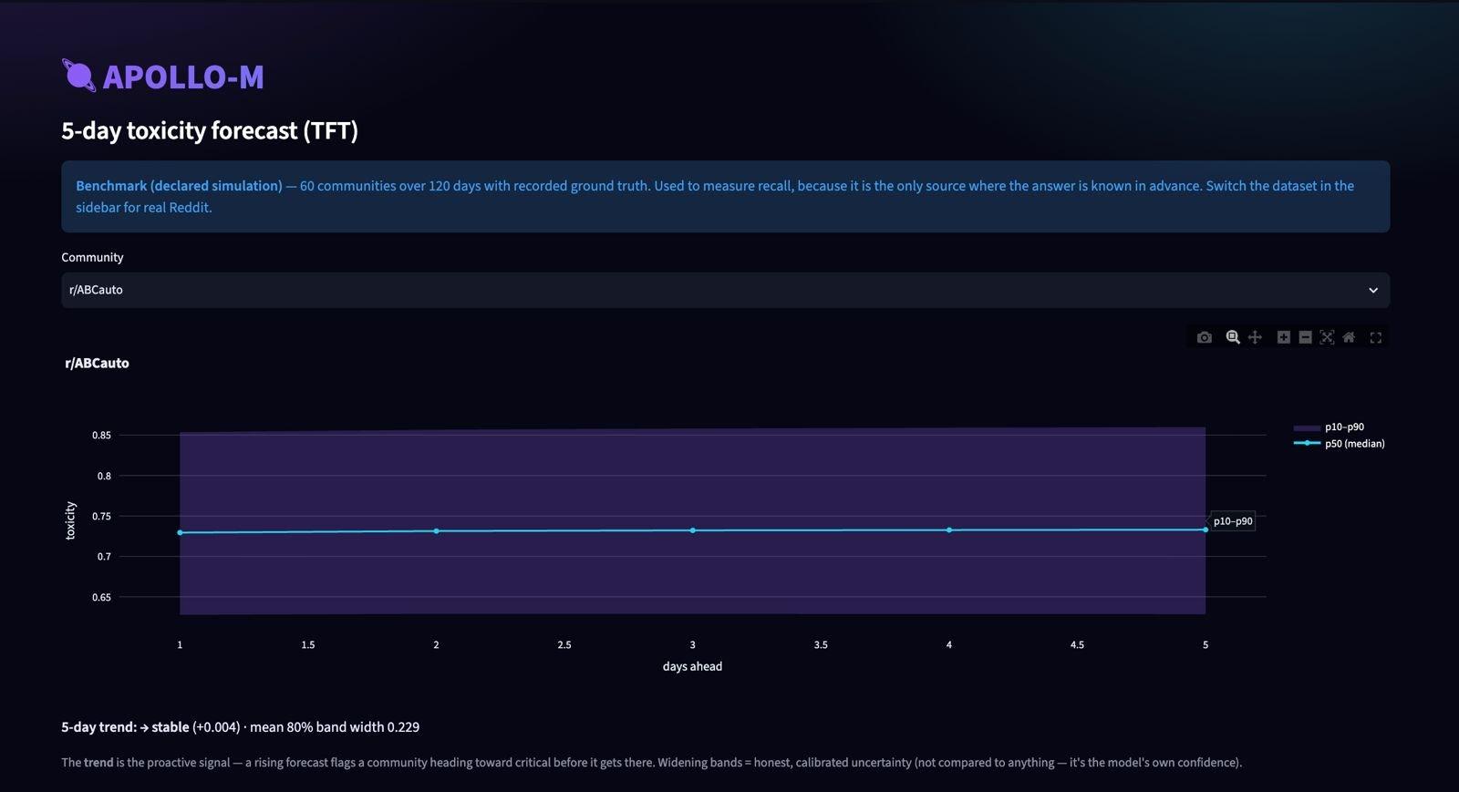
The Live System
REST API with interactive docs
Grafana monitoring, live metrics
Live Reddit fetch, on demand
Five-day forecast with uncertainty
apollo-m.streamlit.app · apollo-api-tllm.onrender.com/docs · cerebro-sandy-beta.vercel.app
Notes:
All of this is live. There is a REST API with interactive documentation, Grafana monitoring reading real metrics, a button that fetches Reddit comments while you watch, and the five-day forecast with its uncertainty band. You can open any of these links right now.

Slide 12
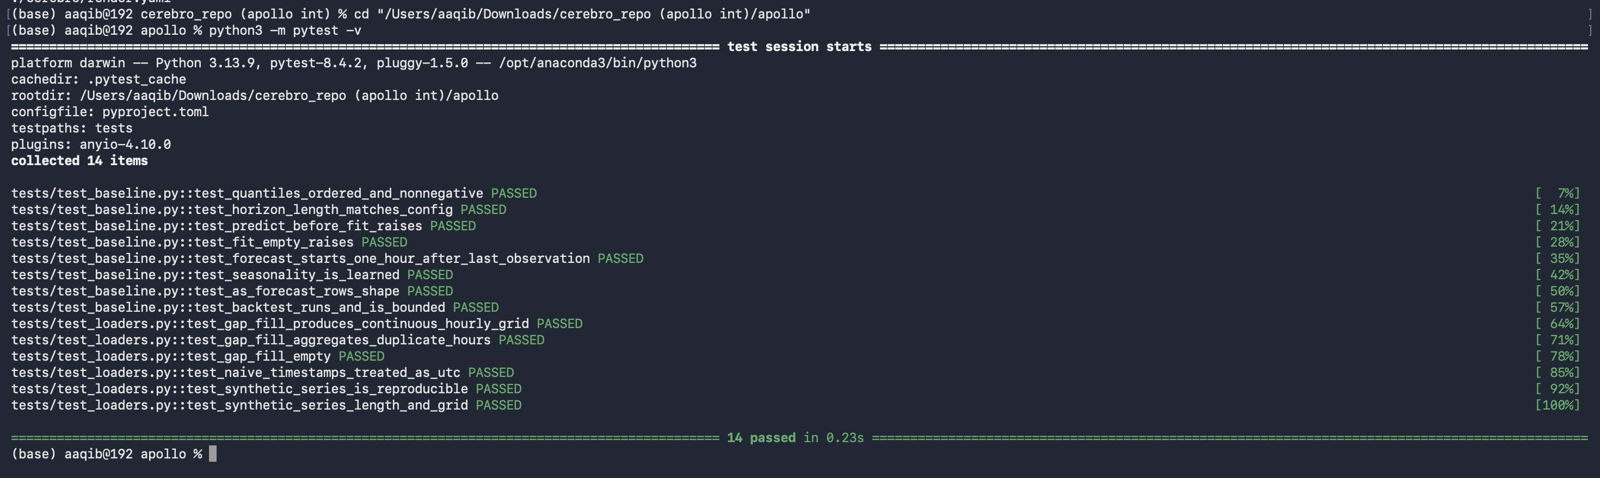
Evidence That It Works
• 14 automated tests on the forecasting pipeline; 67 on the companion system, CEREBRO.
• Toxicity classifier: 90.1% accuracy on real labelled data held back from training.
• Every number in our report comes from a script that can be run again.
Notes:
For evidence: 14 automated tests on the forecasting pipeline, and 67 on CEREBRO, the companion system. The toxicity classifier gets 90.1% on real labelled data we held back. And every number in our report is produced by a script, so it can be checked by re-running it.

Slide 13
Who Would Use It — and Why
Trust and Safety teams
They cannot watch 500 communities at once. We tell them which ten to watch this week.
Reddit, Discord, Twitch, forum hosts
Community platform vendors
A health feature they can resell to their own customers.
Discourse, Circle, Mighty Networks
Brand safety and advertising
Advertisers pay to avoid deteriorating spaces — before the story breaks, not after.
ad-verification firms
Large organisations
Culture problems usually surface far too late.
internal Slack and Teams communities
Why buy rather than build: the hard part is knowing what to measure — and we measured it.
Notes:
Who is this for? Trust and Safety teams first — they cannot watch 500 communities at once, and we tell them which ten matter this week. Then community platform vendors who can resell it, brand safety firms whose advertisers pay to avoid these spaces, and large organisations with internal communities. The hard part is knowing what to measure, and that is the part we have done.

Slide 14
Industry Relevance and the SDGs
Industry: Trust and Safety — where social platforms, brand safety and regulation meet.
SDG 16
Peace, Justice and Strong Institutions
SDG 9
Industry, Innovation and Infrastructure
Target 16.1 — reduce violence.
Online hostility and harassment come before real-world harm. Acting earlier means acting before it spreads.
Target 9.5 — build research capability.
The API, the monitoring stack and the published benchmark are reusable infrastructure, not a one-off model.
Notes:
The industry is Trust and Safety. On the goals: SDG 16, because online hostility comes before real-world harm, and acting earlier means acting before it spreads. And SDG 9, because the API, the monitoring and the published benchmark are reusable infrastructure, not a one-off model.

Slide 15
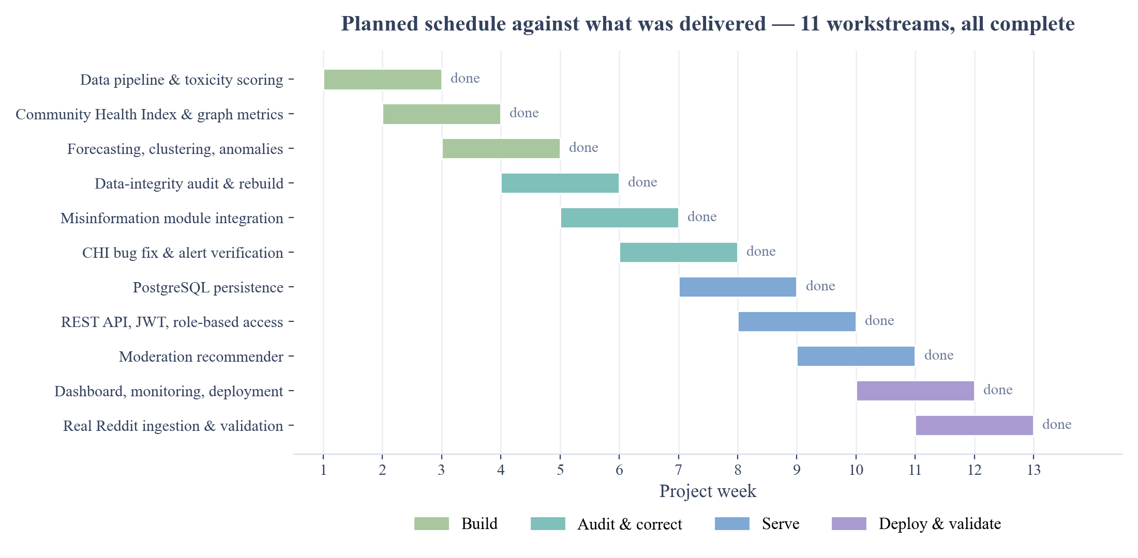
Timeline — Planned Against Delivered
Weeks 4 to 6 were not in the plan — we found real problems in our own data and stopped to fix them.
Notes:
Eleven workstreams, all delivered. The honest part of this chart is weeks 4 to 6 — they were not in our plan. We audited our own data, found real problems, and stopped to fix them before continuing.

Slide 16
What We Are Honest About
• Our ground truth is planted, not observed — we know which communities we made unstable, because nobody publishes a list of real ones.
• So the instability score of 1.000 shows the pipeline is wired correctly, not that it is that accurate in the real world.
• The misinformation model was trained on news articles. On short posts it flags almost everything, so we publish no rate from it.
• Evaluation is single-fold; we do not yet report confidence intervals.
• English only.
Stating the limits is what makes the other numbers believable.
Notes:
What we will not claim. Our ground truth is planted, because nobody publishes a list of genuinely unstable communities — so 1.000 shows the pipeline is wired correctly, not real-world accuracy. The misinformation model was trained on news articles and does not transfer to short posts, so we publish no rate from it. Evaluation is single-fold, and English only.

Slide 17
Next Steps
1
Real ground truth
Reddit publishes quarantine and ban dates. Train up to 60 days before each one, then check whether we flagged it first.
2
Longer history
Extend to 18–24 months per community using bulk archives.
3
Wire the graph model into the health score
Now that it is measured, we know what it does and does not add.
4
Retrain on the right data
Misinformation on social text; the recommender on real moderator decisions.
5
Publish the benchmark
Release the corpus and ground truth so others can reproduce our results.
Notes:
Next: real ground truth, using Reddit's own quarantine and ban dates, training only on what came before and checking whether we flagged it first. Longer history. Wiring the graph model in now that we know what it contributes. Retraining the two out-of-domain models. And publishing the benchmark so others can reproduce us.

Slide 18
Conclusion
We set out to predict community breakdown instead of reacting to it.
• We built it — five layers, from a single comment to a five-day forecast, deployed and publicly reachable.
• We tested it honestly, and found our own health score was the weakest signal we had.
• We fixed it — then a second model failed the same way, which turned one result into a general one.
• It runs on real Reddit data, collected without any API key.
Anyone can build a pipeline. We measured ours and reported what it said.
that is our contribution
Notes:
To close: we set out to predict breakdown rather than react to it. We built it and deployed it. We tested it honestly and found our own score was the weakest signal we had — then fixed it, and confirmed the same failure in a second model. It runs on real data. Anyone can build a pipeline; measuring yours and reporting what it says is the harder part.

Slide 19
Thank You
Questions?
Dashboard apollo-m.streamlit.app
API apollo-api-tllm.onrender.com/docs
Code github.com/kashaffatimajaffrey-design/apollo-m
CEREBRO cerebro-sandy-beta.vercel.app
Notes:
Thank you. All the links are here and everything is live. We are happy to take questions.

