Slide 1
Azure Data Lake Deep Dive
Saveen Reddy
Big Data @ Microsoft
2016/11/08

Slide 2
Introducing Azure Data Lake Analytics Massively parallel, extensible, analytics made simple
Start in seconds, Scale instantly, Pay per job
Develop massively parallel programs with simplicity
Debug and Optimize your Big Data programs with ease
Virtualize your analytics (not covered in this presentation)
Enterprise-grade Support and Security (not covered in this presentation)
Will demonstrate and Explain what powers this

Slide 3
Start in seconds, Scale instantly, Pay per job
Our on-demand service will have you processing Big Data jobs within 30 seconds. There is no infrastructure to worry about because there are no servers, VMs, or clusters to wait for, manage or tune. You can instantly scale the analytic units (processing power) from one to thousands for each job. You only pay for the processing used per job.

Slide 4
Develop massively parallel programs with simplicity
U-SQL is a simple, expressive, and extensible language that allows you to write code once and automatically have it be parallelized for the scale you need. You can process petabytes of data for diverse workload categories such as ETL, machine learning, cognitive science, machine translation, imaging processing, and sentiment analysis by using U-SQL and leveraging existing libraries written in .NET languages, R, or Python..

Slide 5
Debug and Optimize your Big Data programs with ease
Debugging failures in cloud distributed programs are now as easy as debugging a program in your personal environment. Our execution environment actively analyzes your programs as they run and offers recommendations to improve performance and reduce cost. For example, if you requested 1000 AUs for your program and only 50 AUs were needed, the system would recommend that you only use 50 AUs resulting in a 20x cost savings.

Slide 6
DEMO Start in seconds, Scale instantly, Pay per job

Slide 7
Hadoop & Big Data Azure

Slide 8
Big Data in Azure
Azure Data Lake
IaaS Hadoop
HDInsight
Data Lake
Analytics
Data Lake Analytics Currently in PUBLIC PREVIEW.
GA = Q4 CY2016
Hadoop
Spark
HBase
Storm
Hadoop distros on Azure VMs
Azure-managed Hadoop clusters
Big Data as a Service
Data Lake Store Currently in PUBLIC PREVIEW.
GA = Q4 CY2016
Blob Storage
Data Lake Store
Hyper-scale Storage optimized for analytics

Slide 9
Apache Hadoop
A highly reliable, distributed and parallel programming framework for analyzing big data
Hadoop Core
Open source
Java-based
Runs on variety of hardware platforms, including clusters of commodity hardware
Tolerant to failures of nodes, software components, network
Scales with the cluster
Rich ecosystem that supports SQL/NoSQL, Streaming, Real-time and Interactive applications.
MapReduce
Tez
Develop programs based on MapReduce, Tez, etc. on top of YARN
YARN, a distributed resource manager that allocates and controls access to the resources of the cluster manager
HDFS - A scalable, reliable file system (HDFS)
YARN
HDFS

Slide 10
Compute Workloads on YARN
Azure Data Lake Analytics currently offers U-SQL Batch workload.
Interactive, Streaming, ML are on the roadmap for the future
MapReduce & Tez
Spark
ADLA/U-SQL
Batch
Batch
Interactive
Interactive
Streaming
Streaming
ML
ML
YARN
WebHDFS
Data Lake Store
1
1
1
1
1
1
1
1
1
1
1
1

Slide 11
U-SQL Batch Job Execution

Slide 12
Demo: U-SQL Batch Job Execution Job Graph, Playback, & Heatmaps

Slide 13
We will explain the magic
Magic happens here
+
Input Data
Output Data

Slide 14
Overall U-SQL Batch Job Execution Lifetime
Plan
Optimized
Plan
U-SQL Compiler
& U-SQL Catalog
Optimizer
Local Storage
on YARN Container
Job Scheduler
Allocate AUs for Job Manager and start Job
Data Lake Store
Job Manager
(for a specific job)
Allocate AUs for vertexes and schedule vertexes
Vertexes running in YARN Containers

Slide 15
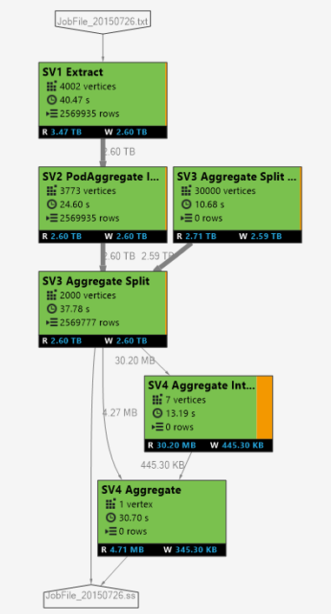
Plans, Graphs, Vertexes, and Containers
U-SQL Script is logical plan to transform input data to output data that is transformed into a set of physical work divided into vertexes.
The inputs & supervertexes are visualized as a “job graph”
INPUT
8 vertices
6 vertices
2 vertices
OUTPUT
A SuperVertex (aka “Stage”) groups vertexes that perform same transformation on the a different section of the same input data.
The number of vertexes in a stage indicates the maximum theoretical parallelization for that stage.

Slide 16
Azure Data Lake Analytics Unit (AU)
1 AU ~= 1 YARN Container
A Windows OS VM
2 cores
6 GB of memory (shared with OS and ADLA and your code)
Don’t get hung up on these numbers! ☺

Slide 17
Vertexes vs AUs vs Containers
Vertexes = Pieces of Work. This number is determined by the U-SQL system. You can influence it. This has nothing to do with job cost ($)
AUs = number of YARN containers assigned to the work. You control this number on a per job basis. This determines job cost ($).
YARN Containers corresponds to # of AUs
Currently 1 to 1
An additional container is used by the Job Manager for a Job. No charge for this extra container.

Slide 18
Demo: U-SQL in VS Visual Studio Integration U-SQL Script Authoring Code-Behind

Slide 19
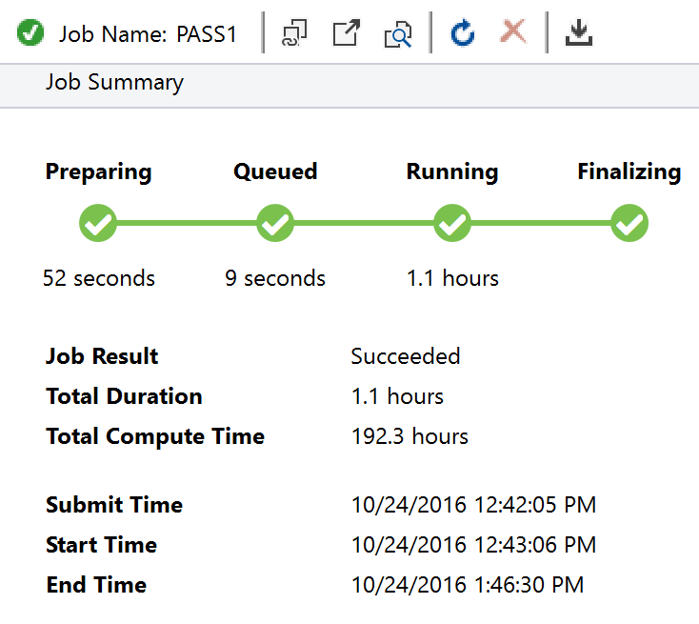
Job Lifecycle States
UX | Internal Job State
Preparing | Preparing.New | A new job appears!
 | Preparing.Compiling | Compile the script to verify it is a valid U-SQL job
Queued | Queued.Queued | jobs enter the queue
 | Queued.Scheduling | Are there enough containers to start the job?
 | Queued.Starting | If yes, then allocate those containers for the job
Running | Running | The U-SQL runtime (1) is now executing vertexes on containers or (2) all the vertexes are finished and the outputs are being finalized.
Finalizing
Ended | Ended | The job has concluded Result = Succeeded | Failed | Cancelled

Slide 20
Compilation

Slide 21
U-SQL Compilation Process
Job Resources
C#
managed dll
C++
Unmanaged dll
Compiler & Optimizer
Algebra
Other files
(system files, deployed resources)
Deployed to Vertices

Slide 22
U-SQL & C#: Unmanaged to Managed Transitions (Part 1)
@a =
SELECT
Customer,
InvoiceAmt/1000.0 AS InvoiceAmtK
FROM @input;
@a =
SELECT
Customer,
ToThousands(InvoiceAmt) AS InvoiceAmtK
FROM @input;

Slide 23
U-SQL & C#: Unmanaged to Managed Transitions (part 2)
@a =
SELECT
Customer,
InvoiceAmt
FROM @input
WHERE Customer == “Contoso”;
@a =
SELECT
Customer,
InvoiceAmt
FROM @input
WHERE Customer.Equals(“Contoso”);

Slide 24
Constant-foldable expressions (part 1)
@input =
EXTRACT CustomerID int,
CustomerName string,
FROM “/input.tsv"
USING Extractors.Tsv();
@result =
SELECT
CustomerID,
CustomerName.Trim() AS CustomerName,
(1000*50/3) AS Value,
System.DateTime.Now AS TheDate
Guid.NewGuid() AS CustomerID
FROM @input;
OUTPUT @result
TO "/output.tsv"
USING Outputters.Tsv();
[1] CustomerID
[2] CustomerName.Trim()
[3] (1000*50/3) AS Value
[4] System.DateTime.Now
[5] Guid.NewGuid()

Slide 25
Constant-foldable expressions (part 2)
How do you assign a unique ID to each ROW?
If creating new Guid() doesn’t work, what do I do?
Use Window Functions
@result =
SELECT
*,
ROW_NUMBER() OVER () AS UID
FROM @input;

Slide 26
Batch Job Queue

Slide 27
Why does a Job stay in the queue?
All jobs enter the job queue. But sometimes they will stay there.
Account Local Cause
Possible Conditions:
Not enough containers available to your account because other jobs are using up all the containers
Enough containers, but Max Job Concurrency forcing job to the queue
Global Cause (very rare)
Possible Conditions:
System-wide shortage of Containers
System-wide shortage of Bandwidth

Slide 28
The Job Queue
Priority-ordered Queue. 1 = Highest Priority.
Total AUs for Account 1 = 10
Max Concurrent Jobs = 6
When a job is at the top of the queue, it will start running if there are enough containers for it.
In Example, 9 of 10 AUs are currently used. Job D needs 4 AUs. So Job D will be queued until 4 AUs are available.
Status | JobName | JobPri | AUs
RUNNING | A | 5 | 2
RUNNING | B | 3 | 4
RUNNING | C | 10 | 3
QUEUED | D | 1 | 4

Slide 29
Understanding Queue Priority
Total AUs for Account 1 = 10
Max Concurrent Jobs = 6
PRIORITY DOES NOT INFLUENCE JOB EXECUTION
Priorities of job A,B,C are irrelevant – these jobs are running. Their Priorities have no meaning while running.
PRIORITY ONLY ORDERS QUEUED JOBS
D,E,F,G,H are ordered in queue depending on their priority
PRIORITY DOESN’T PREMPT RUNNING JOBS
Job D has the higher priority than jobs that are running, but WILL NOT running jobs back into the QUEUE.
Status | JobName | JobPri | AUs
RUNNING | A | 5 | 2
RUNNING | B | 3 | 4
RUNNING | C | 10 | 3
QUEUED | D | 1 | 4
QUEUED | E | 2 | 1
QUEUED | F | 3 | 3
QUEUED | G | 4 | 7
QUEUED | H | 5 | 8

Slide 30
Batch U-SQL Job Execution

Slide 31
Job Resources and Vertexes
SCRIPT
JOB RESOURCES
8 vertices
6 vertices
2 vertices
The Job Manger copies the Job Resources are copied to each container to run a vertex.
Note that all vertexes have access to all the job resources

Slide 32
Execution with Requested Parallelism
Requested Parallelism = 1
Only 1 container can be used at a time
Requested Parallelism = 4
Up to 4 containers can be used
Requested Parallelism = 4
Up to 4 containers can be used. Notice that the last stage can only use 2 containers at a time
8 vertices
8 vertices
8 vertices
6 vertices
6 vertices
6 vertices
2 vertices
2 vertices
2 vertices

Slide 33
Relationships between vertexes
The output of one vertex is the input of another one in a dependent stage
As a result, dependent stages can start even if their antecedent stages are fully completed
CRITICAL PATH = The dependency chain of vertexes that kept the job running to the very end.
8 vertices
8 vertices
8 vertices
6 vertices
6 vertices
6 vertices
2 vertices
2 vertices
2 vertices

Slide 34
DEMO Job Heat maps Job Playback

Slide 35
Stage (SuperVertex)

Slide 36
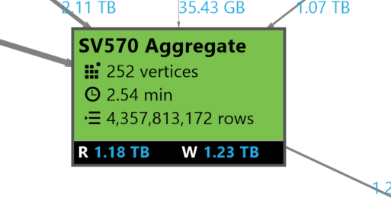
Stage Details
252 Pieces of work
AVG Vertex execution time
4.3 Billion rows
Data Read & Written

Slide 37
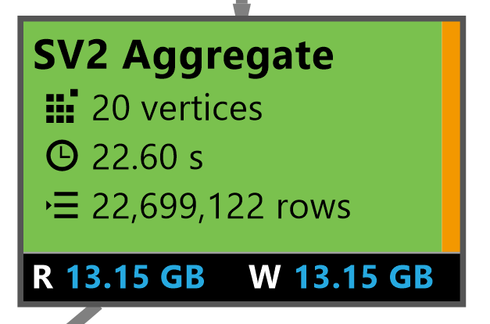
Automatic Vertex retry
A vertex failed … but was retried automatically
A vertex might fail because:
Router congested
Hardware failure (ex: hard drive failed)
VM had to be rebooted
U-SQL job will automatically schedule a vertex on another VM.
Overall Stage Completed Successfully

Slide 38
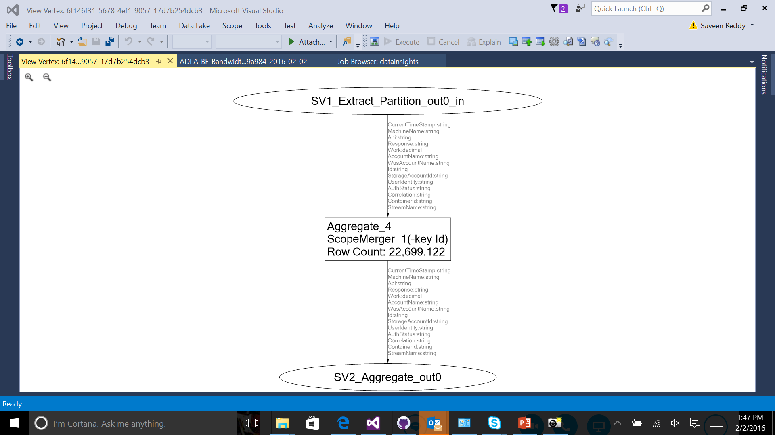
Inside a Stage: The Operator Graph
Operator Graph:
See if UDOs are present
See if expensive operations are being done (SORT)

Slide 39
DEMO Vertex Execution View Critical Path

Slide 40
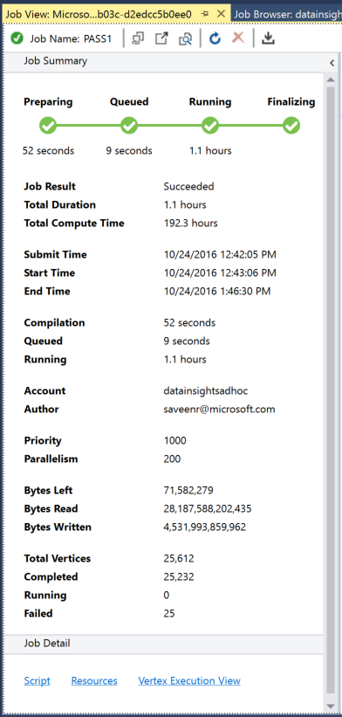
Vertex Execution View

Slide 41
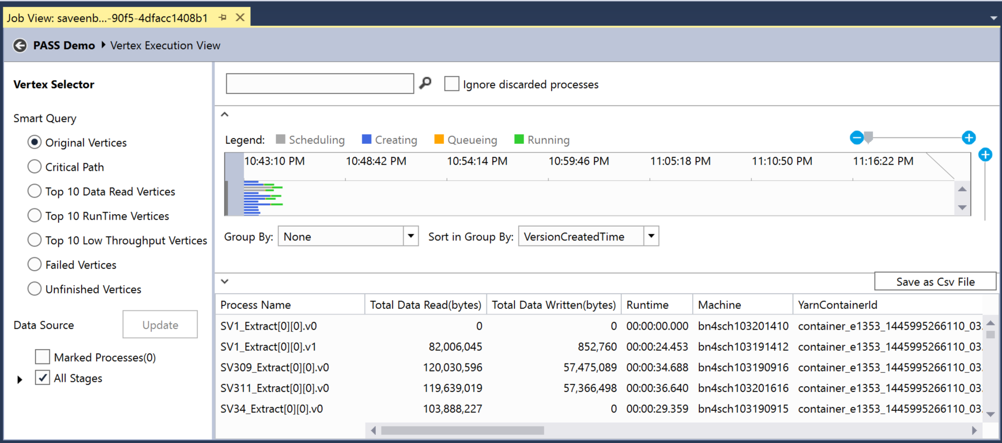
Filter which vertexes to see
All the vertexes

Slide 42
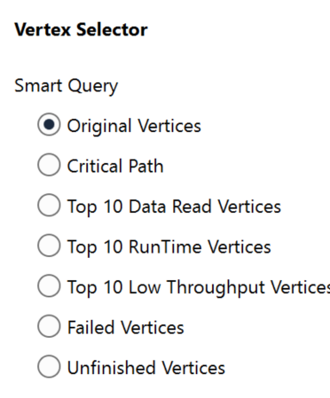
The Critical Path

Slide 43
Local Execution

Slide 44
DEMO Local Execution

Slide 45
Local Execution
Allows developers to test U-SQL jobs without using cloud resources
Key Takeaways
For Testing and Debugging, not meant as a general-purpose mechanisms for running scripts
No network restrictions on local execution
Filename case sensitive in cloud but not locally

