Slide 1
Azure Data Lake Analytics
Performance Overview
Saveen Reddy
Big Data @ Microsoft
2016/11/01

Slide 2
Optimization U-SQL Optimizer and U-SQL Job Manager

Slide 3
Optimizer Notes
Whole Script Optimization
Vertexes allocated to a stage – Not directly controllable. You can INFLUENCE it by partitioning your data.
Row Size Hints – Give the optimizer idea of what to expect. (Can use to speculatively look at plans with larger amount of data)
Predicate Push-Down
Dynamic Stages – Vertexes calculated at runtime

Slide 4
Add Slide Examining Predicate Push Down

Slide 5
Job Manager Notes
Move Code to Data
Vertex Retries
Actively Avoids Problems - Receive feedback from YarnRM, Cluster Monitoring, and Repair Service which improve the scheduling quality
Dynamic graph (execution graph) refinements to handle aggregates/shuffling
Proactive duplicate execution
Re-use Containers - YARN containers based on a cost model (where ever beneficial)
It Scales - The same scheduler runs 5PB jobs in Cosmos
Schedules tasks based on execution graph priority and a cost model that goes beyond “locality” – More details in OSDI paper – “Apollo: Scalable and Coordinated Scheduling for Cloud-Scale Computing”

Slide 6
Resource Allocation & Efficiency

Slide 7
$$JobCost=5c+ \left(minutes ×ADLUAs ×ADLAUcostpermin\right)$$

Slide 8
Allocation
Blue line: Allocated
Allocating 10 AUs
for a 10 minute job.
Cost
= 10 min * 10 AUs
= 100 AU minutes
Time

Slide 9
Over Allocation
Consider using fewer AUs
You are paying for the area under the blue line
You are only using the area under the red line
Blue line: Allocated
Time
Red line: Running
Over Allocated != Bad

Slide 10
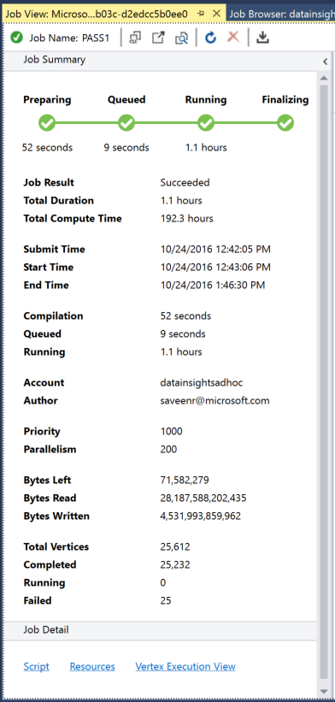
Efficiency
Allocation Efficiency =
(Compute hours) / (AUs * duration)
Example Job
= 192.3 hours / (200 AUs * 1.1 hours)
= 192.3 hours / 220 AUHours
= 0.874
= 87.4% Efficiency very very good!
Efficient != What you always want

Slide 11
“Under allocated”
Consider using more Aus
“Under allocated” jobs are Efficient!
Blue line: Allocated
Time
Red line: Running
Under Allocated != Bad

Slide 12
Add Section on UDOs

Slide 13
DEMO Diagnostics / Resource Usage

Slide 14
YARN Work in Open Source
FEDERATION to enable very large (100K+) YARN clusters, Cross-DC, BCDR
REEF – “libc for BigData”
AMEOBA – work preserving pre-emption
RAYON – Capacity Reservation
MERCURY & YAQ – Optimistic allocation + YARN conservatism to improve performance

Slide 15
Data Lake Store Basics

Slide 16
Store Basics
A VERY BIG FILE
Files are split apart into Extents.
Extents can be up to 250MB in size.
For availability and reliability, extents are replicated (3 copies).
Enables parallelized read
1
2
3
4
5
1
2
3
4
5
1
2
3
4
5
1
2
3
4
5

Slide 17
Parallel writing
Front-end machines for a web service
Log files
Simultaneous
uploads
Azure Data lake

Slide 18
As file size increases, more opportunities for parallelism
Extent
Vertex
Extent
Vertex
Extent
Vertex
Extent
Vertex

Slide 19
The importance of partitioning input data

Slide 20
Search engine clicks data set
A log of how many clicks a certain domain got within a session
SessionID Domain Clicks
3 cnn.com 9
1 whitehouse.gov 14
2 facebook.com 8
3 reddit.com 78
2 microsoft.com 1
1 facebook.com 5
3 microsoft.com 11

Slide 21
Data Partitioning Compared
Extent 1
Extent 2
Extent 3
Extent 1
Extent 2
Extent 3
FB
FB
FB
FB
WH
CNN
WH
CNN
WH
CNN
WH
FB
WH
WH
CNN
FB
CNN
CNN
File:
Keys (Domain) are scattered across the extents
U-SQL Table partitioned on Domain
The keys are now physically in the same place on disk (extent)

Slide 22
CREATE TABLE SampleDBTutorials.dbo.ClickData ( SessionId int, Domain string, Clinks int, INDEX idx1 //Name of index CLUSTERED (Domain) PARTITIONED BY HASH (Domain) ); INSERT INTO SampleDBTutorials.dbo.ClickData SELECT * FROM @clickdata;
How did we create and fill that table?

Slide 23
Find all the rows for cnn.com
// Using a File
@ClickData =
SELECT
Session int,
Domain string,
Clicks int
FROM “/clickdata.tsv”
USING Extractors.Tsv();
@rows = SELECT *
FROM @ClickData WHERE Domain == “cnn.com”;
OUTPUT @rows
TO “/output.tsv”
USING Outputters.tsv();
// Using a U-SQL Table partitioned by Domain
@ClickData =
SELECT *
FROM MyDB.dbo.ClickData;
@rows = SELECT *
FROM @ClickData WHERE Domain == “cnn.com”;
OUTPUT @rows
TO “/output.tsv”
USING Outputters.tsv();

Slide 24
File
U-SQL Table Partitioned by Domain
CNN,
FB,
WH
CNN,
FB,
WH
CNN,
FB,
WH
FB
WH
CNN
EXTENT 1
EXTENT 2
EXTENT 3
PARTITION 1
PARTITION 2
PARTITION 3
Read
Read
Read
Read
Filter
Filter
Filter
Filter
Write
Write
Write
Write
Because “CNN” could be anywhere, all extents must be read.
Thanks to “Partition Elimination” and the U-SQL Table, the job only reads from the extent that is known to have the relevant key

Slide 25
How many clicks per domain?
@rows = SELECT
Domain,
SUM(Clicks) AS TotalClicks FROM @ClickData GROUP BY Domain;

Slide 26
File
U-SQL Table Partitioned by Domain
FB
WH
CNN
CNN,
FB,
WH
CNN,
FB,
WH
CNN,
FB,
WH
EXTENT 1
EXTENT 2
EXTENT 3
PARTITION 1
PARTITION 2
PARTITION 3
Read
Read
Read
Read
Read
Read
Partial Agg
Partial Agg
Partial Agg
Full Agg
Full Agg
Full Agg
Partition
Partition
Partition
Write
Write
Write
Expensive!
Full Agg
Full Agg
Full Agg
Write
Write
Write

Slide 27
U-SQL Table Partitioning
LOGICAL
@date1 |  |  | @date2 |  |  | @date3
ID1 | H1 |  | ID1 | H1 |  | ID1 | H1
ID2 |  |  | ID2 |  |  | ID3
ID3 |  |  | ID4 | H2
ID4 | H2 |  | ID5
ID5 |  |  | ID6 | H3 |  | ID6 | H2
ID6 | H3 |  | ID7 | H4
ID7 |  |  | ID8 |  |  | ID7
 |  |  | ID9 |  |  | ID8
TABLE T (
…
INDEX i
CLUSTERED (id)
PARTITIONED BY (date)
DISTRIBUTED BY HASH (key) INTO 4
)
/catalog/…/tables/Guid(T)/
PHYSICAL
Guid(T.p1).ss
Guid(T.p2).ss
Guid(T.p3).ss

Slide 28
High-Level Performance Advice

Slide 29
Learn U-SQL Leverage Native U-SQL Constructs first
UDOs are Evil ☺ Can’t optimize UDOs like pure U-SQL code.
Understand your Data Volume, Distribution, Partitioning, Growth

Slide 30
Understanding Key Distribution “Data Skew” (aka “a vertex is receiving too much data”)

Slide 32
Natural Data Skew
Extent 1
Extent 2
Extent 3
Extent 1
Extent 2
Extent 3
FB
WH
CNN
FB
WH
CNN
U-SQL Table partitioned on Domain
Relatively even distribution
U-SQL Table partitioned on Domain
Skewed Distribution

Slide 33
Why could this a problem?
Vertexes have a 5 hour runtime limit!
Your UDO may excessively allocate memory.
Your memory usage may not be obvious due to garbage collection

Slide 34
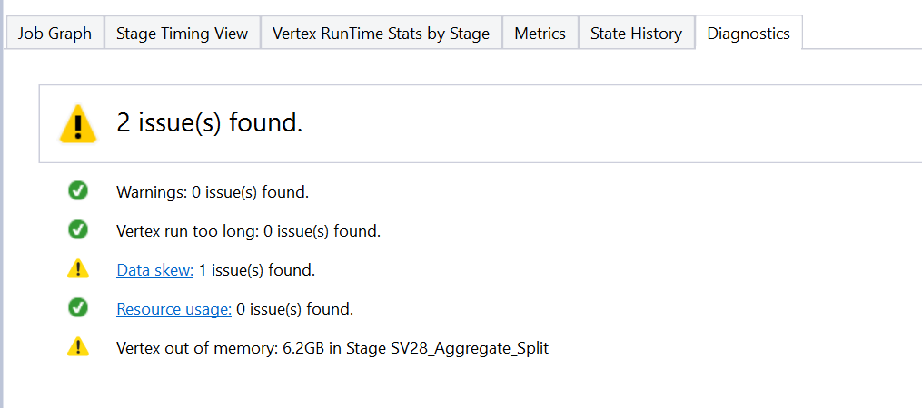
Diagnostics with Data Skew

Slide 35
Add slide explaining the diagnostics

Slide 36
Show the Throttling Limit
Explain more about how it is determined and what to do

Slide 37
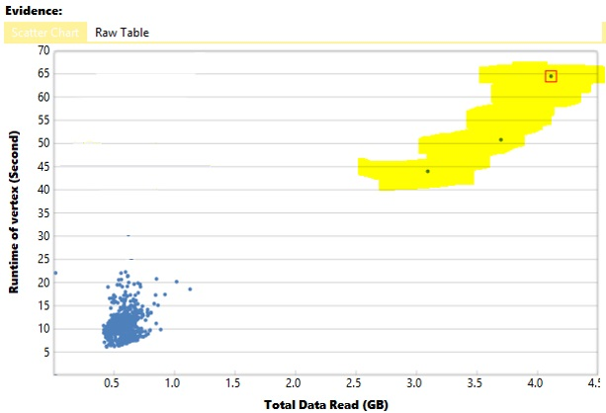
Data Skew Graph
A lot of data brought to a couple of vertexes

Slide 38
What are your Options?
Re-partition your input data to get a better distribution
Use a different partitioning scheme
Pick a different key
Use more than one key for partitioning
Use Data Hints to identify “low distinctness” in keys

Slide 39
@rows =
SELECT
Gender,
AGG<MyAgg>(Income) AS Result
FROM
@HugeInput
GROUP BY Gender;

Slide 40
@HugeInput
Gender==Male
Gender==Female
Vertex 0
Vertex 1

Slide 41
What are your Options?
Use a Recursive Aggregator if possible
If a Row-Level combiner mode if possible
500 Level Topic (ask MRys for details)

Slide 42
A non-recursive operation
Implement a custom SUM aggregator…
Implement a custom SUM aggregator…
VERTEX 1
1
2
3
4
5
6
7
8
36

Slide 43
A recursive operation
Vertex 1
Vertex 2
Vertex 3
1
2
3
4
5
6
7
8
6
15
15
36
Not all operations can be made recursive!

