Slide 1
Azure Data Lake U-SQL Query Store
Saveen Reddy
Big Data @ Microsoft
2010/01/04

Slide 2
ADLA Query Store
ADLA query store provides the capabilities to capture the U-SQL jobs execution information, troubleshoot job performance, evaluate ADLAU allocation efficiency and browse past scripts and libraries.
ADLA query store allows customers to obtain insight from past U-SQL jobs history, by consolidating job basic information in database and store compilation and runtime output in permanent storage. APIs and built-in tools provide easy access to these information.

Slide 3
U-SQL “Query Store”
Similar in spirit to SQL Server 2016 Query Store
Enabled by Default (cannot turn off)
Stores last 30 days of U-SQL Queries
This will be configurable
Some data intensive features are stored old for a few days
Accessible via
REST APIs
SDKs .NET, Java, Python
PowerShel cmdlets
Tools: Portal + ADL Tools for VS

Slide 4
Typical Scenarios
Send get help from someone in debugging a job
Find all the jobs a specific user was submitting.
Find the top users who are wasting money by submitting jobs that use a lot of resources by failing and how much ($) they are wasting
Identify are the common sources of failures in your U-SQL jobs
Features it enables
Job Links
U-SQL Script & Plan “Diffs” (coming after GA)
Recurring Job Detection (coming after GA)

Slide 5
Query Store Architecture
Visual Studio
System Database
Fron-End Service
Compiler
ADLS job folder
Job Compilation
Job Submission
Compilation Output
Job Scheduler
Temp Storage
Runtime Output
Runtime Output
Portal / API
Vertex Scheduling
Job Post Analysis
Job Execution
Runtime

Slide 6
System Database

Slide 7
Job Information in System Database
Information | Example
Job Name | Create a table
Account Name | bigdata
Author | alex@Microsoft.com
Parallelism | 100
Result | Success
Priority | 200
Job ID | 7d7989a6-e325-492d-b00f-e2cb2d103a34
Submit Time | 8/15/2016 1:54:06 PM
Start Time | 8/15/2016 1:54:54 PM
End Time | 8/15/2016 2:54:54 PM
Running Duration | 1 hour
Compilation | 20 seconds
Queue Time | 3 minutes
Error/Warning Information | Failed to write job meta-data due to internal system issue

Slide 8
Job Folder

Slide 9
The Job Folder
Inside the Default ADL Store:
General Form
/system/jobservice/jobs/Usql/
YYYY/MM/DD/hh/mm/
JOBID
An Example
/system/jobservice/jobs/Usql/
2016/01/20/00/00/
17972fc2-4737-48f7-81fb-49af9a784f64

Slide 10
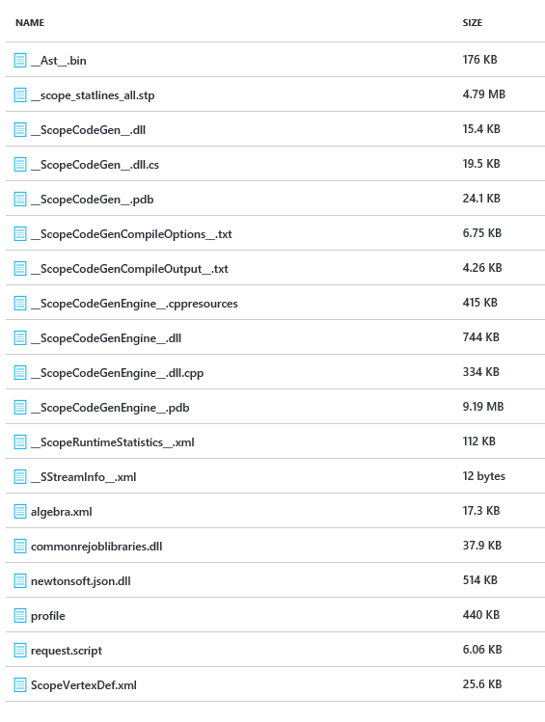
Job Folder Contents
C# code generated by the U-SQL Compiler
C++ code generated by the U-SQL Compiler
Cluster Plan a.ka. “Job Graph” generated by U-SQL Compiler
User-provided .NET Assemblies
User-provided USQL script

Slide 11
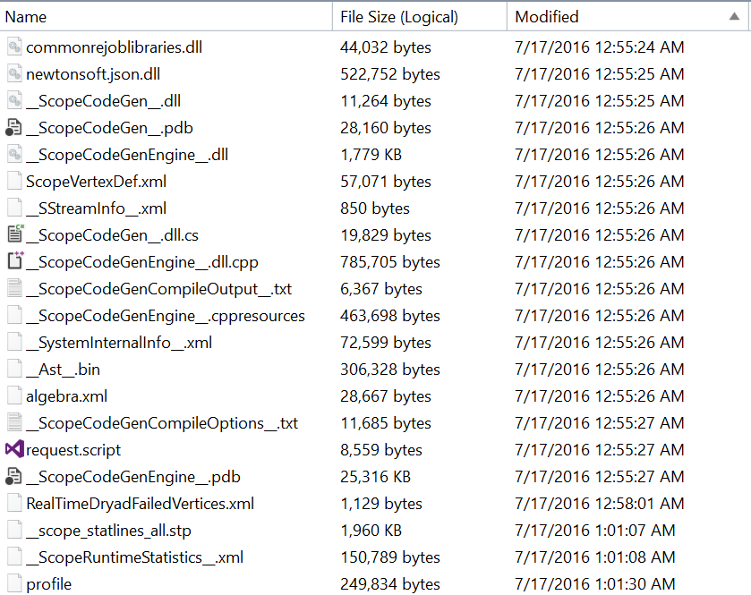
ADLA Job Folder
All the compilation outputs and runtime logs are written to job folder.
Each job has one single job folder.
The path is like: adl://ADLSAccountName.azuredatalakestore.net/system/jobservice/jobs/Usql/year/month/date/hour/minute/jobID
By default, these job folders will expire in 30 days.
Compilation Output
Your Script
Runtime Logs

Slide 12
Temp Storage

Slide 13
ADLA Temp Storage
We store the intermediate data of failed vertex on temp storage.
These data is used for failed vertex debugging.
These data will expire after 7 days.

Slide 14
Experiences

Slide 15
Experiences

Slide 16
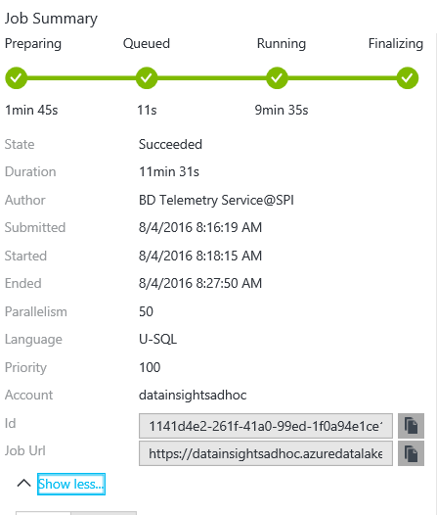
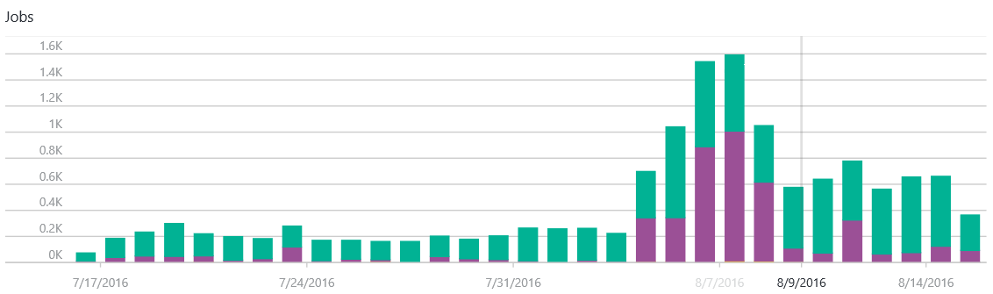
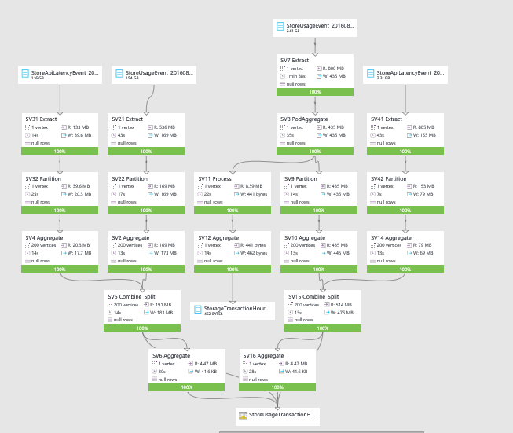
Through UX Portal
You can view your U-SQL jobs daily summary for the past month.
You can view job graph of past 1 month jobs(decided by job folder retention)
You can query job summary of ended jobs for past 3 months

Slide 17
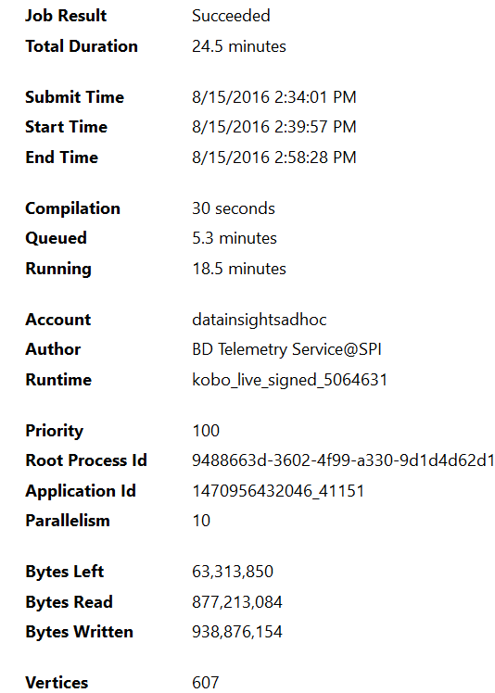
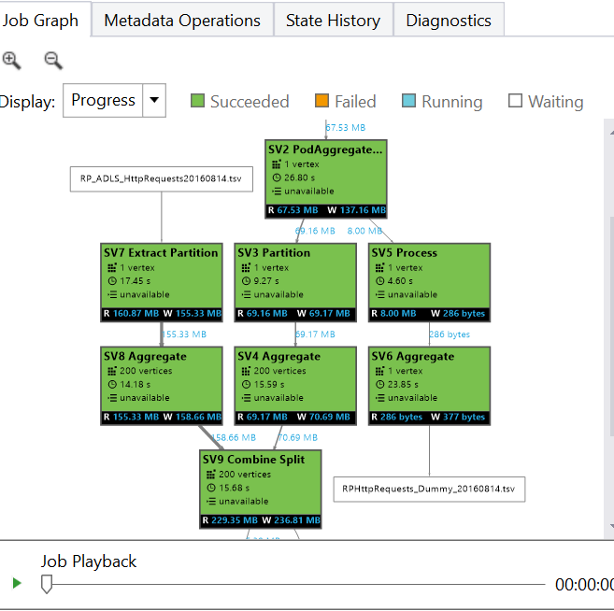
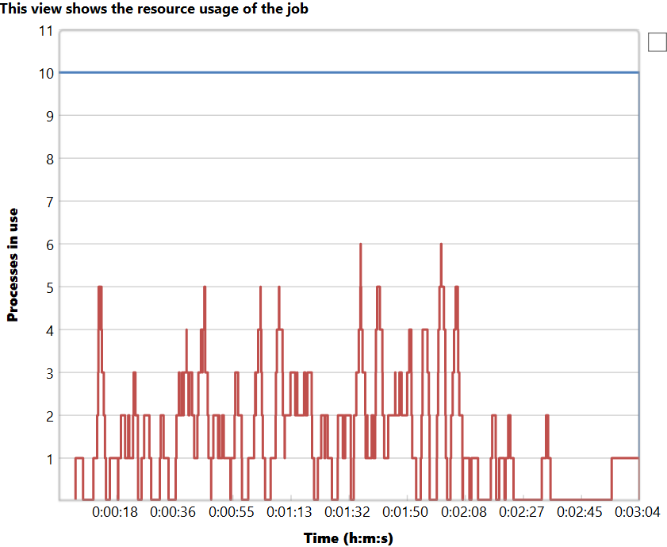
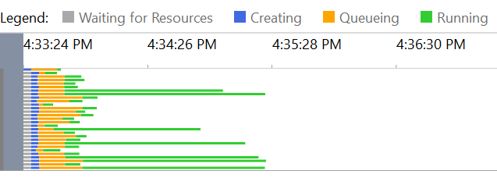
Through VS Tools
You can view your U-SQL jobs summary for past 3 months.
You can view job graph of past 1 month jobs(decided by job folder retention)
You can debug and profile the jobs in past 1 month.
You can do failed vertex debug for jobs in past 7 days.

Slide 18
Add slide on Job Links

Slide 19
Add slide on Futures

Slide 20
Through Rest API or SDK
You can get your U-SQL job information.
Enumerate jobs
For jobs in past 3 months
Get Job Details
For jobs in past 3 months
Get jobs statistics
For jobs in past 1 months

Slide 21
Browse the job folder
You can go to your job folder, download and analyze the files.
The path is like: adl://ADLSAccountName.azuredatalakestore.net/system/jobservice/jobs/Usql/year/month/date/hour/minute/jobID
Useful files:
Request.script: your script
*.dll: your libraries
Algebra.xml: your job execution plan
Profile: each vertex statistics
Warnings
Errors

Slide 22
Example in PowerShell
For the last 24 hours find the users who submitted failed jobs and the number of jobs that submitted that failed.
# Get all Jobs
$jobs = Get-AzureRmDataLakeAnalyticsJob -Account “myaccount”
# Keep the ones that ended in the last 24 hours
$now = Get-Date
$lowerdate = $now.AddHours(-24)
$jobs = $jobs | Where-Object { $_.EndTime -ge $lowerdate }
# Keep only the failed ones
$failed_jobs = $jobs | Where-Object { $_.Result -eq "Failed" }
# Summarize
$result = $failed_jobs | Group-Object Submitter | Select -Property Count,Name

Slide 23
Managing

Slide 24
How to manage query store?
System database which is used to keep job summary is managed by ADLA product team. You can’t make any changes.
Temp storage which is used to keep temporary failed vertex input and output is managed by ADLA product team. You can’t make any changes.
You have most control of your job folder:
Delete any folder/files under job folder
Copy and download folders and files
Set the default retention policy for your U-SQL jobs. ADLA will set the expiration date based on your input. By default, it is 30 days.
You are charged for the storage of job folders.

Slide 25
Demo
The U-SQL “Query Store”
Job Links
Job Searching

Slide 27
Sample 1: Code-Behind
@searchlog =
EXTRACT UserId int,
Start DateTime,
Region string,
Query string,
Duration int?,
Urls string,
ClickedUrls string
FROM "/Samples/Data/SearchLog.tsv"
USING Extractors.Tsv();
@searchlog =
SELECT
Demo.MyHelpers.DoubleIt(Query) AS Query2,
*
FROM @searchlog;
OUTPUT @searchlog
TO "/output/SearchLogResult1.csv"
USING Outputters.Csv();
namespace Demo
{
public static class MyHelpers
{
public static string DoubleIt(string s)
{
throw new System.Exception();
return s + s;
}
}
}

Slide 28
Abstract
This session is a MUST-HAVE to be productive with the performance optimization, troubleshooting, and debugging of U-SQL in Azure Data Lake Analytics. We’ll discuss the underlying components and layers, how to interpret U-SQL execution plans, how to make price/perf tradeoffs, and other fundamental factors that drive query performance. Attendees are expected to be familiar with the basics of the U-SQL language and extensibility features

