Slide 1
Azure Data Lake Store > Access Control Model
Saveen Reddy
Big Data @ Microsoft
2016/11/02

Slide 2
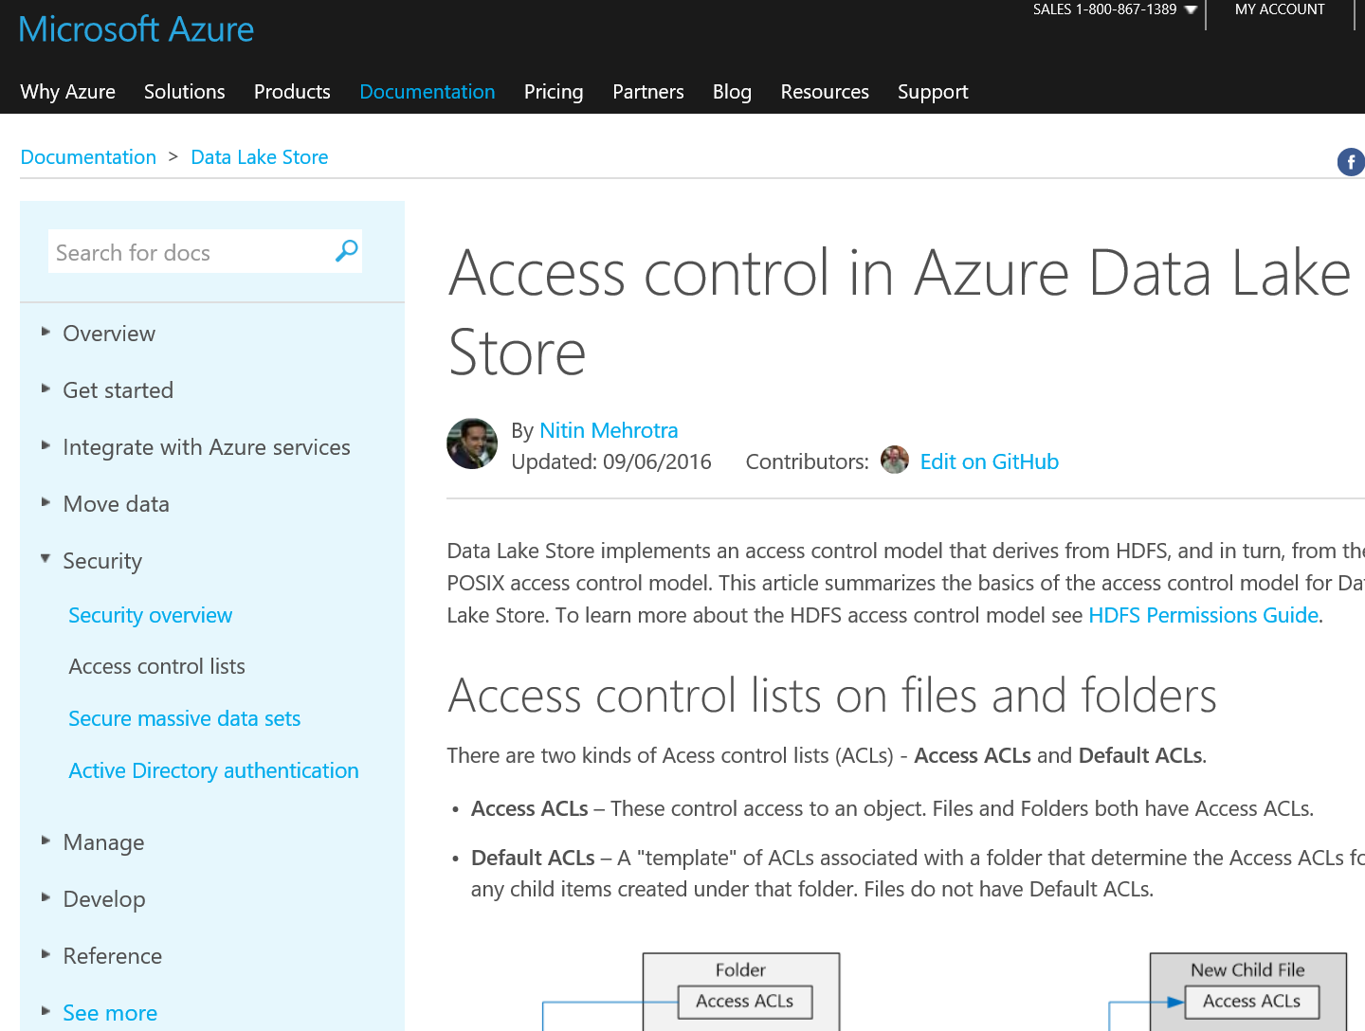
https://azure.microsoft.com/en-us/documentation/articles/data-lake-store-access-control/

Slide 3
What you need to know
ADL Store implements the POSIX ACL model
ADL Store does NOT implement NTFS ACLs
ADL Store ACLs (POSIX ACLS) DO NOT inherit
You MUST learn the POSIX ACL model
Knowledge of NTFS ACLs does not help

Slide 4
Access ACLs versus Default ACLs

Slide 5
What you need to know
Folder
Access ACLs
Access ACLs – These control access to an object. Files and Folders both have Access ACLs.
Default ACLs – A "template" of ACLs associated with a folder that determine the Access ACLs for any child items created under that folder. Files do not have Default ACLs.
Default ACLs
File
Access ACLs

Slide 6
What you need to know
Access ACLs – These control access to an object. Files and Folders both have Access ACLs.
Default ACLs – A "template" of ACLs associated with a folder that determine the Access ACLs for any child items created under that folder. Files do not have Default ACLs.
Folder
New Child File
Access ACLs
Access ACLs
Default ACLs
New Child Folder
Access ACLs
Default ACL

Slide 7
Access ACLs and Default ACLs have the same general structure
Access ACL
Default ACL
Owning user
RWX
Owning user
RWX
Changing the Default ACL on a parent does not affect the Access ACL or Default ACL of child items that already exist.
Owning group
RWX
Owning group
RWX
Named users
RWX
Named users
RWX
Named groups
RWX
Named groups
RWX
other
RWX
other
RWX
mask
RWX
mask
RWX

Slide 8
Users and Identities
Every file and folder has distinct permissions for these identities:
The owning user of the file
The owning group
Named users
Named groups
All other users
The identities of users and groups are Azure Active Directory (AAD) identities so unless otherwise noted a "user", in the context of Data Lake Store, could either mean an AAD user or an AAD security group.

Slide 9
Permissions (RWX)
The permissions on a filesystem object are Read, Write, and Execute and they can be used on files and folders as shown in the table below.
 | File | Folder
Read (R) | Can read the contents of a file | Requires Read and Execute to list the contents of the folder.
Write (W) | Can write or append to a file | Requires Write & Execute to create child items in a folder.
Execute (X) | Does not mean anything in the context of Data Lake Store | Required to traverse the child items of a folder. NTFS DOES NOT HAVE THIS CONCEPT

Slide 10
Short forms for permissions
RWXis used to indicate Read + Write + Execute. A more condensed numeric form exists in which Read=4, Write=2, and Execute=1 and their sum represents the permissions.
Numeric form | Short form | What it means
7 | RWX | Read + Write + Execute
5 | R-X | Read + Execute
4 | R-- | Read
0 | --- | No permissions

Slide 11
Permissions DO NOT inherit!
In the POSIX-style model used by Data Lake Store, permissions for an item are stored on the item itself. In other words, permissions for an item cannot be inherited from the parent items.

Slide 12
Q: What is the #1 misconception about ADLS ACLs?

Slide 13
ANSWER: Users believe (mistakenly) that permissions inherit

Slide 14
Trivia Question: What is NOT inherited in ADLS?

Slide 15
ANSWER: Permissions

Slide 16
Common Scenarios

Slide 17
Permissions needed to Read a File
/
Seattle/
Portland/
Data.txt
For all the folders in the folder structure that contain the file - the caller needs Execute permissions
For the file to be read - the caller needs Read permissions

Slide 18
Permissions needed to Append or Write to a File
/
Seattle/
Portland/
Data.txt
For all the folders in the folder structure that contain the file - the caller needs Execute permissions
For the file to read or append- the caller needs Write permissions

Slide 19
Permissions needed to Delete a File
/
Seattle/
Portland/
Data.txt
For all the folders in the folder structure that contain the file - the caller needs Write permissions
For all the folders in the folder structure that contain the file - the caller needs Write and Execute permissions
Note: Write permissions on the file is not required to delete the file as long as the above two conditions are true.

Slide 20
Permissions needed to enumerate folder
/
Seattle/
Portland/
Data.txt
Execute
Read + Execute

Slide 21
Super Users

Slide 22
A super user has the most rights of all the users in the Data Lake Store.
A super user:
has RWX Permissions to all file and folders
can change the permissions on any file or folder.
can change the owning user or owning group of any file or folder.

Slide 23
Who qualifies as a super user?
In Azure, a Data Lake Store account has several Azure roles:
Owners
Contributors
Readers
Etc.
Everyone in the Owners role for a Data Lake Store account is automatically a super-user for that account. To learn more about Azure Role Based Access Control (RBAC) see Role-based access control.

Slide 24
The Owning User

Slide 25
The user who created the item is automatically the owning user of the item
The owning user:
Change the permissions of a file that is owned
Change the owning group of a file that is owned, as long as the owning user is also a member of the target group.
Note:
The owning user can not change the owning user of another owned file. Only super-users can change the owning user of a file or folder.

Slide 26
The Owning Group

Slide 27
Background
In the POSIX ACLs, every user is associated with a "primary group". For example, user "alice" may belong to the "finance" group. Alice may belong to multiple groups, but one group is always designated as her primary group. In POSIX, when Alice creates a file, the owning group of that file is set to her primary group, which in this case is "finance".

Slide 28
Assignment
When a new filesystem item is created, Data Lake Store assigns a value to the owning group.
Case 1 - The root folder "/". This folder is created when a Data Lake Store account is created. In this case the owning group is set to the user who created the account.
Case 2 (every other case) - When a new item is created, the owning group is copied from the parent folder.
The owning group can be changed by: * Any super-users * The owning user, if the owning user is also a member of the target group.

Slide 29
The Access Check algorithm

Slide 31
Mask + effective permissions

Slide 32
Purpose
The mask is an RWX value that is used to limit access for named users, the owning group, and named groups when performing the Access Check algorithm.

Slide 33
Key Concepts
The mask creates "effective permissions", that is, it modifies the permissions at the time of Access Check.
The mask can be directly edited by file owner and any super-users.
The mask has the ability to remove permissions to create the effective permission. The mask can not add permissions to the effective permission.

Slide 34
Example
Named user
Owning group
Named Group
the mask is set to RWX, which means that the mask does not remove any permissions. Notice that the effective permissions for named user, owning group, and named group are not altered during the access check.
RWX
R-X
---
Mask
RWX
RWX
R-X
---
Effective permissions

Slide 35
Example
Named user
Owning group
Named Group
the mask is set to R-X. So, it turns off the Write permission for named user, owning group, and named group at the time of access check.
RWX
R-X
---
Mask
R-X
R-X
R-X
---
Effective permissions

Slide 36
Example
Named user
Owning group
Named Group
the mask is set to -RX. So, it turns off the Read permission for named user, owning group, and named group at the time of access check.
RWX
R-X
---
Mask
R-X
-WX
--X
---
Effective permissions

Slide 37
Permissions on new files and folders

Slide 38
Key Concepts
When a new file or folder is created under an existing folder, the Default ACL on the parent folder determines:
A child folder’s Default ACL and Access ACL
A child file's Access ACL (files do not have a Default ACL)

Slide 39
A child file or folder's Access ACL
Parent Folder’s DEFAULT ACL
New Child’s ACCESS ACL
When a child file or folder is created, the parent's Default ACL is copied as the child file or folder's Access ACL.
Also, if other user has RWX permissions in the parent's default ACL, it is completely removed from the child item's Access ACL.
Owning user
RWX
COPY
Owning user
RWX
Owning group
RWX
COPY
Owning group
RWX
Named users
RWX
COPY
Named users
RWX
Named groups
RWX
COPY
Named groups
RWX
other
RWX
Remove RWX
other
---
mask
RWX
COPY
mask
RWX

Slide 40
umask
However, if you are familiar with POSIX systems and want to understand in-depth how this transformation is achieved, see the section Umask section in the ACL documentation

Slide 41
A child folder's Default ACL
When a child folder is created under a parent folder, the parent folder's Default ACL is copied over, as it is, to the child folder's Default ACL.
Parent Folder’s DEFAULT ACL
New Child Folder’s default ACL
Owning user
RWX
COPY
Owning user
RWX
Owning group
RWX
COPY
Owning group
RWX
Named users
RWX
COPY
Named users
RWX
Named groups
RWX
COPY
Named groups
RWX
other
RWX
COPY
other
---
mask
RWX
COPY
mask
RWX

Slide 42
Notes
Add Recommendation for NTFS users
Don’t user other
Leave mask alone
make sure directories have X set

Slide 43
Add umask in backup

Slide 44
Show PS Script that gets ACLs and fetches user

Slide 45
Show PS script that updates an ACL

Slide 46
Questions

