Slide 1
Moving data between ADLS and other systems
Mithun Prasad, PhD
Senior Program Manager, Big Data @ Microsoft

Slide 2
Agenda
Overview
Azure Data Lake Store PowerShell cmdlets
AdlCopy
Sqoop
DistCP
Azure Data Factory (ADF)

Slide 3
Cortana Intelligence Suite
Transform data into intelligent action
Information Management
Big Data Stores
Machine Learning and Analytics
Intelligence
Data
Sources
People
Data Factory
Data Lake Store
Machine Learning
Cognitive Services
Data Catalog
SQL Data
Warehouse
Data Lake Analytics
Bot
Framework
Web
Apps
HDInsight
(Hadoop and Spark)
Event Hubs
Cortana
Mobile
Apps
Stream Analytics
Bots
Dashboards & Visualizations
Sensors
and
devices
Power BI
Automated
Systems
Data
Intelligence
Action

Slide 4
Cortana Intelligence Suite
Transform data into intelligent action
Information Management
Big Data Stores
Machine Learning and Analytics
Intelligence
Data
Sources
People
Data Factory
Data Lake Store
Machine Learning
Cognitive Services
Data Catalog
SQL Data
Warehouse
Data Lake Analytics
Bot
Framework
Web
Apps
HDInsight
(Hadoop and Spark)
Event Hubs
Cortana
Mobile
Apps
Stream Analytics
Bots
Dashboards & Visualizations
Sensors
and
devices
Power BI
Automated
Systems
Data
Intelligence
Action

Slide 5
Big Data Analytics – Data Flow
Ingest data
Process data
Download data
Data
sources
Apps
Visualize data
Sensors
and devices

Slide 6

Ingestion
Data can be ingested into Azure Data Lake Store from a variety of sources
SQL
Azure SQL DB
ADL built-in copy service
Azure Data Factory
Hadoop DistCp
Azure Data Factory
Azure Storage Blobs
Azure SQL DW
ADL Store
.NET SDK
CLI
Azure Portal
Azure PowerShell
Table Storage
Azure Stream Analytics
Azure tables
On-premises databases
Azure Event Hubs
Custom programs

Slide 7
ADLS Ingestion – Getting started
Azure Portal
Easy to use
Good for small amount of data
Analyzing data using Portal
PowerShell
Upload file and folders
Control parallelism
Control format of upload
Need to use other services
Data on your desktop
ADL Tools for Visual Studio
Integrated experience
  Drag-and-drop
  Programmatic
  Analytics
CLI
Linux, Mac
Most features of PowerShell
Azure Data Factory
Intuitive CopyData wizard for adhoc copies
Data located in other stores
AdlCopy
Copy data easily from Azure Storage at least cost
Distcp on HDI
Want to analyze data using HDI
Familiarity with OSS tools

Slide 8
ADLS Ingestion – Orchestration
First-class support for ADLS
Support variety of endpoints
  WASB, OnPrem, Relational DB
Integrated with Analytic tools
Programmatic customization
Azure Data Factory
OSS tools
Sqoop - Copy from relational DBs
Distcp - Copy from WASB
Use Oozie & Falcon on HDI to manage
Use Storm for streaming data from Eventhub / Kafka into ADLS
Out-of-the-box tools
PowerShell
Use built-in commandlets
Use PowerShell Workflow Runbooks to manage
Use PowerShell Script Runbooks to manage
Azure Import/Export Service
Transfer data using disks if ExpressRoute is not feasible
Lots of manual steps and not easy to orchestrate
ADLS SDK
Available in various languages (.NET, Java, Node.js, ..)
Upload from distributed sources e.g. server logs
ADF can be used to manage .NET apps
Custom & LOB Apps
REST APIs
For unsupported languages and platforms
Will need custom apps for orchestration

Slide 9
Azure Data Lake Store PS Cmdlets
Export-AzureRmDataLakeStoreItem |  | Downloads a file from Data Lake Store.
Get-AzureRmDataLakeStoreItemContent |  | Gets the contents of a file in Data Lake Store.
Import-AzureRmDataLakeStoreItem |  | Uploads a file to Data Lake Store.
Join-AzureRmDataLakeStoreItem |  | Joins one or more files to create one file in Data Lake Store.
Move-AzureRmDataLakeStoreItem |  | Moves or renames a file or folder in Data Lake Store.
New-AzureRmDataLakeStoreItem |  | Creates a new file or folder in Data Lake Store.
Remove-AzureRmDataLakeStoreItem |  | Deletes a file or folder in Data Lake Store.
More details are here

Slide 10
AdlCopy
More details are here
Primarily it is command line tool, AdlCopy, to copy data very easily from Azure Storage Blobs / Data Lake Store into Data Lake Store.
You can use the AdlCopy tool in two ways:
  Standalone, where the tool uses Data Lake Store resources to perform the task.
  Using a Data Lake Analytics account, where the units assigned to your Data Lake Analytics account are used to perform the copy operation. You might want to use this option when you are looking to perform the copy tasks in a predictable manner.
AdlCopy /Source <Blob source> /Dest <ADLS destination> /SourceKey <Key for Blob account> /Account <ADLA account> /Units <Number of Analytics units>

Slide 11
DistCP
You can use DistCP to copy data to and from an HDInsight cluster storage (WASB) into a Data Lake Store account.
More details are here.
hadoop distcp wasb://<container_name>@<storage_account_name>.blob.core.windows.net/example/data/gutenberg adl://<data_lake_store_account>.azuredatalakestore.net:443/myfolder

Slide 12
Sqoop
Apache Sqoop is a tool designed to transfer data between relational databases and a big data repository, such as Data Lake Store.
You can use Sqoop to copy data to and from Azure SQL database into a Data Lake Store account, in addition to other other relational DBs.
More details are here.
sqoop-import --connect "jdbc:sqlserver://<sql-database-server-name>.database
.windows.net:1433;username=<username>@<sql-database-server-name>;password=
<password>;database=<sql-database-name>“ --table Table1 --target-dir adl://
<data-lake-store-name>.azuredatalakestore.net/Sqoop/SqoopImportTable1

Slide 13
Azure Data Factory (ADF)

Slide 14






Cortana Intelligence Suite
Transform data into intelligent action
Information Management
Big Data Stores
Machine Learning
and Analytics
Dashboards and Visualizations
Business
apps
Power BI
Azure
Data Factory
Azure
Machine Learning
Personal Digital Assistant
Azure
Data Lake
Cortana
People
Custom
apps
Azure
Data Catalog
Azure
HDInsight (Hadoop)
Perceptual Intelligence
Azure
SQL Data Warehouse
Face, vision
Speech, text
Azure
Event Hub
Azure
Stream Analytics
Business Scenarios
Sensors
and devices
Recommendations,
customer churn,
forecasting, etc.
Automated
Systems
DATA
INTELLIGENCE
ACTION

Slide 15
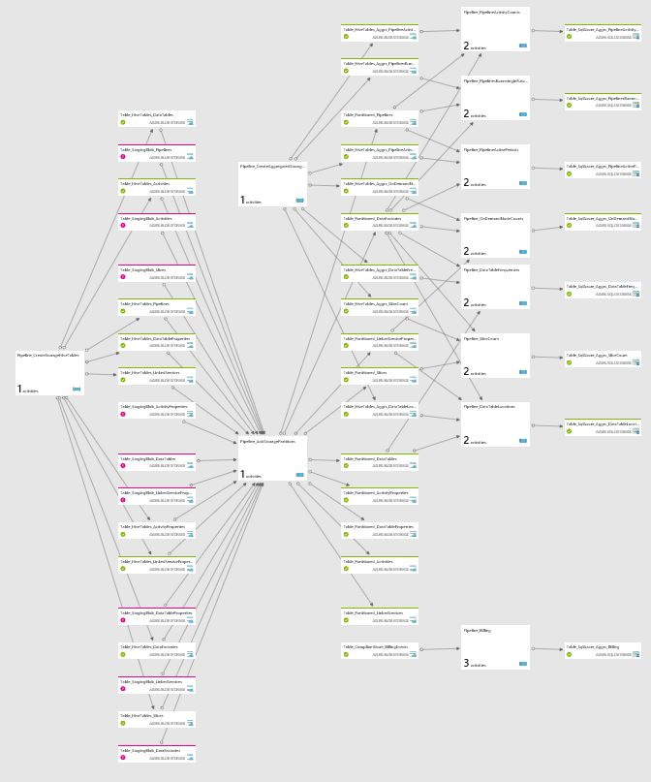

Azure Data Factory
Compose, orchestrate & monitor data services at scale
Fully managed service to support orchestration of data movement and transformation
Connect to relational or non-relational data that is on-premises or in the cloud
Single pane of glass to monitor and manage data processing pipelines
Globally deployed service infrastructure
Cost Effective
No SQL
Hadoop on Azure
BI & analytics
VM
ADL
Data Lake Analytics
Trusted data
DB
Custom Code
Stored Procedures
Machine Learning

Slide 16
Azure Data Factory
Linked Services
Connect data factories to the resources and services you want to use
Connect to data stores like Azure Storage and on premises SQL Server
Connect to compute services like Azure ML, Azure HDI, and Azure Batch
Data Sets
A named reference/pointer to data you want to use as an input or output of an activity
Activities
  Actions you perform on your data
  Takes inputs and produce outputs
Pipelines
Logical grouping of activities for group operations
Compose services to transform data into actionable intelligence
AZURE DATA FACTORY
Manage and monitor
Data and operational lineage
Coordination
and scheduling
Policy
DATA PIPELINES
Processing activity
Processing activity
Raw data
Orchestration
and monitoring
Information
assets
LINKED SERVICES:
Data Movement from
Data processing
Data Movement to
Relational and
non-relational
On-premises or cloud
Hadoop (Hive, Pig, etc.)
Data Lake Analytics
Azure Machine Learning
Stored Procedures
Custom code
Relational and
non-relational
On-premises or cloud

Slide 17
Azure Data Factory
Connects Azure out-of-the-box to all your stores
Category | Data store | Supported as source | Supported as sink
Azure | Azure Data Lake Store Azure Blob storage Azure SQL Database Azure SQL Data Warehouse Azure Table storage Azure DocumentDB | ✓ ✓ ✓ ✓ ✓ ✓ | ✓ ✓ ✓ ✓ ✓ ✓
Databases | SQL Server* Oracle* MySQL* DB2* Teradata* PostgreSQL* Sybase* Cassandra* MongoDB* Amazon Redshift | ✓ ✓ ✓ ✓ ✓ ✓ ✓ ✓ ✓ ✓ | ✓ ✓
File | File System* HDFS* Amazon S3 | ✓ ✓ ✓ | ✓
Others | Salesforce Generic ODBC* Generic OData Web Table (table from HTML) GE Historian* | ✓ ✓ ✓ ✓ ✓
* Can be on-premises or on Azure IaaS, enabled using Data Management Gateway

Slide 18








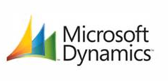


Azure Data Factory Customers

Slide 19
ADF Resources
Learn More
  Product Recommendations Virtual Lab MS Technet
  Azure Big Data Blog
Get Started
  Learning Path
  Azure Portal & Customer Profiling
  Visual Studio plug-in installation
Give Feedback
  UserVoice
Get Help
  ADF Forums

Slide 20
Customizing using SDKs/APIs
Your application
ADL PowerShell
ADL
XPlat CLI
ADL .NET SDK
ADL Node.js SDK
ADL Java SDK
ADL Python*
Only on
Windows OS
Azure and ADL Store REST APIs
* At General Availability

Slide 21
Egress
Data can be egressed from Azure Data Lake Store into numerous targets/sinks
SQL
Azure Data Factory
Hadoop DistCp
Azure SQL DB
Azure Storage Blobs
Azure Data Factory
Azure SQL DW
Apache Sqoop
ADL Store
Table Storage
.NET SDK
CLI
Azure Portal
Azure PowerShell
Azure Tables
On-premises databases
Custom programs

Slide 22







Big Data Analytics – Data Flow
Ingest data
Process data
Download data
Hadoop
Data
sources
Bulk Ingestion
Azure
Data Lake Analytics
Azure
HDInsight
HBASE
Azure
Data Factory
Developer
SDKs
Portal &
Tools
Apache
DistCp, Sqoop
Azure
Data Factory
Developer
SDKs
Apps
AdlCopy
Service
Import/Export
Service
Azure Data Lake Store
Portal &
Tools
Apache
DistCp, Sqoop
Event Ingestion
Visualize data
Import/Export
Service
Sensors
and devices
Stream Analytics
Azure SQL DW
Power BI

Slide 23
In conclusion
Many tools are available to copy data into ADLS and out of ADLS
  More information is here
  You can use generic Azure tools e.g. PowerShell
  You can use Open Source tools e.g. DistCP
  You can use special purpose tools e.g. ADF
  You can create your own tools
Pick the tool that meets your scenario requirements
  Optimize it on the dimension you want – Cost, Performance. Etc.

Slide 24
Questions?

Slide 25
http://aka.ms/AzureDataLake

