Slide 1
Azure Data Lake Overview
Saveen Reddy
Group Program Manager, Big Data @ Microsoft
2017/02/03

Slide 2
Microsoft’s internal Data Lake (Cosmos)
  A data lake for everyone to put their data
  Tools approachable by any developer
  Batch, Interactive, Streaming, ML
  Used across Office, Xbox Live, Azure, Windows, Bing, Skype, etc…
  By the numbers
  Exabytes of data under management
  100Ks of Physical Servers
  100Ks of Batch Jobs
  Millions of Interactive Queries
  Huge Streaming Pipelines
  10K+ Developers running diverse workloads and scenarios
Data Stored
Xbox Live
Office365
LCA
Live
Bing
Yammer
SMSG
CRM/Dynamics
Skype
Exchange
Windows
Malware Protection
Microsoft Stores
Commerce Risk

Slide 3
Reflections on Data
Collect the data first
We couldn’t have predicted the how we would get value from the data when we started collecting.
The Power of Sharing
A side effect of having a unified platform, with a consistent security model. Tools allow me to shape and join all data, while maintaining security, auditing and compliance for key data sets.
Data Virality
Value large datasets helps bootstrap the entire company into using big data.
Visibility & Control more important than ever
Ever growing needs for Auditing, Compliance, Data provenance, Regulatory

Slide 4
Reflections on Engineering
Data Agility
Build systems and data pipelines that allow producers and consumers of data to innovate rapidly
Changing Skillsets
Ramp up hiring of people with experience with data science, Machine Learning, etc.
.
About Creating Value; Not Minimizing Cost
We are spending more to deliver more value for the business. Have become much more mature about spending and efficiency.

Slide 5
Azure Data Lake
Harness all your data.
Bring intelligent actions to your business.

Slide 6
1
2
3
Any Data
Enterprise
Developers

Slide 7
The 3 Azure Data Lake Services
Analytics
Store
HDInsight
Big data queries as a service
Hyper-scale Storage optimized for analytics
Clusters as a service
Notes:
We have 4 Azure Data Lake Services ASA (They own the streaming) Azure Stram Analytics

Slide 8
Scenarios
Notes:
This company could not be competitive without Cosmos

Slide 9

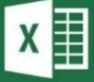
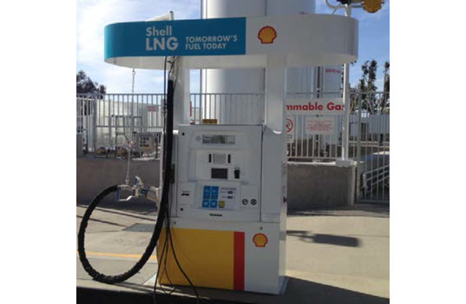
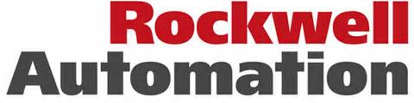
Rockwell Automation has partnered with one of the six oil and gas super majors to build unmanned internet-connected gas dispensers. Each dispenser emits real-time management metrics allowing them to detect anomalies and predict when proactive maintenance needs to occur.
Azure HDInsight
Data
Factory
Power BI for O365
Mobile Device
Hive, Pig,
Real-time notification
Mobile Notification Hub
Azure Blobs
Azure SQL DB
Store sensor data every 5 minutes
    Temperature, pressure, vibration, etc.
    Tens of thousands of data points / second
Notes:
Challenge
Manage sites used for dispensing liquefied natural gas (clean fuel for commercial customers who do heavy-duty road transportation)
Built LNG refueling stations across US interstate highway
Stations are unmanned so they built 24x7 remote management and monitoring to track diagnostics of each station for maintenance or tuning
Built internet-connected sensors embedded in 350 dispenser sites worldwide generating tens of thousands data points per second
Temperature, pressure, vibration, etc.
Data needs outgrew company’s internal datacenter and data warehouse
Solution
Chose Azure HDInsight, Data Factory, SQL Database
Dashboards used to detect anomalies for proactive maintenance
Changes in performance of the components
Energy consumption of components
Component downtime and reliability
Future: Goal is to expand program to hundreds of thousands of dispensers
How They Did It
Collect data from internet-collected sensors
Tens of thousands data points per second
Interpolate time-series prior to analysis
Stored raw sensor data in Blobs every 5 minutes
Use Hadoop to execute scripts and Data Factory to orchestrate
Hive and Pig scripts orchestrated by Data Factory
Data resulting from scripts loaded in SQL Database
Queries detect site anomalies to indicate maintenance/tuning
Produced dashboards with role-based reporting
Azure Machine Learning , SSRS, Power BI for O365
Provide users with customizable interface
View current and historical data (day-to-day operations, asset performance over time, etc.)
Leveraged Azure Mobile Notification Hub for real-time notifications, alarms, or important events

Slide 10
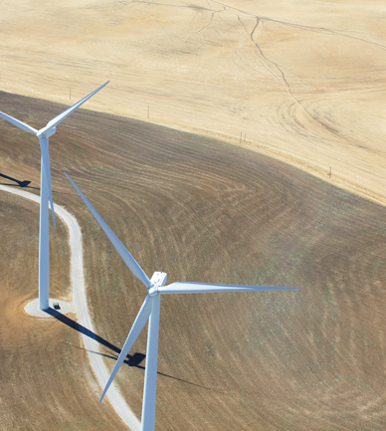
One of the leaders in the development and management of renewable energy infrastructure and services needed to understand data coming from their wind turbines/wind farms in an Internet of Things (IoT) scenario.
100s of windfarms across the globe
Each windfarm has 100+ turbines
Each turbine generates 10 data points every 25 milliseconds.
Initial goal
Provide consumption related analytics to their customers (power companies)
What else could they do with all that data?
Predictive maintenance
How?
Event Hub, Azure Storage, HDInsight
Azure SQL DB, Excel reporting
Notes:
Wind turbines – used in windmills to turn wind into power
These things are phenomenally complex devices
They emit a ton of telemetry
Every 25 milliseconds they emit 10 interesting datapoints
100x of wind mills (turbines) per windfarm
They are managing about a hundred windfarms through their customers
Their customers are the power companies
SO yes this is a “IOT scenario”
Couple of challenges
How am I going to collect all this information – windfarms around the globe, some in remote areas, how to collect
How to I store it cheaply – lot of data – honestly no single row interesting – only interesting in aggregate – but because there’s ns much of it putting in DW it is cost prohibitive
Instead they landed data in cloud from around the world
Cloud allowed storing it cheaply – just store no processing
Then bring processing on top of it to distill and refine the data into something more powerful
They cooked data down - refined, aggregate, duplicate detection
Now they provided interesting metrics to power companies
But since they had the source data around they can ask lots of interesting questions on *all* the data since they started collecting it
Moved beyond charts and graphs bout how the windfarms were performing
Now able to mash that together with maintenance data
To be able to say what are some of the things correlated with my turbines failing
These are very expensive pieces of machinery so if we can find things that are going awry *before* the whole thing breaks its usually much cheaper
Now one of the interesting things they found was if they were more observant about dust conditions .. they were saving million dollar generators by replacing four dollar filters more often
And so this is a interesting example of predictive maintenance

Slide 11
Microsoft Device Telemetry Pipeline
Windows 10, XBOX, Services, …
Hundreds of Billions
Real-time and Near-real-time Analysis of…
Game Achievements
Device Crash Logs
Bluescreen crashdump
Etc.
Critical for “Windows Service”
1Billion
Events Processed Daily
Total Devices
Hundreds of Terabytes
Raw Data Ingested Daily
Notes:
We collect data form
15 T of row data everyday.
Blue Screen is collection that data
Holo lens fail and they were able to show that .

Slide 12
Data Lake Analytics Scenario
ON PREMISES
CLOUD
CONSUMPTION
Data Lake
Web Portals
Customer Behavior
ETL & Analytics
Cleanup, Normalize, Basic Stats
Experimentation
A/B testing at scale. Drive changes based on actual
Customer behavior
Machine Learning
Do ML at Scale (Customer Segmentation & Fraud Detection)
SQL DW
Store
Move via Data Factory
Mobile Apps
Move via Data Factory
Clickstream
Analytics
SQL DB
HDInsight
Power BI
DBs
Data Science
Notebooks

Slide 13
Real World Scenario with Azure Data Lake (Retail)
ON PREMISES
CLOUD
CONSUMPTION
Data Lake
Store
Massive Archive
Web Portals
Initial one time import
“Landing Zone”
Data Lake Store
Once ingested, schedule movement to Permanent stores and processing jobs to create structured data
DW (many instances)
On Prem HDFS
Mobile Apps
Data Lake
Analytics
Move to cloud via AzCopy
Power BI
Incremental
updates
Data is portioned into multiple SQL DWs (one per data consumer. Several hundred consumers)
Structured data created here. Schematized and optimized for queries
Active Incoming Data
Experimentation
Machine Learning
Jupyter
Data Science
Notebooks
A/B testing at scale. Drive changes based on actual
Customer behavior
Do ML at Scale (Customer Segmentation & Fraud Detection)

Slide 14



Cortana Intelligence Suite
Transform data into intelligent actions and predictions
Information Management
Big Data Stores
Machine Learning and Analytics
Intelligence
Data
Sources
Cognitive Services
People
Machine Learning
Bot
Framework
Data Factory
Data Lake Store
Cortana
Data Catalog
SQL Data
Warehouse
Data Lake Analytics
Business Scenarios
Web
Apps
HDInsight
(Hadoop and Spark)
Recommendations,
customer churn,
forecasting, etc.
Event Hub
Document DB
Mobile
Apps
Stream Analytics
Bots
Blob Store
Dashboards & Visualizations
Sensors
and
devices
Power BI
Automated
Systems
Data
Intelligence
Action
Notes:
To make this vision a reality, we Cortana Intelligence Suite – a suite of services in Intelligent cloud that transform data into intelligent insights and actions.

Slide 15
Hadoop & Big Data Azure

Slide 16
Big Data in Azure
IaaS Hadoop
HDInsight
Data Lake
Analytics
Hadoop
Spark
HBase
Storm
Hadoop distros on Azure VMs
Azure-managed Hadoop clusters
Big Data as a Service
Blob Storage
Data Lake Store
Hyper-scale Storage optimized for analytics
Notes:
Data Lake Analytics Big Data as a Services (They planning to do Spark, Hive this confendial)
We have Ha

Slide 17
Apache Hadoop
A highly reliable, distributed and parallel programming framework for analyzing big data
Hadoop Core
Open source
Java-based
Runs on variety of hardware platforms, including clusters of commodity hardware
Tolerant to failures of nodes, software components, network
Scales with the cluster
Rich ecosystem that supports SQL/NoSQL, Streaming, Real-time and Interactive applications.
MapReduce
Tez
Develop programs based on MapReduce, Tez, etc. on top of YARN
YARN, a distributed resource manager that allocates and controls access to the resources of the cluster manager
HDFS - A scalable, reliable file system (HDFS)
YARN
HDFS
Notes:
CPU and Memory Resources. Yarn comtea
5000 biggest cluster out there.
Comos 50.000 vitual machines.
Resources reservation (Mercury Yiq)

Slide 18
Compute Workloads on YARN
MapReduce & Tez
Spark
Data Lake Analytics
YARN
WebHDFS
Data Lake Store
Notes:
This 3 years out

Slide 19
Azure Data Lake Store

Slide 20
Petabyte size files and Trillions of objects
Scalable throughput for massively parallel analytics
HDFS for the Cloud
Always encrypted, Role-based Security & Auditing
Enterprise-grade Support
Azure Data Lake Store
A No limits Data Lake that powers Big Data Analytics
The first cloud Data Lake for enterprises that is secure, massively scalable and built to the open HDFS standard. With no limits to the size of data and the ability to run massively parallel analytics, you can now unlock value from all your unstructured, semi-structured and structured data.

Slide 21
Petabyte size files and Trillions of objects
Scalable throughput for massively parallel analytics
Reliable
Automatically replicates your data
Three copies within a single region
Highly available
Unlimited Storage
Unlimited account sizes
Individual file sizes from gigabytes to petabytes
No limits to scale
Built for running large analytics systems that require massive throughput
Optimized for parallel I/O
Automatically optimizes for any throughput

Slide 22
HDFS for the Cloud
Built from the ground up as a Hadoop file system
HDI Cluster Types
Hadoop
Storm
Spark
HBase (Future)
Tools running in HDI Clusters
Sqoop
Distcp
Hadoop Distros
Hortonworks (Future)
Cloudera (Future)
Other
Microsoft R Services
Apache Hadoop (v2.8)

Slide 23
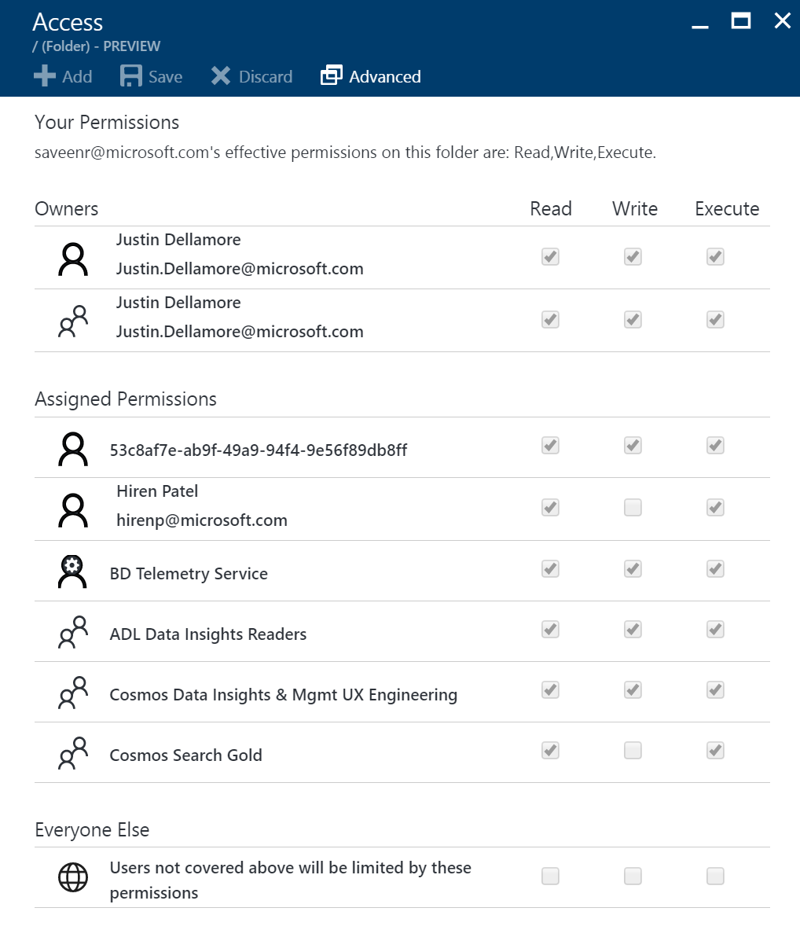
Always encrypted, Role-based Security & Auditing
Role-based Access Control
POSIX-compliant Access Control Lists (ACLs) on Files and Folders
Integrated with Azure Active Directory
Auditing for all operations. Audit logs that can be analysed with ADL U-SQL Scripts
Transparent server-side encryption with Azure-managed (Azure Key Vault) and customer-managed keys

Slide 24
Data Lake Store vs Blob Storage
 | Azure Data Lake Store | Azure Blob Storage
Purpose | Optimized for Analytics | General purpose bulk storage
Scenarios | Batch, Interactive, Streaming, ML | App backend, backup data, media storage for streaming
Units of Storage | Accounts / Folders / Files | Accounts / Containers / Blobs
Structure | Hierarchical File System | Flat namespace
Supports WebHDFS | Yes | No
Billing | Pay for data stored and for I/O | Pay for data stored and for I/O
Region Availability | US (Other regions coming) | All Azure Regions
Authentication | Azure Active Directory | Access keys
Authorization | POSIX ACLs on Files and Folders | Access Keys
Server-side Encryption | Yes | Yes

Slide 25
Azure Data Lake Analytics

Slide 26
Start in seconds, Scale instantly, Pay per job
Develop massively parallel programs with simplicity
Debug and Optimize your Big Data programs with ease
Virtualize your analytics
Enterprise-grade Support and Security
Azure Data Lake Analytics
Massively parallel, extensible, analytics made simple
The first cloud analytics service where you can easily develop and run massively parallel data transformation and processing programs in U-SQL, R, Python and .NET over petabytes of data. With no infrastructure to manage, process data on demand, scale instantly, and only pay per job.

Slide 27
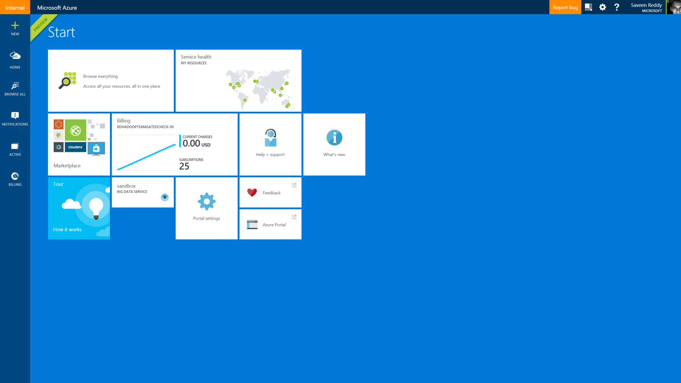
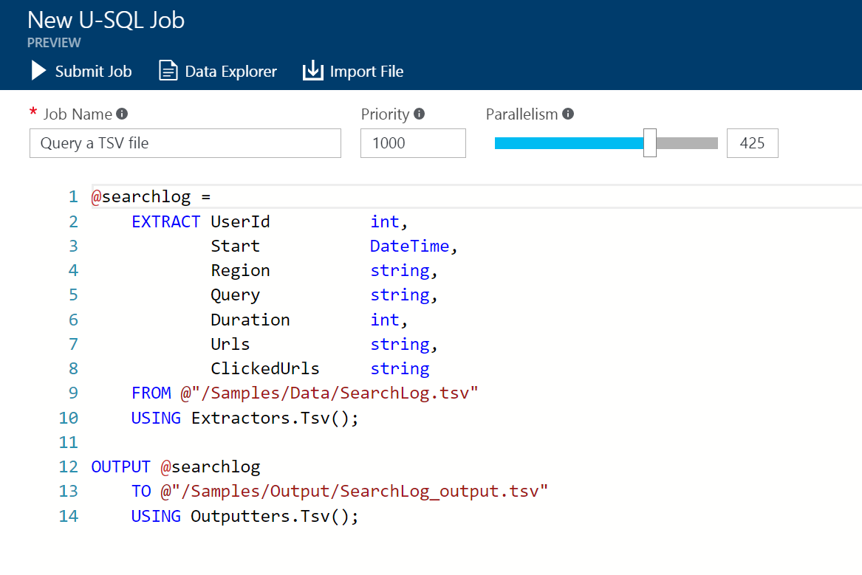
Start in seconds, Scale instantly, Pay per job
Our on-demand service will have you processing Big Data jobs within 30 seconds. There is no infrastructure to worry about because there are no servers, VMs, or clusters to wait for, manage or tune. You can instantly scale the analytic units (processing power) from one to thousands for each job. You only pay for the processing used per job.
1. In Azure Portal create a Data Lake Analytics Account
4. Submit the job
3. Choose how much compute resources to reserve for parallelism
2. Write a big data program with U-SQL

Slide 28
DEMO
Getting Started

Slide 29
ProTip: Restrictions on the name of an ADLA and ADLS account
Only lowercase alphabetical and numbers are allowed
Whitespace is not allowed
Punctuation such as . , ; : are not allowed
No special characters such as - + _*
Size: The names must be between 3 to 24 characters in length
FYI: An ADLA and ADLS account can have the same name

Slide 30
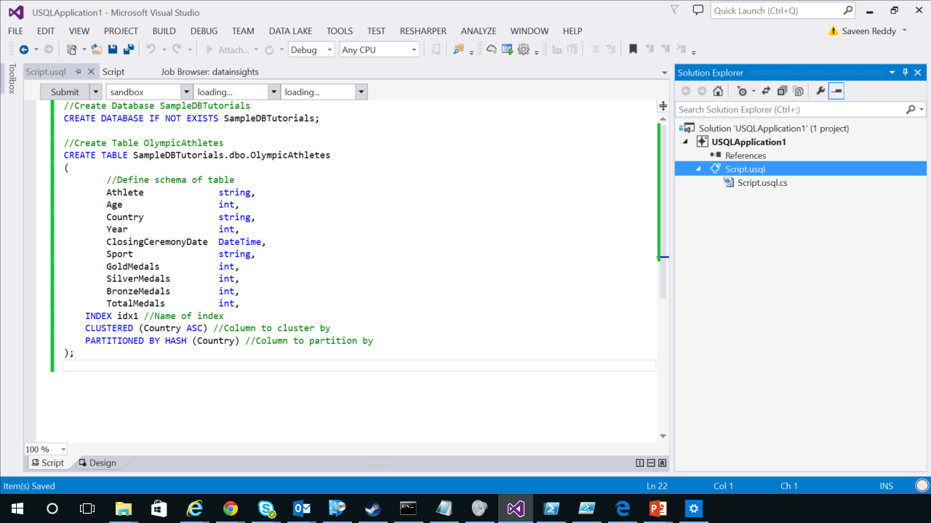
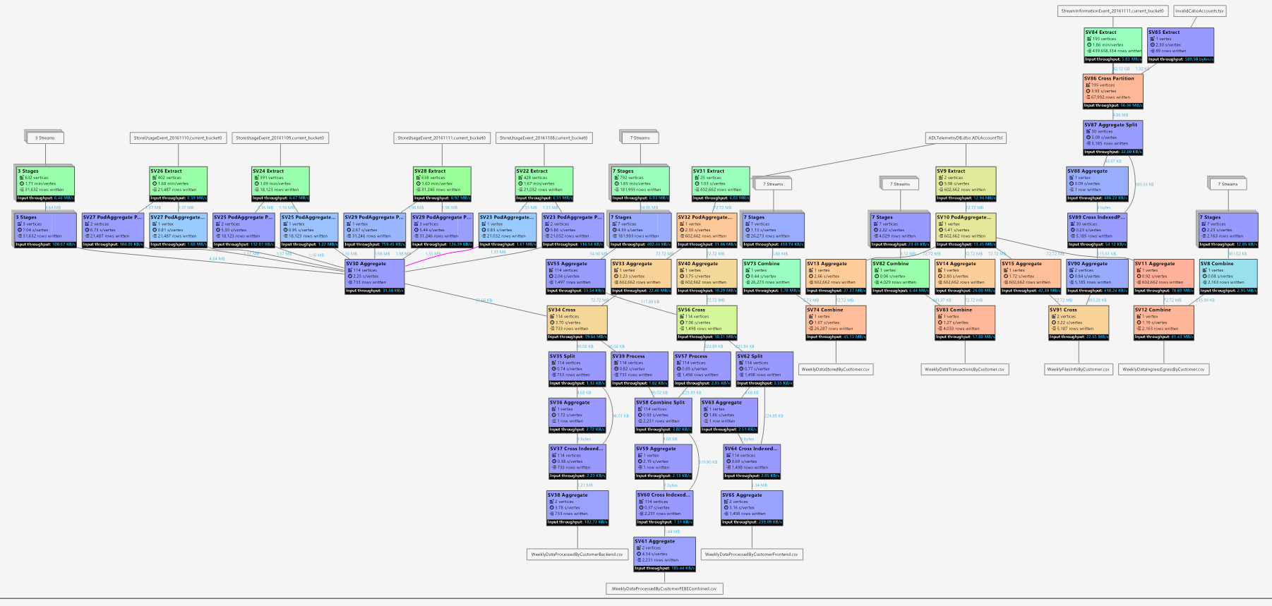
Develop massively parallel programs with simplicity
Debug and Optimize your Big Data programs with ease
U-SQL is a simple, expressive, and extensible language that allows you to write code once and automatically have it be parallelized for the scale you need. You can process petabytes of data for diverse workload categories such as ETL, machine learning, cognitive science, machine translation, imaging processing, and sentiment analysis by using U-SQL and leveraging existing libraries written in .NET languages, R, or Python..
Debugging failures in cloud distributed programs are now as easy as debugging a program in your personal environment. Our execution environment actively analyzes your programs as they run and offers recommendations to improve performance and reduce cost. For example, if you requested 1000 AUs for your program and only 50 AUs were needed, the system would recommend that you only use 50 AUs resulting in a 20x cost savings.

Slide 31
DEMO
Authoring and Optimization

Slide 32
Virtualize your analytics
Azure Storage Blobs
U-SQL can use data from sources in Azure. Where possible data transformation is pushed close to the source data to minimize data transfer and maximize performance.
Data Lake
Store
Azure
SQL DB
Data Lake
Analytics
Azure
SQL DW
SQL DB in Azure VM

Slide 33
U-SQL

Slide 34
Familiar syntax to millions of SQL & .NET developers
Unifies declarative nature of SQL with the imperative power of C#
Unifies structured, semi-structured and unstructured data
Federated query support over all data
U-SQL
A new language for Big Data

Slide 35
1
U-SQL
Basics
(1) DECLARE constant values using C# Expressions
(2) EXTRACT performs schema on read for files and places results in a RowSet
(3) RowSet refinement and dataflow programming
(4) OUTPUT for writing files. Built-in handling for CSV & TSV
Notes:
Whole-script optimization
DECLARE @endDate DateTime = DateTime.Now;
DECLARE @startDate DateTime = @endDate.AddDays(-7);
@orders =
EXTRACT
OrderId int,
Customer string,
Date DateTime,
Amount float
FROM "/input/orders.txt"
USING Extractors.Tsv();
@orders = SELECT * FROM @orders
WHERE Date >= startDate AND Date <= endDate;
@orders = SELECT * FROM @orders
WHERE Customer.Contains(“Contoso”);
OUTPUT @orders
TO "/output/output.txt"
USING Outputters.Tsv();
2
3
4
Notes:
Declare variables (defining a date range
Is like common table expression on SQL. (2)
USQL does not subqueries .
@orders is just and input output. It NOT a temp table. Kind of CTEs
@ is also use for string expressions
When you have an output is like break.
It get compile as C++ source code. we save 10-20% compile time with C==

Slide 36
CREATE ASSEMBLY OrdersDB.SampleDotNetCode
FROM @"/Assemblies/Helpers.dll";
REFERENCE ASSEMBLY OrdersDB.Helpers;
@rows =
SELECT
OrdersDB.Helpers.Normalize(Customer) AS Customer,
Amount AS Amount
FROM @orders;
@rows =
PROCESS @rows
PRODUCE OrderId string, FraudDetectionScore double
USING new OrdersDB.Detection.FraudAnalyzer();
OUTPUT @rows
TO "/output/output.dat"
USING OrdersDB.CustomOutputter();
U-SQL
Reusing .NET Code
(1) CREATE ASSEMBLY to register code in the U-SQL Catalog
(2) REFERENCE ASSEMBLY to bring code to each container (vertex)
(3) Directly call C# methods from Assemblies in U-SQL Expressions
(4) PROCESS to perform row-by-row transformation of data with User-Defined Operator UDO
(5) OUTPUT with custom Outputter UDO to support user-defined formats.
1
2
3
4
5
Notes:
If you want to run something on ADL you have to create and Assemble

Slide 37
Fundamentals

Slide 38
Usage-based Billing
HDInsight
Billed for
Cluster time
Data Lake Analytics
Billed for
Compute resources used for the duration of your query
Data Lake Store
Billed for
Amount of data stored
Number of I/O operations

Slide 39
Enterprise-Grade Support & Security
99.9% Uptime
24/7 Support
Defense-in-depth
  Perimeter security
  Azure AD Auth
  RBAC & ACLs
  Encryption at rest and on the wire
  All operations Audited

Slide 40
ADL Analytics Compared To….

Slide 41
HDInsight
clusters as service
ADL Analytics
big data queries as a service
Customization
Control
Flexibility
Leverage the Hadoop ecosystem (Spark, Storm, Hbase, …)
Convenience
Efficiency
Automatically scale
A simple way to get started using familiar concepts, languages, and tools
Mix and match them depending on what you need.
Share data in the Azure Data Lake Store

Slide 42
Azure SQL DW
ADL Analytics
SQL Language & Tools
Scale DW with DWUs
Massively parallelize SQL
U-SQL (+Hive in the future) & Open Source Tools
Scale per query (1 to 1000+ nodes)
Interoperate with Open Source technologies and data formats (Mahout, ORC, Parquet,…)
Massively parallelize .NET code, R, Python
Mix and match them depending on what you need.
Share data in the Azure Data Lake Store

Slide 43
Q & A

Slide 44
http://aka.ms/AzureDataLake

