Slide 1
Azure Data Lake Analytics
Python Management SDK
Saveen Reddy
Big Data @ Microsoft
2016/11/22

Slide 2
Documentation
https://docs.microsoft.com/en-us/azure/data-lake-store/data-lake-store-get-started-python
https://docs.microsoft.com/en-us/azure/data-lake-analytics/data-lake-analytics-get-started-python

Slide 3
Setup
Anaconda Python 3.5 (64 bit)

Slide 4
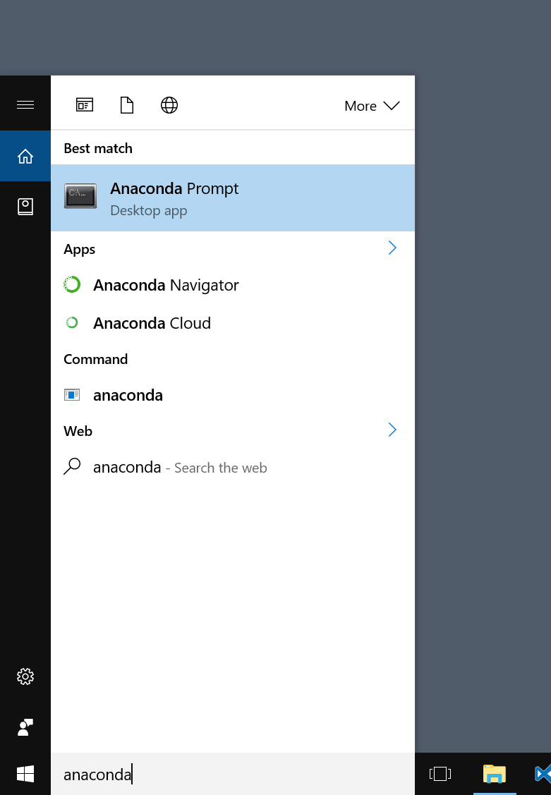
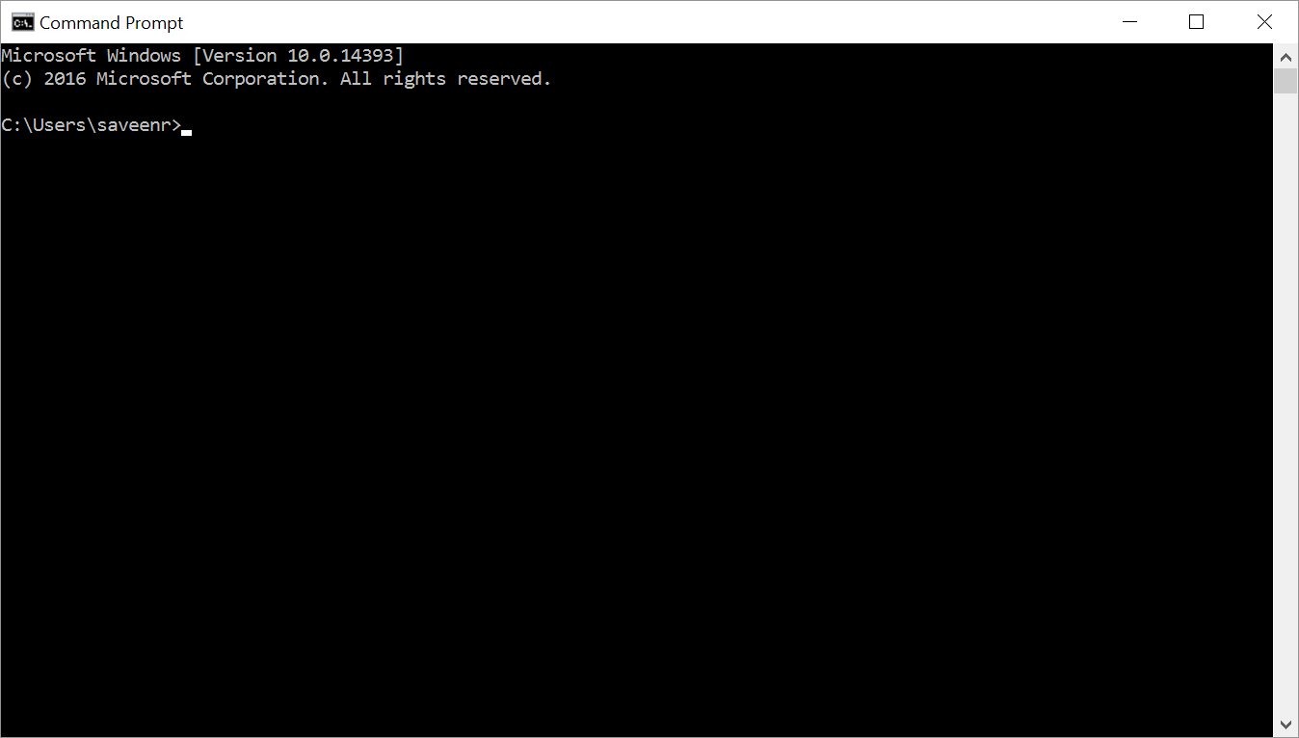
Launching Anaconda Prompt
Launch as Administrator!

Slide 5
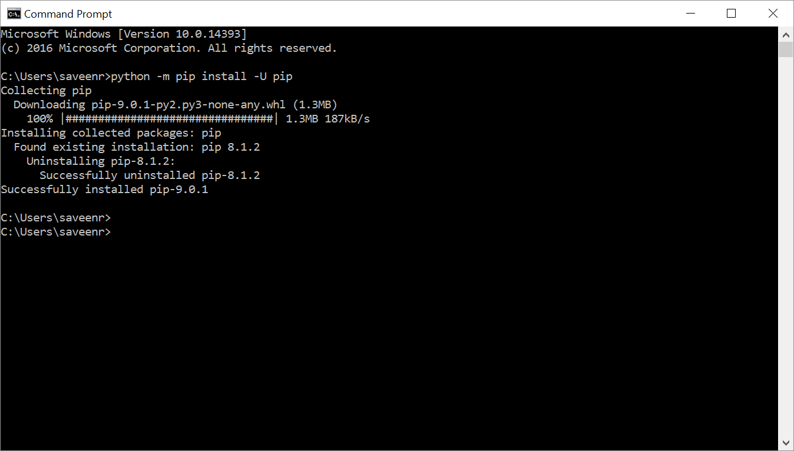
Making Sure you have the latest pip
Linux or MacOS
pip install -U pip
Windows
python -m pip install -U pip

Slide 6
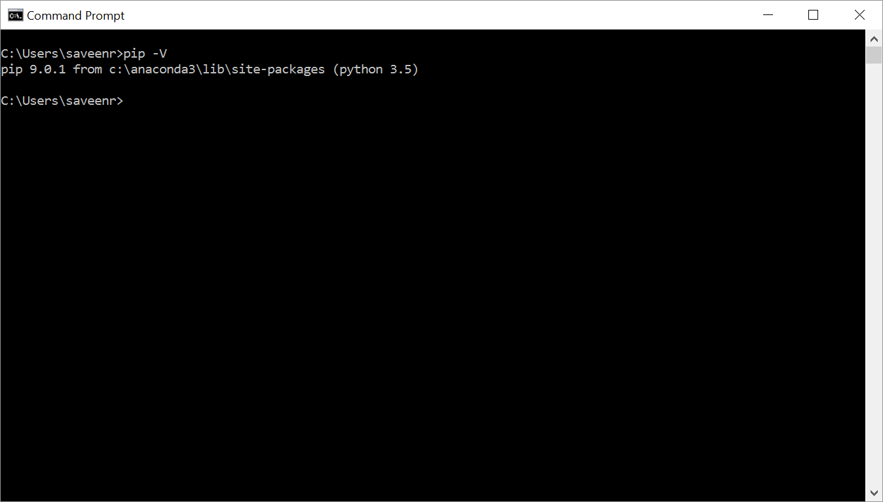
Verify the version of pip
Pip –V
(this presentation was done with version 9.0.1)

Slide 7
Run these pip commands
pip install --upgrade pip
pip install azure
Pip install azure-datalake-store
Pip install azure-mgmt-datalake-store
pip install mrest
pip install mrestazure

