Slide 1
Azure Data Lake Analytics
Debugging & Optimizing U-SQL
Saveen Reddy
Big Data @ Microsoft
2016/02/09

Slide 2
Prerequisites
U-SQL Language
Rowsets
Expressions
Inputs & Outputs
U-SQL Programming Features
Grouping & Aggregation
FileSets
Window Functions
Sorting
Catalog, Databases, TVFs, Assemblies
UDOs
Deployed Resources
Query Execution (we will do a quick review)
Job / Script / Plan
Compilation
Stage & Vertex

Slide 3
Agenda
15%
60%
25%
Query Execution Review
Job Failures
Job Performance
For going deep on performance optimization see Michael Rys’s session from TechReady23 on U-SQL Performance and Debugging.

Slide 4
What you’ll get out of the session
Job Failures
common causes
Checklist
Job Performance
Concepts
Guidelines
Checklist
Tools
Azure Data Lake Tools for Visual Studio
Azure Portal
Azure PowerShell
Getting Help
What to do when someone comes to you? .. When you need to get help from someone else or Microsoft.
Where to send them for help?

Slide 5
Query Execution Review
(condensed)

Slide 6
Overall U-SQL Batch Job Execution Lifetime
Plan
Optimized
Plan
U-SQL Compiler
& U-SQL Catalog
Optimizer
Local Storage
on YARN Container
Job Scheduler
Allocate AUs for Job Manager and start Job
Data Lake Store
Job Manager
(job specific)
Allocate AUs for vertexes and schedule vertexes
Vertexes running in YARN Containers

Slide 7
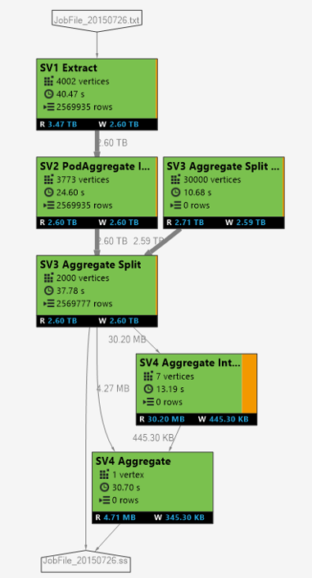
Plans, Algebras, Graphs, Vertexes, and Analytics Units
Analytics Unit (AU)
1 AU ~= 1 YARN Container
A Windows OS VM
2 cores
6 GB of memory (shared with OS and ADLA and your code)
AU vs Vertex
Vertexes – pieces of work. Developer Influences the number.
AUs – use this many YARN containers to execute that work. Developer controls this number in jub submission
Job Algebra visualized as a Job Graph
U-Script(“Logical Plan”) transformed into a Job Algebra (“Physical Plan”)
INPUT
Units of work are vertexes (white boxes) grouped into Stages (a.k.a. SuperVertex).
OUTPUT
U-SQL Compilation
All inputs must be known at compile time
All outputs must be known at compile time (We are working on Dynamic outputs)

Slide 8
Compilation & Vertex Deployment
Job Resources
Compiler
& Optimizer
C#
managed dll
C++
Unmanaged dll
Deployed Resources
Algebra
Deployed to Vertices
User Assemblies
Additional Files
Other files
(system files, deployed resources, user assemblies, etc.)
The JM copies the Job Resources are copied to each container to run a vertex.
All vertexes have access to all the job resources

Slide 9
Execution with Requested Parallelism
Requested Parallelism = 1
Only 1 container can be used at a time
Requested Parallelism = 4
Up to 4 containers can be used
Requested Parallelism = 4
Up to 4 containers can be used. Notice that the last stage can only use 2 containers at a time

Slide 10
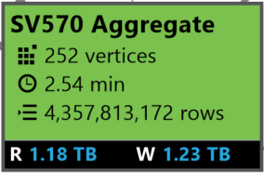
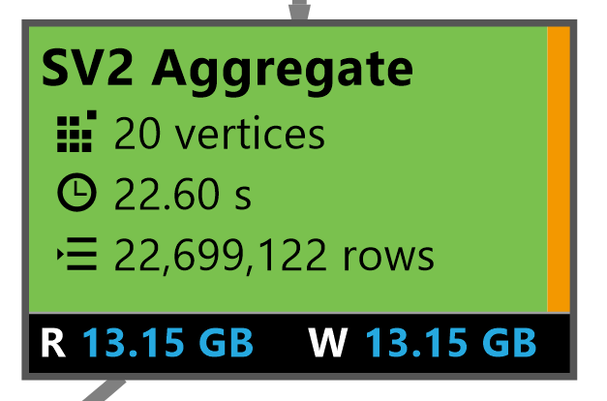
Stage Details
A vertex failed … but was retried automatically
# of vertices
AVG Vertex execution time
4.3B rows
Overall Stage Completed Successfully
Data Read & Written
Notes:
A vertex might fail because:
Router congested
Hardware failure (ex: hard drive failed)
VM had to be rebooted
U-SQL job will automatically schedule a vertex on another VM.

Slide 11
Relationships between vertexes
Dependent stages can start even if their antecedent stages are still running
The output of one vertex is the input of another one in a dependent stage
CRITICAL PATH
The longest dependency chain of vertexes. (there’s always one)
VERTEX DETERMINISM If the query needs to regenerate input data for a vertex, earlier vertexes can be rerun

Slide 12
Vertex Allocation
Not directly controllable
INFLUENCED BY
Input Data
Number of Partitions
How data is distributed in the partitions
Nature of the operation
ORDER BY might use a single vertex
REDUCE on COL
Normally Get at most 1 vertex per partition
A vertex might receive more than one partition (optimizer pushes more work to single vertex)
A recursive reducer where the partition is big might result in more vertexes per partition
U-SQL Data Hints
OPTION ( SKEWFACTOR( col ) = 0.5 )
OPTION( ROWCOUNT = 500 )
Etc..
Tradeoff between over and under partitioning

Slide 13
“Views” (Tools)

Slide 14
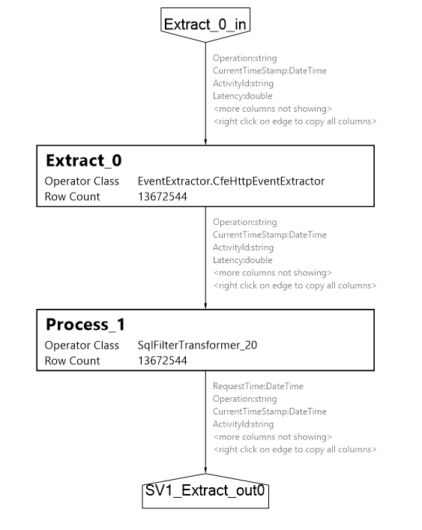
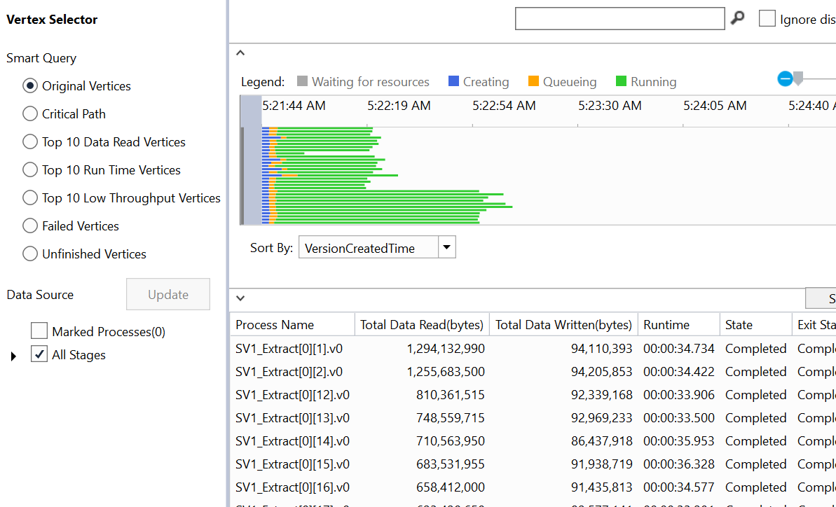
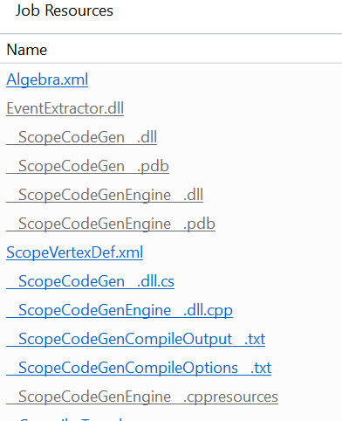
Views of a U-SQL Job
Stage Operator Graph view
Job Graph view
Vertex Execution View
Compile
Script view
(editable text)
Design view
(Logical graph)
Resource View

Slide 15
DEMO
Script Views
Job Graph
Operator Graph
Job Folder

Slide 16
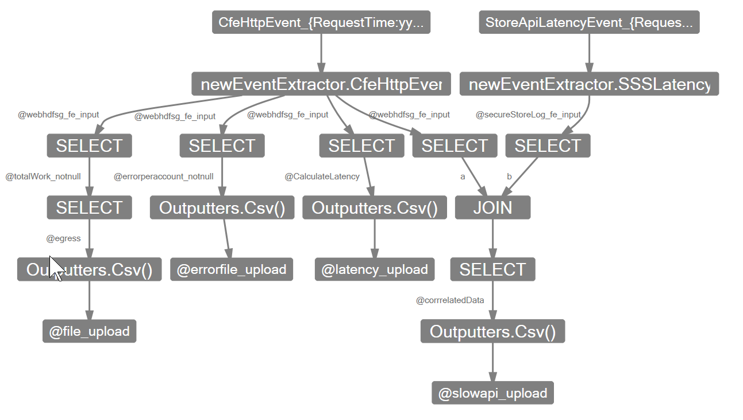
U-SQL Design View
Show either
Statements as Nodes, Rowsets as Edges
Rowsets as Nodes, Statements as Edges
Show the columns in the rowsets
Show JOIN conditions
WHERE clauses
ORDER BY

Slide 17
Job Failures

Slide 18
Errors can happen in these steps
In Azure Data Lake
Submission
Compilation
Execution
Finalizing
Understand Causes
Distinguish between USER CODE issues and SYSTEM issues
How it impacts billing
How the errors manifest to customers

Slide 19
DEMO
Finding Failed Jobs
(Portal & VS)
& Job Links

Slide 20
PowerShell: Get all Failed Jobs submitted by me
Login AzureRmAccount –Subscription “ADLTrainingMS”
Get-AdlJob `
–Account “saveenrtr24analytics” `
–State Ended `
–Result Failed `
–SubmittedAfter ((Get-Date).AddDays(-1)) `
–Submitter saveenr@microsoft.com `

Slide 21
Submission & Compilation Failures

Slide 22
Submission Failure
Common causes
Authentication Failure
Specifying wrong subscription, tenant
RBAC role in ADLA not set
Script too big (around 4MB)
Notes
The System didn’t even get a chance to look at the script
It’s not in the U-SQL Query Store
There’s no job link

Slide 23
Compilation Failures
Three Key reasons in Descending Order
#1 There is a syntax error in the U-SQL Script (70%)
#2 The U-SQL script identifies a file that does not exist (or can’t access)
#3 Compilation time-out
Notes
Unlike Submission failures, Compilation Failures have made it into the ADLA System. These are in the U-SQL Query Store.
Be aware that ADLS is case-sensitive for filenames
Cross region query not supported – may manifest as unfound files

Slide 24
Compilation Time-Out
Compilation time limit = 25 minutes
Compile time strongly affected by number of input files
For manually named files
Compile_time( n ) = 16s + (0.280s * n)
n = number of input files
Thus, 5K input files = 23.6 minutes
For FileSets
Compile times for streamsets will be larger than manually named files
Will provide numbers in the future
Notes
Numbers above are for files in ADLS not WASB.
Contact us for preview of fast file sets v2 (dramatic increase in number of files supported via FileSets)

Slide 25
The Correct Script
// NO ERROR
@searchlog =
EXTRACT UserId int,
Start DateTime,
Region string,
Query string,
Duration int,
Urls string,
ClickedUrls string
FROM @"/Samples/Data/SearchLog.tsv"
USING Extractors.Tsv();
OUTPUT @searchlog
TO @"/Samples/Output/SearchLog_output.tsv"
USING Outputters.Tsv();

Slide 26
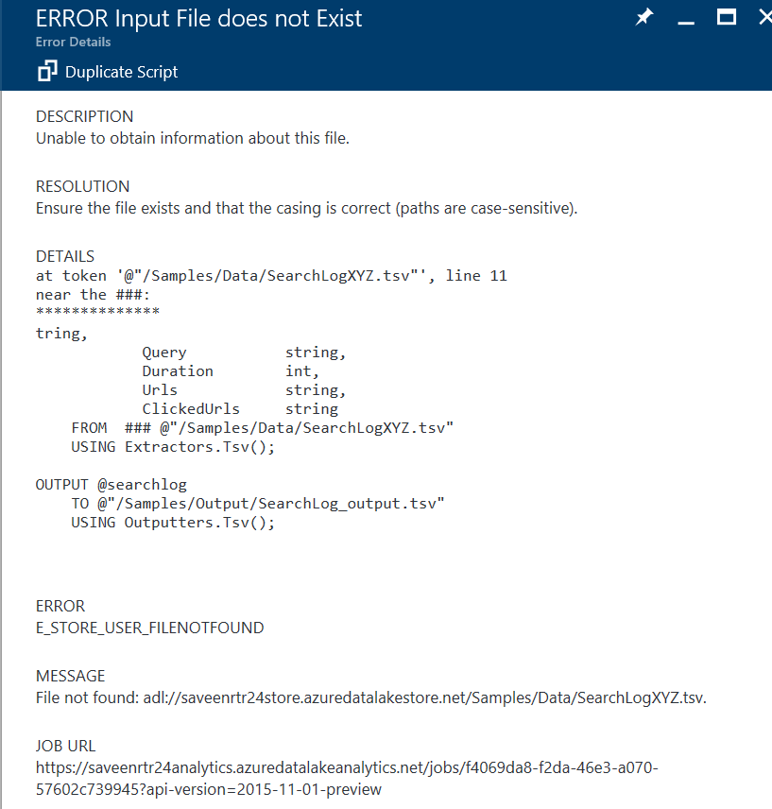
File Does not Exist
// ERROR Input File does not Exist
@searchlog =
EXTRACT UserId int,
Start DateTime,
Region string,
Query string,
Duration int,
Urls string,
ClickedUrls string
FROM @"/Samples/Data/SearchLogXYZ.tsv"
USING Extractors.Tsv();
OUTPUT @searchlog
TO @"/Samples/Output/SearchLog_output.tsv"
USING Outputters.Tsv();

Slide 27
### how to read a compile error
the problem is near the ###
Here’s the ###

Slide 28
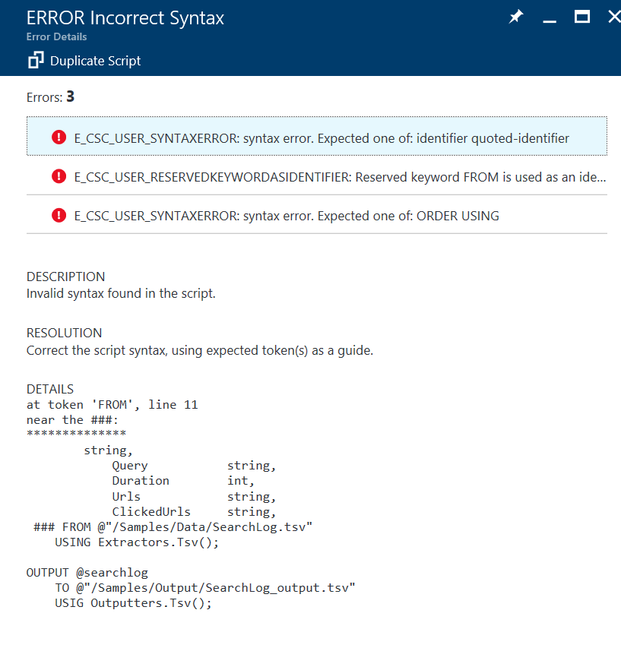
Incorrect Syntax (multiple)
// ERROR Incorrect Syntax
@searchlog =
EXTRACT UserId int,
Start DateTime,
Region string,
Query string,
Duration int,
Urls string,
ClickedUrls string,
FROM @"/Samples/Data/SearchLog.tsv"
USING Extractors.Tsv();
OUTPUT @searchlog
TO @"/Samples/Output/SearchLog_output.tsv"
USIG Outputters.Tsv();

Slide 29
Execution Failures

Slide 30
Execution Failures
SYSTEM (<1%)
Something in the ADL system has gone wrong. (I.e. not your fault).
Sometimes these issues are transient. Resubmitting may work!
Microsoft will reimburse you for the cost of these jobs
There’s nothing you can do to fix a system issue.
Contact Support for help
USER CODE (99.9%)
There’s something about what you did that is causing the problem
The issue may be related to your …
Input data
Existence
Size
Format
Key Distribution (“Data Skew”)
C# code
C# expressions in a U-SQL Script
C# UDFs
Code in Libraries you are Using

Slide 31
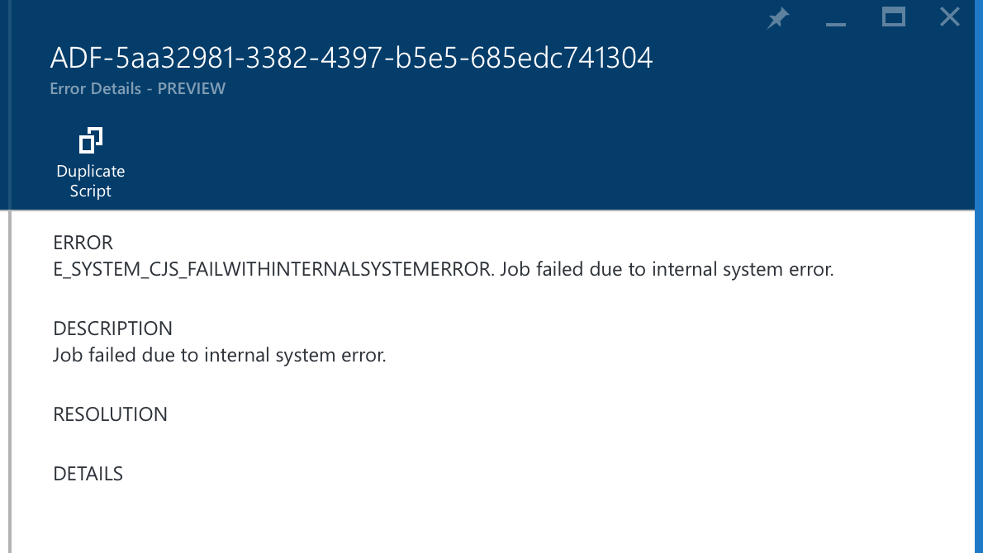
If it says SYSTEM in the Error Code it’s a system issue `
Example of a System Error

Slide 32
Breakdown of User Errors during Execution
A Small Set of Errors Account for the majority (89.6%) of User Errors
Unexpected Number of Columns (40% of User Errors)
Column Conversion Errors (36% of User Errors)
User Code throw an Exception (10.6% of User Errors)
Input File not Found (3% of User Errors)
It’s worth your time to explore why these errors might happen and how they manifest themselves in the UX

Slide 33
The Correct Script
@searchlog =
EXTRACT UserId int,
Start DateTime,
Region string,
Query string,
Duration int,
Urls string,
ClickedUrls string
FROM @"/Samples/Data/SearchLog.tsv"
USING Extractors.Tsv();
OUTPUT @searchlog
TO @"/Samples/Output/SearchLog_output.tsv"
USING Outputters.Tsv();

Slide 34
Mismatch in Number of Columns (input has 7, we EXTRACT 6)
// ERROR Mismatch in number of columns
@searchlog =
EXTRACT UserId int,
Start DateTime,
Region string,
Query string,
Duration int,
Urls string
// , ClickedUrls string
FROM @"/Samples/Data/SearchLog.tsv"
USING Extractors.Tsv();
OUTPUT @searchlog
TO @"/Samples/Output/SearchLog_output.tsv"
USING Outputters.Tsv();

Slide 35
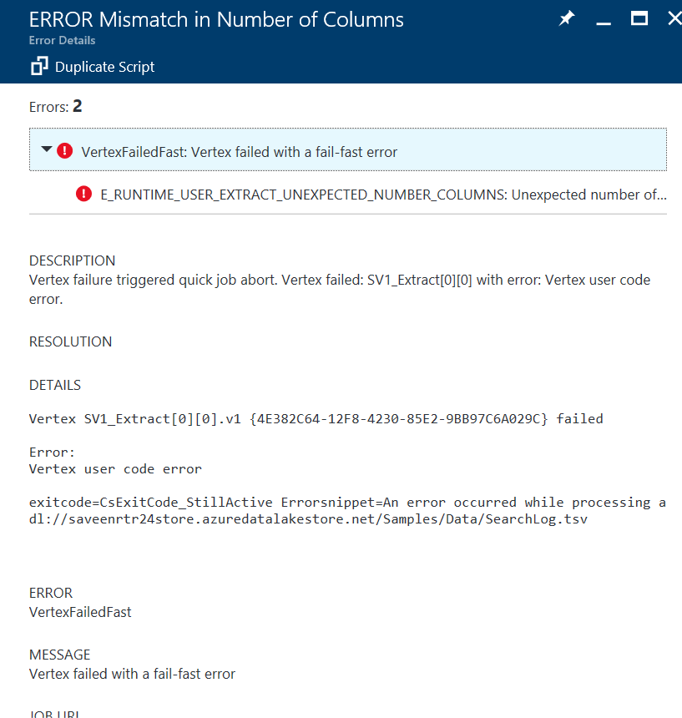
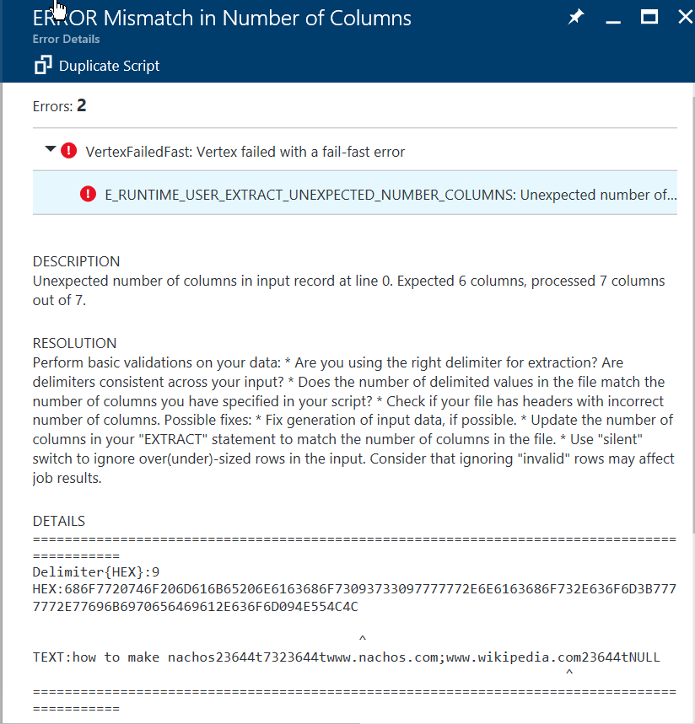

Slide 36
Incorrect Column DataType
// ERROR Incorrect Column DataType
@searchlog =
EXTRACT UserId DateTime,
Start DateTime,
Region string,
Query string,
Duration int,
Urls string,
ClickedUrls string
FROM @"/Samples/Data/SearchLog.tsv"
USING Extractors.Tsv();
OUTPUT @searchlog
TO @"/Samples/Output/SearchLog_output.tsv"
USING Outputters.Tsv();

Slide 37
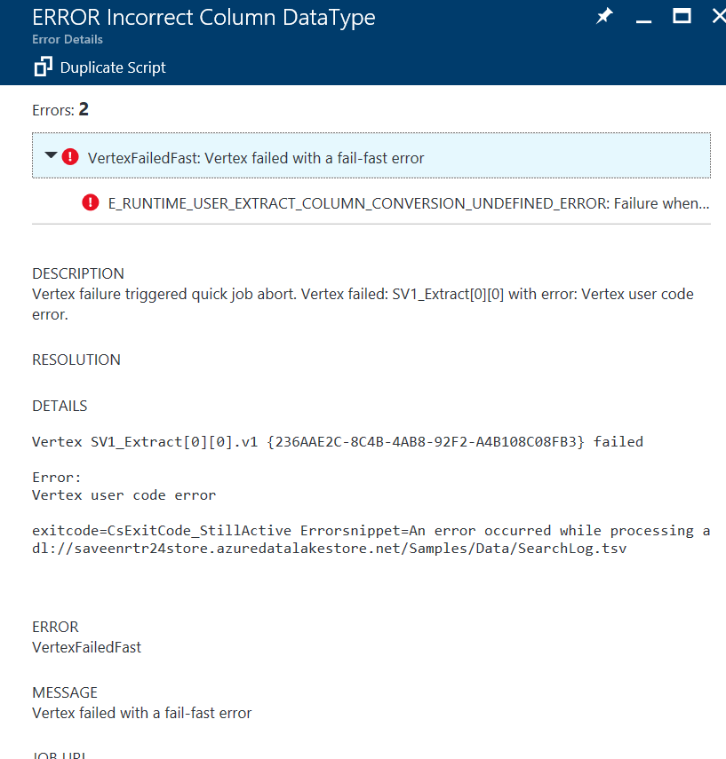
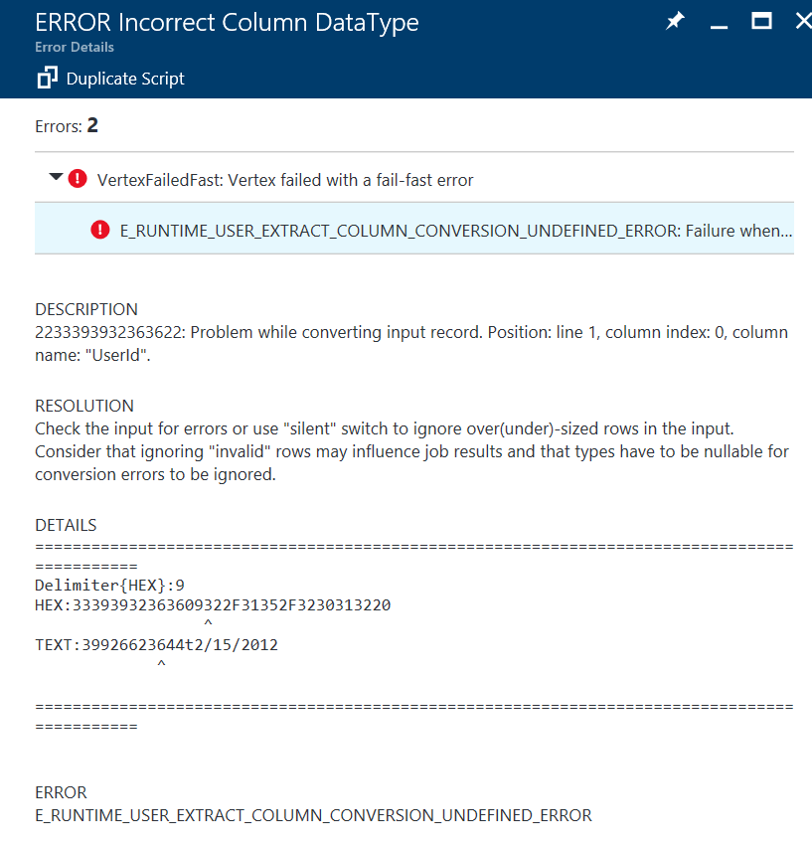

Slide 38
Divide by Zero in Expression (Error is dependent on input data)
// ERROR Divide by Zero in Expression
@searchlog =
EXTRACT UserId int,
Start DateTime,
Region string,
Query string,
Duration int,
Urls string,
ClickedUrls string
FROM @"/Samples/Data/SearchLog.tsv"
USING Extractors.Tsv();
@searchlog =
SELECT *,
(1/(60-Duration)) AS InverseDuration
FROM @searchlog;
OUTPUT @searchlog
TO @"/Samples/Output/SearchLog_output.tsv"
USING Outputters.Tsv();

Slide 39
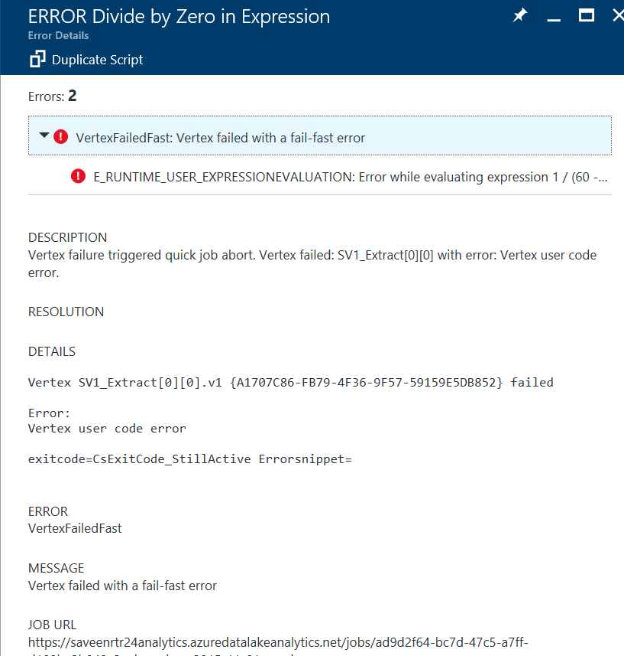
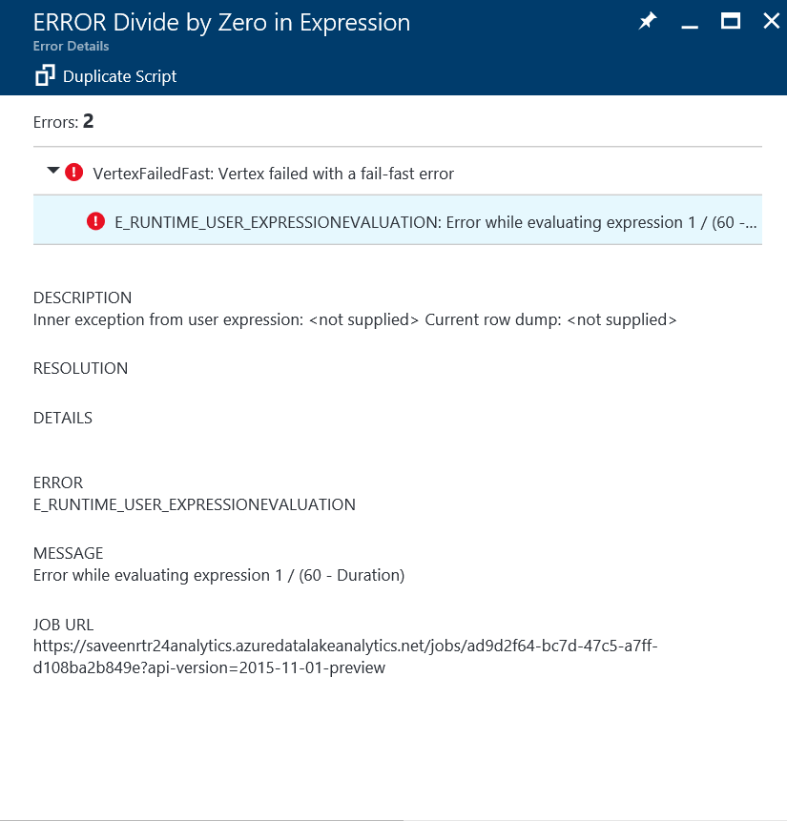

Slide 40
Vertex Debugging
Local Debugging of a Vertex = Run the Vertex on your machine

Slide 41
Experience Overview
ADLA Account
Failed Job
Failed vertex
Your Dev Box
VS Project
Visual Studio
Visual Studio
Failed vertex

Slide 42
Local Vertex
C# Project
(Local Vertex Debug Project)
Job Resources
U-SQL Runtime
Data Read by Vertex

Slide 43
Local Vertex Debug Scenarios for Custom Code
Case #1 Code Behind
You have access to the source code – it’s in the code behind cs file
Case #2 Separate Assembly of yours
You have access to the source code – as a separate Visual Studio C# Project including .CS and PDBs
Case #3 Third-Party Assembly
You only have the binary.
You do not have the source code or the PDBs
Case #1 Local Vertex Debug works GREAT and SEAMLESSLY
Case #2 and Case #3 – Use the same techniques in these cases as for debugging a C# program
We are going to make Case #2 easier in the future.

Slide 44
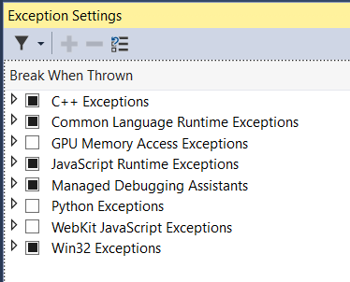
Preparing VS for Local Vertex Debug
Before debugging, make sure you checked Common Language Runtime Exceptions in Exception Settings window
You can Launch the Exception Settings window via
Keyboard Shortcut: Ctrl + Alt + E
Debug > Windows > Exception Settings
Search for “Exception Settings” in the VS Search box. Select the item under “Menus”

Slide 45
DEMO
Vertex Debugging

Slide 46
Handling a Job Failure

Slide 47
Job Execution Failure Checklist
Provide this information
Is it a System Failure?
Contact Support.
If failed to read an input. Do the inputs exist? Verify that you can access the inputs from the portal.
Did the U-SQL ever work?
If YES:
provide the job link.
Examine the job diff
Paste in the full error text
(Pay attention to sub-errors)
If possible
Provide the smallest possible script that reproduces the problem. (Useful for user errors)
Did a Vertex Fail because of User Code?
Try to debug the vertex locally.
Attach the job graph as an image
Attach the script.

Slide 48
Local Job Execution

Slide 49
Local Execution Summary
Allows you to test scripts on your own machine before submitting to the service and spending money
Work out the basic issues before you submit to the service
Not intended as a perfect replica of cluster execution

Slide 50
Local Execution versus “Cluster” execution
Outbound network connections
Local: no restriction
Cluster: explicitly disallowed
File case-sensitivity
Local: Case insensitive files on NTFS
Cluster: Case-sensitive on ADLS
Other
Local: If assembly is in GAC it will be used regardless of what you are downloading from the vertex
Local vertex Debug != Local Execution

Slide 51
Local Execution SDK
Local Execution SDK

Slide 52
Comparing Jobs

Slide 53
The greatest lie ever told

Slide 54
“The job ran perfectly yesterday. It failed or is slower today. I didn’t change anything in the script or input data.”
– Every developer ever

Slide 55
DEMO
Job Diff

Slide 56
Tips

Slide 57
Performance & Optimization

Slide 58
Job Performance Checklist
Did the U-SQL ever work faster before?
If YES:
provide the job link.
Examine the job diff
Find Hotspots
Look at the views in VS
Run the Job graph playback
Examine at the Job Diagnostics
Vertex Time Distributions
Are vertexes spending a lot of time
Are vertexes getting a lot of data
Which Stages use UDOs?
What are the UDOs doing?

Slide 59
Summary of optimization
Performance Optimization is much harder than debugging job failures
Debugging Failures
the code is more clearly doing something wrong (throws exception)
Performance
The interplay between code and data. Highly variable.
Often no single right answer at all scales. May require very different techniques at massive scales.
Sometimes tuning a job means rewriting the job or picking a different data distribution
Requires experimentation and measurement

Slide 60
Learn U-SQL Leverage Native U-SQL Constructs first Learn Query Execution Without this you will not be able to deal with performance issues Understand your Data Volume, Distribution, Partitioning, Growth UDOs are Evil ☺ Can’t optimize UDOs like pure U-SQL code.
High Level Performance Advice

Slide 61
We’ve baked in several key diagnostics tools into Visual Studio Always look at these if you are interested in Performance
Job Diagnostics

Slide 62
DEMO
Job Diagnostics
Resource Modeler

Slide 63
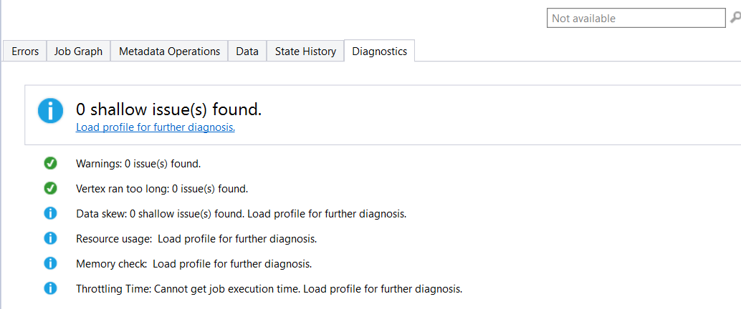
Job Diagnostics (before Profile load)

Slide 64
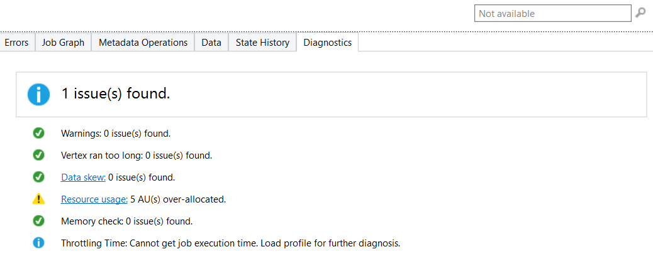
Job Diagnostics (after profile load)

Slide 65
Understanding your Data
Partitioning & Distribution

Slide 66
U-SQL Table Partitioning & Distribution
LOGICAL
@date1 |  |  | @date2 |  |  | @date3
ID1 | H1 |  | ID1 | H1 |  | ID1 | H1
ID2 |  |  | ID2 |  |  | ID3
ID3 |  |  | ID4 | H2
ID4 | H2 |  | ID5
ID5 |  |  | ID6 | H3 |  | ID6 | H2
ID6 | H3 |  | ID7 | H4
ID7 |  |  | ID8 |  |  | ID7
 |  |  | ID9 |  |  | ID8
TABLE T (
…
INDEX i
CLUSTERED BY (id)
PARTITIONED BY (date)
DISTRIBUTED BY HASH (key) INTO 4
)
/catalog/…/tables/Guid(T)/
PHYSICAL
Clustering ->Data Locality
Partition -> Data lifecycle management. Partition elimination
Distribution -> Data Locality + distribution elimination
Guid(T.p1).ss
Guid(T.p2).ss
Guid(T.p3).ss

Slide 67
@output = SELECT * FROM @clickstream WHERE domain == “CNN”;
Partition1
Partition2
Partition3
PARTITION 1
PARTITION 2
PARTITION 3
FB
FB
FB
Read
Read
Read
WH
WH
CNN
WH
Filter
Filter
Filter
CNN
Write
Write
Write
CNN
Because “CNN” could be anywhere, all extents must be read.
File:
Keys (Domain) are scattered across the partitions

Slide 68
@output = SELECT * FROM @ clickstream WHERE domain == “CNN”;
PARTITION 1
PARTITION 2
PARTITION 3
Partition1
Partition2
Partition3
FB
WH
CNN
Read
CNN
FB
WH
Filter
WH
FB
Write
CNN
Thanks to “Partition Elimination” and the U-SQL Table, the job only reads from the extent that is known to have the relevant key
U-SQL Table partitioned on Domain
Rows with the same keys are on the same partition.

Slide 69
@output =
SELECT domain, SUM(clicks) AS total
FROM @clickstream
GROUP BY domain;
PARTITION 1
PARTITION 2
PARTITION 3
Read
Read
Read
PARTITION 1
PARTITION 2
PARTITION 3
Partial Agg
Partial Agg
Partial Agg
Read
Read
Read
Partition
Partition
Partition
Full Agg
Full Agg
Full Agg
Write
Write
Write
Full Agg
Full Agg
Full Agg
Write
Write
Write

Slide 70
Picking Partition Keys & Distributions
Partitions should map to your data lifecycle
Example: Often aligns with data loading: Load data each day -> your partition by date
Partition so that you can enable as much partition elimination as possible
NOTE: often interesting in event date not date of loading
Avoid over partitioning
Try to keep number of partitions in table <2K
Query with predicates that reduce to < low hundreds
How can I see how a table is portioned?
The index definition is available in VS and Portal
The specific distribution stats are not available yet. Planned for the future.
You can pick multiple partition keys
If you never filter on or aggregate by a key don’t make it a partition
Don’t pick every key – normally pick 1 to 3 keys.

Slide 71
UDOs are Evil

Slide 72
Summary
UDOs represent a POWERFUL extension mechanism
But they are frequently (ab)used
UDOS are often not needed
Our Internal Investigation: 90% of UDOs could be replaced with a SELECT and a CROSS APPLY
Easy to get working at small scale.
Can be very difficult to work at large scale. UDO issues may not be apparent on small (GB to TB) amounts of data. Their issues only show up later.

Slide 73
Ladder of UDO pain
Extractors – should be OK
Outputters – should be OK
Processors – entering the danger zone
Custom Aggregators - entering the danger zone
Reducers – solidly in the danger zone
Combiners – Experts only

Slide 74
Futures

Slide 75
What’s coming
Data Skew Analysis in VS
Usage Modeler in Portal
Enhanced Query Store
Find all the jobs that have issues
Find the amount of AU hours ($) that have been wasted last week
Ability to add PDBs to your Assemblies
Won’t be distributed to each vertex (this is good)
Will be downloaded for easier debugging of Assembly Code (this is good)
Better debugging for U-SQL/Python and U-SQL/R extensions

Slide 76
Q & A

